Slide 1
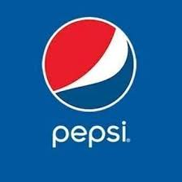
Financial Analytics – Pepsi Stock
Digvijaysinh Desai - 0776134
Nishtha Vijay Mistri - 0780925
Aman Sharma - 0780943

Slide 2
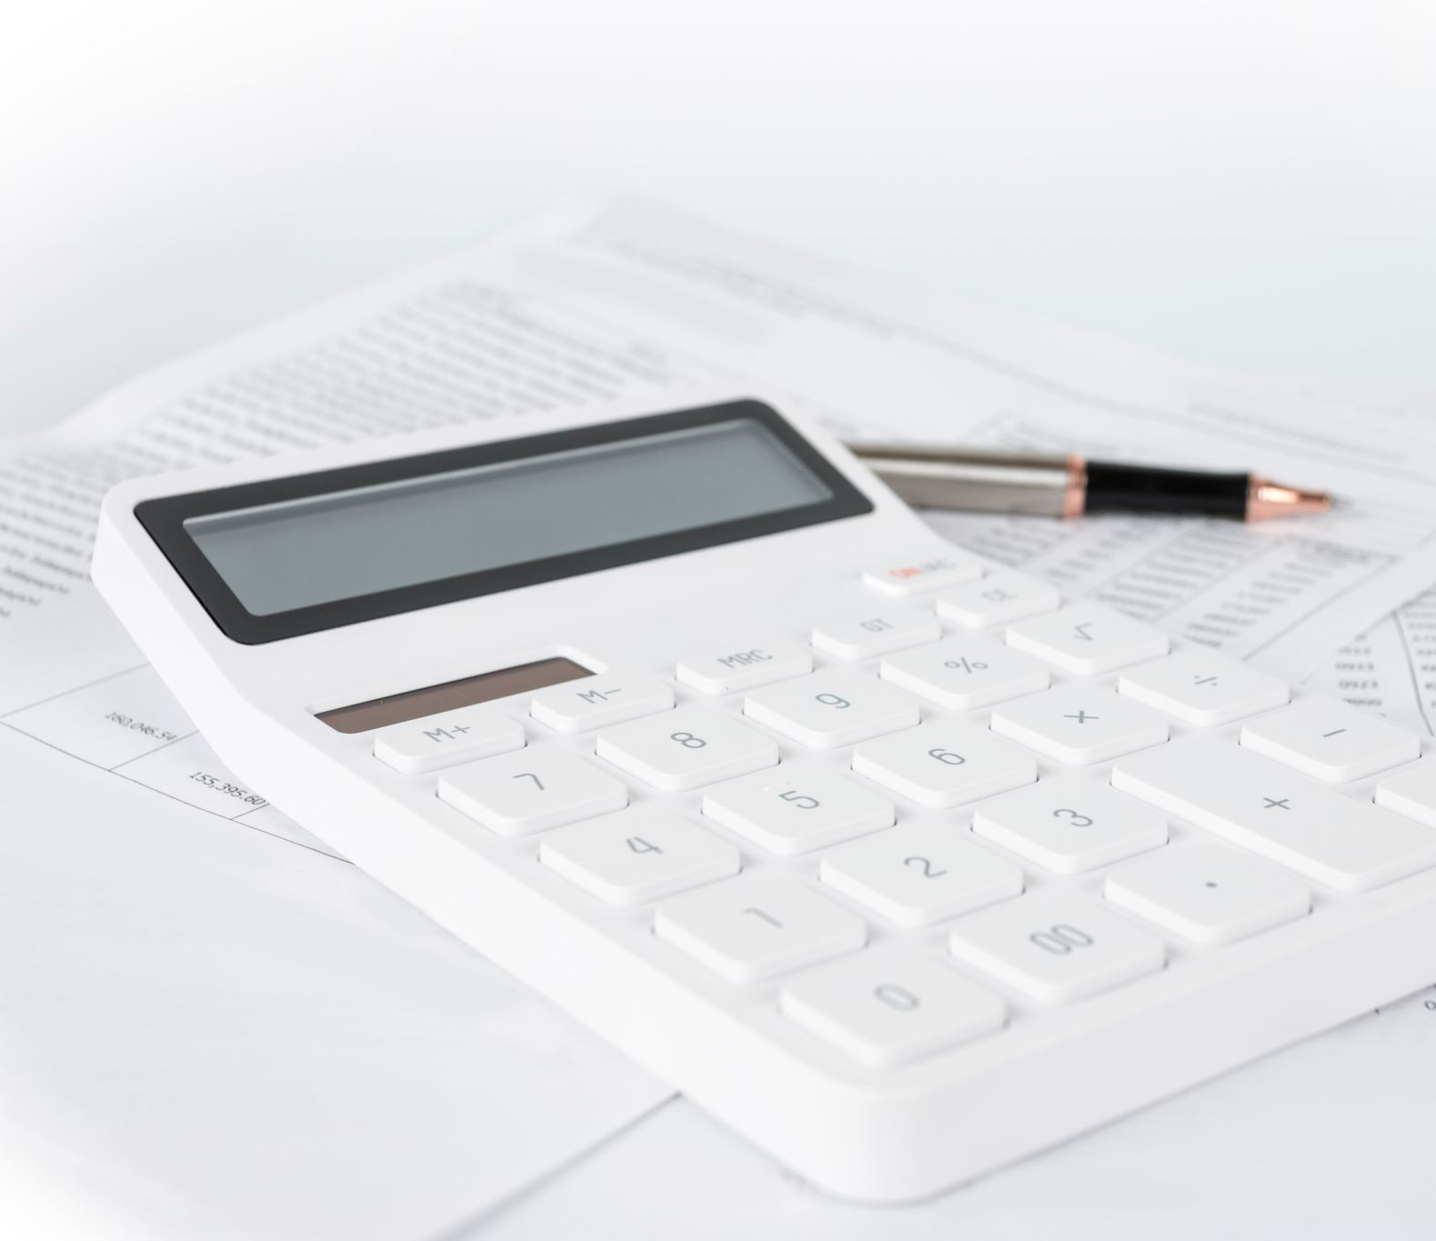
Index
Business case
Financial History
CAPM Model
Ratio Calculation
Technical Analysis
Recommendation

Slide 3

Business Case

Slide 4
Business Case
PepsiCo, Inc. is an American multinational food, snack, and beverage corporation headquartered in Harrison, New York.
Pepsi was first introduced as "Brad's Drink" in New Bern, North Carolina in 1893 by Caleb Bradham, who made it at his drugstore where the drink was sold. It was renamed Pepsi-Cola in 1898.
PepsiCo products are enjoyed by consumers more than one billion times a day in more than 200 countries and territories around the world.

Slide 5
Business Case
PepsiCo generated $79 billion in net revenue in 2021, driven by a complementary beverage and convenient foods portfolio that includes Lay's, Doritos, Cheetos, Gatorade, Pepsi-Cola, Mountain Dew, Quaker, and SodaStream.
PepsiCo's product portfolio includes a wide range of enjoyable foods and beverages, including many iconic brands that generate more than $1 billion each in estimated annual retail sales.

Slide 6
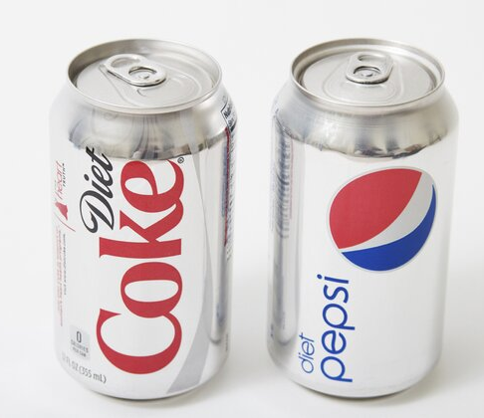
Competitors
In 2020, Coca-Cola was ranked as the leading carbonated soft drink (CSD) company in the United States with a volume share of 44.9 percent. Ranked second, PepsiCo garnered a volume share of 25.9 percent that year.

Slide 7
Financial History

Slide 8
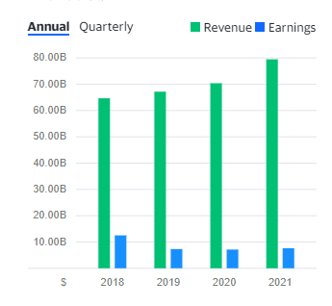
From the historic data, we can conclude that, Total revenue is increasing in a positive manner for the PepsiCo Stock.

Slide 9
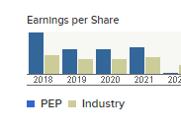
Earning per share value is also high for the PepsiCo stock, which means investor can gain more profit with this share.

Slide 10
Valuation

Slide 11
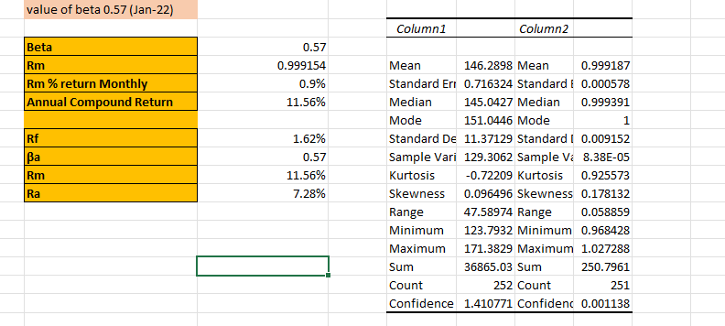
CAPM Model
The capital asset pricing model (CAPM) is used to determine expected returns on capital investments.
Beta value 0.57 as dated on the January 2022.

Slide 12
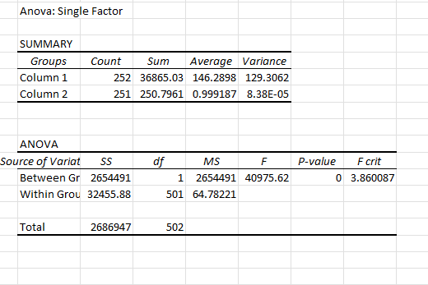
CAPM Model

Slide 13
Ratio calculation

Slide 14
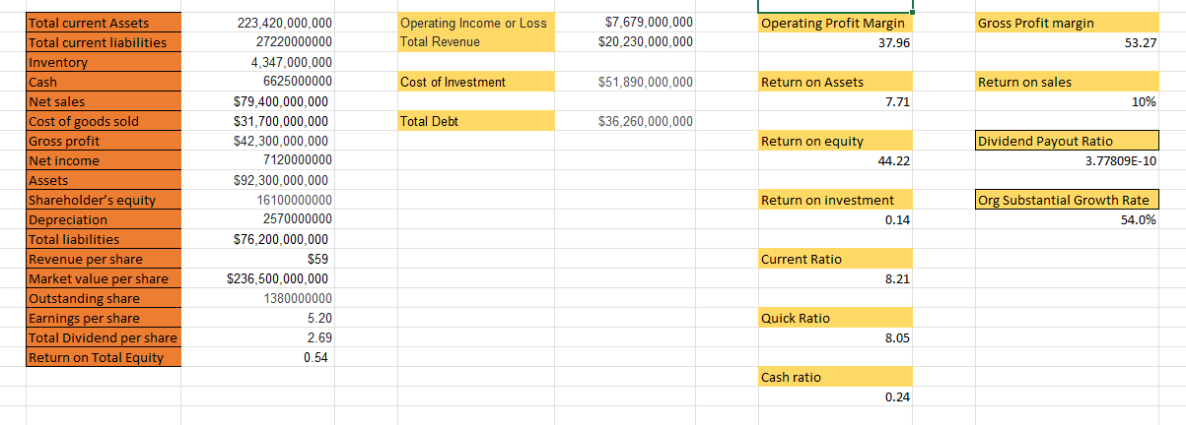
A financial ratio or accounting ratio is a relative magnitude of two selected numerical values taken from an enterprise's financial statements.
They are used most effectively when results over several periods are compared. This allows you to follow your company’s performance over time and uncover signs of trouble.

Slide 15

Technical Analysis

Slide 16
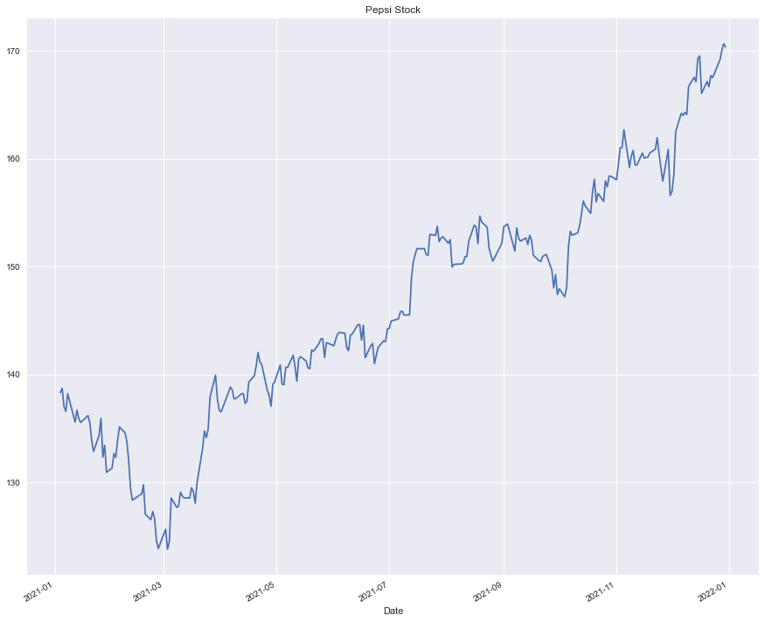
From the above graph, it can be seen that, PepsiCo stock price dropped rapidly in March 2021 due to some reason , and then it increasing in a positive manner.

Slide 17
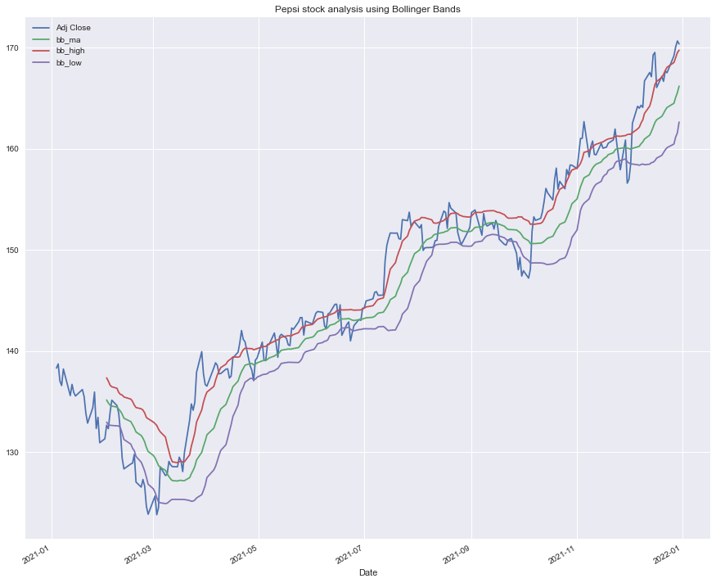
Bollinger Bands
With Bollinger band, we projected High & Low Vales along with the Adj close.

Slide 18
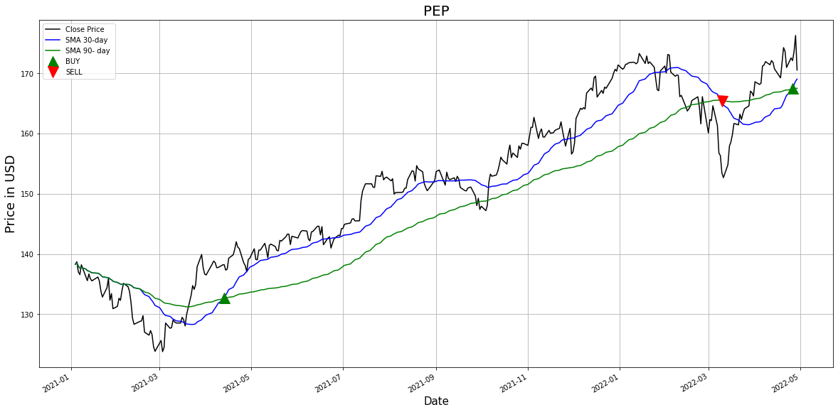
Stock Signals
When to buy and when to sell projected in above graph.

Slide 19
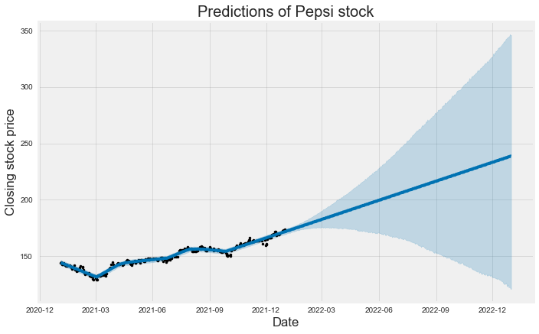
Forecasting
Using historic data, we created the forecast model.

Slide 20
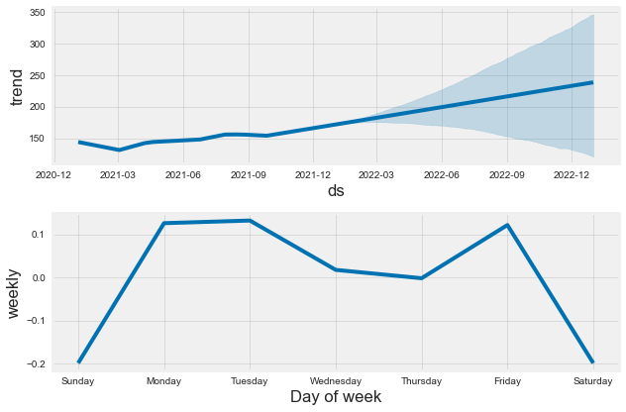
Forecasting
We can see that; PepsiCo stock price goes higher on Friday and low on Wednesday.

Slide 21
Recommendations
From our analysis, we conclude that, in current time not to buy or sell PepsiCo stock, a person needs to hold the stock because –
The company has 40.05 B in debt with debt to equity (D/E) ratio of 2.19, meaning that the company heavily relies on borrowing funds for operations.
PepsiCo have a median target of 182.00, with a high estimate of 200.00 and a low estimate of 160.00. The median estimate represents a +6.36% increase from the last price of 171.11.
PepsiCo has a current ratio of 0.85, suggesting that it has not enough short-term capital to pay financial commitments when the payables are due.

Slide 22
References
https://en.wikipedia.org/wiki/Pepsi
https://www.statista.com/statistics/225504/leading-carbonated-soft-drink-companies-in-the-us/#:~:text=Leading%20U.S.%20CSD%20companies%202020%2C%20based%20on%20volume%20share&text=In%202020%2C%20Coca%2DCola%20was,of%2025.9%20percent%20that%20year.
https://www.macroaxis.com/invest/advice/PEP
https://www.bdc.ca/en/articles-tools/money-finance/manage-finances/financial-ratios-what-are-how-use
https://www.pepsico.com/who-we-are/about-pepsico

Slide 23
Thank You

