Slide 1
Synapse : Academic Resource Sharing System
DBMS Project MADE BY : ANYA RAJAN, AAYUSHI DWIVEDI,ARPIT SINGAL SUMIT SINGH, KARTIKA JOSHI

Slide 2
PROBLEM STATEMENT
Notes are scattered across platforms (WhatsApp, Drive, etc.)
Hard to find reliable and organized study material
No central system for sharing & accessing notes

Slide 3
SOLUTION (SYNAPSE)
Centralized platform for academic resources
Subject-wise organization
Upload, download, buy/sell notes
Peer-driven content system

Slide 4
USERS & FEATURES
Here students are both buyers and sellers
Features
Upload Notes
Browse Subjects
Purchase Notes
Review and Rate
Favorite Content

Slide 5
DATA MODEL OVERVIEW
Users & Universities
Subjects & Notes
Purchases & Payments
Reviews, Tags, Favorites

Slide 6
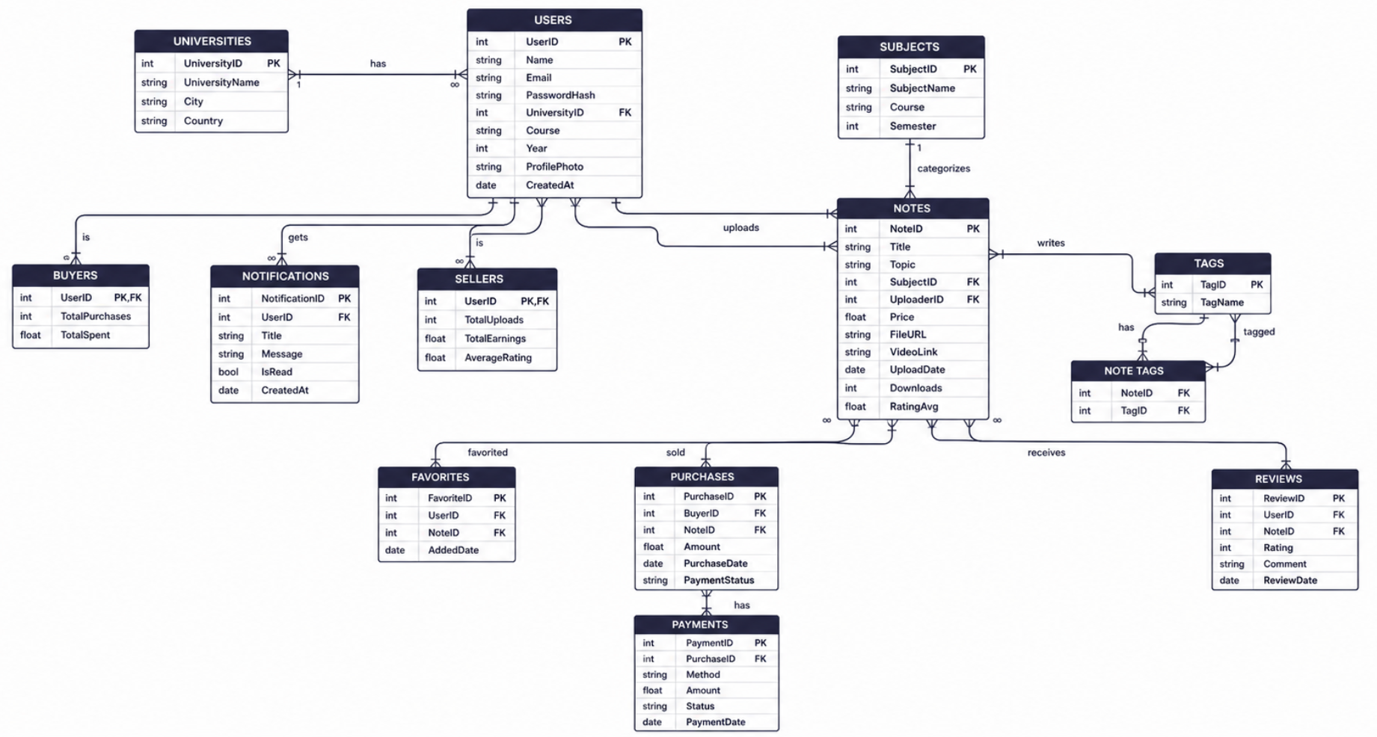
ER DIAGRAM OF DATABASE

Slide 7
RELATIONSHIPS(FEW MAJOR EXAMPLES)
1:N
UNIVERSITY
USERS
1:N
USERS
NOTES
1:N
SUJECTS
NOTES
M:N
USERS
NOTES
Bridge table
PURCHASES
M:N
NOTES
TAGS
Bridge table
NOTES_TAGS

Slide 8
JOINS
SELECT n.Title, n.Price, u.Name AS SellerName, uni.UniversityName
FROM NOTES n
JOIN SELLERS s ON n.UploaderID = s.UserID
JOIN USERS u ON s.UserID = u.UserID
JOIN UNIVERSITIES uni ON u.UniversityID = uni.UniversityID;
Concept: Joins are used to combine data from multiple tables based on related columns.
Why we used it: To fetch complete information (notes + seller + university) stored across different tables.
Code Explanation: Retrieves each note along with its seller’s name and university by joining NOTES, SELLERS, USERS, and UNIVERSITIES tables.

Slide 9
GROUP BY AND HAVING
SELECT s.SubjectName, COUNT(n.NoteID) AS TotalNotes
FROM SUBJECTS s
JOIN NOTES n ON s.SubjectID = n.SubjectID
GROUP BY s.SubjectName
HAVING COUNT(n.NoteID) >= 1;
Concept: GROUP BY groups records based on a column, and HAVING filters grouped results.
Why we used it: To analyze data and identify subjects with multiple uploaded notes.
Code Explanation: Groups notes by subject and displays subjects that have at least one note uploaded.

Slide 10
SUBQUERIES
SELECT Name, Email
FROM USERS
WHERE UserID IN (
SELECT UserID
FROM BUYERS
WHERE TotalSpent > (SELECT AVG(TotalSpent) FROM BUYERS)
);
Concept: A subquery is a query inside another query used for comparison or filtering.
Why we used it: To compare individual user spending with the overall average spending.
Code Explanation: Finds users whose total spending is greater than the average spending of all buyers.

Slide 11
FUNCTIONS
-- Aggregate: Find total earnings of all sellers
SELECT SUM(TotalEarnings) AS GlobalEarnings, AVG(AverageRating) AS GlobalRating FROM SELLERS;
-- Scalar: Display user names in UPPERCASE
SELECT UPPER(Name) AS UppercaseName, LENGTH(Name) AS NameLength FROM USERS;
Concept: Functions perform calculations on data (aggregate for groups, scalar for individual values).
Why we used it: To generate insights like total earnings and to format/display data.
Code Explanation: Calculates total earnings and average rating of sellers, and formats user names in uppercase with their length.

Slide 12
VIEWS
CREATE OR REPLACE VIEW ActiveSales AS
SELECT p.PurchaseID, u.Name AS BuyerName, n.Title AS NoteTitle, p.Amount, pay.Method, pay.Status
FROM PURCHASES p
JOIN BUYERS b ON p.BuyerID = b.UserID
JOIN USERS u ON b.UserID = u.UserID
JOIN NOTES n ON p.NoteID = n.NoteID
JOIN PAYMENTS pay ON p.PurchaseID = pay.PurchaseID;
Concept: A view is a virtual table created from a query to simplify complex data access.
Why we used it: To reuse complex joins and simplify querying of sales data.
Code Explanation: Creates a view combining purchases, users, notes, and payments, then retrieves completed sales records from it.

Slide 13
STORED PROCEDURES
DELIMITER //
CREATE PROCEDURE AddFavorite(IN p_UserID INT, IN p_NoteID INT)
BEGIN
duplicate error
IF NOT EXISTS (SELECT 1 FROM FAVORITES WHERE UserID = p_UserID AND NoteID = p_NoteID) THEN
INSERT INTO FAVORITES (UserID, NoteID) VALUES (p_UserID, p_NoteID);
END IF;
END //
DELIMITER ;
CALL AddFavorite(1, 3);
Concept: A stored procedure is a pre-defined SQL block that can be reused multiple times.
Why we used it: To automate operations and avoid duplicate data insertion.
Code Explanation: Adds a note to favorites only if it does not already exist for the user.

Slide 14
TRANSACTIONS
Concept
A transaction is a sequence of database operations executed as a single unit to ensure data integrity using ACID properties:
Atomicity → All steps succeed or none
Consistency → Database remains valid
Isolation → No interference between transactions
Durability → Changes are permanently saved
What we did
We implemented a complete purchase workflow as a transaction:
Created a purchase record
Generated the corresponding payment record
Updated buyer’s total purchases and spending
Updated seller’s total earnings
Why we used it
To prevent partial or inconsistent data
Ensures purchase, payment, and updates happen together
Avoids cases like:
Payment done but purchase not recorded

Slide 15
INDEXING
CREATE INDEX idx_user_email ON USERS(Email);
CREATE INDEX idx_note_title ON NOTES(Title);
SELECT * FROM USERS LIMIT 1;
Concept: Indexing improves database performance by speeding up data retrieval.
Why we used it: To optimize frequently searched fields like email and note titles.
Code Explanation: Creates indexes on email and note title to make search queries faster.

