Slide 1

Restaurant Table Ordering System (Queen's Kitchen)
Front End Engineering - I (25CSE0203) — Project Based Evaluation-I
Department of Computer Science & Engineering • Chitkara University
TEAM MEMBERS (GROUP G14 | PROJECT ID: G14-PID-11)
• Priyanshi (Team Leader) — Roll No: 2510990889
• Nishtha Sharma — Roll No: 2510990840
• Priyanshi — Roll No: 2510990916
• Trisha Jindal — Roll No: 2510990815

Slide 2
GROUP G14 • PROJECT ID: G14-PID-11 (P-21) • FRONT END ENGINEERING - I
Project Vision & Core Objectives
01. The Problem & Need
• Dining floor order delays caused by manual paper order slips.
• Waitstaff travel overhead between dining tables and kitchen chefs.
• Risk of misplaced paper tickets during peak dining rush hours.
• Lack of live order status visibility for seated restaurant guests.
• Need for a modular, high-speed digital table ordering SPA architecture.
02. What We Built
• React 18 single page application for dynamic table ordering.
• Live Kitchen Display System (KDS) for instant order dispatch.
• Multi-table cart state persistence across active seated tables.
• Automated billing engine with 5% GST and ₹10 Service Charge.
• Built-in Re-Render Audit profiling tool for DOM performance testing.
03. Key Objectives
• Eliminate order lag via centralized multi-table state management.
• Optimize component re-renders during high-volume cart updates.
• Provide intuitive table status tracking (Ordering, Served, Billed).
• Stress-test React Fiber reconciliation using dynamic menu data.
• Deliver a scalable, production-ready frontend for restaurant operations.

Slide 3
GROUP G14 • PROJECT ID: G14-PID-11 (P-21) • FRONT END ENGINEERING - I
Syllabus-Aligned Technology Stack
React 18 (SPA Engine)
• Declarative component UI engine.
• Virtual DOM reconciliation & fiber tree.
• Concurrent rendering & state batching.
• Component lifecycle & custom hooks.
Vite 5 (Build Tool)
• Lightning-fast Hot Module Replacement (HMR).
• Native ES Module development server.
• Optimized Rollup production bundler.
• Zero-config fast startup environment.
React Router v6
• Client-side single page navigation.
• Smooth route switching (/Home, /Kitchen, /Audit).
• Active state matching & URL parameters.
• Declarative Route & Link components.
React Icons
• Scalable vector SVG icon library.
• Lightweight & accessible icons.
• Intuitive cart, table, & kitchen visual cues.
• Seamless UI action indicators.
CSS3 & Flexbox/Grid
• Custom responsive layout architecture.
• Dark mahogany & gold visual theme palette.
• Glassmorphic card containers & rounded borders.
• Fluid desktop & mobile display scaling.
Centralized State Layer
• Global state container at App.jsx root.
• Synchronizes multi-table carts & order queues.
• Instant state dispatch to Kitchen View.
• Persistent table status synchronization.

Slide 4
GROUP G14 • PROJECT ID: G14-PID-11 (P-21) • FRONT END ENGINEERING - I
Core Component Architecture & Modularity
Header.jsx
• Table selector dropdown & seating capacity filter.
• Dataset benchmark toggle (9 vs 200 items).
• Real-time audit mode banner indicator.
• Navigation routing links for SPA views.
OrderSidebar.jsx
• Draft cart item manager & quantity controls.
• Cumulative billed history view per table.
• Automated 5% GST & ₹10 Service Charge split.
• One-click 'Send to Kitchen' order dispatch.
MenuCard.jsx
• Dish thumbnail display with 16:9 crop.
• Portion size badges & dietary tags (Veg/Non-Veg).
• Price display in Terracotta Orange styling.
• Add to Cart trigger with real-time feedback.
KitchenView.jsx
• Real-time kitchen tickets queue for active tables.
• Dish breakdown, quantities, & special notes.
• 'Mark as Served' chef action trigger.
• Live status sync updating table indicators.
ReRenderAuditPanel.jsx
• Empirical component re-render event logger.
• Performance metric comparison (Naive vs Optimized).
• Live re-render counter badges per component.
• Interactive DOM profiling benchmark suite.
menuData.js
• Decoupled array-of-objects data schema.
• Dynamic 200-item benchmark dataset generator.
• Price, category, & portion metadata specs.
• Pure data provider maintaining clean SoC.

Slide 5

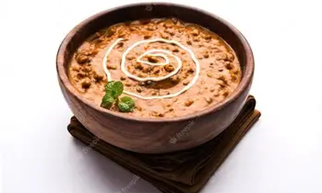
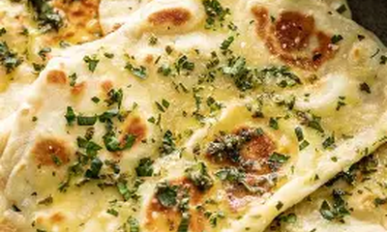
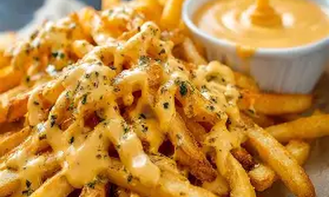
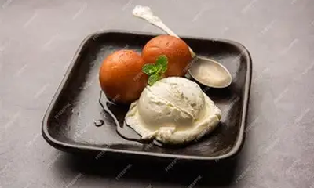
GROUP G14 • PROJECT ID: G14-PID-11 (P-21) • FRONT END ENGINEERING - I
Culinary Menu Dataset & Portion Scaling
Samosa & Chutney
₹60
VEG • SNACK
2 Pcs with Mint Chutney
Crispy golden pastry filled with spiced potatoes.
Stock: Available • Prep: 10 Mins
Dal Makhani
₹180
VEG • MAIN
300g Serving Bowl
Slow-cooked black lentils simmered overnight in cream.
Stock: Available • Prep: 15 Mins
Garlic Butter Naan
₹60
VEG • BREAD
3 Pcs Oven Baked
Tandoor-baked flatbread brushed with garlic butter.
Stock: Available • Prep: 8 Mins
Cheesy Fries
₹150
VEG • FAST FOOD
250g Loaded Basket
Golden fries smothered in melted cheese.
Stock: Available • Prep: 12 Mins
Gulab Jamun
₹120
DESSERT • POPULAR
2 Jamuns + Scoop
Warm jamuns served with cold vanilla ice cream.
Stock: Available • Prep: 5 Mins

Slide 6
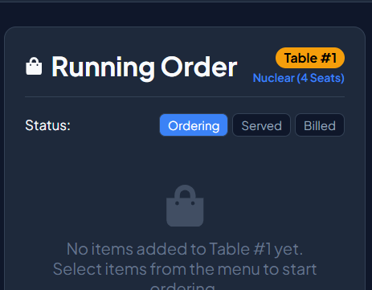
GROUP G14 • PROJECT ID: G14-PID-11 (P-21) • FRONT END ENGINEERING - I
Multi-Table State Management & Kitchen Sync
State Synchronization Mechanics
• Centralized State Hub (App.jsx): Global states (tableCarts, tableBilledHistory, tableServedItems) live at root level.
• Instant KDS Order Dispatch: Clicking 'Send to Kitchen' populates KDS tickets immediately without page reload.
• Automated Table Status Sync: Completing a kitchen ticket updates table status to 'Served' automatically across views.
• Cross-Route State Persistence: Interactions remain consistent when navigating between /Home, /Kitchen, and /Audit.
• Multi-Table Seating Capacity: Supports independent draft carts across multiple seated dining tables simultaneously.

Slide 7
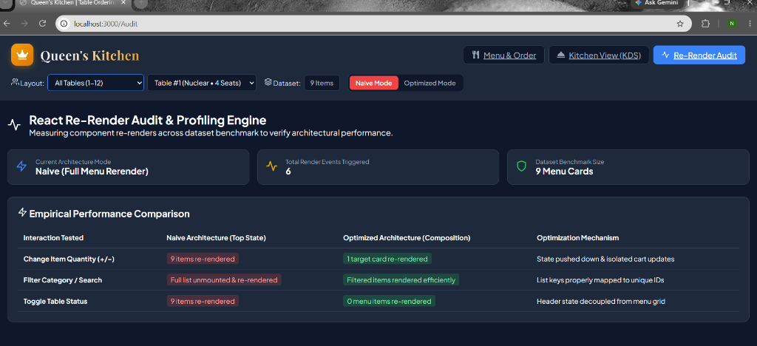
GROUP G14 • PROJECT ID: G14-PID-11 (P-21) • FRONT END ENGINEERING - I
Re-Render Audit Engine & Virtual DOM Profiling
Performance Metrics & Profiling
• Empirical Performance Profiling: Built-in /Audit route tracking component re-render events during cart updates.
• Naive Mode (Top State): Mutating top-level state re-renders all 9 (or 200) menu cards per click.
• Optimized Mode (Composition): Component composition isolates state so only 1 target card re-renders.
• Dataset Stress Benchmark: Toggles dataset size from 9 items to 200 items to stress-test React Fiber reconciliation.
• Empirical DOM Metrics: Provides real-time rendering statistics to evaluate frontend efficiency.

Slide 8
GROUP G14 • PROJECT ID: G14-PID-11 (P-21) • FRONT END ENGINEERING - I
Future Engineering Scope & Technical Roadmap
Phase 2: QR Code & Self-Ordering
• Guest mobile QR code table scanning.
• Digital menu browsing on personal devices.
• Direct-to-kitchen self-ordering workflow.
• Contactless seating & order confirmation.
Phase 3: Digital Payments & Cloud Sync
• Integrated UPI, Credit/Debit card gateway.
• Automated split-bill payment processing.
• WebSocket real-time multi-branch sync.
• Cloud backend database persistence.
Phase 4: AI Recommendations & Inventory
• Smart dish pairing & upsell suggestions.
• Automated inventory deduction on sales.
• Predictive ingredient restocking alerts.
• Analytics dashboard for restaurant managers.

Slide 9
THANK YOU
RESTAURANT TABLE ORDERING SYSTEM (QUEEN'S KITCHEN)
Department of Computer Science & Engineering • Chitkara University
GROUP G14 • PROJECT ID: PID-11 • FRONT END ENGINEERING - II

