Slide 1


BANASTHALI VIDYAPITH
CSD024
TripConnect
Submitted By-
Sakshi Agarwal 2316526
Nandini Gupta 2316476
Smriti Sharma 2316567
Nishtha Garg 2316489
Guided By-
Dr. Vaibhav Vyas
Associate Professor
B.Tech CSE V Semester

Slide 2

CONTENTS
INTRODUCTION |  |  |  |  |  | 3
PURPOSE AND SCOPE |  |  |  |  |  | 4
PRODUCT FUNCTION |  |  |  |  |  | 5
USE CASE DIAGRAM |  |  |  |  |  | 6
HARDWARE REQUIREMENTS |  |  |  |  |  | 7
SOFTWARE REQUIREMENTS |  |  |  |  |  | 8
TECH STACK |  |  |  |  |  | 9
DIAGRAMS DATA FLOW DIAGRAM | 10
ACTIVITY DIAGRAM | 11
SEQUENCE DIAGRAM | 14
CLASS DIAGRAM | 19
DATABASE | 20
SCREEN IMAGE | 27
REFERENCE | 29

Slide 3
INTRODUCTION
TripConnect is a smart travel platform that makes planning journey simple and exciting .Users can design their own trips by choosing destinations, dates, and budgets, or explore ready-made packages for solo, family, or group travel. The platform also connects like-minded traveler's, making journeys more fun and social. With secure payments, easy bookings, and helpful notifications, TripConnect is your all-in-one travel companion.

Slide 4
PURPOSE
SCOPE
• Simplify the travel planning process for users through a centralized platform that supports both customized trip creation and inbuilt package selection.
• Enable travellers to create profiles, set preferences, and connect with compatible travel companions for shared journeys.
• Let users create profiles with travel preferences.
• Match users with suitable travel buddies.
• Enable customized trip planning and provide predefined packages.
• Support trip booking, secure payments, and notifications.
• Allow communication between travellers and include reviews/ratings.

Slide 5
PRODUCT FUNCTION
TripConnect is a travel platform that makes trip planning, booking, and networking easy for travelers.
User Profiles – Create and manage accounts with travel preferences and past trips.
Package Booking – Browse, view details, and book ready-made packages.
Custom Trips – Plan personalized itineraries based on budget and schedule.
Matchmaking & Search – Find and connect with travelers with similar interests and filter packages by need.
Notifications – Get alerts for bookings, updates, and messages.
Admin Tools – Manage users, trips, and packages while ensuring platform security.
Payments – Support secure online payments for bookings and trips.

Slide 6
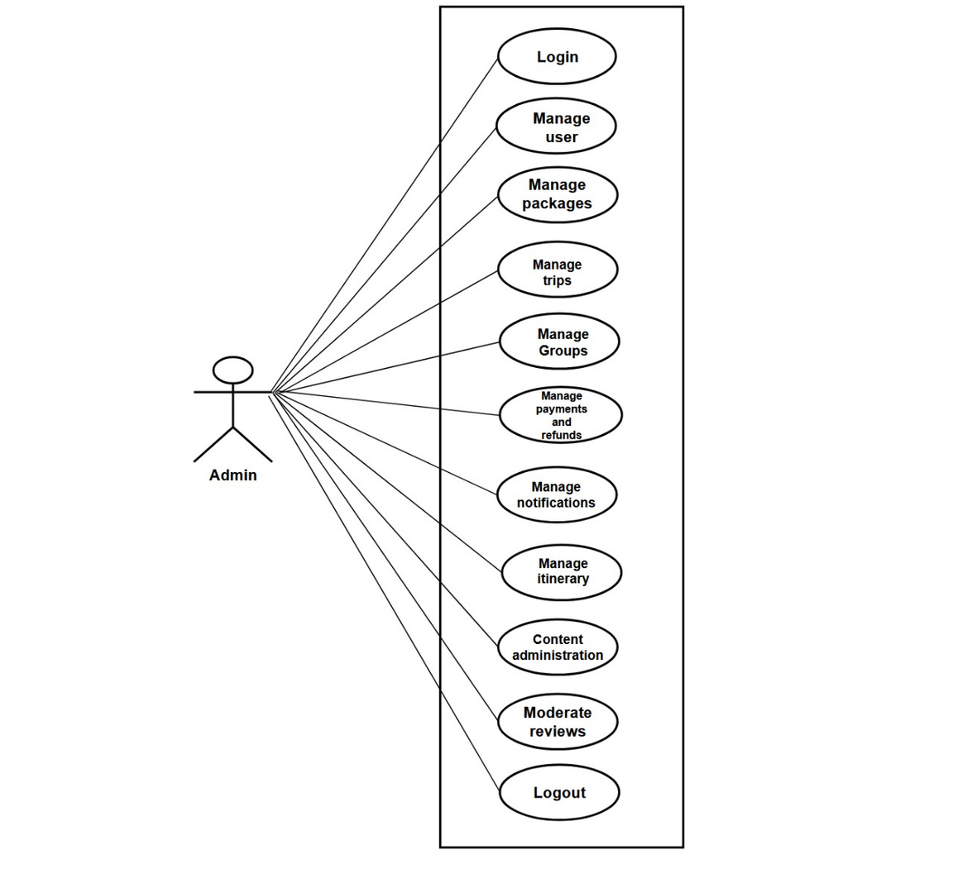
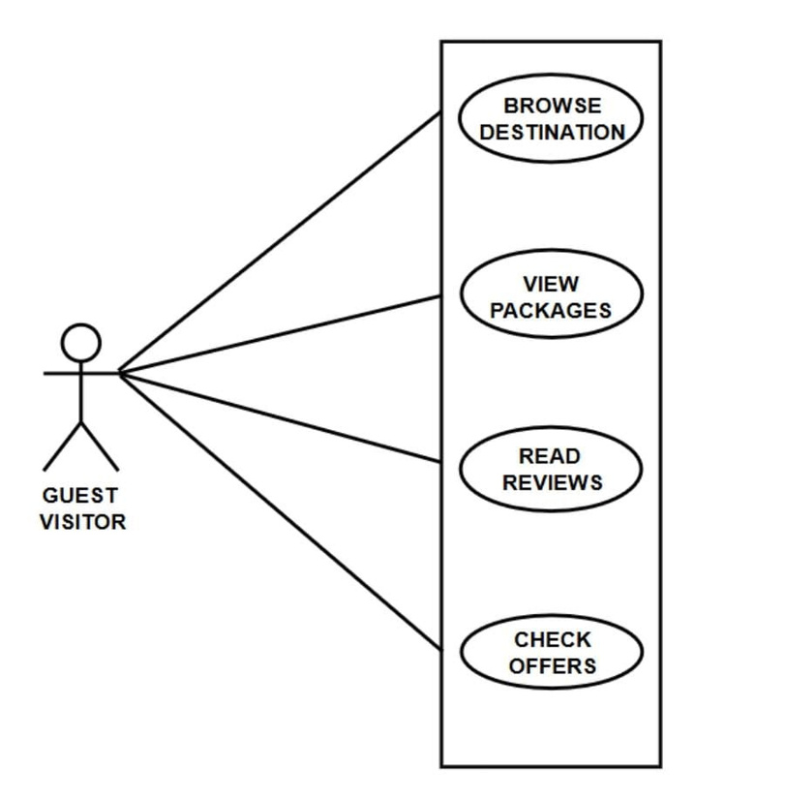
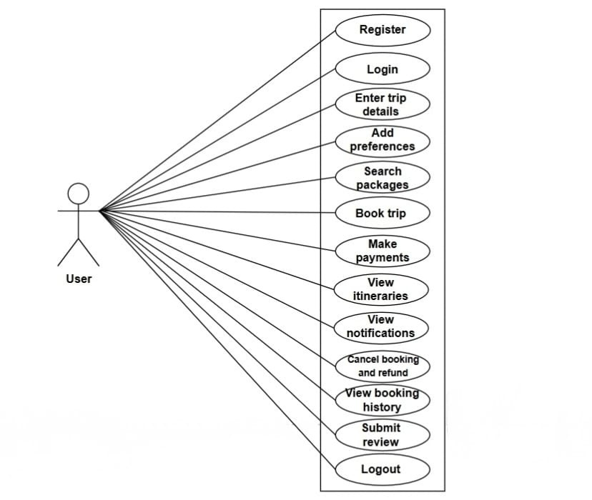
USE CASE DIAGRAMS

Slide 7
HARDWARE INTERFACES
TripConnect is a software platform accessed via standard computing and mobile devices. The system does not require any specialized hardware. The hardware interface considerations are as follows:
User Devices
Supported devices include desktops, laptops, tablets, and smartphones.
Interfaces are standard input/output devices: touchscreen, keyboard, mouse.
Networking Hardware
Requires standard network connectivity (Wi-Fi, 4G/5G, Ethernet) to access the platform.
Communication occurs over standard web protocols (HTTP/HTTPS).
Payment Processing
Interacts with online payment gateways via the internet.
No direct connection to physical card readers or other specialized payment hardware is needed. Conclusion
TripConnect has no dedicated hardware interface requirements beyond standard computing devices and network connectivity.

Slide 8
SOFTWARE INTERFACES
MongoDB – Serves as the primary database for storing user details, packages, groups, payments, chats, and travel history. Communication is handled via the MongoDB Node.js driver with data exchanged in BSON/JSON format.
Stripe API – Provides secure online payment processing for bookings, cancellations, and refunds. Interaction occurs through REST APIs over HTTPS, with requests and responses formatted in JSON, ensuring safe and reliable transactions.
Google Maps API – Enables TripConnect to display destinations, routes, and itineraries. The system communicates with the API using HTTPS requests and receives JSON-formatted responses to visualize trip details.

Slide 9
TECH STACK
The TripConnect website will be built using the following key
technologies:
FRONTEND TOOLS- React.js / Redux / Material UI / Axios.
BACKEND TOOLS- Node.js / Express.js / Mongoose / MongoDB.
OTHER TOOLS AND TECHNOLOGIES- Stripe API / Twilio / Socket IO / Navigation / AI-ML

Slide 10
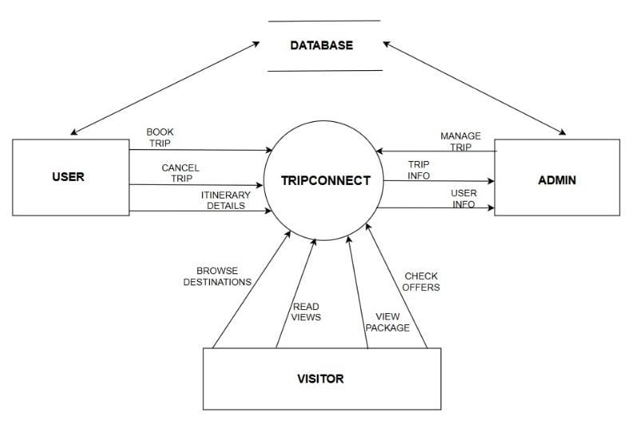
DFD - LEVEL 0

Slide 11

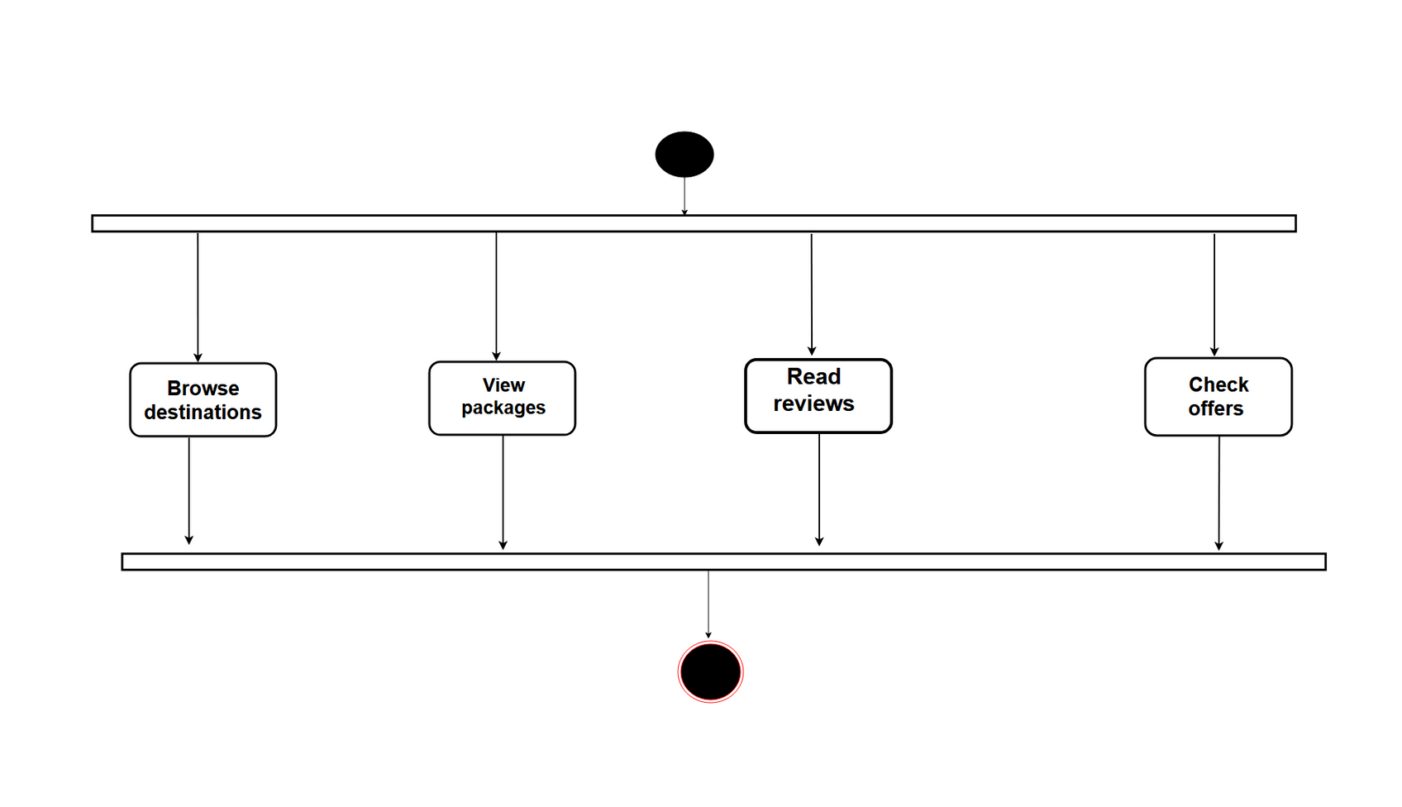
ACTIVITY DIAGRAMS
GUEST VISITOR

Slide 12
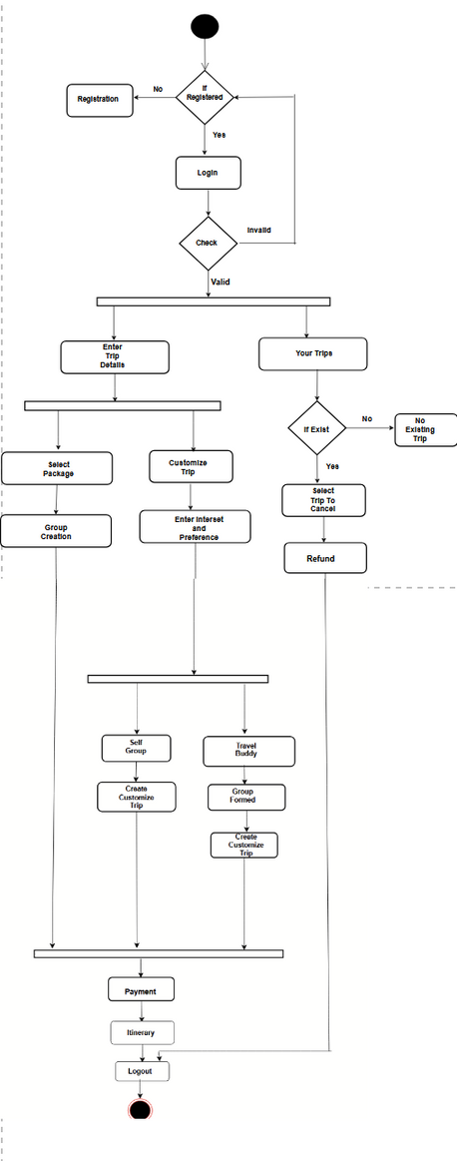
USER

Slide 13
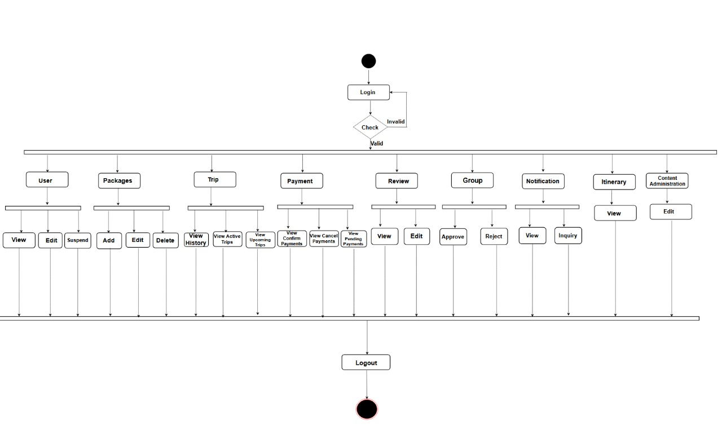
ADMIN

Slide 14
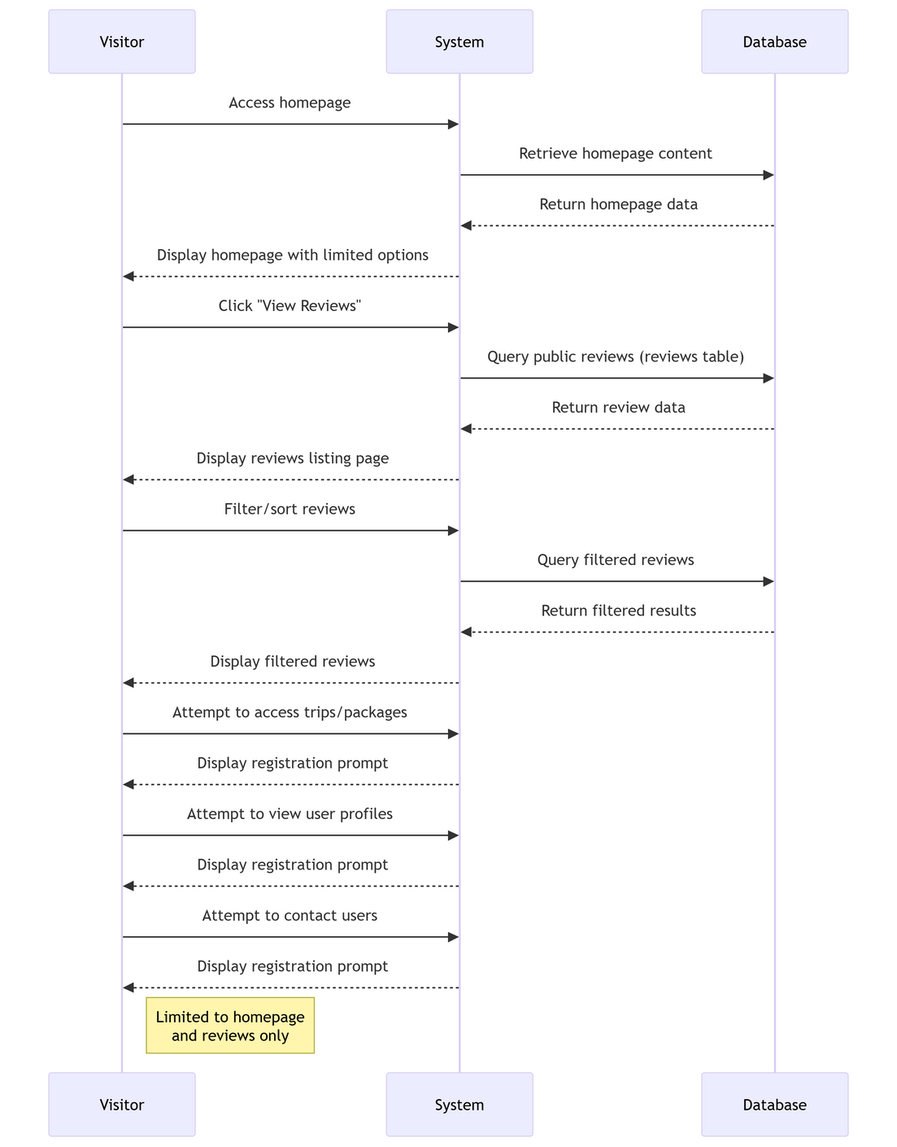
SEQUENCE DIAGRAMS
Visitor

Slide 15
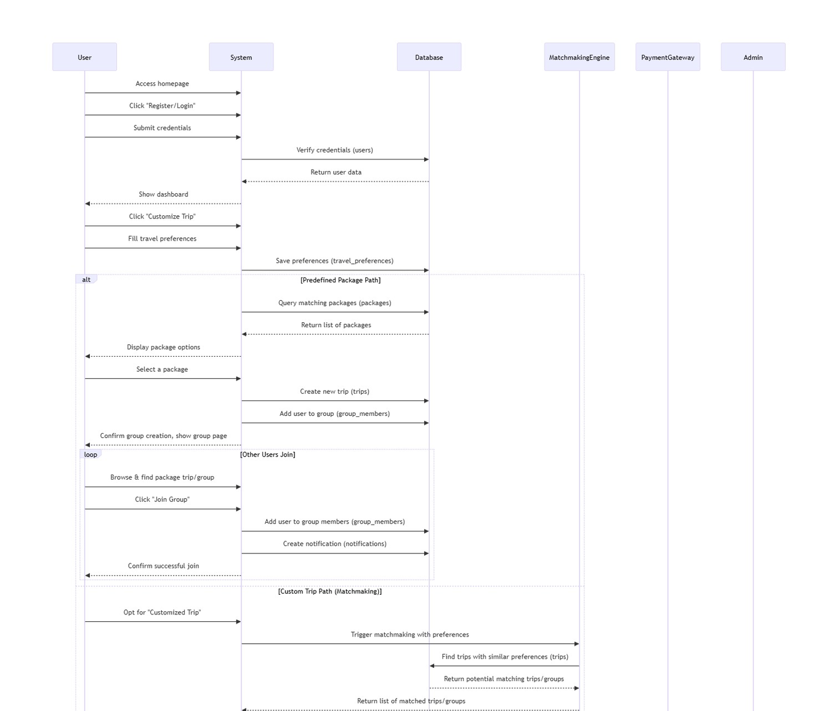
User

Slide 16
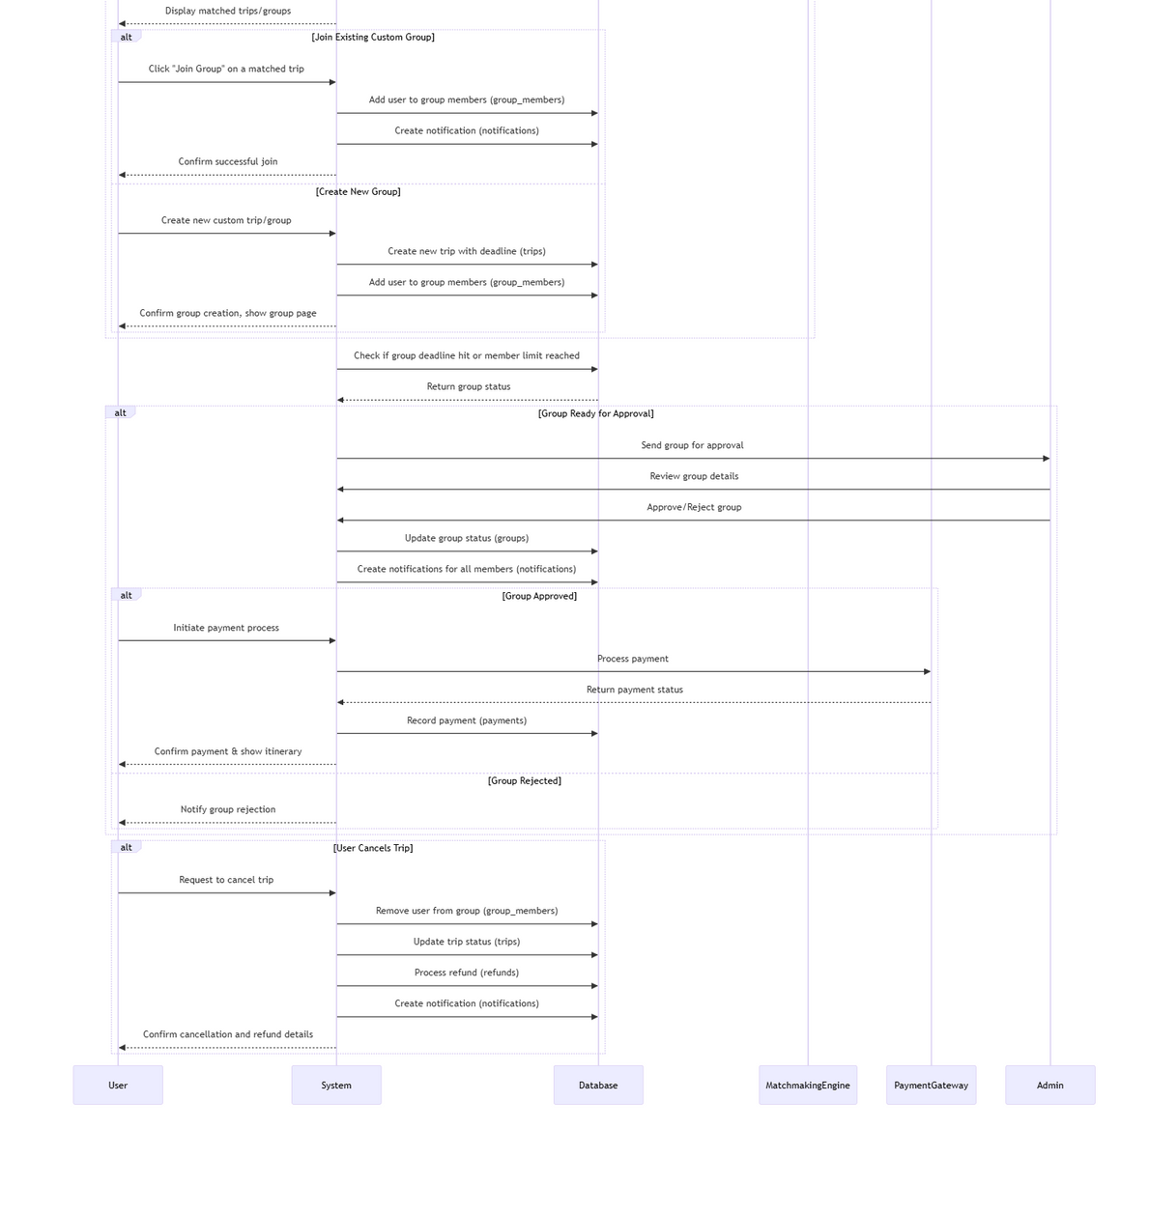

Slide 17
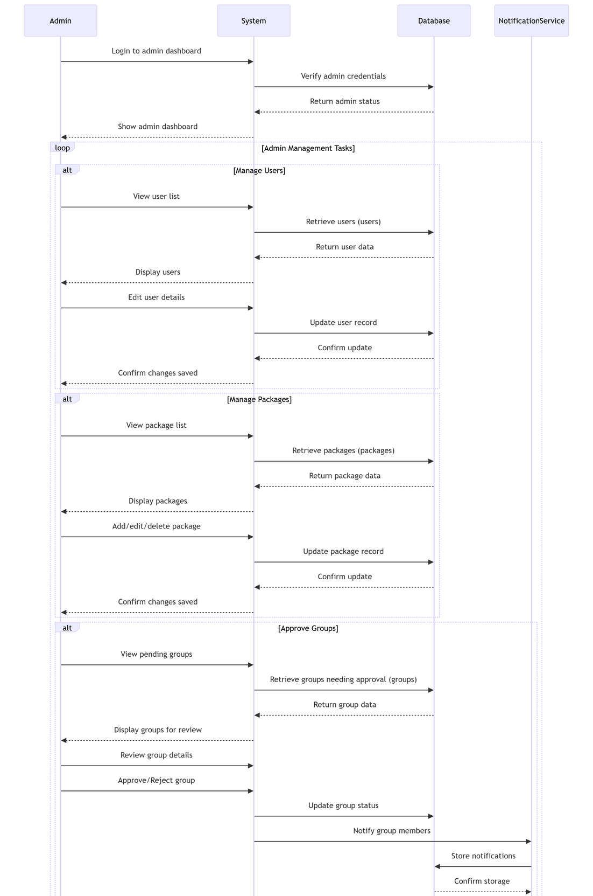
Admin

Slide 18
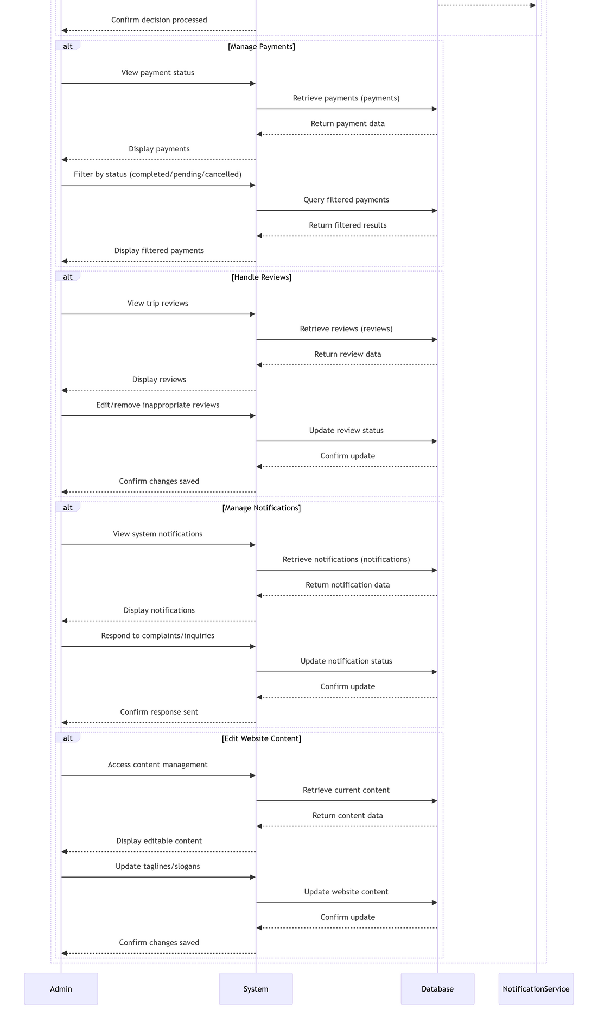

Slide 19
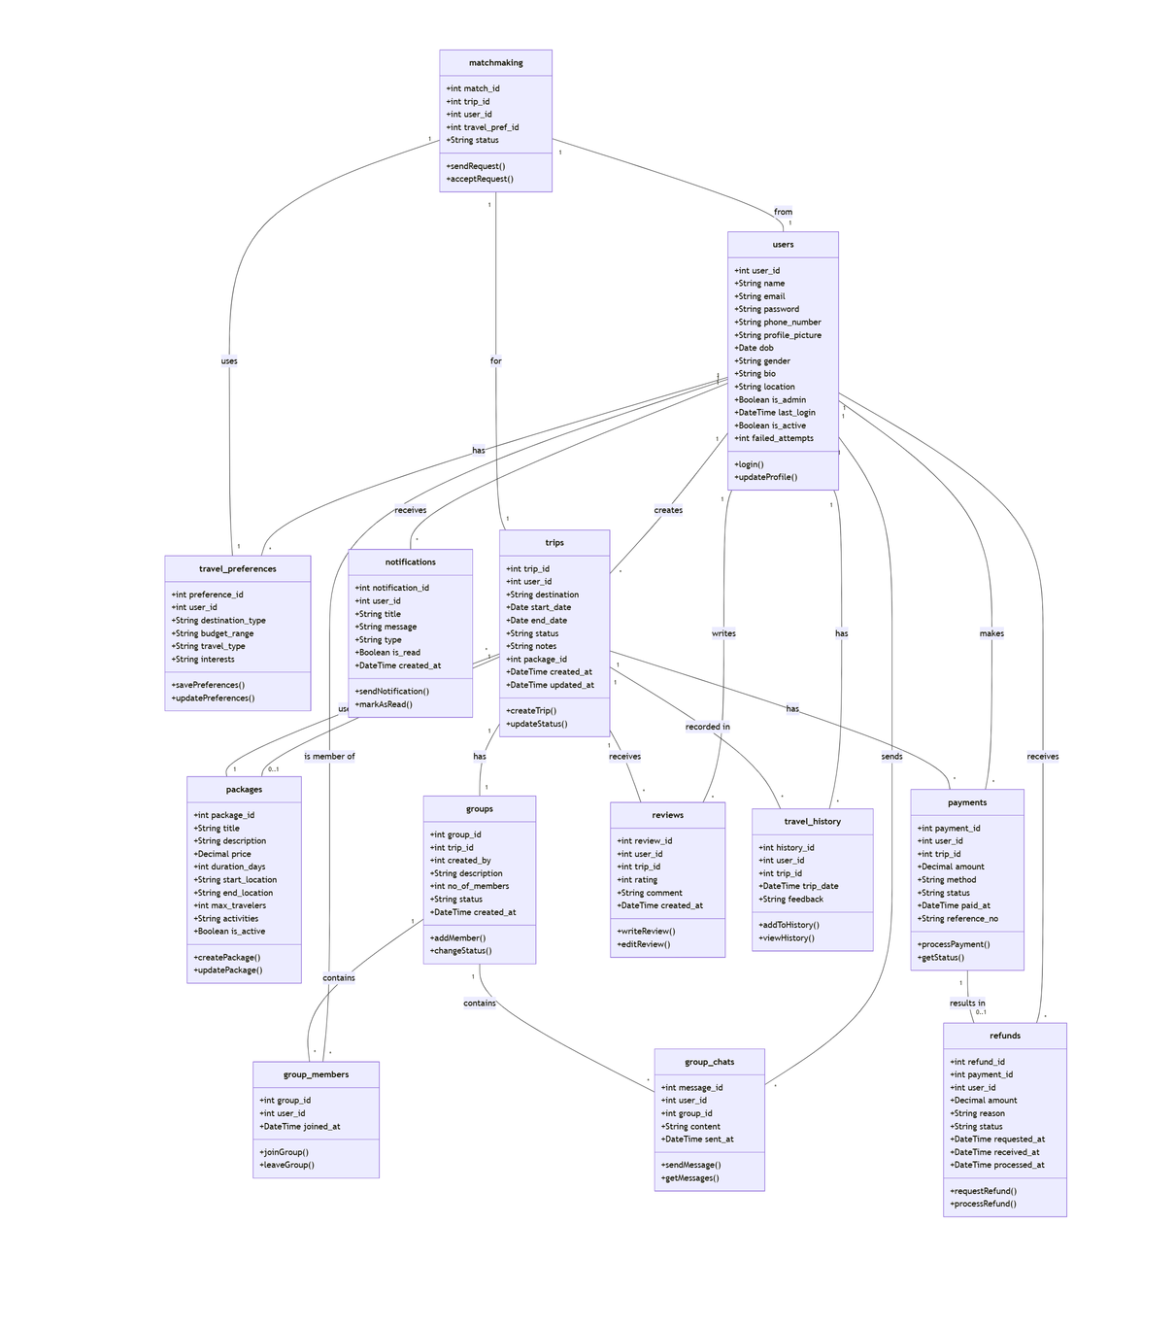
Class Diagram

Slide 20
DATABASE TABLES
USER TABLE
TRIPS
Field | Type | Description
user_id | Number (Auto Increment) | Primary key
name | String | User’s full name
email | String (Unique) | User’s email
phone number | String (Unique) | User’s phone number
password | String | Hashed password
profile picture | String | Path to profile image
dob | Date | Date of birth
gender | Enum(‘Male’,’Female’,’Other’) | Gender
bio | String | Biography
location | String | Location
stamin | Boolean | Admin status
last login | DateTime | Last login timestamp
is_active | Boolean | Active status
failed_attempts | Number | Failed login attempts
Field | Type | Description
preference_id | Number (Auto Increment) | Primary Key
user_id | Number (Ref: Users) | User Reference
destination_type | String | Preferred destination type
budget_range | String | Budget range
travel_type | Enum (‘Solo’,’Group’,’Family’) | Type of travel
interests | String | User’s travel interests

Slide 21
DATABASE TABLES
TRAVEL PREFERENCE
GROUPS
Field | Type | Description
preference_id | Number (Auto Increment) | Primary Key
user_id | Number (Ref: Users) | User Reference
destination_type | String | Preferred destination type
budget_range | String | Budget range
travel_type | Enum (‘Solo’,’Group’,’Family’) | Type of travel
interests | String | User’s travel interests
Field | Type | Description
group_id | Number (Auto Increment) | Primary key
trip_id | Number (Ref:trips) | Trip reference
created_by | Number (Ref:users) | Creator user interface
description | String | Group description
no_of_members | Number | Number of members
created_at | DateTime | Creation timestamp

Slide 22
DATABASE TABLES
GROUP CHATS
MATCHMAKING
Field | Type | Description
group_id | Number (Auto Increment) | Primary key
trip_id | Number (Ref:trips) | Trip reference
created_by | Number (Ref:users) | Creator user interface
description | String | Group description
no_of_members | Number | Number of members
created_at | DateTime | Creation timestamp
Field | Type | Description
match_id | Number (Auto Increment) | Primary key
trip_id | Number(Ref:trips) | Trip reference
user_id | Number(Ref:users) | User reference
travel_pref_id | Number(Ref:travel_preferences | Travel preference reference

Slide 23
DATABASE TABLES
PACKAGES
GROUP CHATS
Field | Type | Description
match_id | Number (Auto Increment) | Primary key
trip_id | Number(Ref:trips) | Trip reference
user_id | Number(Ref:users) | User reference
travel_pref_id | Number(Ref:travel_preferences | Travel preference reference
Field | Type | Description
message_id | Number(Auto Increment) | Primary key
group_id | Number (Ref:groups) | Group reference
sender_id | Number(Ref:users) | Sender reference
content | String | Chat message content
sent_at | DateTime | Message timestamp

Slide 24
DATABASE TABLES
PAYMENTS
REFUNDS
Field | Type | Description
payment_id | Number (Auto Increment) | Primary key
user_id | Number (Ref:users) | User reference
trip_id | Number(Ref:trips) | Trip reference
amount | Decimal | Payment amount
method | String | Payment method
status | Enum(‘Pending,’Completed’,’Failed’) | Payment status
paid_at | DateTime | Payment timestamp
reference_no | String | Payment reference number
Field | Type | Description
payment_id | Number (Auto Increment) | Primary key
user_id | Number (Ref:users) | User reference
trip_id | Number(Ref:trips) | Trip reference
amount | Decimal | Payment amount
method | String | Payment method
status | Enum(‘Pending,’Completed’,’Failed’) | Payment status
paid_at | DateTime | Payment timestamp
reference_no | String | Payment reference number

Slide 25
DATABASE TABLES
REVIEWS
TRAVEL HISTORY
Field | Type | Description
payment_id | Number (Auto Increment) | Primary key
user_id | Number (Ref:users) | User reference
trip_id | Number(Ref:trips) | Trip reference
amount | Decimal | Payment amount
method | String | Payment method
status | Enum(‘Pending,’Completed’,’Failed’) | Payment status
paid_at | DateTime | Payment timestamp
reference_no | String | Payment reference number
Field | Type | Description
history_id | Number (Auto Increment) | Primary key
user_id | Number (Ref:users) | User reference
trip_id | Number (Ref:trips) | Trip reference
trip_date | DateTime | Date of trip
feedback | String | User feedback

Slide 26
DATABASE TABLES
NOTIFICATION
Field | Type | Description
notification_id | Number (Auto Increment) | Primary key
user_id | Number (Ref:users) | User reference
title | String | Notification title
message | String | Notification message
type | Enum(‘trip’,’review’,’message’,’admin_alert’) | Notification type
is_read | Boolean | Read status
created_at | DateTime | Created timestamp

Slide 27
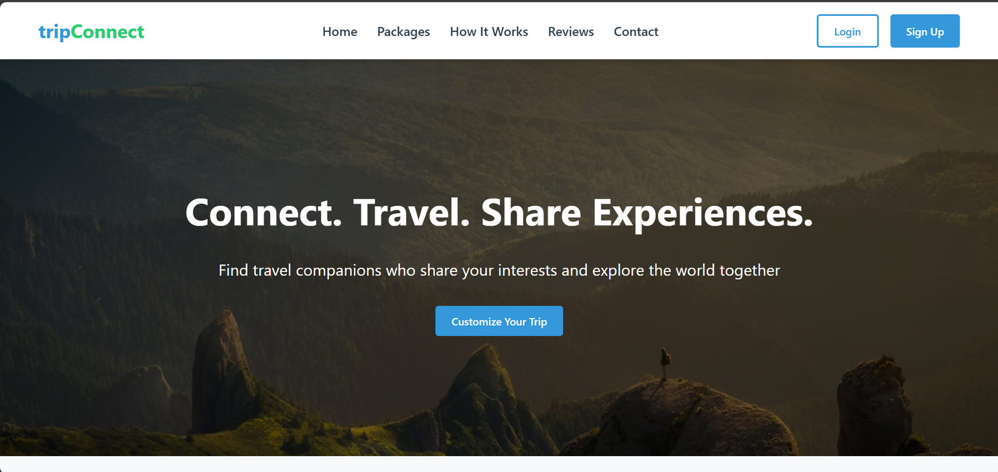
SCREEN IMAGES
Homepage

Slide 28
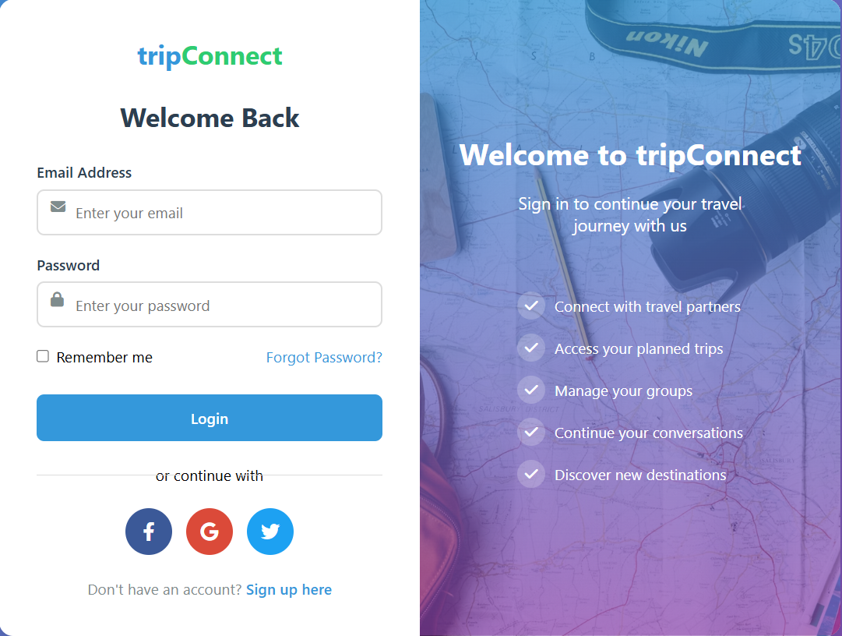
SCREEN IMAGES
Login

Slide 29
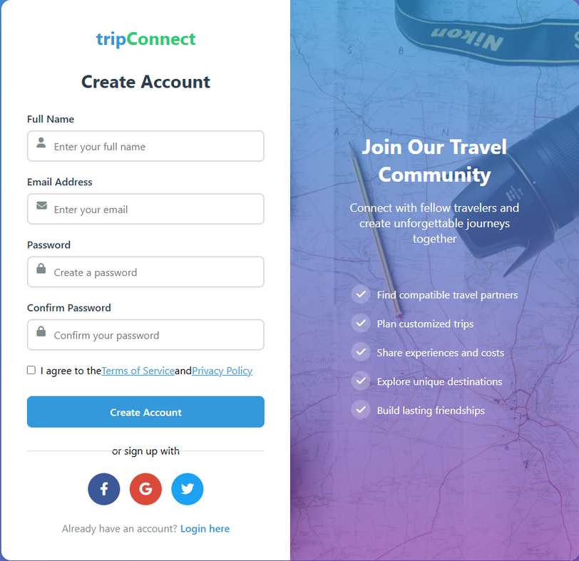
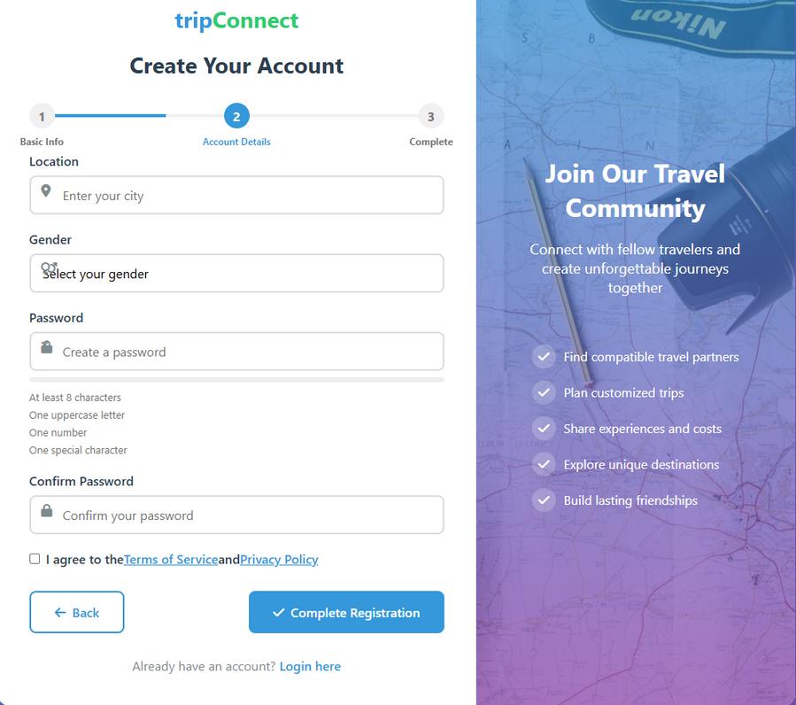
SCREEN IMAGES
Register

Slide 30
REFERENCES
• IEEE Std 830-1998 – IEEE Recommended Practice for Software Requirements Specifications.
• Sommerville, Ian. Software Engineering, 10th Edition, Pearson, 2016.
• Pressman, Roger S. Software Engineering: A Practitioner’s Approach, 8th Edition, McGraw-Hill, 2014.
• TutorialsPoint. “Software Requirements Specification (SRS) Tutorial.” Available at: https://www.tutorialspoint.com/software_engineering/software_requirements.htm
• GeeksforGeeks. “Software Requirements Specification (SRS) – Introduction.” Available at: https://www.geeksforgeeks.org/software-requirements-specification-srs/

Slide 31

THANK YOU

