Slide 1
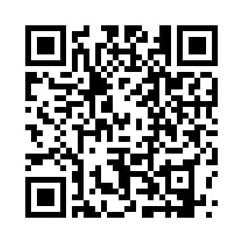
Product Recommendation System
Github Url
Namrata Ajmeri (110022098)
Nishtha Patel (110023893)
Richa Kansara(110023778)
Jainam shah (110024454)

Slide 2
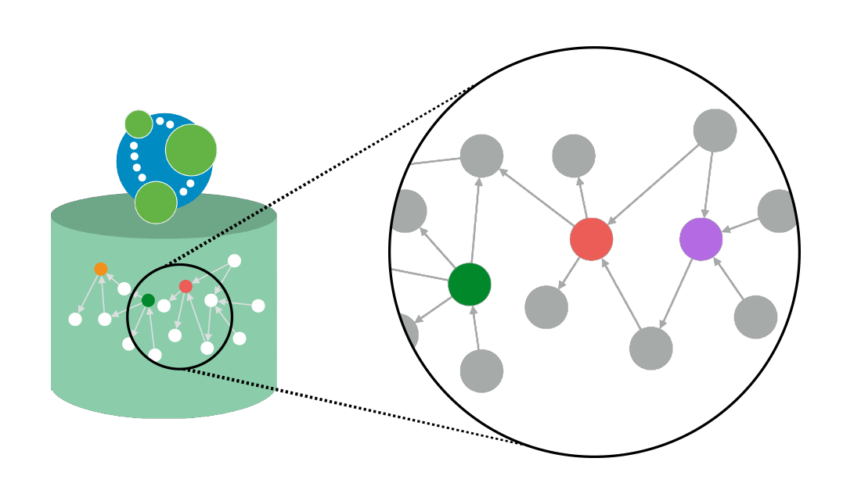
Introduction
The aim of Product Recommendation System is to recommend product to the users based on their and other consumer’s search and search history using graph database.
Big tech companies are using world’s leading graph database to collect massive amount of data that is generated everyday. These data is used to announce new items to the users.
By using graph database, our system will process and generate outcome in a faster manner and can recommend products to the customer in comparatively less time than any relational database.

Slide 3


Existing related work
Every ecommerce website or social media website implements recommendation feature in their own way.
E.g. Amazon, Instacart etc., recommends similar products to their customer based on their search and interest.
Graph database Neo4j is used by Walmart, ebay, Adobe and Microsoft
Walmart uses graph database to quickly query a customer’s purchases in the past and notes new interest shown by the buyer

Slide 4

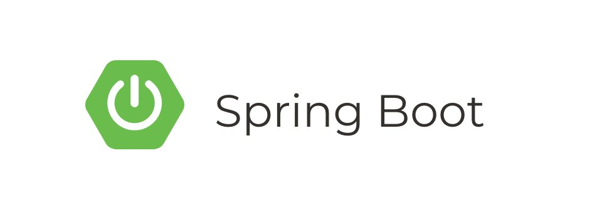
Techniques related to advanced database:
Technologies used are :
Application type : Spring Boot Java Web Application
Web Framework : Spring Boot enabled Spring-WebMVC, Spring-Data-Rest
Persistence Access : Spring-Data-Neo4j 5.0.5
Database : Neo4j-Server 4.1.0
We implemented the recommendation feature using Neo4j Graph database where we can go to any depth through graph algorithms such as DFS or BFS in linear time complexity.

Slide 5
Demo

Slide 6
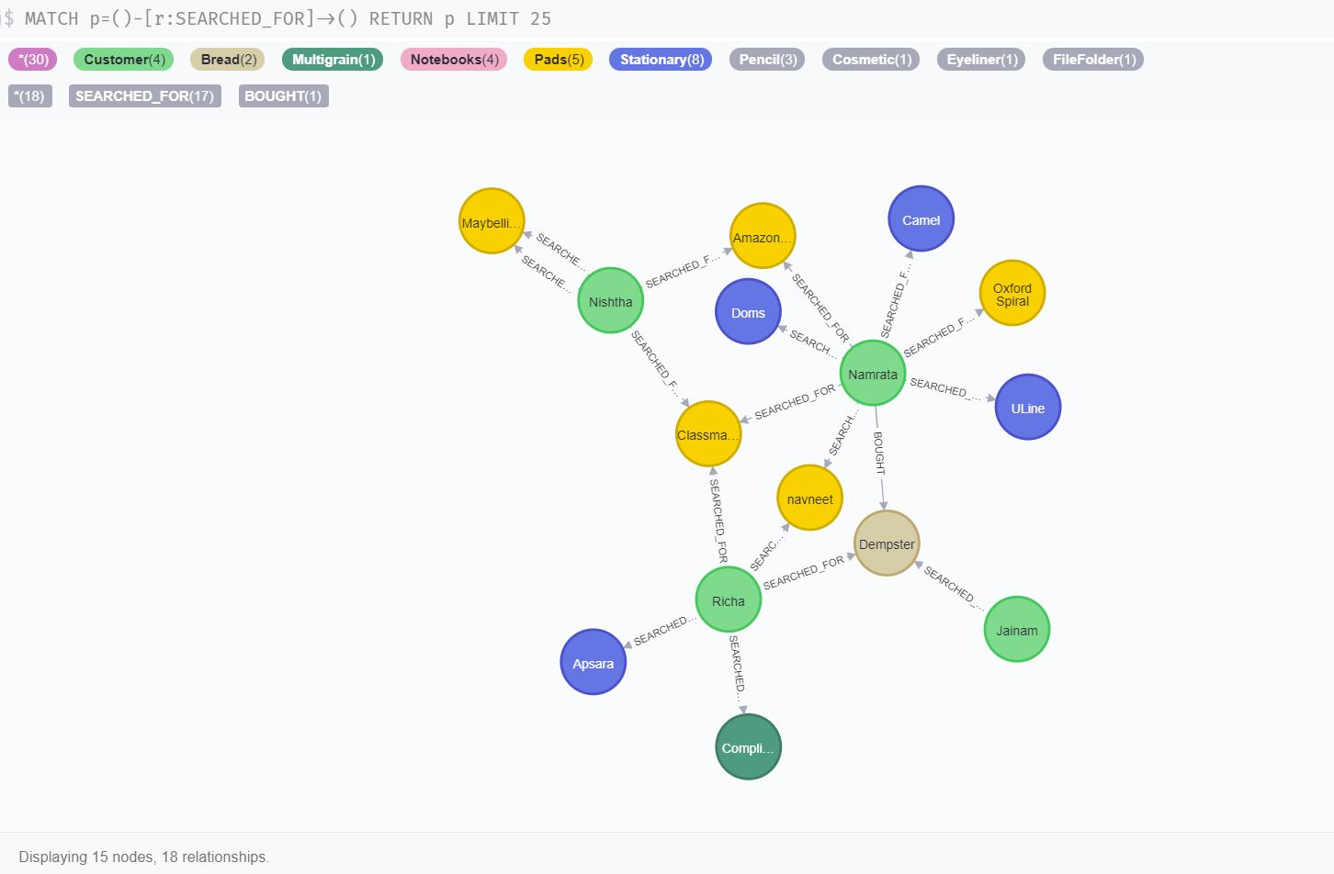
Graph Database (Neo4j)

Slide 7
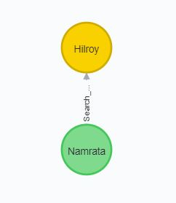
Explanation
In graph database Neo4j, nodes of type Customer and product are created using Cypher query language
Relation between them is defined by an edge
Edge name is the relation name
Here,
Hilroy is a Product
Namrata is the Customer
Search_for is the relation

Slide 8
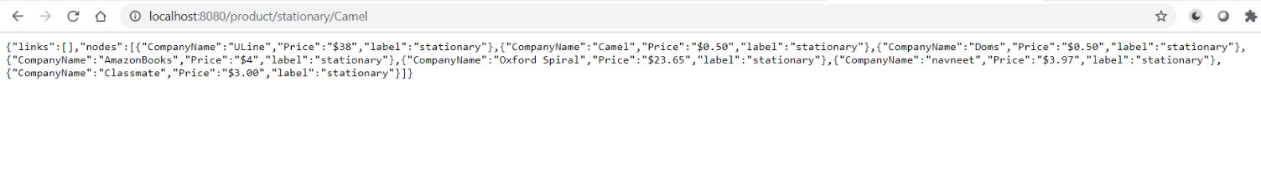
Request-Response of the system
W
Whenever user searches for any product (say stationary item), the stationary item searches done by other customers are displayed as recommendations to the user.
The response given by our system is in JSON format.

Slide 9
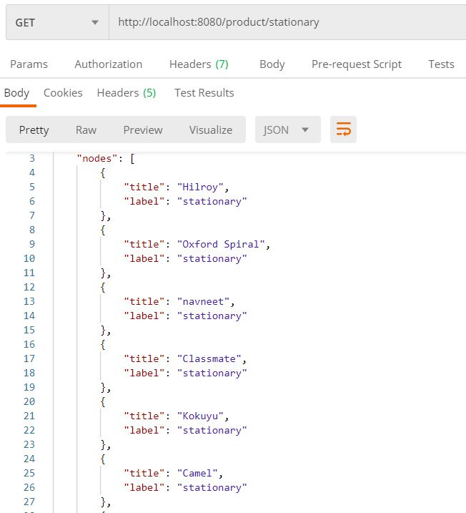
Postman (client)
GET request submitted
Response in JSON format

Slide 10
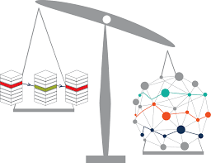
Advantages over relational database
In RDBMS, similar operations need at least one inner join to execute.
In case of graph database, these kind of operations takes linear time.
No unnecessary matching of data in graph database.

Slide 11

We implemented our system using graph database that processed data quickly as well as recommended products to the customer efficiently in comparatively less time.

Slide 12


