Slide 1
Project Presentation Exploratory Project
On
PROPREP
Prakash Singh, Nishtha, Pratibha, Prabhat Kumar
2210992058, 2210991992, 2210992079, 2210992048
Supervised By
Dr. Lalit Sharma
Department of Computer Science and Engineering,
Chitkara University, Punjab

Slide 2
Content
Introduction
Objectives
Work Flow
Tech Stack
Features
Limitations
Conclusion
Future Scope

Slide 3
Introduction
ProPrep is an advanced AI-driven solution designed to empower job seekers through smart resume building and realistic mock interview simulations. Built with Next.js, Drizzle ORM, Gemini AI, and Clerk, it delivers personalized guidance and real-time feedback to boost confidence and performance.
Key Features:
Interview Simulator: Tailors questions by role, industry, and experience level.
Real-Time Feedback: Analyzes responses instantly, highlighting strengths and improvement areas.
AI Resume Builder: Crafts optimized, keyword-rich resumes aligned with industry standards.
ProPrep offers a complete toolkit to help candidates stand out and succeed in competitive job markets.

Slide 4
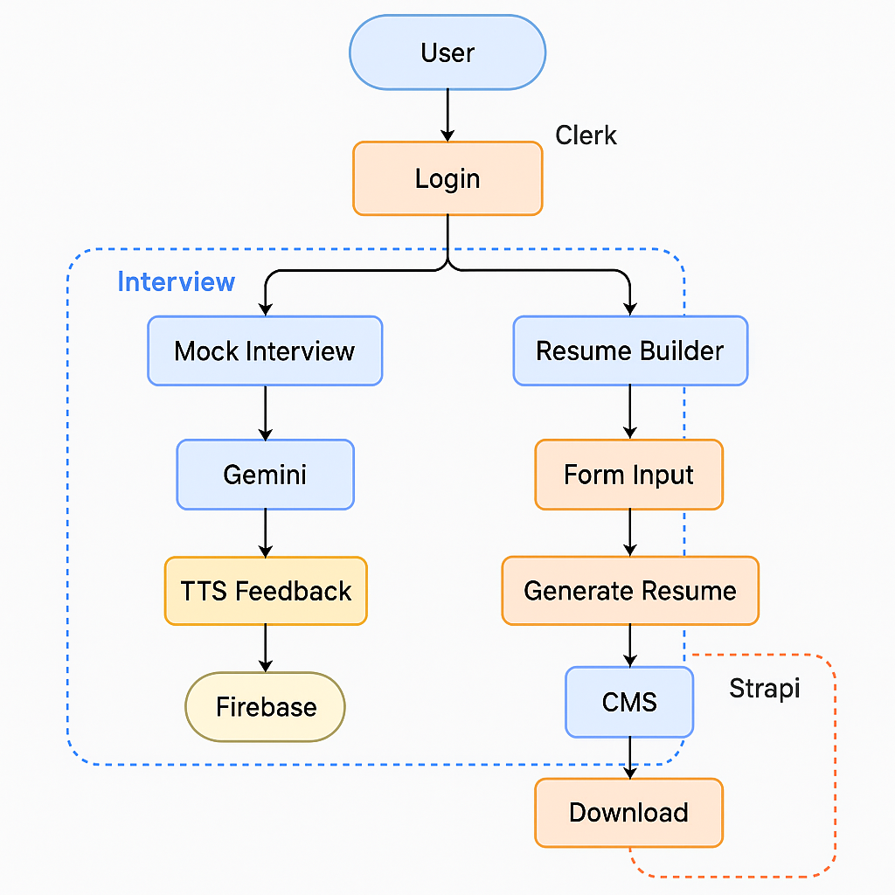
Work Flow

Slide 5
Objectives
Objective | Status
Enable Secure User Access | ✅ Achieved via Clerk for both Resume Builder and Mock Interview modules
Provide a Fully Functional Resume Builder | ✅ Completed with dynamic forms, UI, and Firebase integration
Simulate Mock Interviews for Practice | ✅ Users can participate in mock interviews
Store and Analyze Interview Data | 🔄 Planned – Data storage and feedback analysis pending
Deliver AI-Powered Feedback | 🔄 Planned – Gemini AI integration in progress
Offer a Seamless User Experience | 🔄 In Progress – UI improvements and backend enhancements ongoing

Slide 6
Tools and Technologies
Category | Technology | Purpose
Frontend Framework | Next.js | Building fast, scalable web pages
Styling & UI | Tailwind CSS + Shaden UI | Responsive design and pre-built components
Authentication | Clerk | Secure login/signup and user session management
Database | Firebase | Storing resume data and user information
AI Integration | Gemini AI (Planned) | Smart suggestions for resume content and interview feedback
Resume Preview | Custom React Components | Live preview of resume while editing
Routing & Navigation | React Router | Managing page transitions and user flow
Deployment | Vercel | Hosting and deploying the web application
Version Control | Git + GitHub | Tracking code changes and collaboration

Slide 7
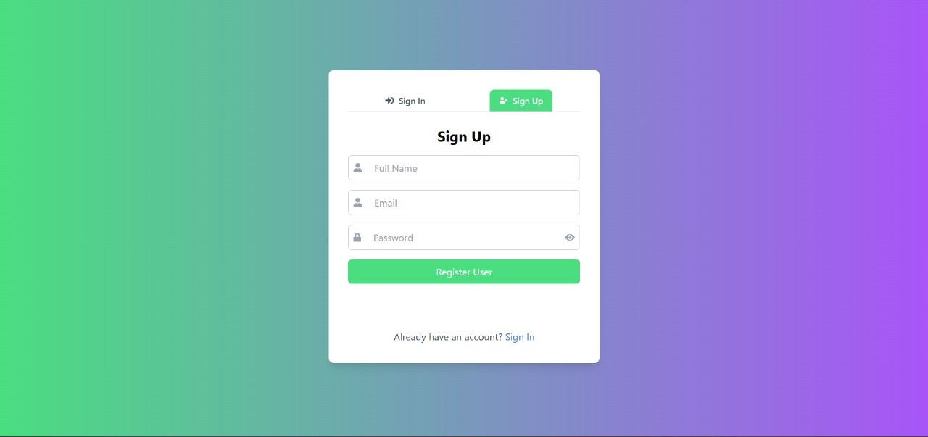
Resume Builder Module
Users create an account
Simple and secure form
Built with Clerk for authentication
Responsive and easy to use on any device

Slide 8
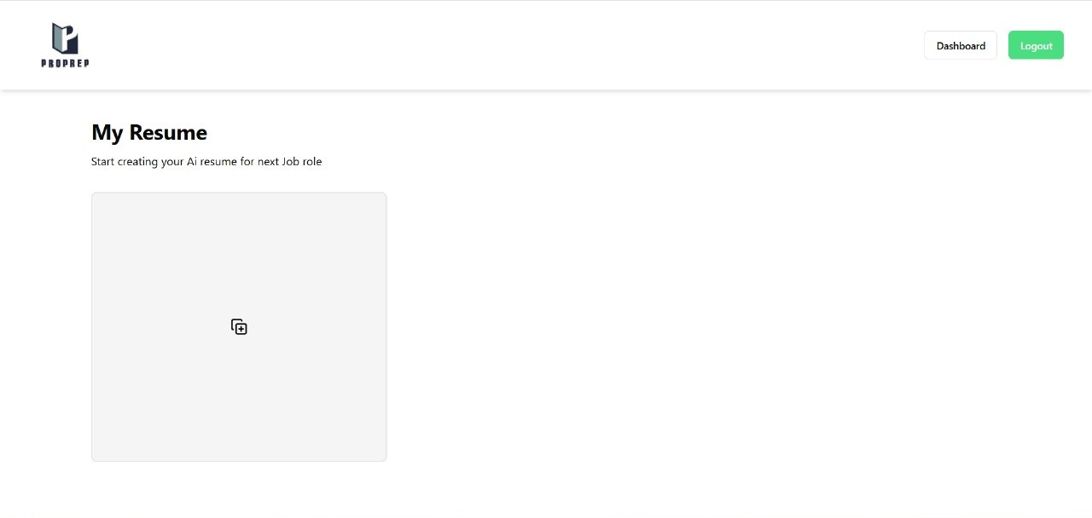
Resume Builder Module
Resume management interface
Dynamic state handling
React hooks, Context API

Slide 9
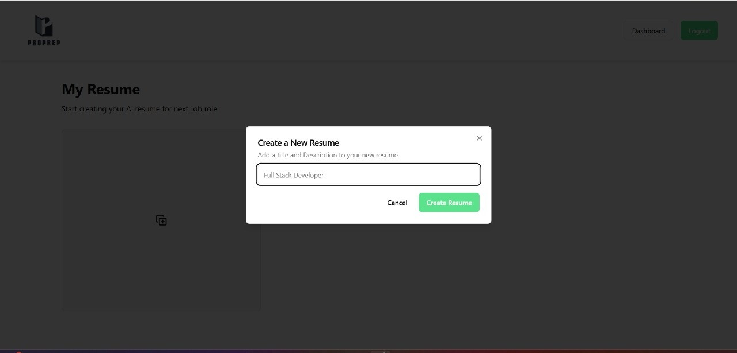
Resume Builder Module
Modal dialog implementation
Form input handling
React, Headless UI

Slide 10
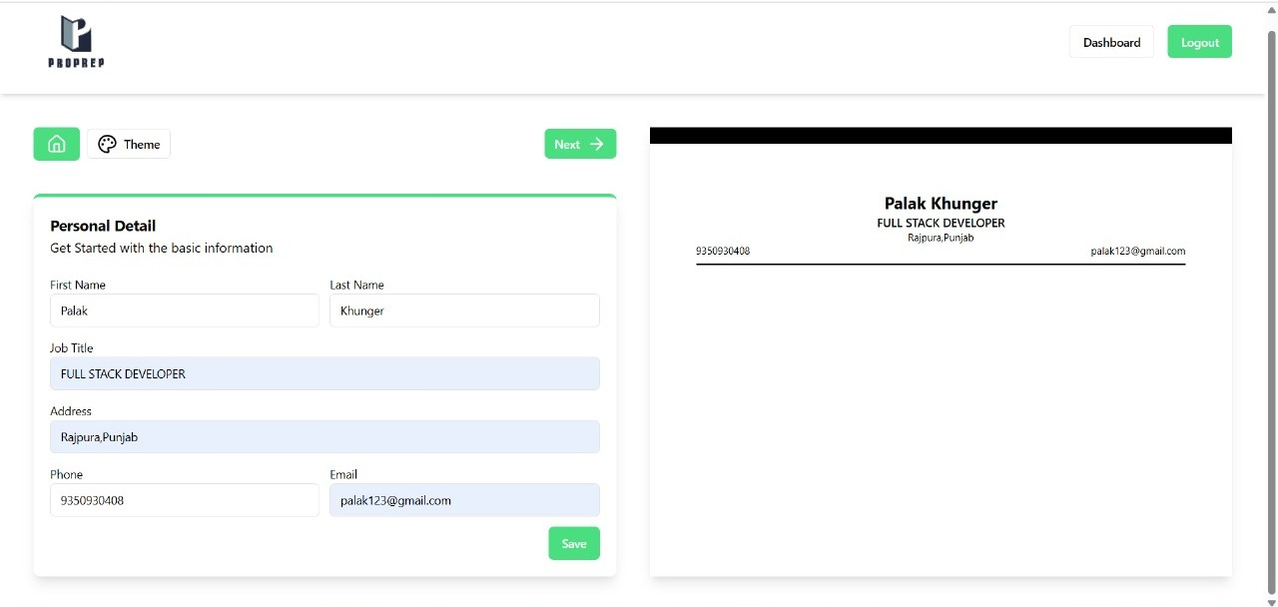
Resume Builder Module
Real-time data binding
Controlled components

Slide 11
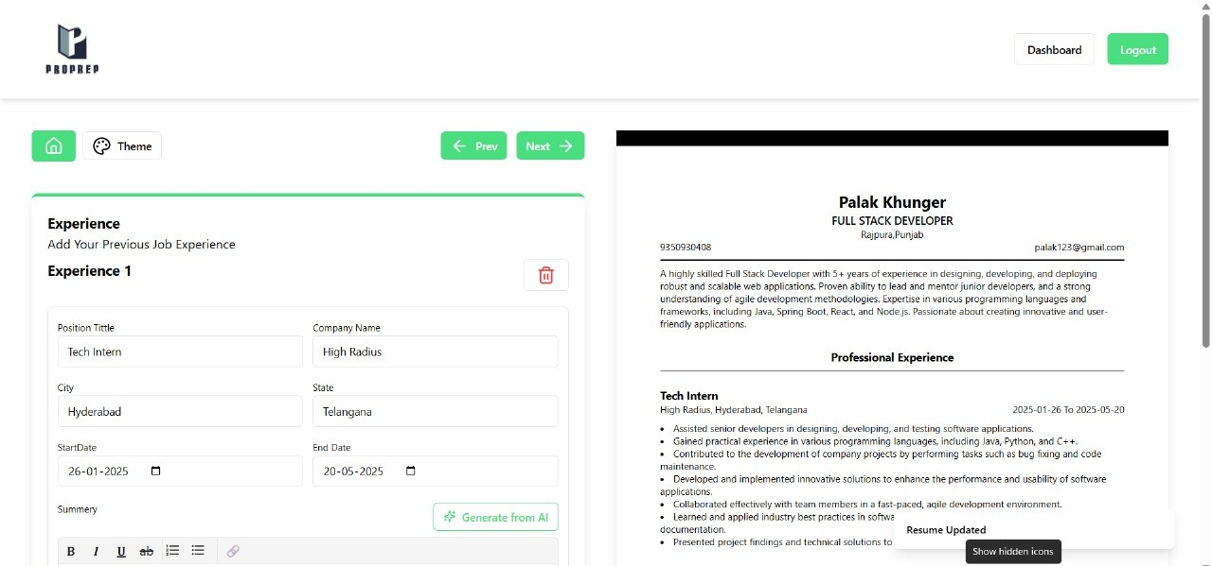
Resume Builder Module
AI-powered content generation
API integration
React, OpenAI API

Slide 12
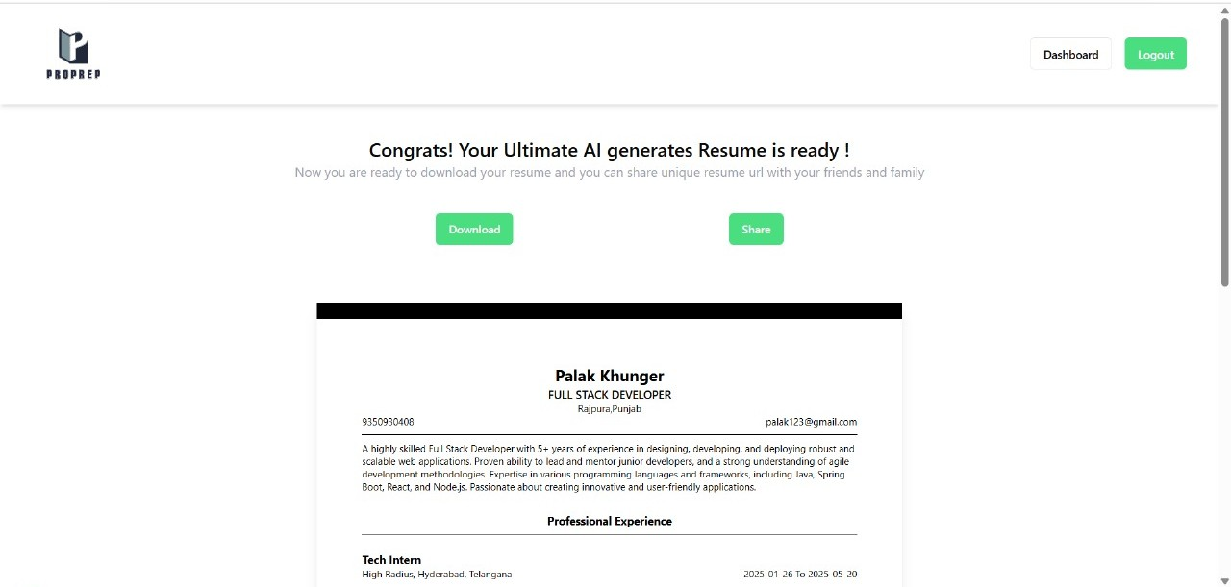
Resume Builder Module
PDF generation and export
Sharing functionality
React, jsPDF, Cloud Storage

Slide 13
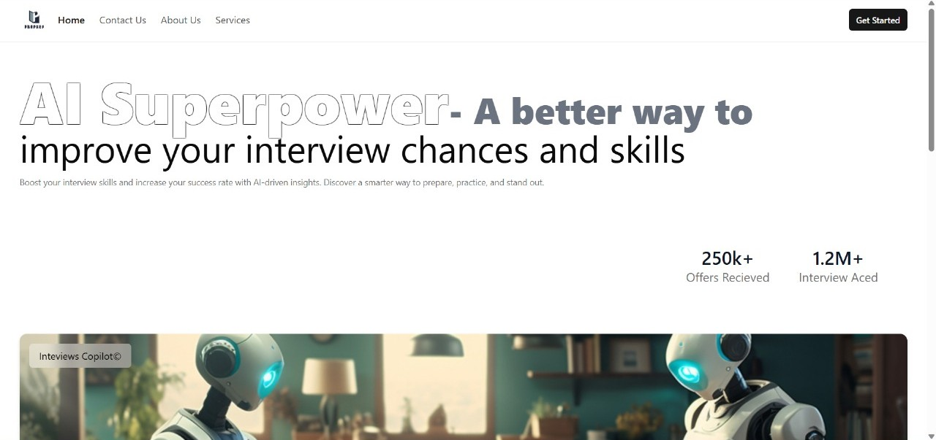
Mock Interview Module
AI-powered mock interview feature.
Boosts interview skills with personalized practice.
Clean, user-friendly interface.
Built with Next.js, Tailwind CSS, Firebase

Slide 14
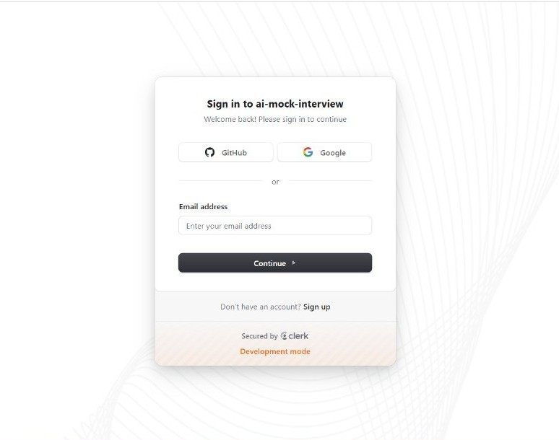
Mock Interview Module
Secure sign-in via Google or GitHub.
Authentication managed by Clerk.
Simple, responsive design.
Built with React, TypeScript, Tailwind CSS.

Slide 15
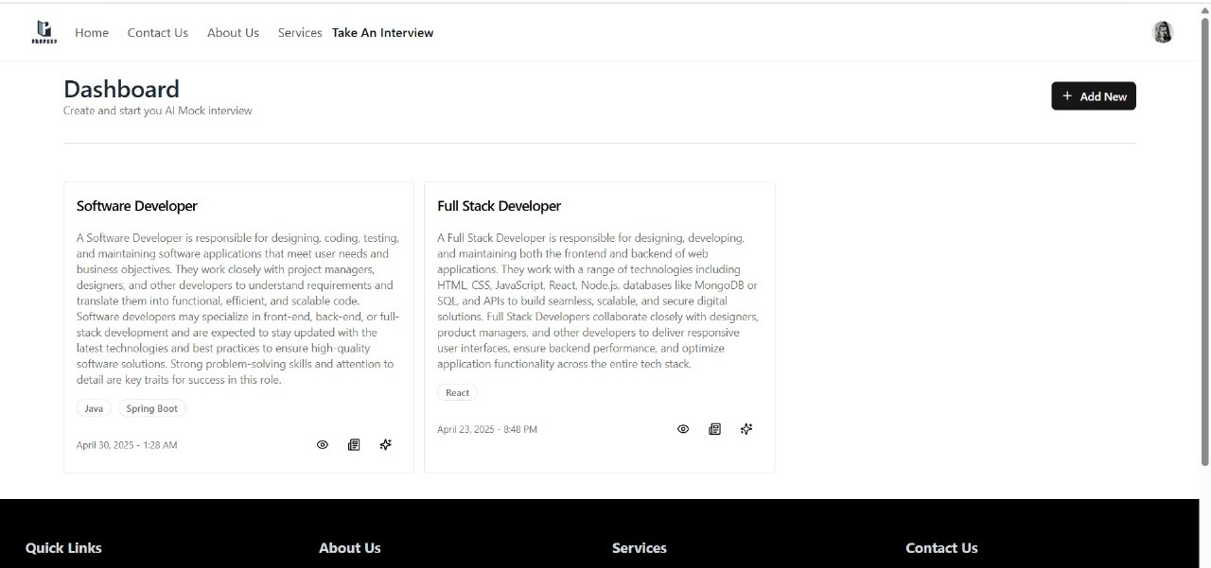
Mock Interview Module
Displays job roles and descriptions.
Allows starting new mock interviews.
Responsive card layout.
Powered by Next.js and Firebase.

Slide 16
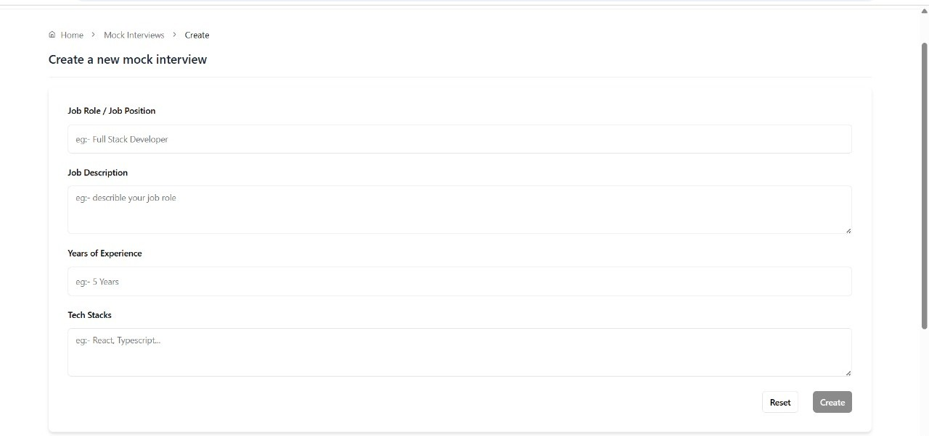
Mock Interview Module
Collects job role, experience, tech stack.
Generates tailored mock interviews.
User-friendly form layout.
Uses React and Firebase.

Slide 17
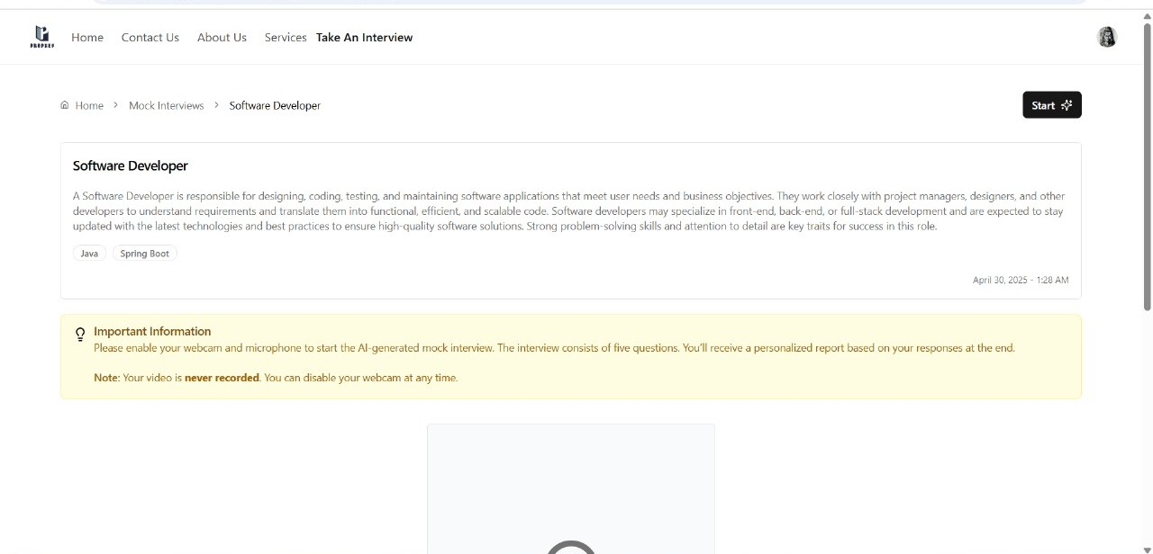
Mock Interview Module
Provides role description and instructions.
AI-generated five-question interviews.
Clear, concise guidance.
Built with Next.js and Firebase.

Slide 18
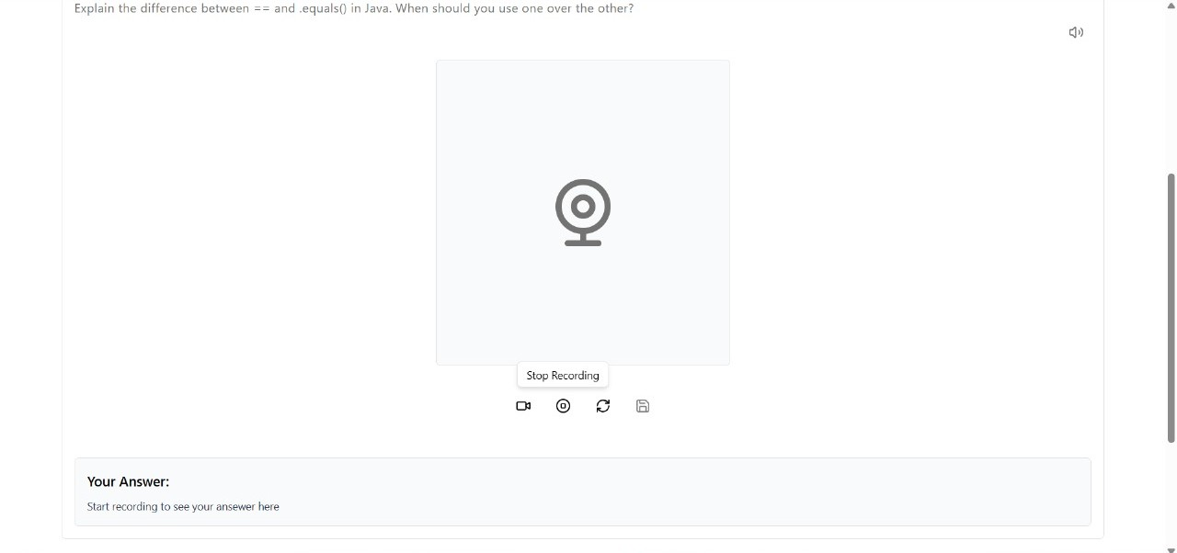
Mock Interview Module
Displays questions with optional recording.
Simulates real interview pressure.
Secure session management.
Built with React and Clerk.

Slide 19
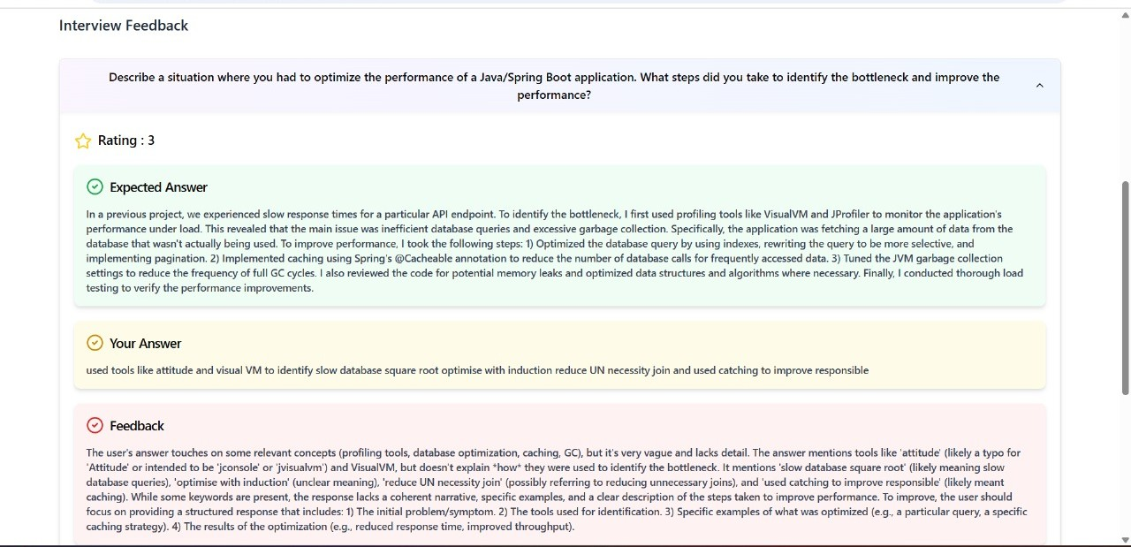
Mock Interview Module
Provides ratings and suggestions.
Helps users improve performance.
Stores responses securely.
Powered by Firebase and Gemini AI (planned).

Slide 20
Limitations
AI Feedback Accuracy: May not always provide perfect insights, especially for industry-specific jargon or complex answers.
Speech Analysis Challenges: Accuracy can be affected by accents, background noise, and variations in speaking styles.
Third-Party Dependencies: Relies on Clerk (authentication), Cloudinary (file storage), and WebSocket/Socket.io (real-time interaction), which may face downtimes.
Limited Customization: AI-generated questions may not fully replicate human interview depth; manual customization options are limited.
Data Privacy & Security: Requires strong security measures for storing interview recordings and ensuring compliance with privacy regulations.
Resume Optimization Constraints: While the AI resume builder generates optimized suggestions, it may not always perfectly match specific job roles, especially for niche positions or unconventional career paths. More industry-specific resume customization features are expected in the future.

Slide 21
Conclusion
Key Takeaways
AI-Enhanced Resume Builder - ProPrep integrates Gemini AI to provide smart keyword suggestions, formatting tips, and tailored resume enhancements based on user input and target job roles.
Scalable & Modern Tech Stack - Built using React.js, Clerk, Tailwind CSS, Shadcn UI, and planned integration with Gemini API for AI features. The platform ensures a responsive, scalable, and secure experience.
Personalized Mock Interviews (Planned) - AI-powered mock interviews inspired by Google Interview Warmup will simulate real questions, evaluate voice/text responses, and provide real-time improvement tips.
User-Centered Experience - Focus on seamless authentication, real-time data storage, and structured resume building to support job seekers in building confidence and preparing effectively.
Future Vision
AI Avatars for Mock Interviews
Personalized Career Roadmap
Multi-Language Support
Community & Networking

Slide 22
Future Scope
AI-Powered Resume Optimization – Extend ProPrep’s capabilities to optimize resumes based on job descriptions and ATS compatibility.
Interview Success Prediction – Use AI analytics to predict users' chances of success based on their interview performance.
Community & Mentorship Program – Build a platform for users to connect with industry professionals for guidance and networking.
Integration with Job Portals – Connect with job platforms to provide users with relevant job recommendations based on their performance.
Video Recording & Playback – Allow users to record their mock interviews for self-assessment and improvement.

Slide 23

23

