Slide 1
Project Presentation of Co-Op Project at Industry (Module-1)
On
Media’s Effect on Public Opinion: A Survey-Based Analysis
Sahil (2210992209) Kanishk (2210991739) Madhav (2210991864) Nishtha (2210991994)
Supervised By
Mrs. Preeti Saini, Department of CSE
Chitkara University
Department of Computer Science and Engineering,
Chitkara University, Punjab

Slide 2

Introduction & Objective
Background
Objective
• The media plays a pivotal role in shaping public perception, attitudes, and political discourse in modern democracies.
• The rise of social media, algorithmic curation, and digital platforms has amplified media’s influence on opinion formation.
• Misinformation, filter bubbles, and biased reporting raise serious concerns about democratic deliberation and informed citizenship.
• Examine major theories of media influence: agenda-setting, framing, social amplification of risk, and uses and gratifications.
• Conduct a primary survey on public perceptions of media credibility, trust, and political influence.
• Compare the impact of traditional versus digital media channels on opinion formation.
• Identify how individual factors like media literacy and political knowledge moderate these effects.
2

Slide 3

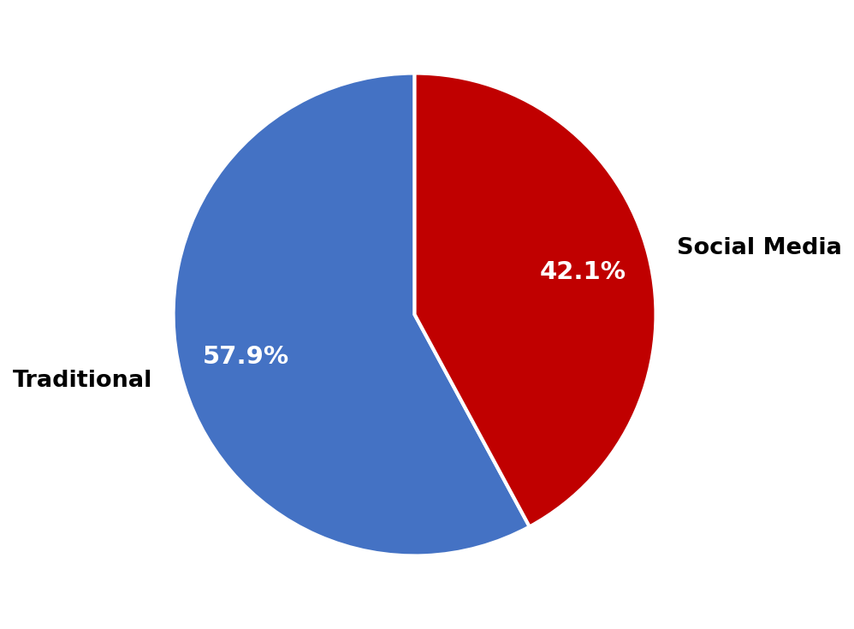
Methodology & Framework
Survey Methodology: Primary Data Collection
Structured questionnaire deployed via Google Forms across diverse respondents
Mixed-method: Likert scales, multi-select, and open-ended response items
Themes: media trust, fact-checking, platform usage, perceived bias
Quantitative tabulation supplemented by literature synthesis from 50+ years of research
Survey Design
Distribute & Reach
Collect Responses
Analyze (Statistics)
Theory Mapping
Findings & Insights
Theoretical Frameworks Examined
Agenda-Setting | Framing Theory | Social Amplification of Risk | Uses & Gratifications
3

Slide 4
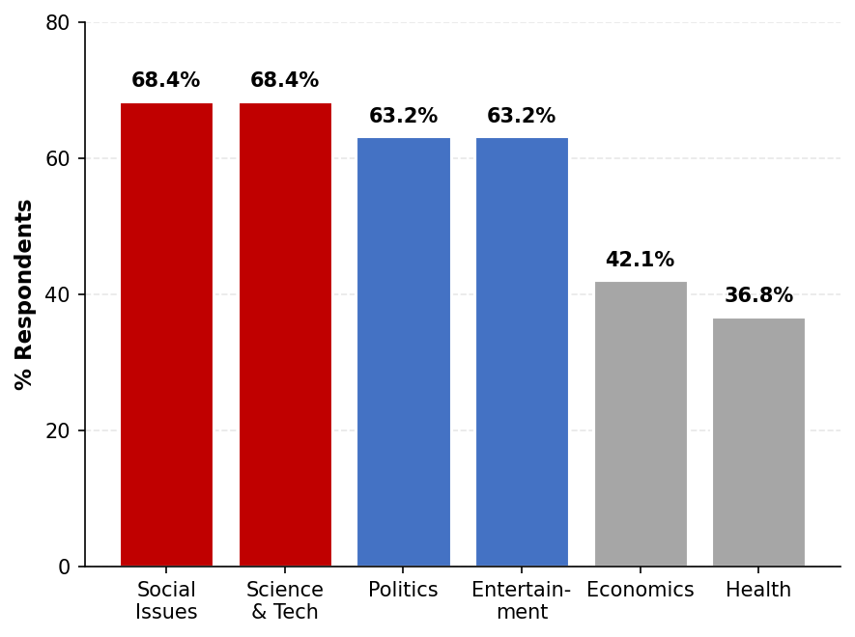
Key Findings: News Topic Salience
Key Takeaways
✓ Social Issues and Science & Tech tied at 68.4% importance
✓ Politics and Entertainment closely follow at 63.2% each
✗ Health (36.8%) and Economics (42.1%) receive the least attention
Theoretical Lens
• Agenda-setting: media salience drives public salience
• Topics with high coverage rank higher in importance
• Audiences favor progressive, future-oriented content
Political Influence
• Most rate media’s political influence 6 to 9 of 10
• Strong agenda-setting effect on political narratives
Conclusion: Topic salience in media coverage strongly predicts public attention, with social and political content dominating perceived importance.
4

Slide 5
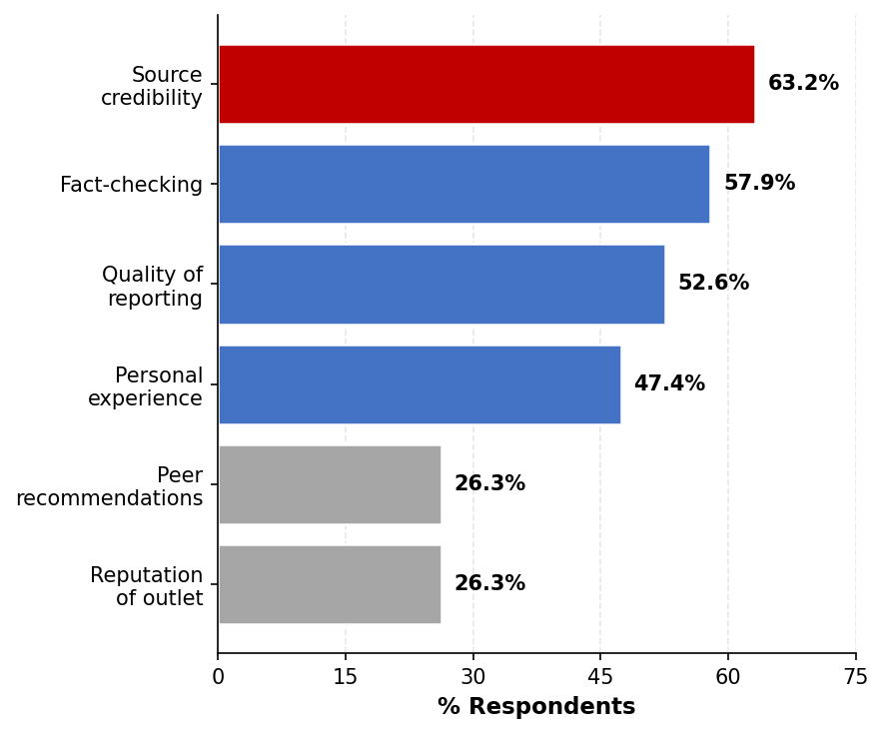
Trust Drivers: What Shapes Credibility
What the Survey Reveals
Source credibility is the dominant trust driver at 63.2%, ranked top among all attributes.
Fact-checking is the second-strongest signal at 57.9%, edging out brand reputation.
Peer recommendations and outlet reputation tied at 26.3%, less weight than expected.
Trust is shifting from brand-based to evidence-based consumption.
Insight: Audience Skepticism
Trust ratings cluster between 5 and 7 of 10
73% demand unbiased reporting from media
Reader takeaway: critical thinking is emerging, but verification habits remain inconsistent.
Trust factor analysis shows audiences increasingly value verification and source rigor over brand familiarity.

Slide 6
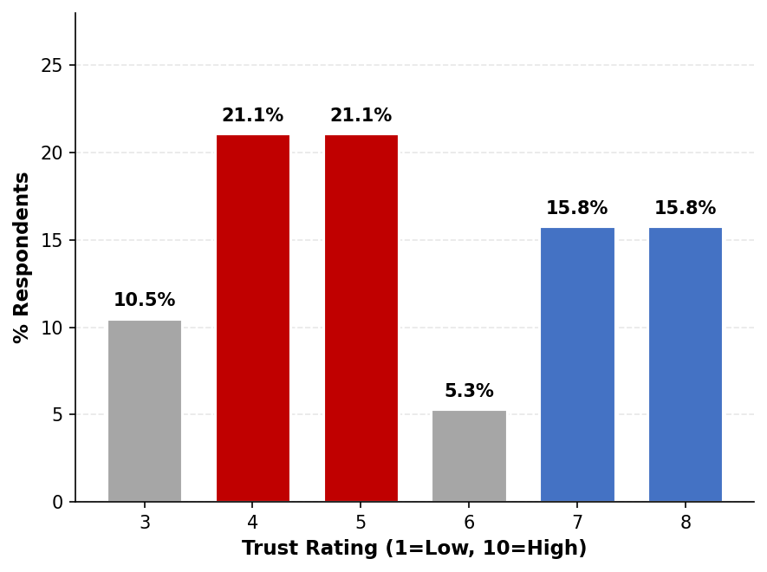
Trust Calibration: How Skeptical Are Audiences?
Key Finding
Trust ratings cluster between 4 and 7 of 10, none above 8.
42% rate trust at 4 or 5 of 10
Yet 89.5% still rely on social media for daily news.
A clear trust-usage gap: audiences distrust social media yet consume it most, signalling the credibility crisis at the heart of digital opinion formation.
6

Slide 7
Conclusion & Future Scope
Conclusion
Media exerts substantial influence through agenda-setting, framing, and risk amplification.
Source credibility (63.2%) and fact-checking (57.9%) emerged as the strongest trust drivers.
Social media dominates usage (89.5%) yet trails traditional media on trust.
Filter bubbles, algorithmic curation, and misinformation intensify polarisation.
Media literacy and political knowledge significantly moderate exposure effects.
Limitations
Small sample size limits statistical generalizability across populations.
Self-reported responses may carry social desirability and recall bias.
Cross-sectional design captures attitudes at a single moment, not change over time.
Future Scope
Longitudinal studies tracking opinion shifts across major news cycles.
Cross-national comparison of media systems and their democratic outcomes.
Experimental designs to isolate causal pathways from exposure to belief change.
Strengthening media literacy, accountability, and platform transparency to safeguard informed democratic discourse.
7

Slide 8
References
[1] McCombs, M. E., & Shaw, D. L., "The agenda-setting function of mass media," Public Opinion Quarterly, 1972.
[2] Entman, R. M., "Framing: Toward clarification of a fractured paradigm," Journal of Communication, 1993.
[3] Kasperson, R. E. et al., "The social amplification of risk: A conceptual framework," Risk Analysis, 1988.
[4] Katz, E., Blumler, J. G., & Gurevitch, M., "Utilization of mass communication by the individual," SAGE, 1974.
[5] Chong, D., & Druckman, J. N., "Framing theory," Annual Review of Political Science, 2007.
[6] Pariser, E., "The filter bubble: What the internet is hiding from you," Penguin Press, 2011.
[7] Cinelli, M. et al., "The COVID-19 social media infodemic," Nature Scientific Reports, 2020.
[8] Zaller, J. R., "The nature and origins of mass opinion," Cambridge University Press, 1992.
[9] van der Linden, S., & Lewandowsky, S., "Countering misinformation through inoculation and prebunking," ERSP, 2021.
Thank You!
Sahil | Kanishk | Madhav | Nishtha | Mentor: Mrs. Preeti Saini
8

