Slide 1
TEAM NAME:
Unfazed
TEAM MEMBERS: 1. Khushi Kashyap 2. Kajal Meshram
3. Nishu Kumari
4. Mallika Singh
Graduating Years 2026
2026
2026
2026
College Name
VIT-AP University VIT-AP University
VIT-AP University
VIT-AP University

Slide 2
ABOUT US:
Major Projects:
BrailleEase: Real-time text recognition and Braille conversion.
Learning Management System: Full-stack educational platform.
Reviva: Integrated travel platform with website, chatbot, and recommendation model.
Hackathon Experiences:
Smart India Hackathon (SIH): Participated in a national-level hackathon.
Aerospanza: Reached Top 10 teams.
Strengths:
Full-stack development ,AWS
Languages: Java, JavaScript, Python, SQL
Frameworks: React, NodeJS, Express.js, BootStrap, Tailwind
Databases: MongoDB, MySQL
Tools: GitBash, GitHub
Template Engine: EJS

Slide 3
FormRx: Medical Diagnosis Extractor
REAL-LIFE PROBLEM
PROBLEM STATEMENT: (PS-2)
SOLUTION
Insurance companies struggle with slow and error-prone claims processing due to manual extraction of medical diagnoses from handwritten forms.
This process leads to inefficiencies and inaccuracies, increasing both time and cost for insurers.
GOAL:
Build an AI-powered solution to automate the extraction of medical diagnoses from handwritten medical forms, ensuring accuracy and speed in the claims process.
FormRx offers a cutting-edge system combining OCR (Optical Character Recognition) and NER (Named Entity Recognition) technologies to digitalize handwritten diagnoses, improving processing times and data accuracy.
KEY BENEFITS:
Automation: Eliminates manual data entry.
Accuracy: Reduces human error by using advanced AI models.
Scalability: Capable of processing large volumes of medical forms effortlessly
Medical Diagnosis Extraction. Develop a solution to accurately extract medical diagnoses from handwritten medical forms to digitalize medical forms and improve the efficiency as well as accuracy of claims processing.

Slide 4
PROCESS FLOW:
Form Capture
Pre-processing & Segmentation
Optical Character Recognition (OCR)
Diagnosis Extraction and Validation
Output Generation and Integration
The process begins with the capture of handwritten medical forms. These forms can be submitted electronically or physically. The system will automatically scan and digitalize the forms, ensuring high-quality image processing for accurate analysis.
The digitalized forms undergo preprocessing to enhance image quality, remove noise, and improve readability. Image segmentation techniques are then applied to identify individual text fields and diagnose sections within the form.
Advanced OCR algorithms are employed to convert handwritten text into machine-readable format. This step is crucial for accurately recognizing and transcribing the diagnoses present on the forms.
A machine learning model trained on a comprehensive dataset of medical diagnoses is used to identify and extract the relevant diagnoses from the OCR output. The extracted diagnoses are then validated against a predefined medical lexicon to ensure accuracy.
The extracted diagnoses are organized and presented in a structured format, such as a spreadsheet or database. This data can be seamlessly integrated into existing healthcare systems, facilitating efficient claims processing and analysis.

Slide 5
TECH STACK USED:
Cloud Service Provider: AWS, Google Cloud, Azure, etc.
Database: MongoDB, PostgreSQL, MySQL, etc.
Backend: Python, Flask, Django, Node.js, etc.
Frontend: React, Angular, Vue.js, etc.
Additional tools/libraries/frameworks: TensorFlow, PyTorch, Tesseract OCR

Slide 6
SOLUTION ARCHITECTURE:
User Interface
The user interface will provide a user-friendly platform for uploading handwritten medical forms. Users can either upload scanned images or directly capture forms through their mobile devices.
Image Preprocessing
Upon receiving the form images, the system will apply preprocessing techniques such as noise reduction, image enhancement, and resizing to optimize the image quality for subsequent analysis.
Text Segmentation
Text segmentation algorithms will identify the relevant text fields within the form, separating them from other elements like graphics or irrelevant sections.
Optical Character Recognition (OCR)
The extracted text fields are then passed through an OCR engine that converts the handwritten text into machine-readable format. The system will employ advanced OCR algorithms capable of handling complex handwriting styles and variations.
Diagnosis Extraction and Validation
A machine learning model trained on a comprehensive dataset of medical diagnoses is employed to extract the relevant diagnoses from the OCR output. The extracted diagnoses are then validated against a predefined medical lexicon to ensure accuracy.
Data Storage and Output Generation
The extracted diagnoses are stored in a secure database for long-term access and analysis. The system will generate output in various formats, such as spreadsheets, CSV files, or APIs, to facilitate integration with existing healthcare systems.

Slide 7
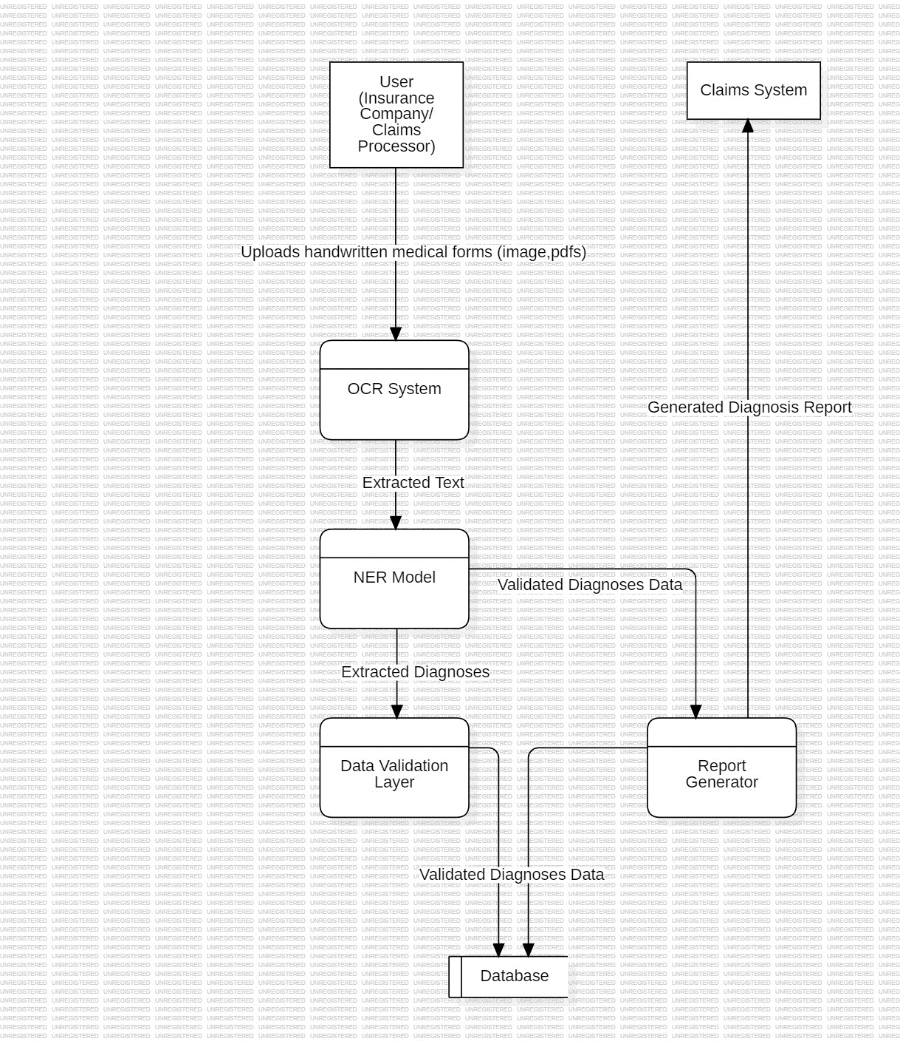
DATA-FLOW DIAGRAM:
User (Insurance Company/Claims Processor): The entity that provides the handwritten medical forms.
OCR System: Converts the uploaded medical form images/PDFs into machine-readable text.
NER Model: Extracts specific medical diagnoses from the text provided by the OCR system.
Data Validation Layer: Checks and ensures the accuracy and completeness of the extracted data.
Database: Stores the validated medical diagnoses for future reference and retrieval.
Report Generator: Creates a structured report or spreadsheet of the extracted diagnoses for easy integration.
Claims System: The final destination where the processed diagnosis report is sent for claims processing.

Slide 8
UNIQUE SELLING POINT (USP) :
1
High Accuracy
Our solution utilizes advanced machine learning algorithms and a comprehensive training dataset, enabling it to achieve high accuracy in identifying and extracting medical diagnoses from handwritten forms.
2
Scalability and Efficiency
The cloud-based architecture allows for seamless scalability to handle large volumes of forms, ensuring efficient processing and minimizing turnaround times.
3
Data Integration and Automation
The system is designed to seamlessly integrate with existing healthcare systems, automating the process of diagnosis extraction and streamlining data management.
4
Security and Compliance
We prioritize data security and compliance with industry standards, ensuring the confidentiality and integrity of patient information.

Slide 9
FUTURE POSSIBLE ENHANCEMENTS:
Multilingual Support
Real-Time Diagnosis Extraction
Extending the system to support multiple languages will cater to a wider range of healthcare providers and institutions worldwide, enabling global accessibility and utilization.
Developing real-time capabilities for diagnosis extraction will significantly accelerate the process, allowing for immediate access to critical medical information.
Integration with Electronic Health Records (EHRs)
Advanced Analytics and Predictive Modeling
Integrating the system with existing EHR systems will streamline data flow and provide a comprehensive view of patient health records, enhancing clinical decision-making.
Leveraging the extracted diagnoses to develop advanced analytics and predictive models will enable healthcare professionals to gain insights into disease patterns, identify trends, and optimize patient care.

Slide 10




RISKS, CHALLENGES & DEPENDENCIES:
Data Privacy and Security
Data Quality and Accuracy
Maintaining patient data privacy and security is paramount. Implementing robust security measures and adhering to industry regulations like HIPAA is essential.
The accuracy of the system relies heavily on the quality and consistency of the training data. Ensuring data integrity and addressing potential biases is crucial.
Time Constraints and Development Costs
User Adoption and Training
Ensuring user adoption and providing adequate training for healthcare professionals to use the system effectively is crucial for successful implementation.
Developing and deploying a complex system requires significant resources and time. Managing project timelines and minimizing development costs are crucial considerations.

Slide 11
ACCEPTANCE CRITERIA COVERAGE:
1
Fill Rate
The system is designed to achieve a high fill rate for identified and extracted diagnoses, ensuring the capture of a significant percentage of cases.
2
Accuracy
The system utilizes advanced algorithms and a comprehensive training dataset to achieve high accuracy in extracting diagnoses, minimizing the risk of errors.
3
Data Integration
The system is designed to seamlessly integrate with existing healthcare systems, streamlining data flow and enhancing efficiency.
4
User Interface
The user interface is designed to be user-friendly and intuitive, facilitating easy adoption and utilization by healthcare professionals.

Slide 12
Thankyou!

