Slide 1

News App
Wipro Batch-46
Mentor - Ramkumar
Team:
1.Nishu Kumari - 1519358
2.Sandhya Keerthigari - 1196149
3.Tejasvi Singh - 1662621
4.Harsh Vardhan Rajput - 1177286

Slide 2
Outline
Problem Statement
Objective
Microservices
Project Overview
Onboarding-Architecture
Project Flow
Technology and Tools Used
Conclusion

Slide 3

Problem Statement
User should be able to register him/herself in the news application and login .
User must get the latest news articles.
User should be able to search news with the help of keywords.
User must have chance to add articles into favorite list and view them.

Slide 4
Objective
The primary purpose of the news app is to make sure user can acces the latest news articles and add articles to their favorite list and view them as well as delete them.

Slide 5
Use case diagram
Login
Database
Register
Favorite
Search
Api
Top news

Slide 6
Microservices
Authentication API
Favorite API
External API Service

Slide 7
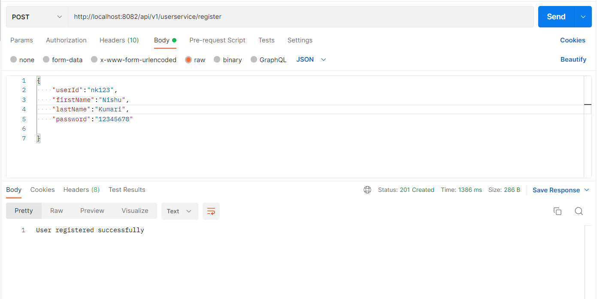
Register

Slide 8
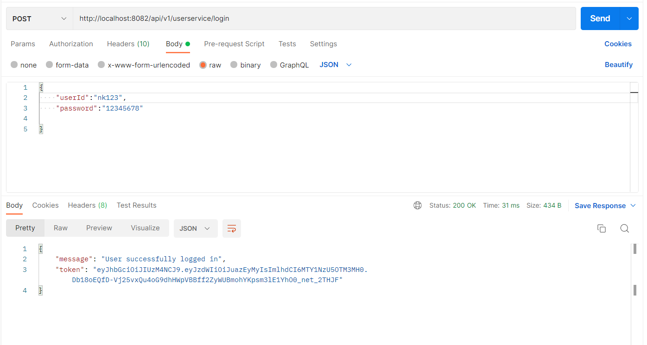
Login

Slide 9
Modules
Top-News Module
Search Module
Favorite Modules

Slide 10
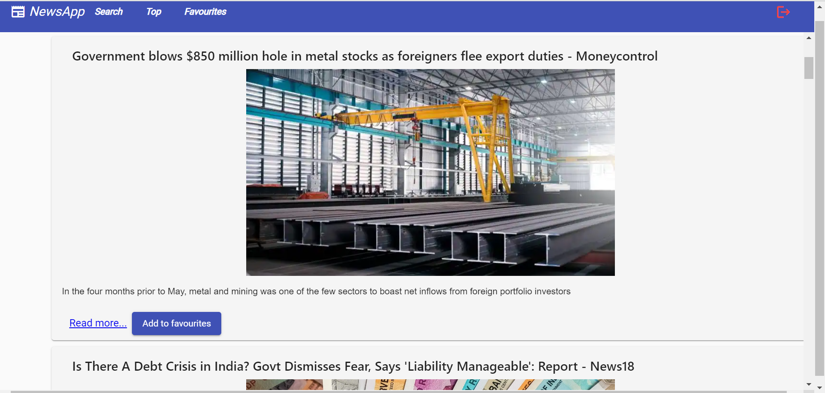
Top news Module

Slide 11
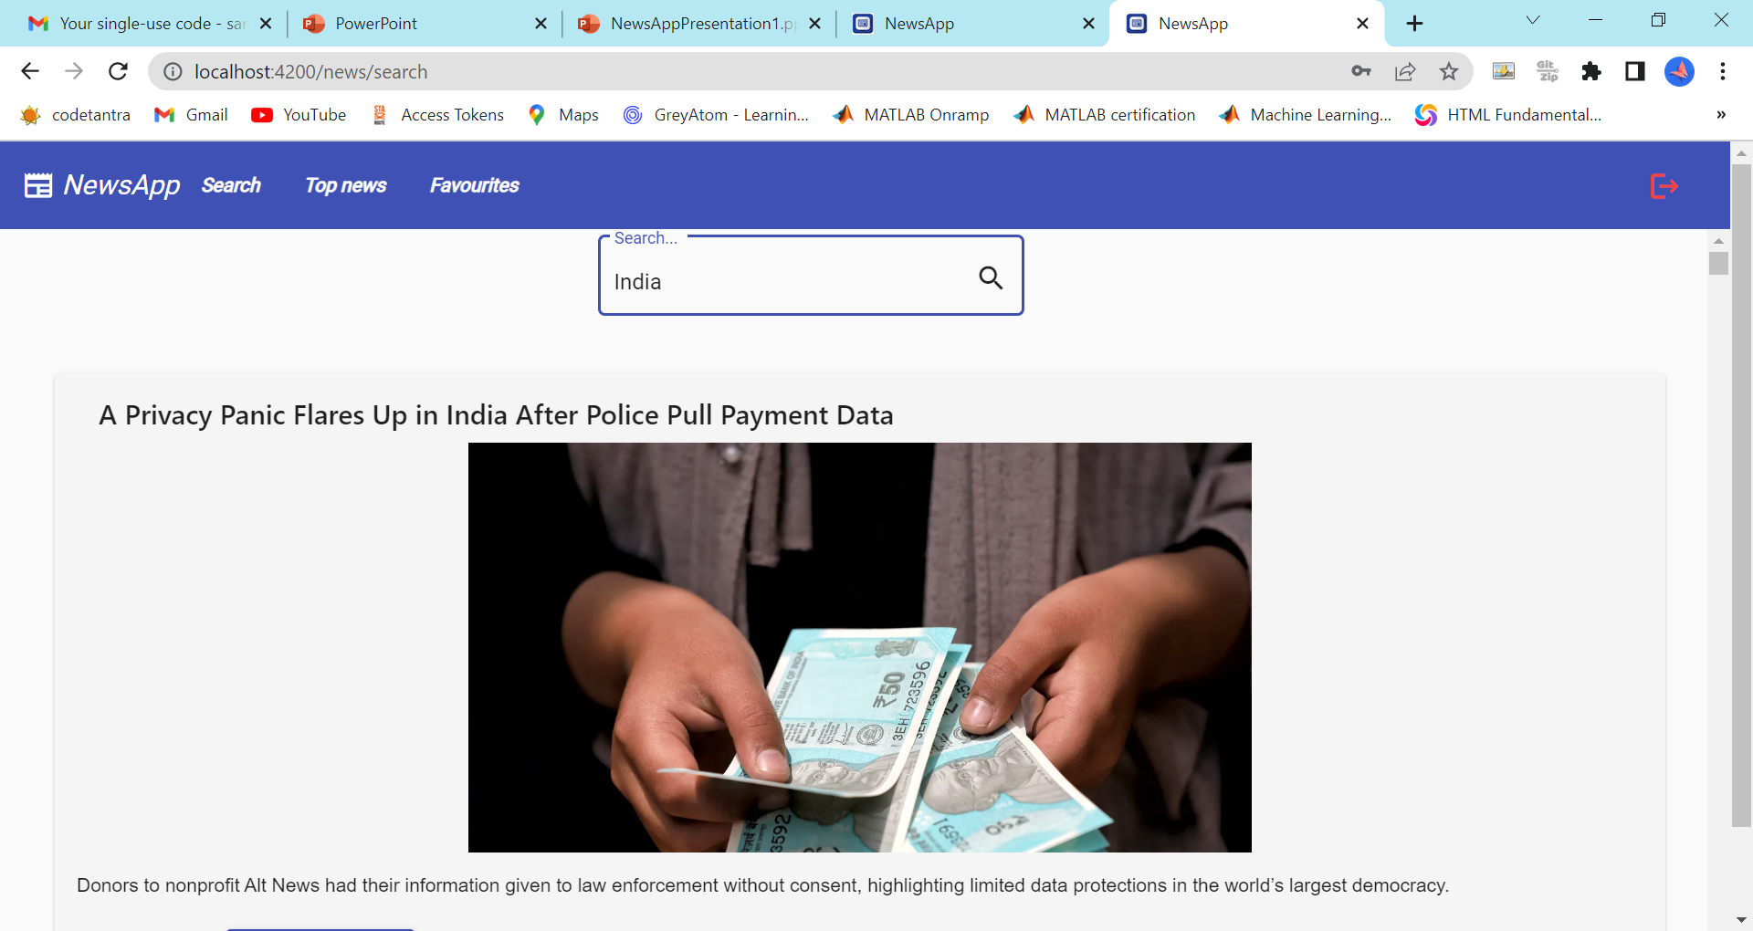
Search module

Slide 12
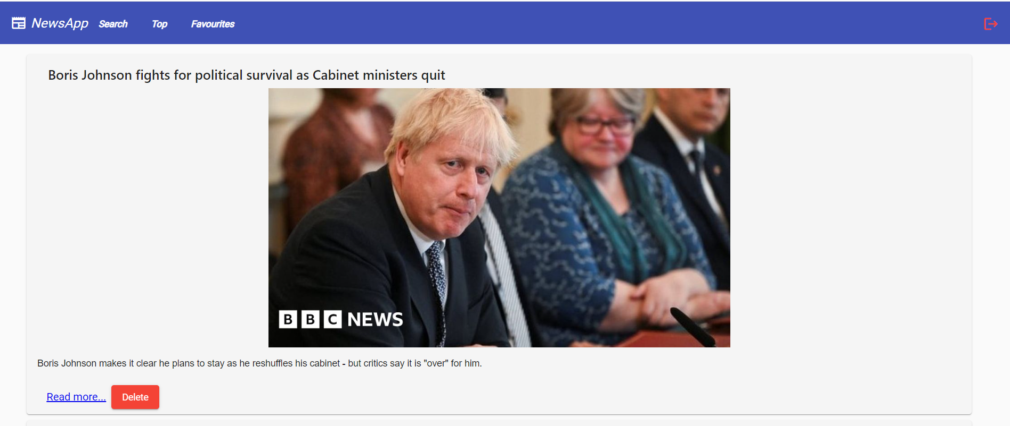
Favorite Module

Slide 13
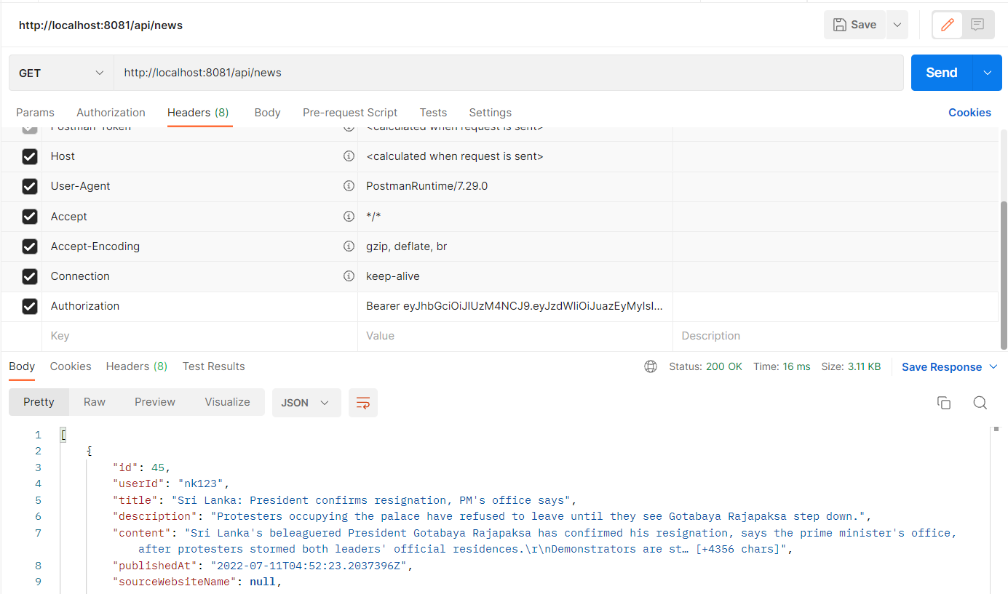
News id

Slide 14
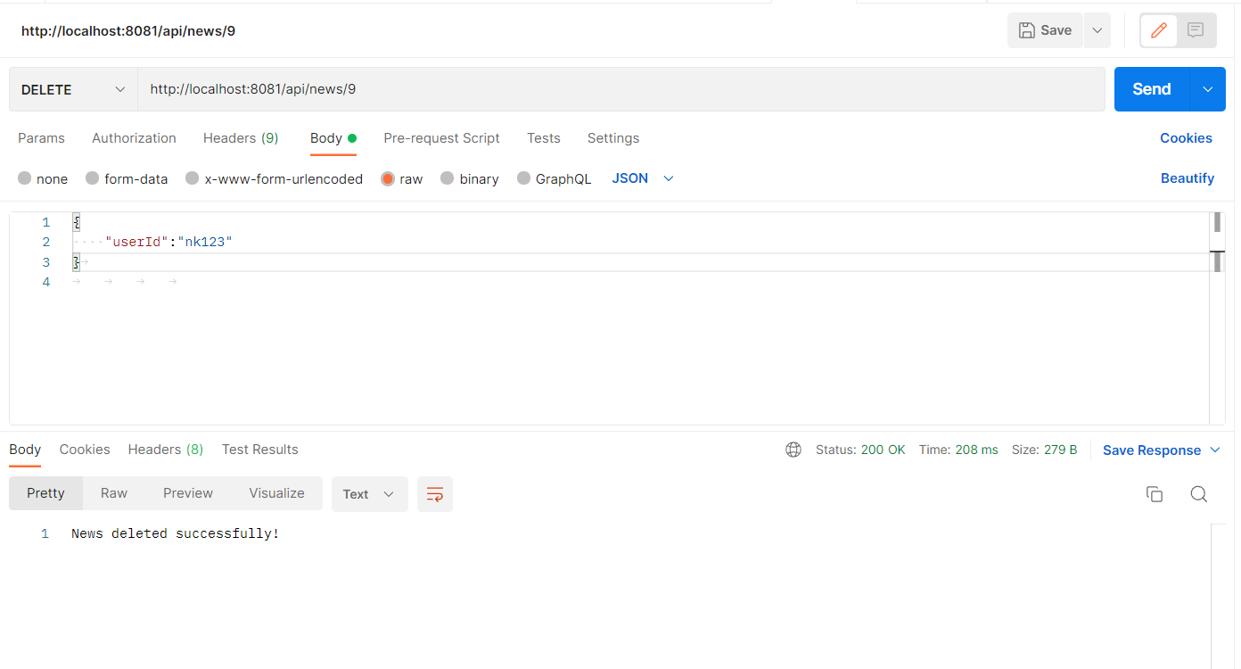
Delete news by Id

Slide 15
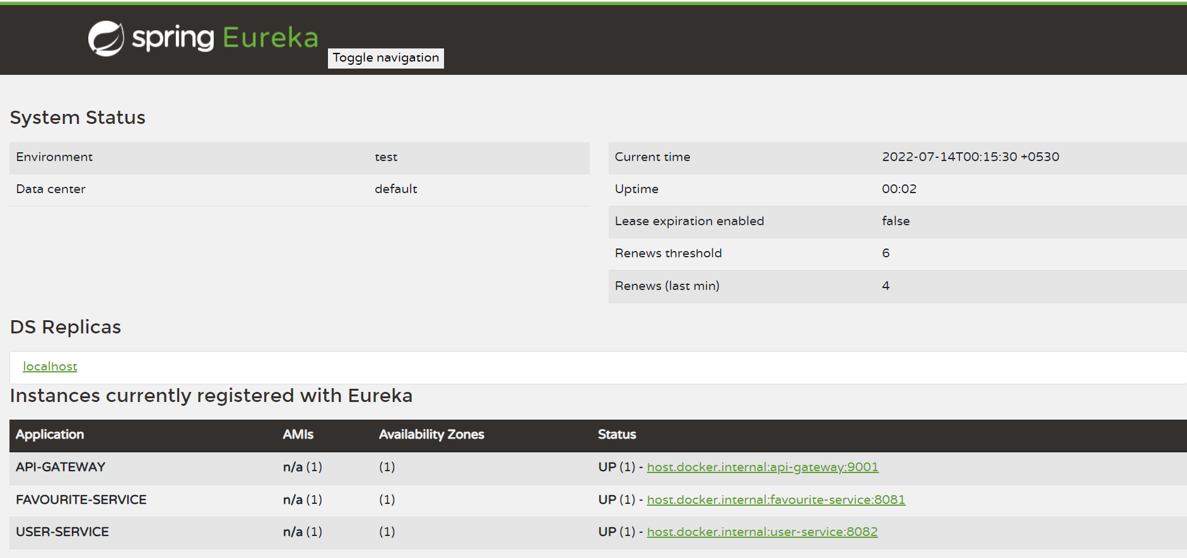
Modules registering into Eureka server

Slide 16
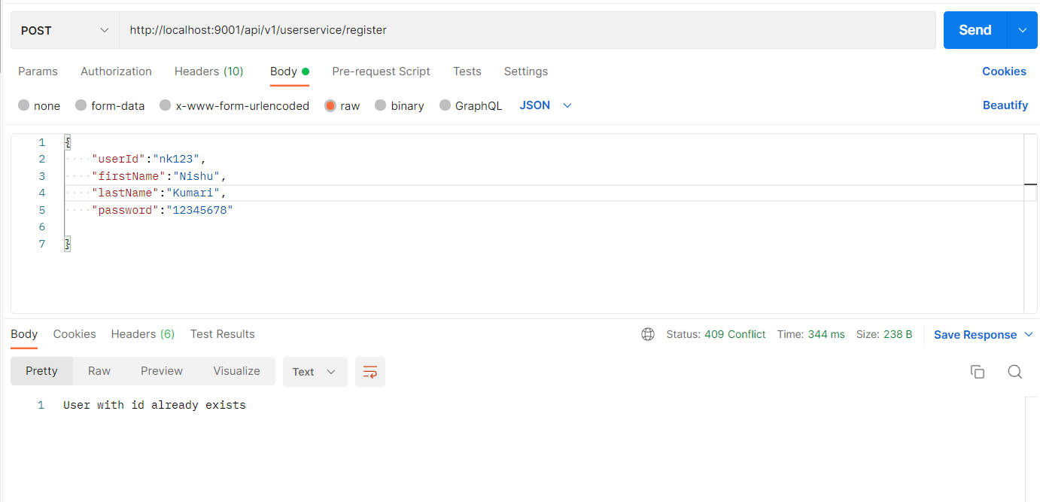
Implementing of microservices

Slide 17
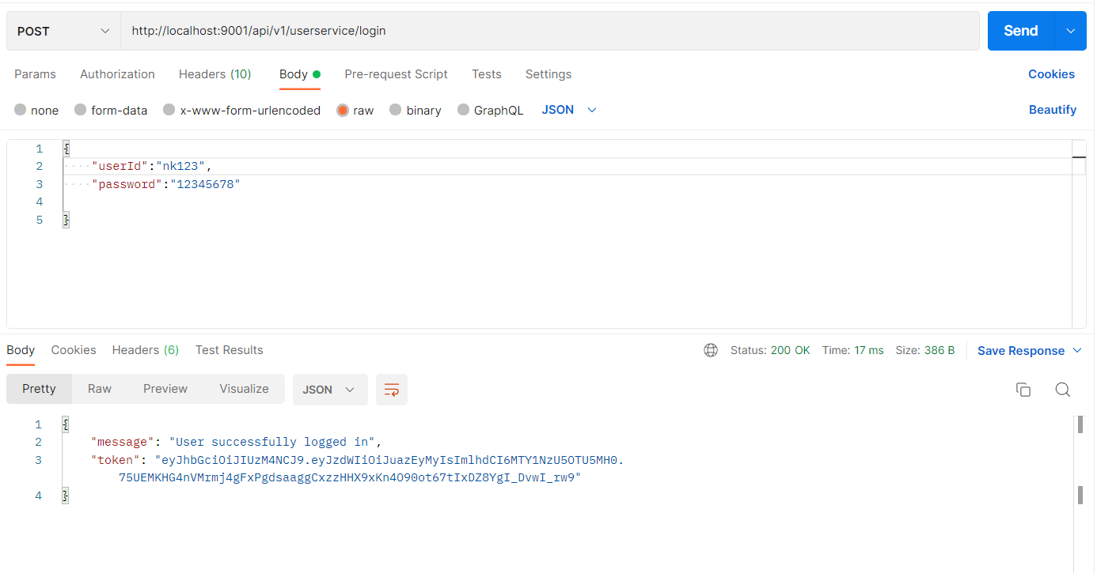

Slide 18
News API
https://newsapi.org
News API has been used for collecting different news sources at one spot. On sending request it will give response in JSON format which contains source id, title, description, image URL, article URL, author, time etc.

Slide 19
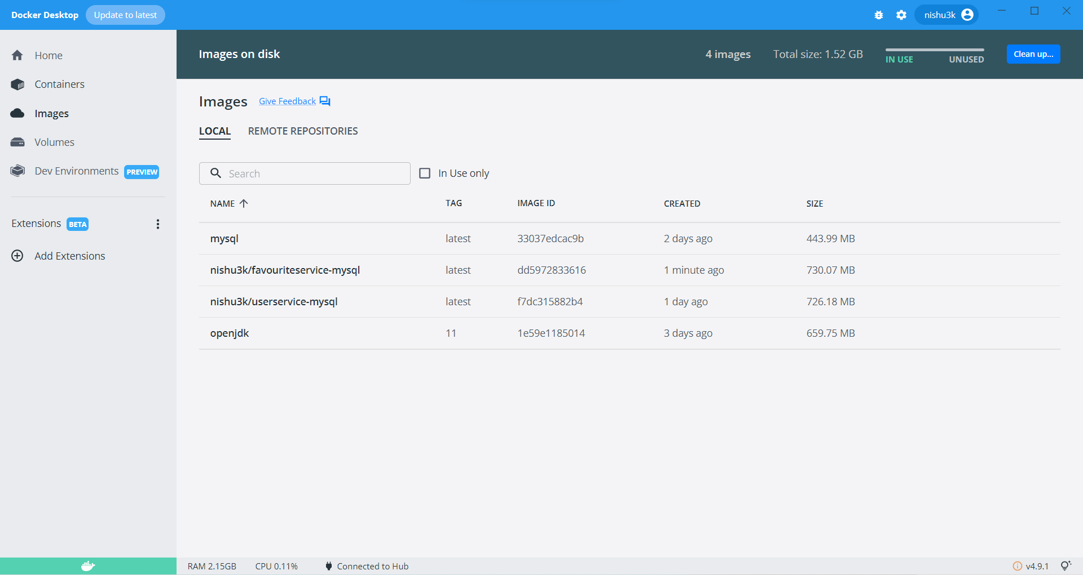
Docker

Slide 20
Project Overview

Slide 21
Project Overview
Authentication API
Favorite API
External API Service
Login
Top
News List
Home
Favorites List
Register
Search
External API
SQL
Server
SQL
Server
Internet

Slide 22
Onboarding Architecture

Slide 23
Architecture
Authentication API
JWT validator
SQL Server
Login/Register
POST request
Token generated
Top News API
Get Top News
GET
NewsApi.org
Front End
Angular
POST /GET/
DELETE
Favorite News
Get Favorite News
Post Favorite News
Delete Favorite News
SQL Server
POST /GET/
DELETE
GET
Search News
GET
NewsApi.org

Slide 24
Project Flow

Slide 25
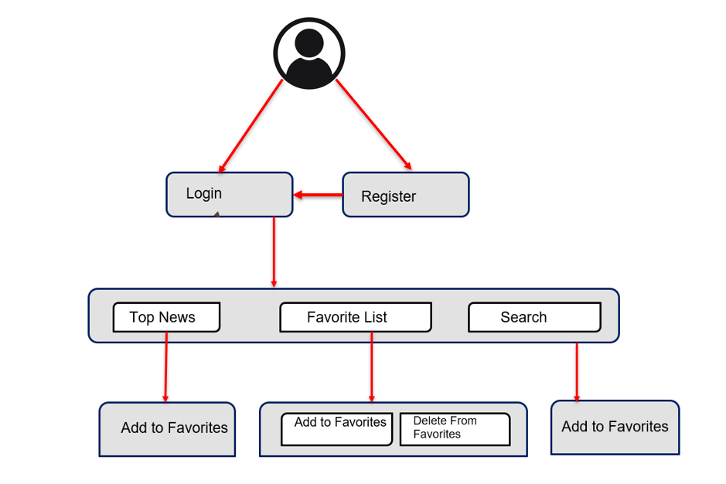
Project Flow
Read more
Add to favorites
Delete news

Slide 26






Technologies and Tools Used

Slide 27
Thank You

