Slide 1

RaDix
By
S V SAI VATHSAL 22BD1A663W
K PHANI DATTA 22BD1A662V
T NISHANTH REDDY 22BD1A663Y
G ROHITH 23BD5A6601
DATE OF REVIEW:18/12/2024

Slide 2
PROBLEM STATEMENT
Healthcare professionals struggle with accurate diagnoses due to high patient volumes and manual workflows, causing delays and errors. A deep learning-driven system can automate disease detection, severity classification, and reporting, enhancing efficiency, accuracy, and patient care.

Slide 3
CONTENTS
Objectives
Feature List
UI Screens
Technology Stack
Workflow
Developments
Challenges Faced
Project Outcome
Conclusion

Slide 4
OBJECTIVES
Smart Diagnostics: Detects diseases accurately with deep learning.
Instant Reports: Creates detailed medical reports within seconds.
Effortless Workflows: Simplifies tasks for healthcare professionals.
Built to Grow: Scales seamlessly with more data and tech.
Secure by Design: Keeps patient data private and secure.
Cost Efficiency: Cuts costs by automating manual processes.
Better Decisions: Offers insights for improved treatment plans.
Seamless Integration: Easily connects with hospital systems like HIS.

Slide 5
FEATURE LIST
1.Auto-Generated Reports
2.Image Analysis
3.Data Upload
4.HIS Integration
5.Database Support
6.User Dashboard
7.Admin Panel
8.Data Security
9.System Performance

Slide 6
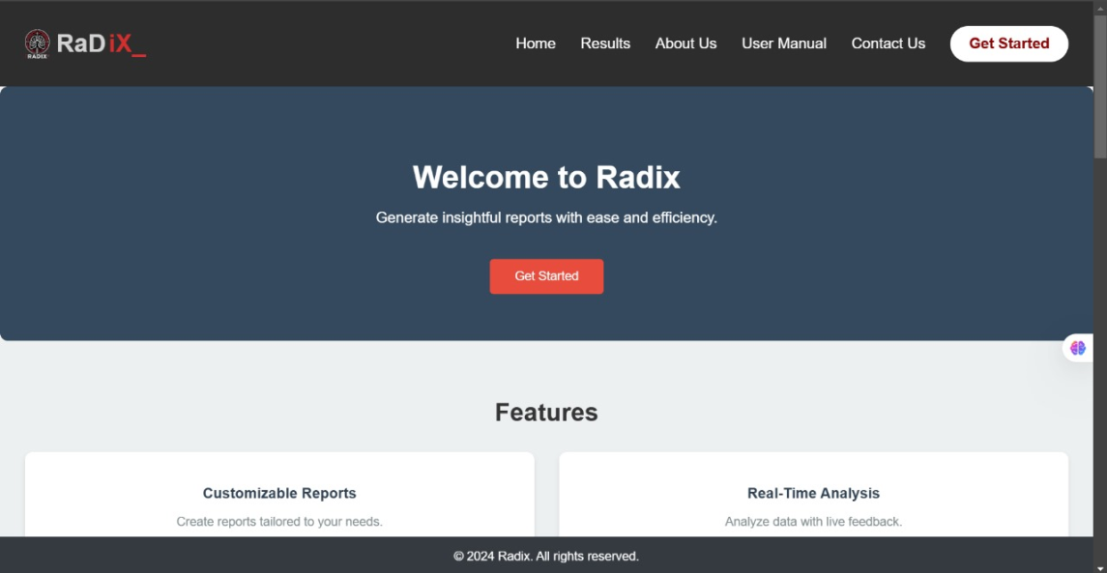
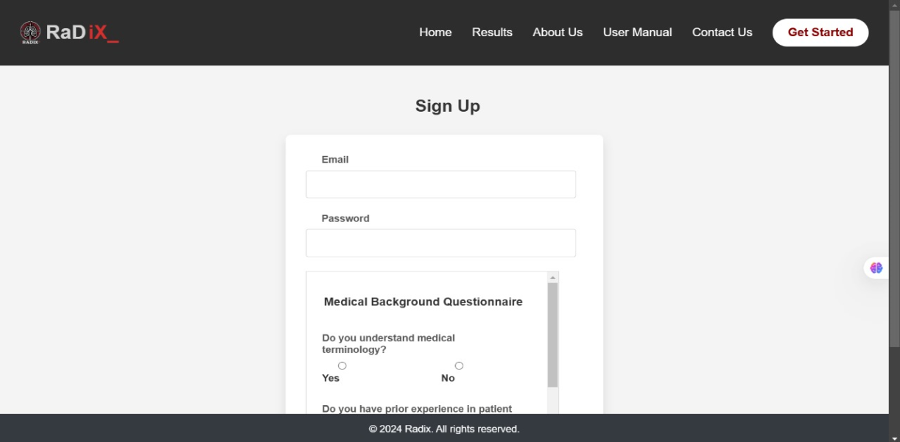
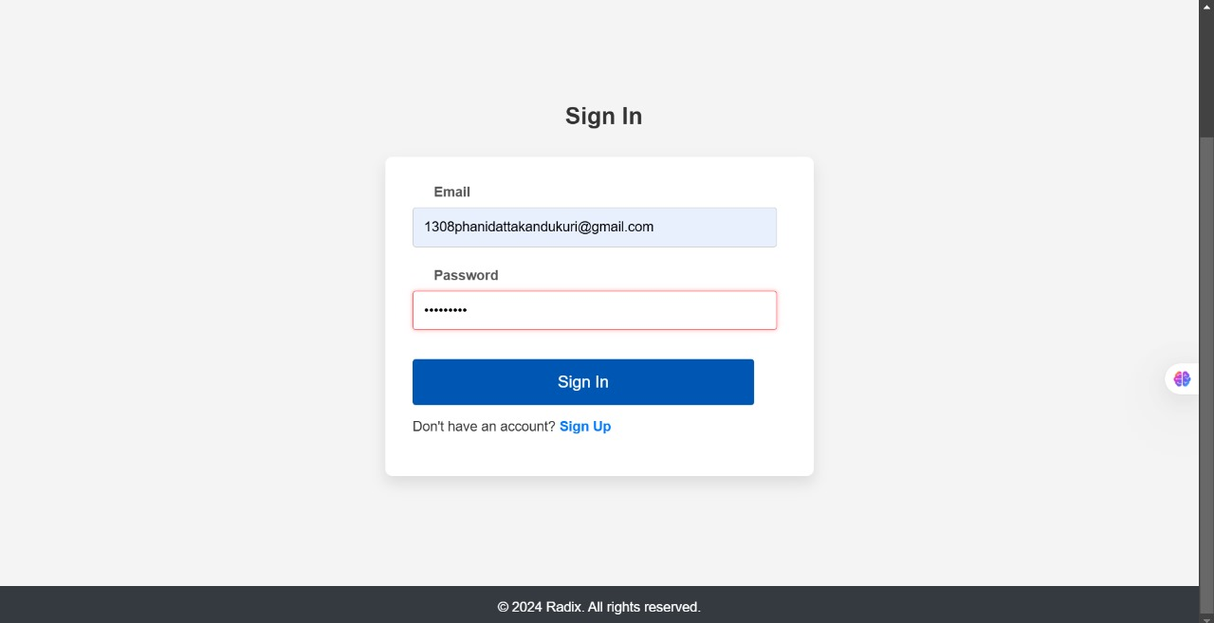
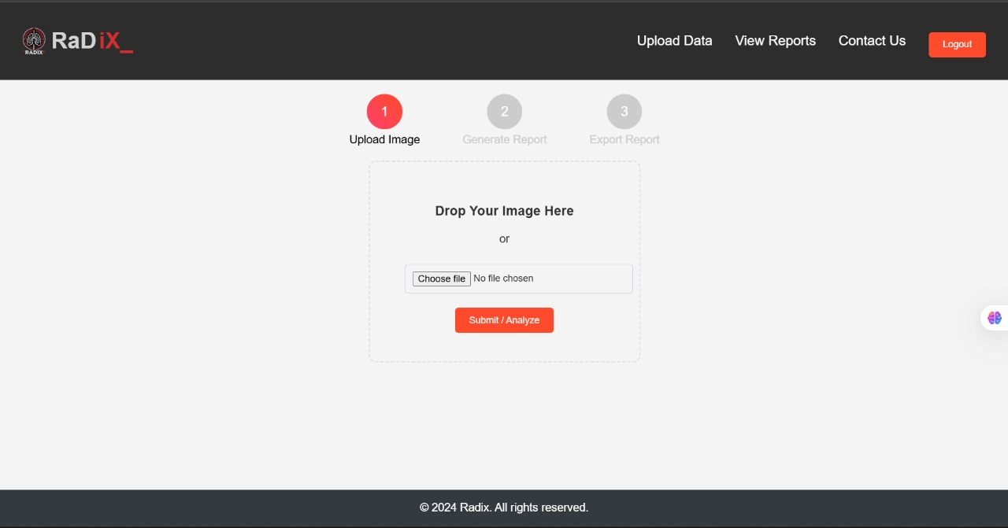
UI SCREENS(MOCK-UPs)

Slide 7
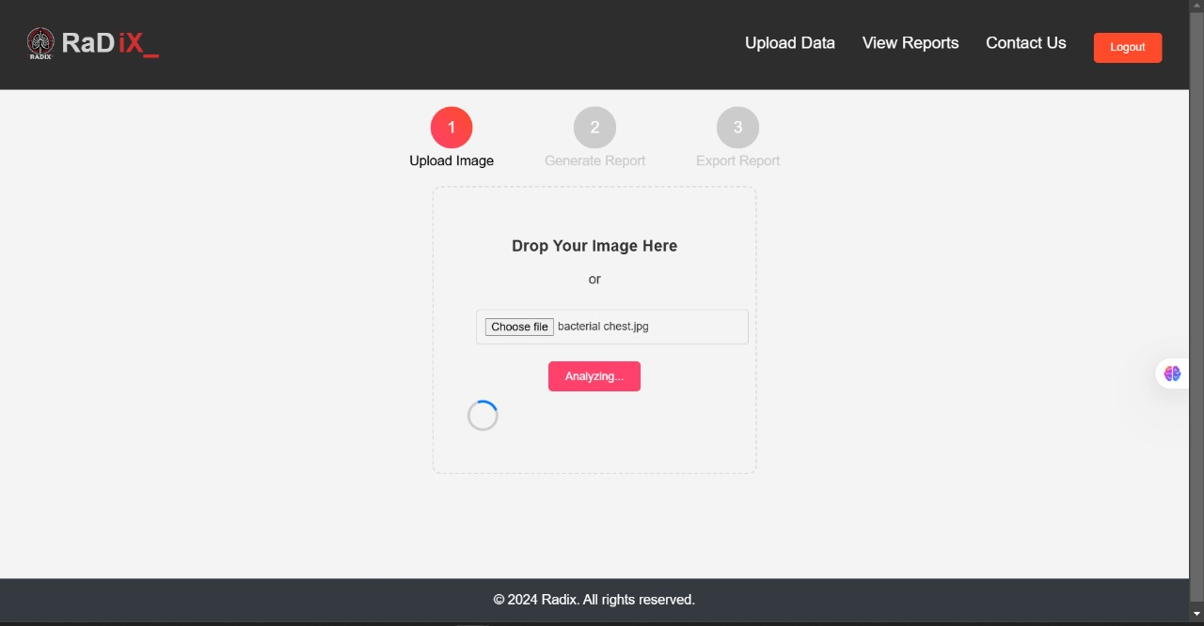
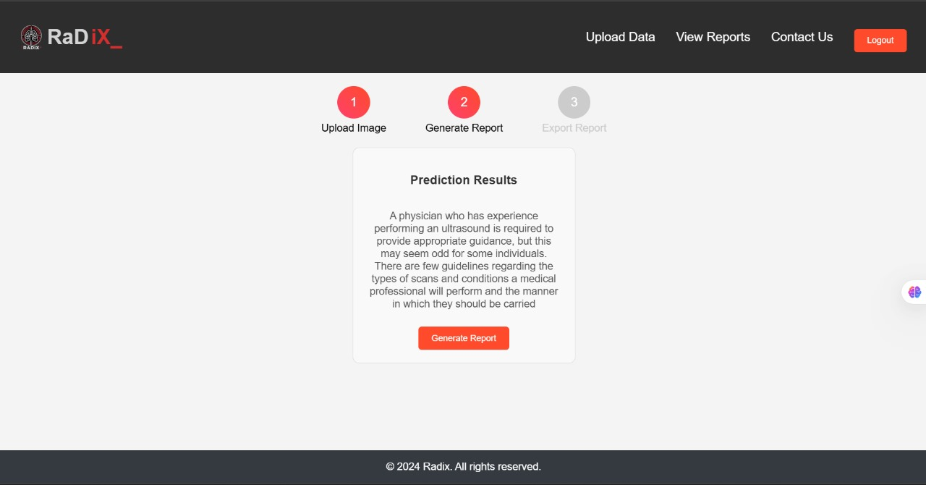
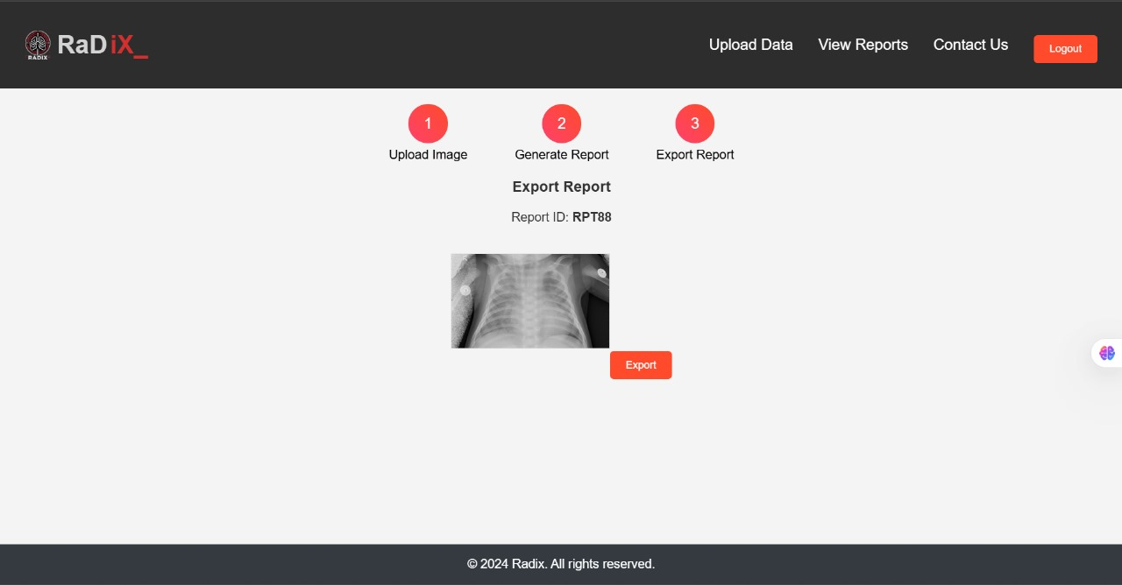
UI SCREENS(MOCK-UPs)

Slide 8
TECHNOLOGY STACK:
FRONT-END
REACT.JS : For building a dynamic and responsive user interface.
Tailwind CSS : For styling and creating user-friendly components.
BACK-END
Express.JS : For designing and building web applications quickly and easily
Python : Primary programming language for backend logic.
Flask or Django : For building APIs and handling server-side processes.
FireBase : For database management

Slide 9

WORKFLOW
Data Input
Report Delivery
Data Processing
Report Generation

Slide 10
DEVELOPMENT
1. Pseudo Code:
Algorithms for data validation, analysis, and report generation.
2. Testing:
Unit and integration testing for reliability.
Stress tests for data security.
3. Tools Used:
Front-End : React.js ,Tailwind CSS.
Back-End : Express.js , Flask/Django , Firebase.
Testing : Postman(API Testing) , Selenium(UI Testing).
Deployment : AWS/GCP for hosting and scalability .

Slide 11
CHALLENGES FACED
1. Data Quality:
Challenge : Inconsistent input data.
Mitigation : Added preprocessing for validation and cleaning.
2.Integration with HIS:
Challenge : Compatibility with hospital systems.
Mitigation : Used standard APIs for integration.
3.Performance Optimization:
Challenge : Slow processing for large data.
Mitigation : Optimized AI models and workflows.
4.Data Security:
Challenge : Protecting patient data.
Mitigation : Ensured HIPAA compliance with encryption.

Slide 12
PROJECT OUTCOME
1. Summary:
Successfully developed a system for automated disease detection and report generation.
2. Competition:
Offers faster diagnostics and smoother HIS integration than manual systems.
3. Improvement Opportunities:
Expand to support more medical imaging types and additional diseases.
Enhance real-time processing capabilities.
4. Demo:
Live demonstration of X-ray upload, AI analysis, and report generation.

Slide 13
CONCLUSION
RaDix's development has been a transformative journey, providing key insights :
Technology-Wise:
Mastered front-end tools like React.js and Tailwind CSS for intuitive designs.
Leveraged Express.js, Flask and Firebase for robust backend and database.
Built a scalable, secure system compliant with HIPAA standards.
Designed a user-friendly interface with smooth backend integration.
Project Execution-Wise:
Learned effective team collaboration, modular development, and prioritization.
Gained experience in system testing, debugging, and seamless integration.
Executed end-to-end system testing, ensuring functionality, and user satisfaction.
Optimized project workflows, balancing speed and quality for efficient execution.

Slide 14
THANK YOU

