Slide 1

Explain Deployment tool like Chef, SaltStack and Docker
B.Nishwanth-23R05A6705
B.HEMANTH-23R05A6706

Slide 2
Introduction to Deployment Tools
Help automate configuration, deployment, and scaling of infrastructure.
Ensure consistency, speed, and reliability in operations.
Reduce manual errors and downtime.

Slide 3

What is Chef?
Developed in Ruby.
Uses "recipes" and "cookbooks" for configuration.
Follows Pull-based model (nodes pull configurations).
Ideal for complex infrastructure automation.
Example:
Large-scale enterprise environments with frequent configuration updates.

Slide 4
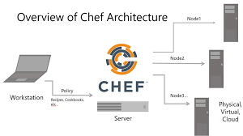
Chef Architecture
Chef Server: Central store of cookbooks.
Workstation: Writes and uploads configurations.
Nodes: Run the Chef client to apply configurations.

Slide 5
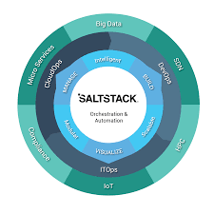
What is SaltStack?
Written in Python.
Uses YAML for configuration.
Supports both Push and Pull models.
Faster execution with an event-driven architecture.
Example:
Real-time infrastructure monitoring and orchestration.

Slide 6
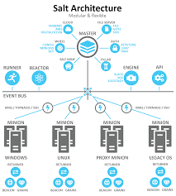
SaltStack Architecture
Master: Controls configuration.
Minions: Servers that receive and execute commands.
Grains & Pillars: Provide static and dynamic data

Slide 7
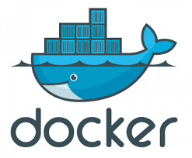
What is Docker?
Containerization platform.
Packages applications and dependencies into containers.
Ensures portability, scalability, and isolation.
Example:
Microservices architecture and DevOps CI/CD pipelines.

Slide 8
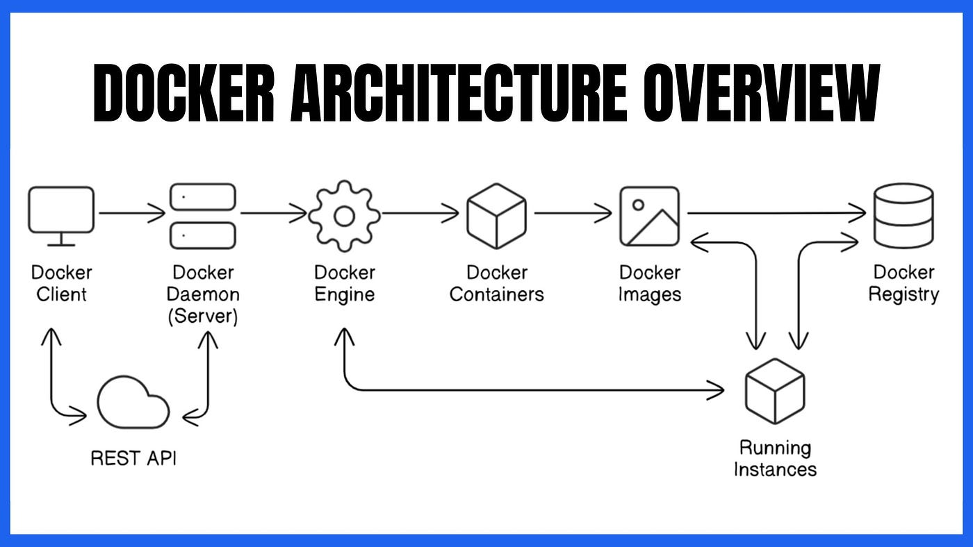
Docker Architecture
Docker Engine: Core runtime.
Images: Templates for containers.
Containers: Lightweight and isolated environments.
Docker Hub: Public image registry.

Slide 9
Conclusion
Chef and SaltStack focus on configuration management.
Docker focuses on application deployment using containers.
All are crucial tools in the DevOps ecosystem.

Slide 10

Thank You

