Slide 1
CAN Translator Initial Design
07.02.2022

Slide 2
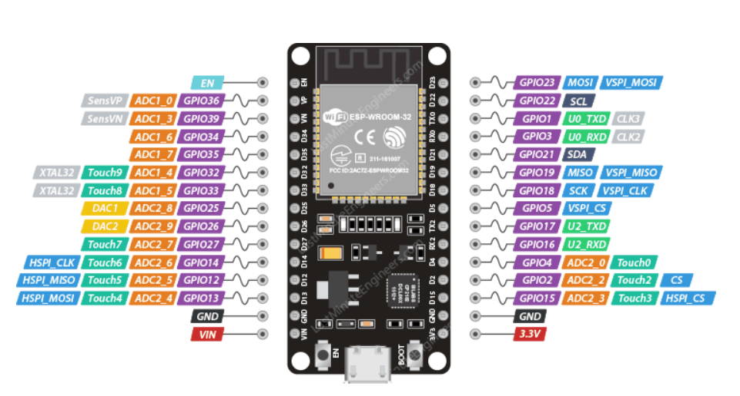
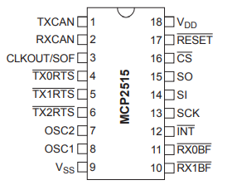
ESP32 - MCP2515 Pinout
2 MCP2515 will be used for CAN0 & CAN1
 | ESP32 | MCP2515
CAN0 | GPIO26: SPI_CLK | PIN13: SCK
 | GPIO18: SPI_MISO | PIN15: SO
 | GPIO19: SPI_MOSI | PINT14: SI
 | GPIO27: SPI_CS | PIN16: CS
 | GPIO34: CAN0_INT | PIN10: INT
CAN1 | GPIO26: SPI_CLK | PIN13: SCK
 | GPIO18: SPI_MISO | PIN15: SO
 | GPIO19: SPI_MOSI | PINT14: SI
 | GPIO15: SPI_CS | PIN16: CS
 | GPIO35: CAN1_INT | PIN10: INT

Slide 3
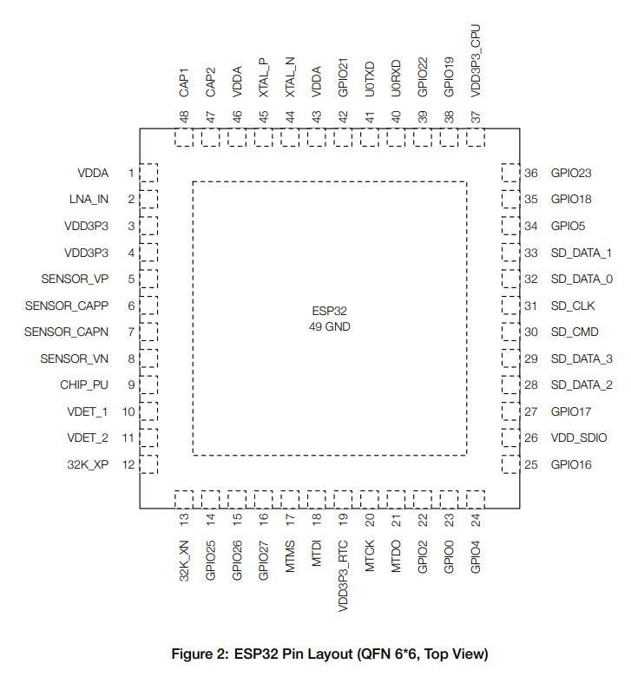
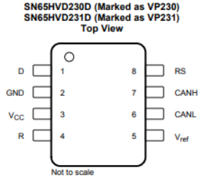
Block Diagram
SPI
ESP Pins:26,19,18,27, 34
CAN 0
SPI
ESP Pins:26,19,18,15, 35
CAN 1
CAN 2

Slide 4
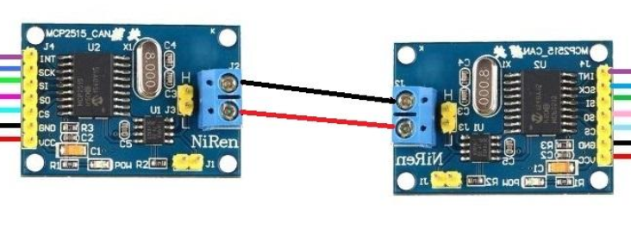
Testing Transmit and Receive with 2 MCP2515
Short CAN Channel 0 to Channel 1
CAN 0 shall transmit a value
Received data in CAN 1 shall be displayed in the debug monitor for verification
CAN 0
CAN 1

Slide 5
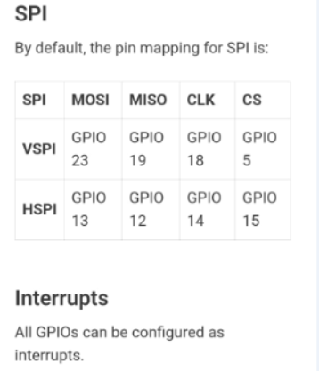
Reference

