Slide 1
IMPACT OF MOBILE ON MENTAL HEALTH
NISSI S.

Slide 2

Introduction:
Mobile phones have become an inseparable part of daily life.
Used for communication, education, entertainment, and work.
Help us stay updated and connected with the world.
However, excessive use affects our focus and mental peace.
Understanding its effects is important for a healthy balance.

Slide 3
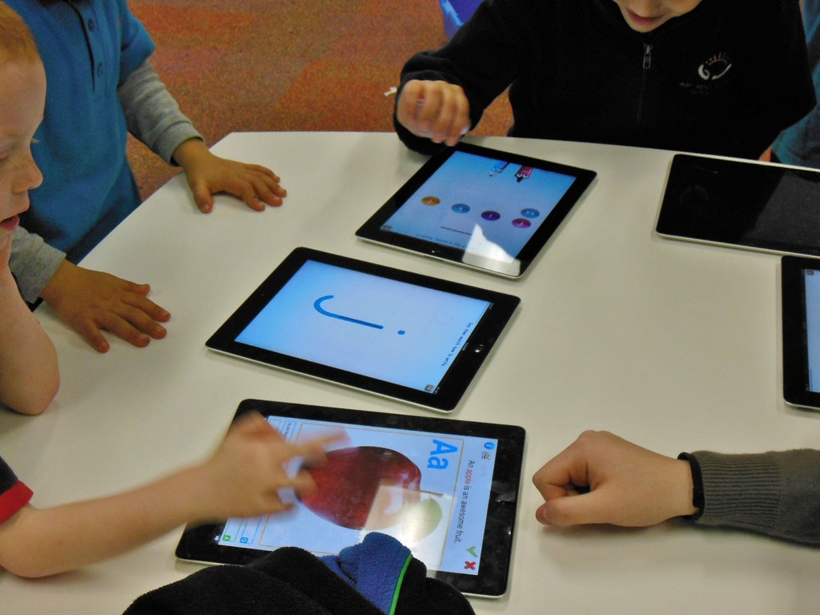
Positive Impacts
Quick and easy communication with family and friends.
Provides access to education through online platforms.
Helps in emergencies and gives a sense of safety.
Encourages social awareness and community connections.
Entertainment through music, movies and games and reduces stress.

Slide 4

Negative Impacts
Social media comparison causes low confidence and anxiety.
Reduces concentration and productivity.
Blue light from screens disturbs sleep and rest.
Decreases real-life communication and social skills.
Leads to loneliness and isolation.
Continuous screen use leads to Eye Strain and Headaches.

Slide 5
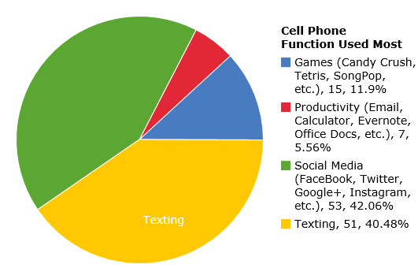
USAGE OF MOBILE

Slide 6
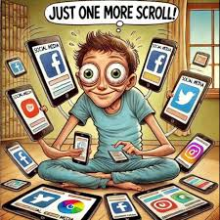
Signs of Mobile Addiction:
Constant urge to check messages or notifications.
Feeling anxious when the phone is not nearby.
Losing track of time while scrolling and gaming.
Ignoring studies or work responsibilities.
Lack of interest in offline activities.
Poor sleep or tiredness due to late night phone usage.

Slide 7




DISSORDERS CAUSED BY MOBILE ADDICTION:
Insomnia
Nomophobia
Anxiety
Depression

Slide 8
Solutions:
Fix a daily screen-time limit and follow it strictly.
Turn off unnecessary notifications.
Spend time outdoors or with family and friends.
Take short breaks from social media regularly.
Use digital well being tools to monitor screen time.

Slide 9
Conclusion:
Mobile phones are helpful tools for learning and connection.
Overuse can disturb mental and emotional health.
Maintaining balance is the key to using technology wisely.
A healthy mind needs rest, focus, and real communication.
“Control your phone – don’t let it control you…..”

Slide 10


