Slide 1

Correction Challenge ES6
Challenge ES6
2020

Slide 2
PROBLEM 1

Slide 3
TASK:
Given an array of objects "pets", each object containing the name, type and year the pet was born:
const pets =
[
{ name: 'Max', type: 'dog', bornOn: 2018 },
{ name: 'Angel', type: 'cat', bornOn: 2015 },
{ name: 'Jasper', type: 'dog', bornOn: 2016 }
]
1. You are going to write a function getAge() that calculates the age of each pet, and returns a new array with the new values of the age added to each object.
2. You are going to write a function that returns an array containing only the dogs.
3. You are going to write a function that finds the pet having the name "Jasper" and returns the string "Jasper is 4 years old."

Slide 4
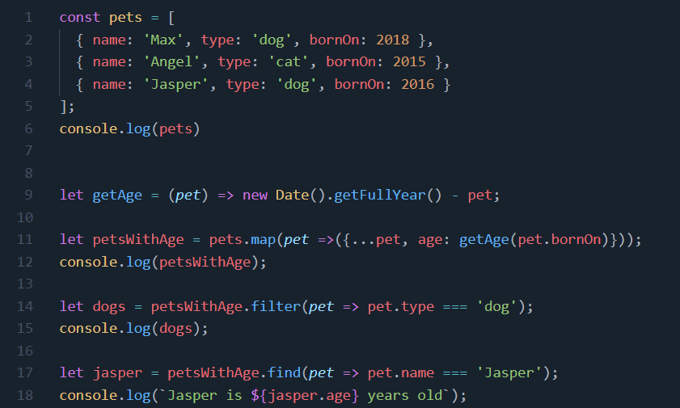
CORRECTION:

Slide 5
PROBLEM 2

Slide 6
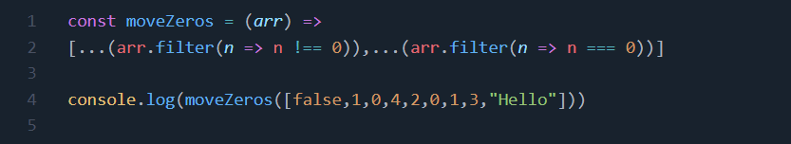
TASK:
Write a function that takes an array and moves all of the zeros to the end, preserving the order of the other elements.
Ex.: [false,1,0,4,2,0,1,3,"Hello"] => [false,1,4,2,1,3,"Hello",0,0]
CORRECTION:

Slide 7
PROBLEM 3

Slide 8
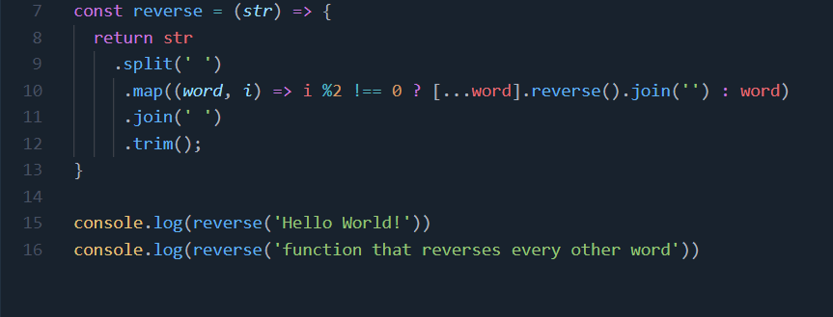
TASK:
Write a function that reverses every other word in a given string, then return the string. Throw away any leading or trailing whitespace, while ensuring there is exactly one space between each word.
Ex.: "Hello world!" => "Hello !dlrow"
CORRECTION:

Slide 9
www.gomycode.co

