Slide 1
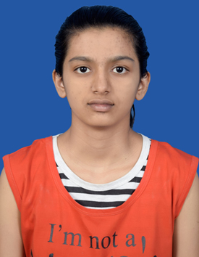
Student Details
Name: Nitisha Patil
SkillsBuild Email ID: npatil.2021@gmail.com
College Name: New Horizon College of Engineering
College State: Karnataka
Internship Domain and Internship Start and End Date: Cyber Security/13.10.2023 – 26.11.2023

Slide 2
Problem Statement/Project Topic
Project topic: Hiding message in an image

Slide 3
Agenda
Steganography is the art of covertly embedding or concealing information within seemingly innocuous cover media, such as images, audio files, or text. Unlike cryptography, which focuses on securing communication through encryption, steganography aims to ensure that the existence of the hidden message remains undetected. In the context of hiding messages in images, subtle modifications to the pixel values or metadata are employed to integrate concealed data seamlessly. This technique has diverse applications, ranging from secure communication and data protection to digital watermarking. The effectiveness of steganography lies in its ability to maintain privacy and confidentiality by keeping the existence of hidden information inconspicuous.

Slide 4
Project Overview
The project centers around leveraging steganography, the art of concealing messages within images, to address the imperative of secure communication and data protection. My purpose is to explore innovative methodologies for embedding and extracting hidden information seamlessly, ensuring covert channels for secure transmission. The scope encompasses the application of steganography across various domains, from confidential data exchange to digital forensics. Objectives include unraveling the intricacies of steganographic techniques, implementing robust methodologies, and evaluating real-world implications.

Slide 5
Who are the End Users
The end users of this steganography project encompass a diverse array of
individuals and organizations with distinct characteristics and needs. This includes:
Individual Users:
Characteristics: Privacy-conscious individuals, journalists, activists.
Needs: Secure communication, protection of sensitive information.
Benefits: Enhanced personal and professional data security, confidentiality in digital exchanges.
Businesses and Corporations:
Characteristics: Corporate entities, research institutions.
Needs: Confidential data transmission, protection against industrial espionage.
Benefits: Strengthened corporate communication security, safeguarding proprietary information.

Slide 6
Law Enforcement and Intelligence Agencies:
Characteristics: Government agencies, security organizations.
Needs: Covert information exchange, undercover communication.
Benefits: Improved covert communication channels, aiding in surveillance and intelligence gathering.
Digital Forensic Experts:
Characteristics: Forensic analysts, cybersecurity professionals.
Needs: Detection and analysis of hidden messages.
Benefits: Tools for uncovering concealed information, aiding in digital investigations.
In essence, the project caters to a wide audience, addressing the varied needs of those who seek secure communication, data protection, and enhanced privacy across different sectors.

Slide 7
Your Solution and its Value Proposition
The solution revolves around an advanced steganographic framework designed to meet the diverse needs of end users seeking secure communication and data protection. Key elements of our solution and their corresponding value propositions are:
Robust Embedding Techniques:
Solution: Utilization of cutting-edge embedding methodologies in image files.
Value Proposition: Enables seamless integration of hidden messages, ensuring covert communication channels that are resistant to detection.

Slide 8
User-Friendly Interface:
Solution: Intuitive and user-friendly steganography tools.
Value Proposition: Provides accessibility for individuals with varying technical expertise, making secure communication effortless.
Versatility Across Domains:
Solution: Applicability across individual, corporate, and governmental sectors.
Value Proposition: Offers a versatile tool for secure data transmission, catering to the unique needs of different user groups.

Slide 9
How did you customize the project and make it your own?
The project stands out through distinctive customization and innovative features that elevate it above existing solutions in the realm of steganography. Key aspects that make our solution remarkable include:
Integration of RSA Algorithm:
Harnessed the power of the RSA algorithm for message encryption, adding an extra layer of security to our steganographic solution.
This cryptographic technique enhances the confidentiality of embedded messages, catering to users who prioritize advanced encryption in covert communication.

Slide 10
User-Friendly Tkinter GUI:
The creation of an intuitive GUI using Tkinter , providing users with a seamless and accessible platform for embedding messages into images.
The emphasis on user experience ensures that the solution is not only powerful but also approachable for individuals with varying technical backgrounds.
Cross-Domain Applicability:
The solution is designed to be versatile, catering to a diverse user base across individual, corporate, and governmental sectors.
This adaptability distinguishes the project, offering a comprehensive steganographic tool that addresses the unique needs of different user groups.

Slide 11
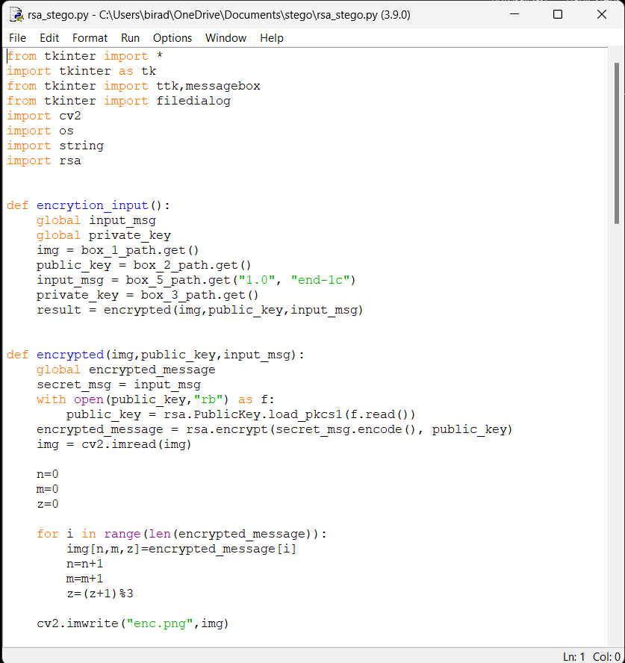
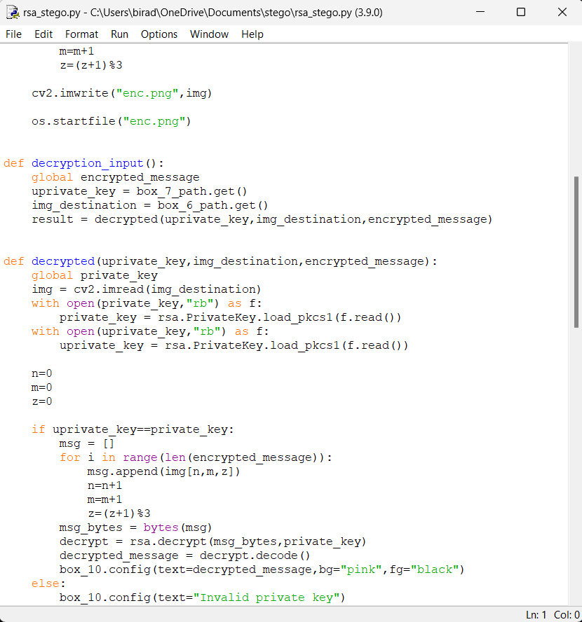
Modelling

Slide 12
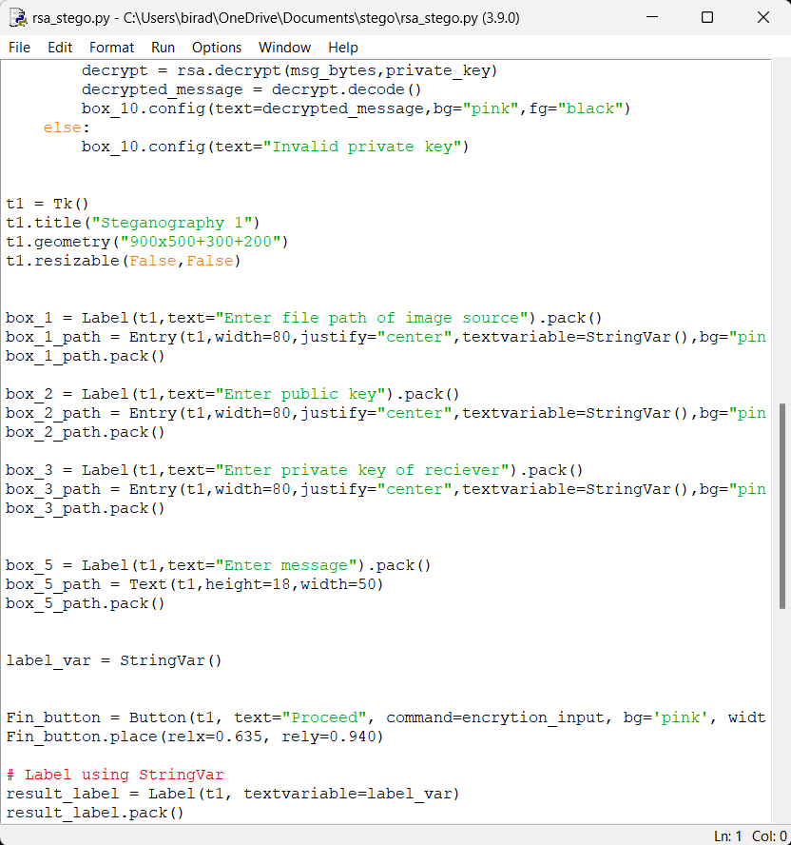
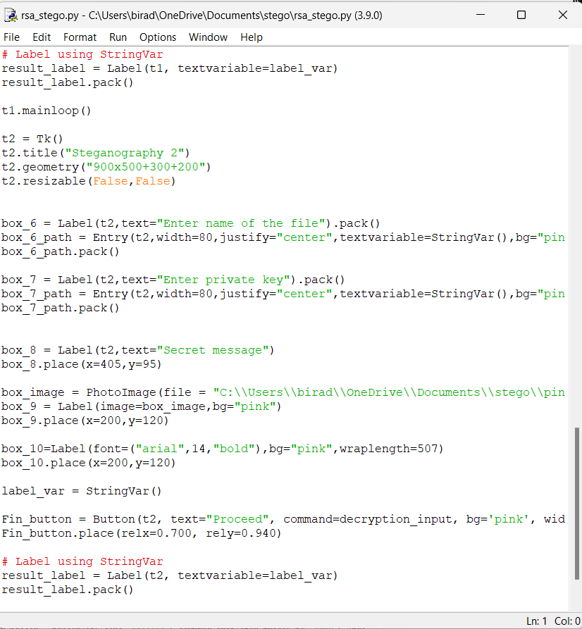

Slide 13
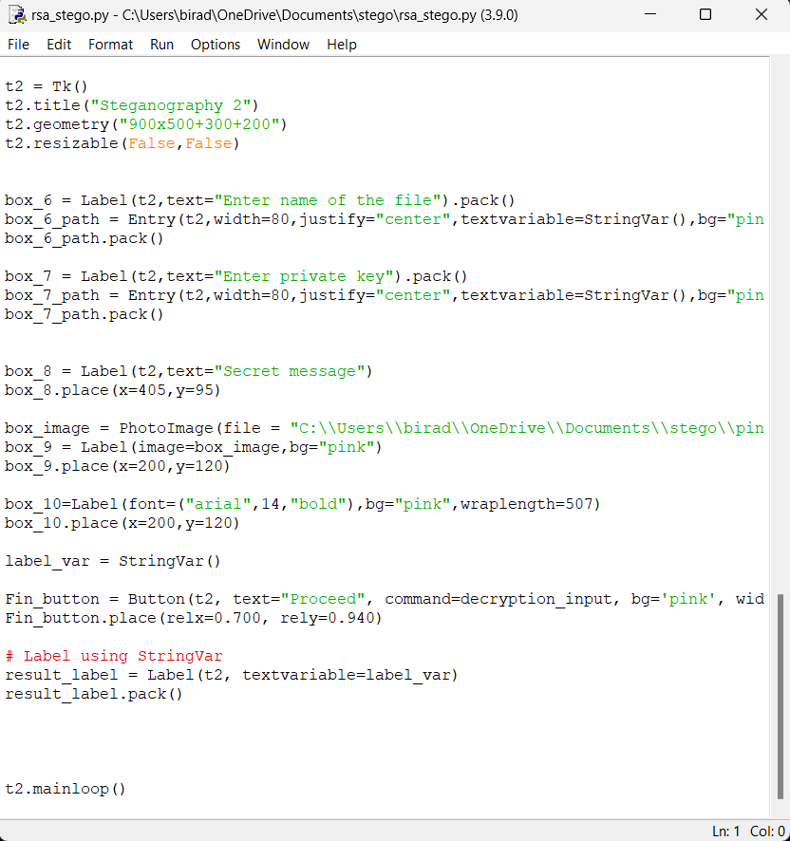
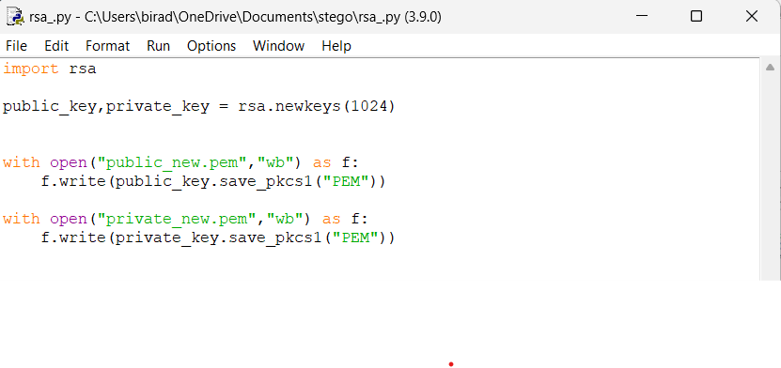
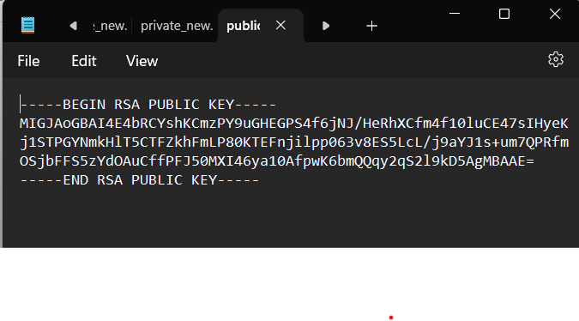
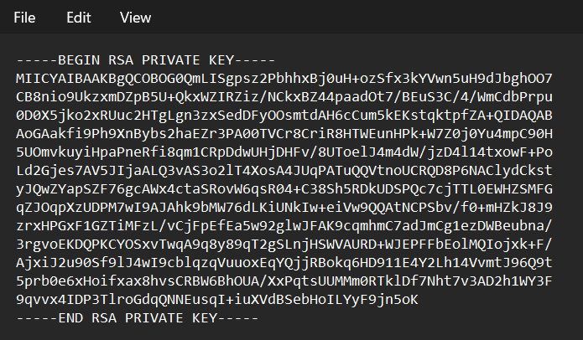

Slide 14
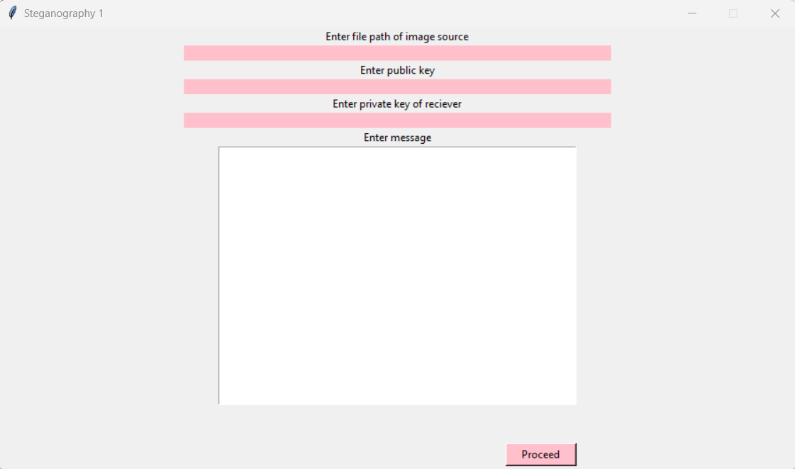
Modelling
Step 1: Enter the file path of the image where you wish to conceal the message.
Step2: Enter the file path of the public key.
Step 3: Enter the file path of the private key.
Step 4: Enter the message.
Step 5: Click on “Proceed”.

Slide 15
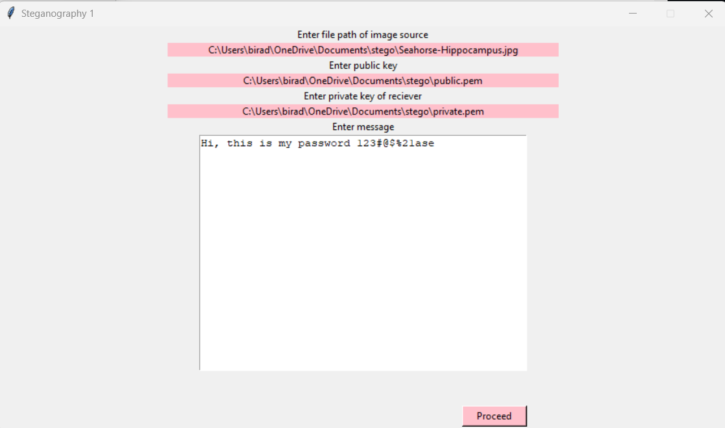

Slide 16


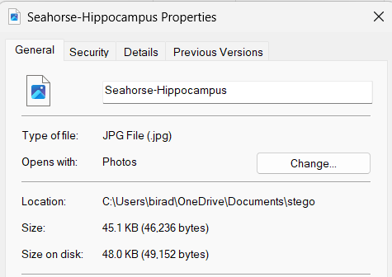
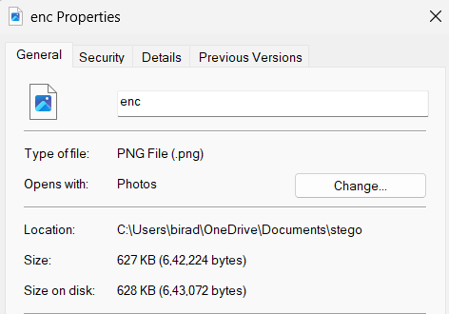
Before Steganography
After Steganography
Image size before steganography : 45.1 KB
Image size after steganography : 627 KB

Slide 17
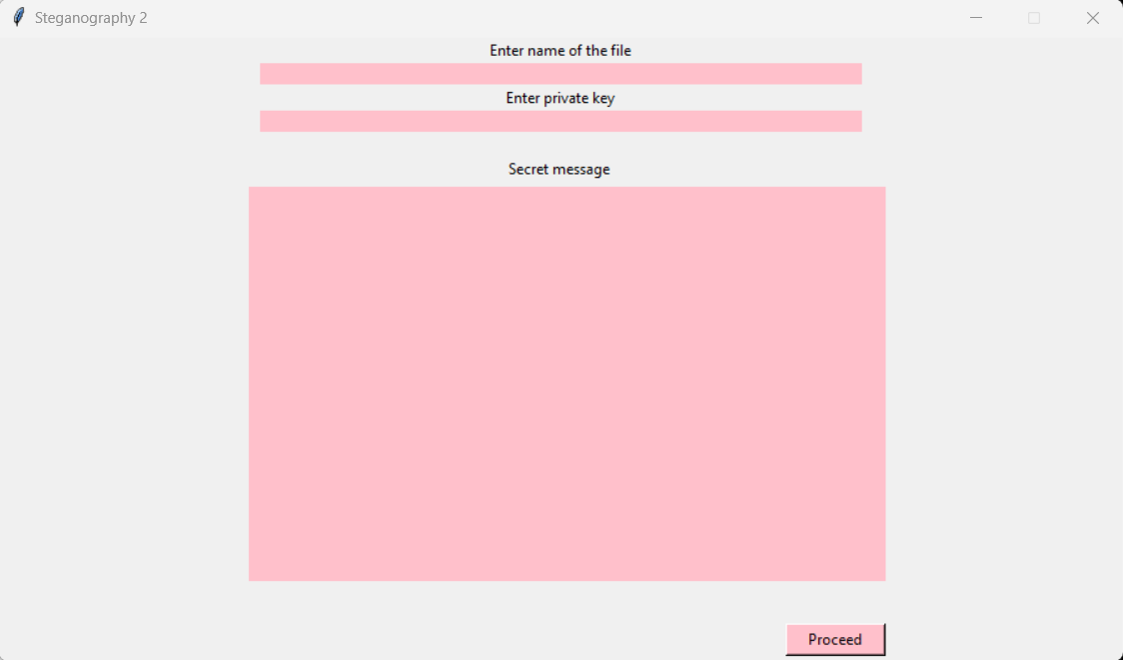
Step 6: Enter name of the image
file in which the message is
hidden.
Step 7: Enter your private key.
Step 8: Click on “Proceed”.

Slide 18
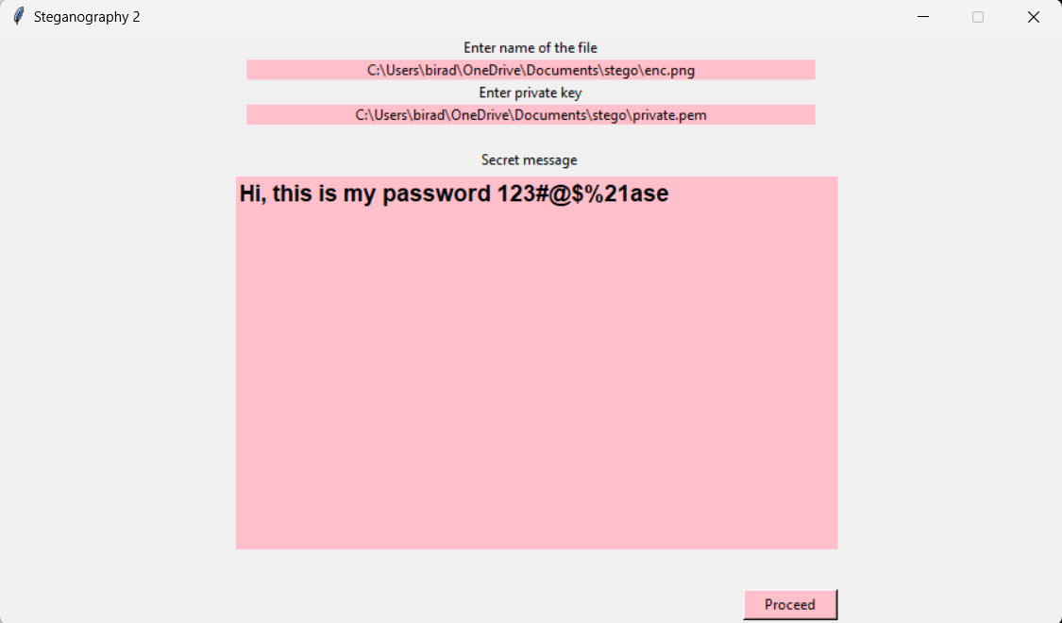

Slide 19
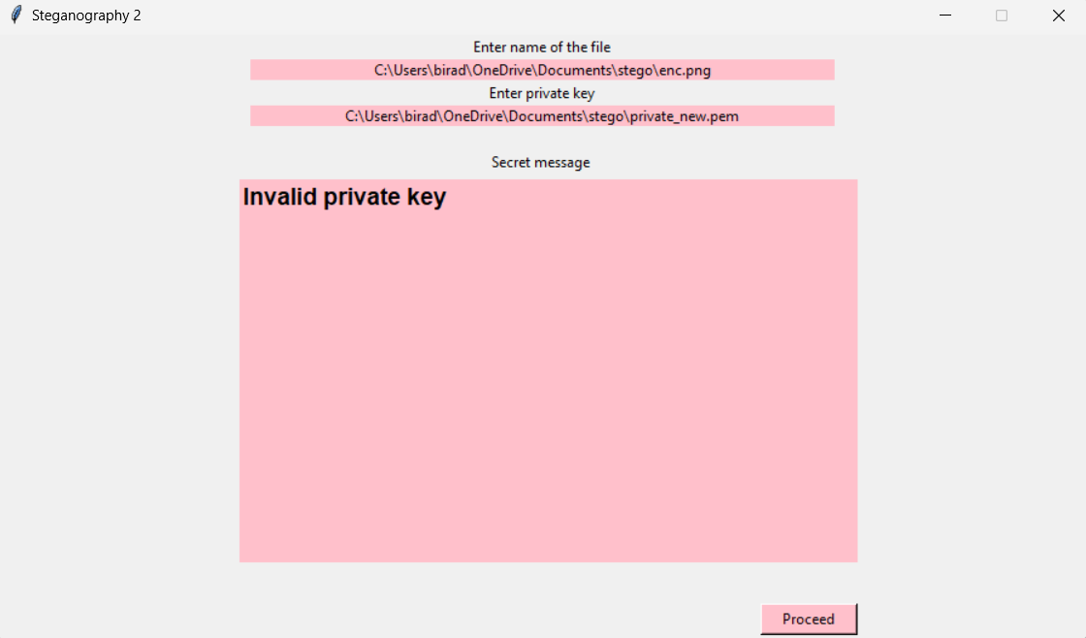
Entering the wrong private key

Slide 20
Results
User-Friendly Experience with GUI:
The implementation of a Tkinter GUI has significantly enhanced user experience.
End users can seamlessly hide messages within images without delving into the intricacies of the process, making steganography accessible to a wider audience.
Abstraction for Non-Technical Users:
The level of abstraction provided by the GUI simplifies the embedding process.
Even non-technical users can engage with our steganographic tool, promoting inclusivity and ease of use.

Slide 21
Enhanced Security through RSA Encryption:
Integration of the RSA algorithm ensures robust message encryption before embedding.
The security layer added by RSA makes it challenging for potential attackers to decrypt the concealed message, bolstering the confidentiality of hidden information.
Prevention of Unauthorized Decryption:
The use of RSA encryption prevents unauthorized decryption attempts.
Even if an attacker gains access to the embedded image, deciphering the encrypted text without the private key remains a formidable challenge, ensuring the integrity of covert communication.

Slide 22
Links
Github repo
https://github.com/nitpat25/Steganography.git
Code
https://github.com/nitpat25/Steganography/blob/main/rsa_stego.py

