Slide 1
Data Analytics
Estimation of AirBnB property investment as a profitable Marwari business
Name: Natasha Cheri SRN: 261
Name :Nitish Rathore SRN: 270
Name :Vishal Lodha SRN: 507

Slide 2
Abstract and Scope
AirBnB is an online marketplace that connects people who want to rent out their homes with people who are looking for accommodations in specific locales.
AirBnB hosts make, on average, about $924 a month(CNBC News) according to research from low-interest lender Earnest. Of course, that income can vary dramatically depending on where you're based, how frequently you rent out your place, the quality of your home and the services you provide.
Considering the above, we are finding the best location to buy a new property that will be hosted on Airbnb for investment.

Slide 3
Implementation Details
Exploratory Data Analysis Module:
Technology Used:- Python/VSCode
Implementation details: We have dropped the columns with null values and used matplotlib and seaborn libraries from Python to plot scatterplots and barplots to make inferences from the dataset. In the EDA we have plotted multiple graphs to understand the data more precisely. The following are the graphs that we have plotted:
Type of room v/s Number of rooms (Bar graph)
Neighbourhood v/s Number of rooms (Bar graph)
Neighbourhood v/s Average price (Bar graph)
Neighbourhood v/s Availability 365 (Bar graph)
Neighbourhood v/s No of days occupied (Bar graph)
Airbnb Properties by Price/Night (Scatter Plot)

Slide 4
Airbnb Properties availability throughout the year (Scatter Plot)
Airbnb Properties by Annual Income (Scatter Plot)
Airbnb Properties by Total Income per Neighborhood (Scatter Plot)
Annual Income per property of a specific neighborhood (Scatter Plot)
Time to get back investment(in years) (Scatter Plot)
Streamlit Module:
Technology Used:- Python/VSCode
Implementation details: We have implemented a UI which let’s the user to visualise plots for distribution of annual income of the neighborhood and also allows the user to enter investment of a particular area and outputs the annual income after tax deductions in UK along with AirBnB service fee deduction

Slide 5
Implementation Details
KNN Module:
Technology Used: Python/VSCode
Implementation details: We are calculating the average income of a particular neighborhood and then modeling it to respective latitude and longitude of that area. If the user wishes to calculate the income for a particular latitude/longitude we are implementing weighted KNN algorithm taking the nearest 3 neighbors into consideration.

Slide 6
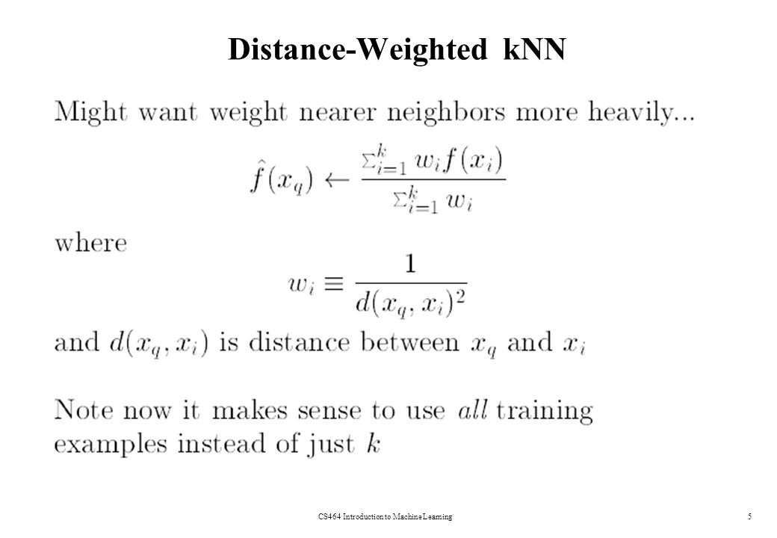
KNN algorithm working:
Let L = { ( x_{i} , y_{i} ) , i = 1, . . . ,n } be a training set of observations x_{i} with given class y_{i} and let x be a new observation(query point), whose class label y has to be predicted.
Compute d(x_{i}, x) for i = 1, . . . ,n , the distance between the query point and every other point in the training set.
Select D’ ⊆ D, the set of k nearest training data points to the query points
Predict the class of the query point, using distance-weighted voting. The v represents the class labels. Use the following formula

Slide 7
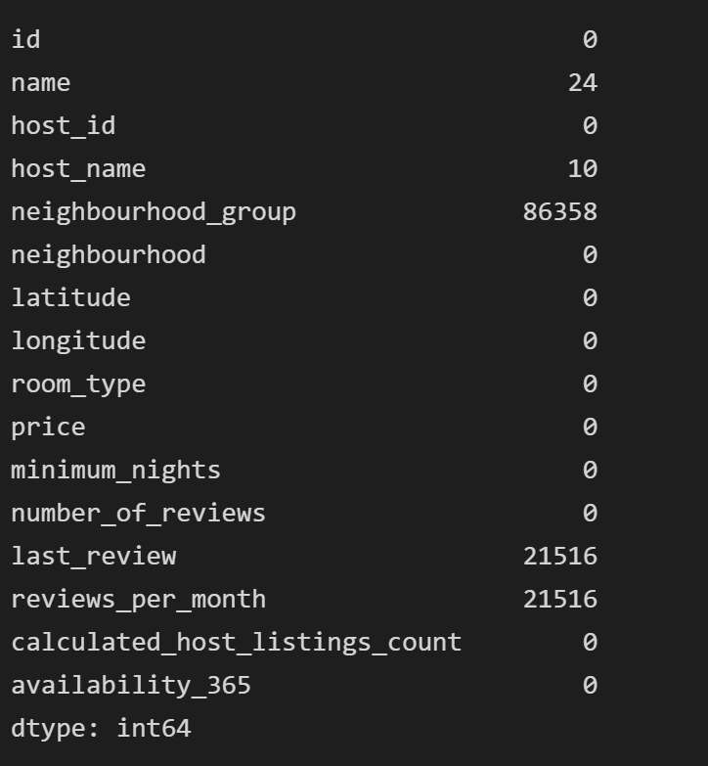
Project Demonstration
Checking and removing the null values

Slide 8
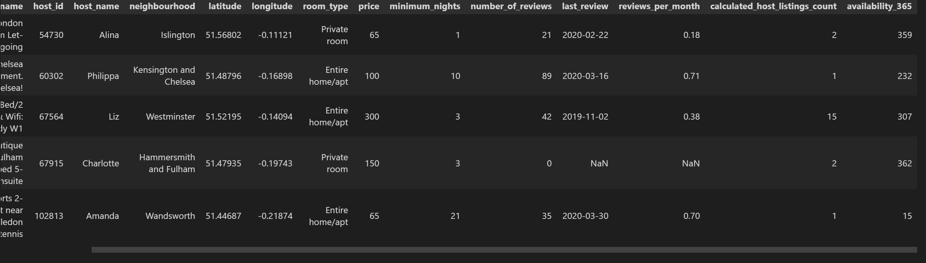
Dataset after removing the null values

Slide 9
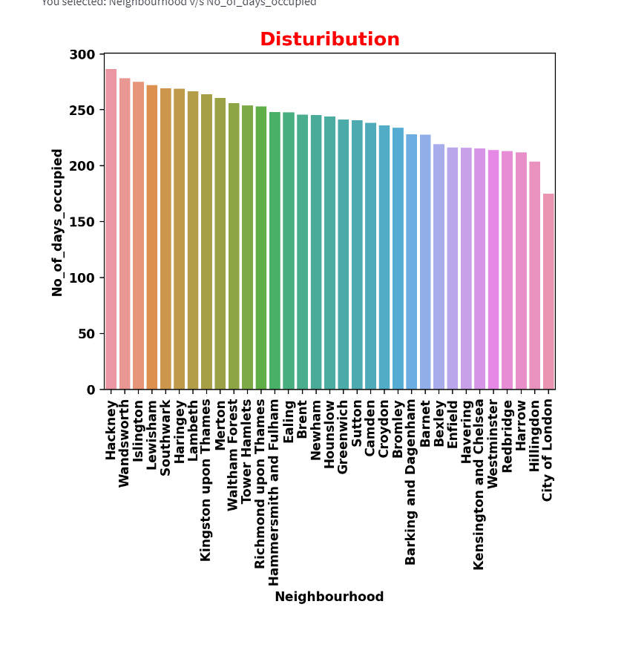
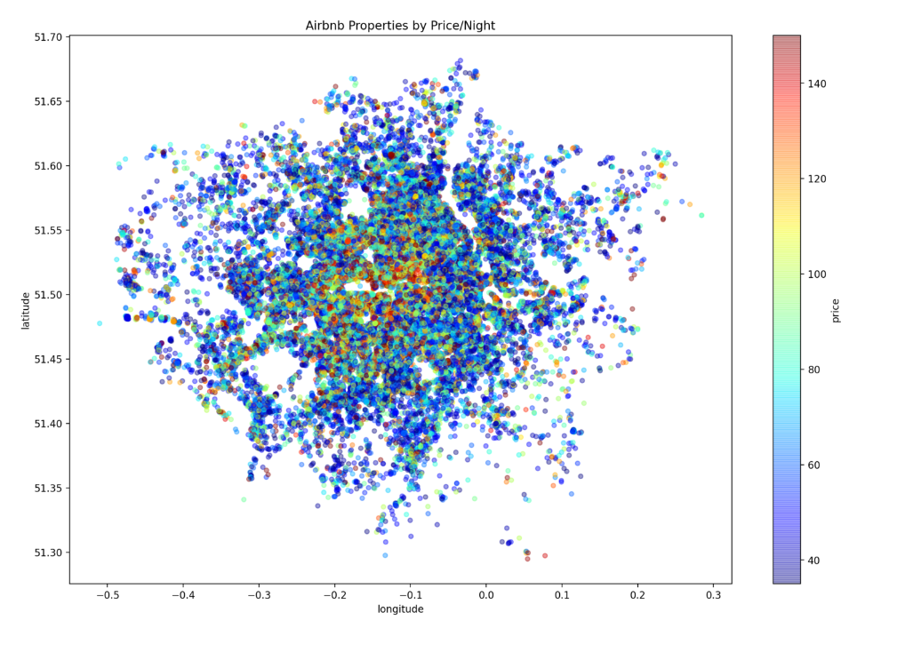
Neighborhood distribution over no. of days
AirBnB Properties price/night distribution

Slide 10
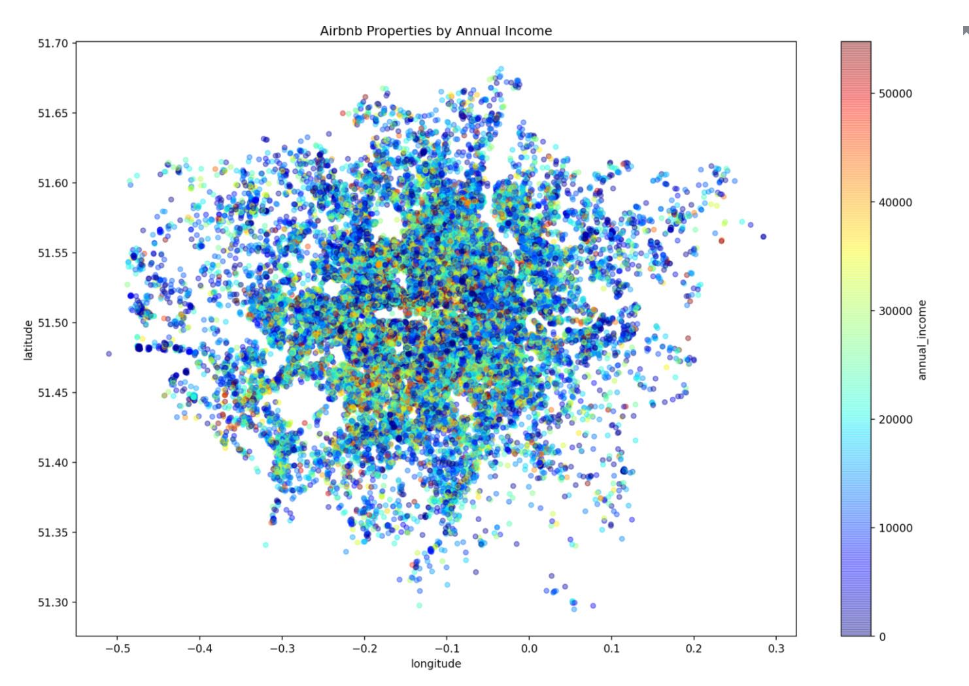
Exploratory data analysis results to generate the annual income of the city

Slide 11
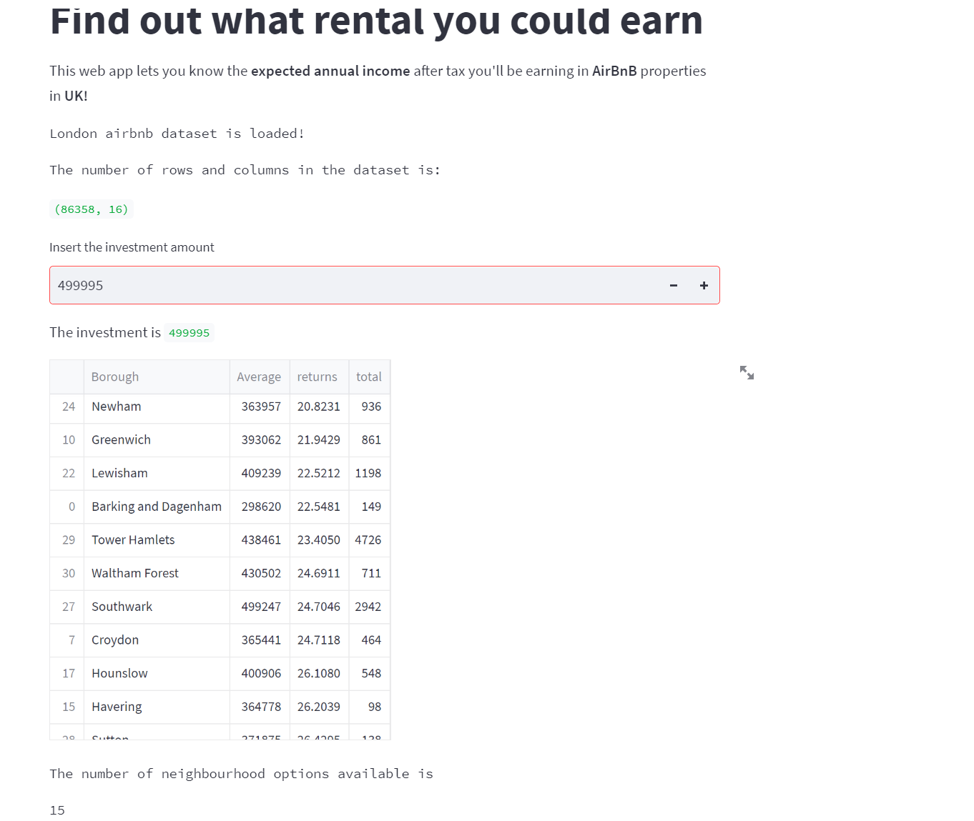
StreamLit App UI for rental calculation

Slide 12
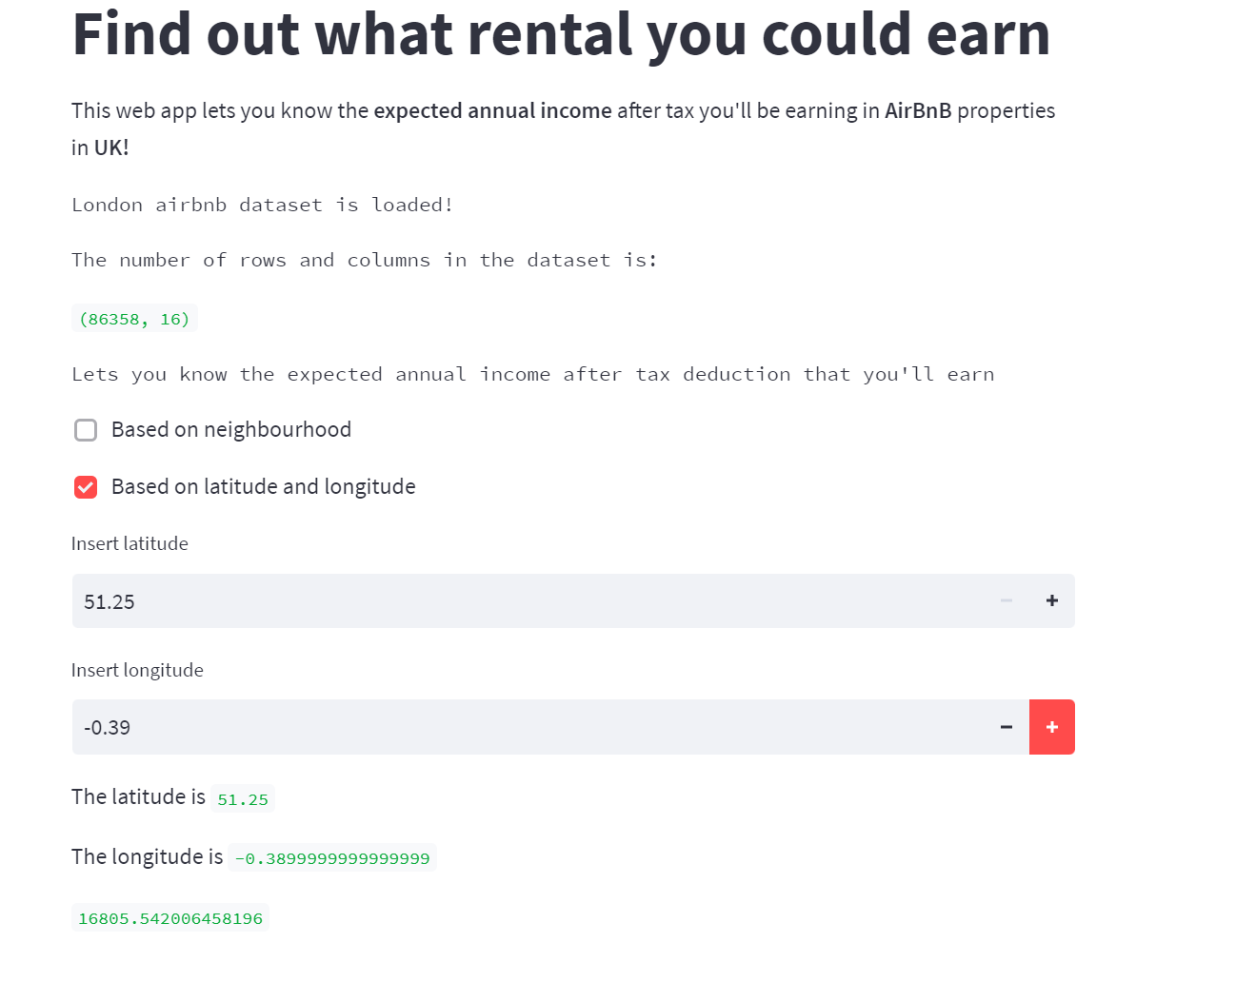
StreamLit App UI for rental investment and returns

Slide 13
PERFORMANCE METRIC
Mean Absolute Error: We have chosen this as the performance metric, as this gives us a confidence bound and which inturn gives us a lower and upper estimate of the profits earned per year which gives our client the idea to think and invest in the right property.

Slide 14
Conclusion and Future work
From the London AirBnB dataset, we perform exploratory data analysis to estimate the occupancy rate and calculate average income of a neighbourhood based on occupancy rate in a year and the rent per night for different type of rooms.
Following which, we have implemented a KNN algorithm to calculate the expected income of a particular property in that neighbourhood
Future work:
In future we wish to implement a way to calculate the profits for the investors who take the property on lease.
Also we plan to expand the business to other cities in other countries.
We would also like to take into consideration the specifications of different properties, as each property is not similar there are different features with each and we have assumed everything to be uniform by dropping them from the dataset.

Slide 15
References
References pertaining to Research:
Petruzzi, Marina & Marques, Gabriela & Carmo, Manuel & Correia, Antónia. (2020). Airbnb and neighbourhoods: an exploratory study. International Journal of Tourism Cities. ahead-of-print. 10.1108/IJTC-08-2019-0119
A. Zhu, R. Li and Z. Xie, "Machine Learning Prediction of New York Airbnb Prices," 2020 Third International Conference on Artificial Intelligence for Industries (AI4I), 2020, pp. 1-5, doi: 10.1109/AI4I49448.2020.00007.
A. Garlapati, K. Garlapati, N. Malisetty, D. R. Krishna and G. Narayana, "Price Listing Predictions and Forthcoming Analysis of Airbnb," 2021 12th International Conference on Computing Communication and Networking Technologies (ICCCNT), 2021, pp. 1-7, doi: 10.1109/ICCCNT51525.2021.9579773
Xie, Karen & Mao, Zhenxing. (2019). Locational Strategy of Professional Hosts: Effect on Perceived Quality and Revenue Performance of Airbnb Listings. Journal of Hospitality and Tourism Research. 43. 10.1177/1096348019836277.

Slide 16
Thank You

