Slide 1


CS598:Deep Learning for HealthCare
Research Paper Reproduction Project
An Extensive Data Processing Pipeline for MIMIC-IV
Nita Agarwal, May 6, 2023

Slide 2

General Problem
General problem the original paper aims to solves is to fill the gap of a standardized , flexible, customizable data pipeline to extract and pre-process the data available in MIMIC-IV dataset.
The existing cohort extraction and pre-processing pipelines are missing the flexibility of letting the user interact and decide as per their need of the type of cohort required or are processing only ICU data( and not the non-ICU data).

Slide 3
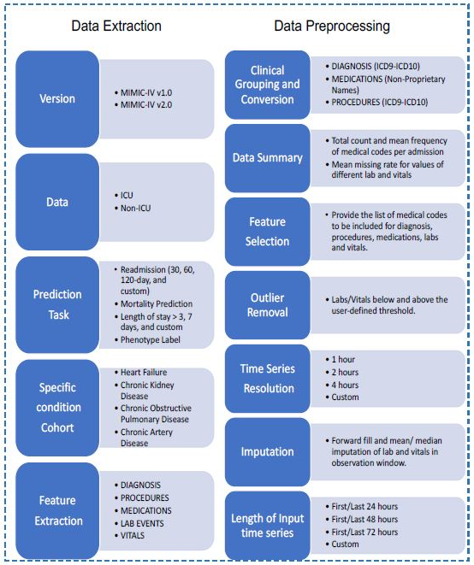
Approach taken in paper
To Provide a configurable framework for data extraction, cleaning and pre-processing pipeline which is extendible, flexible, processes both ICU and non-ICU data.
Data Extraction unit takes user input for version , type of data(ICU/non-ICU), specific cohort condition (ex. disease) and feature extraction It then extracts and stores the generated cohort in form of csv files.
Data Preprocessing unit clinically groups the data, selects the features, cleans the raw data by removing outliers, impute missing entries and also generate time-series dataset by binning the sequential data into time intervals as per user's preference.
The pipeline also includes two optional parts for modeling and evaluation. Users can construct a model to train for a prediction task and use performance metrics for study comparisons.

Slide 4
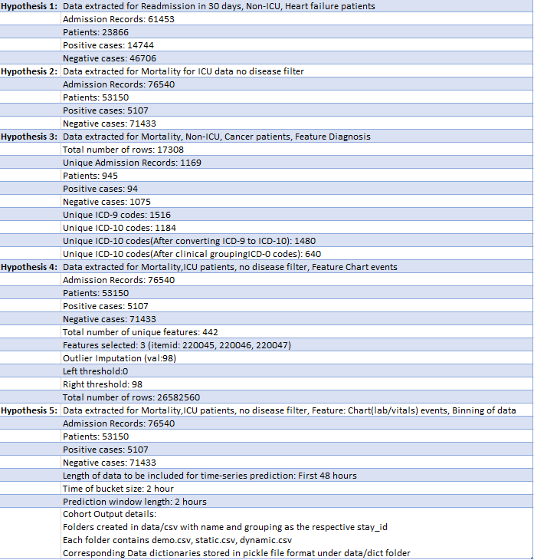
Reproduction Attempts
Hypothesis 1: Pipeline can extract cohort features from MIMIC-IV based on user input of feature and on specific condition of the disease chosen by the user.
Hypothesis 2: Pipeline can extract cohort for prediction task of mortality in ICU patients.
Hypothesis 3: Pipeline can pre-process cohort from MIMIC-IV dataset for clinical grouping and conversion based on user input along with providing summary of the resultant cohort.
Hypothesis 4: Pipeline can pre-process cohort for outlier imputation, and selection of feature based on user inputs.
Hypothesis 5: Pipeline can pre-process cohort by binning the sequential data into time intervals based on the timeseries length according to user inputs.
**Testing done on MIMIC-IV dataset V1.0

Slide 5
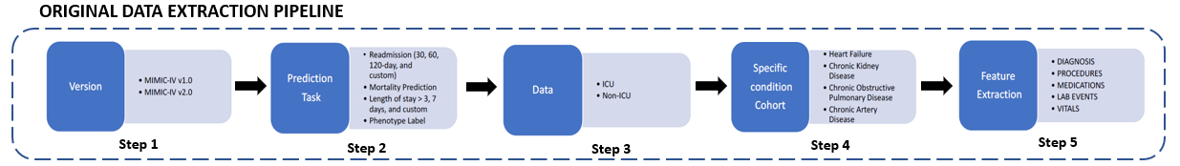
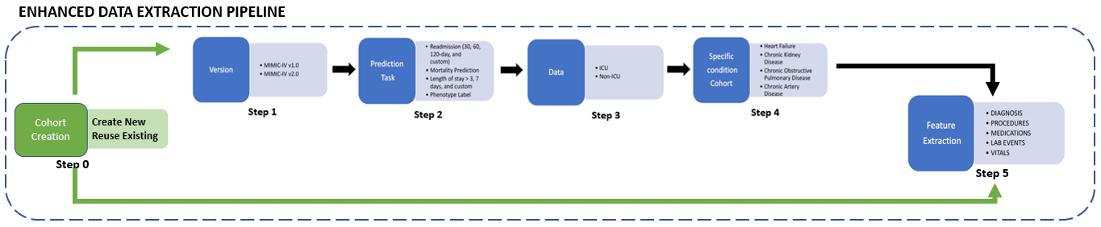
Ablation
The current data pipeline seems to be executed in steps one after the other. If the environment is restarted, the data extracted by the pipeline in last cycle cannot be used this time for further processing . In this case the pipeline must be again started from step 1 and extract the already extracted files again instead of reusing them
I have successfully added the code to provide user with a flexibility to choose to start the processing from the already extracted intermediate cohort. This will skip few of the steps in the extraction pipeline thereby taking less processing time to reach to later steps.

Slide 6
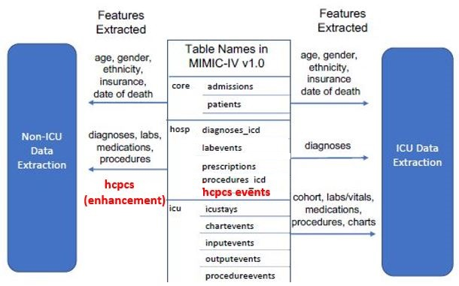
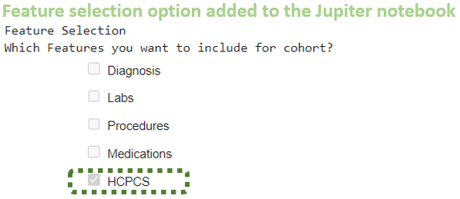
Enhancements
I have successfully added feature extraction logic for HCPCS events. The code works for both 1.0 and 2.0 version of MIMIC-IV data. https://physionet.org/content/mimiciv/1.0/hosp/hcpcsevents.csv.gz
I have added code for taking user inputs for extracting data for additional disease such as Cancer
[Bonus initiative] I was able to successfully contribute by adding HCPCS feature to PyHealth mimic4.py. Approved PR https://github.com/sunlabuiuc/PyHealth/pull/134

