Slide 1

OOP

Slide 2
Content
Classes & objects
OOP pillars
Decorators

Slide 3
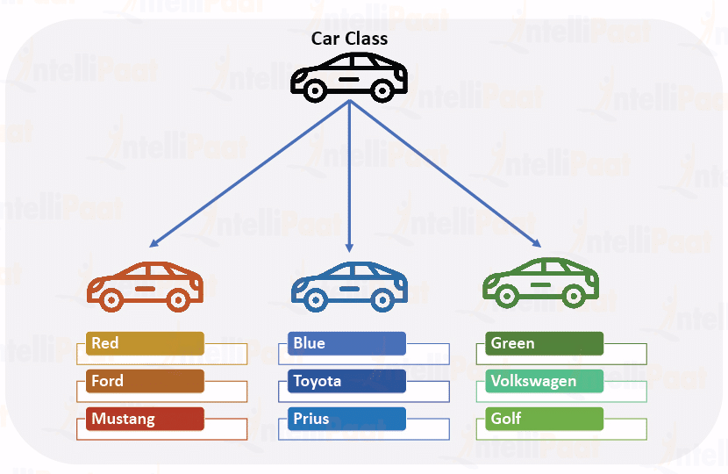
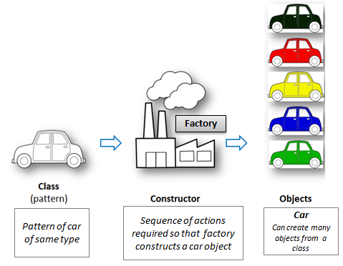
OOP
Notes:
A class is
An object is

Slide 4
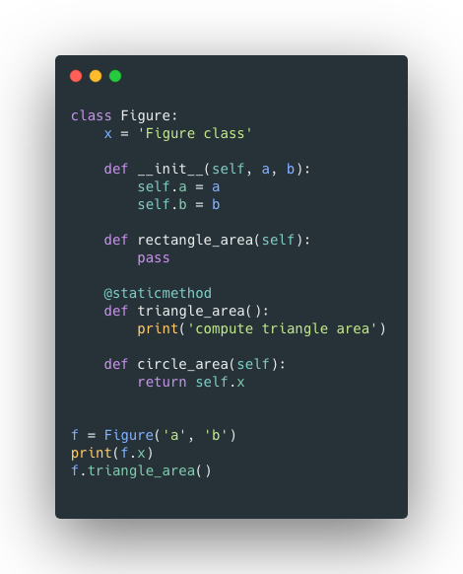
OOP
In Python almost everything is an object
Class – template of how an object will looks like
Object – instance of a class
Constructor
Self parameter
Object methods
Object properties

Slide 5
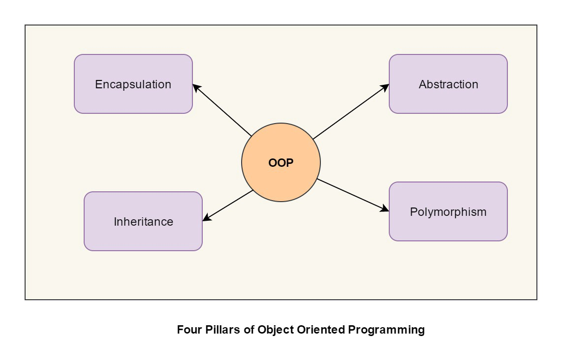
OOP

Slide 6
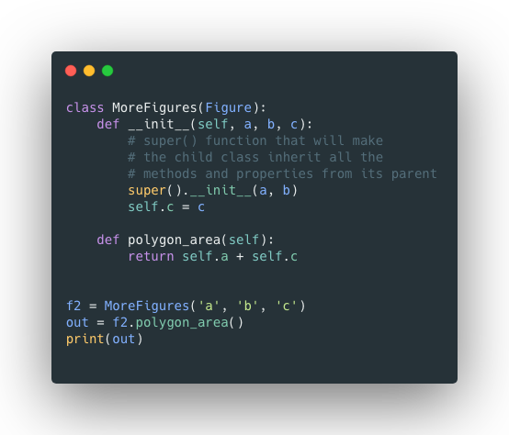
OOP - inheritance

Slide 7
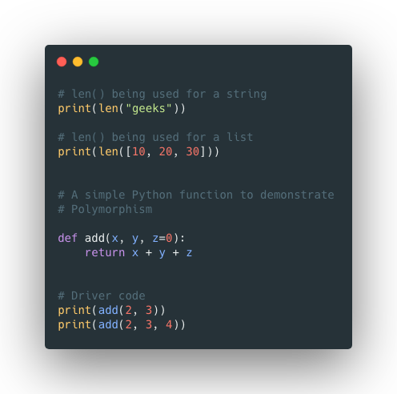
OOP - polymorhpism
Build in
Using functions

Slide 8
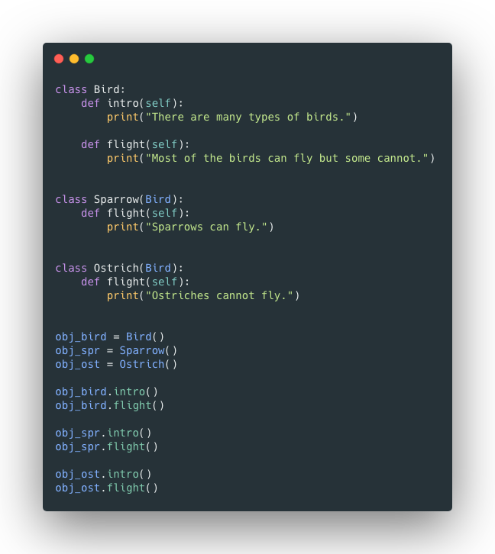
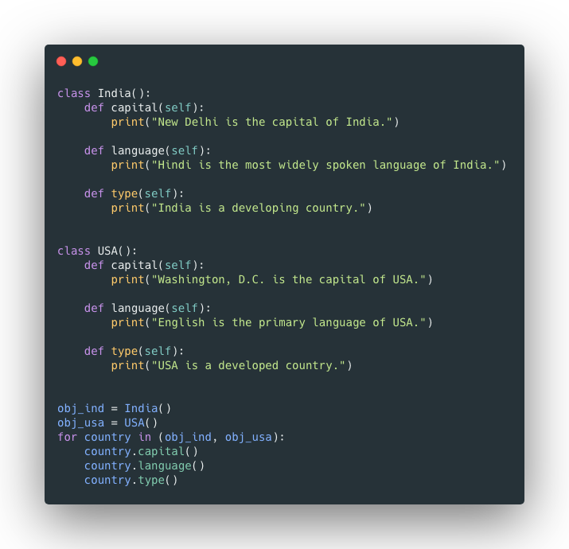
OOP - polymorhpism
Using classes
Using inheritance

Slide 9
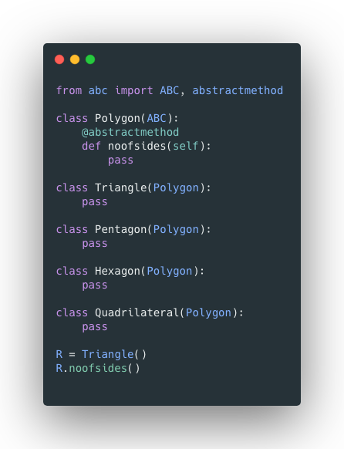
OOP - Abstraction
Implement the abstract methods
Create objects and call methods used to the nr. of sides for each figure

Slide 10
OOP - Imports
From another module
From another package

Slide 11
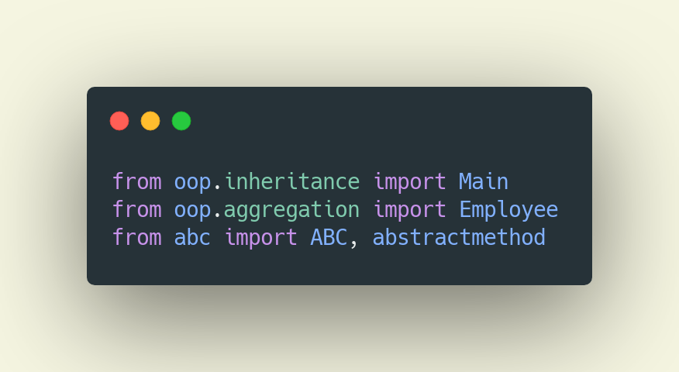
OOP - Imports

Slide 12
OOP – More advanced concepts
Class methods
Static methods
Multiple inheritance
Dunder methods overriding
Overloading in Python
Composition
Aggregation

Slide 13
OOP – More advanced concepts (class methods)
A class method is a method that is bound to the class and not the object of the class.
They have the access to the state of the class as it takes a class parameter that points to the class and not the object instance.
It can modify a class state that would apply across all the instances of the class. For example, it can modify a class variable that will be applicable to all the instances.

Slide 14
OOP – More advanced concepts (static methods)
A static method is also a method that is bound to the class and not the object of the class.
A static method can’t access or modify the class state.
It is present in a class because it makes sense for the method to be present in class.

Slide 15
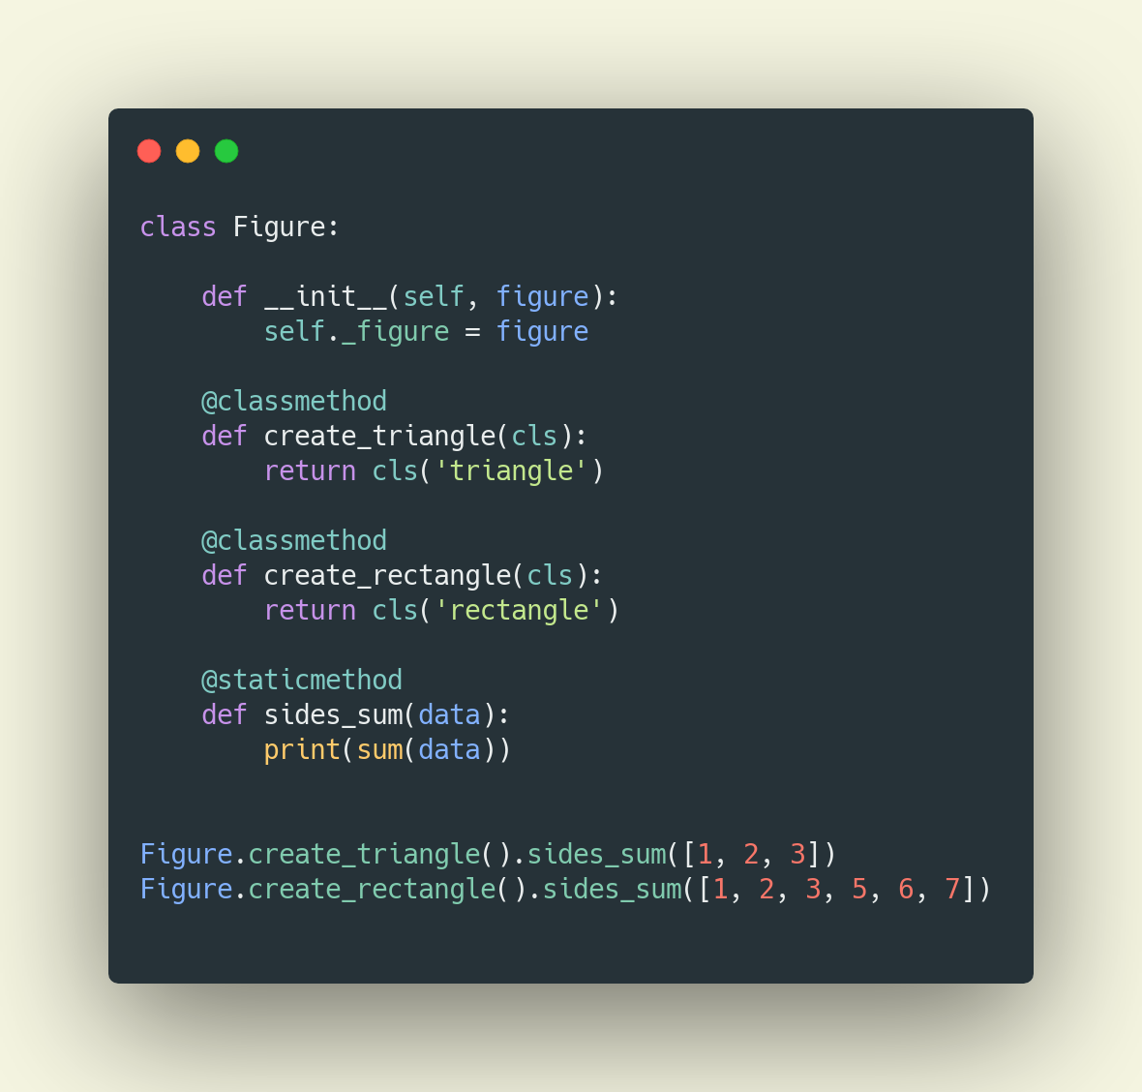
Static and class methods

Slide 16
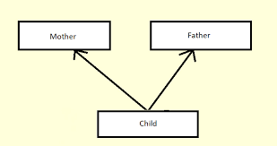
OOP – More advanced concepts (multiple inheritance)

Slide 17
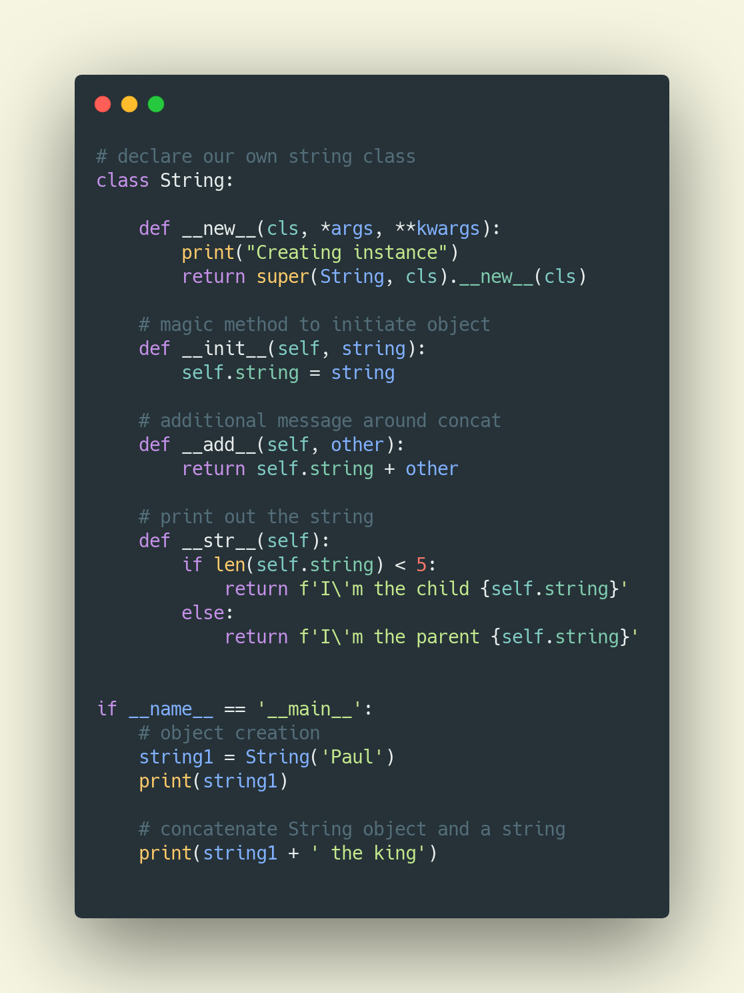
Dunder methods

Slide 18
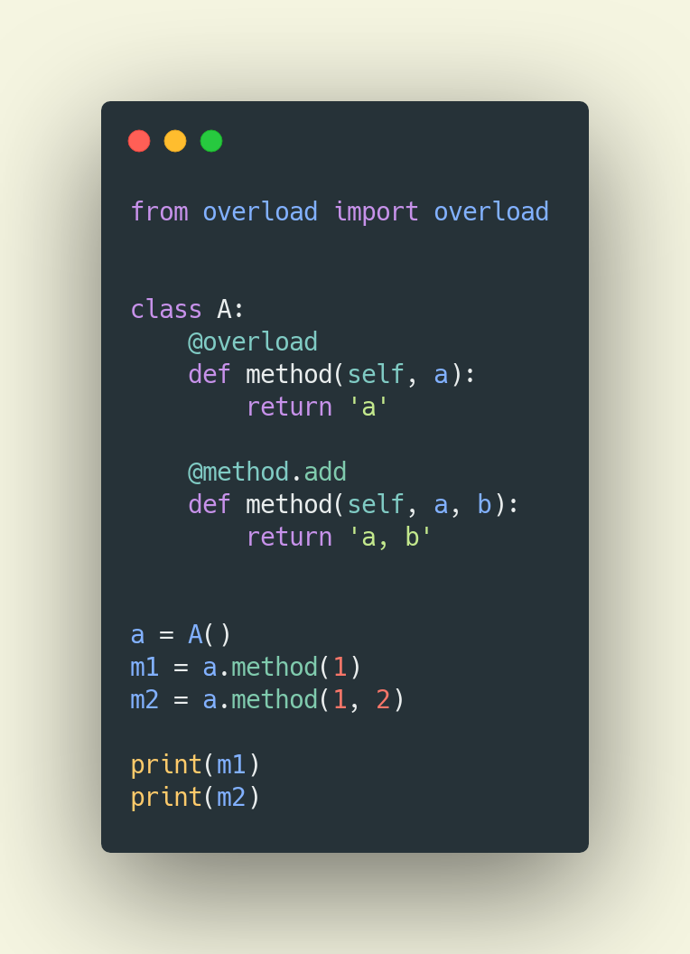
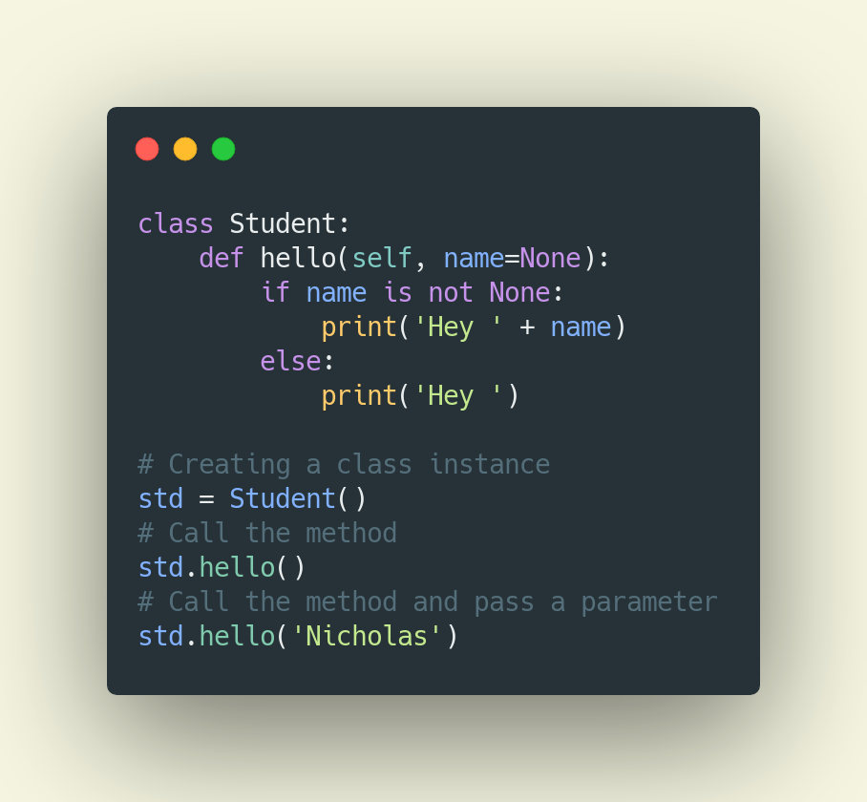
Overloading
Method 1 using overloading package
Method 2 using functions

Slide 19
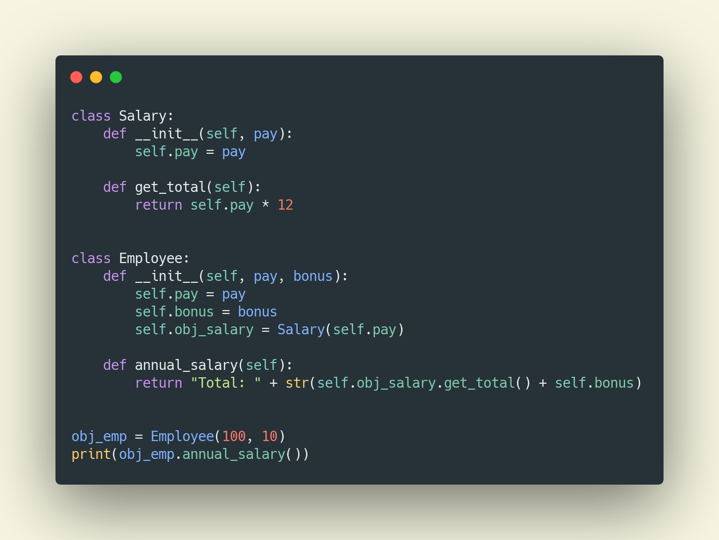
Composition

Slide 20
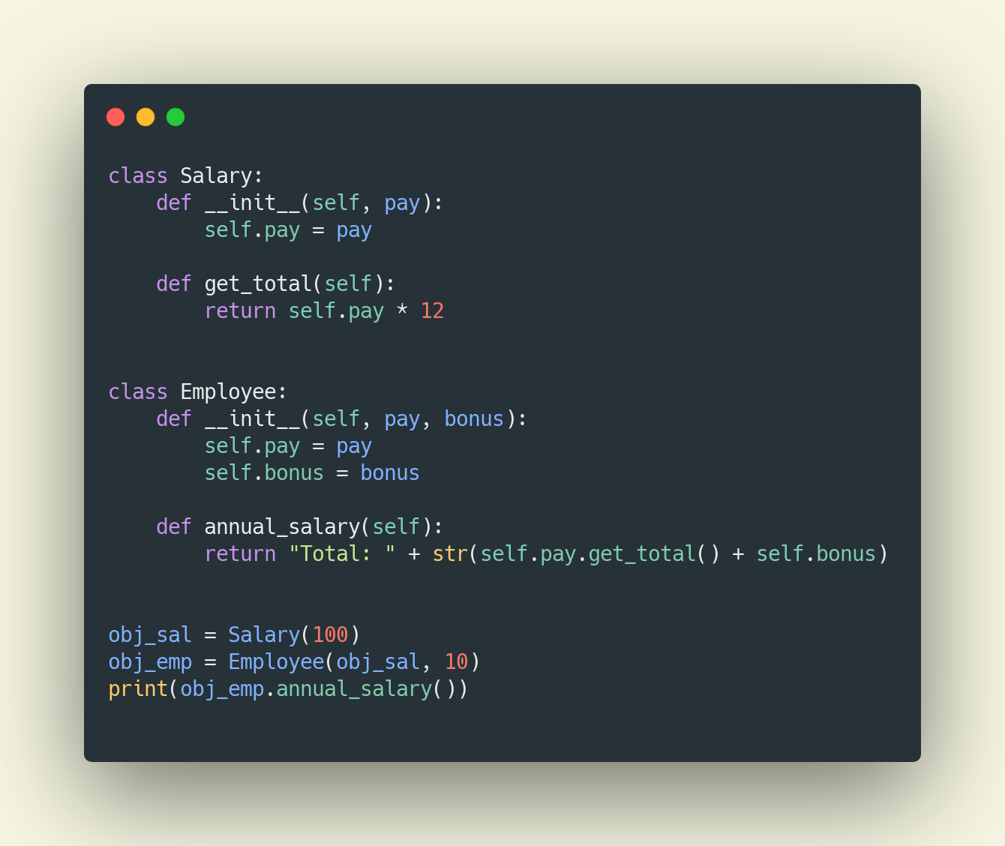
Aggregation

Slide 21
Decorators
A decorator takes in a function, adds some functionality and returns it.
Alter the behavior of a function
@decorate
First step, need to know what a function is
Let’s build a simple one

Slide 22
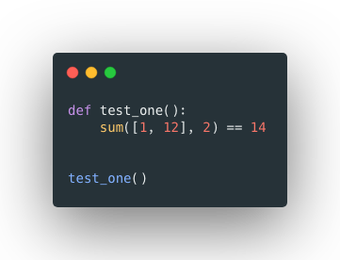
Decorators
decorators are possible due to the ability of functions to act like variables
decorators super charge our function
higher order function HOC
hoc is a function that accept another function

Slide 23
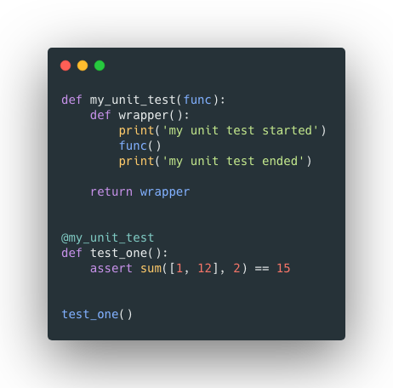
Decorators
Build the decorator
Decorate the function
Run it again

Slide 24
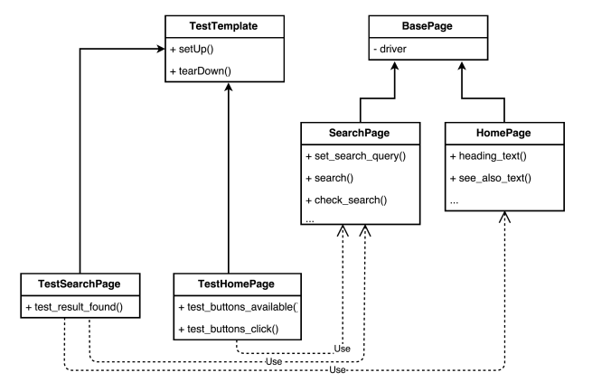
UML diagrams

Slide 25
Exercise
Migrate
Migrate the geometrical computations in OOP style
Define
Define an abstract class for Figure
Use
Use inheritance somehow
Apply
Apply polymorphism
Encapsulate
Encapsulate some information

Slide 26
OOP - Exercises
Building a test runner using decorators
Decorate a test based on the testing applicable testing types
Testing scope can be smoke, regression and performance
Write 5 dummy tests at 1 from smoke, 3 from regression and 1 performance
The output will be generated in a text file

Slide 27
OOP - Exercises
Combine the previous two exercises
The testing must be applied to the oop classes
Publish code to the Github

