Slide 1
Advanced topics: Semi-static replication using ANNs Group 4: Divya Gajera (14932644) & Nitai Nijholt (12709018)

Slide 2
Objectives
Pricing: Calculate the fair value of the derivative at any timepoint
Hedging: Construct a semi-static hedge using short-maturity European options that replicate the derivative's payoff.
Estimate forward path sensitivities in complex derivatives

Slide 3
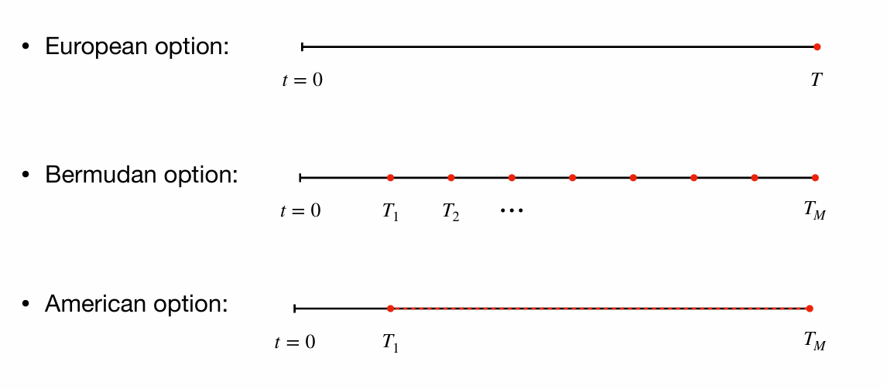
Bermudan Option

Slide 4


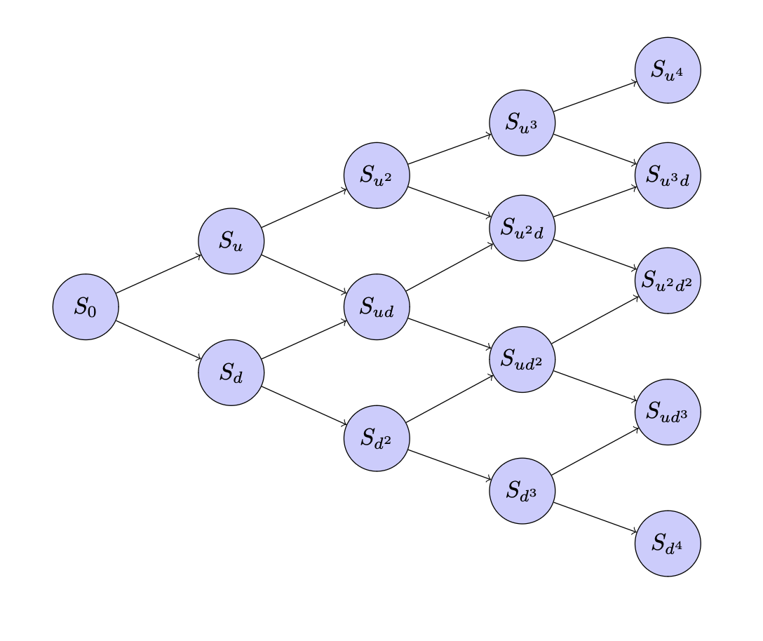
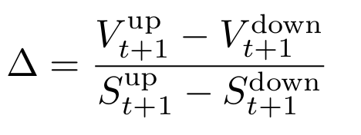
Binomial Method
t = 0
t = T/2
t = T
Notes:
Downside: Curse of dimensionality

Slide 5
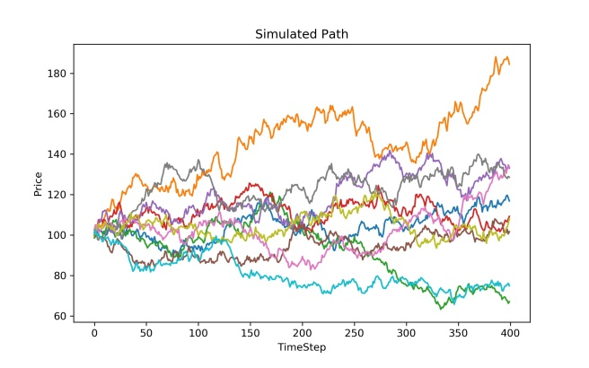
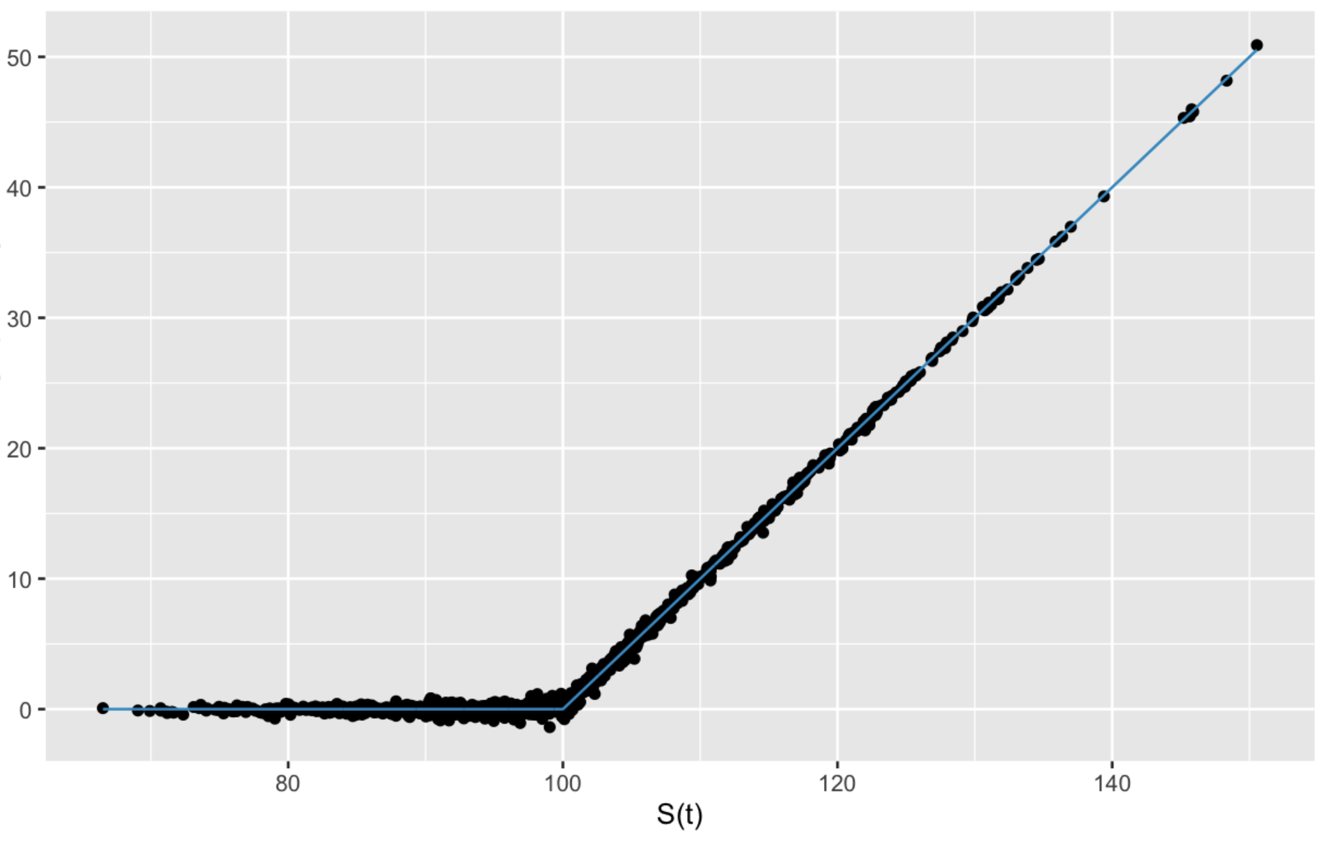
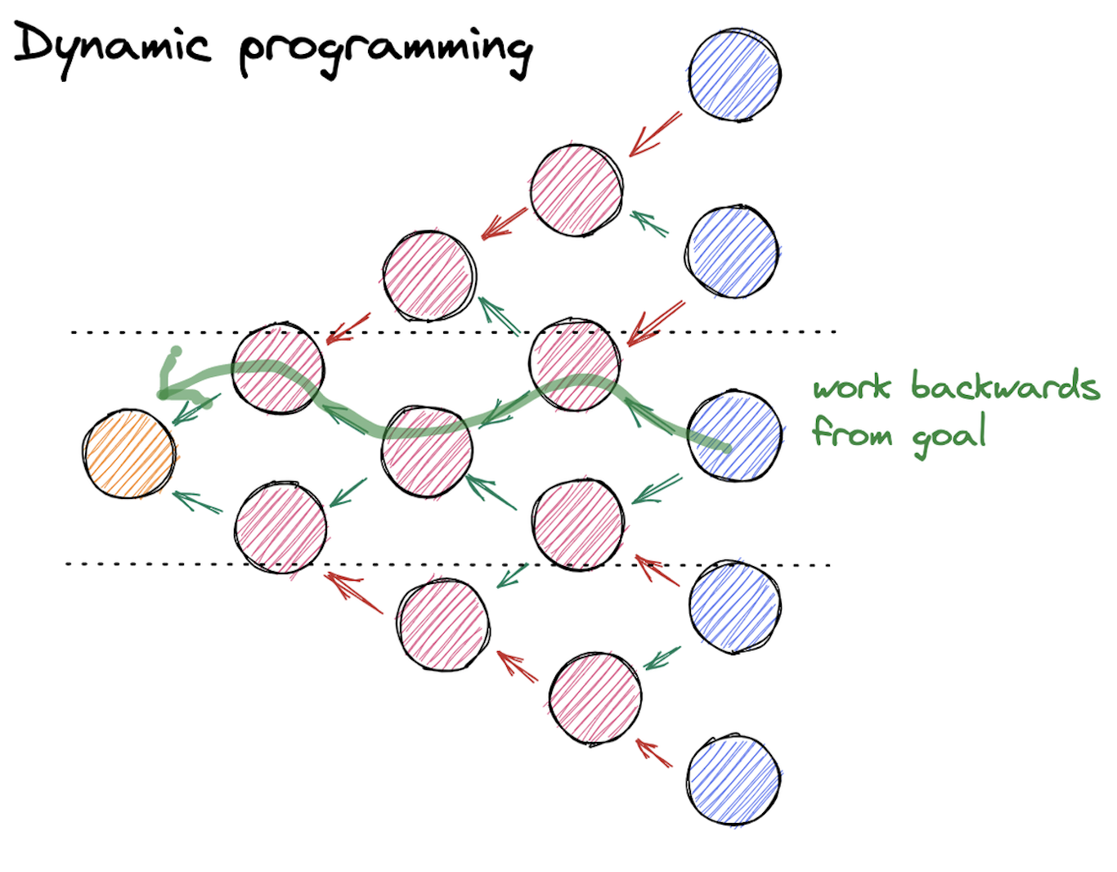
Monte Carlo Approach
Monte Carlo Approach to approximate Bermudan option price consists of three main components:
Dynamic Programming - backward induction process that determines the optimal exercise strategy.
Simulations - Simulate a large number of price paths for the underlying asset using stochastic processes (e.g., Geometric Brownian Motion)
Regression - It fits the simulated future payoffs (from Monte Carlo paths) to the state variables (e.g., current asset prices).
Notes:
Dynamic Programming - Starting from the final exercise date, the algorithm compares the intrinsic value (value if exercised) with the continuation value (expected value of holding the option) at each step. This process is repeated at each exercise point, propagating decisions backward to compute the option price at the initial time.
Regression in the context of Bermudan option pricing is used to estimate the continuation value of the option at each exercise point during the backward induction process. By regressing the simulated future payoffs against the current state variables (e.g., asset price), the continuation value is approximated as a function of the state. This allows the algorithm to determine whether holding the option (continuation value) or exercising it (intrinsic value) is more optimal at that point.
Downsides computationally intensive due to high number of simulation paths required

Slide 6
Monte Carlo Approach
The Monte Carlo methods for pricing Bermudan style options can be broadly divided in two categories :
1. Regress Now - Regression is performed at each exercise date using the current state variables (e.g., asset prices at that date) to approximate the continuation value. The continuation value at ​ is calculated directly based on the regression results.
2. Regress Later - Regression is deferred to later times, estimating the continuation value in terms of future states (e.g., payoffs at a future time step). The regression result at is used retrospectively to decide the exercise policy at ​
Notes:
In the regress-later approach, to compute the conditional expectation at tm, one first approximates the value function at time tm+1 by regressing the option values at tm+1 against the basis functions constructed using the simulated data at tm+1.
The basis functions in the regress-later approach are chosen such that their conditional expectations can be computed exactly, which in turn results in the necessary conditional expectation at tm. Therefore, in the regress later scheme, regression performed at tm+1 is used to make the early exercise decision at tm

Slide 7
Motivation RLNN
Challenges in pricing complex derivatives
Finite difference or Tree methods suffers from Curse of dimensionality
Monte Carlo performs better, but high computational cost
Dynamic hedging breaks down in low liquidity environment
Notes:
Option Value:
The value of the Bermudan option depends on the underlying asset price (StS_tSt​) and the holder's optimal exercise policy, which is defined as an unknown stopping time (τ\tauτ).
Backward Induction:
The value is computed iteratively, starting from the last exercise date and moving backward to the initial time.

Slide 8
Motivation RLNN
Advantages RLLN:
(Semi) Static Hedging
Interpretability
Lower Computational Cost
Universal Approximation Theorem
Notes:
Option Value:
The value of the Bermudan option depends on the underlying asset price (StS_tSt​) and the holder's optimal exercise policy, which is defined as an unknown stopping time (τ\tauτ).
Backward Induction:
The value is computed iteratively, starting from the last exercise date and moving backward to the initial time.

Slide 9
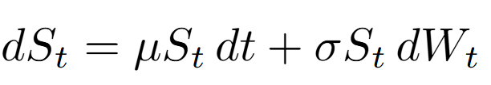





RLNN Algorithm
Main idea: Approximate pay-off of complex derivative using linear combination of simple European Options
Algorithm Steps:
1. Generate simulations of N underlying asset paths using GBM:
2. Compute option payoffs at maturity for each path:
3. Train Neural Network each time step to approx. option values:
4. Compute continuation value using the trained network:
5. Option Value Update: Update option values:
6. Repeat step 3-5 backward to the initial time.
Image credit: Hoencamp, J. (2024, Fall). Advanced topics: Semi-static replication using ANNs. Advanced Topics in Computational Finance, University of Amsterdam.

Slide 10


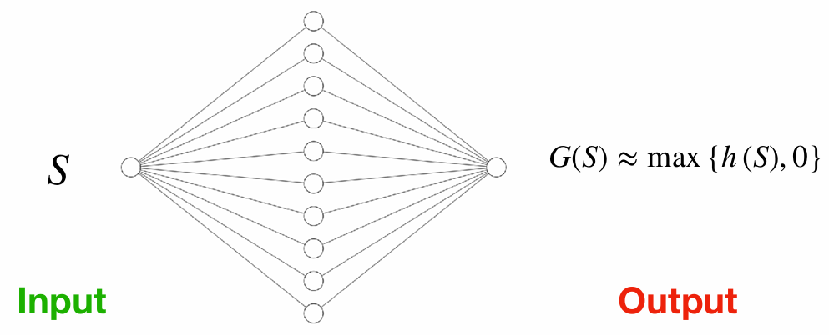
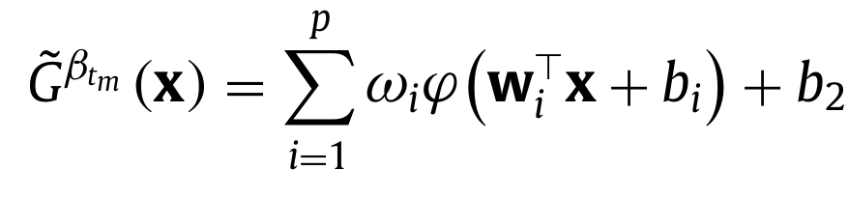
RLNN Algorithm
Main idea: Approximate pay-off of complex derivative using linear combination of simple European Options
NN structure:
Hidden Layer Uses ReLU activation functions
Each neuron represents payoff of single European option
Portfolio weights correspond to ; biases to strike
Regress later because it uses feed forward neural network for the regression at each time step
Image credit: Hoencamp, J. (2024, Fall). Advanced topics: Semi-static replication using ANNs. Advanced Topics in Computational Finance, University of Amsterdam.

Slide 11
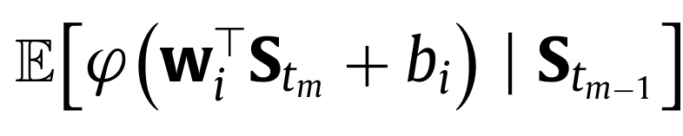

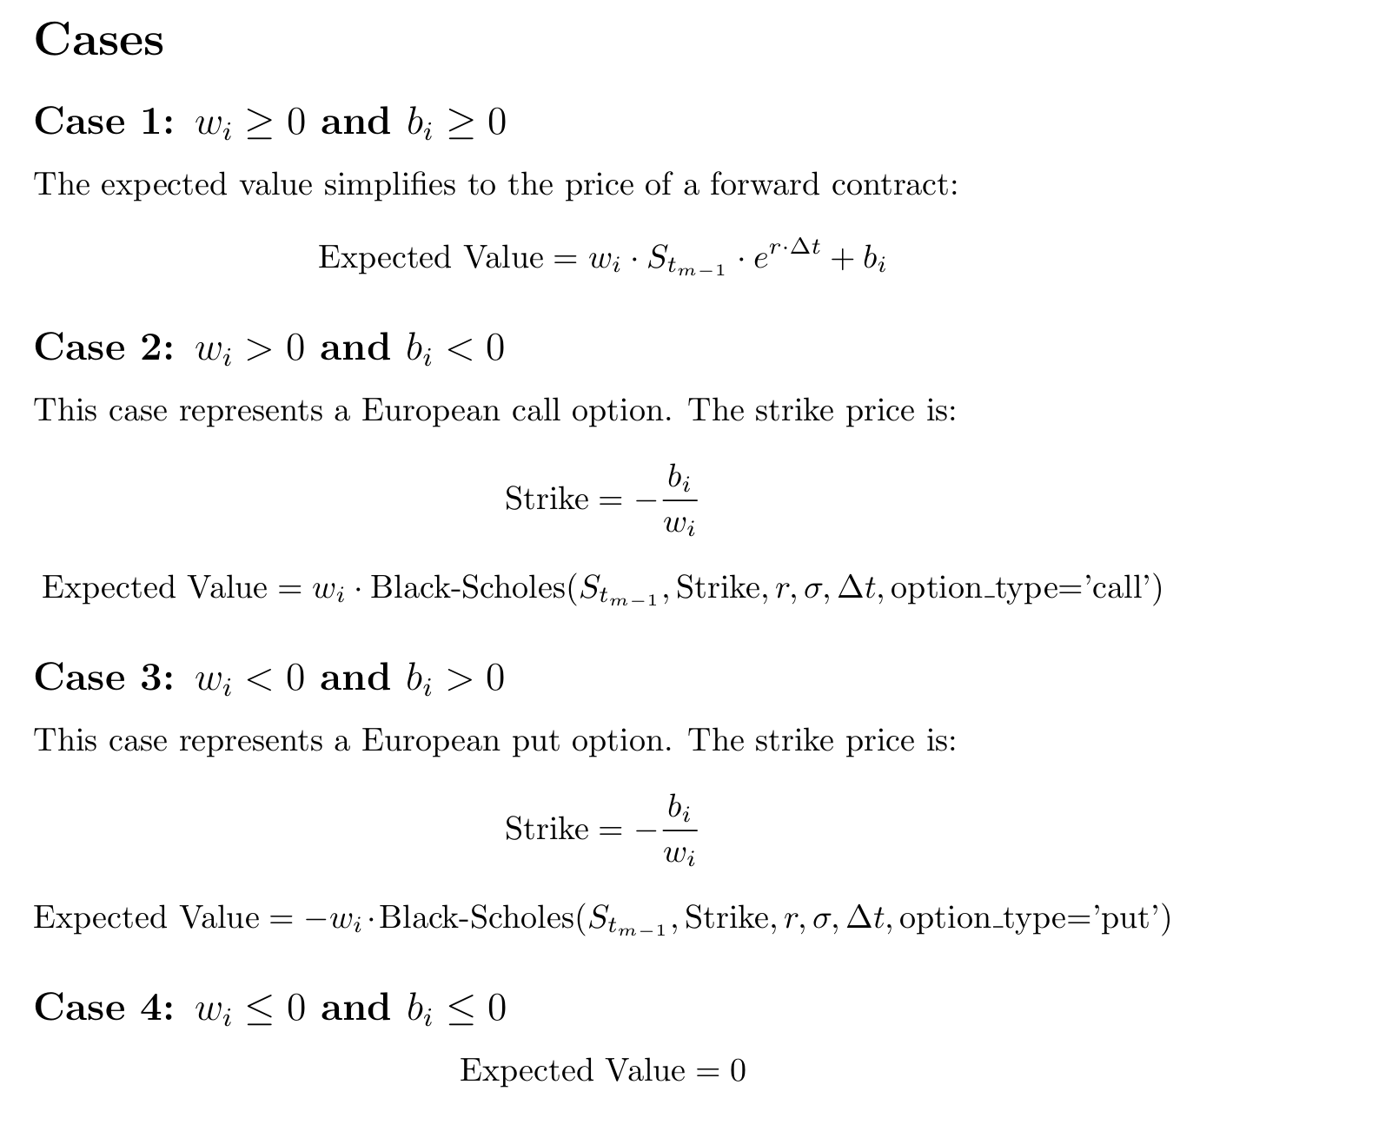
Expected value

Slide 12
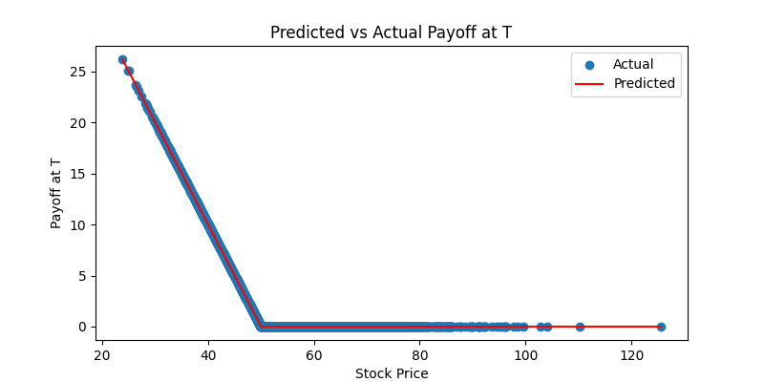
Initial Results

Slide 13
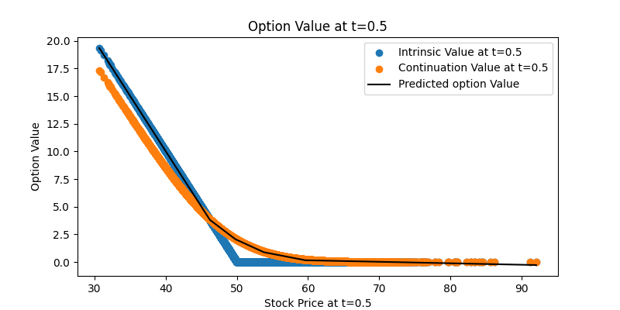
Initial Results

Slide 14
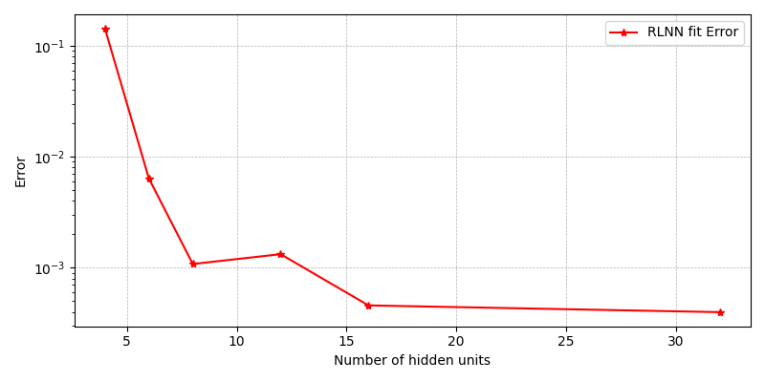
Hyperparameter tuning

Slide 15
Hyperparameter tuning

Slide 16
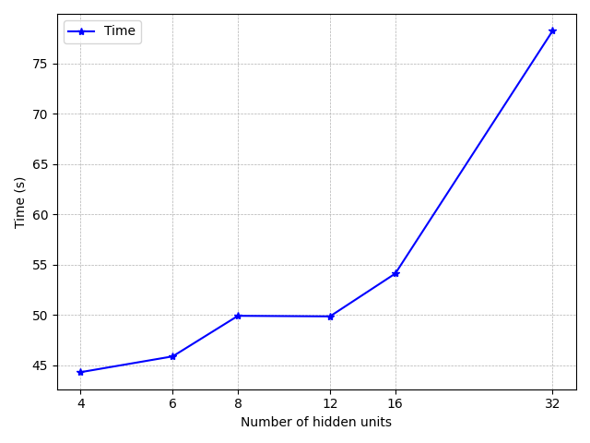
Hyperparameter tuning

Slide 17
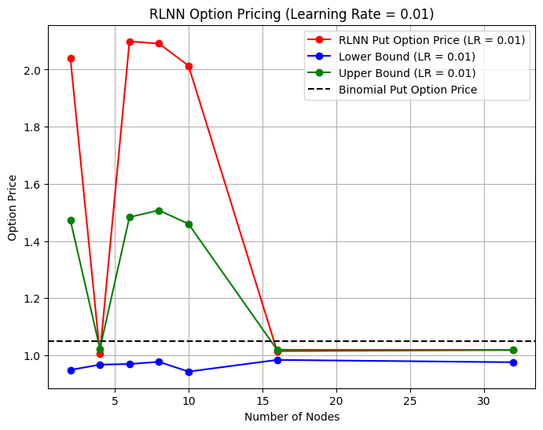
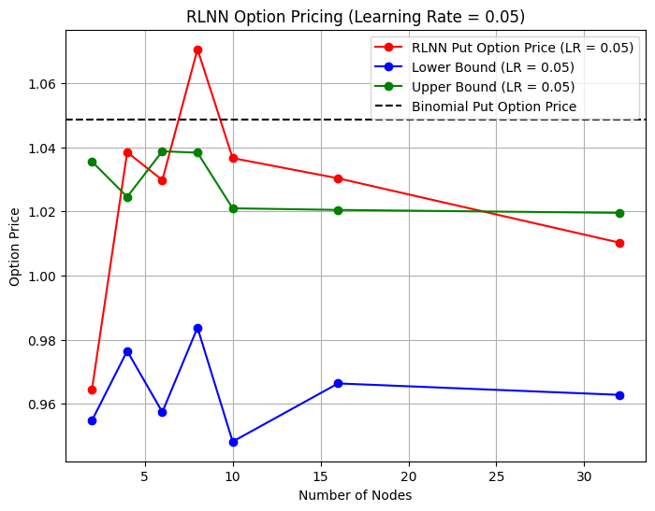
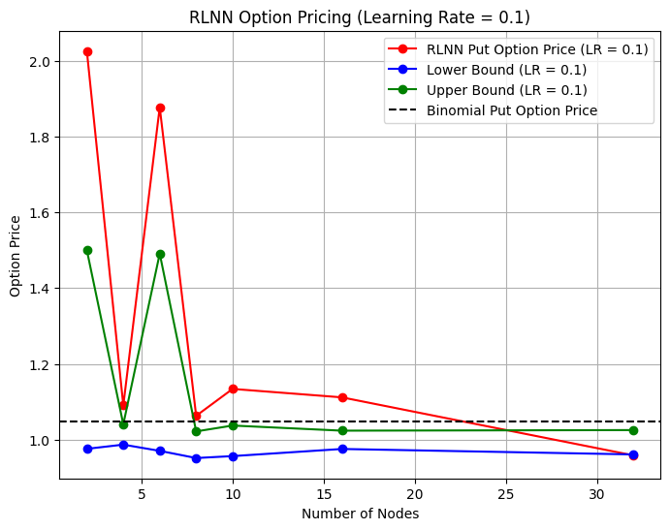
Hyperparameter tuning

Slide 18
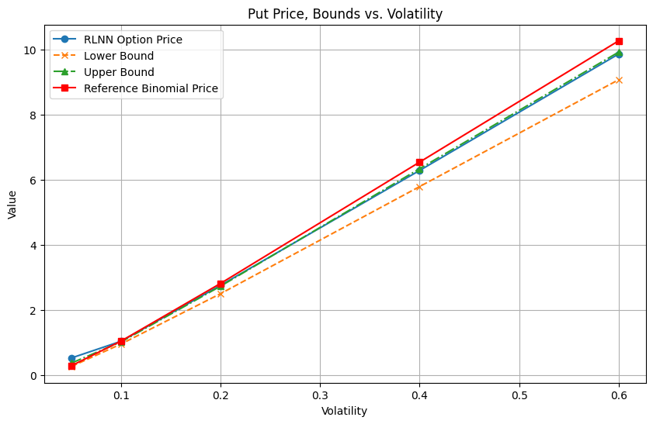
Results: Vega

Slide 19
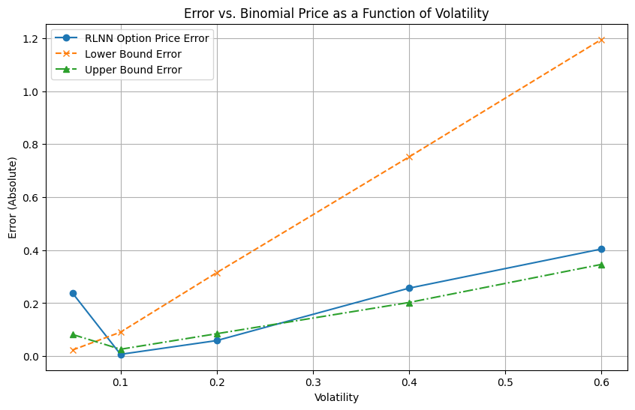
Results: Vega

Slide 20
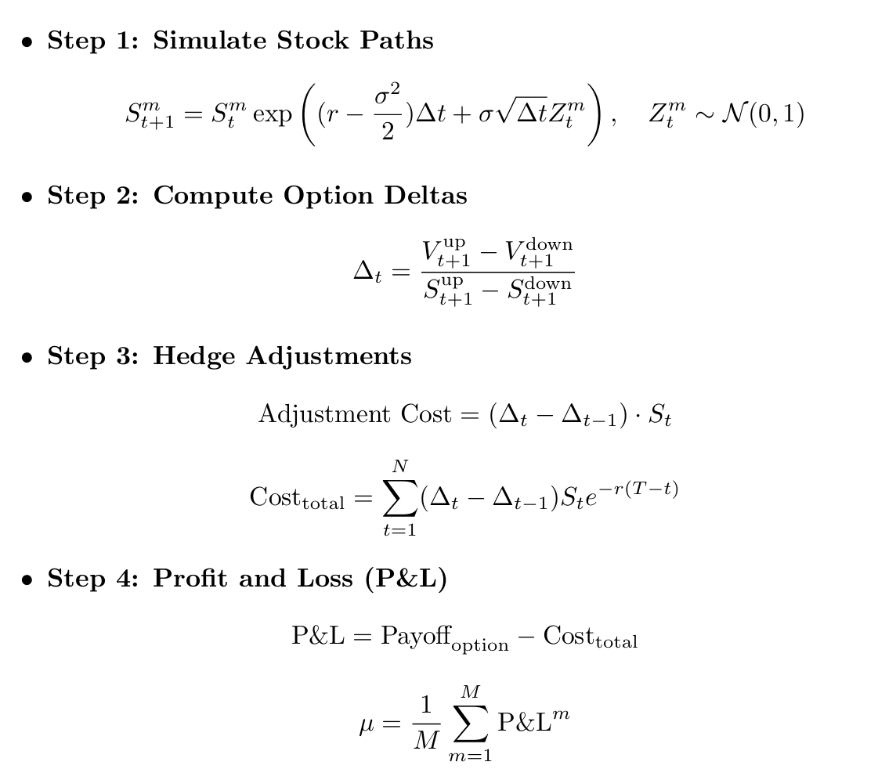


Delta Hedging

Slide 21

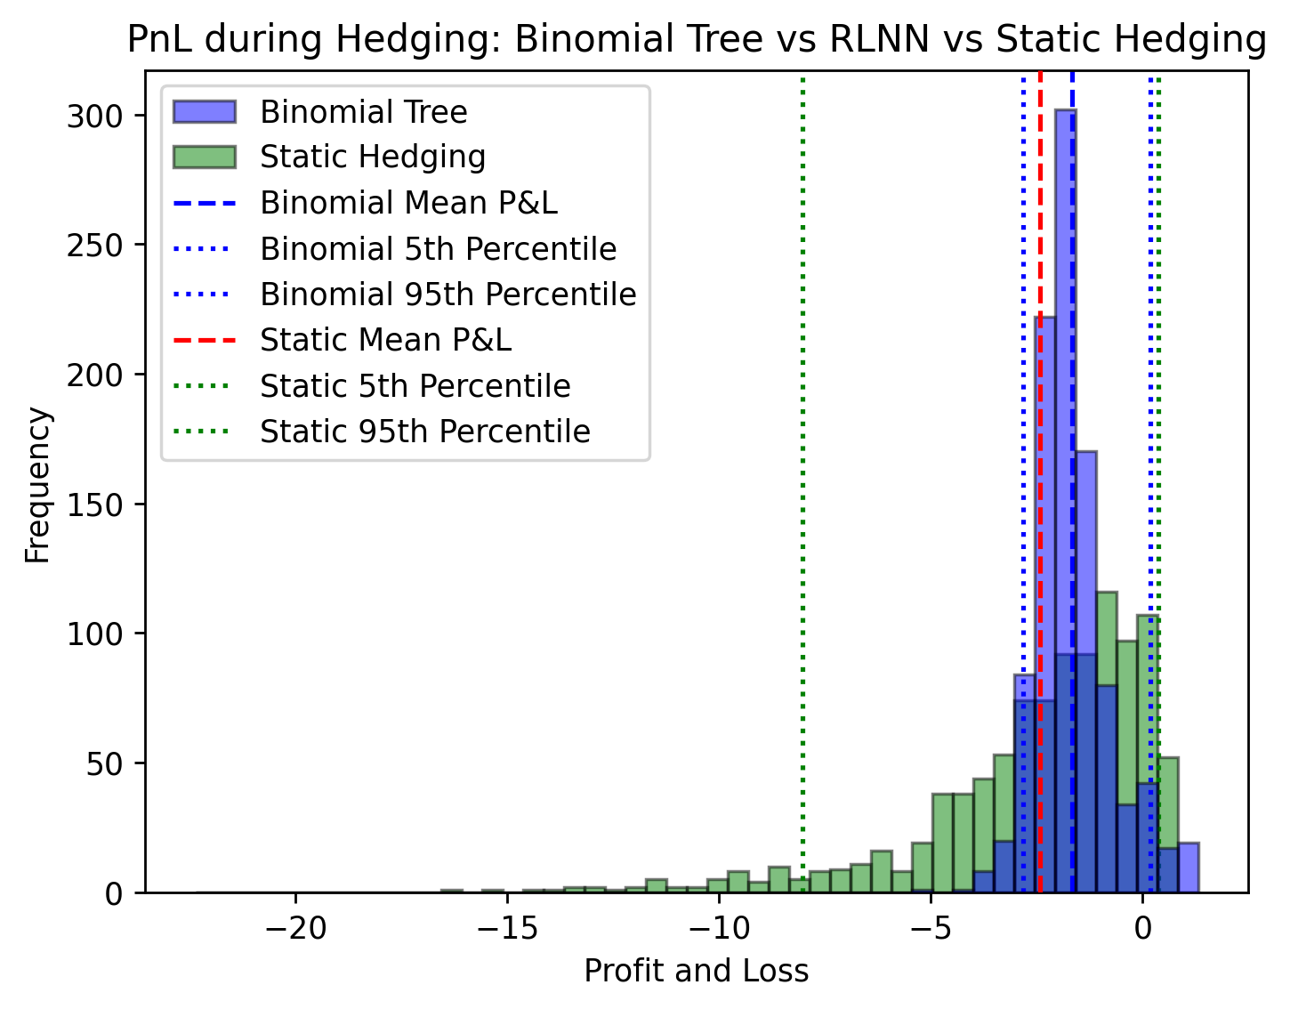
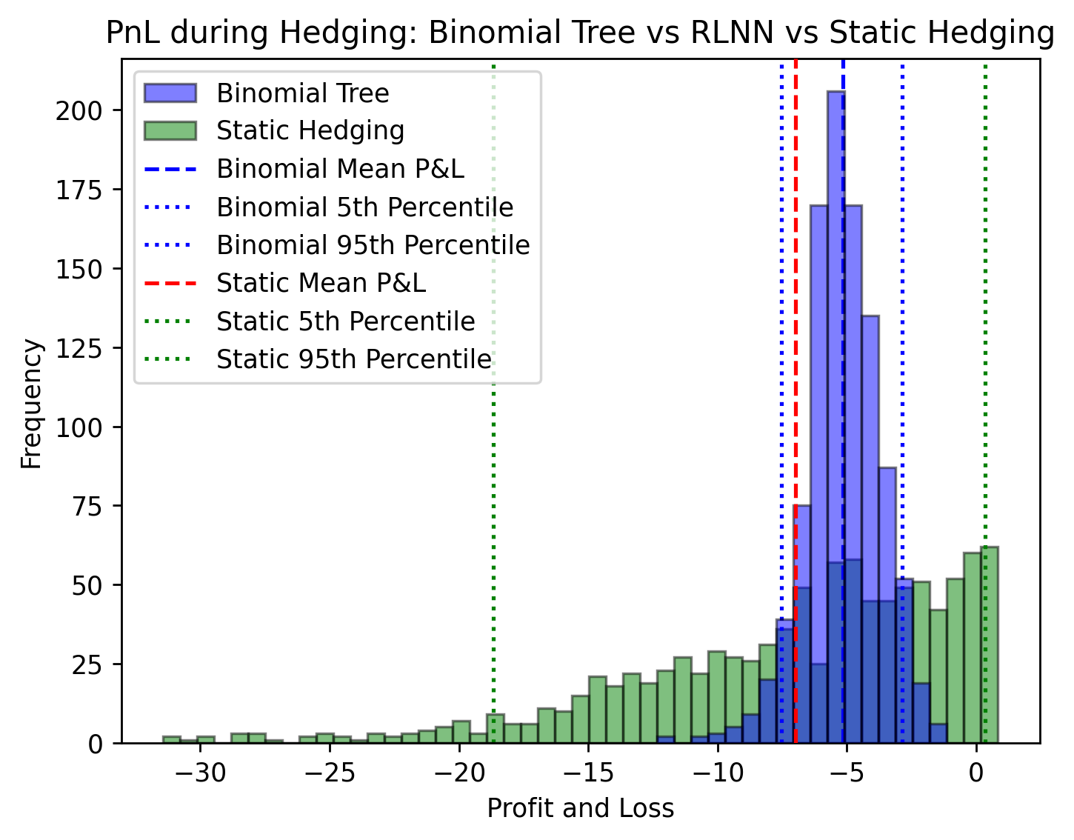
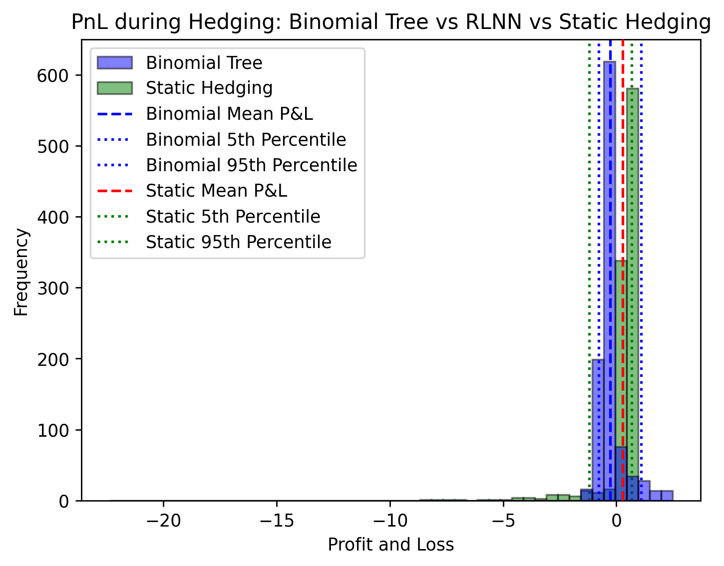

Results: Delta Hedging
Profit & Loss RLNN Statis Hedge vs. Binomial Tree Hedge
σ = 0.1
σ = 0.05
σ = 0.2

Slide 22
Extensions
Multi asset derivatives

Slide 23
Appendix: Further extensions if time allows
GPU implementation (inc. computational efficiency assessment)
Backtesting (assess feasibility of static hedge in practice)

Slide 24
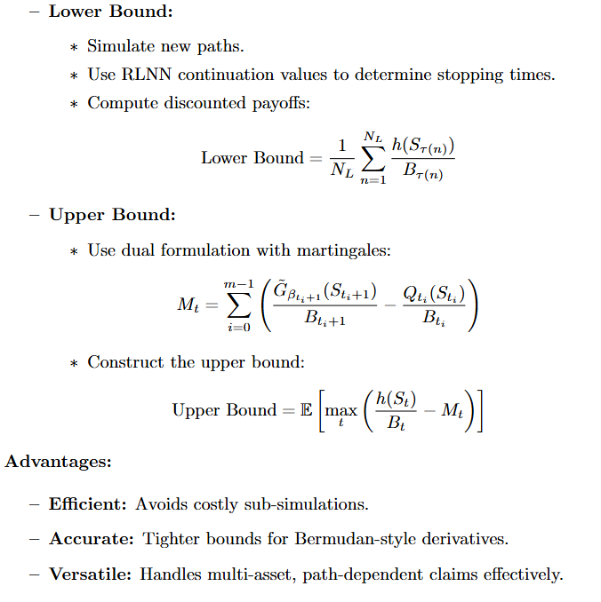
Appendix: Bounds Computation

Slide 25
References
[1] Lokeshwar, V., Bharadwaj, V., & Jain, S. (2022). Explainable neural network for pricing and universal static hedging of contingent claims. Applied Mathematics and Computation, 417, 126775.

