Slide 1
HACKATHON ChattyPDF
M. Sc Data Science
Dhivyadharshini B – 21PD06
Jaisubasri K – 21PD14
Nithish R – 21PD23

Slide 2
CONTENTS
Problem Statement
Ollama
LLM Model
Problem Approach
Payload Format

Slide 3
PROBLEM STATEMENT
Design and implement a chatbot system capable of ingesting and interpreting uploaded documents (e.g., PDFs) to provide accurate, fact-based responses quickly and reliably. The chatbot should utilize LLM APIs and other retrieval techniques.
Deliverables:
1. Responsive REST APIs connected with Simple UI
Good to have:
a. Support bulk upload and processing
b. Security by design
c. Improved User experience using UI and streaming APIs
d. Employ effective techniques (e.g., prompt engineering, context-verification, or
grounding) to prevent “hallucinations” by verifying that all responses directly
reference the source material.

Slide 4

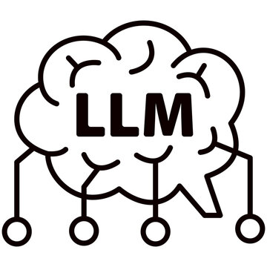


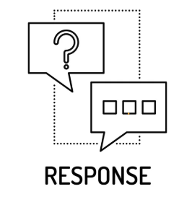


Slide 5

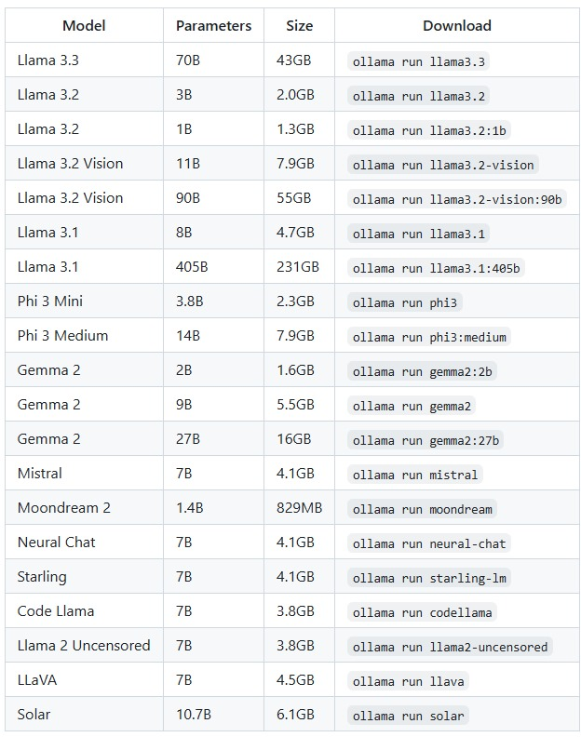
OLLAMA
With Ollama, developers can create highly responsive AI-driven chatbots that run entirely on local servers, ensuring that customer interactions remain private.
Running chatbots locally lets businesses avoid the latency associated with cloud-based AI solutions, improving response times for end users.
Ollama’s ability to run LLMs locally is also helpful in areas with limited or no internet access.
Example is integrating Ollama into customer relationship management (CRM) systems to enhance automation and data analysis, ultimately improving decision-making and customer insights.
CONCLUSION:
It lets us run LLMs locally and provides complete control over data privacy and security

Slide 6
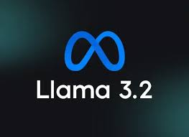
LLM MODEL
Model Information:
The Llama 3.2 instruction-tuned text only models are optimized for multilingual dialogue use cases, including agentic retrieval and summarization tasks.
They outperform many of the available open source and closed chat models on common industry benchmarks.
Llama 3.2 was pretrained on up to 9 trillion tokens of data from publicly available sources.
Model Developer: MetaModel
Architecture:
Llama 3.2 is an auto-regressive language model that uses an optimized transformer architecture. The tuned versions use supervised fine-tuning (SFT) and reinforcement learning with human feedback (RLHF) to align with human preferences for helpfulness and safety.
Llama 3.2 was pretrained on up to 9 trillion tokens of data from publicly available sources.
Supported Languages: English, German, French, Italian, Portuguese, Hindi, Spanish, and Thai are officially supported.

Slide 7
PROBLEM APPROACH
PDF Text Extraction
Tool Used: PyPDF2
Objective: Extract text content from multiple PDF documents.
Process:
The PyPDF2 library is used to read and extract text from PDF files.
The paths of the PDFs are retrieved and stored for processing.
Basic metadata such as title, author, and creation date of the PDF is also retrieved during this extraction process.
Processing with LLaMA Model (v3.2)
Tool Used: LLaMA 3.2 (a large language model)
Objective: Analyze and interpret the extracted PDF content.
Process:
The extracted text from the PDFs is sent to a locally hosted LLaMA model.
The model processes the content and provides insightful responses based on the questions posed by the user.

Slide 8
REST API Integration
Objective: Send and receive data between the Streamlit interface and the LLaMA model.
Process:
A REST API is set up to communicate with the LLaMA model.
The API receives the text and user queries, processes them through the model, and returns the generated responses.
Streamlit Interface
Objective: Create an interactive and intuitive UI for the user.
Process:
The interface is built using Streamlit, allowing users to upload PDFs, interact with the model, and view the results in real-time.
Users can input questions related to the extracted content, and the model will respond accordingly.

Slide 9
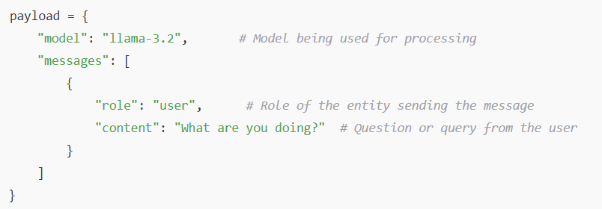
PAYLOAD FORMAT

Slide 10
Thank you
Any Questions?

