Slide 1

Doraemon_Explorer_Hub Phase-2
By-Nitanshi Agarwal

Slide 2

Project Description
Build an Angular application, the "Doraemon Explorer Hub," that caters to the curiosity of Doraemon fans by providing insights into their favorite characters, gadgets, and memorable scenes with the navigation featuring to redirecting the default page. Also applying the services and data comes from the httpclient so use the httpclient and webapifeatures.

Slide 3


What functionalities and components we required?
Nav bar
Characters Components:
Characters Details Components
Gadgets Components
Gadgets Details Component
Gallery Components
Message Service
Observable Events
Dependency Injection
Routing and Navigation
Error Handling
Http client
Web api
CRUD Operations

Slide 4
Web api
Nav-Bar(app)
Character
Gadget
Gallery
Message-detail
Add-detail
Search-detail
Message service
Character-detail
Gadget-detail
Data service
InmemoryWebApi

Slide 5
Learning Outcome
Routing and Navigation
Dependency Injection
Crud Operations
Different functionalities(pipe, async)

Slide 6
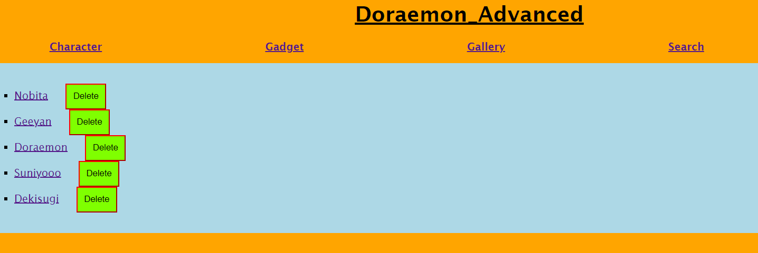
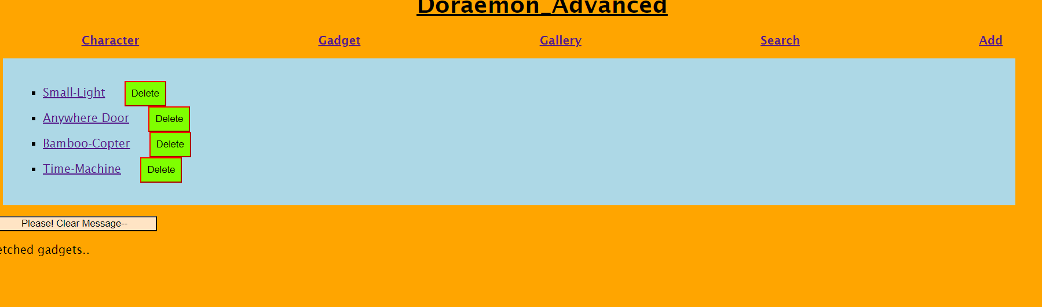

Slide 7
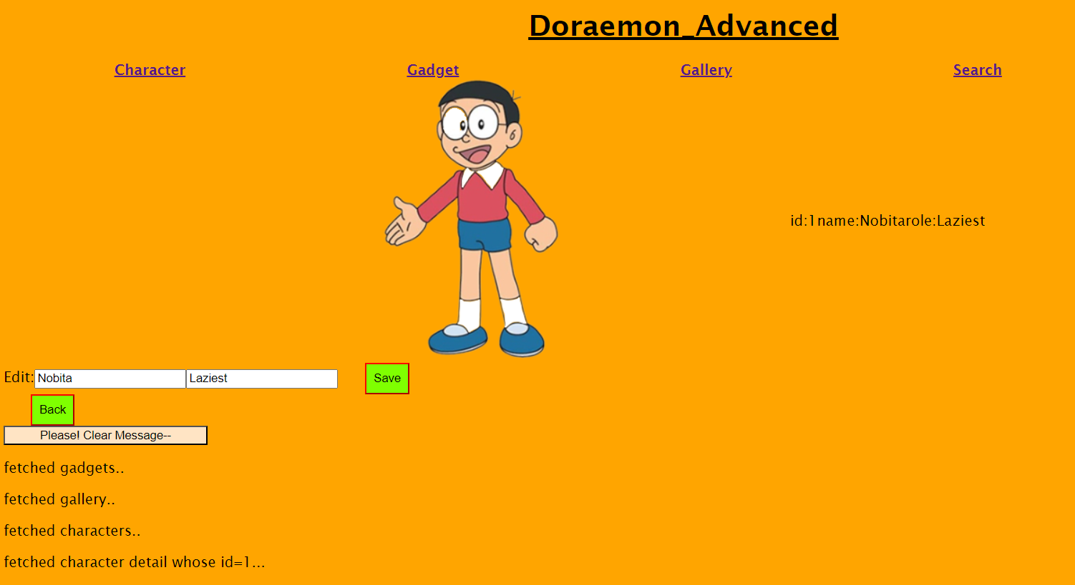

Slide 8
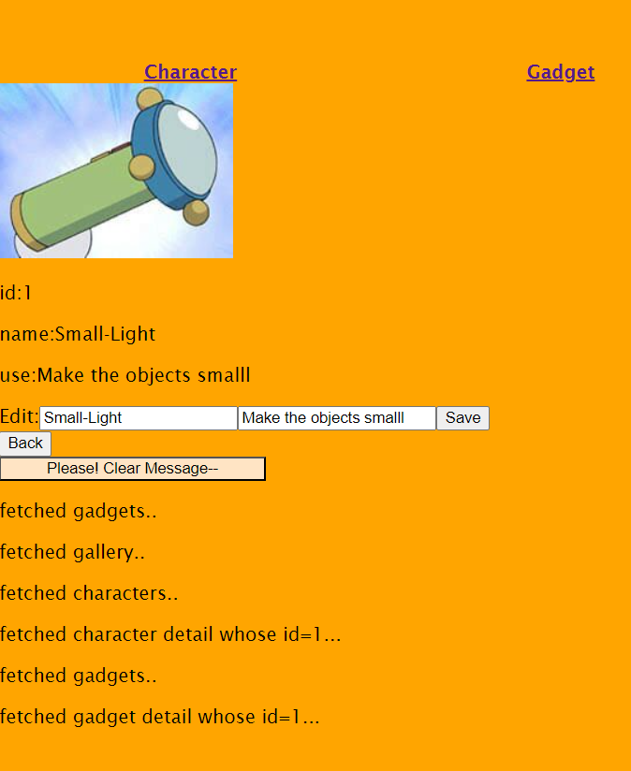

Slide 9

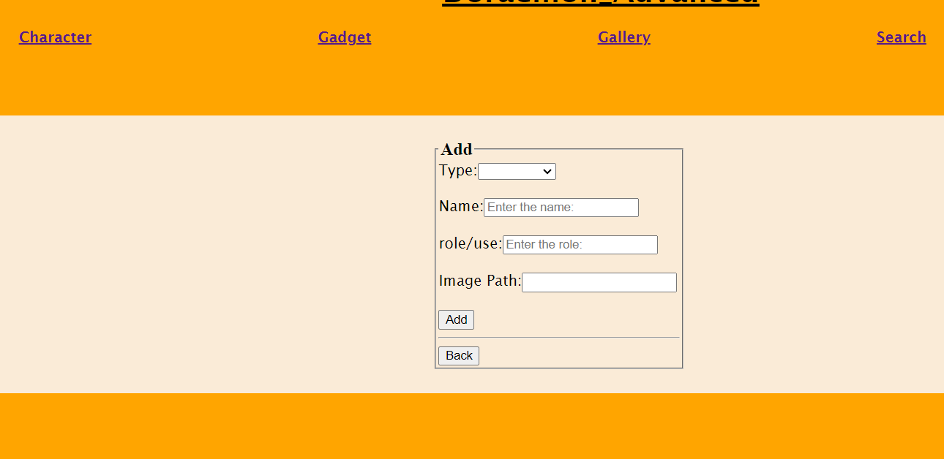
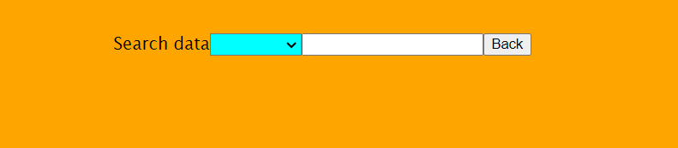


Slide 10

THANK YOU!

