Slide 1

Project Description
Build an Angular application, the "Doraemon Explorer Hub," that caters to the curiosity of Doraemon fans by providing insights into their favorite characters, gadgets, and memorable scenes with the navigation featuring to redirecting the default page. Also applying the services and data comes from the HttpClient so use the HttpClient and InMemoryWebAPI . Also implementing the CRUD operations which are necessary for add , update , and delete the details.

Slide 2


What functionalities and components we required?
Nav bar
Characters Component
Characters Details Component
Gadgets Component
Gadgets Details Component
Gallery Component
Message Service
Observable Events
Dependency Injection
Routing and Navigation
Error Handling
Http Client
Web API
CRUD Operations

Slide 3
Web api
PROJECT OVERVIEW
NAV_BAR
Character
Gadget
Gallery
Message-detail
Add-detail
Search-detail
Message service
Character-detail
Gadget-detail
Data service
InmemoryWebApi

Slide 4
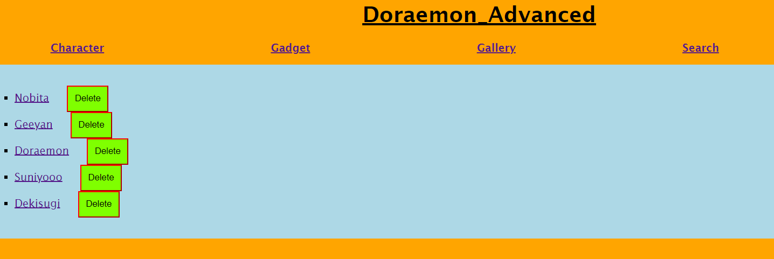
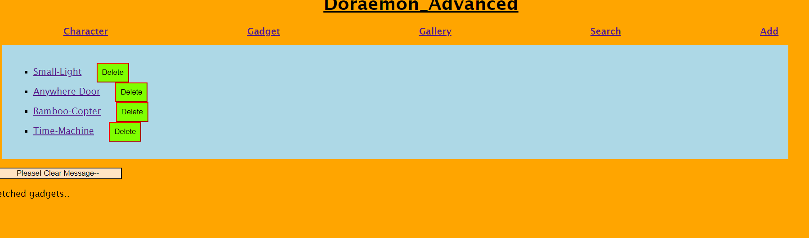

Slide 5
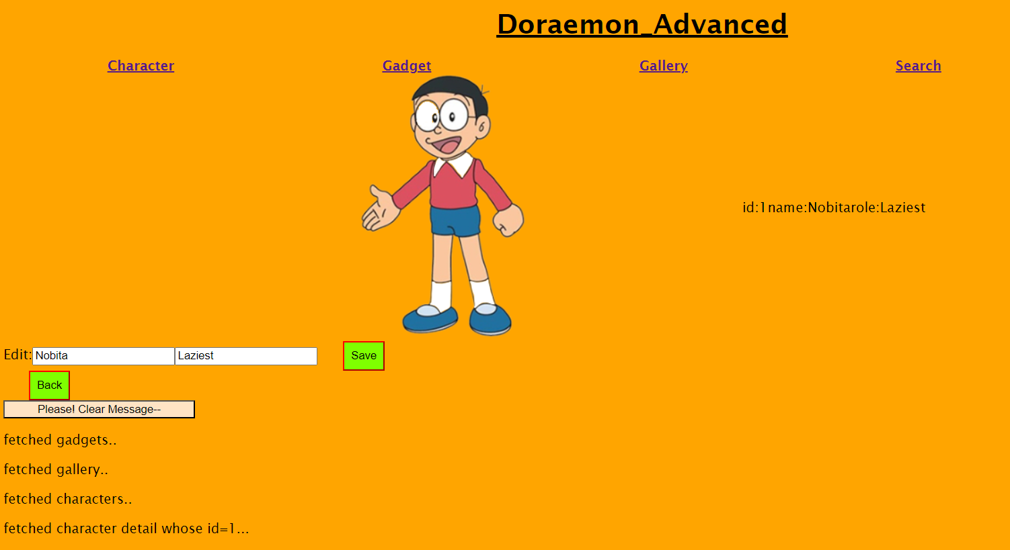

Slide 6
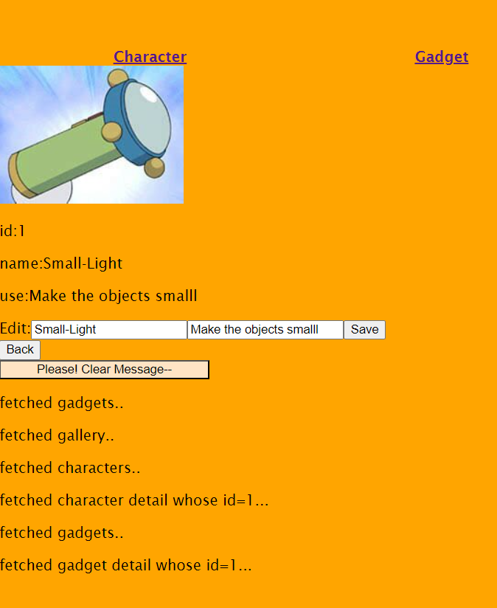

Slide 7

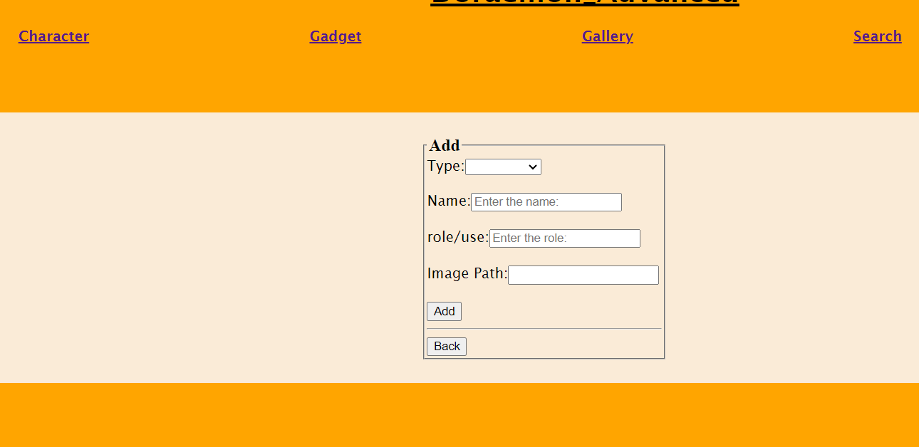
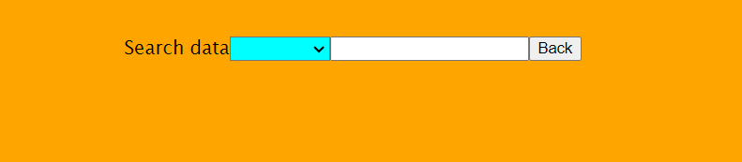


Slide 8
Learning Outcome
Routing and Navigation
Dependency Injection
Crud Operations
Different functionalities(pipe, async)

Slide 9

THANK YOU!

