Slide 1

DevOps Lifecycle
Understanding the Continuous Software Delivery Process
Plan Code Build
Test Release Deploy
Monitor
Assignment II | DevOps Engineering

Slide 2
The Problem with Traditional Development
Silos
No Feedback
Dev and Ops teams worked in complete isolation with separate goals
Teams had no visibility into how software performed in production
Slow Delivery
Manual Work
Software releases took weeks or months through manual handoffs
Repetitive tasks like testing and deployment done by hand
Late Failures
Blame Culture
Bugs discovered only after deployment — expensive to fix
When things broke, teams blamed each other instead of fixing root causes
These bottlenecks created a need for a new, integrated approach to software delivery.

Slide 3



What is DevOps?
DevOps is a set of practices, cultural philosophies, and tools that combines software development (Dev) and IT operations (Ops) to shorten the software development lifecycle and deliver high-quality software continuously.
Culture
Automation
Measurement
Sharing
Shared ownership, collaboration between Dev and Ops
CI/CD pipelines reduce manual effort and human error
Metrics and monitoring drive continuous improvement
Knowledge and tooling shared across the entire team

Slide 4
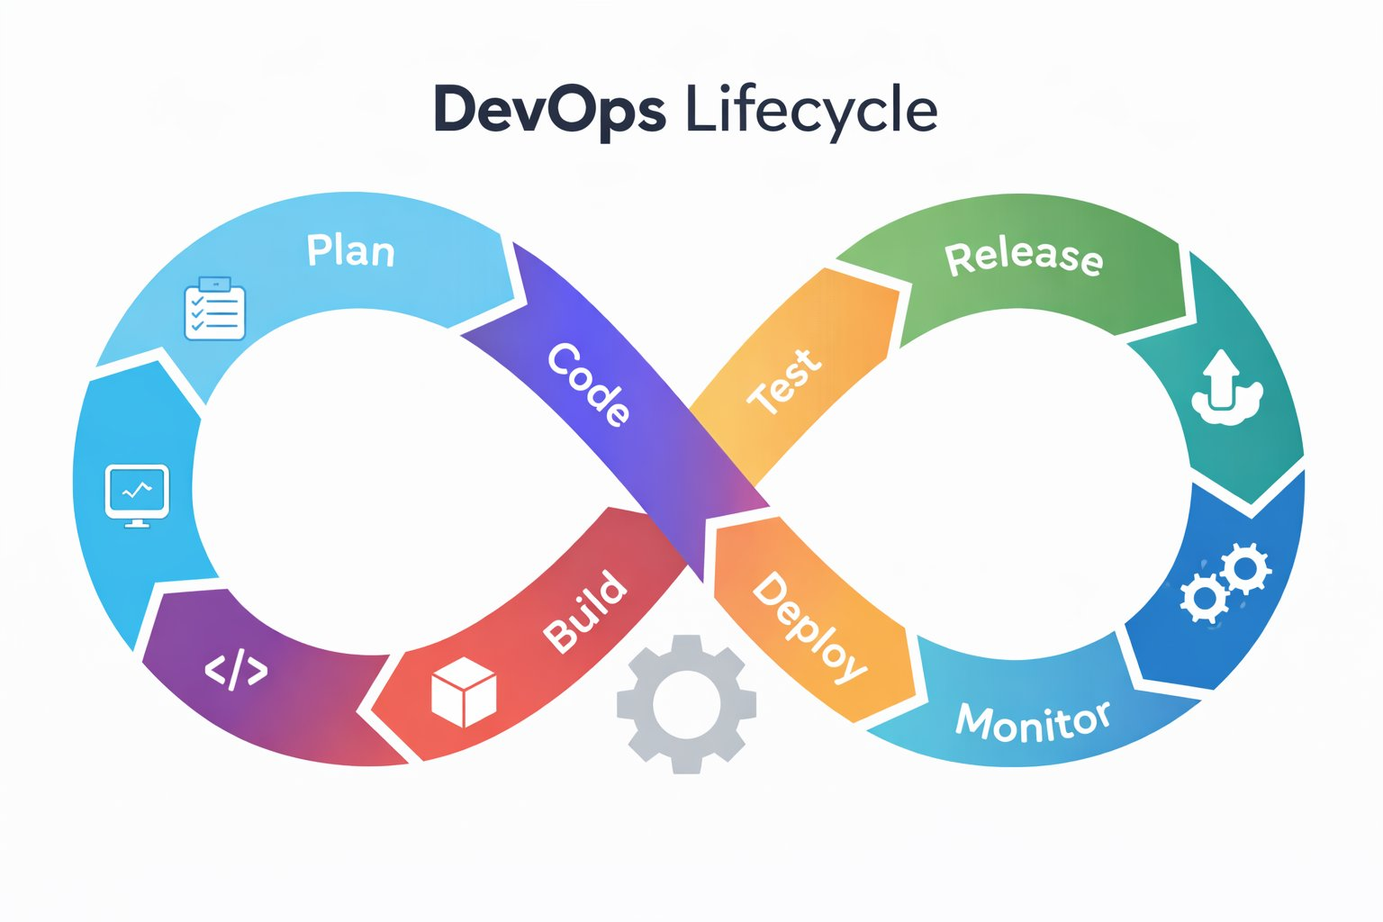
The DevOps Lifecycle
A continuous, feedback-driven loop of eight interconnected stages

Slide 5
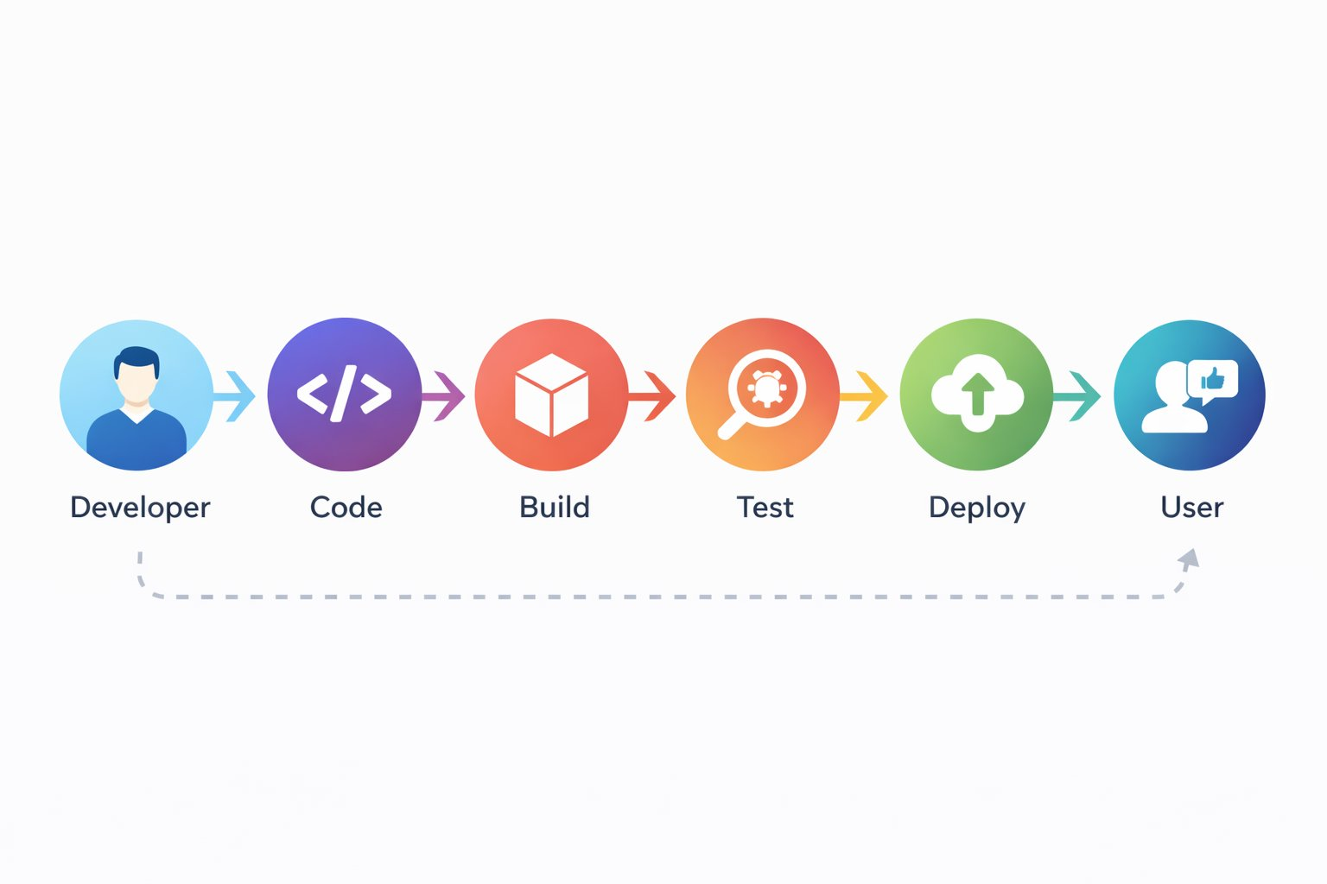
Developer to User — The Flow
Every code change travels through a structured pipeline before reaching the end user
The dashed feedback arrow represents continuous improvement — user feedback informs the next planning cycle.

Slide 6




Lifecycle Stages — Development Side
01 Plan
02 Code
03 Build
04 Test
Teams define features, user stories, and sprint goals using tools like Jira or Trello. Clear requirements prevent rework downstream.
Developers write and commit code to version-controlled repositories. Peer reviews and branching strategies maintain quality.
Source code is compiled, dependencies resolved, and artifacts created. Build automation tools like Maven or Gradle handle this step.
Automated test suites — unit, integration, and regression — validate the build. Defects are caught here, not in production.

Slide 7



Lifecycle Stages — Operations Side
05 Release
06 Deploy
07 Operate
08 Monitor
Tested artifacts are packaged and prepared for deployment. Approval gates and release notes ensure stakeholder alignment.
Infrastructure-as-Code tools like Terraform provision environments. Containers and orchestration platforms enable consistent deployments.
The system runs in production. On-call teams manage incidents, perform capacity planning, and handle routine operations.
APM tools like Datadog or Prometheus track latency, error rates, and throughput. Alerts are triggered on anomalies.

Slide 8
Real-World Scenario: Swiggy's Live Order Tracking
Scenario: A product manager notices that customers are abandoning orders mid-delivery because they cannot see real-time tracking updates. The engineering team is tasked with shipping a redesigned tracking feature within 5 days.
PM defines requirements in Jira — GPS polling intervals, UI components, edge cases for delivery delays.
Automated tests simulate 10,000 concurrent tracking sessions; a crash bug is found and fixed before release.
Plan
Test
Developers build the tracking service in a feature branch, enabling code review before merging to main.
The feature is deployed to 2% of users via a canary release — not all 8 crore users at once.
Code
Deploy
Jenkins compiles the backend service and bundles the React Native UI in under 3 minutes.
Datadog alerts fire when p99 latency spikes. Engineers roll back one microservice and the issue resolves in 4 minutes.
Build
Monitor

Slide 9
Why DevOps Delivers Business Value
46x
440x
96x
5x
More frequent software deployments
Faster lead time from commit to deploy
Faster mean time to recover from failure
Lower change failure rate
Source: DORA State of DevOps Report
Speed
Reliability
Scalability
Collaboration
Automated pipelines ship features in hours, not weeks. Rapid iteration keeps products competitive.
Smaller, frequent releases reduce deployment risk. Automated rollbacks prevent prolonged outages.
Infrastructure-as-Code enables repeatable environments that scale without manual configuration.
Shared tooling and on-call responsibilities break down the wall between Dev and Ops teams.

Slide 10
The Engine of DevOps: CI/CD
Continuous Integration
Continuous Delivery
Continuous Deployment
Developers merge code to a shared branch multiple times a day
Each merge triggers an automated build and test sequence
Problems are caught within minutes, not after weeks of divergence
Tools: GitHub Actions, Jenkins, GitLab CI
Every passing build is automatically packaged and ready to release
Deployment to staging is fully automated; production requires manual approval
Teams can release on any day, at any time, with confidence
Tools: Spinnaker, AWS CodePipeline, Harness
Every passing build is automatically deployed to production with no manual step
Used by organizations with high test coverage and mature monitoring
Netflix deploys thousands of times per day using this model
Tools: Argo CD, Flux, Kubernetes GitOps

Slide 11
Monitoring — The Heartbeat of DevOps
Monitoring converts operational data into actionable improvements. Without it, the lifecycle cannot close.
Key Metrics to Track
Closing the Feedback Loop
Latency
1
Detect
How long requests take. High latency directly correlates with user abandonment.
Monitoring alerts fire when a metric crosses a defined threshold.
Error Rate
2
Triage
Percentage of requests that fail. A spike often signals a bad deployment.
On-call engineers investigate using dashboards and distributed traces.
Throughput
3
Respond
Requests processed per second. Drops indicate infrastructure or code problems.
A fix is deployed or a rollback is triggered through the same pipeline.
Saturation
4
Improve
How full a resource is — CPU, memory, disk. Predicts when systems will fail.
Post-incident reviews feed learnings back into the Plan stage as backlog items.

Slide 12
Traditional Development vs DevOps
Aspect
Traditional
DevOps
Deployment Cycle
Weeks to months
Hours to days
Team Structure
Separate Dev and Ops silos
Cross-functional, shared ownership
Testing
Manual, done at end of cycle
Automated, continuous throughout
Feedback
Post-release feedback only
Real-time monitoring and fast iteration
Infrastructure
Manually provisioned servers
Infrastructure-as-Code, fully automated
Failure Handling
Long investigation and hotfixes
Automated rollbacks, blameless post-mortems

Slide 13
Team Contributions
Member 1
Member 2
1
Research Lead
2
Content Author
Literature review, source collection, identifying real-world case studies and DORA metrics.
Writing slide narratives, scenario construction, stage-by-stage lifecycle explanations.
Member 3
Member 4
3
Visual Designer
4
Presenter
Slide layout, diagram integration, color palette, and formatting consistency.
Verbal delivery, Q&A preparation, final rehearsal coordination.

Slide 14
References
Forsgren, N., Humble, J., & Kim, G. — Accelerate: The Science of Lean Software and DevOps
1
Book / DORA Research
Foundational research on high-performing DevOps teams. Presents the DORA metrics framework used to quantify delivery speed and stability. Novel insight: uses survey-based research at scale to prove causal links between technical practices and organizational outcomes.
AWS — What is DevOps? (aws.amazon.com/devops/what-is-devops)
2
Official Documentation
Authoritative cloud-vendor perspective on DevOps principles and tooling. Covers CI/CD, microservices, infrastructure-as-code, and monitoring. Depth: practitioner-level with architecture diagrams. Useful for linking lifecycle theory to real cloud implementations.
Microsoft Learn — DevOps Resource Center (learn.microsoft.com/devops)
3
Official Documentation
Comprehensive learning path covering DevOps culture, practices, and Azure-specific tooling. Novel insight: includes enterprise adoption paths and maturity models. Depth: from beginner conceptual overview to advanced pipeline design.
Google Cloud — DORA State of DevOps Report 2023
4
Industry Research Report
Annual industry survey tracking DevOps performance metrics across thousands of organizations globally. Used for deployment frequency and MTTR statistics cited in this presentation. Depth: quantitative analysis with industry benchmarks and trend data.

