Slide 1

Topic 1
DevOps Overview
and Evolution
Traditional
From Traditional Development to Modern DevOps Practices
Agile
DevOps
This presentation was originally prepared for Topic 5 (DevOps Lifecycle). Upon clarifying the assignment allocation, it has been rebuilt for the assigned topic - DevOps Overview and Evolution - with fully original content, a scenario-based example, and all required diagrams.
Name: Nitanshu Tak
Batch: 2 CCVT SapID: 500121943
Assignment II | DevOps Engineering

Slide 2
The World Before DevOps
Understanding the pain points of traditional software development
1
Requirements
Business teams wrote extensive specs, often taking months before any code was written.
2
Design
Architects produced technical documents in isolation, with little input from developers.
3
Development
Developers coded for weeks or months, never testing against production-like environments.
4
Testing
A separate QA team received the finished build and discovered hundreds of bugs at once.
5
Deployment
Operations teams manually configured servers and pushed releases — often on a Friday night.
This linear, sequential model — Waterfall — meant any late-stage change required restarting the entire process.

Slide 3






Core Problems — Why Traditional Development Failed
Six systemic failures that made software delivery slow, risky, and expensive
Organizational Silos
Slow Release Cycles
Dev and Ops teams had separate managers, separate goals, and separate incentives. Developers were rewarded for shipping features; Ops for keeping systems stable. These goals were fundamentally at odds.
Annual or quarterly releases were the norm. By the time software reached users, market conditions had changed and competitors had moved ahead. Feedback arrived far too late to course-correct.
Late Defect Discovery
Manual, Error-Prone Ops
Bugs accumulated throughout development but were only caught during a final testing phase, weeks after the code was written. Fixing them meant revisiting forgotten context and often introduced new bugs.
Server provisioning, deployment scripts, and environment configuration were all done by hand. A single misconfiguration could take down an entire production system.
No Shared Accountability
Rigid to Change
When production issues occurred, teams blamed each other. Operations blamed developers for bad code; developers blamed operations for poor infrastructure. No one owned the outcome together.
Customer feedback discovered post-release could not be incorporated quickly. Requirements evolved, but the process did not. Entire project plans had to be renegotiated for small changes.

Slide 4
Agile — The First Step Toward Speed
Agile addressed development speed, but left the deployment problem unsolved
What Agile Changed
What Agile Left Unsolved
Iterative Development
Deployment Still Manual
Work was broken into 2–4 week sprints. Software was built and reviewed incrementally rather than as one massive release.
Agile produced working software every sprint, but getting it into production still required manual handoffs to Operations teams who were entirely separate.
Cross-functional Teams
No Shared Infrastructure
Developers, testers, and product managers sat together and communicated daily through stand-ups and retrospectives.
Developers built code on laptops; Ops managed production servers. Environments were different, so 'it works on my machine' was a genuine problem.
Customer Collaboration
Testing Often an Afterthought
Working software was demonstrated to stakeholders every sprint. Feedback was incorporated in the next cycle, not the next year.
Automated testing was recommended by Agile but rarely enforced. Many teams still relied on end-of-sprint manual QA cycles.
Adaptive Planning
Ops Not in the Sprint
Roadmaps could change sprint-to-sprint based on new information, rather than being locked in a requirements document from month one.
Operations was only involved at release time. They had no context on what changed or why, making troubleshooting slow and frustrating for everyone.

Slide 5
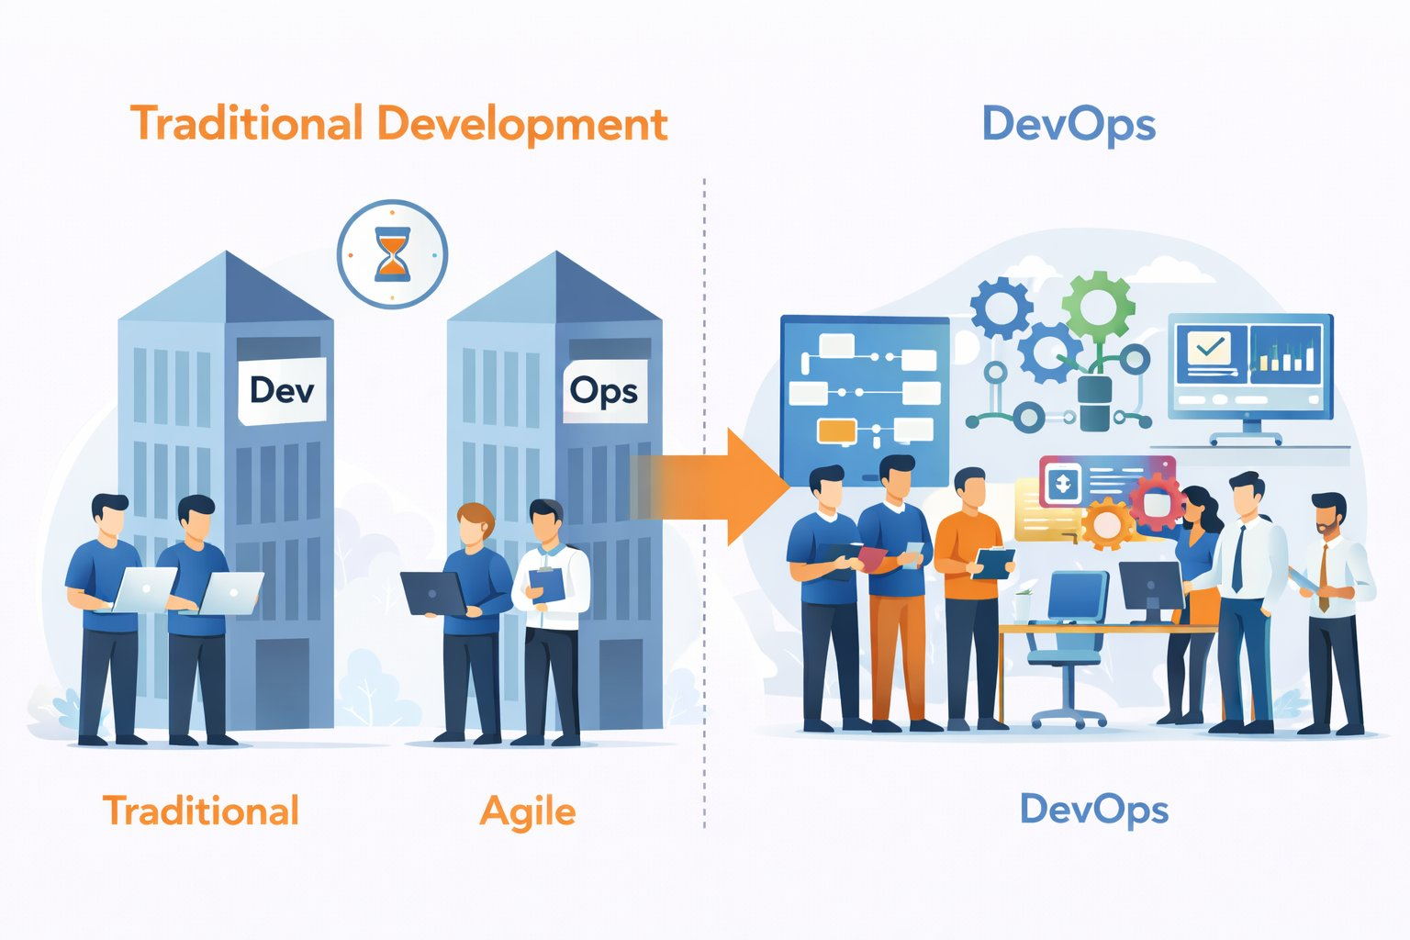
The Evolution of Software Development
Three paradigm shifts, each solving the failures of what came before
Each stage emerged from genuine failure: Waterfall's rigidity drove Agile adoption; Agile's deployment gap drove DevOps. Evolution was never theoretical - it was forced by industry pain.

Slide 6
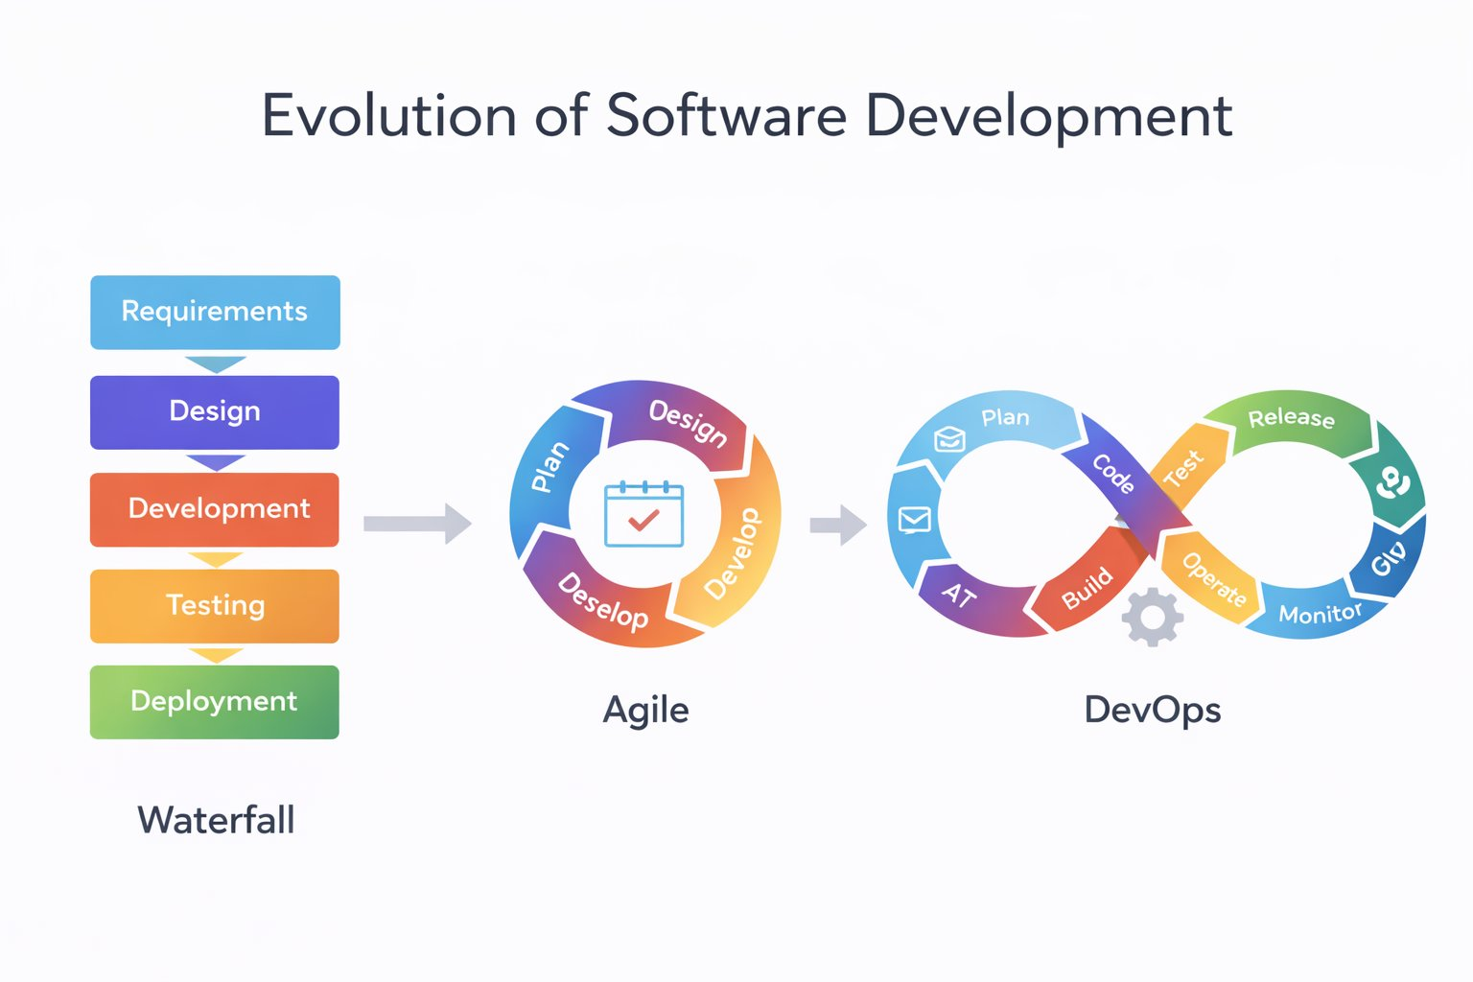
Traditional, Agile, and DevOps — Side by Side
The illustration captures how team structure and tooling transformed across each era
Left: isolated Dev and Ops buildings with a time bottleneck. Right: a unified cross-functional team collaborating on shared tooling, pipelines, and dashboards.

Slide 7
What is DevOps?
A culture, a set of practices, and a toolchain - not a product or a job title
DevOps is the union of people, process, and technology to continuously deliver value to customers. It bridges the gap between software development and IT operations through shared ownership, automated pipelines, and a culture of continuous improvement — enabling organizations to build, test, and deploy software reliably and at speed.
Culture
Automation
Measurement
Sharing
Shared ownership of the entire software delivery lifecycle. Developers and Operations teams are jointly accountable for reliability.
Repetitive tasks — building, testing, deploying — are automated through CI/CD pipelines, eliminating human error and reducing cycle time.
Every decision is informed by data. Teams track deployment frequency, lead time, failure rate, and recovery time as core performance indicators.
Knowledge, tooling, and post-incident learnings are shared openly across teams, creating a continuously improving system rather than isolated expertise.
DevOps is not a role you hire for - it is a way of working that entire engineering organizations adopt.

Slide 8
DevOps Core Principles
The five practices that separate high-performing DevOps teams from the rest
Continuous Integration
01
Every code commit triggers an automated build and test sequence. Integration problems are caught within minutes rather than discovered weeks later during a merge conflict crisis.
Continuous Delivery
02
Software is always in a deployable state. The pipeline ensures every change that passes automated tests can be released to production at any time, with a single command.
Infrastructure as Code
03
Servers, networks, and environments are defined in version-controlled configuration files. Any environment can be reproduced exactly, eliminating the 'works on my machine' problem permanently.
Monitoring and Observability
04
Every deployed system emits metrics, logs, and traces. Teams detect and understand production failures before users report them, and use data to drive improvement decisions.
Feedback Loops
05
Insights from production monitoring feed directly back into the planning process. Each iteration incorporates what was learned in production, creating a continuously improving system.

Slide 9
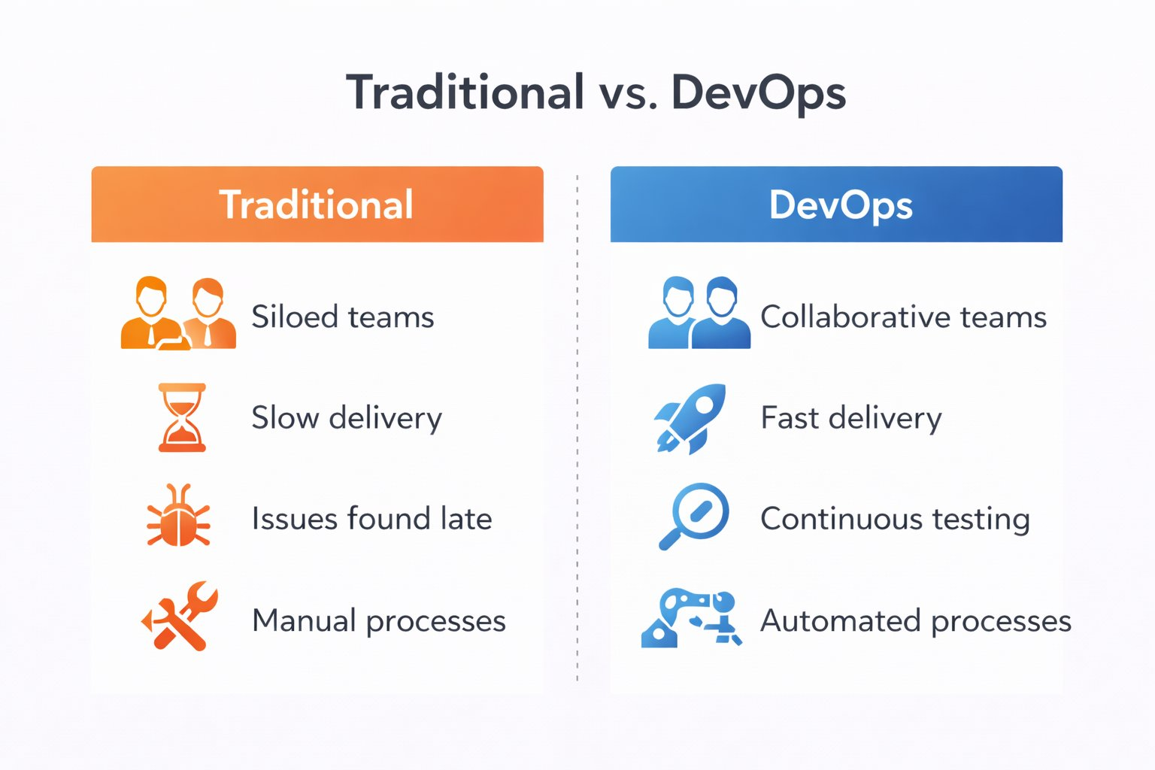
Traditional vs DevOps — Key Contrasts
Four dimensions where DevOps fundamentally changes how software is delivered
Team Structure
Siloed teams optimize for their own goals. Collaborative teams own outcomes together — if production breaks at 2am, both Dev and Ops fix it together.
Delivery Speed
Waterfall delivers in months; Agile in weeks; DevOps in hours. Each acceleration was enabled by removing a manual handoff from the process.
Quality
Late testing finds bugs expensively. Continuous testing catches defects at the point of introduction — when context is fresh and the fix is cheap.
Automation
Manual processes scale linearly with team size. Automated pipelines scale infinitely. One engineer can ship to a million users with the same pipeline as ten users.

Slide 10
Comparison at a Glance
Six dimensions that illustrate why DevOps replaced traditional approaches in high-performing teams
Dimension
Traditional Development
DevOps
Team Structure
Dev and Ops as separate departments
Unified, cross-functional squads
Release Frequency
Monthly, quarterly, or annual cycles
Multiple times per day
Testing Approach
Manual QA at the end of the project
Automated, continuous throughout
Deployment Process
Manual configuration by Ops team
Scripted, automated pipelines
Customer Feedback
Available only after full release
Real-time via monitoring and A/B tests
Failure Response
Blame, long investigation, hotfixes
Blameless post-mortems, fast rollbacks

Slide 11
Real-World Scenario: Zomato's Rating System Overhaul
Scenario: Zomato's restaurant rating algorithm was outdated — it weighted one-star reviews and five-star reviews equally, causing good restaurants to appear alongside poorly-rated ones. The product team needed to replace the algorithm and redesign the rating display without taking the app offline or disrupting 15 million daily active users.
Traditional Approach — What Would Have Happened
DevOps Approach — What Actually Happened
Planning (6 weeks)
Sprint Planning (2 days)
Business analysts wrote a full requirements document and got sign-off from three departments before any development started.
Product, Dev, and Ops aligned in one session. Story written, acceptance criteria defined, pipeline updated to include new test scenarios.
Development (3 months)
Feature Flags (week 1)
Three separate dev teams built components in isolation. No shared environments — each team used different test datasets.
Engineers built the new algorithm behind a feature flag — invisible to users, testable in production with synthetic data.
Handoff to QA (3 weeks)
Canary Deployment (week 2)
QA received the build and found 140 bugs. Developers had moved on to new sprints and had to context-switch back.
Algorithm activated for 1% of users. Real behavior monitored with Grafana. No issues. Expanded to 10%, then 25%, then 100% over 5 days.
Deployment (2 days)
Automated Rollback Ready
Operations manually provisioned new servers, ran migration scripts, and monitored logs. The app was down for 4 hours during the cutover.
If p99 latency exceeded 200ms or error rate crossed 0.5%, the pipeline was configured to automatically roll back within 90 seconds.
Outcome
Outcome
Total time: 6 months. Rating system launched with several edge-case bugs that only appeared under real traffic. Users noticed before monitoring did.
Total time: 11 days. Zero downtime. The new rating system outperformed the old one within a week based on user engagement data.
6 months vs 11 days. Zero downtime vs 4-hour outage. The only difference was how the two teams chose to work.

Slide 12
Business Value of DevOps
Why organizations invest in DevOps - measured outcomes, not promises
208x
106x
2,604x
7x
More frequent deployments than low performers
Faster lead time from commit to production
Faster mean time to restore after failure
Lower change failure rate in production
Source: DORA State of DevOps Report - based on over 32,000 survey responses from engineering professionals globally.
Speed to Market
Improved Reliability
Developer Productivity
Customer Satisfaction
CI/CD pipelines compress weeks of manual work into hours. Competitive advantage comes from shipping a tested feature before a competitor ships anything.
Smaller, frequent changes are less risky than large quarterly releases. Automated rollbacks mean failures are fixed in minutes, not hours.
Automated pipelines remove toil. Engineers spend time solving problems rather than manually configuring environments or waiting for QA sign-off.
Faster iteration means customer feedback gets incorporated in days. Products improve continuously rather than waiting for the next annual release.

Slide 13
DevOps Across the Industry - Who Does It and How
Real adoption patterns from organizations at different stages of DevOps maturity
Amazon
Advanced
Deploys to production every 11.7 seconds on average
Thousands of small autonomous services (microservices), each owned by a two-pizza team. Fully automated pipelines. No release windows — any engineer can ship any time.
Netflix
Advanced
Runs 700+ microservices, deploys hundreds of times daily
Pioneered chaos engineering — deliberately injecting failures in production to test resilience. Feature flags allow A/B testing on millions of users simultaneously.
Flipkart
Advanced
Handles 8 million+ orders during Big Billion Days
Uses CI/CD pipelines with automated load testing integrated. Canary deployments prevent full-scale failures during peak traffic events. Observability is mandatory.
DevOps maturity is not binary. Organizations begin by automating one pipeline stage and progressively extend coverage as confidence grows.

Slide 14
Team Contributions
Member 1
Member 2
1
Research Lead
2
Content Author
Literature review, DORA metrics sourcing, industry case studies for Amazon, Netflix, and Flipkart.
Slide narratives, Waterfall/Agile/DevOps evolution explanations, Zomato scenario construction.
Member 3
Member 4
3
Visual Designer
4
Presenter
Slide layout, diagram placement, color palette, spacing and formatting consistency.
Verbal delivery, Q&A preparation, final rehearsal and timing coordination.

Slide 15
References
Forsgren, N., Humble, J., & Kim, G. — Accelerate: The Science of Lean Software and DevOps (2018)
1
Primary source for DORA metrics cited in this presentation. Uses four-year longitudinal survey data to establish causal links between DevOps practices and organizational performance. Novel insight: proves that software delivery performance predicts organizational performance, not just efficiency.
Book / Research
AWS — What is DevOps? — aws.amazon.com/devops/what-is-devops
2
Cloud-vendor perspective on DevOps principles with architecture examples. Particularly useful for understanding how CI/CD pipelines are implemented in practice. Depth: practitioner-level, with specific guidance on toolchain selection and pipeline design patterns.
Official Docs
Microsoft Learn — DevOps Resource Center — learn.microsoft.com/devops
3
Comprehensive learning path from conceptual overview to enterprise adoption models. Covers maturity stages, team structure patterns, and Azure DevOps tooling. Novel insight: maturity model framework allows teams to self-assess and prioritize improvements.
Official Docs
Google Cloud — DORA State of DevOps Report 2023
4
Annual industry survey across 32,000+ respondents tracking DevOps adoption globally. Provides benchmark data on deployment frequency, lead time, MTTR, and change failure rate. Depth: quantitative analysis with industry-specific segmentation and trend data since 2014.
Industry Report

