Slide 1


HELIOS: Cloud-Native Anomaly Detection & Self-Healing Agent
A comprehensive ML + Cloud Monitoring research implementation that transforms cloud infrastructure into an intelligent, self-aware system capable of detecting and responding to anomalies in real-time.
Made By: Nitanshu Tak
SapID: 500121943
Specialization: CCVT Batch – 2
Submitted To: Avita Katal Ma’am

Slide 2
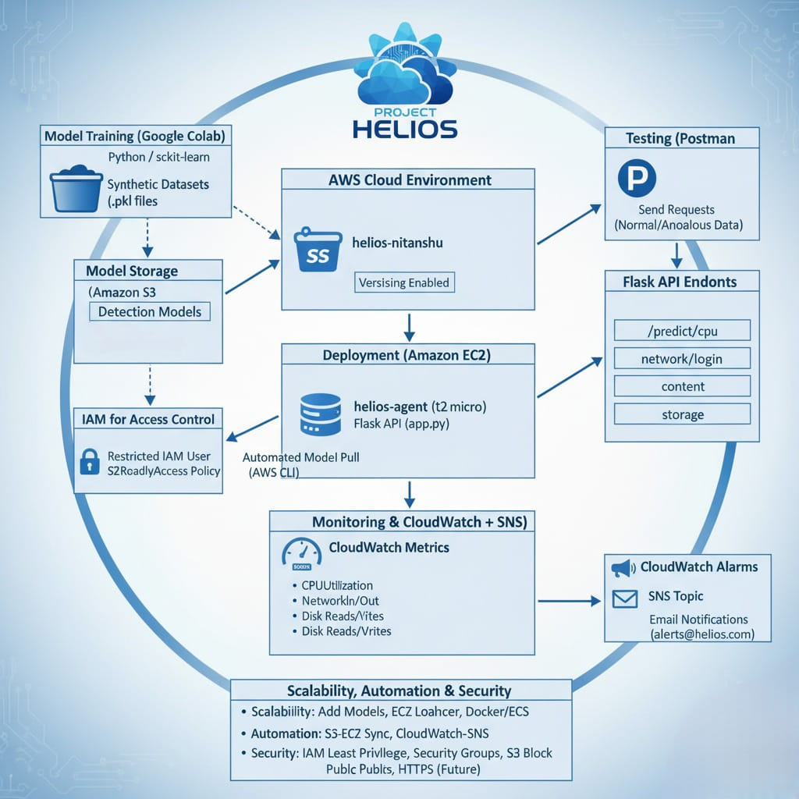
The Cloud Challenge
CPU Spikes
Unexpected processing overloads that crash applications and degrade performance
Network Surges
Traffic anomalies that overwhelm bandwidth and create bottlenecks
Security Breaches
Unauthorized access attempts and malicious content injections
Storage Overload
Sudden storage consumption that leads to system failures
Traditional rule-based monitoring systems rely on static thresholds and fail to adapt to dynamic, evolving patterns. The result: costly downtime, security violations, and inefficient resource utilization.

Slide 3
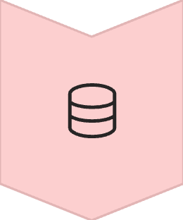




System Architecture Overview
Data Layer
Synthetic datasets created and ML models trained on Google Colab for comprehensive anomaly detection
Storage Layer
AWS S3 securely stores trained models (.pkl files) with versioning enabled for reliability
Compute Layer
AWS EC2 runs Flask-based anomaly detection API with real-time processing capabilities
Security Layer
IAM roles and Security Groups ensure restricted access and principle of least privilege
Monitoring & Alerting
CloudWatch provides real-time visualization while SNS delivers instant anomaly notifications

Slide 4





Five AI-Powered Anomaly Detectors
CPU Usage Monitor
Network Traffic Analyzer
Login Anomaly Detector
Isolation Forest algorithm identifies anomalous CPU spikes outside normal operating levels (5-60% normal, 85-100% anomalous)
KMeans clustering distinguishes between normal request patterns (~100 req/sec) and traffic surges (~500 req/sec)
Logistic Regression identifies suspicious login attempts based on failed attempts and timing patterns
Content Injection Guard
Storage Utilization Tracker
TF-IDF with Logistic Regression detects malicious URLs and content injection attempts in real-time
Isolation Forest monitors storage growth patterns, flagging sudden spikes (900-1000MB) vs normal usage (100-300MB)

Slide 5
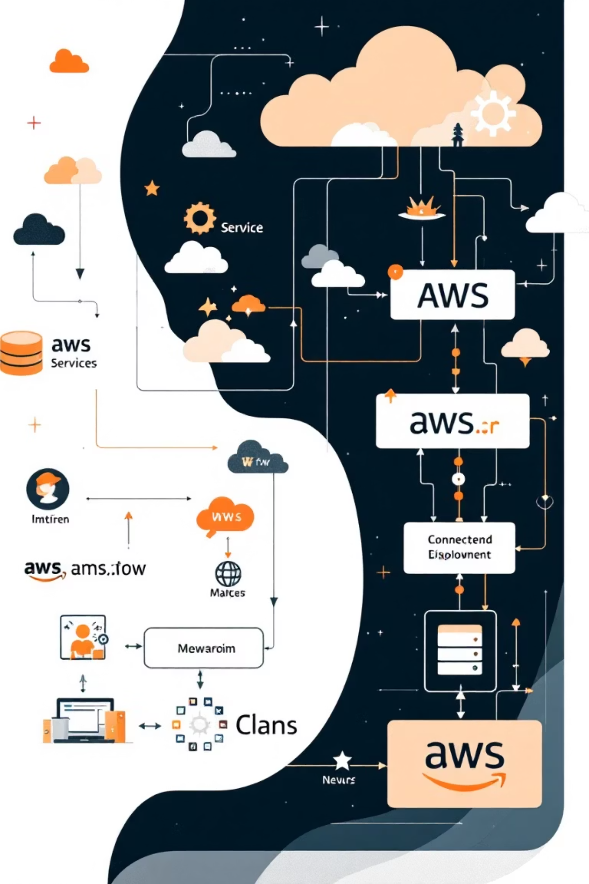
Implementation Journey
1
Phase 1: Model Training
Five ML models trained on Google Colab using synthetic datasets, exported as serialized .pkl files for deployment
2
Phase 2: AWS Deployment
Models uploaded to S3 bucket 'helios-nitanshu', Flask API deployed on EC2 instance 'helios-agent' with security configurations
3
Phase 3: Monitoring Setup
CloudWatch dashboards created, SNS topic 'HeliosAlerts' configured for email notifications, alarms set for threshold violations
4
Phase 4: End-to-End Testing
Complete pipeline validated: anomaly detection, real-time alerts, dashboard visualization, and email notifications working seamlessly

Slide 6

Real-World Testing Results
Successful Validations
5
Flask endpoints correctly identified anomalies across all five detection types
CloudWatch alarms triggered automatically during CPU stress testing
ML Models
SNS delivered real-time email alerts to subscribed addresses
Dashboard displayed live metrics with accurate visualizations
Successfully deployed and tested
Complete system operated at zero cost under AWS Free Tier
100%
Postman Testing: All API endpoints validated with both normal and anomalous data inputs, demonstrating 100% accuracy in anomaly classification
Accuracy
Correct anomaly predictions
0
Cost
AWS Free Tier implementation

Slide 7




Technology Stack & Services
Google Colab
AWS S3
ML model training environment with Python and scikit-learn libraries
Secure model storage with versioning and controlled access policies
AWS EC2
CloudWatch
Flask API hosting with configured security groups and IAM integration
Real-time monitoring dashboards and automated alarm systems
AWS SNS
Postman
Instant email notifications for anomaly alerts and system events
API endpoint testing and validation tool for comprehensive system verification

Slide 8
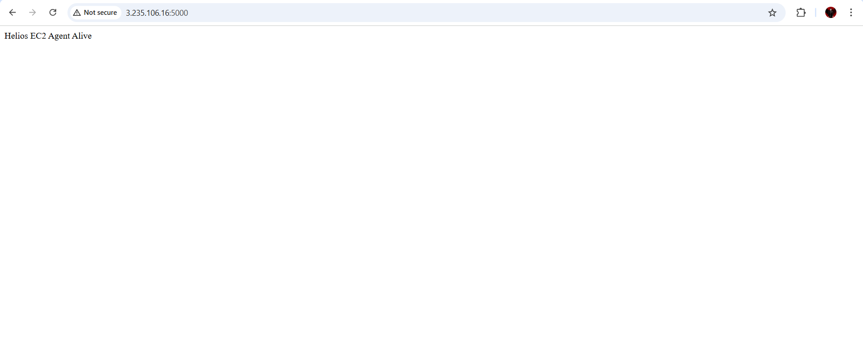
Security & Scalability Features
Security Implementation
Scalability Design
Automation Capabilities
IAM user with S3ReadOnlyAccess policy (principle of least privilege)
Additional models easily deployable via S3 folder structure
Models automatically pulled from S3 on agent launch
EC2 Security Groups restricted to essential ports only
Multiple EC2 instances supported behind load balancer
CloudWatch alarms trigger SNS without human intervention
S3 bucket access blocked from public internet
Docker containerization ready for ECS/EKS deployment
Future scope: AWS Lambda integration for auto-healing
HTTPS capability for secure data transmission
Auto-scaling policies based on detected anomalies
Multi-region deployment expansion potential

Slide 9




Future Enhancements & Research Directions
Intelligent Auto-Scaling
AWS Lambda Integration
Develop dynamic scaling policies that respond to anomaly patterns, optimizing resource allocation in real-time
Implement serverless auto-healing functions that automatically remediate detected anomalies without human intervention
Real-World Dataset Training
Multi-Region Deployment
Transition from synthetic to production datasets for improved accuracy and real-world applicability
Expand system architecture across multiple AWS regions for enhanced reliability and global anomaly detection
"This project will further be extended and detailed in my research paper on a similar topic, contributing to the advancement of AI-driven cloud infrastructure resilience."

Slide 10


Project Impact & Conclusions
Key Achievements
Helios successfully demonstrates the integration of AI/ML anomaly detection with AWS cloud capabilities, creating an end-to-end self-healing pipeline. The project validates the feasibility of autonomous cloud systems that can detect, alert, and potentially remediate issues without human intervention.
100%
Through comprehensive testing and real-world deployment, Helios proves that intelligent, automated systems can significantly enhance cloud resilience and security while operating cost-effectively within free-tier constraints.
System Reliability
End-to-end pipeline validation

