Slide 1
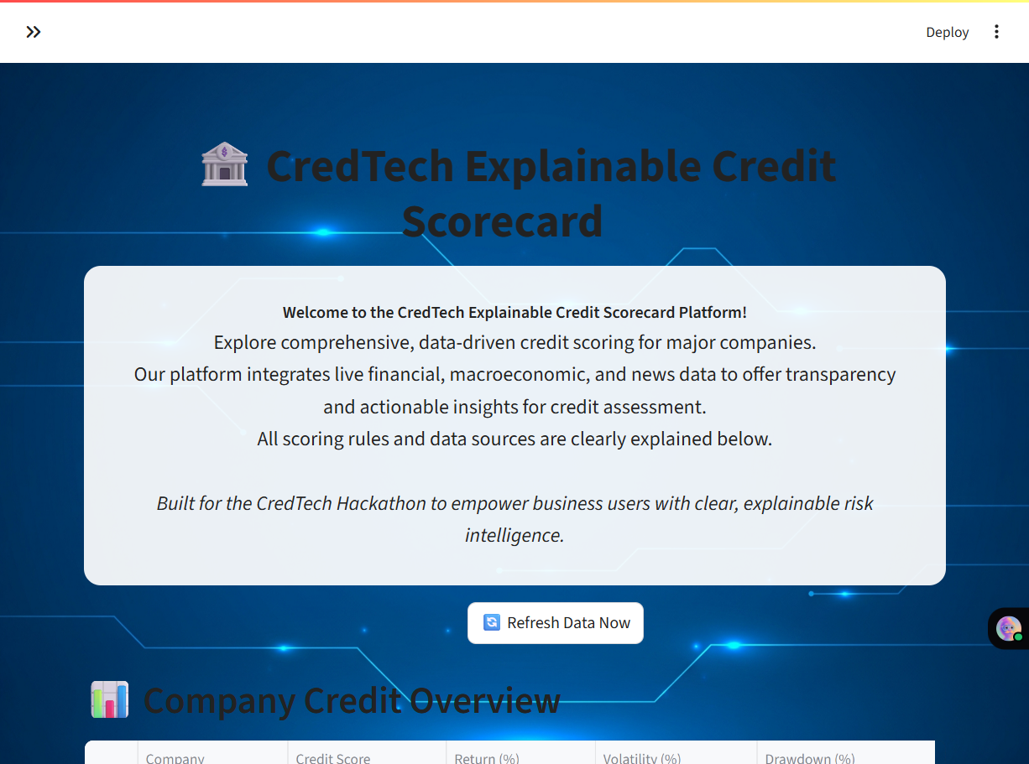
TransparaScore
Explainable Credit Intelligence Platform
CredTech Hackathon
By: Nitanshu Tak | LinkedIn | Live App | GitHub

Slide 2
Agenda
Problem & Motivation
Solution Overview
Data Sources & Pipeline
Scoring Engine & Explainability
Product UX (Live Demo)
Architecture & Deployment
Risks, Ethics & Compliance
Roadmap & Q&A

Slide 3
The Problem
Credit ratings are opaque, infrequent, and lag real-world events
Investors and regulators need timely, transparent credit intelligence.
Legacy ratings do not explain 'why' a score changes.
Unstructured signals (news, events) are often ignored or underutilized.
Requirement: A real-time, explainable, analyst-friendly platform.

Slide 4
Hackathon Brief
Build a Real-Time Explainable Credit Scorecard.
Ingest multi-source data: financial, macroeconomic, and unstructured (news/events).
Emphasize explainability: factor contributions, event reasoning, trend indicators.
Deliver: Dashboard, code repo, deployed app link, and demo video.

Slide 5
Solution: TransparaScore
Transparent, real-time credit intelligence
Multi-source data ingestion (Yahoo, FRED, World Bank, Reuters, GDELT).
Composite credit score built from Financial, Macro, and Event signals.
Explainability layer: factor breakdowns + news-driven rationale.
Interactive analyst dashboard with CSV export and refresh.

Slide 6
Why It Stands Out
Clarity over black-box models: rule-based, transparent scoring.
Event-aware scoring: integrates unstructured news signals.
Deployed & demo-ready: judges can explore live now.
Extensible to interpretable ML (trees + SHAP) for future upgrades.

Slide 7
Data Sources
📈 Financial: Yahoo Finance (prices, returns, volatility).
🌍 Macro: FRED & World Bank (inflation, GDP, rates).
📰 Unstructured: Reuters RSS & GDELT (events, sentiment proxies).
All sources are public/free; used for demo/educational purposes.

Slide 8
Data Pipeline
Sources
Ingestion
(HTTP/APIs)
Processing
(Pandas)
Scoring Engine
Explainability
Dashboard
(Streamlit)
Export/Share

Slide 9
Scoring Engine: Overview
Financial + Macro + Event signals → Composite Score (0–100)
Financial Score: returns, volatility, drawdowns, liquidity.
Macro Score: inflation, GDP growth, unemployment, rates.
Event Score: news-driven positive/negative signals (keywords).
Weighted blend → Final Credit Score with explainability.

Slide 10
Financial Score
Signals & Rules (example)
Momentum: recent returns ↑ ⇒ positive points; sharp drawdowns ⇒ penalties.
Volatility: lower realized volatility ⇒ higher stability ⇒ positive points.
Liquidity: higher average volume ⇒ reliability ⇒ positive points.
Simple, transparent rules; weights documented in code.

Slide 11
Macro Score
Signals & Rules (example)
Inflation: rising inflation ⇒ headwind ⇒ negative points.
GDP Growth: stronger growth ⇒ tailwind ⇒ positive points.
Unemployment: rising joblessness ⇒ risk ⇒ negative points.
Rates: rising long-term yields ⇒ financing cost ↑ ⇒ negative points.

Slide 12
Event Score
News-aware signals (rule-based NLP)
Positive: upgrade, profit beat, new order wins, approvals, partnerships.
Negative: fraud, downgrade, bankruptcy, default, litigation, layoffs.
Parse headlines from Reuters/GDELT; classify via keyword rules.
Transparent mapping from events → score deltas.

Slide 13
Composite Score
Weighted blend with explainability
FinalScore = w1*Financial + w2*Macro + w3*Events (weights documented).
Outputs factor contributions used in explainability view.
Enables drill-down for analysts: 'what moved the score and why'.

Slide 14
Explainability
Built-in, human-readable reasoning
Factor contribution bars + textual rationale.
Event snippets with direct links to sources.
Trend indicators (recent rise/fall, momentum changes).
All logic is auditable and reproducible.

Slide 15
Product UX
Analyst-friendly dashboard
Left: controls, symbol selection, refresh.
Center: score
overview and trend
charts.
Right: event feed with sentiment signals.
Bottom: CSV export
and data disclaimer.

Slide 16
Live Demo Flow
How to present in 5–7 minutes
1) Start with the problem and the goal of transparency.
2) Select a company → show score and factor breakdown.
3) Open news events → show how events move the score.
4) Show macro panel → explain macro tailwinds/headwinds.
5) Export CSV → highlight reproducibility + audit trail.

Slide 17
Architecture
From sources to insights
Data Sources → Ingestion (HTTP) → Processing (Pandas).
Scoring Engine → Explainability → Streamlit UI.
Secrets managed via Streamlit Cloud (no keys in repo).
Deployed as a public app for judges to explore.

Slide 18
Deployment & Ops
Streamlit Cloud
GitHub repo with clean code and placeholders for keys.
Secrets configured in Streamlit Cloud (st.secrets).
requirements.txt ensures reproducible builds.
Auto-redeploy on push; quick rollbacks if needed.

Slide 19
Security, Ethics & Compliance
No personal data; only public financial/macroeconomic/news sources.
Clear disclaimer: demo/educational, not financial advice.
Respect robots.txt and API terms; no redistribution of raw content.
Explainable design reduces model risk and supports auditability.

Slide 20
Machine Learning Integration
Streamlit Cloud
ML-Powered Credit Scoring
Gradient Boosted Trees for modeling credit risk patterns
SHAP values used for the explainability of the model
predictions
Feature Inputs
Financial ratios (Return %, Volatility, Drawdown)
Macroeconomic indicators (Inflation, Interest rates, GDP)
Event-driven data (News sentiment, Policy shifts)

Slide 21
Machine Learning Integration
Streamlit Cloud
Explainability Layer
Transparent contribution of each feature to the final score
Enables business users to trust and validate predictions
Future Enhancements
Ensemble methods for higher accuracy
Real-time retraining pipeline with streaming data

Slide 22
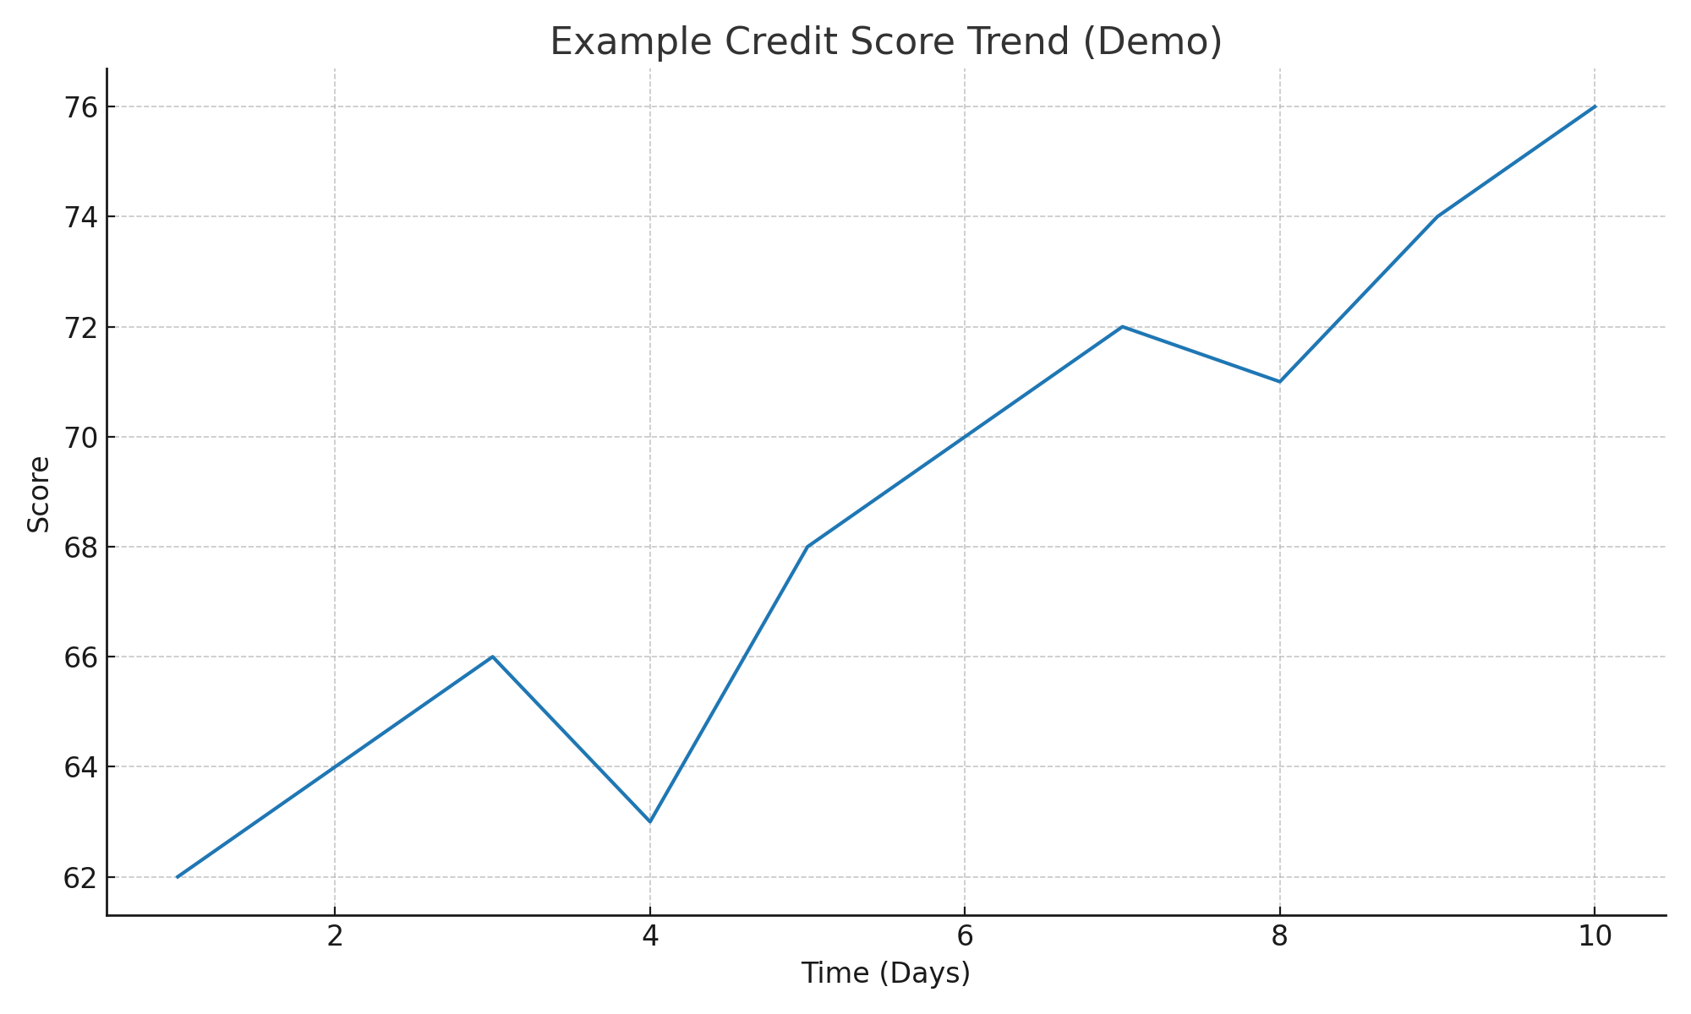
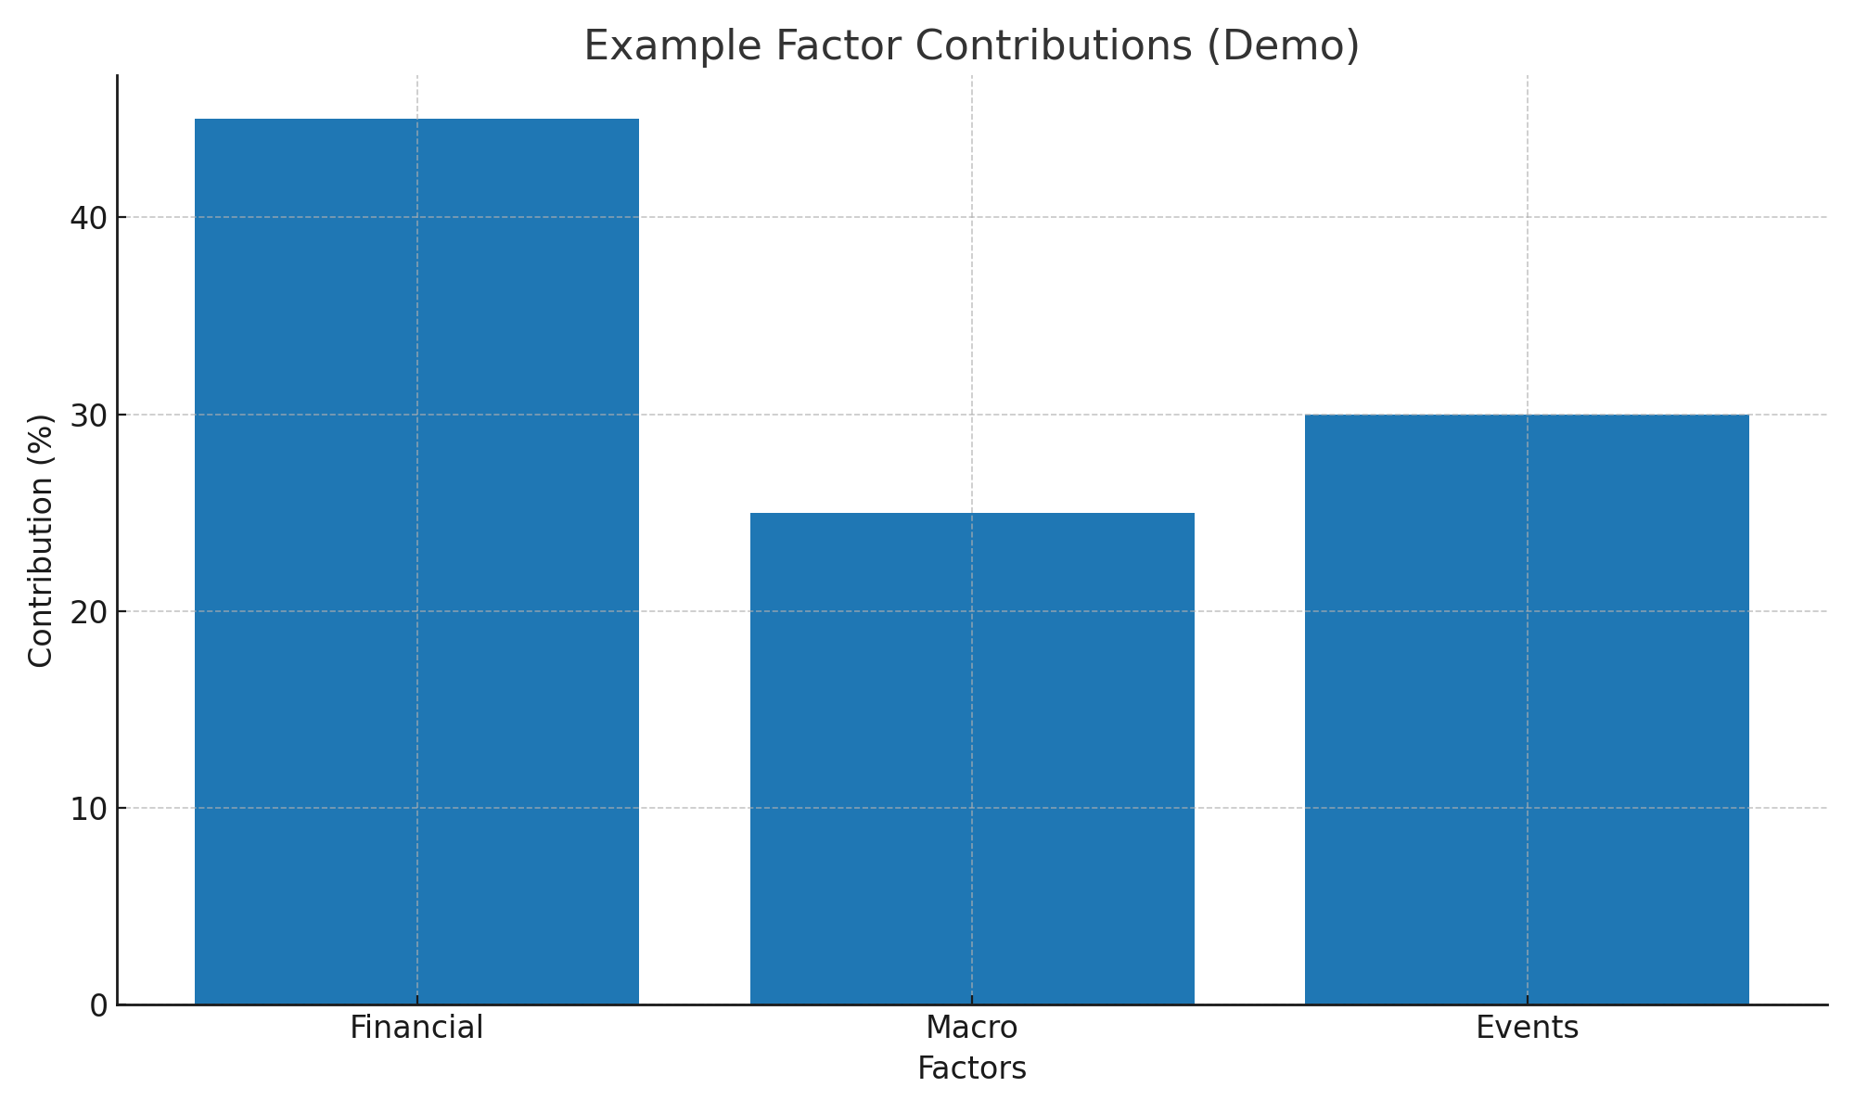
Example Outputs
Illustrative visuals used in the dashboard

Slide 23
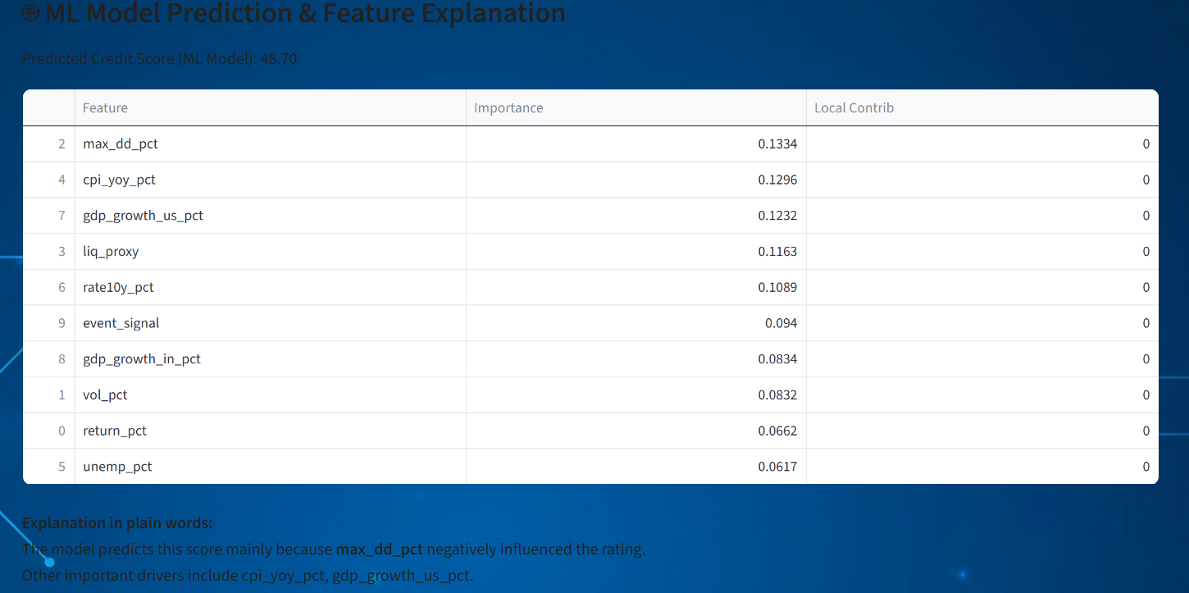
Example Outputs
Illustrative visuals used in the dashboard

Slide 24
Links & Contact
Live App: https://nitanshu-tak-transpara-score.streamlit.app/
GitHub Repo: TransparaScore on GitHub
LinkedIn: Nitasnshu Tak

Slide 25
Thank You
Questions?
Contact: LinkedIn (clickable in Links slide).
Live demo available now.

