Slide 1
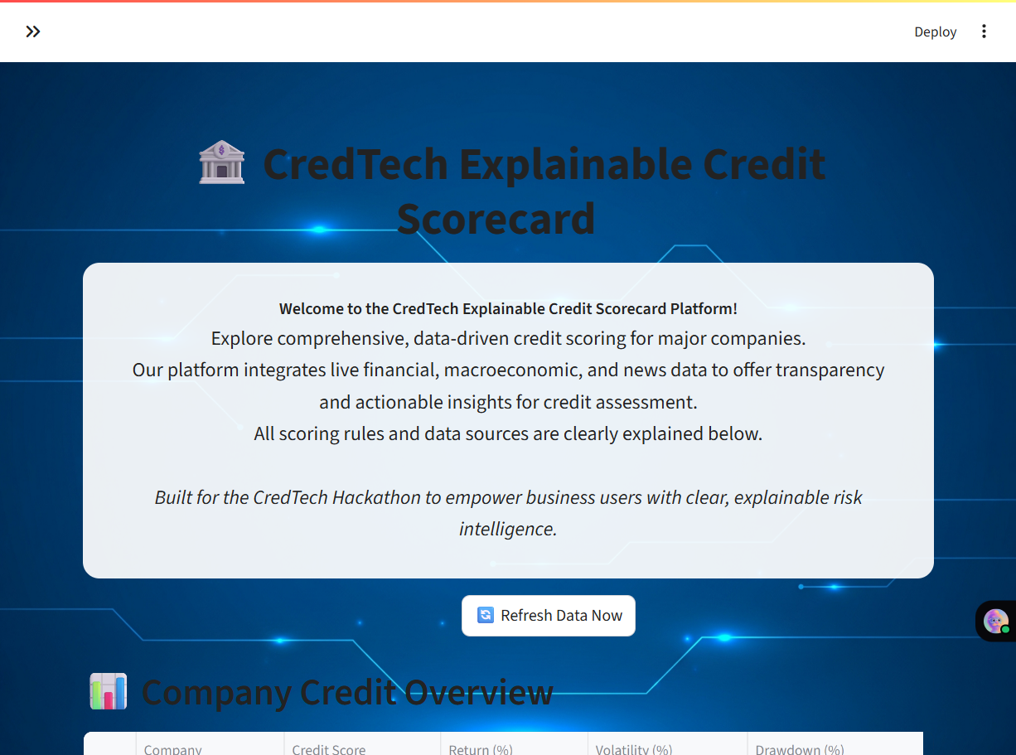
TransparaScore
Explainable Credit Intelligence Platform
CredTech Hackathon
By: Nitanshu Tak | LinkedIn | Live App | GitHub

Slide 2
Agenda
Problem & Motivation
Solution Overview
Data Sources & Pipeline
Scoring Engine & Explainability
Product UX (Live Demo)
Architecture & Deployment
Risks, Ethics & Compliance
Roadmap & Q&A

Slide 3
The Problem
Credit ratings are opaque, infrequent, and lag real-world events
Investors and regulators need timely, transparent credit intelligence.
Legacy ratings do not explain 'why' a score changes.
Unstructured signals (news, events) are often ignored or underutilized.
Requirement: A real-time, explainable, analyst-friendly platform.

Slide 4
Hackathon Brief
Build a Real-Time Explainable Credit Scorecard.
Ingest multi-source data: financial, macroeconomic, and unstructured (news/events).
Emphasize explainability: factor contributions, event reasoning, trend indicators.
Deliver: Dashboard, code repo, deployed app link, and demo video.

Slide 5
Solution: TransparaScore
Transparent, real-time credit intelligence
Multi-source data ingestion (Yahoo, FRED, World Bank, Reuters, GDELT).
Composite credit score built from Financial, Macro, and Event signals.
Explainability layer: factor breakdowns + news-driven rationale.
Interactive analyst dashboard with CSV export and refresh.

Slide 6
Why It Stands Out
Clarity over black-box models: rule-based, transparent scoring.
Event-aware scoring: integrates unstructured news signals.
Deployed & demo-ready: judges can explore live now.
Extensible to interpretable ML (trees + SHAP) for future upgrades.

Slide 7
Data Sources
📈 Financial: Yahoo Finance (prices, returns, volatility).
🌍 Macro: FRED & World Bank (inflation, GDP, rates).
📰 Unstructured: Reuters RSS & GDELT (events, sentiment proxies).
All sources are public/free; used for demo/educational purposes.

Slide 8
Data Pipeline
Sources
Ingestion
(HTTP/APIs)
Processing
(Pandas)
Scoring Engine
Explainability
Dashboard
(Streamlit)
Export/Share

Slide 9
Scoring Engine: Overview
Financial + Macro + Event signals → Composite Score (0–100)
Financial Score: returns, volatility, drawdowns, liquidity.
Macro Score: inflation, GDP growth, unemployment, rates.
Event Score: news-driven positive/negative signals (keywords).
Weighted blend → Final Credit Score with explainability.

Slide 10
Financial Score
Signals & Rules (example)
Momentum: recent returns ↑ ⇒ positive points; sharp drawdowns ⇒ penalties.
Volatility: lower realized volatility ⇒ higher stability ⇒ positive points.
Liquidity: higher average volume ⇒ reliability ⇒ positive points.
Simple, transparent rules; weights documented in code.

Slide 11
Macro Score
Signals & Rules (example)
Inflation: rising inflation ⇒ headwind ⇒ negative points.
GDP Growth: stronger growth ⇒ tailwind ⇒ positive points.
Unemployment: rising joblessness ⇒ risk ⇒ negative points.
Rates: rising long-term yields ⇒ financing cost ↑ ⇒ negative points.

Slide 12
Event Score
News-aware signals (rule-based NLP)
Positive: upgrade, profit beat, new order wins, approvals, partnerships.
Negative: fraud, downgrade, bankruptcy, default, litigation, layoffs.
Parse headlines from Reuters/GDELT; classify via keyword rules.
Transparent mapping from events → score deltas.

Slide 13
Composite Score
Weighted blend with explainability
FinalScore = w1*Financial + w2*Macro + w3*Events (weights documented).
Outputs factor contributions used in explainability view.
Enables drill-down for analysts: 'what moved the score and why'.

Slide 14
Explainability
Built-in, human-readable reasoning
Factor contribution bars + textual rationale.
Event snippets with direct links to sources.
Trend indicators (recent rise/fall, momentum changes).
All logic is auditable and reproducible.

Slide 15
Product UX
Analyst-friendly dashboard
Left: controls, symbol selection, refresh.
Center: score
overview and trend
charts.
Right: event feed with sentiment signals.
Bottom: CSV export
and data disclaimer.

Slide 16
Live Demo Flow
How to present in 5–7 minutes
1) Start with the problem and the goal of transparency.
2) Select a company → show score and factor breakdown.
3) Open news events → show how events move the score.
4) Show macro panel → explain macro tailwinds/headwinds.
5) Export CSV → highlight reproducibility + audit trail.

Slide 17
Architecture
From sources to insights
Data Sources → Ingestion (HTTP) → Processing (Pandas).
Scoring Engine → Explainability → Streamlit UI.
Secrets managed via Streamlit Cloud (no keys in repo).
Deployed as a public app for judges to explore.

Slide 18
Deployment & Ops
Streamlit Cloud
GitHub repo with clean code and placeholders for keys.
Secrets configured in Streamlit Cloud (st.secrets).
requirements.txt ensures reproducible builds.
Auto-redeploy on push; quick rollbacks if needed.

Slide 19
Security, Ethics & Compliance
No personal data; only public financial/macroeconomic/news sources.
Clear disclaimer: demo/educational, not financial advice.
Respect robots.txt and API terms; no redistribution of raw content.
Explainable design reduces model risk and supports auditability.

Slide 20
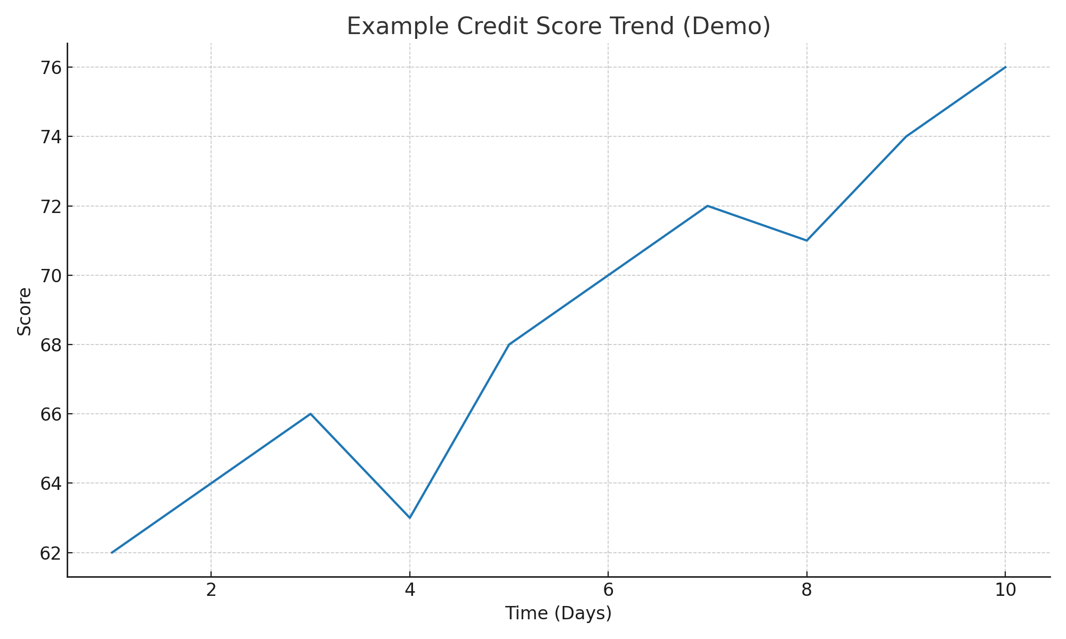
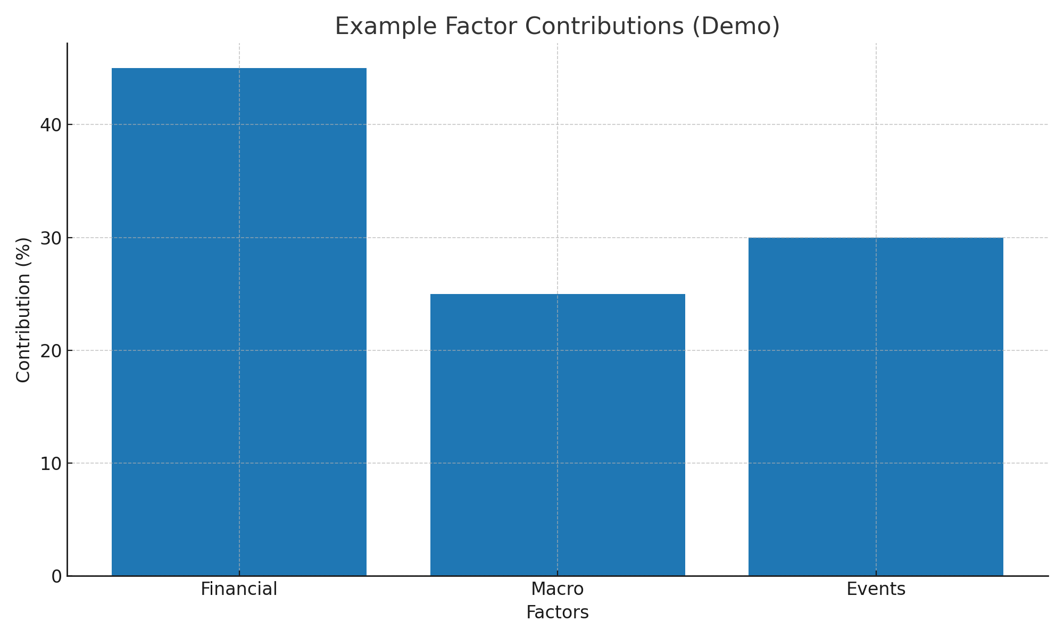
Example Outputs
Illustrative visuals used in the dashboard

Slide 21
Links & Contact
Live App: https://transparascore.streamlit.app/
GitHub Repo: TransparaScore on GitHub
LinkedIn: Nitasnshu Tak

Slide 22
Thank You
Questions?
Contact: LinkedIn (clickable in Links slide).
Live demo available now.

