Slide 1
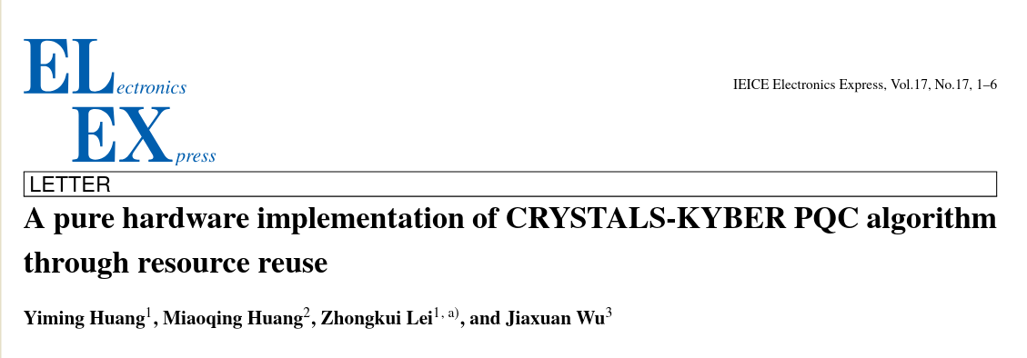
Pakin Panawattanakul
4 / Aug /2025

Slide 2
Presentation outline
Objective & Scope
FPGAs used in implementation
Accelerator architecture
Future work

Slide 3
Objective & Scope
Optimize resource utilization for Kyber Accelerator
  Reuse module for encryption and decryption
  Use BRAM to store intermediate data
    Between module
    Pipeline
Not include key-generation
Aritmetic Pipeline in NTT and Hash Module

Slide 4
Notations
Bit stream =
Polynomial ring

Slide 5
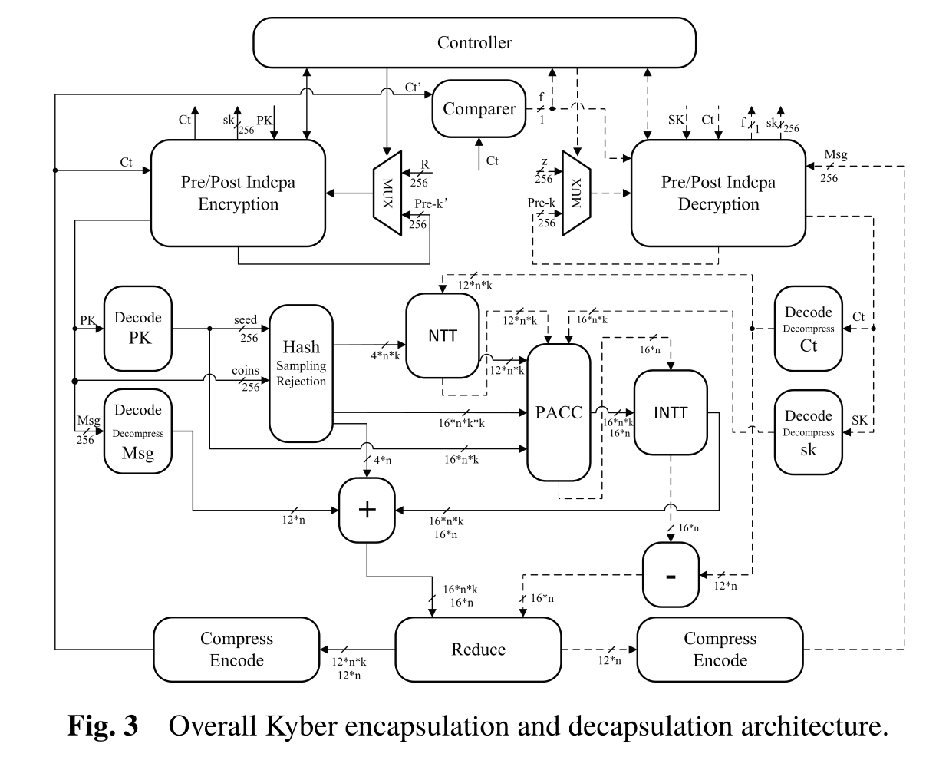
Modules sections
Control
Encapsulation
Decapsulation
Main computation
Note Computations module are shared between Encapsulation and Decapsulation
`

Slide 6
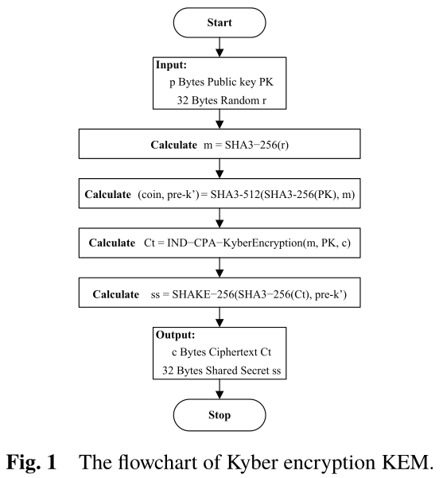
Encapsulation
Module &
Dataflow

Slide 7
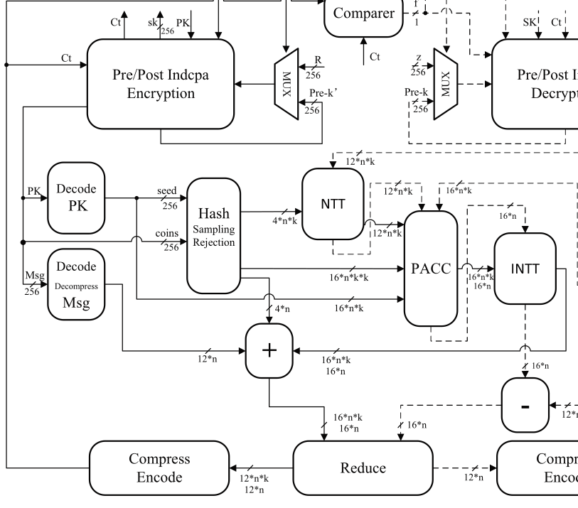

Pre/Post Indcpa Encryption
Pre-Encryption
Input
Public key:
R = Random 256 bits,
Output
m = SHA3-256(R) , Plain text message

Slide 8
Decode PK
Split public key into two part
Input : public keys
Output
Seed = ρ
Increase coef size 12→16bits
t

Slide 9
Decode Msg
Input : m plain text = )
Calculate
For every bit covert: 0 → 0, 1 → 1665
Output : (polynomial form )
q=3329

Slide 10
Hash Sampling Rejections
Input
Seed =
Coins =
Output : small polynomial errors &
Part of public keys

Slide 11
NTT Module
Convert polynomial to NTT form
Input : small polynomial
Output : polynomial in NTT, Polynomial Ring form

Slide 12
PACC : Polynomial Accumulator
Compute polynomial aritmetic in NTT form with mondgomery multiplications
Input : Error Polynomial, variable from PK
Output
Note is only intermediate value before computation of

Slide 13
INTT Module
Convert Polynomial in NTT back to normal form
Input :
Output

Slide 14
Addition Module (+)
Compute polynomial addition
Input
Output

Slide 15
Reduce Module
Mondgomery reduction reduce the coefficient to be with in [0,q)
Input : polynomials
v
u
Output : polynomials ring
u
v

Slide 16
Compress encode
Compress ciphertext using rounded funciton
Input : u,v
Compute
Output
Cipher text

Slide 17
Post Indcpa Encryption
Input
Ct : cipher text
Output
Ct : cipher text
Ss = SHAKE-256(SHA3-256(Ct), )

Slide 18
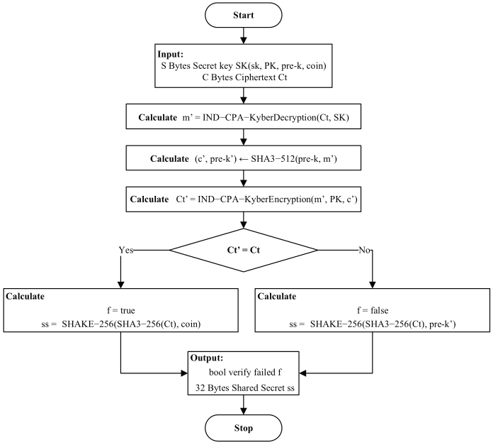
Decapsulation
Module & Dataflow

Slide 19
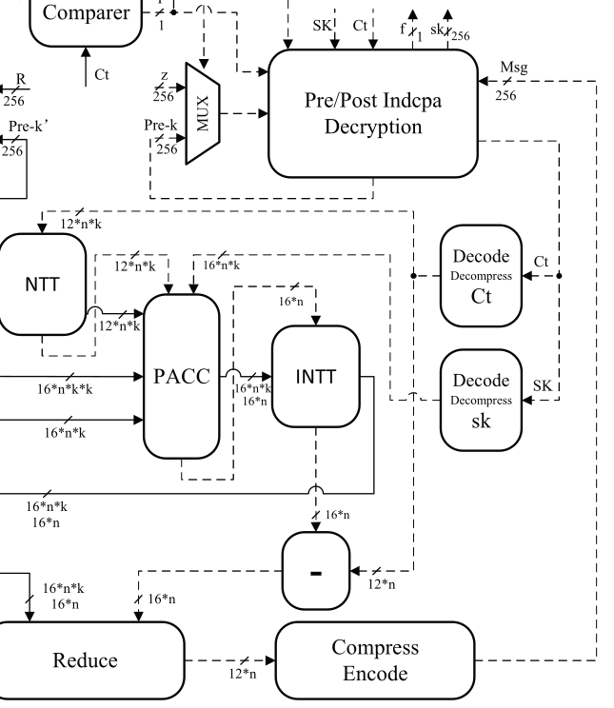
Pre Indcpa Decryption
Recive and pass input to other module as it is
Input
Cipher text :
Private key :
Output:
Cipher text :
Private key :

Slide 20
Decode Ct
Recive and pass input to other module
Input : Cipher text
Output:

Slide 21
Decode SK
Decode Encapsulation key then Transpose encryption key
Input : Private key
Output : encryption key

Slide 22
NTT module
Convert polynomial to NTT
Input : Part of cipher text
Output : cipher text in NTT form

Slide 23
PACC : Polynomial Accumulator
Compute polynomial aritmetic in NTT form with mondgomery multiplications
Input
Part of cipher text :
Encryptions key (transposed) :
Output : intermidiate data

Slide 24
INTT module
Inverse polynomial in NTT to normal form
Input : intermediate data (NTT form)
Output : intermidiate data (normal form)

Slide 25
Subtraction Module (-)
Subtract
Input : intermediate data (NTT form)
Output : intermidiate data (normal form)

Slide 29
Dual port BRAM

Slide 31
Reference to Kyber Algorithm
https://cryptography101.ca/kyber-dilithium/

Slide 32
Kyber PKE

Slide 33
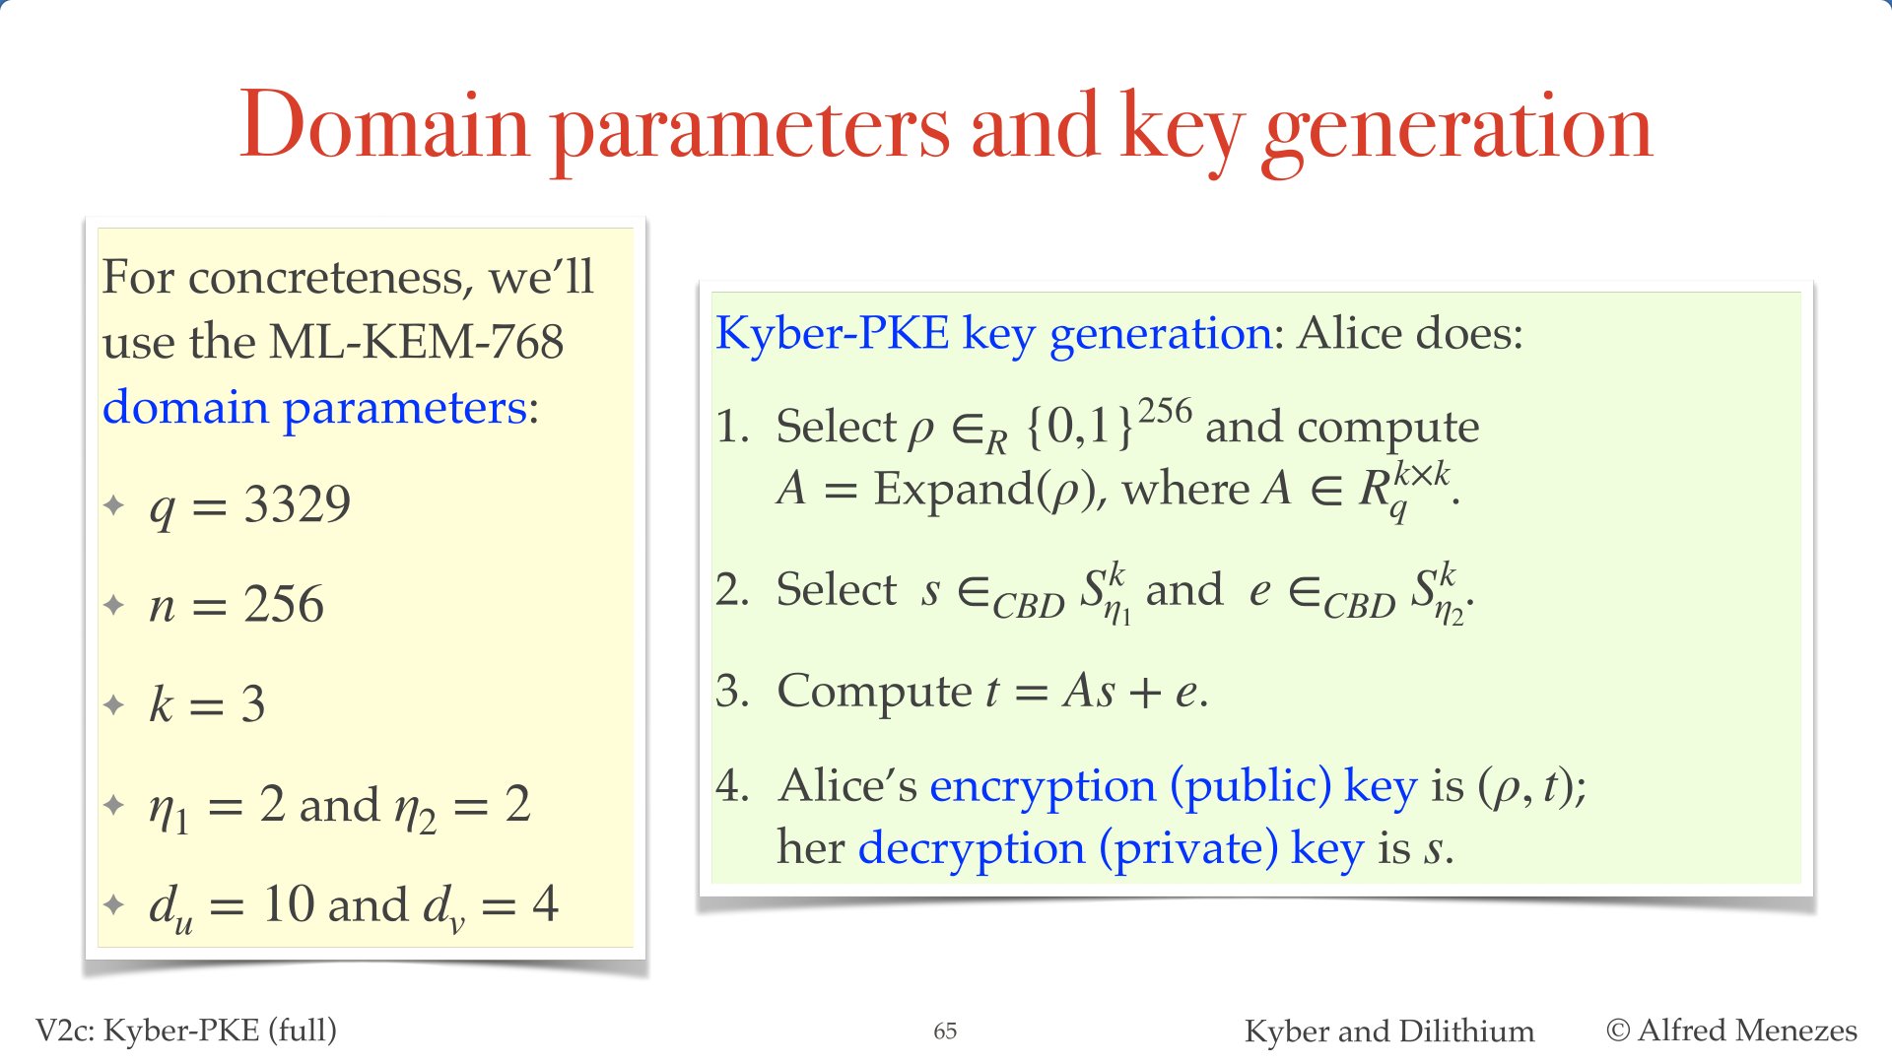

Slide 34
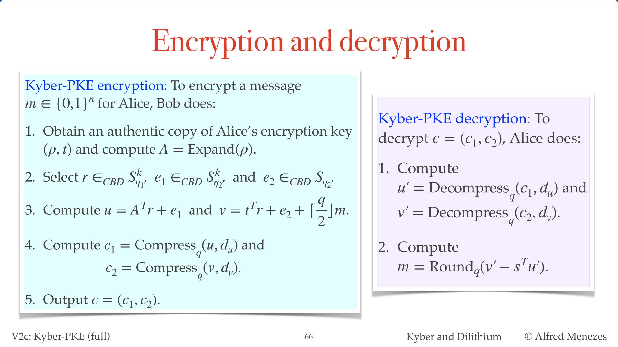

Slide 35
Kyber KEM

Slide 36
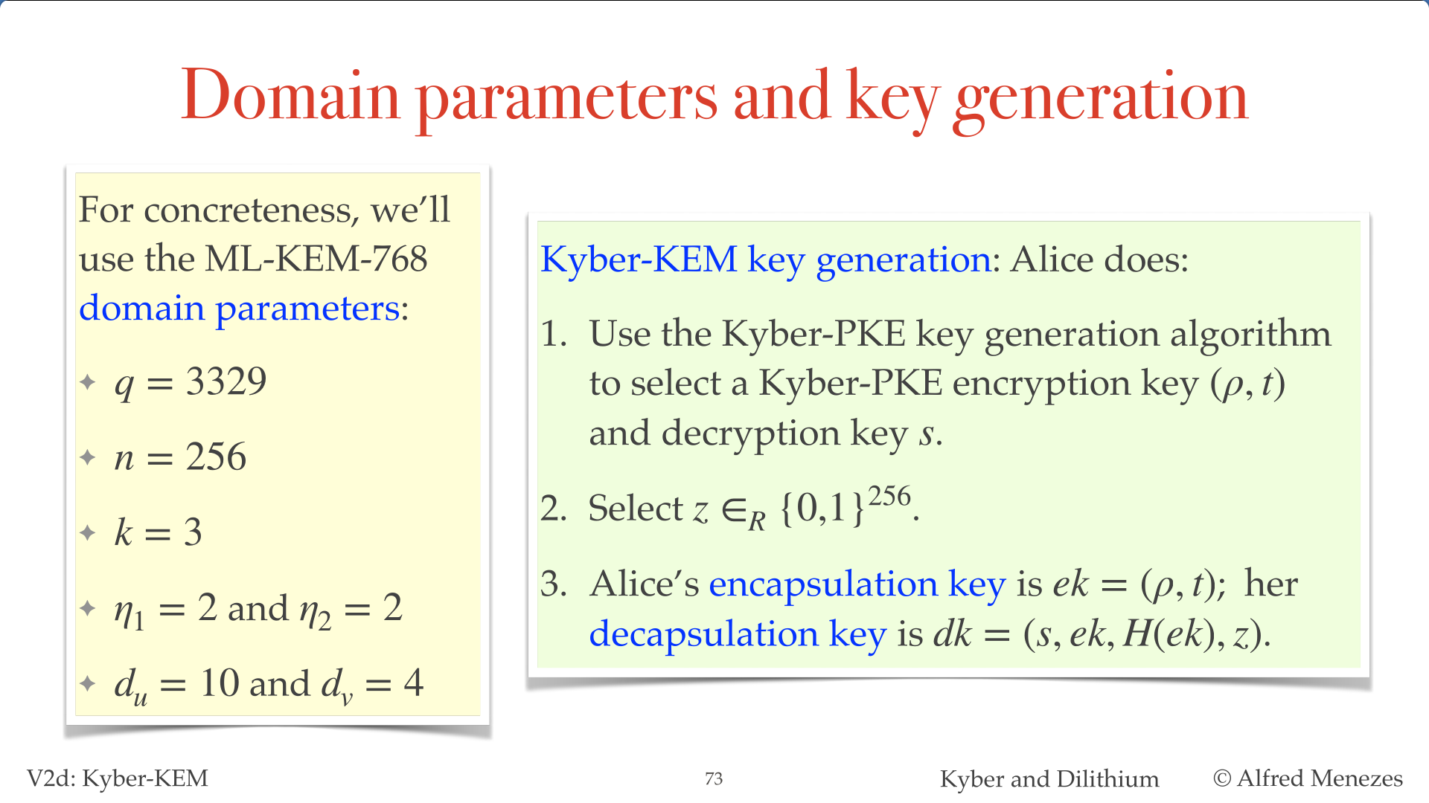

Slide 37
