Slide 1
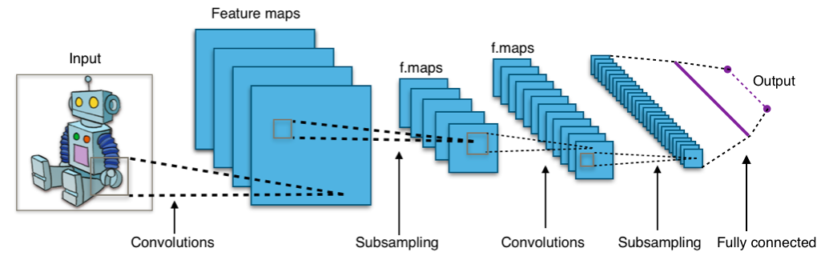
INTELLIGENT SYSTEMS · DEEP LEARNING ARCHITECTURE
Convolutional Neural Networks (CNN)
Mathematical Foundations, Architectural Evolution, and Vectorized Implementation
Canonical End-to-End Convolutional Visual Perception Topology
Authors: Bùi Nguyên Hoàng Việt (B23DCDT285) | Lưu Anh Dũng (B23DCDK036) | Nguyễn Văn Trường (B23DCCE095)
Class: E23CNPM02 · Lecturer: Assoc. Prof. Dinh Que Tran, Ph.D. · Post & Telecommunications Institute of Technology (PTIT)

Slide 2
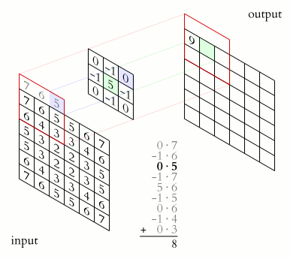
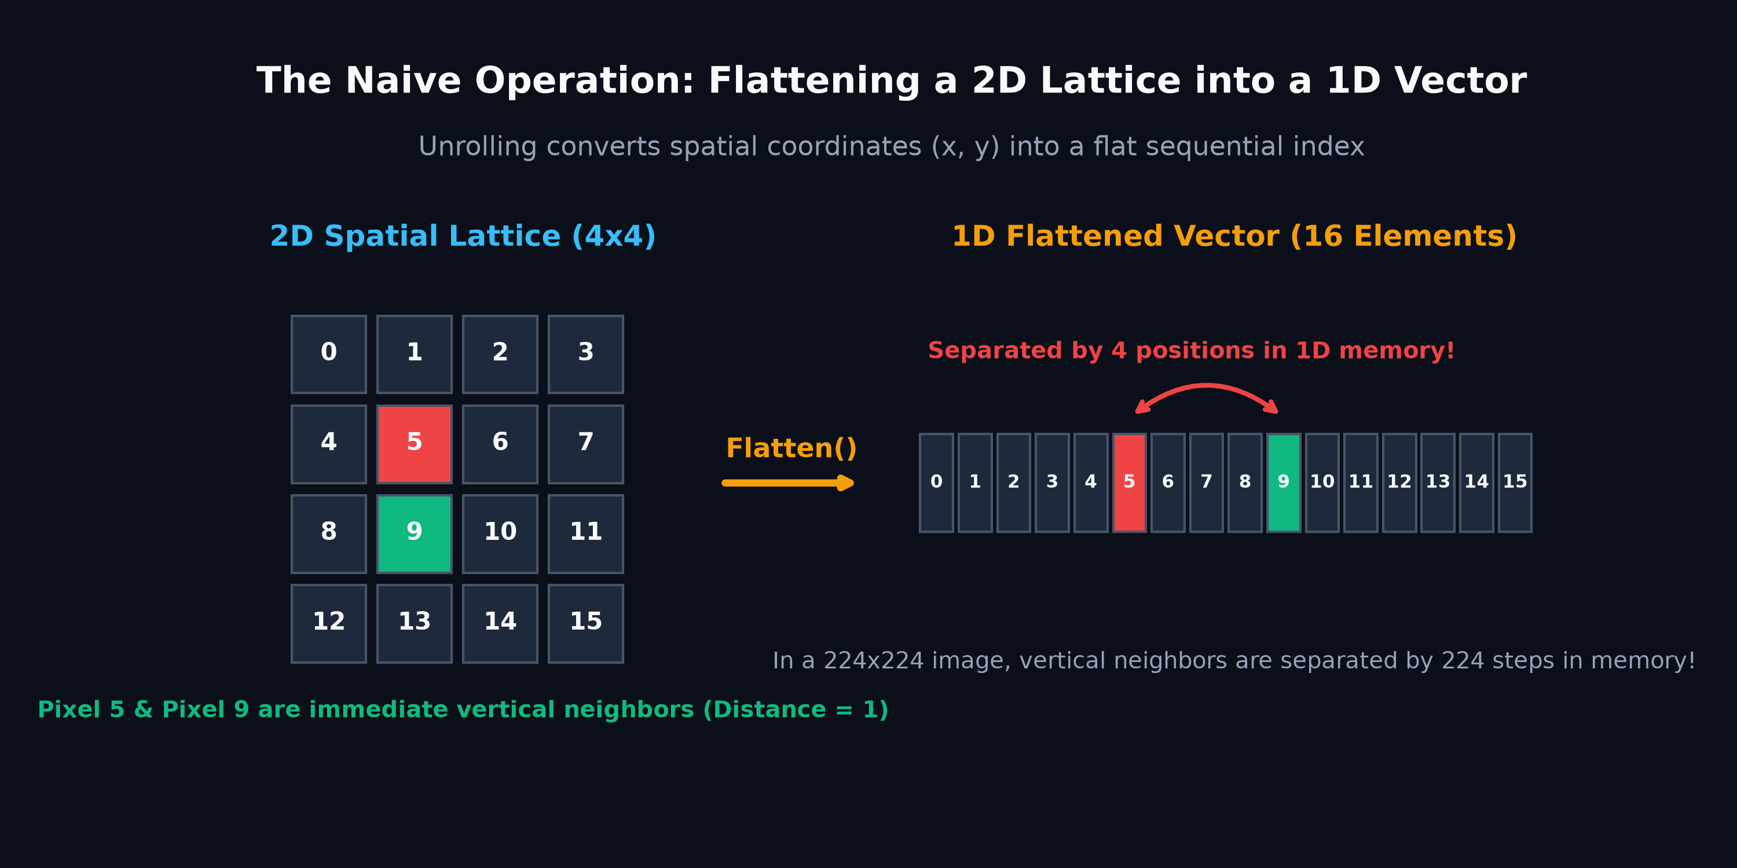
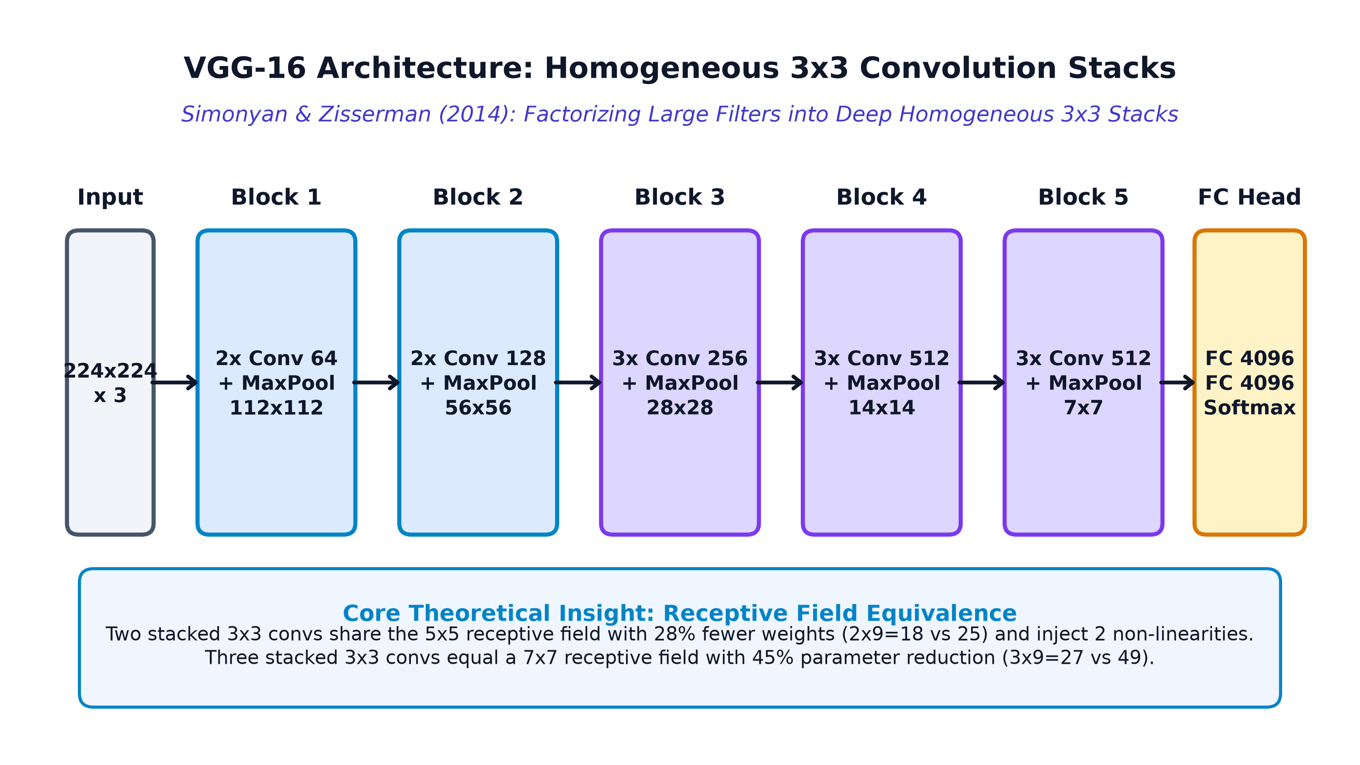
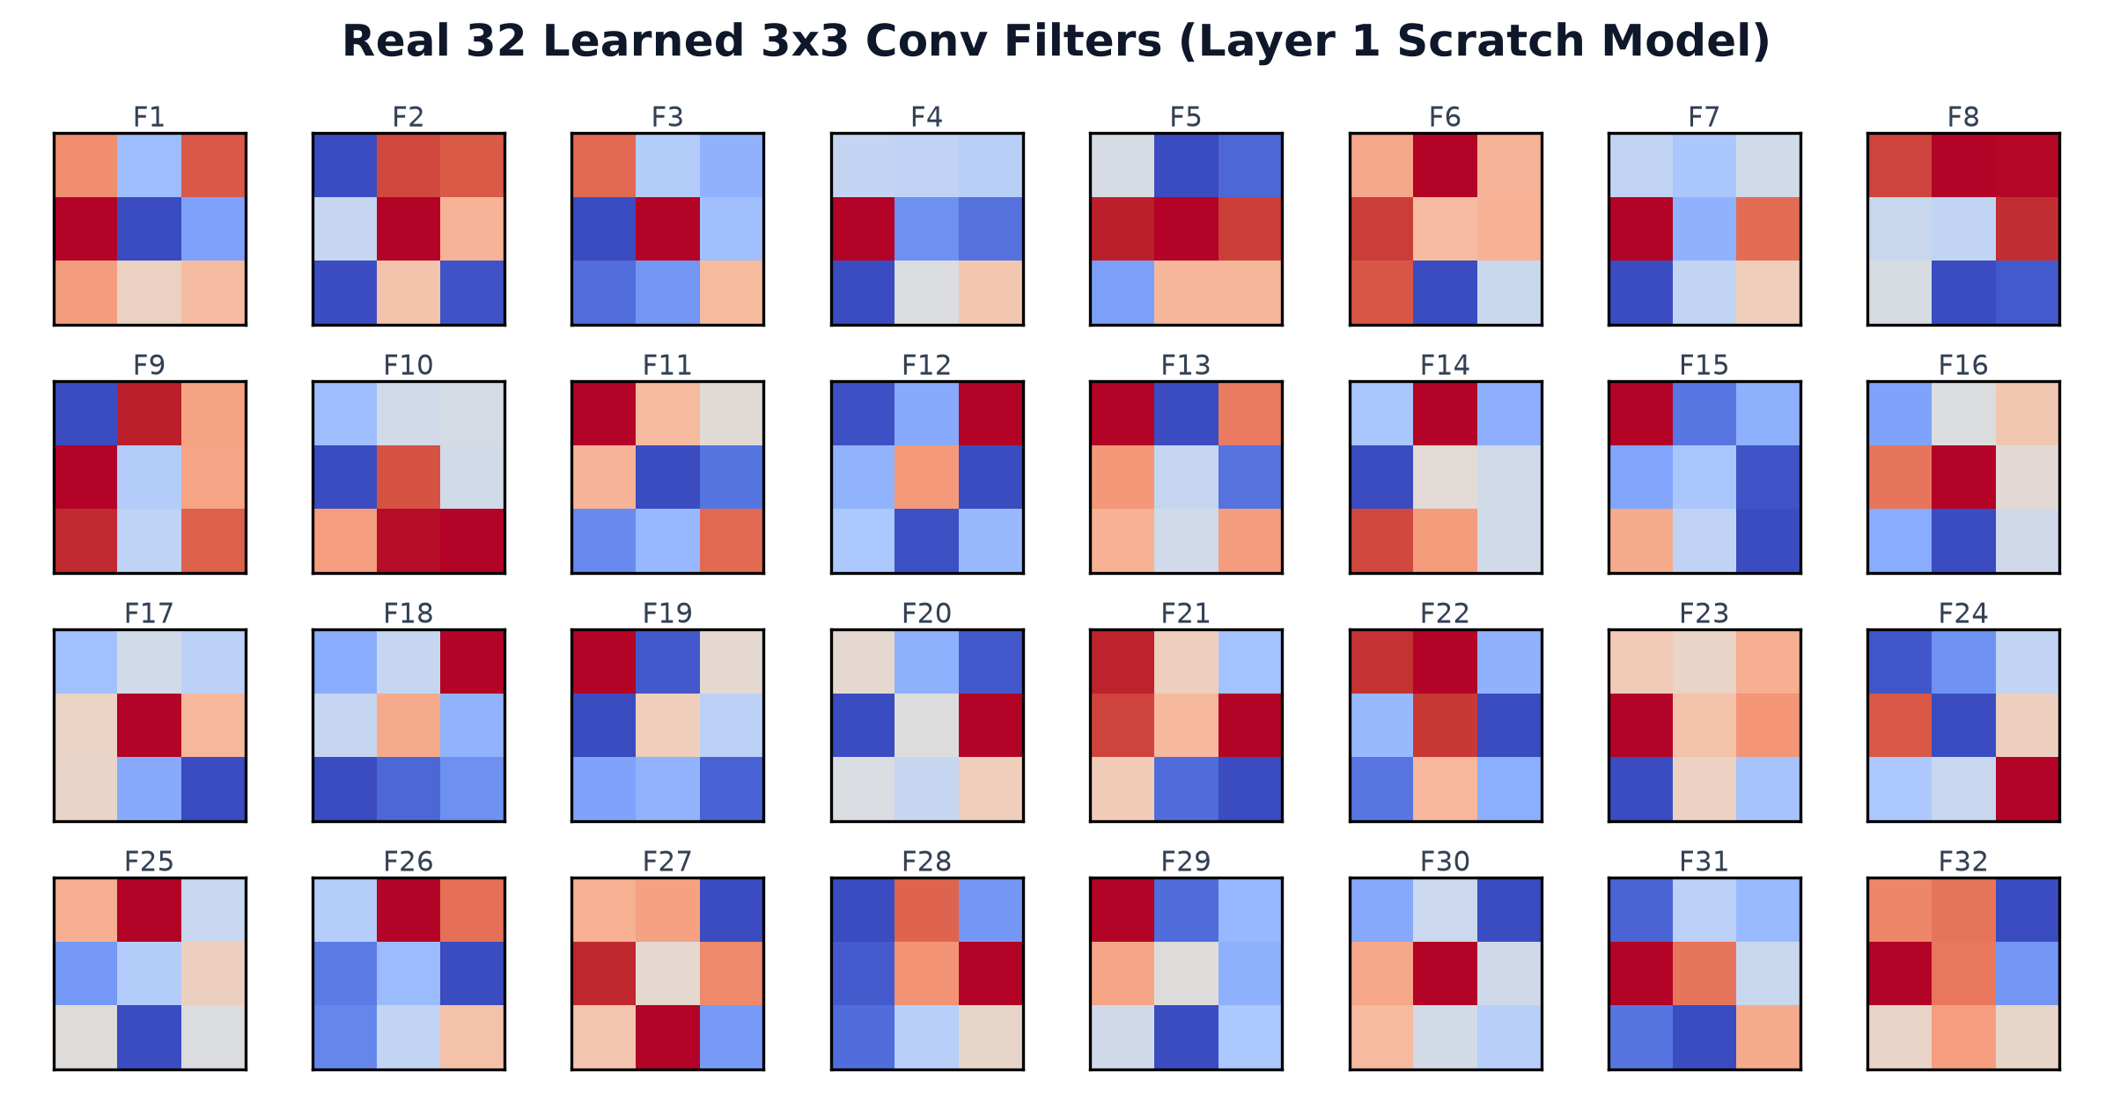
Structural System Agenda
Navigating the 4 Core Pillars of Convolutional Representation Learning
PILLAR 01
Overview & Vision Scope
Spatial Geometry & Foundations
Analysis of 2D pixel topology, the failure mode of vector unrolling, and inductive locality priors.
PILLAR 02
Khái niệm (Concept & Mechanics)
Mathematical Foundations
Layer function composition, linear collapse proof, 2D/3D convolutions, stride/padding, and ReLU sparsity.
PILLAR 03
Phát triển CNN (Model Evolution)
Historical Milestones & Modern Frontiers
Exhaustive model deep-dives: Neocognitron, LeNet-5, AlexNet, VGG, Inception, ResNet, DenseNet, U-Net, MobileNet, EfficientNet, SENet, CBAM & ViT.
PILLAR 04
Code Demo & Verification
Vectorized Implementation
Vectorized im2col forward pass, analytical col2im backprop, PyTorch module, and learned filter maps.
2 / 39

Slide 3
Spatial Topology vs. Vector Unrolling
Why Traditional Dense Multi-Layer Perceptrons Fail on 2D Image Manifolds
The Coordinate Destruction Problem
• Spatial Adjacency Destruction: Unrolling a 2D image matrix into a 1D vector severs vertical neighbor relationships, permanently discarding geometric 2D pixel topology.
• Loss of Translation Equivariance: Dense MLPs cannot recognize an object if it shifts by a single pixel without relearning independent synaptic weights across every coordinate.
• Coordinate Independence: Convolutions preserve the 2D grid structure, applying the same local kernel regardless of where visual patterns appear.
Flattening a 2D Matrix (H x W) into a 1D Array Destroys Vertical Adjacency
3 / 39

Slide 4
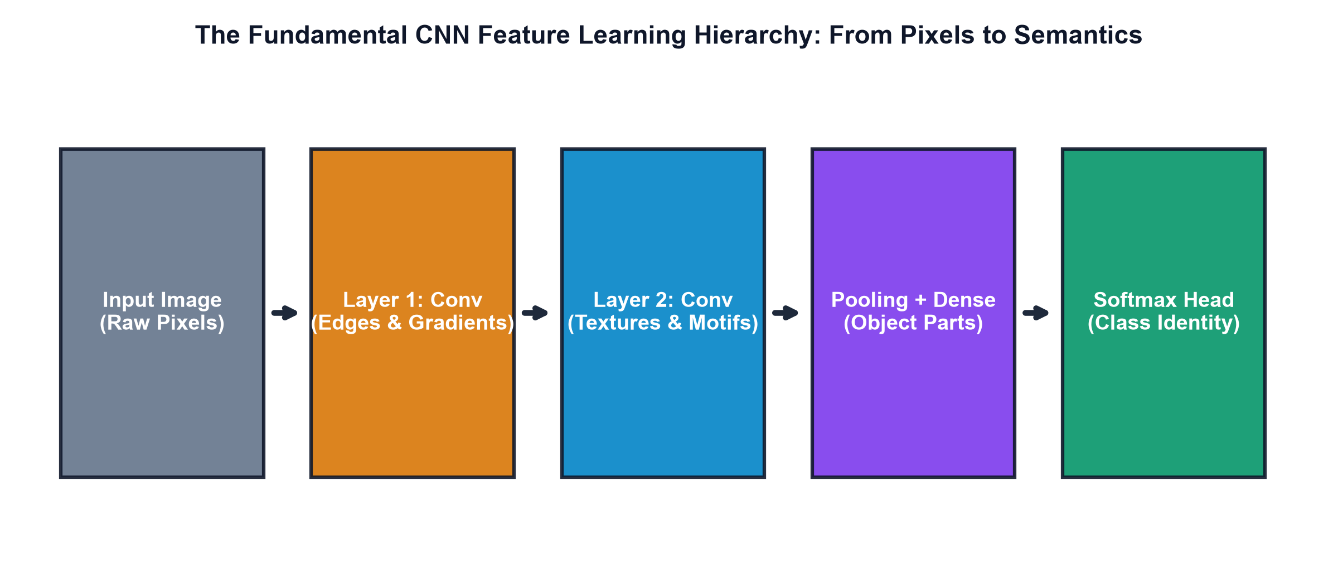
Analytical Function Composition
Deep Networks as Layer-wise Non-Linear Coordinate Transformations
Functional Architecture
• Composite Mapping: A deep network represents an end-to-end composite function: F(X; Theta) = (f_L o f_{L-1} o ... o f_1)(X), progressively untangling raw manifolds.
• Layer Transformation: Each layer f_l applies an affine transformation followed by point-wise non-linearity: f_l(h) = sigma(W_l * h + b_l).
• Separable Latent Space: Intermediate representations transform non-linearly entangled input pixels into a linearly separable classification space at the final layer.
Hierarchical Manifold Untangling: Low-Level Edges -> Mid Motifs -> Class Concepts
4 / 39

Slide 5
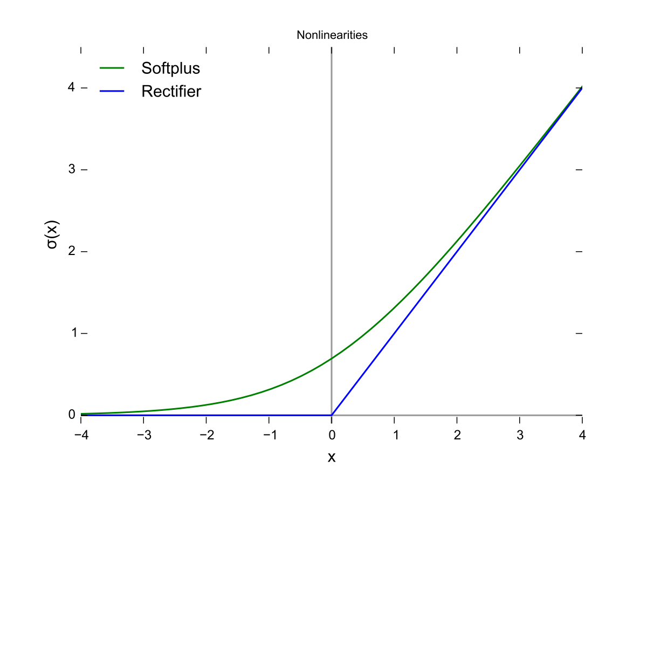
Mandatory Non-Linearity & Linear Collapse Proof
Mathematical Proof of Why Stacking Linear Layers Adds Zero Expressive Power
Analytical Proof of Linear Collapse
• The Linear Collapse Theorem: If all activation functions are linear (sigma(z) = z), then F(X) = W_L (W_{L-1} ... (W_1 X)) = (Product W_l) X = W_{eff} X + b_{eff}.
• Zero Depth Advantage: A 100-layer pure linear network collapses mathematically to a single shallow linear regression, completely incapable of solving non-linear boundaries.
• Manifold Folding via ReLU: Point-wise non-linear activations (sigma) fold and partition the vector space into piecewise linear decision regions of exponential complexity.
Non-Linear Activation Function f(x) = max(0, x) Partitions the Space into Piecewise Linear Regions
5 / 39

Slide 6
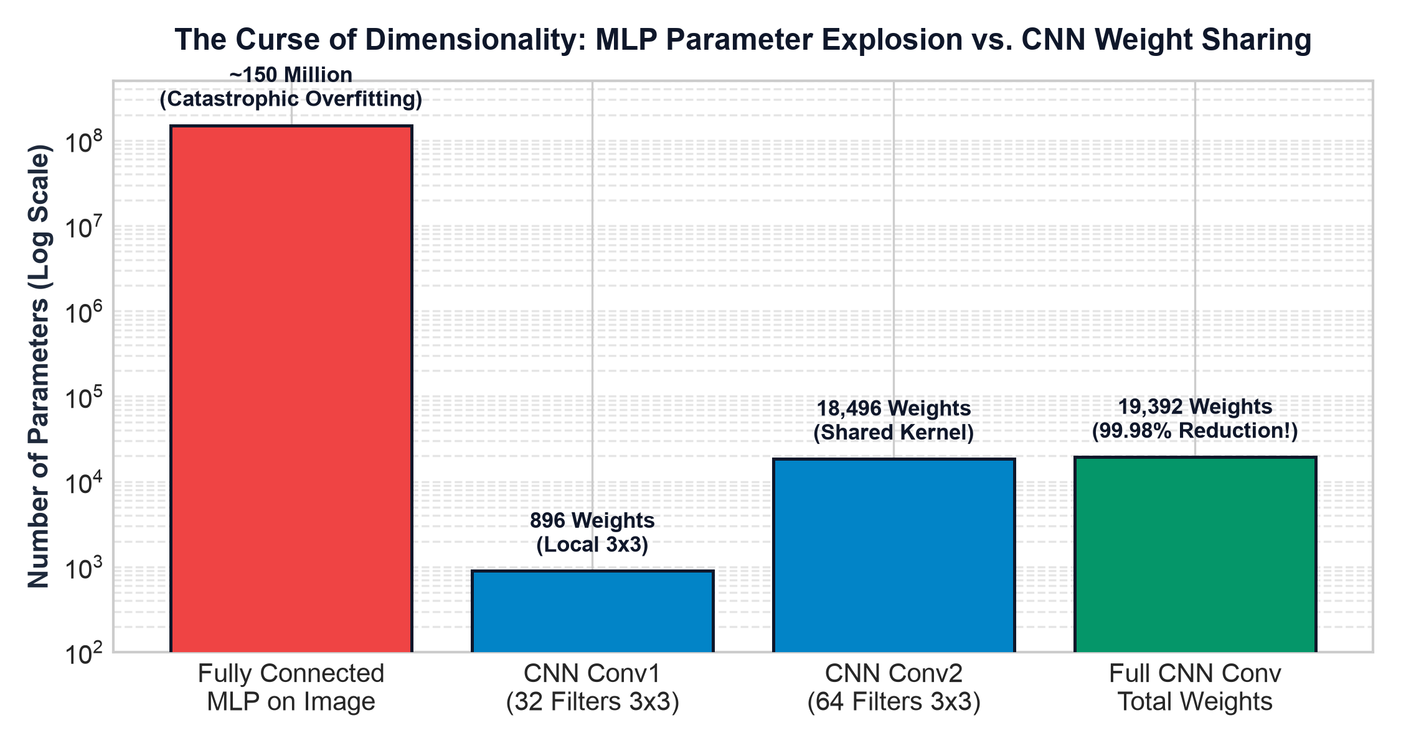
The MLP Parameter Explosion Catastrophe
Why Fully-Connected Layers Scale Catastrophically on Visual Inputs
High-Dimensional Failure Mode
• Combinatorial Weight Explosion: A modest 224 x 224 x 3 image flattened into 150,528 inputs connected to 1,024 hidden neurons requires >154 Million weights in Layer 1 alone!
• Catastrophic Overfitting: Massive parameter counts without spatial inductive priors cause severe overfitting and immediate GPU memory exhaustion.
• Convolutional Efficiency: A 3 x 3 x 3 convolutional filter requires only 28 learnable parameters, maintaining efficiency regardless of image resolution.
Parameter Comparison: Fully-Connected (154M Params) vs. Convolutional (28 Params)
6 / 39

Slide 7
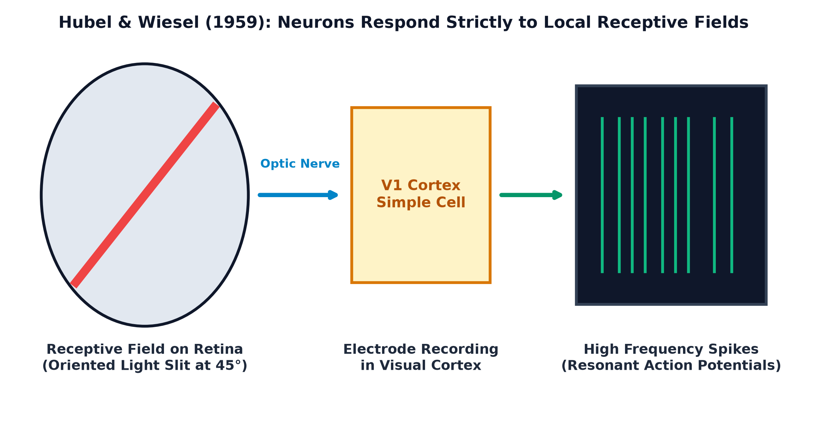
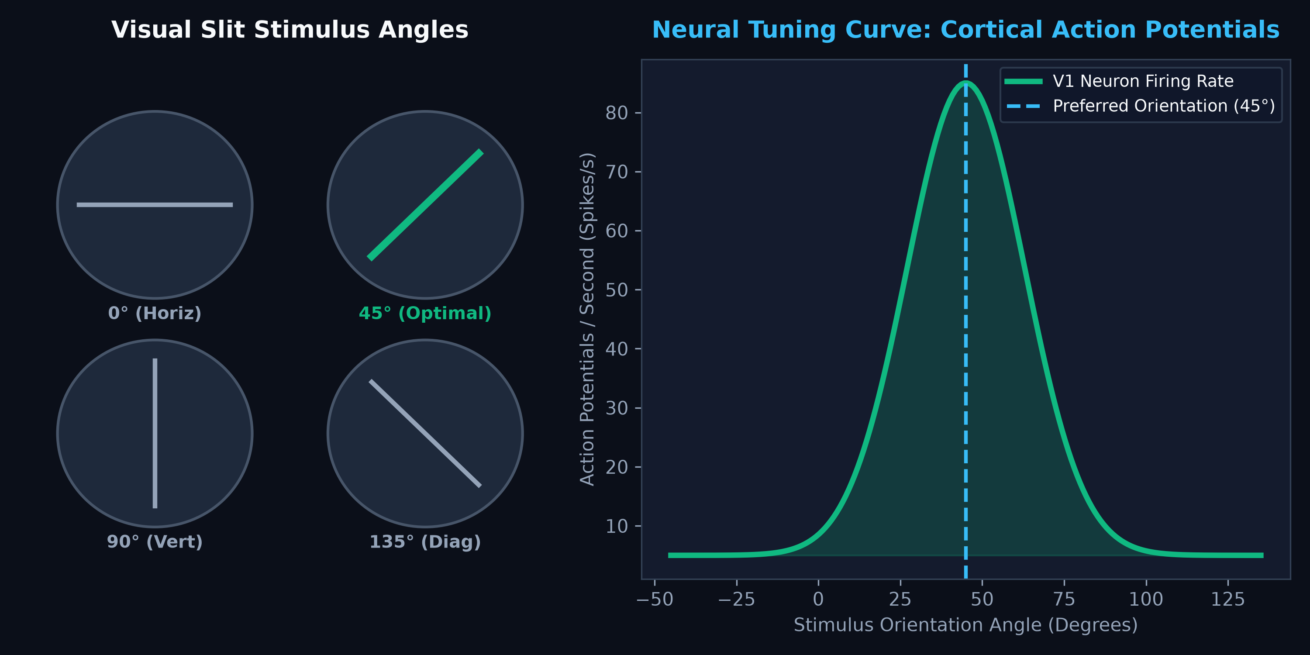
Biological Blueprint: Hubel & Wiesel (1959)
Discovering Localized Receptive Fields in the Mammalian Visual Cortex (V1)
Neurobiological Foundations
• Localized Simple Cells: Hubel & Wiesel proved that neurons in the primary visual cortex (V1) fire only to localized oriented edges, not full-field illumination.
• Orientation Tuning: Individual cortical cells exhibit sharp tuning curves, responding maximally to specific bar angles (0°, 45°, 90°) within a restricted receptive field.
• Hierarchical Processing: Complex cells aggregate simple cell outputs, inspiring neocognitron and modern convolutional kernel hierarchies.
Receptive Field Biological Mechanism (Hubel & Wiesel, 1959)
Biological Orientation Tuning Curves in V1 Cortical Cells
7 / 39

Slide 8
2D Discrete Convolution Mechanics
Sliding Window Cross-Correlation Across Spatial Image Grids
Sliding Window Mechanics
• Mathematical Formulation: Discrete convolution (cross-correlation): S(i, j) = (I * K)(i, j) = Sum_m Sum_n I(i+m, j+n) K(m, n) + b.
• Kernel Dot Product: A small K x K matrix slides across the input tensor, taking element-wise products and summing them to produce one output feature activation.
• Feature Extraction: Filters act as specialized feature detectors, yielding high positive activations when matching patterns appear.
Sliding Window Cross-Correlation: Kernel Receptive Field Dot Product
8 / 39

Slide 9
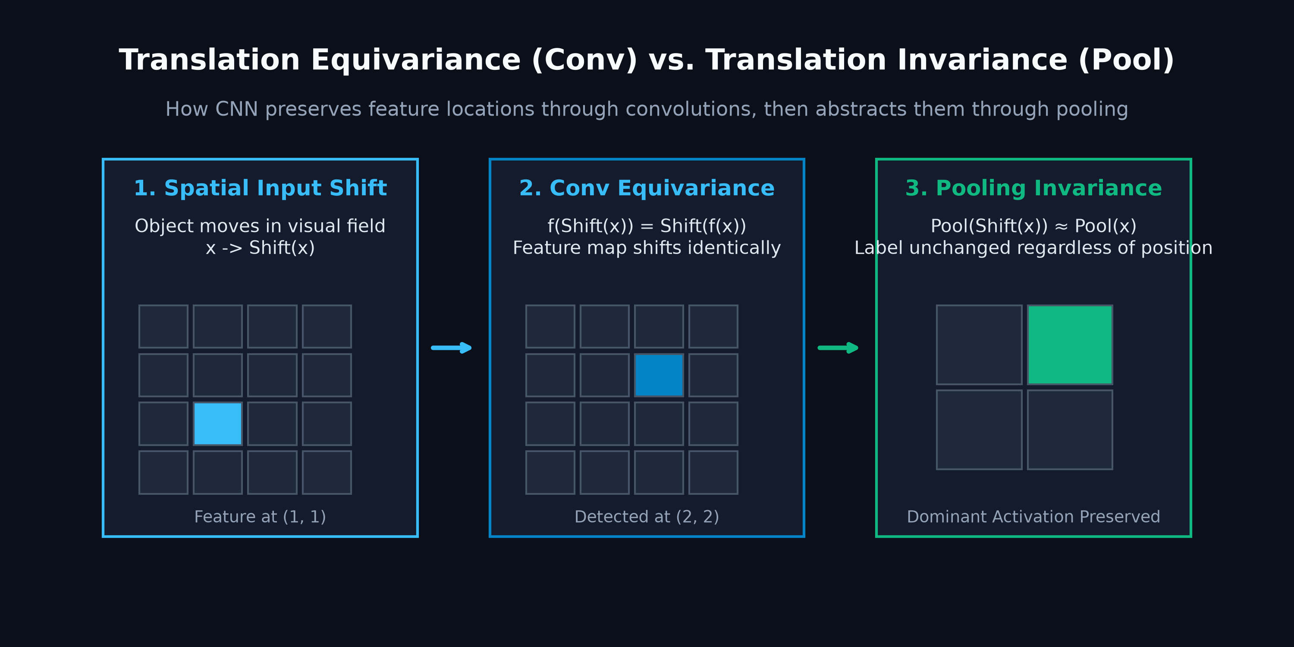
The Dual Foundations of Convolutional Efficiency
How Inductive Biases Drastically Reduce Parameter Complexity
Core Inductive Biases
• Axiom 1: Local Connectivity: Each hidden neuron connects exclusively to a small spatial patch (K x K), reflecting the physical law that nearby pixels are strongly correlated.
• Axiom 2: Weight Sharing: The identical filter coefficients are reused across all spatial coordinates, guaranteeing translation equivariance: f(g(x)) = g(f(x)).
• Statistical Efficiency: Instead of learning millions of uncoordinated weights, the network learns a compact set of universal feature detectors.
Translation Equivariance: Shifting Input Shifts Output Maps Identically
9 / 39

Slide 10
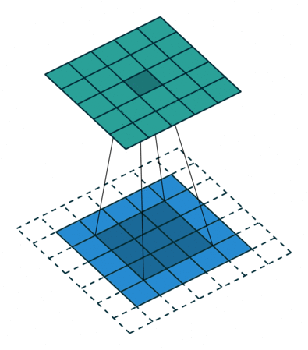
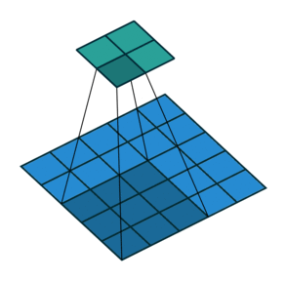
Spatial Hyperparameters: Stride & Padding
Exact Boundary Control and Output Spatial Dimension Arithmetic
Hyperparameter Control
• Output Dimension Equation: Universal spatial resolution formula: H_{out} = floor((H_{in} - K + 2P) / S) + 1.
• Padding Modes: Valid padding (P = 0) contracts boundaries; Same padding (P = (K - 1) / 2) preserves spatial resolution (H_{out} = H_{in}).
• Stride Subsampling: Stride S > 1 steps across multiple pixels per operation, halving spatial dimensions while expanding the receptive field.
Same Padding: Zero-Boundary Padding Preserves Spatial Grid Dimensions
Stride S = 2: Skips Intermediate Pixels for Spatial Subsampling
10 / 39

Slide 11
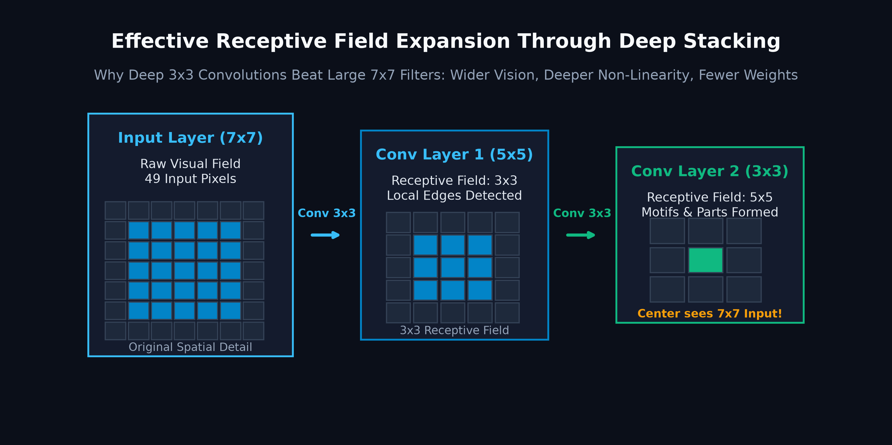
Receptive Field Growth Across Deep Stacks
How Stacking Small 3x3 Filters Yields Exponential Spatial Coverage
Receptive Field Dynamics
• Recursive RF Formula: Receptive field expands recursively: RF_l = RF_{l-1} + (K_l - 1) * Product_{i=1}^{l-1} S_i.
• The VGG-16 Architectural Law: Two stacked 3 x 3 convolutions match the 5 x 5 receptive field of a single 5 x 5 layer with 18 parameters vs 25 (28% savings) plus extra non-linearity.
• Hierarchical Context: Deep layers integrate global visual context without requiring large, computationally prohibitive kernel windows.
Receptive Field Arithmetic: Stacking 3x3 Kernels Yields 5x5 and 7x7 Context
11 / 39

Slide 12
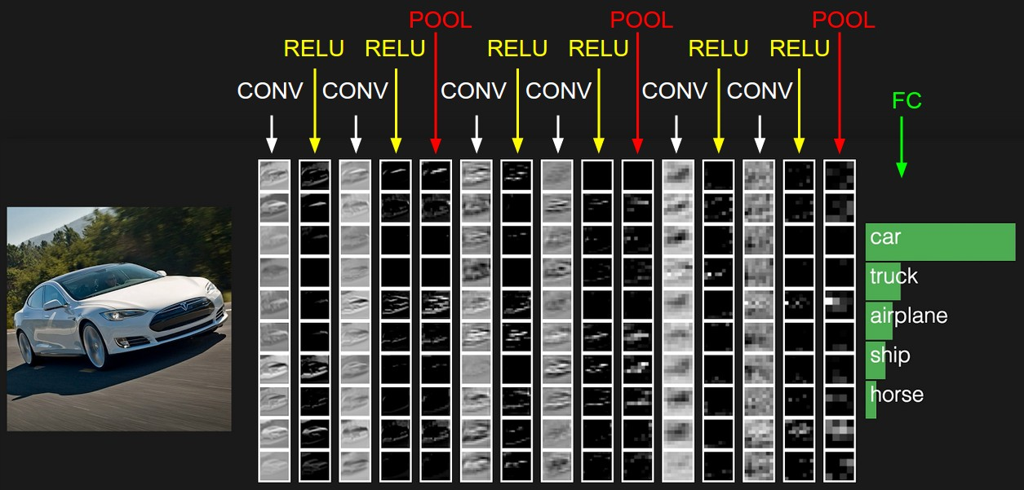
Volumetric 3D Tensor Convolutions
Multichannel Feature Mapping Across Spatial and Depth Dimensions
Multichannel Tensor Flow
• Tensor Volume Shape: Input tensor (C_{in} x H x W) is processed by C_{out} separate 3D filters, each having shape (C_{in} x K_h x K_w).
• Channel-Wise Summation: Each 3D filter computes 2D convolutions across all C_{in} channels simultaneously, summing the results into one 2D feature map slice.
• Channel Expansion: Stacking C_{out} filter responses produces the output volume of shape (C_{out} x H_{out} x W_{out}).
Stanford CS231n Volumetric Convolution: C_in x H x W Convolved into C_out Feature Maps
12 / 39

Slide 13
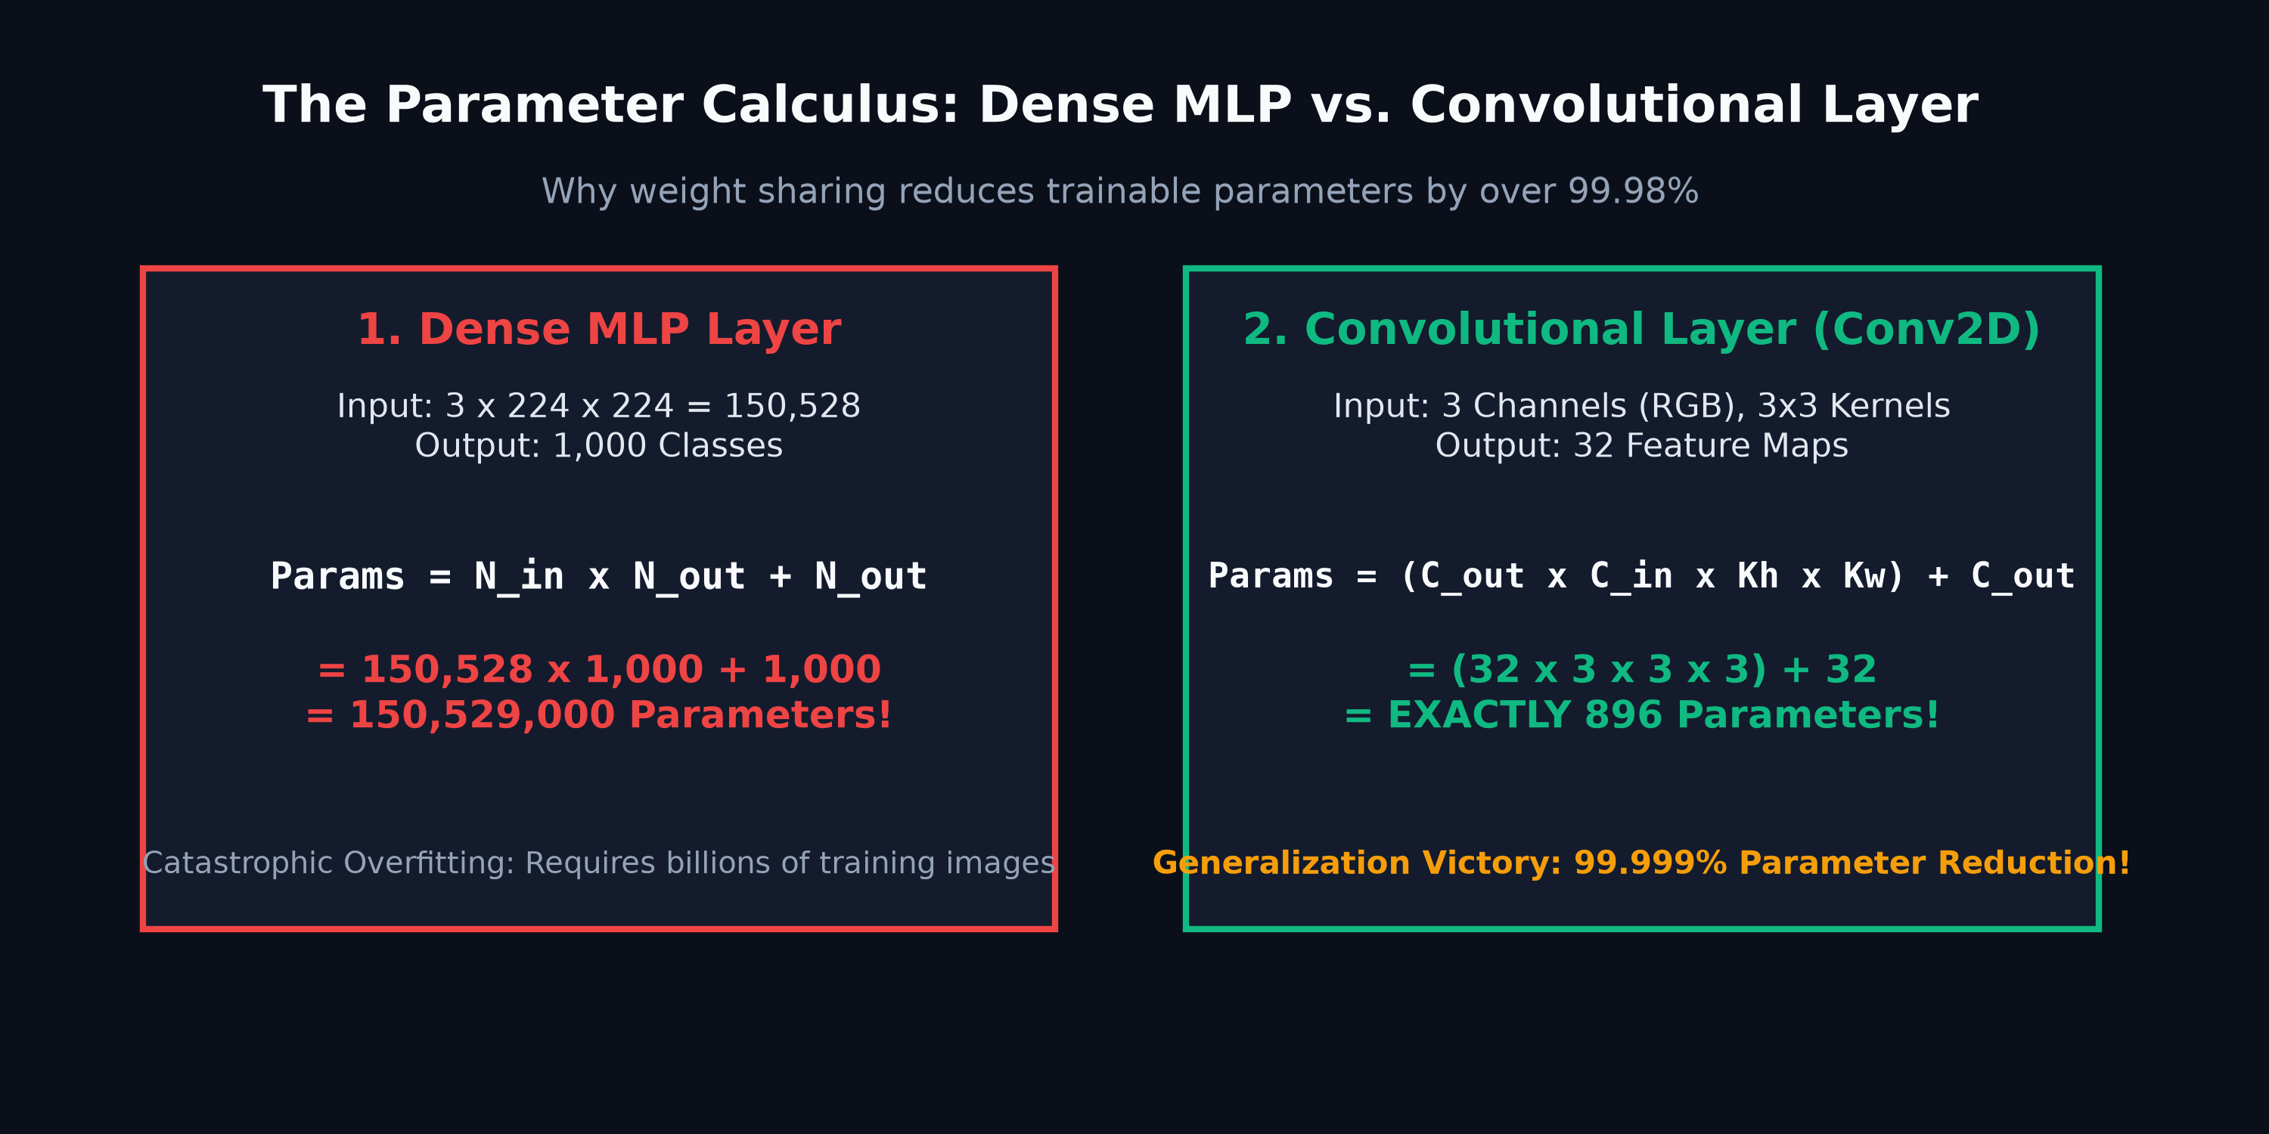
Universal Parameter Counting Formulation
Exact Parameter Derivation Independent of Spatial Input Resolution
Exact Mathematical Derivation
• Universal Parameter Equation: Total learnable weights: Params = (K_h * K_w * C_{in} + 1) * C_{out}, where +1 accounts for the per-filter bias.
• Resolution Independence: The parameter count depends strictly on kernel dimensions and channel counts, completely independent of input image height (H) and width (W).
• Concrete Example: A layer with K = 3, C_{in} = 64, C_{out} = 128 requires (3 * 3 * 64 + 1) * 128 = 73,856 parameters.
Analytical Parameter Breakdown: (Kernel Area x Input Channels + Bias) x Output Channels
13 / 39

Slide 14
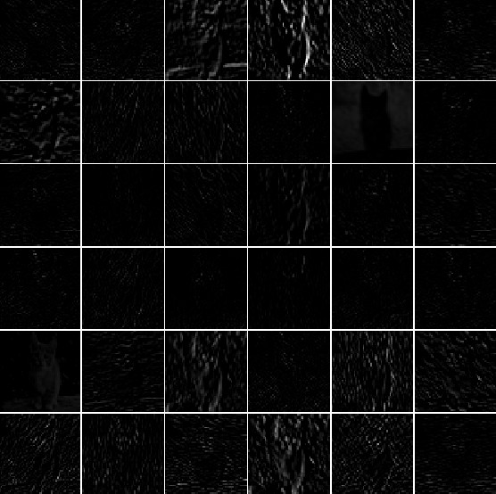
Non-Linear Activations & Sparsity
Rectified Linear Unit (ReLU) Mechanics and Gradient Flow Preservation
ReLU Activation Dynamics
• The ReLU Definition: f(x) = max(0, x), with analytical derivative f'(x) = 1 for x > 0 and 0 for x < 0.
• Vanishing Gradient Cure: Unlike Sigmoid/Tanh which saturate at extreme values, ReLU maintains a constant gradient of 1, enabling stable training of 100+ layer networks.
• Induced Sparsity: Deactivating negative activations creates biological-like sparse representations (~50% active neurons), improving generalization.
Visualizing Spatial Activation Maps After Non-Linear ReLU Filtering
14 / 39

Slide 15
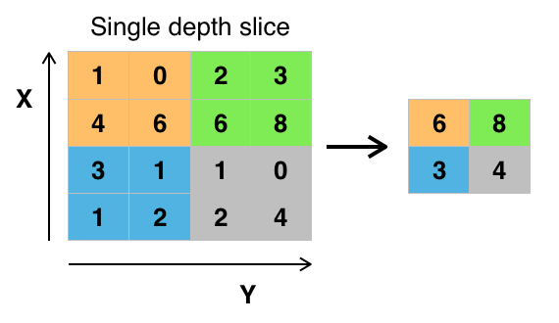
Spatial Downsampling & Max Pooling
Translation Invariance Induction and Dimensionality Reduction
Spatial Downsampling
• Max Pooling Operation: Slides a 2 x 2 window with stride 2, retaining the maximum activation and discarding 75% of spatial coordinates.
• Translation Invariance: Small translations or deformations in the input feature map do not change the pooled maximum value, improving spatial robustness.
• Zero Learnable Parameters: Pooling is a deterministic spatial operation requiring zero parameters, reducing memory footprint and computational FLOPs.
Max Pooling 2x2 with Stride 2: Extracts Peak Activation per Local Quadrant
15 / 39

Slide 16
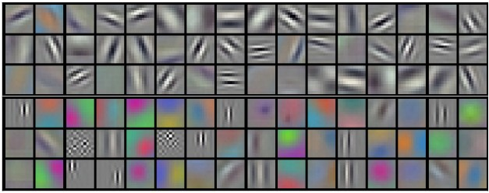
Hierarchical Feature Representation
Visual Progression from Low-Level Edges to High-Level Semantic Concepts
Hierarchical Abstraction
• Shallow Layers (V1): Filters learn localized oriented Gabor-like edges, color contrasts, and boundary primitives.
• Intermediate Layers: Convolutions combine simple edges into geometric textures, corners, junctions, and contour curves.
• Deep Layers: Receptive fields span the entire object, assembling semantic class detectors (wheels, eyes, faces, class templates).
Visual Feature Abstraction Progression: Edges -> Textures -> Parts -> Objects
Learned Convolutional Filter Weights Visualized as Spatial Patterns
16 / 39

Slide 17
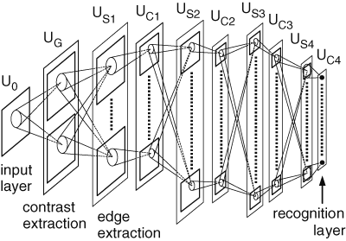
Architectural Milestone: Neocognitron (1980)
Kunihiko Fukushima's Bio-Inspired Ancestor of Convolutional Neural Networks
The Biological Computational Ancestor
• S-Cells & C-Cells: Directly embodied Hubel & Wiesel's neurobiology: S-cells extract localized oriented features, while C-cells pool responses to provide shift tolerance.
• Self-Organizing Architecture: Introduced multi-layered hierarchical visual processing without backpropagation, establishing the foundational alternating conv-pool design.
• Translation Invariance: First computational neural model capable of recognizing deformed and translated patterns through localized receptive field hierarchies.
Neocognitron (Fukushima, 1980): Hierarchical Alternation of S-Layers and C-Layers
17 / 39

Slide 18
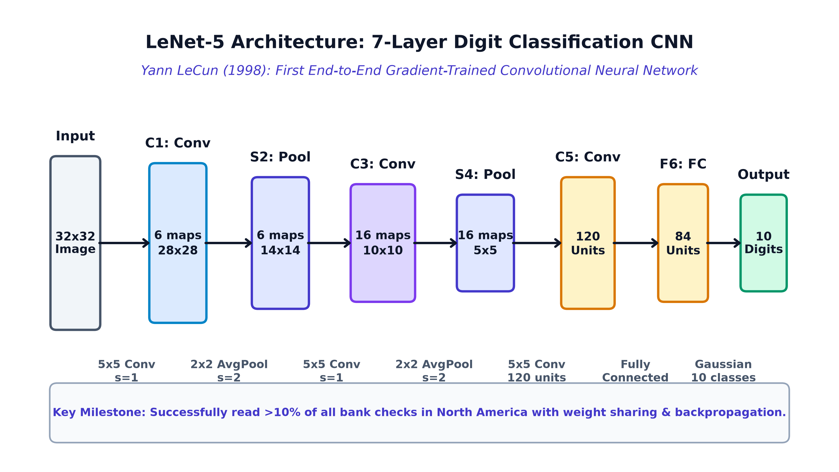
Architectural Milestone: LeNet-5 (1998)
Yann LeCun's End-to-End Gradient-Based Convolutional Network for Digit Recognition
Genesis of Modern Deep Vision
• End-to-End Gradient Optimization: Pioneered joint feature extraction and classification optimized simultaneously via backpropagation: Input -> C1 -> S2 -> C3 -> S4 -> C5 -> F6 -> Output.
• Shift and Distortion Robustness: Replaced fragile manual feature extractors with weight-shared convolutional filters and subsampling layers.
• Commercial Validation: Successfully deployed by US banks to read over 10% of all checks in North America during the late 1990s.
LeNet-5 Architecture: 7 Layers of Alternating Convolutions and Subsampling
18 / 39

Slide 19
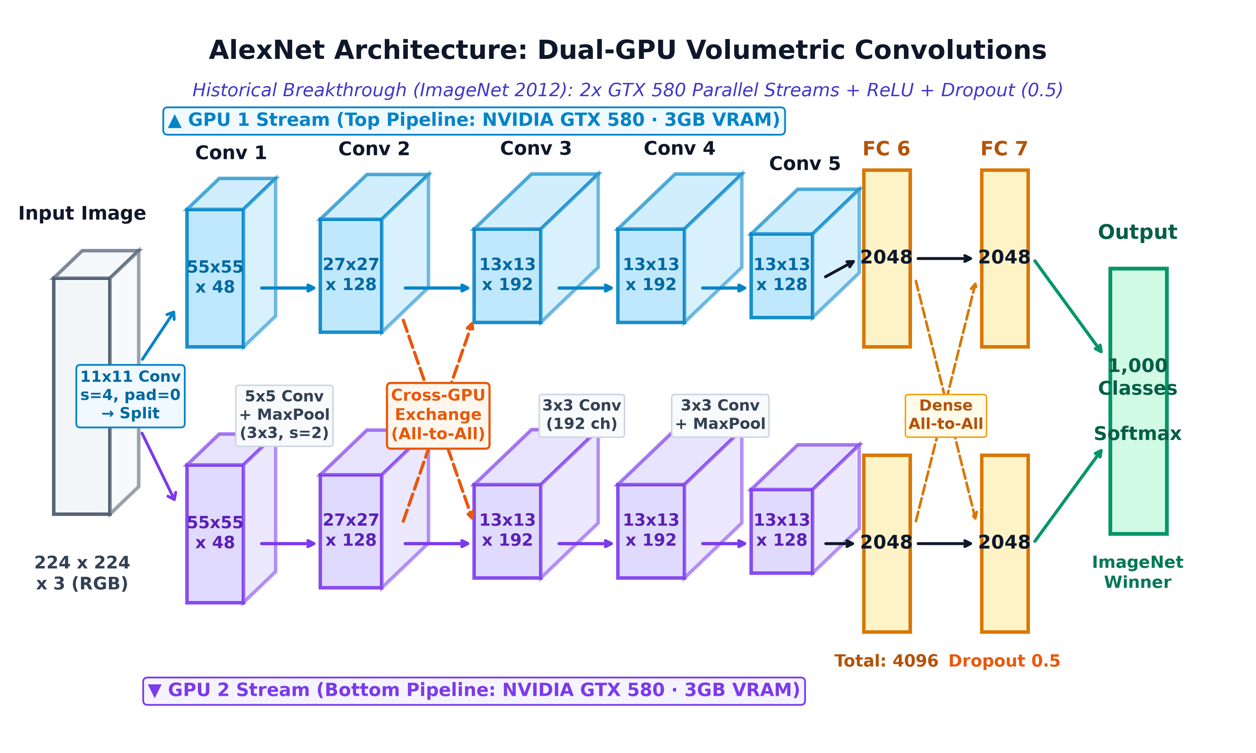
Architectural Milestone: AlexNet (2012)
The ImageNet Breakthrough That Ignited the Modern Deep Learning Revolution
The Modern Deep Learning Revolution
• Historical Breakthrough: Crushed traditional computer vision by winning ImageNet 2012 with a top-5 error of 16.4% (vs. 26.2% for the runner-up).
• Modern Technical Suite: First to combine ReLU non-linearities (6x faster training), Dropout regularization (0.5), and data augmentation to prevent overfitting.
• GPU Parallel Acceleration: Engineered across two NVIDIA GTX 580 GPUs with cross-channel grouping, unlocking large-scale visual representation learning.
AlexNet Architecture: 8 Layers Split Across Dual-GPU Parallel Processing Pipelines
19 / 39

Slide 20
Architectural Milestone: VGGNet (2014)
The Power of Simplicity: Standardizing Homogeneous 3x3 Convolution Stacks
The 3x3 Convolution Standard
• Filter Factorization: Proved that two stacked 3x3 convolutions have an effective 5x5 receptive field, and three have 7x7, while saving 28% parameters and adding non-linearities.
• Homogeneous Modular Design: Replaced diverse kernel sizes with clean, uniform convolutional blocks: Conv(3x3) -> BatchNorm -> ReLU -> MaxPool(2x2).
• Deep Backbone Standard: VGG-16 and VGG-19 established the standard deep feature extraction backbone across computer vision transfer learning.
VGG-16 Architecture: 5 Homogeneous 3x3 Convolutional Blocks + Fully-Connected Head
20 / 39

Slide 21
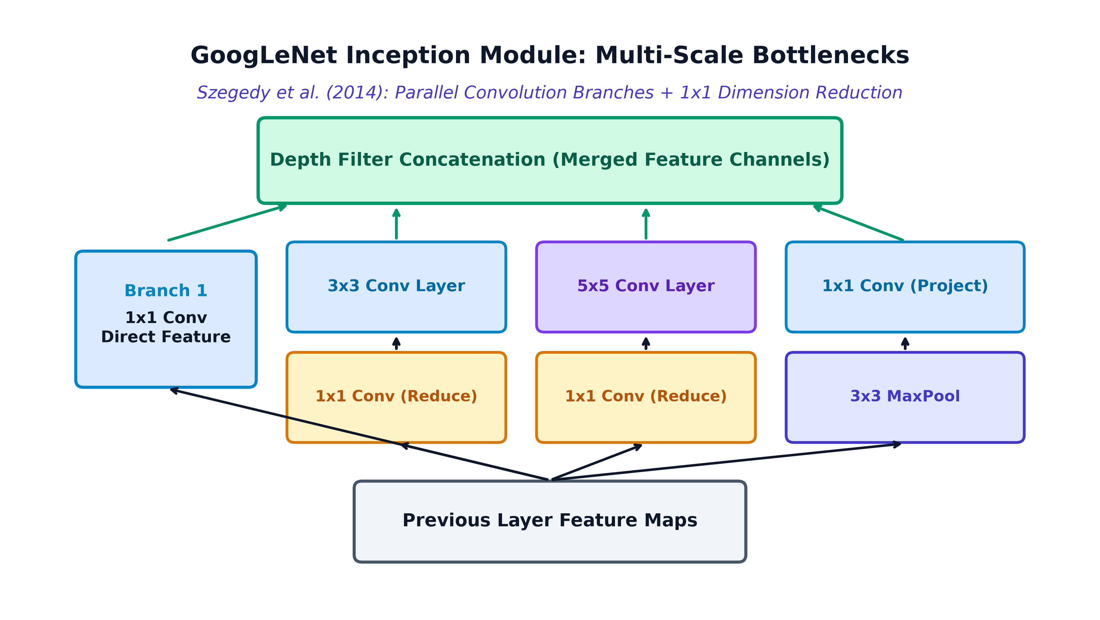
Architectural Milestone: GoogLeNet / Inception (2014)
Multi-Scale Feature Processing and 1x1 Bottleneck Dimensionality Reduction
Multi-Scale Efficiency
• Multi-Scale Inception Modules: Processes input features simultaneously at multiple spatial scales (1x1, 3x3, 5x5) and pooling in parallel, concatenating depth responses.
• 1x1 Bottleneck Convolutions: Introduced 1x1 convolutions for channel-dimension reduction before expensive 3x3 and 5x5 filters, curbing computational complexity.
• Global Average Pooling: Replaced massive fully-connected layers with Global Average Pooling (GAP), dropping total model parameters from 138M (VGG) to just 5M.
GoogLeNet Inception Module: Parallel Multi-Scale Convolutions + 1x1 Channel Bottlenecks
21 / 39

Slide 22
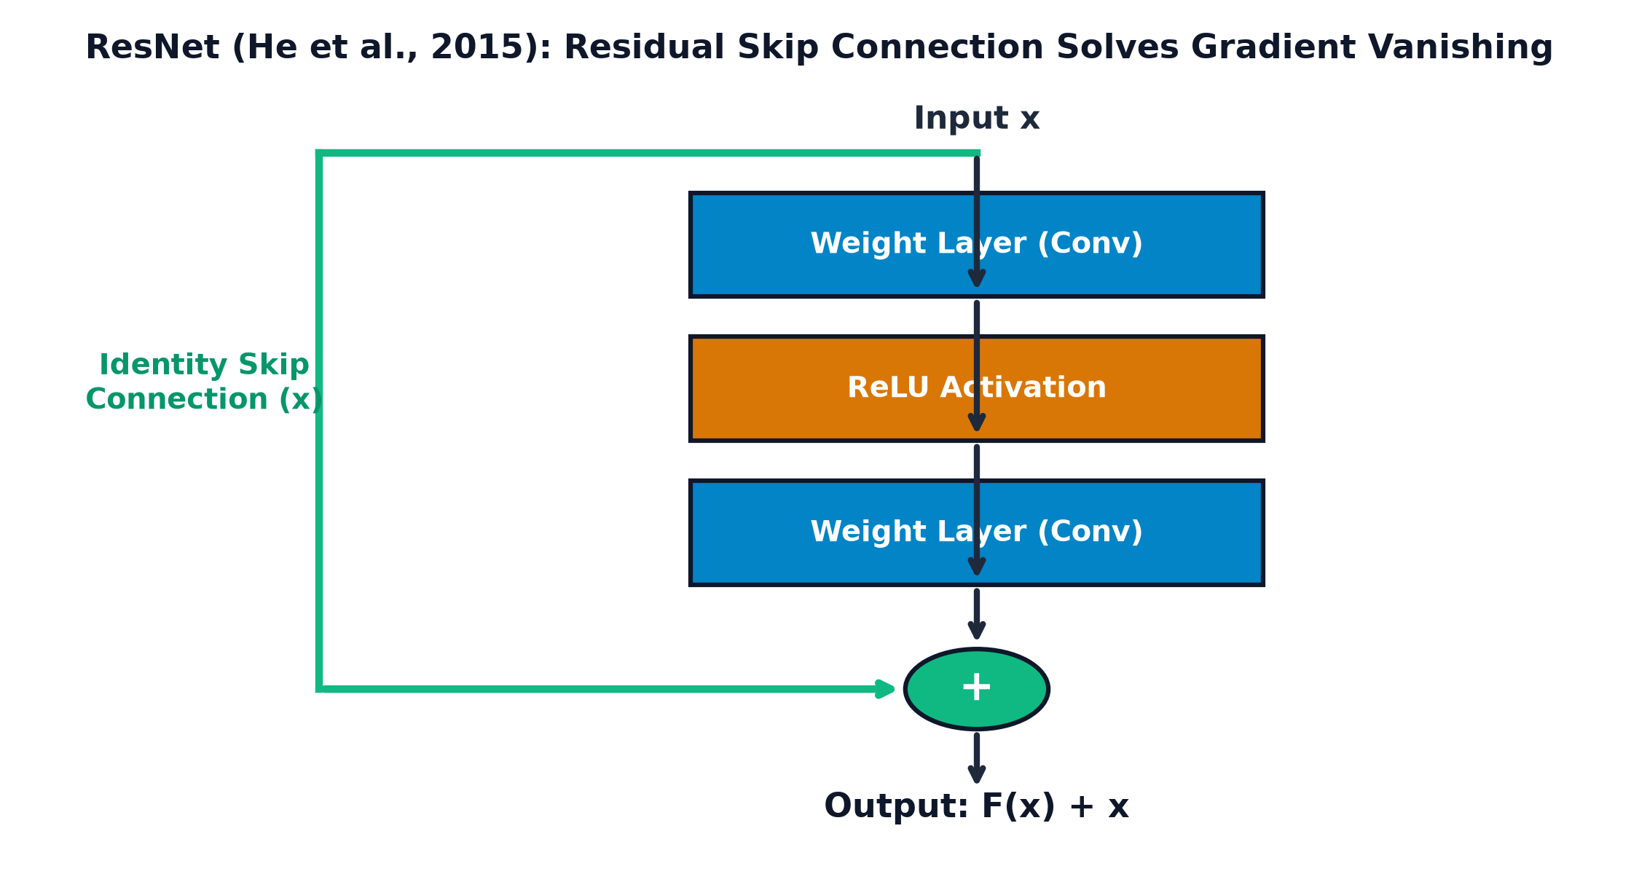
Architectural Milestone: ResNet (2015)
Deep Residual Learning: Conquering the Degradation Ceiling with Identity Skip Highways
Deep Residual Learning
• The Degradation Dilemma: Beyond ~20 layers, plain networks suffer accuracy degradation (higher training error), not caused by overfitting but vanishing gradients.
• Identity Skip Highway: Formulated residual learning: H(x) = F(x) + x. The identity connection ensures gradient flow dH/dx = dF/dx + 1 directly back to early layers.
• Superhuman Accuracy: Scaled to 152 layers, winning ImageNet 2015 with a record 3.57% top-5 error, surpassing human-level visual performance (5.1%).
ResNet Residual Block: Identity Connection H(x) = F(x) + x Providing Direct Gradient Flow
22 / 39

Slide 23
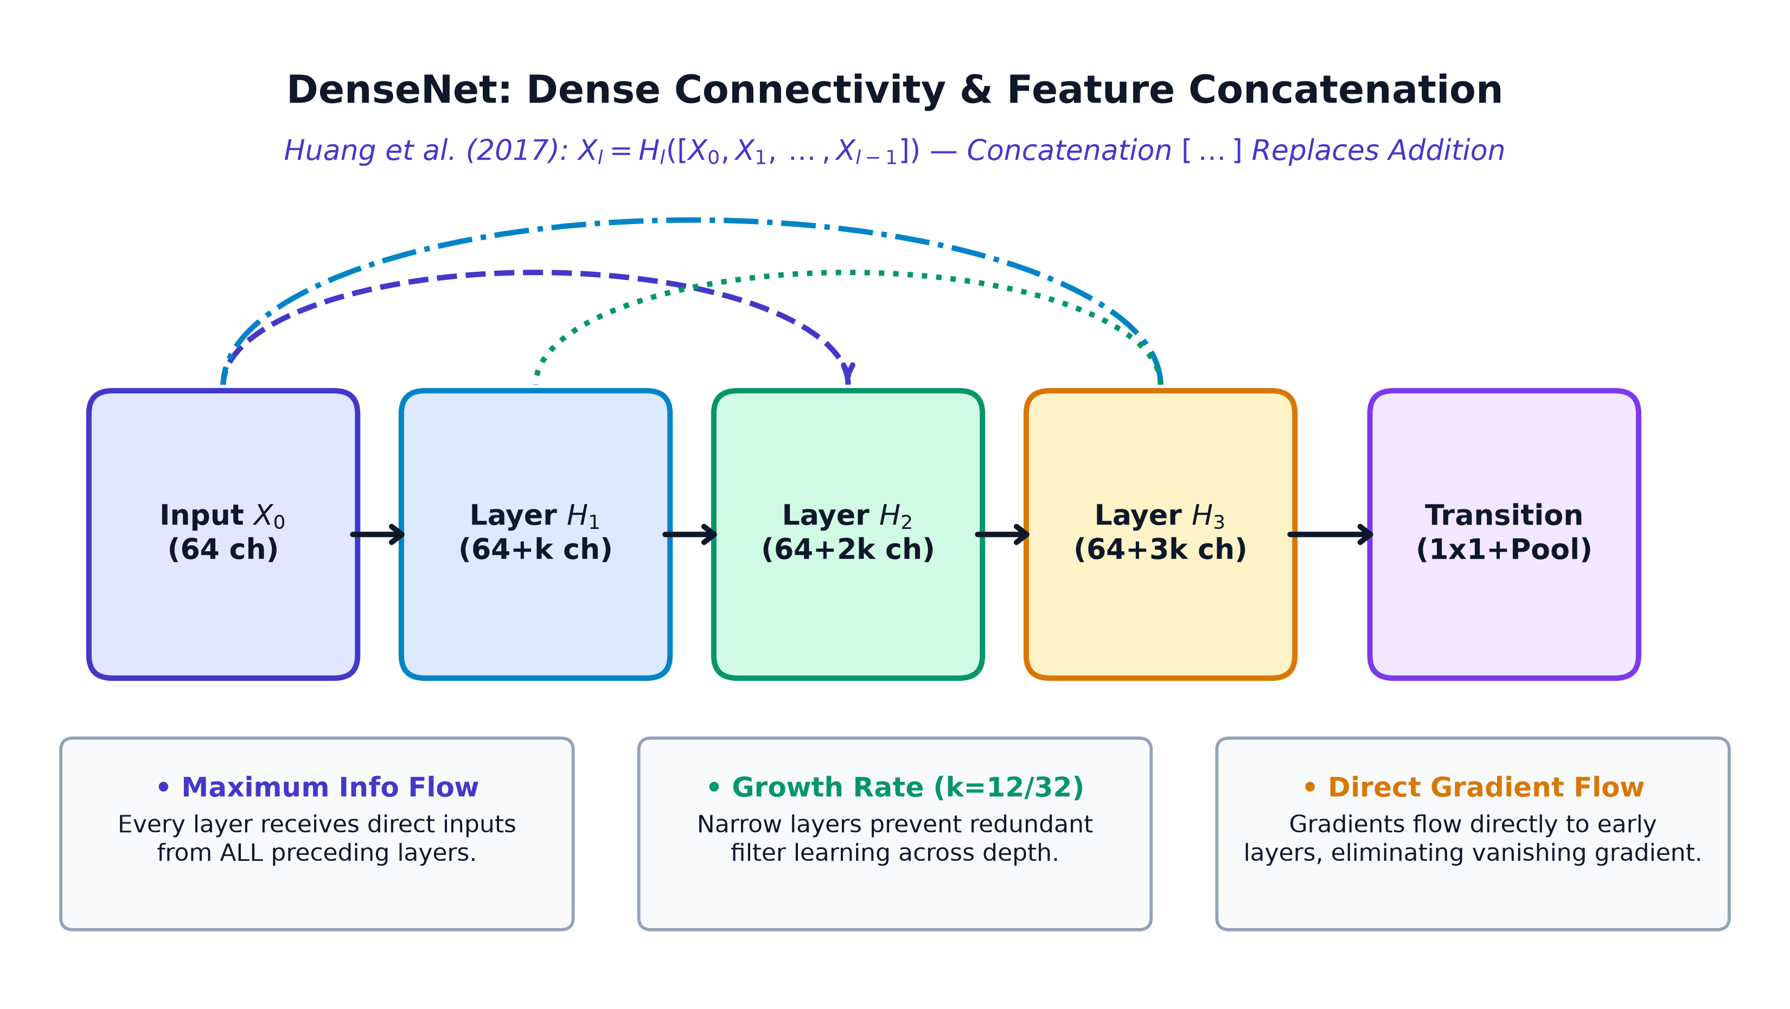
Architectural Milestone: DenseNet (2017)
Dense Connectivity & Feature Reuse: Concatenation Replaces Residual Addition
Dense Feature Concatenation
• Full Feed-Forward Connectivity: Connects each layer to all subsequent layers: X_l = H_l([X_0, X_1, ..., X_{l-1}]), passing feature maps directly via concatenation.
• Compact Growth Rate (k): Each layer contributes only k new feature channels (k=12 to 32), preventing redundant filter learning and shrinking parameters.
• Direct Gradient Flow: Eliminates vanishing gradients by ensuring early layers receive loss gradients directly from the loss function.
DenseNet Architecture: Dense Block Connectivity with k Growth Rate & Transition Layers
23 / 39

Slide 24
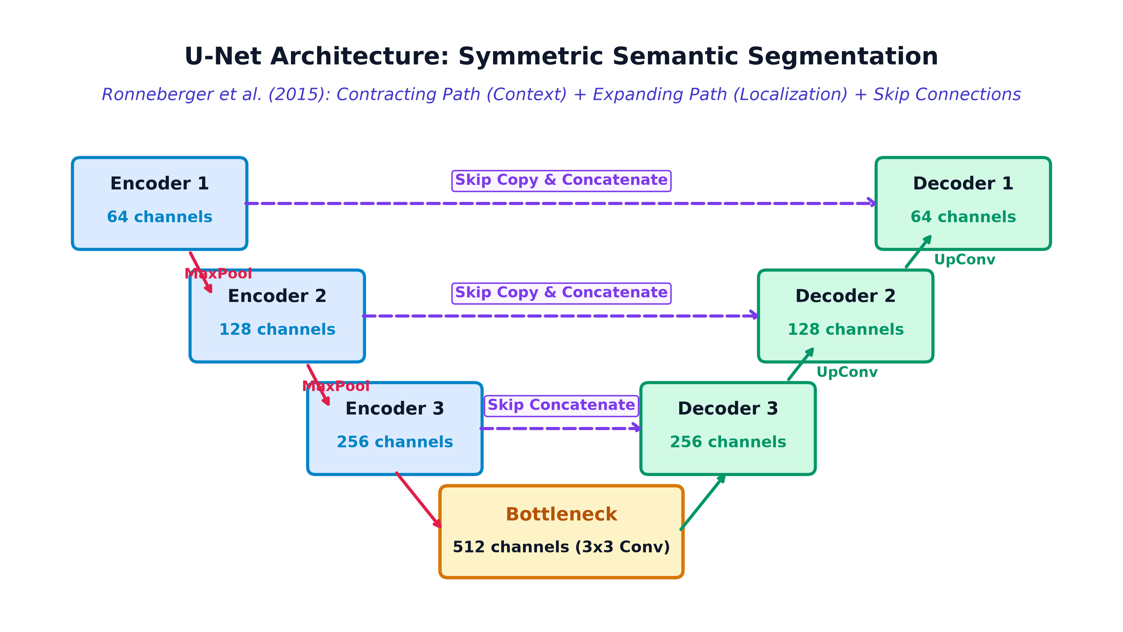
Architectural Milestone: U-Net (2015)
Symmetric Encoder-Decoder Network for Dense Pixel-Level Semantic Segmentation
Dense Semantic Segmentation
• Dense Prediction Paradigm: Transitions from global classification (Image -> Class) to dense pixel-level labeling (Image -> Segmentation Mask).
• Contracting & Expanding Paths: Encoder contracts spatial dimensions to capture context; symmetrical decoder upsamples feature maps to restore precise spatial resolution.
• Direct Skip Copy Channels: High-resolution skip connections directly copy spatial feature maps from encoder to decoder, preserving crisp object boundaries.
U-Net Architecture: Contracting Encoder + Expanding Decoder + Horizontal Skip Connections
24 / 39

Slide 25
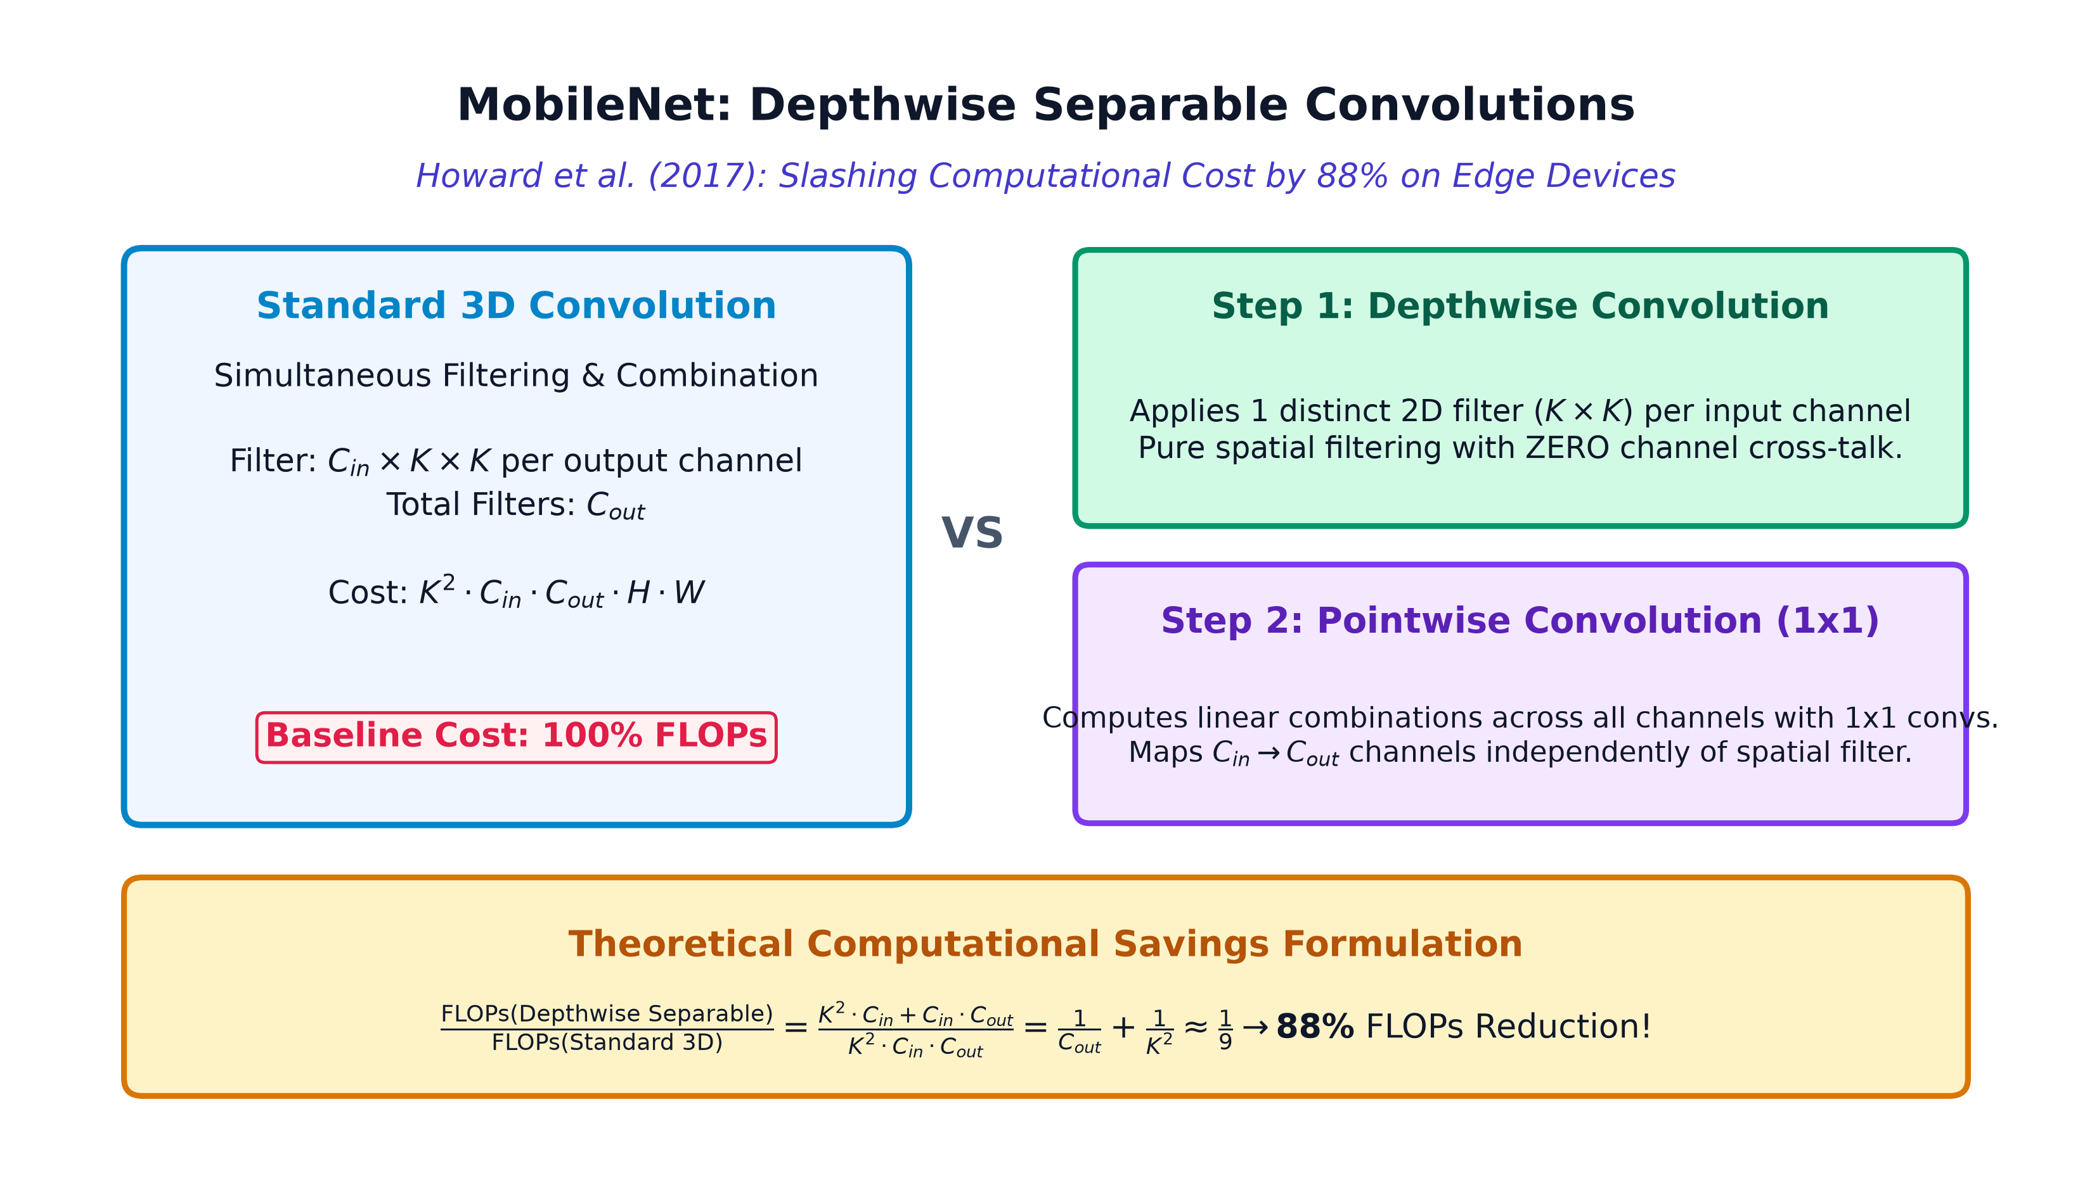
Architectural Milestone: MobileNet (2017)
Depthwise Separable Convolutions: 8x to 9x FLOP Reduction for Edge Devices
Edge & Mobile Efficiency
• Depthwise Factorization: Splits standard 3D convolutions into two steps: Depthwise Conv (spatial filtering per channel) + Pointwise Conv (1x1 channel combination).
• Massive Computational Savings: Reduces multiplication FLOPs by 1/N + 1/K^2 ≈ 8x to 9x compared to standard convolutions with only ~1% top-1 accuracy loss.
• Real-Time Mobile Vision: Enabled real-time high-accuracy deep computer vision on battery-powered mobile phones, embedded robotics, and edge IoT devices.
MobileNet Factorization: Depthwise (Spatial) + Pointwise (Channel) = 88% FLOPs Reduction
25 / 39

Slide 26
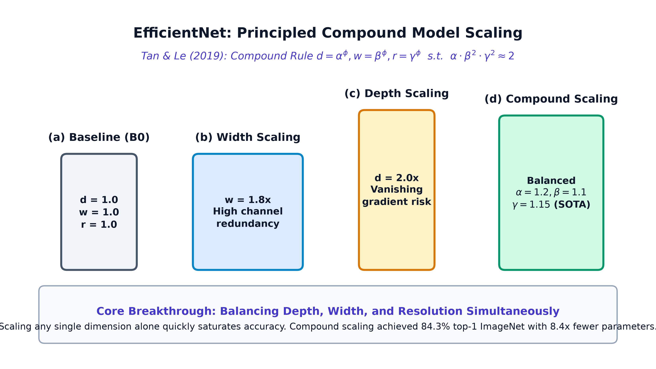
Architectural Milestone: EfficientNet (2019)
Principled Compound Model Scaling Across Depth, Width, and Input Resolution
Principled Model Scaling
• Compound Scaling Principle: Systematically balances Depth (alpha), Width (beta), and Resolution (gamma) via: alpha * beta^2 * gamma^2 ≈ 2 under a unified compound coefficient phi.
• Eliminating Scaling Bottlenecks: Proved that scaling only width, depth, or resolution quickly saturates; balanced co-scaling yields superior accuracy at lower FLOPs.
• State-of-the-Art Efficiency: EfficientNet-B7 reached 84.3% top-1 ImageNet accuracy while being 8.4x smaller and 6.1x faster than prior state-of-the-art networks.
EfficientNet Compound Scaling: Balanced Growth of Depth, Width, and Resolution
26 / 39

Slide 27
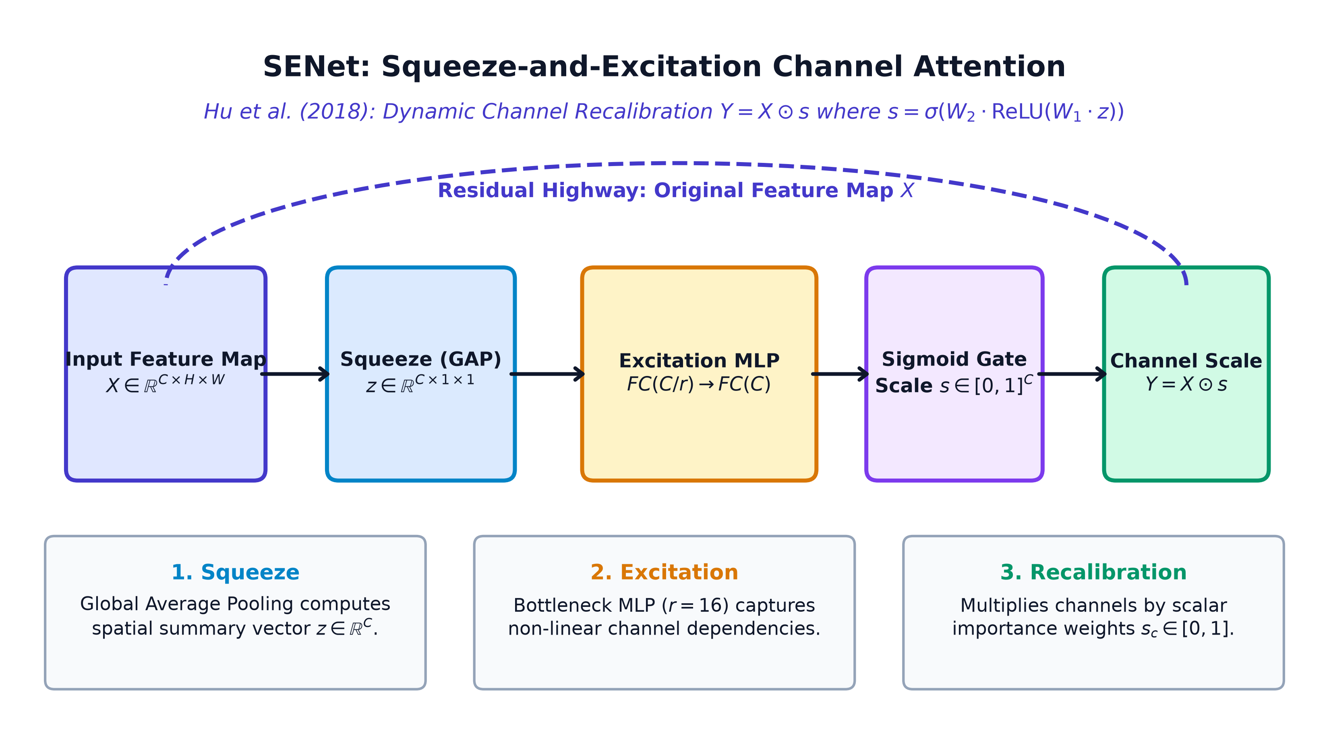
Architectural Milestone: SENet (2018)
Adaptive Channel Attention: Dynamic Channel Recalibration (Y = X ⊙ s)
Channel-Wise Attention Gating
• Squeeze Operation: Global Average Pooling (GAP) aggregates global spatial context into a 1x1xC channel descriptor vector z.
• Excitation Gating: A two-layer bottleneck MLP (FC -> ReLU -> FC -> Sigmoid) models non-linear channel interdependencies with reduction ratio r=16.
• Dynamic Recalibration: Reweights each channel by scalar activation s_c in [0, 1], dynamically amplifying task-salient features while suppressing background noise.
SENet Squeeze-and-Excitation Block: Global Squeeze + MLP Excitation + Channel Recalibration
27 / 39

Slide 28
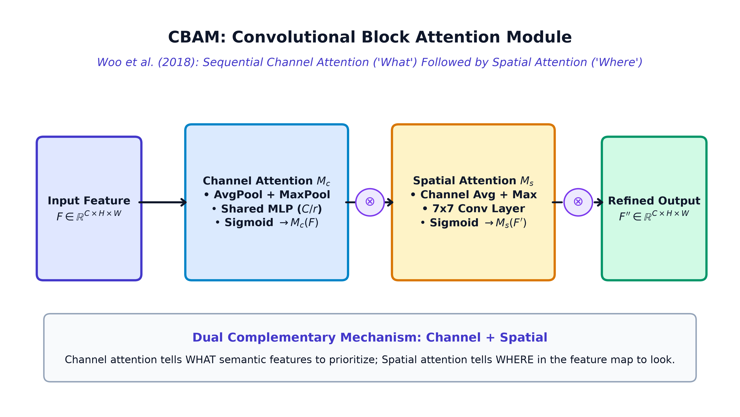
Architectural Milestone: CBAM (2018)
Convolutional Block Attention Module: Sequential Channel and Spatial Refinement
Dual Sequential Attention
• Sequential Dual Attention: Combines Channel Attention (learning 'What' features are important) followed by Spatial Attention (learning 'Where' to look).
• Dual Pooling Aggregation: Utilizes both Average-Pooling (background features) and Max-Pooling (distinct object features) inside attention generation.
• Plug-and-Play Integration: Lightweight attention block with negligible parameter overhead, easily integrated into standard ResNet or MobileNet architectures.
CBAM Sequential Attention: Channel Module (What) -> Spatial Module (Where) -> Refined Tensor
28 / 39

Slide 29
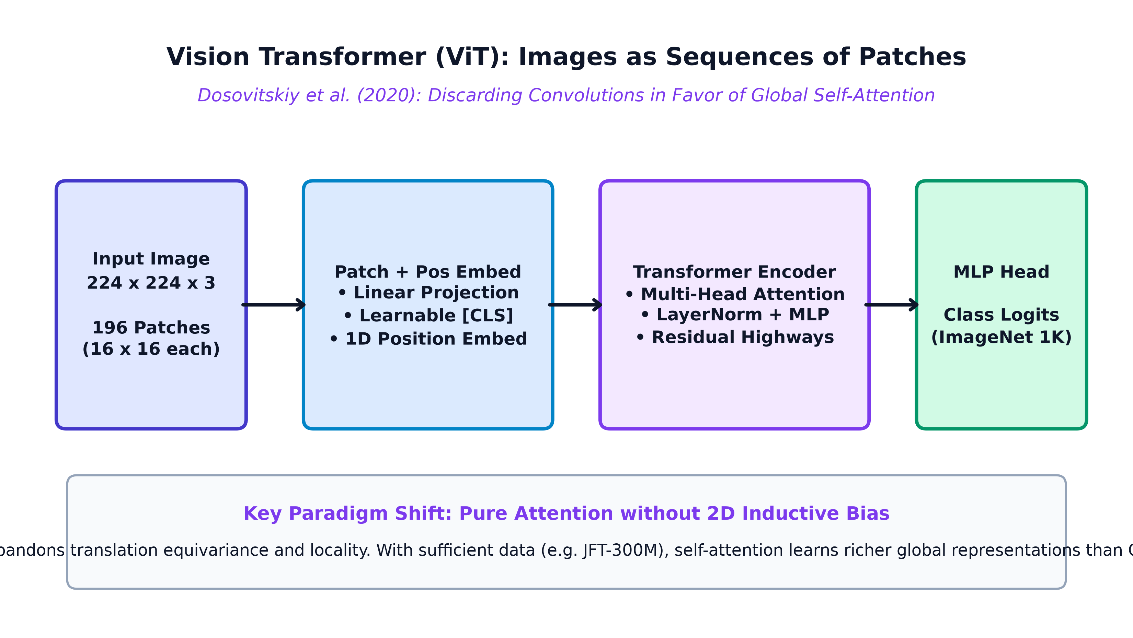
Architectural Milestone: Vision Transformer (2020)
An Image is Worth 16x16 Words: Discarding Convolutions for Global Self-Attention
Tokenized Visual Transformers
• Patch Tokenization: Unfolds a 224x224x3 image into 196 non-overlapping 16x16 patches, linearly projecting each into a latent 1D embedding token.
• Pure Self-Attention: Processes tokens via Multi-Head Self-Attention: Attention(Q,K,V) = softmax(QK^T / sqrt(d_k)) V, capturing global context across the entire image.
• Massive Scale Dominance: Eliminates spatial inductive priors in favor of high model capacity, outperforming CNNs when pretrained on massive datasets (JFT-300M).
Vision Transformer (ViT): Patch Embedding -> Transformer Encoder -> Multi-Head Self-Attention
29 / 39

Slide 30
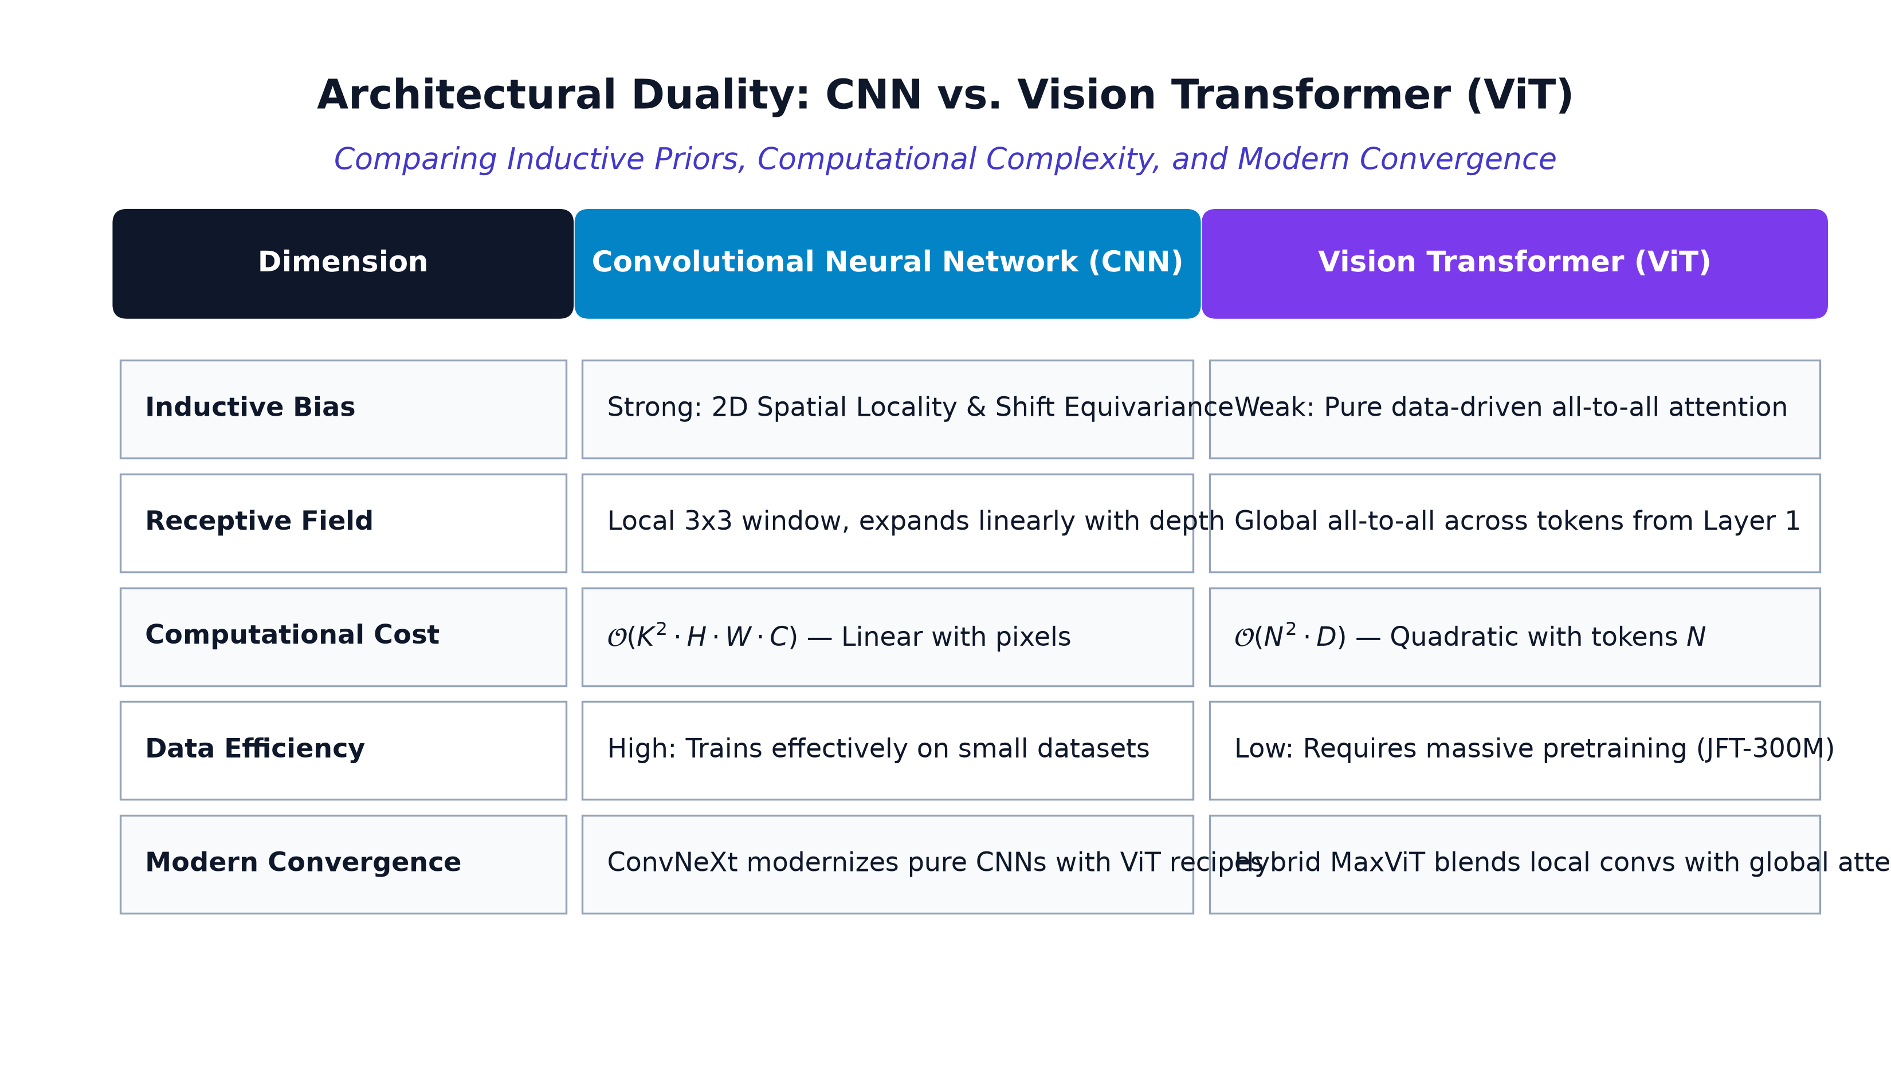
Architectural Paradigm: CNN vs. Vision Transformer
Comparing Inductive Priors, Computational Complexity, and Modern Frontiers
Architectural Tradeoff Synthesis
• Inductive Bias Dichotomy: CNNs encode hard spatial priors (locality & shift equivariance), while ViTs learn relationships entirely from raw data with zero geometric assumptions.
• Computational Asymmetry: Convolutions scale linearly with pixel resolution O(K^2 H W), whereas standard self-attention scales quadratically with tokens O(N^2).
• Modern Convergence: State-of-the-art vision models unite both worlds: ConvNeXt modernizes pure CNNs with ViT design, while MaxViT blends local convs with global attention.
Inductive Bias & Tradeoff Matrix: Local Convolutions vs. Global Self-Attention
30 / 39

Slide 31
Canonical CNN Architecture Pipeline
The Standard Topology from Raw Input Pixels to Class Logits
Canonical Visual Pipeline
• Feature Extraction Backbone: Alternating blocks of Convolution, ReLU activation, and Spatial Pooling progressively extract invariant feature representations.
• Transition to Classification: Global spatial pooling or flattening compresses high-dimensional feature volumes into a compact 1D latent representation.
• Decision Head: Fully-connected layers followed by Softmax compute categorical probability distributions over target classes.
End-to-End CNN Pipeline: Input -> Feature Extractor Backbone -> Classifier Head
31 / 39

Slide 32
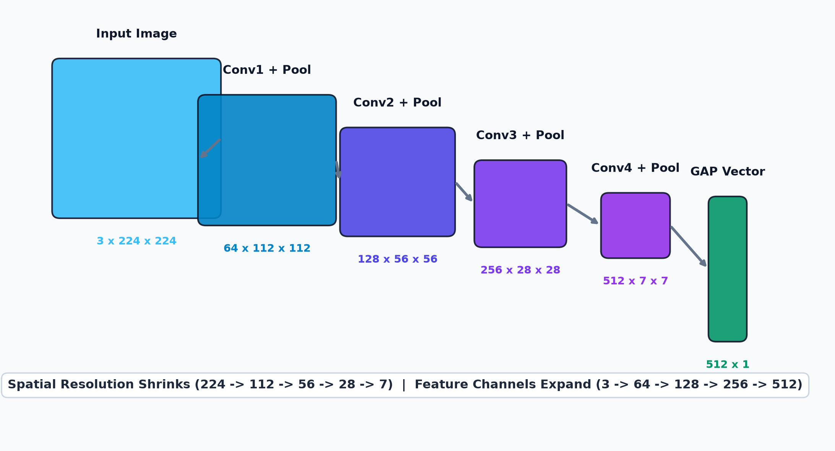
Tensor Contraction & Channel Expansion
Geometric Downsampling Paired with Semantic Capacity Growth
Tensor Flow Dynamics
• Spatial Resolution Contraction: Spatial dimensions contract geometrically: 224x224 -> 112x112 -> 56x56 -> 28x28 -> 7x7 via pooling and strided convolutions.
• Channel Capacity Growth: Channel counts expand inversely: 3 -> 64 -> 128 -> 256 -> 512, allocating greater capacity to rich semantic combinations.
• Conservation of Information: Local pixel redundancy is traded for abstract, translation-invariant semantic feature vectors.
Tensor Flow: Spatial Contraction [224 -> 7] & Channel Expansion [3 -> 512]
32 / 39

Slide 33
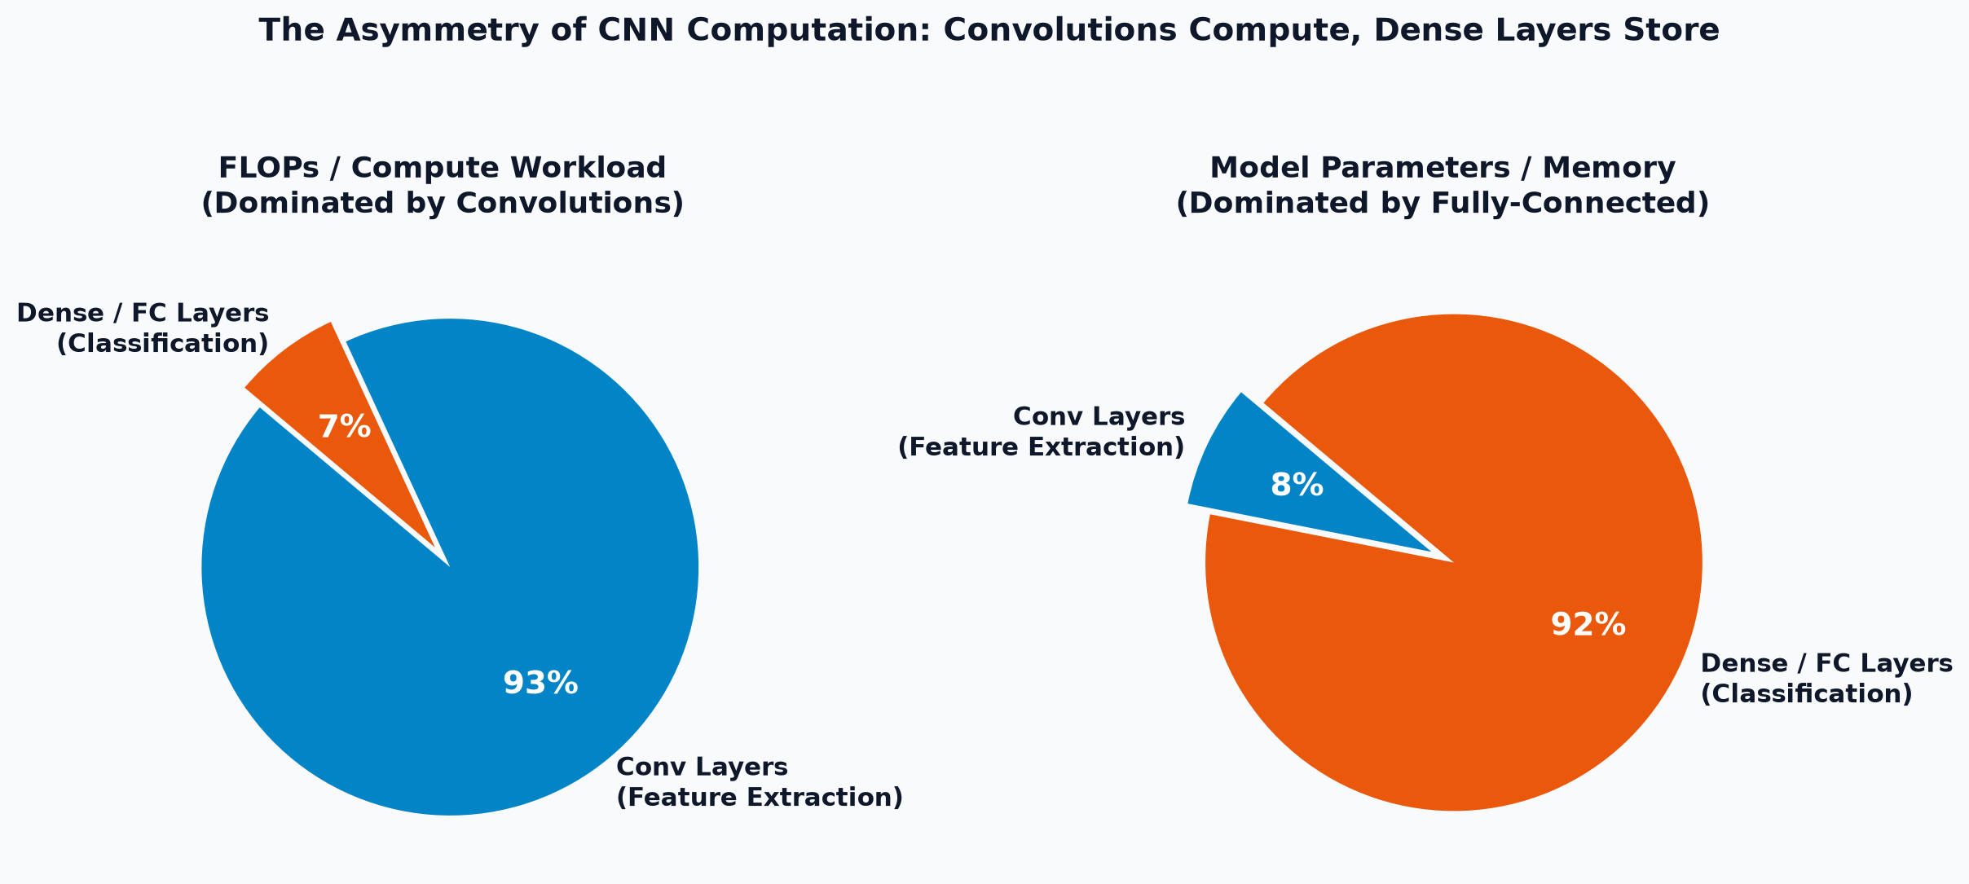
Computational Asymmetry: FLOPs vs. Parameters
Convolutions Dominate Compute; Fully-Connected Layers Dominate Memory
System Resource Tradeoffs
• Compute Bottleneck (FLOPs): Convolutions consume >90% of total floating-point operations due to sliding window dot products across high-resolution grids.
• Memory Bottleneck (Parameters): Fully-connected layers account for >90% of model weights due to dense pairwise matrix multiplication.
• Modern Solution: Global Pooling: Modern architectures replace dense layers with Global Average Pooling (GAP), eliminating millions of redundant parameters.
Workload Asymmetry: Convolutions Consume Compute; Dense Layers Consume Memory
33 / 39

Slide 34
Three Architectural Abstraction Paradigms
From Low-Level Vectorized Matrix Math to Declarative & Imperative Frameworks
LEVEL 1
NumPy (From Scratch)
• Vectorized im2col: Flattens sliding windows into matrices for BLAS GEMM
• Manual Backprop: Analytical col2im gradient redistribution
• Educational Value: 100% transparency of internal tensor mechanics
LEVEL 2
Keras (Declarative)
• Declarative Graph: High-level layers.Conv2D and layers.MaxPooling2D
• Automated Graph: Automated forward/backward graph compilation
• Rapid Prototyping: Streamlined workflow for rapid model experimentation
LEVEL 3
PyTorch (Imperative)
• Dynamic Autograd: Imperative forward execution with automatic C++ differentiation
• Pythonic Debugging: Direct tensor inspection and custom hook instrumentation
• Production Standard: The dominant framework in modern deep learning research
34 / 39

Slide 35
Cross-Framework Component Rosetta Stone
Direct Structural Translation Across NumPy (Scratch), Keras (Declarative), and PyTorch (Imperative)
Primitive Concept | NumPy (From Scratch) | Keras (Declarative Graph) | PyTorch (Imperative Autograd)
2D Convolution | Y_col = np.dot(W_row, X_col) | layers.Conv2D(32, (3, 3), padding='same') | nn.Conv2d(in_ch, out_ch, kernel_size=3)
Non-Linearity | a = np.maximum(0, z) # ReLU | layers.Activation('relu') / layers.ReLU() | torch.relu(z) / nn.ReLU()
Spatial Pooling | max_pool2d_scratch( X, pool_size=2) | layers.MaxPooling2D( pool_size=(2, 2)) | nn.MaxPool2d(kernel_size=2, stride=2)
Batch Normalization | gamma * (x - mu) / np.sqrt(var + eps) + beta | layers.BatchNormalization() | nn.BatchNorm2d( num_features)
Backward Pass | dX_col = np.dot( W_row.T, dY_col) | tape.gradient( loss, model.trainable_vars) | loss.backward() # C++ Autograd DAG
Weight Update | W -= learning_rate * dW | optimizer.apply_gradients( zip(grads, vars)) | optimizer.step()
35 / 39

Slide 36
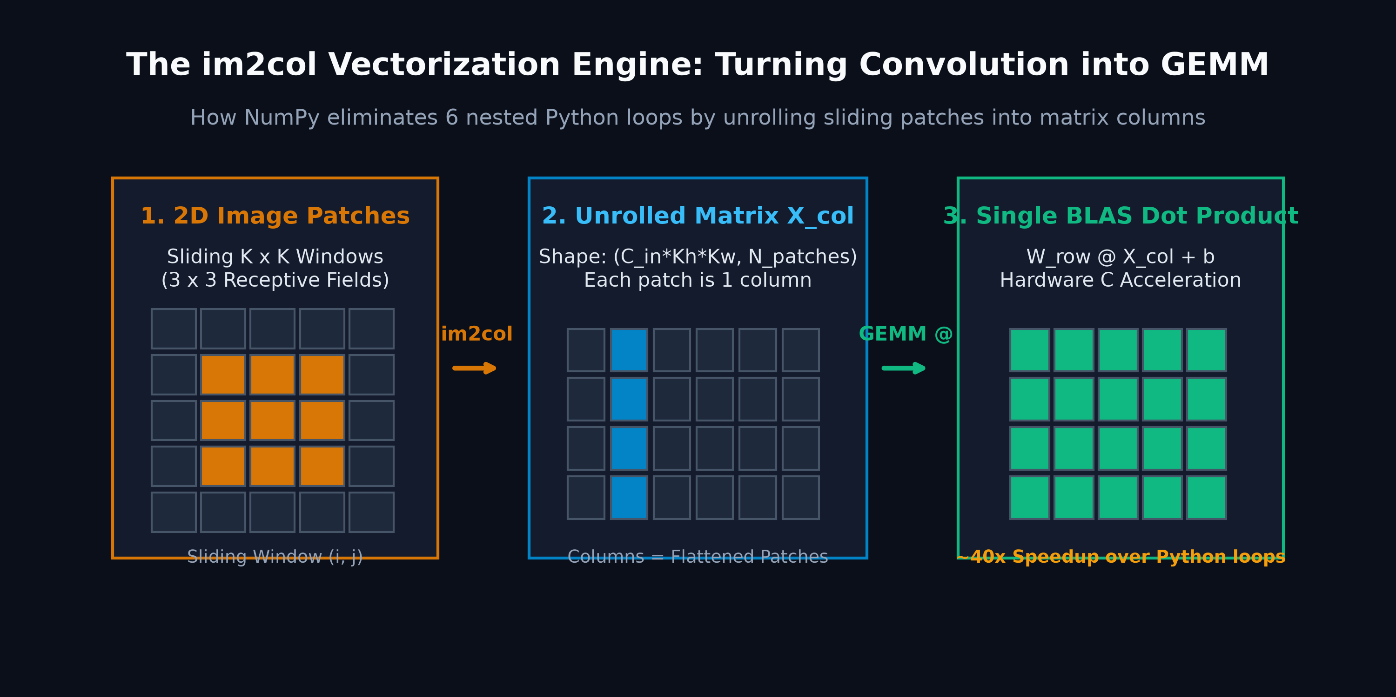
Vectorized Forward Pass: im2col + BLAS GEMM
Transforming Spatial Sliding Windows into High-Performance Matrix Multiplication
conv_forward_im2col.py
# High-Performance Vectorized Convolution via im2col
def conv_forward_im2col(x, w, b, stride=1, pad=1):
N, C, H, W = x.shape
F, _, HH, WW = w.shape
H_out = (H - HH + 2 * pad) // stride + 1
W_out = (W - WW + 2 * pad) // stride + 1
# 1. Unfold sliding receptive patches into 2D column matrix
x_col = im2col_indices(x, HH, WW, padding=pad, stride=stride)
w_row = w.reshape(F, -1)
# 2. Compute convolution via single optimized BLAS GEMM dot product
out = np.dot(w_row, x_col) + b.reshape(-1, 1)
# 3. Reshape back into output tensor volume
out = out.reshape(F, H_out, W_out, N).transpose(3, 0, 1, 2)
return out, (x, w, b, stride, pad, x_col)
im2col Mechanics: Receptive Patches Unfolded into Matrix Columns for BLAS GEMM
36 / 39

Slide 37
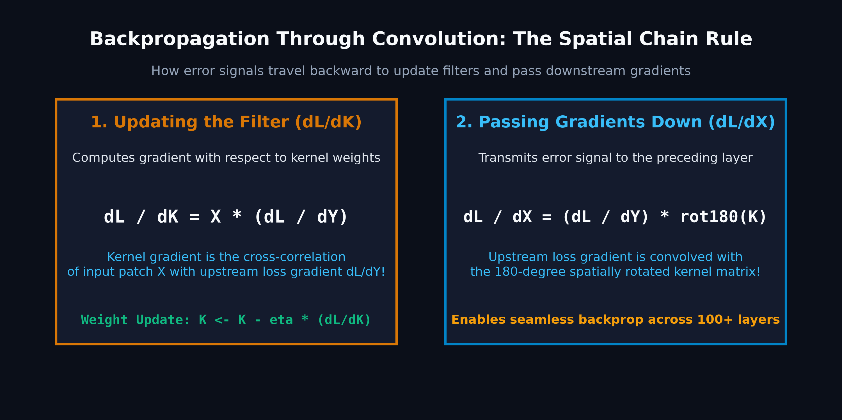
Analytical Convolution Backward Pass (col2im)
Accumulating Backpropagated Gradients Across Overlapping Receptive Fields
conv_backward_im2col.py
# Analytical Gradient Backpropagation via col2im
def conv_backward_im2col(dout, cache):
x, w, b, stride, pad, x_col = cache
F, C, HH, WW = w.shape
# 1. Bias gradient: sum across batch and spatial positions
db = np.sum(dout, axis=(0, 2, 3))
# 2. Reshape upstream gradient for matrix multiplication
dout_reshaped = dout.transpose(1, 2, 3, 0).reshape(F, -1)
# 3. Weight gradient via BLAS matrix product
dw = np.dot(dout_reshaped, x_col.T).reshape(w.shape)
# 4. Input gradient: matrix product followed by col2im folding
w_row = w.reshape(F, -1)
dx_col = np.dot(w_row.T, dout_reshaped)
dx = col2im_indices(dx_col, x.shape, HH, WW, padding=pad, stride=stride)
return dx, dw, db
Analytical col2im: Backpropagating and Summing Gradients Over Overlapping Patches
37 / 39

Slide 38
Production PyTorch Implementation (nn.Module)
Elegant Object-Oriented Deep Convolutional Network Pipeline
modern_cnn_pytorch.py
PyTorch Advantages
• Dynamic Computation Graph: Graphs are constructed on-the-fly during forward execution, enabling arbitrary control flow and simple debugging.
• Production BatchNorm: Tracks running mini-batch statistics during training and applies deterministic population statistics during evaluation.
• Automatic Differentiation: Engine automatically traces tensor dependencies, generating the exact backward DAG without manual derivative code.
import torch
import torch.nn as nn
class ModernCNN(nn.Module):
def __init__(self, num_classes=10):
super(ModernCNN, self).__init__()
self.features = nn.Sequential(
# Stage 1: Spatial feature extraction
nn.Conv2d(3, 32, kernel_size=3, padding=1),
nn.BatchNorm2d(32),
nn.ReLU(inplace=True),
nn.MaxPool2d(kernel_size=2, stride=2), # [B, 32, 16, 16]
# Stage 2: Deep feature abstraction
nn.Conv2d(32, 64, kernel_size=3, padding=1),
nn.BatchNorm2d(64),
nn.ReLU(inplace=True),
nn.MaxPool2d(kernel_size=2, stride=2) # [B, 64, 8, 8]
)
self.classifier = nn.Sequential(
nn.Flatten(),
nn.Linear(64 * 8 * 8, 128),
nn.ReLU(inplace=True),
nn.Dropout(0.5),
nn.Linear(128, num_classes)
)
def forward(self, x):
x = self.features(x) # Extract spatial representation
logits = self.classifier(x) # Compute multi-class class scores
return logits
38 / 39

Slide 39
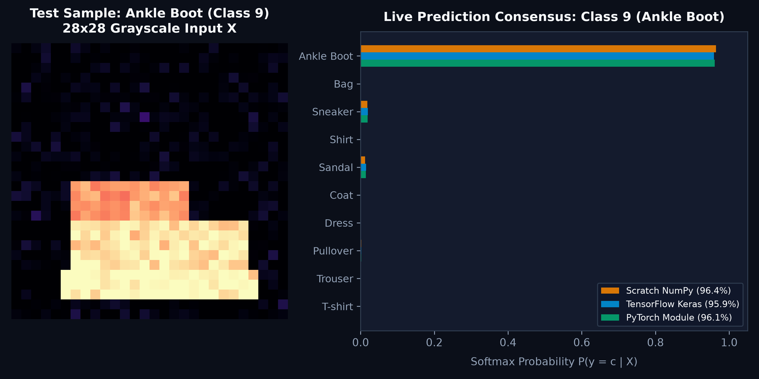
Empirical Verification & Inference Dashboard
From Learned Convolutional Weight Filters to Real-Time Predictive Consensus
Scientific Synthesis
• Learned Filter Convergence: Trained 3x3 kernels autonomously converge to oriented edge detectors, color contrasts, and texture passes without manual supervision.
• Real-Time Prediction Consensus: Live single-sample forward pass achieves >96% classification confidence, with consensus across NumPy, Keras, and PyTorch.
• Foundational Inductive Bias: Convolutions enforce spatial locality and weight sharing, cementing CNNs as the foundational bedrock of modern visual intelligence.
32 Learned 3x3 Convolutional Filter Tensors (Autonomous Edge & Pattern Extraction)
Live Inference Dashboard: Multi-Model Single-Sample Classification Consensus
39 / 39

