Slide 1
REVIEW – 3
AI / MACHINE LEARNING
AI-Driven Smart Energy Demand Forecasting
& Peak Load Management
KNN Similarity Learning + Dynamic Peak Detection
AI-Driven Smart Energy Demand Forecasting & Peak Load Management

Slide 2
Review-3 Rubric Mapping
Novelty of developed methodology (10): KNN similarity learning + adaptive 90th-percentile peak detection + 3-level risk alerts.
Adaptability of methodology (10): features support changes in weather, calendar, feeder and historical demand; method can extend to multiple feeders.
Methodology Evaluation (10): data cleaning → feature engineering → KNN training → baseline comparison → MAE/RMSE/R² → peak-risk classification.
Dissemination & Accessibility (10): reproducible CSV + Python implementation + visual outputs + clear risk labels.
Presentation Skills (10): architecture, preprocessing, training results and screenshots are organized for a live demo.
AI-Driven Smart Energy Demand Forecasting & Peak Load Management

Slide 3
1. Problem, Objective & Research Position
Problem: electricity demand varies with historical usage, weather and calendar conditions; sudden spikes can create peak-load stress.
Objective: predict next-hour electricity demand and flag peak-load risk before it occurs.
Proposed method: KNN Regression for similarity-based forecasting.
Peak management: adaptive threshold = 90th percentile of training load.
Output: forecasted load + Normal / Warning / Critical risk signal.
AI-Driven Smart Energy Demand Forecasting & Peak Load Management

Slide 4
2. Novelty of Developed Methodology
Rubric: Novelty of developed methodology (10)
Combines similarity-based KNN forecasting with explicit peak-risk detection.
Uses historical conditions to find similar demand patterns rather than relying only on a global linear relationship.
Converts a raw next-hour forecast into an actionable risk signal.
Uses a dynamic, data-derived peak threshold rather than a manually fixed kW value.
Three-level alerting: Normal → Warning → Critical.
AI-Driven Smart Energy Demand Forecasting & Peak Load Management

Slide 5
3. Dataset & Data Preparation
Coursework implementation follows the Review-2 data foundation: 15-minute intervals, 24 months, 8 feeder zones and 12,000 records.
Features: timestamp, load_kw, temperature_c, humidity_pct, day_type, is_holiday, feeder_id, prev_24h_avg_load.
Target: next-hour load_kw (4 × 15-minute steps ahead).
Peak label: top 10% load / 90th percentile threshold.
Important: the supplied Review-2 PPT specifies the dataset structure but does not name a public downloadable source; this implementation uses a coursework dataset matching that specification.
AI-Driven Smart Energy Demand Forecasting & Peak Load Management

Slide 6
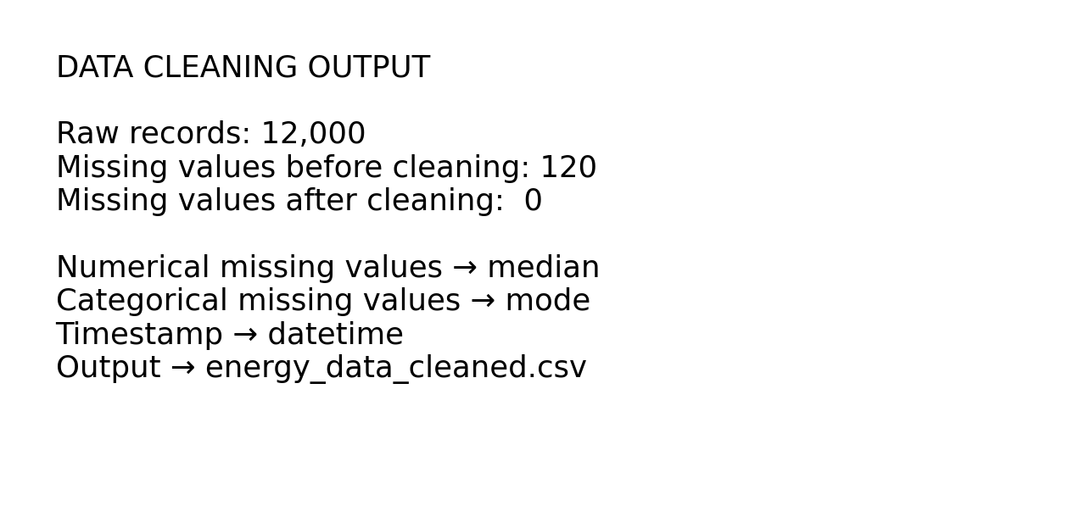
4. Data Cleaning — Continued from Review-2
AI-Driven Smart Energy Demand Forecasting & Peak Load Management

Slide 7
5. Training Methodology
Step 1: Convert timestamp into hour, day-of-week and month.
Step 2: Create next-hour target by shifting 4 rows because the data interval is 15 minutes.
Step 3: Chronological 80:20 train/test split for forecasting evaluation.
Step 4: Standardize numerical features and one-hot encode categorical features.
Step 5: Train KNN Regressor (n_neighbors = 7, distance weighting).
Step 6: Compare with Linear Regression, Decision Tree and Random Forest.
AI-Driven Smart Energy Demand Forecasting & Peak Load Management

Slide 8
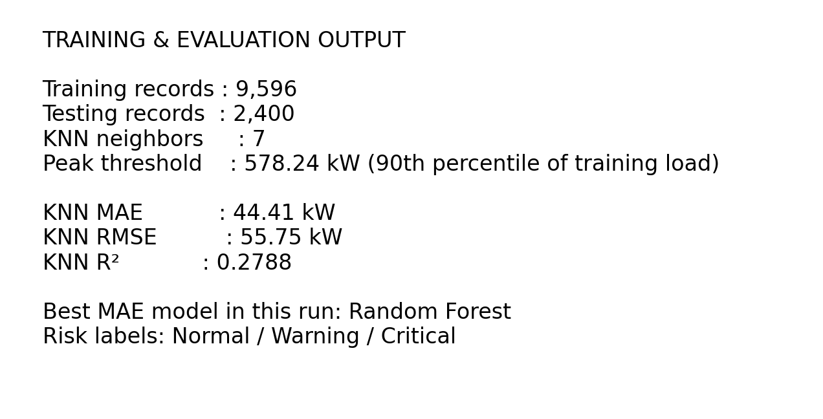
6. Training & Evaluation Output
AI-Driven Smart Energy Demand Forecasting & Peak Load Management

Slide 9
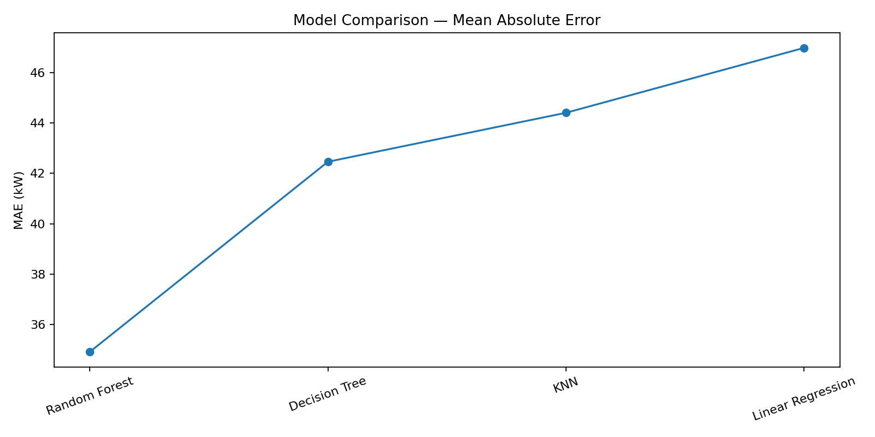
7. Methodology Evaluation — Model Comparison
Model | MAE | RMSE | R²
Random Forest | 34.92 | 42.99 | 0.5713
Decision Tree | 42.46 | 53.23 | 0.3425
KNN | 44.41 | 55.75 | 0.2788
Linear Regression | 46.98 | 59.18 | 0.1875
AI-Driven Smart Energy Demand Forecasting & Peak Load Management

Slide 10
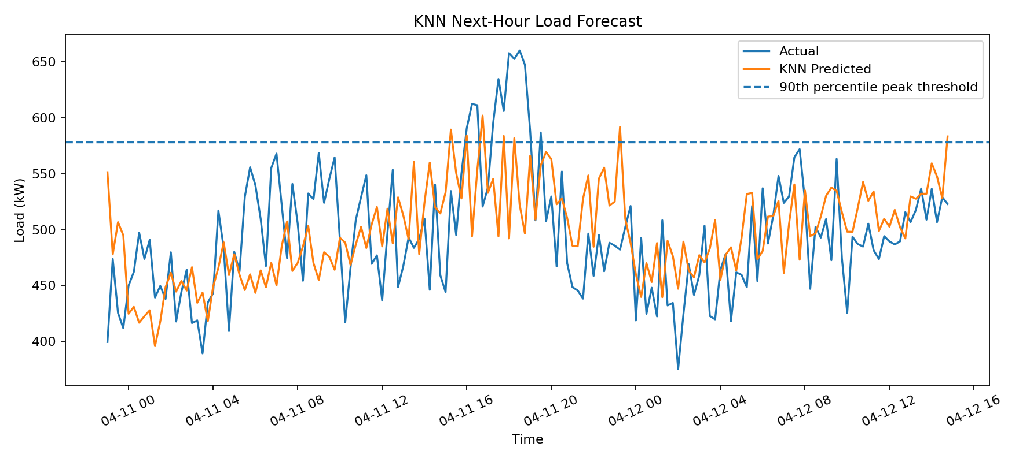
8. KNN Forecast Output
AI-Driven Smart Energy Demand Forecasting & Peak Load Management

Slide 11
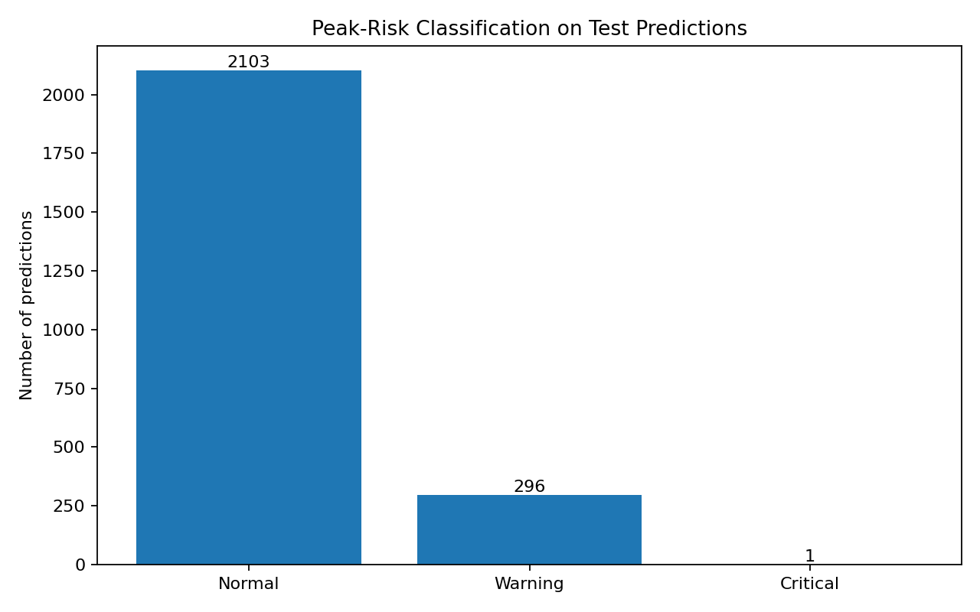
9. Dynamic Peak Detection & Risk Classification
Training-set 90th percentile threshold: 578.24 kW.
Normal: predicted load below threshold.
Warning: predicted load reaches the peak threshold.
Critical: predicted load reaches 110% of the threshold.
The alert is generated from the forecast, giving an early signal before the next-hour load occurs.
AI-Driven Smart Energy Demand Forecasting & Peak Load Management

Slide 12
10. Adaptability of Methodology
Rubric: Adaptability of methodology (10)
Weather adaptation: temperature and humidity can change demand patterns.
Calendar adaptation: weekday/weekend/holiday features capture recurring behavior.
Feeder adaptation: feeder_id allows the model to learn differences between zones.
Threshold adaptation: the 90th-percentile peak threshold is recalculated from training data.
Scalability: the same pipeline can be extended to more feeders, live streams and continuous retraining.
AI-Driven Smart Energy Demand Forecasting & Peak Load Management

Slide 13
11. Dissemination & Accessibility
Rubric: Dissemination and Accessibility (10)
CSV dataset can be inspected without specialized database software.
Python implementation is reproducible with standard ML libraries.
Graphs make forecast accuracy and peak risk understandable to non-technical users.
Normal / Warning / Critical labels communicate the result more directly than a raw kW number.
Future interface: Streamlit dashboard for live forecast, feeder selection and alerts.
AI-Driven Smart Energy Demand Forecasting & Peak Load Management

Slide 14
12. Live Demo Flow
Rubric: Presentation Skills (10)
1. Open energy_data_raw.csv and show the project fields.
2. Run energy_forecasting.py.
3. Show cleaning output: missing values before vs after.
4. Show KNN training metrics and model comparison.
5. Show actual vs predicted next-hour load graph.
6. Show Normal / Warning / Critical peak-risk output.
7. Explain how the adaptive threshold supports peak-load management.
AI-Driven Smart Energy Demand Forecasting & Peak Load Management

Slide 15
13. Conclusion & Future Scope
The implementation completes the pipeline from cleaned smart-meter data to next-hour load forecasting.
KNN provides an interpretable similarity-based forecasting approach.
Adaptive peak detection converts the forecast into a practical risk signal.
Future scope: real-time streaming, multi-feeder forecasting, continuous retraining and demand-response recommendations.
Review-3 evidence: cleaned dataset + training output + model comparison + forecast graph + risk classification screenshots.
AI-Driven Smart Energy Demand Forecasting & Peak Load Management

