Slide 1
Project-6
-Manne Niteesh Chandra

Slide 2
Prerequisite
Introduction
Required Tools
Working

Slide 3
Introduction
Git:
Git is a version control system.
Git helps you keep track of code changes.
Git is used to collaborate on code.
Jenkins:
Jenkins is a tool that is used for automation, and it is an open-source server that allows all the developers to build, test and deploy software. It works or runs on java as it is written in java. By using Jenkins we can make a continuous integration of projects(jobs) or end-to-endpoint automation.

Slide 4
Docker:
Docker is an open source platform that enables developers to build, deploy, run, update and manage containers—standardized, executable components that combine application source code with the operating system (OS) libraries and dependencies required to run that code in any environment.

Slide 5
Kubernetes:
Kubernetes is an open source platform for managing containerized applications. It automates the deployment, scaling, and management of these applications. It is portable, extensible, and declarative, and has a large and growing ecosystem of services and tools. The name Kubernetes comes from Greek, meaning helmsman or pilot.

Slide 6
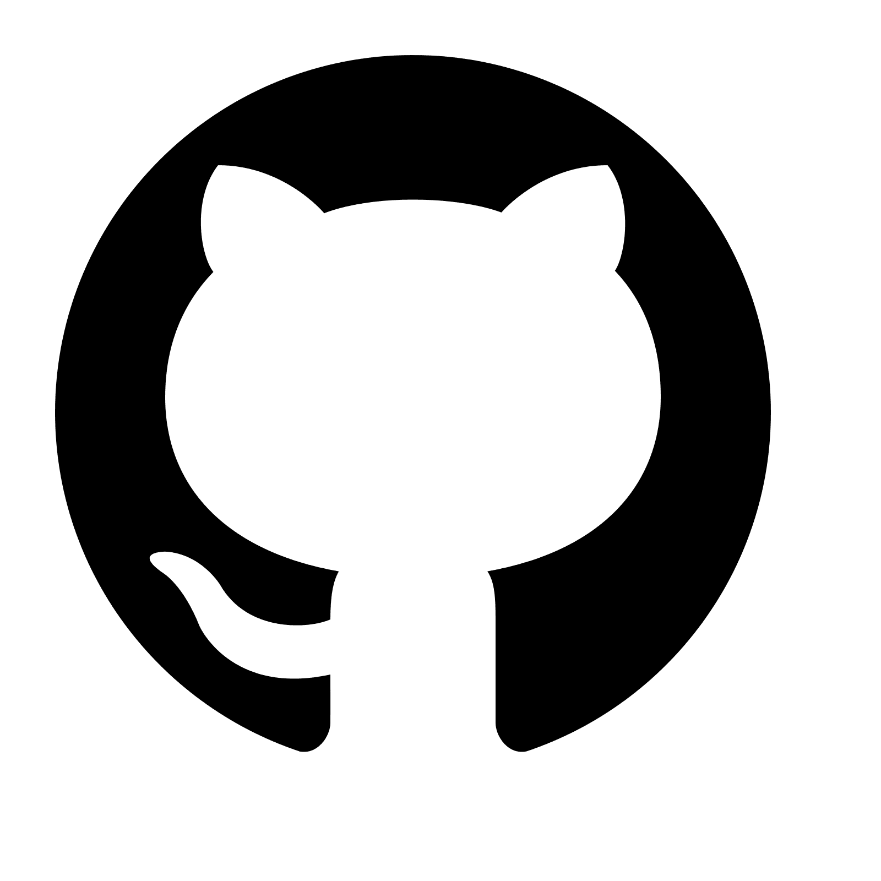
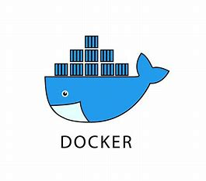
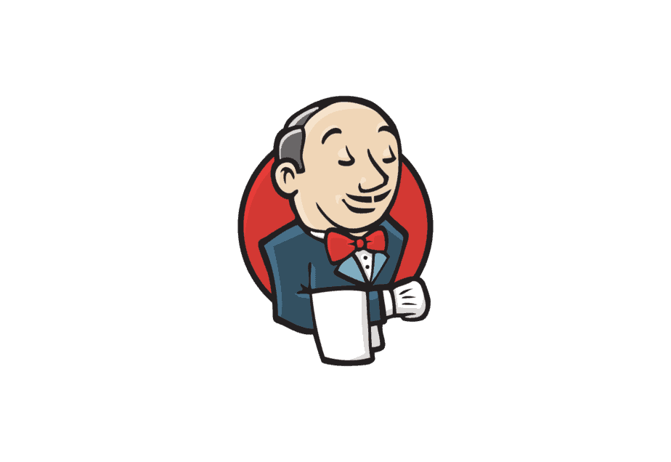
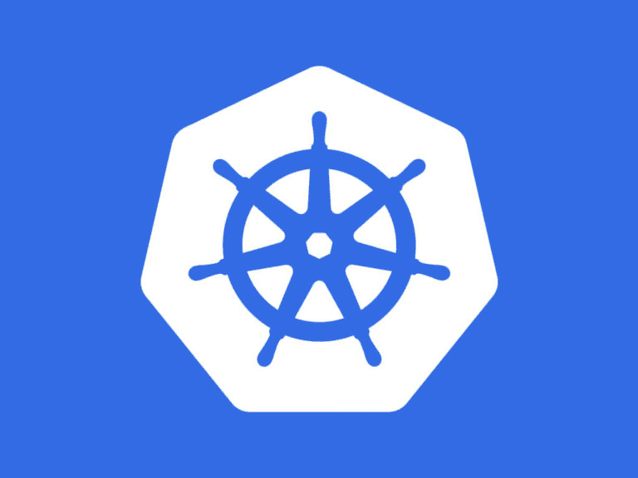
Required Tools

Slide 7
Working
Clone the repositories of Java and javascript)
first build the Java application then write a dockerfile for it
Build javascript application then see the output.
Build the dockerfile for it.
Link these two projects i.e., give java application url in the javascript code in src/app/contact.service.ts
Pull the javascript image again now.

Slide 8
Check the containers are running or not.
Push these two images to the Dockerhub.
Then install Kubernetes
Write deployment files for both applications.
Service file for both applications with loadbalancer.

Slide 9
Thank You

