Slide 1
Starbucks Market Analysis
Group Details –
Group no. 3
Group Members :
1. Arjun Chowhan – 850490
2. Harshad Patil – 852307
3. Niteesha Balla – 850488
4. Tejaswi Kalla – 852124
5. Yashwanth Paladi - 849467

Slide 2
Introduction
Starbucks cooperation is an American company founded in 1971 in Seattle. Starbucks has about 182,000 employees across 19,767 company operated and licensed stores in 62 countries.
You are hired as a data analytic expert in Starbucks and you want to help Starbucks make better decisions and be able to extract knowledge out of its big data.

Slide 3
Problem Statement
Following problems were identified in the sample dataset based on the research.
Whereas, the primary focus is on Problem no. 1-
Dataset: Starbucks Dataset.csv
High prices with no customer rewards.
Multiple branches within small geographical radius.
The use of semi-automated machines instead of fully automated machines eventually lost the brand's authenticity.
Lack of hospitality training to employees.

Slide 4
Five V’s of Big Data Traits
Big data consists of data from various sources that are generally represented in terms of five characteristics:
Volume.
Velocity.
Variety.
Veracity.
Value.

Slide 5
Volume
The size and amount of big data that needs to be processed and analyzed.
Sample Data: Starbucks Dataset.csv
In the above sample data set, we can find that there are 25,600 records which we can consider as the volume of the chosen data set.

Slide 6
Velocity
The speed at which the data is received, stored and managed.
As per the mentioned sample data set, we can say that the specific number of customer orders or the order search queries received within a day, an hour or any other unit of time.
Data is collected for every 120 seconds which can be considered as velocity for the chosen data set.

Slide 7
Variety
The diversity and range of different datatypes, including unstructured data, semi-structured data, and raw data.
The different datatypes which were commonly used in the chosen data set based on fields is as follows-
Int
Float
String

Slide 8
Veracity
The truth or accuracy of data and information assets, which often determines executive level confidence.
To achieve quality of data, we need to process data to information by ensuring that there are no counting errors or missing values present in the data set.
While referring to our chosen data set, we found around 9000+ missing values are present.

Slide 9
Value
Being able to pull value from big data is a requirement, as the value of big data increases significantly depending on the insights that can be gained from them.
While considering the sample data set, it is estimated that the cost and time to process the data to information is approximately 8 – 10 hours based on the accuracy of data.

Slide 10
Data Analytics Strategies
Collection of data- We have collected data from an open source database which we have provided in our earlier slides as Starbucks.csv
Cleansing – Removal of unnecessary columns and replacing missing values to create information with accurate data.
Organizing – Arranging the data in a tabular form to create a structured form of data.
Storing and Governing data – Storage of data on a secure platform like cloud to make it easily accessible.
Analyzing – After performing all the above steps, data is analyzed using predictive and prescriptive analysis to provide the desired output.

Slide 11
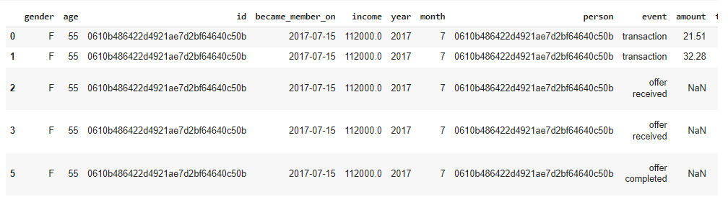
Analysis on Starbucks Dataset
Following steps were implemented while doing analysis for Starbucks Dataset-
1. Importing the modules and summarizing the dataset.

Slide 12
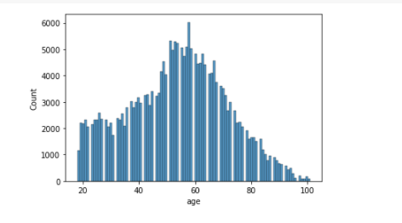
2. Displaying distribution of customer ages in the dataset.

Slide 13
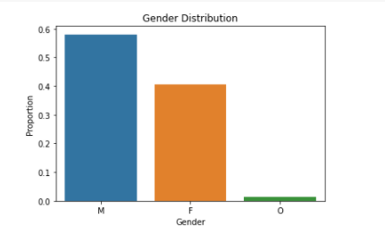
3. Checking the gender distribution of customers in the dataset.
From below chart, its clear that the proportion of male customers is higher than the female ones.

Slide 14
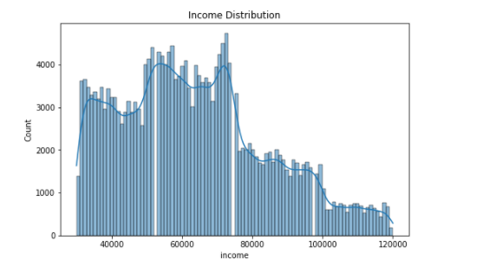
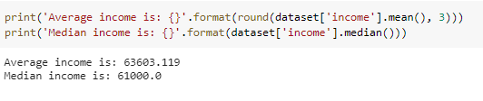
4. Checking the income distribution of the dataset and calculating the average and median incomes of customers.

Slide 15
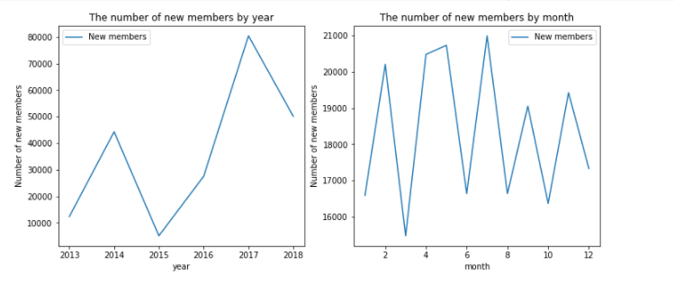
5. Distribution of new customers with respect to the year and month.

Slide 16
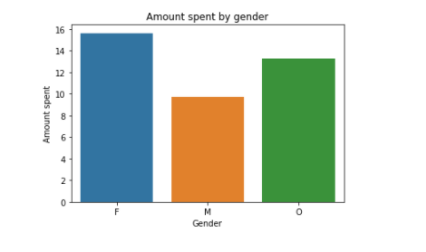
6. Average amount spent by the person grouped by gender.
From below graph, it is clear that females spend more in Starbucks when compared to male customers.

Slide 17
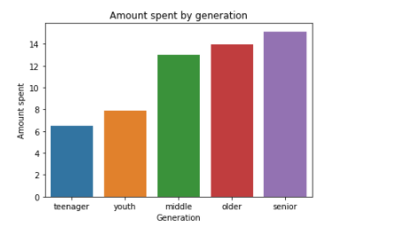
7. Generating amount spent based on generation.
From below graph, it is evident that middle aged people spend more when compared to the youth.

Slide 18
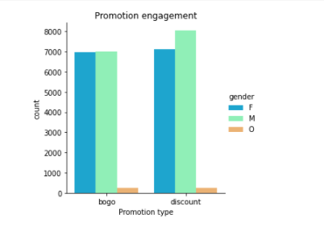
8. Distribution of gender and promotion type.
As we can see, Males used more discounts compared to females. Interestingly, customers engaged more in the discount promotion than the bogo (buy one get one) promotion.

Slide 19
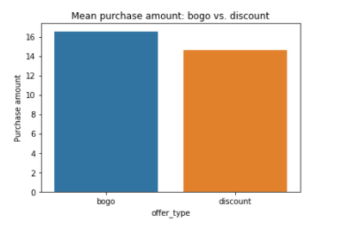
9. Getting the distribution of mean purchase amount of bogo vs discount.
In spite of little less engagement, bogo shows little higher mean purchase amount than discount. It might be the effect of the 'difficulty'. The 'difficulty'(a.k.a. the minimum required spend) might affect the promotion engagement.

Slide 20
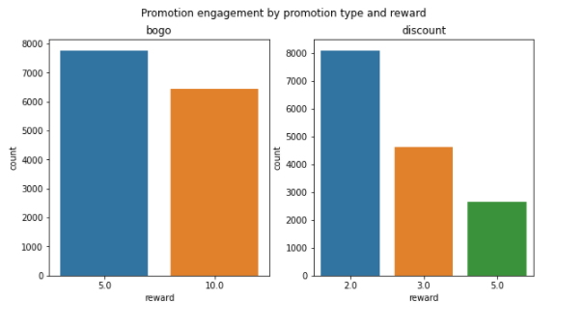
10. Getting the promotion engagement by promotion type and reward.
From below graph we can see that, The lower reward, the more engagements regardless of the promotion type.

Slide 21
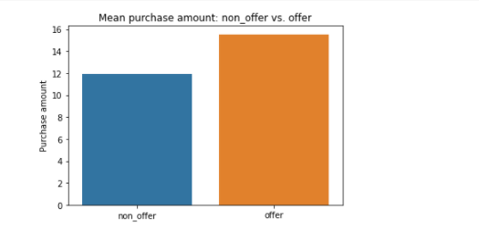
11. Getting the purchase amount based on offers provided.

Slide 22
Conclusion from above Analysis
By performing analysis on above slides, we can conclude that there are about $7.5 of mean purchase amount difference between 'non_offer' and 'offer'. Although engaging the promotions needs the minimum required purchase amount(a.k.a. 'difficulty' in our dataset), the difference is pretty significant.
From our Predictive Analysis, we can conclude that as there are many men who crave for discounts, if we increase the offers and increase the minimum required purchase amount slightly it can result in generating more revenue and profits.

Slide 23
Other Solutions
Along with Predictive Analysis, with Prescriptive Analysis following solutions are also provided-
1. Providing hospitality training to employees to increase customer satisfaction.
2. Replace fully automated machines with semi-automated machines and provide proper production training to their employees, eventually improving the product's aroma to provide customers with an authentic Starbucks experience.
3. Collect data from customer feedback surveys to improvise the service.
4. Launching new stores in the locations with more population and closing the stores where there are nominal sales.

Slide 24
References
Kaggle Dataset. Starbucks Analysis. https://www.kaggle.com/inextro/starbucks-analysis/notebook#1.3.-When-do-people-typically-become-a-member?
Ratnadeep Gawade (2021, August). https://www.kaggle.com/ratnadeepgawade/starbucks
Ihor Muliar (2021). Starbucks Customer Data. https://www.kaggle.com/ihormuliar/starbucks-customer-data
Think School. (2022, January). [How Starbucks' Legendary Leader brought the company out of a Crisis?: STARBUCKS Casestudy (Howard S)]. https://www.youtube.com/watch?v=vvzpciKoU5g&t=797s

Slide 25
Thank you

