Slide 1

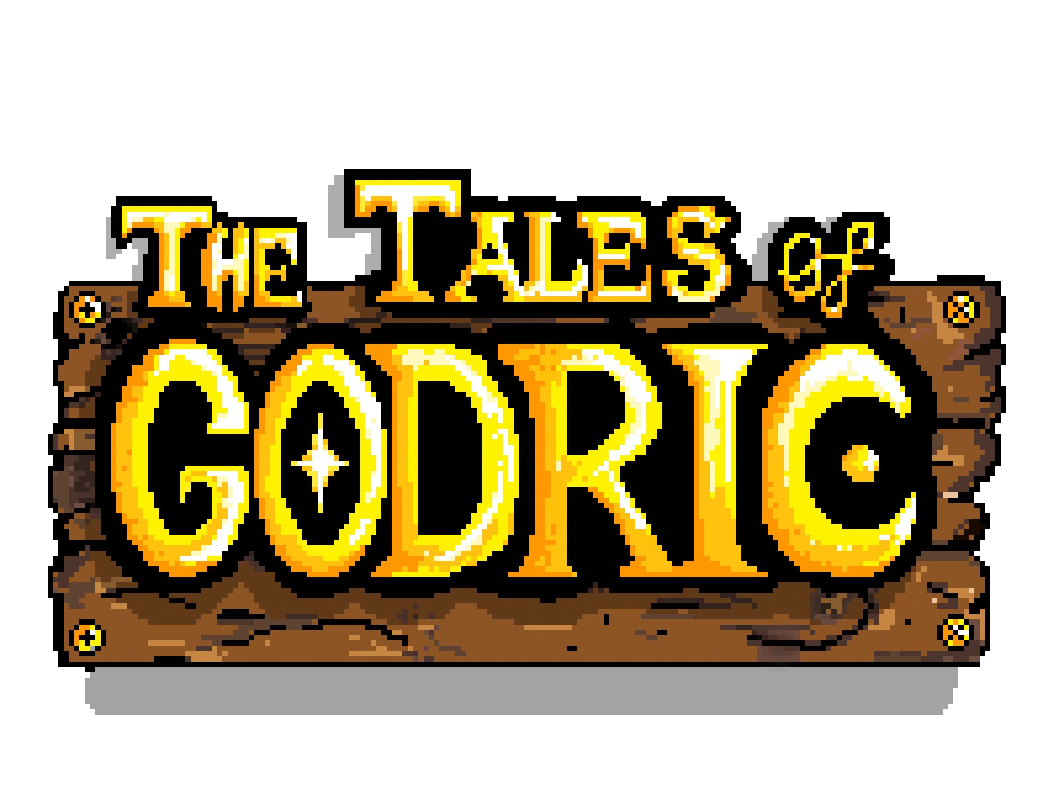
Project Presentation by Philipp Gerstl

Slide 2

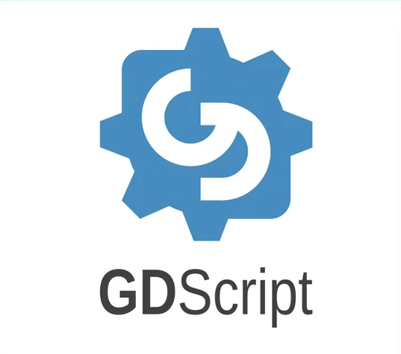
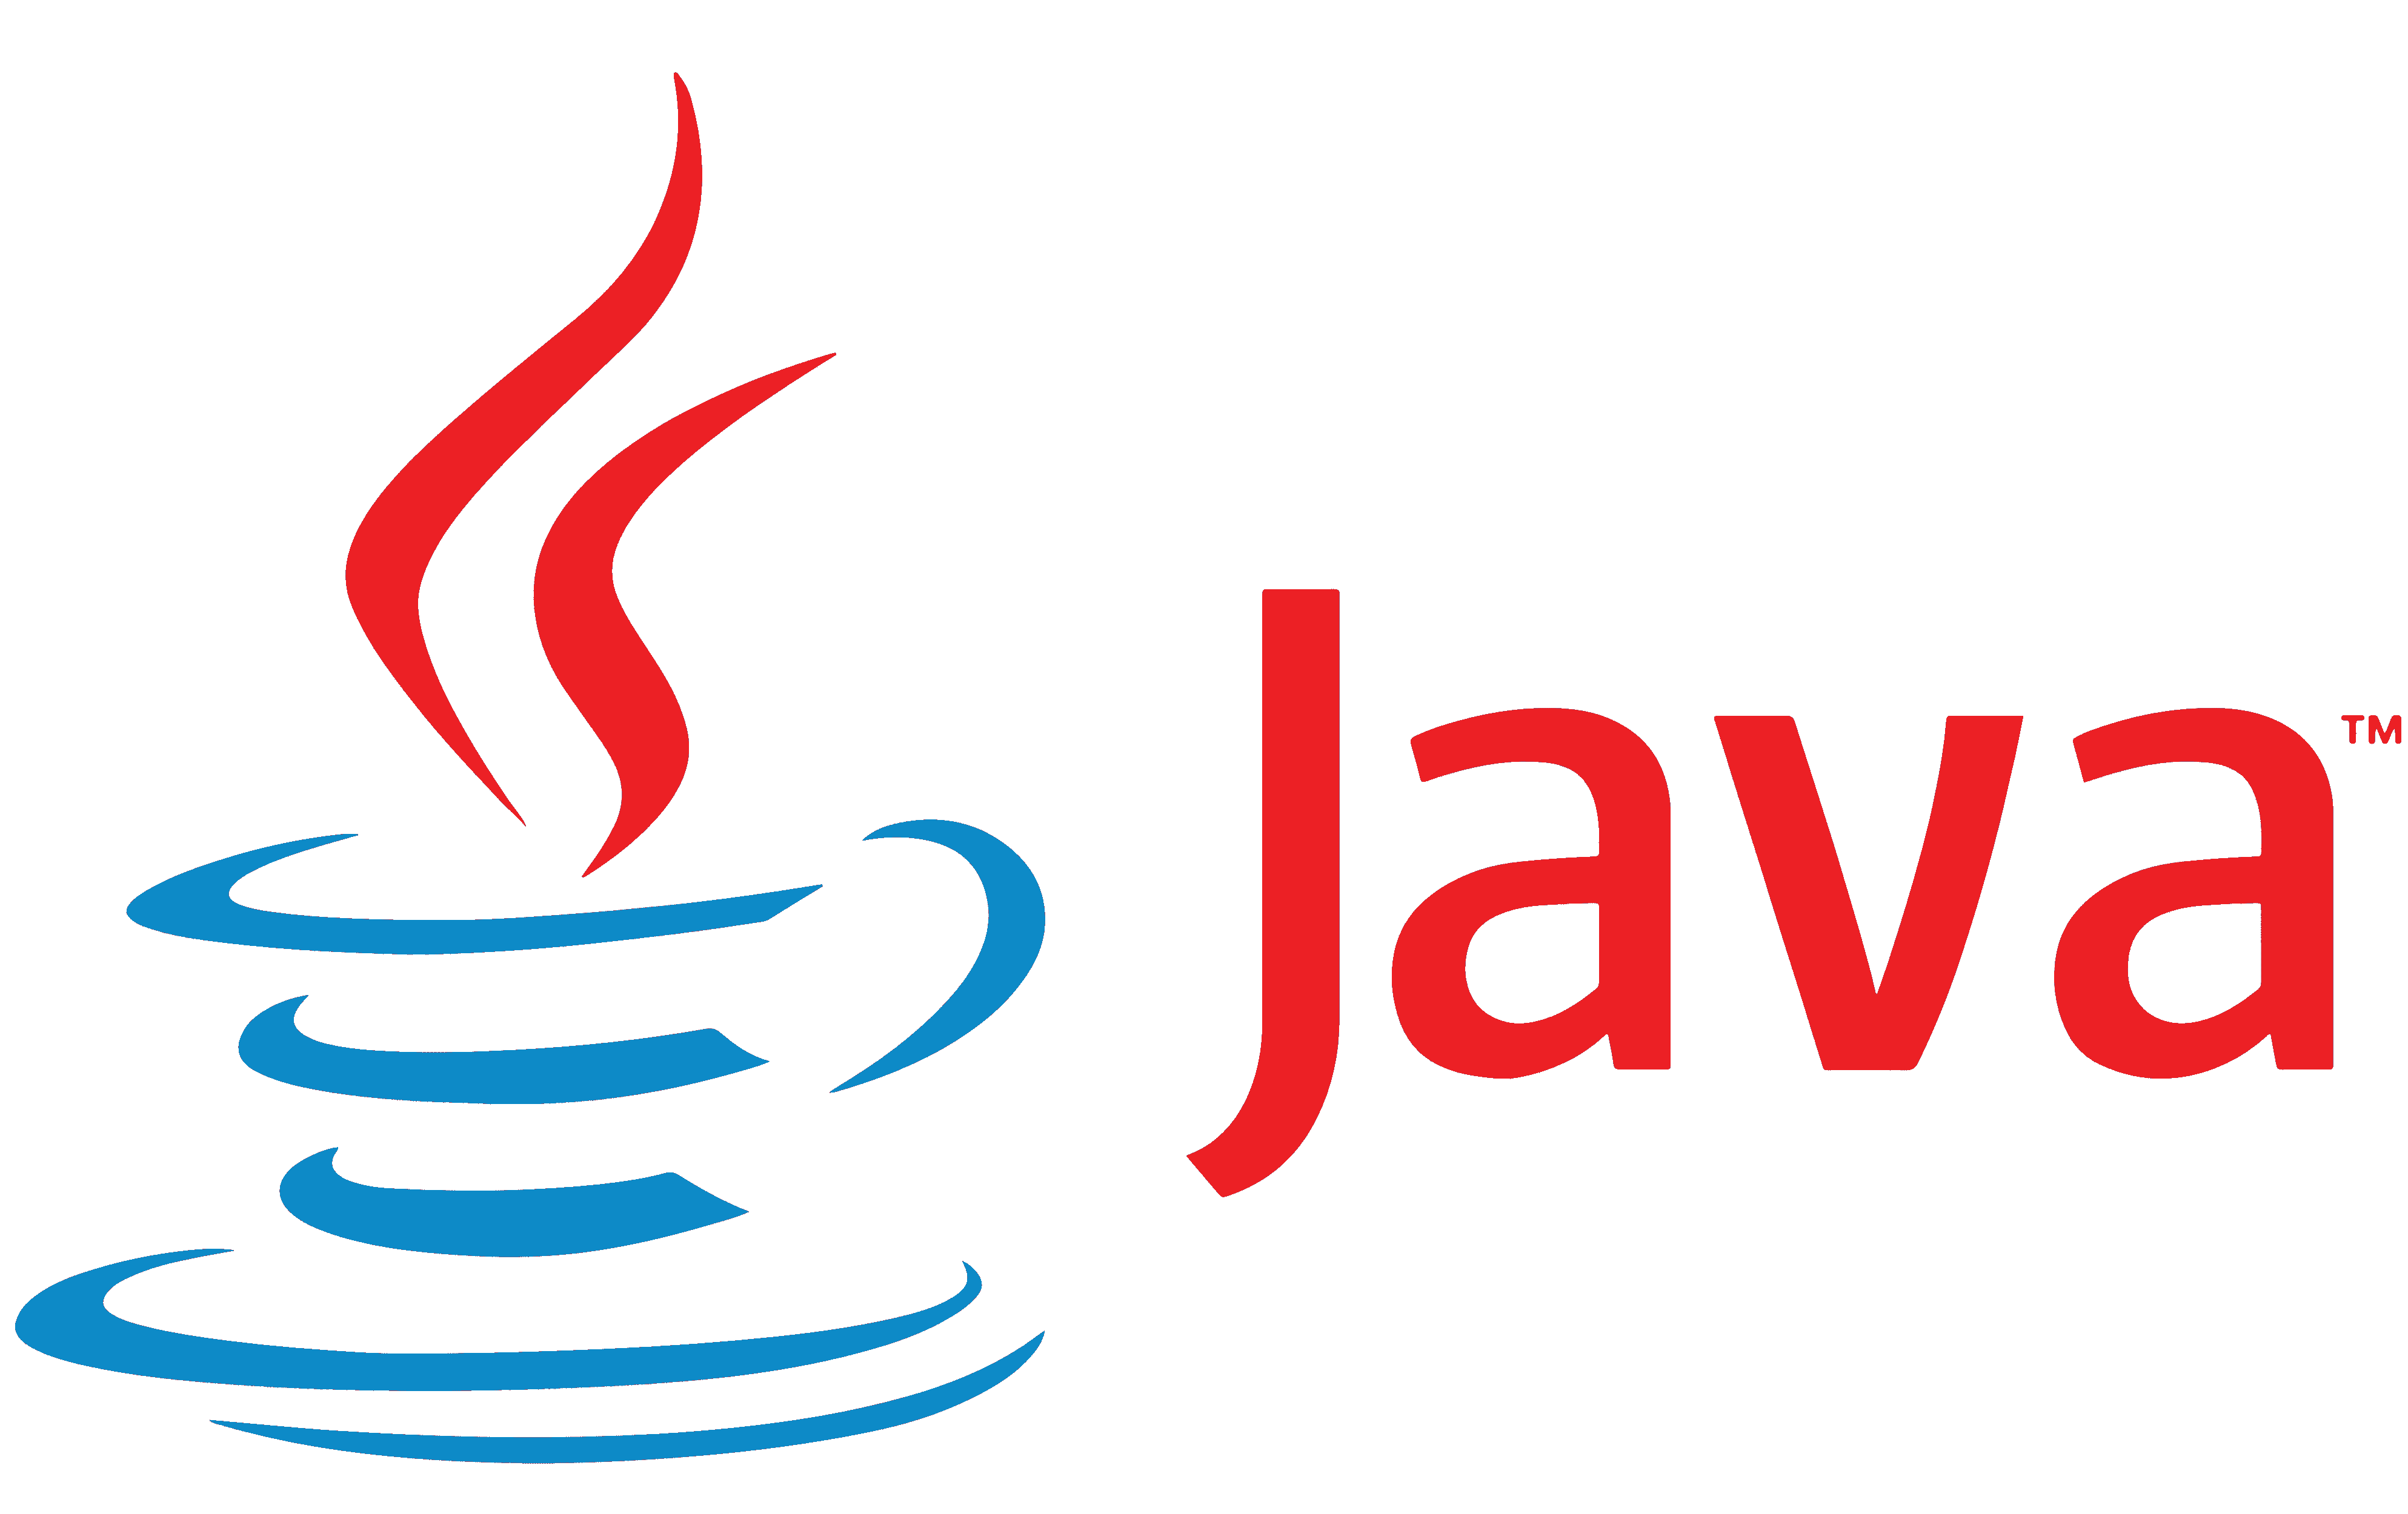


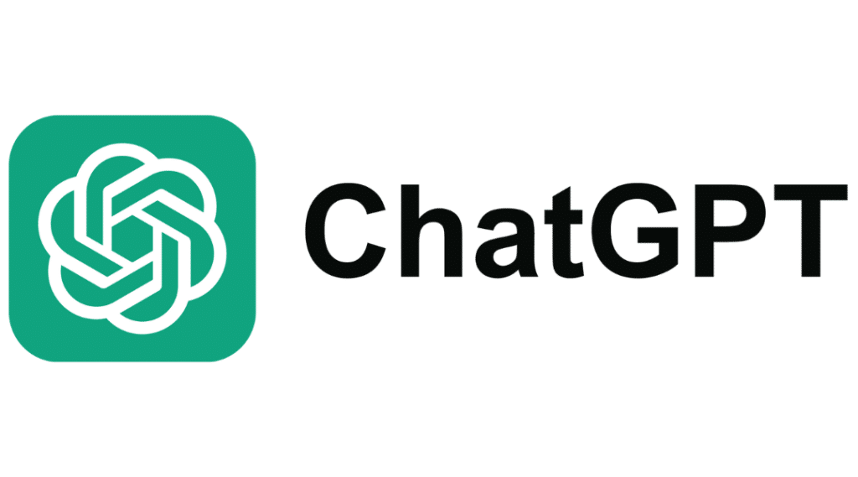
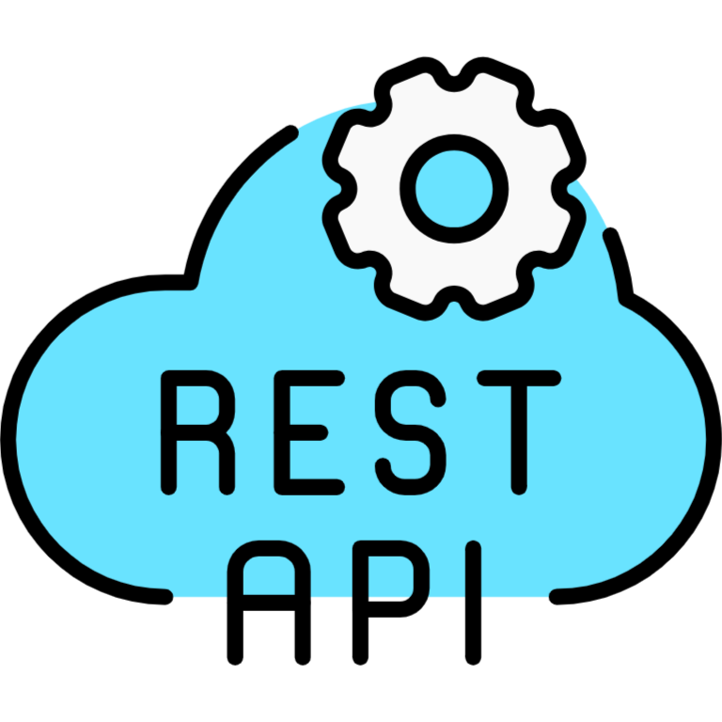
What Technologies did I use?

Slide 3
What were my struggles?
I had no Idea/Experience about Game Developing
Learning how to make my Game with YouTube and updating stuff with ChatGPT since a lot of the info was outdated
Finding out how to make a REST-API and set it up correctly
Getting all the methods I needed up and running
Since GDScript is based on python I had to learn the new Syntax
Finding the right information for the current Version of Godot
This language is only used in the Godot Engine so less information about it compared to JAVA

Slide 4

What is a REST-API?
What is ?

Slide 5
What is a REST-API?
http://localhost:8080/api/users/updateBalance
HTTP-Request
Send Query
Returning Data
“Balance updated Successfully” or
“ErrorMessage”
Returning Data

Slide 6
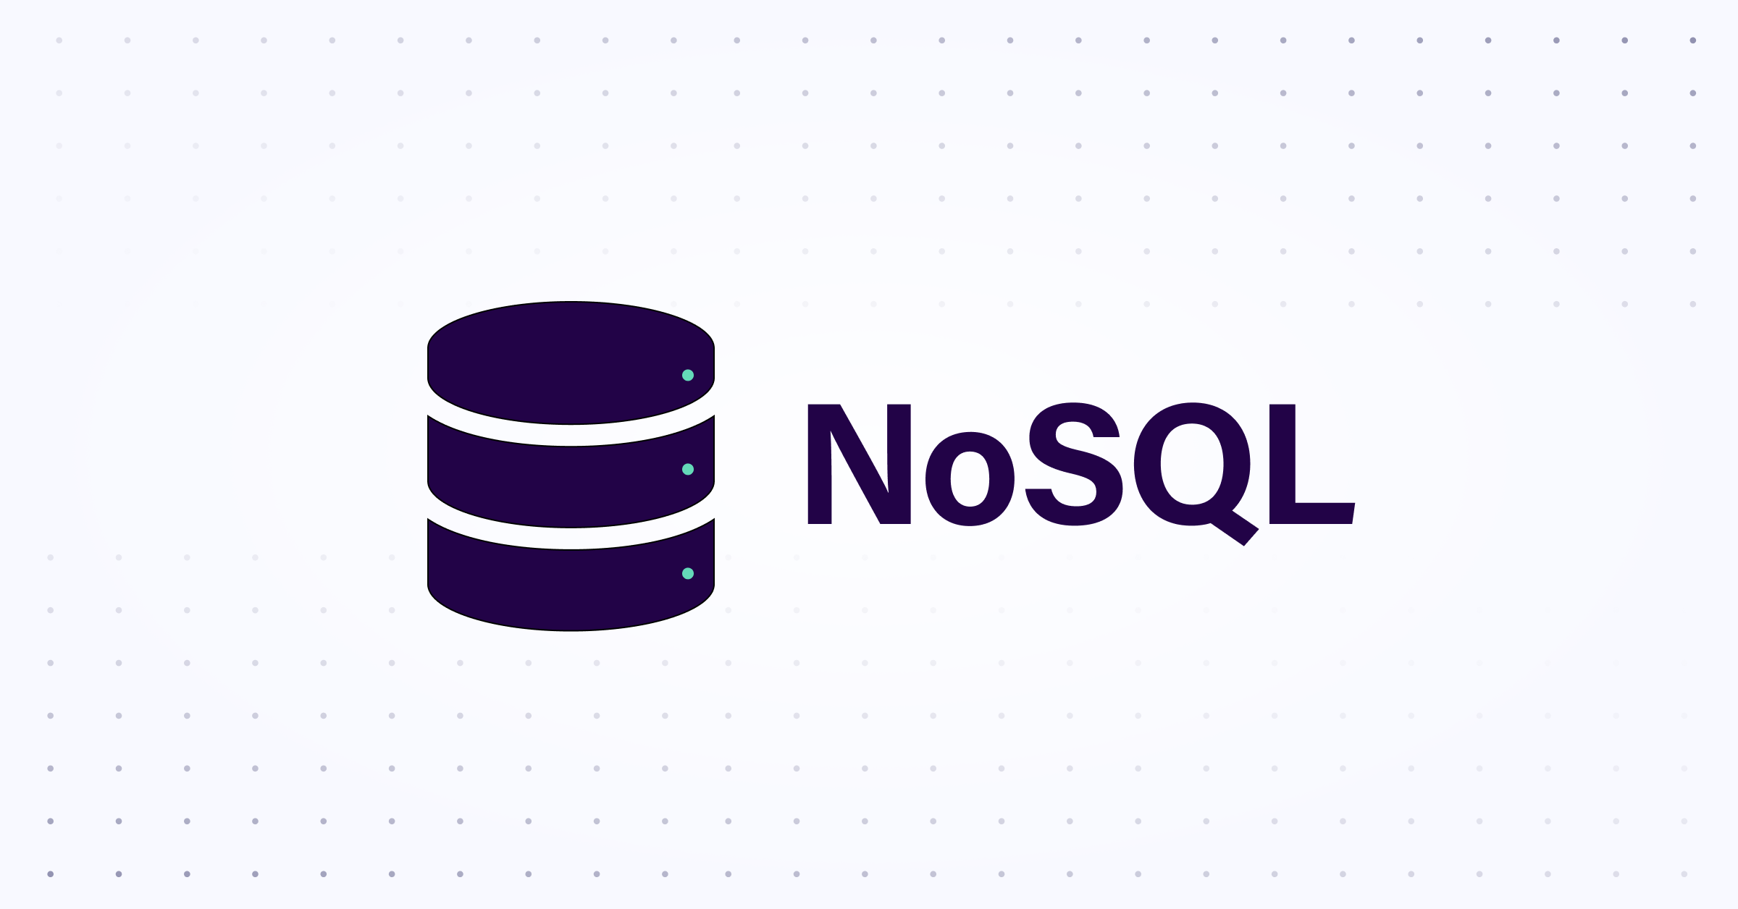

SQL – NOSQL Pros:
Easy to learn
Simple, English-like syntax makes it accessible to beginners
Standardized
SQL is widely supported across major relational database systems (MySQL, PostgreSQL, SQL Server, etc.)
Powerful Query Capabilities
Handles complex queries, filtering, and data manipulation efficiently
Data Integrity
Ensures data accuracy and reliability through Constraints (e.g., primary keys, foreign keys)
ACID Compliance
Supports safe, reliable transactions, for critical data handling
Scalability
NoSQL databases are designed for horizontal scaling, making them better suited for large, distributed systems
Flexibility
Schema-less design allows for easy handling of unstructured or semi-structured data without predefined schemas
Handling Big Data
NoSQL is optimized for handling massive datasets and real-time data processing
High Availability
Often built with replication and partitioning in mind, ensuring fault tolerance and uptime
Diverse Data Models
Supports various data models(key-value, document, column-family, graph), offering flexibility for different use cases

Slide 7
SQL – NOSQL Cons:
Scalability Challenges
Difficult to horizontally scale across multiple servers compared to NoSQL
Complex Optimization
Large or complex queries may require manual tuning for optimal performance
Rigid Schema
Fixed schema design can be less flexible for dynamic or unstructured data
Vendor Lock-In
Some features are vendor-specific, complicating migrations between different SQL systems
Less Suited for Big Data
Struggles with massive, real-time, datasets compared to NoSQL or specialized systems
Lack of Standardization
No universal query language like SQL, so each NoSQL database has its own syntax and APIs
Eventual Consistency
Many NoSQL systems sacrifice strong consistency for availability and partition tolerance, which may not be suitable for all applications
Complex Queries
NoSQL systems may struggle with complex querying and aggregations, often requiring additional processing layers
Limited ACID Transactions
Full ACID compliance is often limited or not supported, making NoSQL less ideal for applications that require strong transactional guarantees
Learning Curve
Each NoSQL database (MongoDB, Cassandra, Redis, etc.) has unique design patterns and requires specialized knowledge for optimization and use

Slide 8
Why did I use MongoDB?
Easy to use
Widely Recommended
Since it‘s a NoSQL database it doesn‘t require a fixed schema which is good since with Game Developing you have a lot of different data structures (player stats, game levels, inventories, etc.)
Games often experience rapid growth in users or data (player data, in-game assets, etc.). MongoDB is designed to scale horizontally by distributing data across multiple servers, ensuring it can handle high traffic and large datasets efficiently, which for me was just a no-brainer for future proofing
Many games require fast, real-time data reads and writes, like leaderboards, matchmaking, or player interactions. MongoDB‘s architecture supports low-latency queries and fast data access, which is critical for a smooth gaming experience
Game data often includes complex relationships (players with multiple inventories, achievements, etc.). MongoDB’s document-based storage allows these nested structures to be stored in a single record, reducing complexity and improving read performance.

Slide 9
Future Plans
Adding Multiplayer
Writing/Creating more Story(NPC interactions, dialogues, quests, etc.)
Making a fully working Inventory system
Adding a better Item system
Ability to harvest trees or different ores to sell to the NPS’s or make weapons out of
Adding/Making whatever else my 2 brain cells can come up with :D

Slide 10
THANK YOU FOR YOUR ATTENTION
Special THANKS to
Ruben, Patricia, Nicolas and Alex for their help!

