Slide 1


Project Presentation by Philipp Gerstl

Slide 2

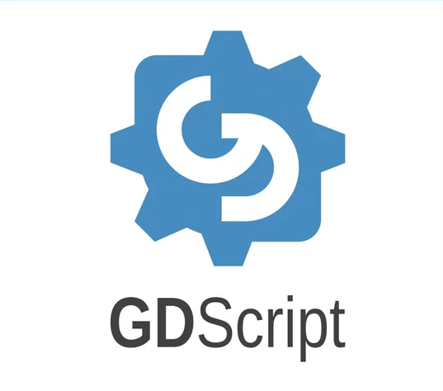
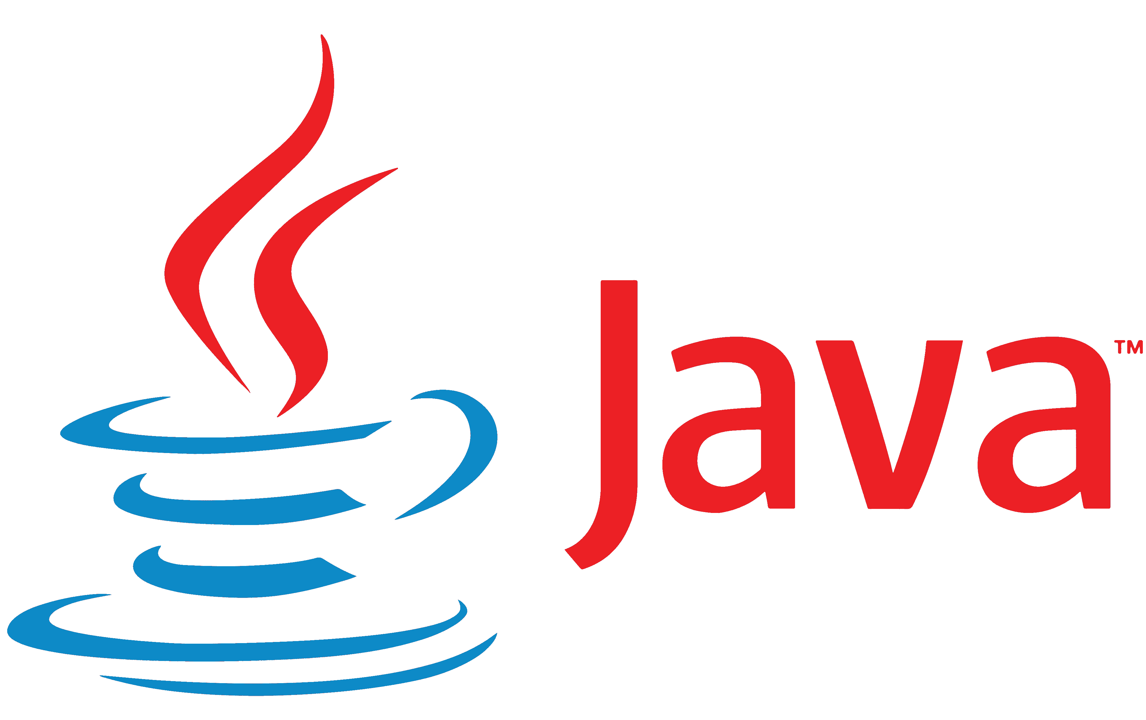




What Technologies did I use?

Slide 3
What were my struggles?
No Idea/Experience about Game Developing
Outdated Tutorials
ChatGPT for Help
How to Setup
Making Specific Methods
New Syntax
Finding right Information
Only used in Godot Engine

Slide 4

What is a REST-API?
What is ?

Slide 5
What is a REST-API?
http://localhost:8080/api/users/updateBalance
HTTP-Request
Send Query
Returning Data
“Balance updated Successfully” or
“ErrorMessage”
Returning Data

Slide 6
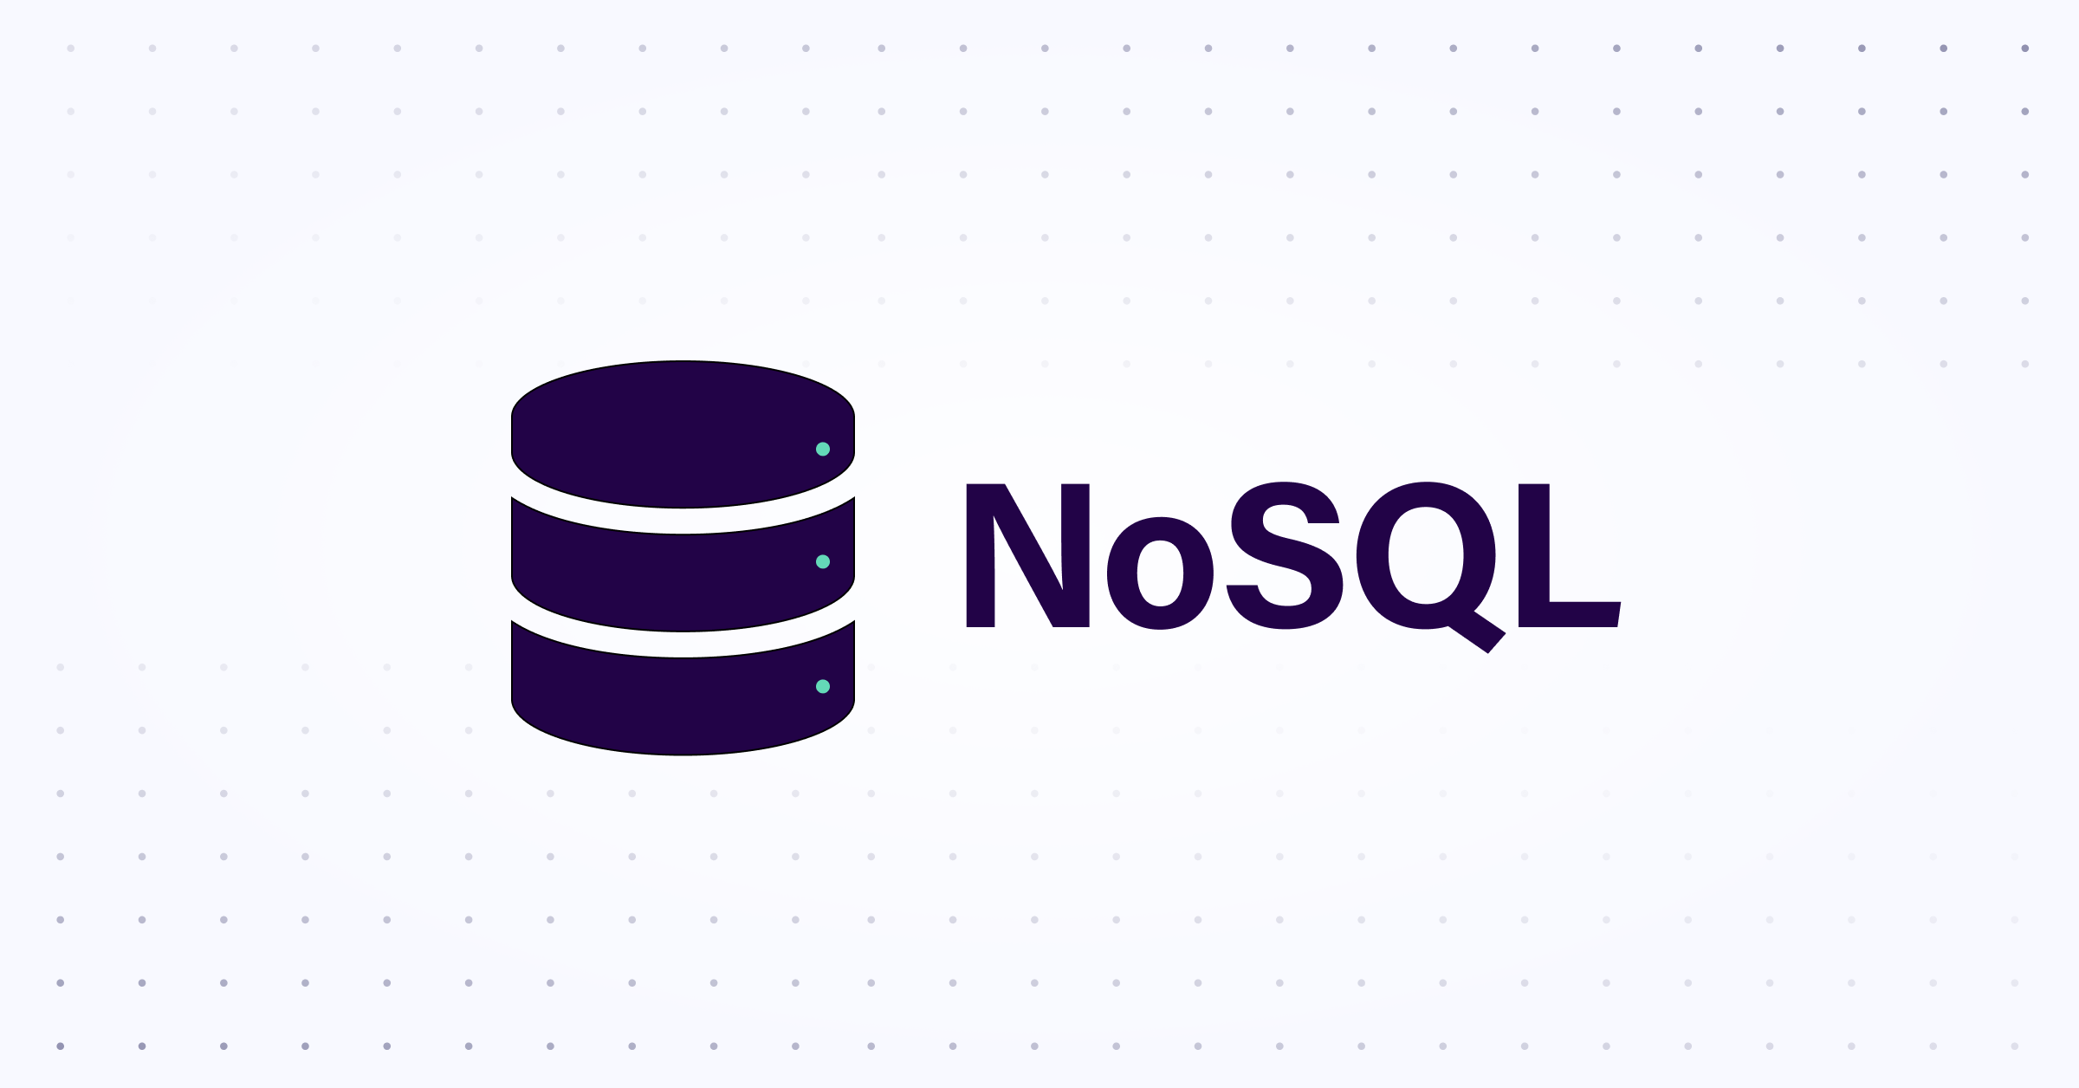

SQL – NOSQL Pros:
Easy to learn
Simple, English-like syntax makes it accessible to beginners
Standardized
SQL is widely supported across major relational database systems (MySQL, PostgreSQL, SQL Server, etc.)
Powerful Query Capabilities
Handles complex queries, filtering, and data manipulation efficiently
Data Integrity
Ensures data accuracy and reliability through Constraints (e.g., primary keys, foreign keys)
ACID Compliance
Supports safe, reliable transactions, for critical data handling
Scalability
NoSQL databases are designed for horizontal scaling, making them better suited for large, distributed systems
Flexibility
Schema-less design allows for easy handling of unstructured or semi-structured data without predefined schemas
Handling Big Data
NoSQL is optimized for handling massive datasets and real-time data processing
High Availability
Often built with replication and partitioning in mind, ensuring fault tolerance and uptime
Diverse Data Models
Supports various data models(key-value, document, column-family, graph), offering flexibility for different use cases

Slide 7
SQL – NOSQL Cons:
Scalability Challenges
Difficult to horizontally scale across multiple servers compared to NoSQL
Complex Optimization
Large or complex queries may require manual tuning for optimal performance
Rigid Schema
Fixed schema design can be less flexible for dynamic or unstructured data
Vendor Lock-In
Some features are vendor-specific, complicating migrations between different SQL systems
Less Suited for Big Data
Struggles with massive, real-time, datasets compared to NoSQL or specialized systems
Lack of Standardization
No universal query language like SQL, so each NoSQL database has its own syntax and APIs
Eventual Consistency
Many NoSQL systems sacrifice strong consistency for availability and partition tolerance, which may not be suitable for all applications
Complex Queries
NoSQL systems may struggle with complex querying and aggregations, often requiring additional processing layers
Limited ACID Transactions
Full ACID compliance is often limited or not supported, making NoSQL less ideal for applications that require strong transactional guarantees
Learning Curve
Each NoSQL database (MongoDB, Cassandra, Redis, etc.) has unique design patterns and requires specialized knowledge for optimization and use

Slide 8
Why did I use MongoDB?
Easy to use
Widely Recommended
No Fixed Schema
Horizontally Scalable
MongoDB‘s architecture supports low-latency queries and fast data access,
MongoDB is document-based

Slide 9
Future Plans
Adding Multiplayer
Writing/Creating more Story(NPC interactions, dialogues, quests, etc.)
Making a fully working Inventory system
Adding a better Item system
Ability to harvest trees or different ores to sell to the NPS’s or make weapons out of
Adding/Making whatever else my 2 brain cells can come up with :D

Slide 10
THANK YOU FOR YOUR ATTENTION

