Slide 1
Hyper Text Markup Language
(HTML)

Slide 2
Hyper Text Markup Language
(HTML)
It is a marking up language used for linking one piece of
information to another.
HTML has ability to be connected to other texts, and its
navigated by system of links, which can be non-sequential in
nature.

Slide 3
Hyper Text Markup Language
(HTML)
It is a developed tool for the internet based information.
It is a set of markup symbols or codes inserted in a file intended
for display on a world wide web browser page.

Slide 4
Hyper Text Markup Language (HTML)
Hyper | Text | Markup | Language
No longer does the reader have to read things in order. This enables then to skip around between sections. This “loss of order” is what makes HTML hyper. | This is what you will use to convey your ideas to the reader as good as English letters. | In a web page, HTML marks up the text. This is what HTML is all about. | It’s the language used to create web pages.

Slide 5
Hyper Text Markup Language
(HTML)
To learn HTML you will need :
A web browser.
Anything from Microsoft Internet Explorer and Netscape’s
Navigator to NCSA Mosaic will be fine. If you’re looking at this
page, then you obviously have one of these.
An ASCII text editor.
This includes windows Notepad, Macintosh Simple text, or a
word processor.

Slide 6
Hyper Text Markup Language
(HTML)
How to name your HTML document :
You should name your HTML document with the .html extension. An HTML document doesn’t deserve to have it’s extension truncated to .htm unless it’s absolutely necessary.
If your operating system is…..
Windows 95/98/NT, Macintosh. Save your files with the .html extension. Name your files whatever you want (avoid the space, Quotations, and any other weird characters) and add the suffix .html.

Slide 7
Hyper Text Markup Language
(HTML)
Here are some legal examples of file names :
Dogs.html
Myfirstpage.html
Htmlrules.html
A_really_long_but_legal_filename.html.
It is suggested that you stay away from capital letters to reduce confusion.

Slide 8
BASIC STRUCTURE

Slide 9
Basic Structure
<HTML>
<HEAD>
<TITLE> HTML Basic </TITLE>
</HEAD>
<BODY>
Hi, This is my first web page.
</BODY>
</HTML>

Slide 10
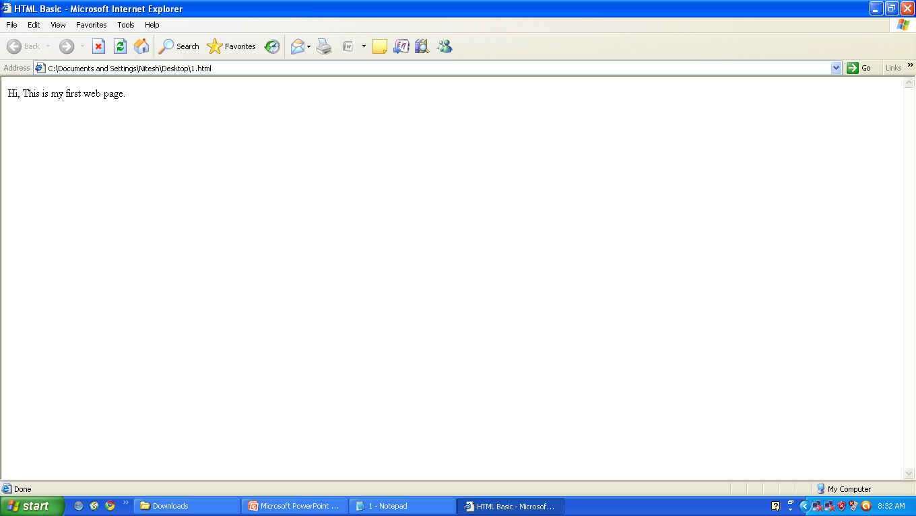

Slide 11
Basic Structure
<HTML> and </HTML> tags
Line 1 of what you typed in (<HTML>) tells the browser that what follows is an HTML document, and the last line (</HTML>) tells the browser that the HTML document is finished.
<HEAD> and </HEAD> tags
Each page of your web pages should have these tags. Statements (or tags) that give information to a person visiting your website, or information such as those needed for a Search Engine are placed between the <HEAD> and </HEAD> tags.

Slide 12
Basic Structure
<TITLE> and </TITLE> tags
One of the statement that must included between the <HEAD> and </HEAD> tags is the TITLE of your web pages.
<BODY> and </BODY> tags
<BODY> tells browser that what follows is to be the body of the web pages.
</BODY> tells the browser that the body part of the page has ended.
Thus the <BODY> and </BODY> tags are container tags, containing the body of your document.

Slide 13
Basic Structure
<BODY> and <BODY> tags
Contains all the text and tags.
This part will be displayed on the browser screen.
Contains the actual contents of the document.
But the tags will not be displayed on the browser screen. The
tags only tell the browser screen. The tags only tell the
browser how to display the information.

Slide 14
Basic Structure
TAG and ATTRIBUTES
TAG :
Tells the browser
“TO DO SOMETHING”
ATTRIBUTES :
Goes inside the TAG and tells the Browser
“HOW TO DO IT”

Slide 15
FORMATTING TAGS

Slide 16
FORMATTING TAGS
<Font> …… </Font> , <B> …… </B> , <I> …… </I> , <U> ……</U> ,
<P> …… </P> , <BR> , special characters , predefined headings
<Font> …… </Font> : Font tag
<B> Bold </B> : Makes text or word bold
<I> Italics </I> : Makes text or word italic
<U> Underline </U> : Makes text or word underline
<BR> : Enforce line breaks
&nbsp; &lt; : Special Characters
<h1> …….. </h1> to : Predefined headings
<h6> …….. </h6>
<P> ……….. </P> : Paragraph

Slide 17
<Font> …… </Font> Tag
Used to change the text size , font face and also to change the color of blocks of text.
FONT is a container element in that it has an opening FONT tag (<FONT>) and a closing FONT tag (/FONT).
The SIZE attribute indicates the size that the font is to be changed to. Sizes range in value from 1 to 7.
A value of 3 is the default size.

Slide 18
<Font> …… </Font> Tag
<HTML>
<HEAD>
<TITLE> HTML Basic </TITLE>
</HEAD>
<BODY>
<font size=5> PowerPoint is designed to give your slide
presentations a consistent appearance.</font> There
are four ways that PowerPoint helps you control the
look of your slides with design templates, masters,
color schemes and slide layouts.
</BODY>
</HTML>

Slide 19
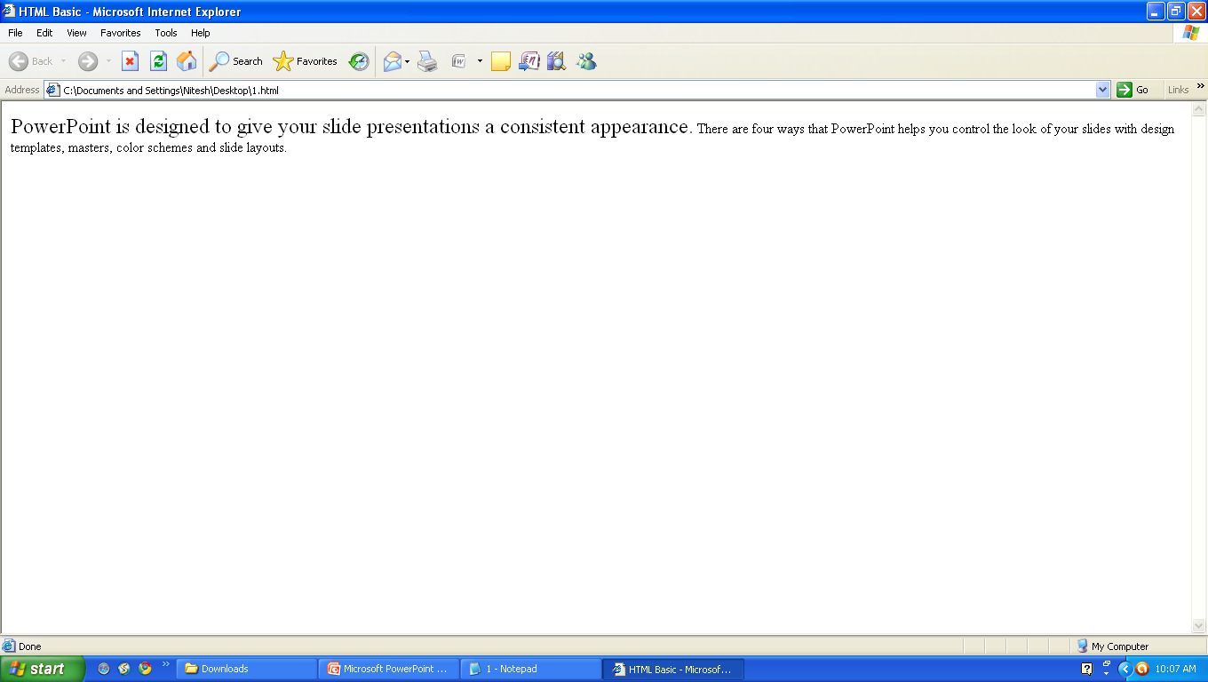

Slide 20
<b> …… </b> Tag
<HTML>
<HEAD>
<TITLE> HTML Basic </TITLE>
</HEAD>
<BODY>
<font size=5 face=“arial” > PowerPoint is designed to
give your slide presentations a <b>consistent
appearance</b>. There are four ways that PowerPoint
helps you control the look of your <b> slides </b> with
design templates, masters, color schemes and slide
layouts. </font>
</BODY>
</HTML>

Slide 21
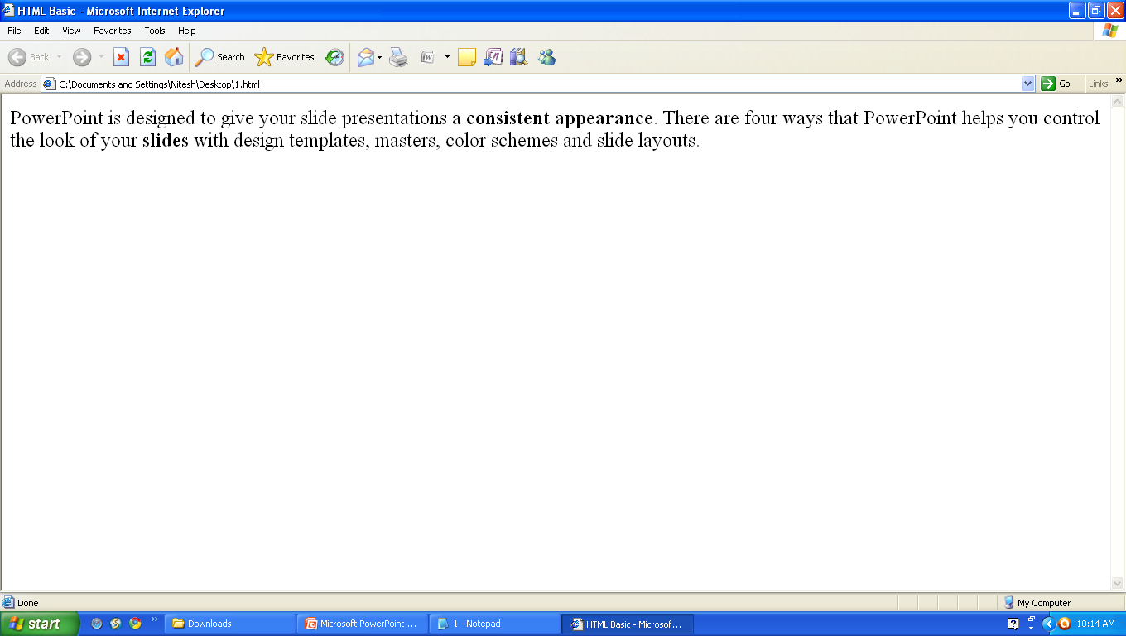

Slide 22
<I> …… </I> Tag
<HTML>
<HEAD>
<TITLE> HTML Basic </TITLE>
</HEAD>
<BODY>
<font size=5 face=“arial” color=“blue”> <I>PowerPoint
is </I> designed to give your <I> slide presentations
</I> a <b>consistent appearance</b>.There are four
ways that PowerPoint helps you control the look of
your <b> slides </b> with design templates, masters,
color schemes and slide layouts. </font>
</BODY>
</HTML>

Slide 23
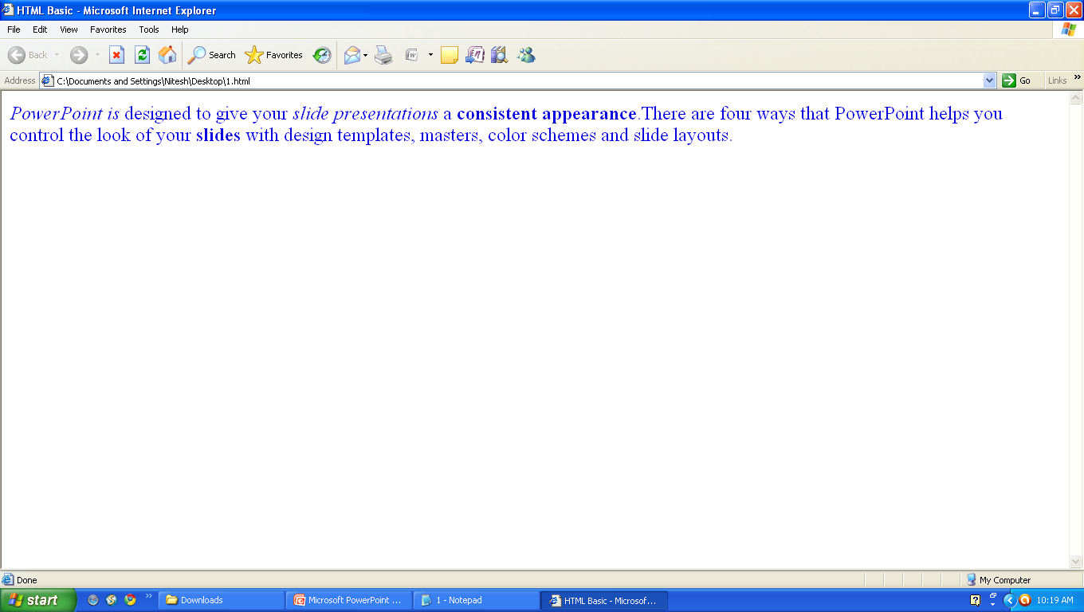

Slide 24
<U> …… </U> Tag
<HTML>
<HEAD>
<TITLE> HTML Basic </TITLE>
</HEAD>
<BODY>
<font size=5 face=“arial” color=“blue”> <I>PowerPoint
is </I> designed to give your <I> slide presentations
</I> a <b>consistent appearance</b>.There are <U>
four ways </U> that PowerPoint helps you control the
look of your <b> slides </b> with design templates,
masters, color schemes and slide layouts. </font>
</BODY>
</HTML>

Slide 25


Slide 26
MORE ON <Font> …… </Font> Tag
<HTML>
<HEAD>
<TITLE> HTML Basic </TITLE>
</HEAD>
<BODY bgcolor=“#ffffff”>
<font size=5 face=“arial” color=“blue”> <I>PowerPoint
is </I> designed to give your <I> slide presentations
</I> a <b>consistent appearance</b>.There are <U>
four ways </U> that PowerPoint helps you control the
look of your <b> slides </b> with design templates,
masters, color schemes and slide layouts. </font>
</BODY>
</HTML>

Slide 27
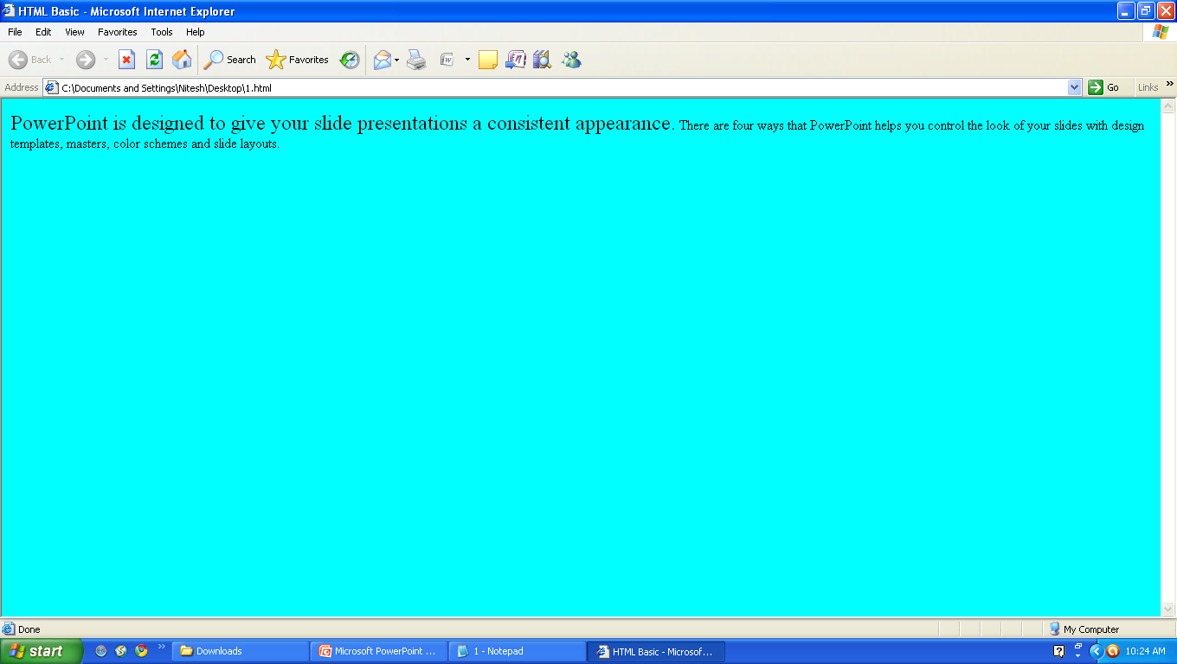
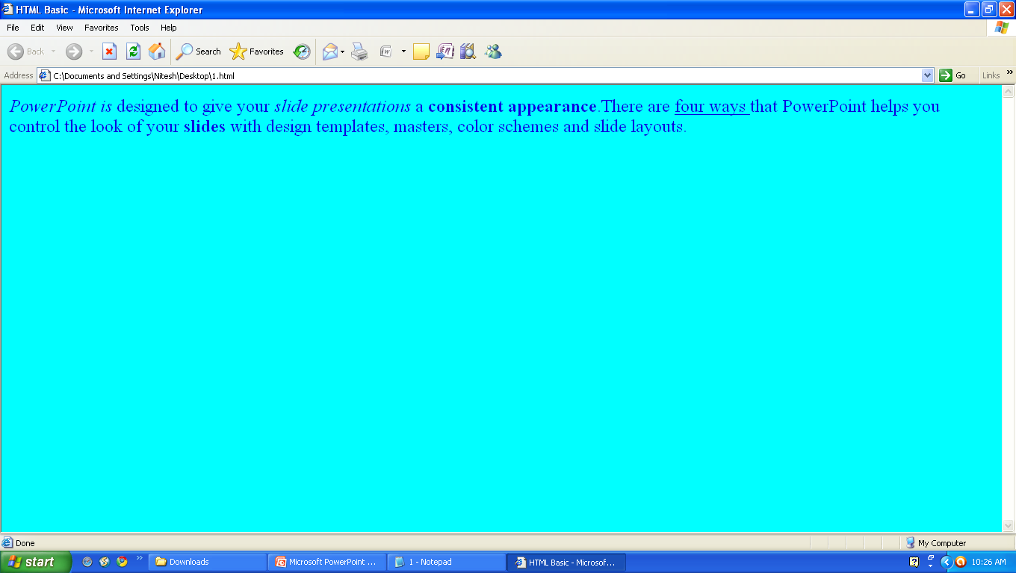

Slide 28
Margin with <BODY> Tag
Margin : This attribute allows the user to set the top, left hand margin of the document.
Example :
<BODY topmargin=“10” leftmargin=“15”>
This will leave 10 pixels for top margin and 15 pixels for left margin.

Slide 29
Background and Text color
<HTML>
<HEAD>
<TITLE> HTML Basic </TITLE>
</HEAD>
<BODY background=“nature.gif”>
<font size=5 face=“arial” color=“blue”> <I>PowerPoint
is </I> designed to give your <I> slide presentations
</I> a <b>consistent appearance</b>.There are <U>
four ways </U> that PowerPoint helps you control the
look of your <b> slides </b> with design templates,
masters, color schemes and slide layouts. </font>
</BODY>
</HTML>

Slide 30
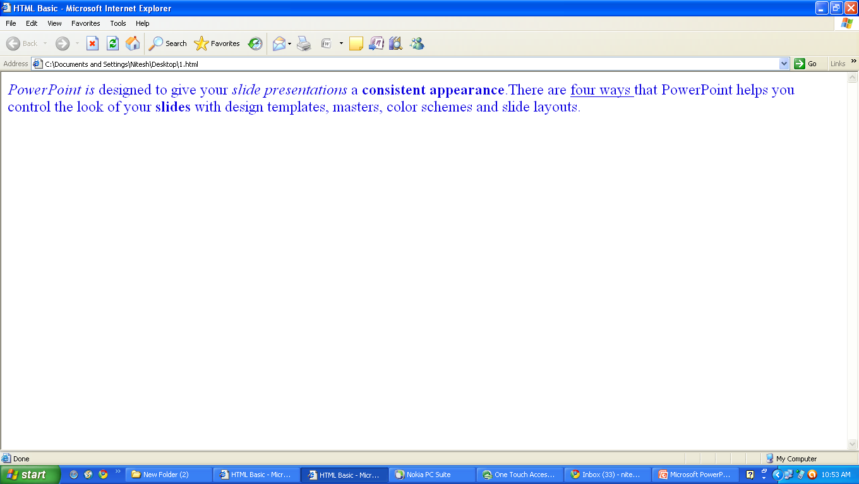

Slide 31
<BR> Tag
<HTML>
<HEAD>
<TITLE> HTML Basic </TITLE>
</HEAD>
<BODY bgcolor=“#ffffff”>
<font size=5 face=“arial” color=“blue”> <I>PowerPoint
is </I> designed to give your <I> slide presentations
</I> a <b>consistent appearance</b>.There are <U>
four ways </U> that PowerPoint helps you control the
look of your slides: <br> <br> Design templates <br>
Masters <br> Color schemes and <br> Slide layouts.
</font>
</BODY>
</HTML>

Slide 32
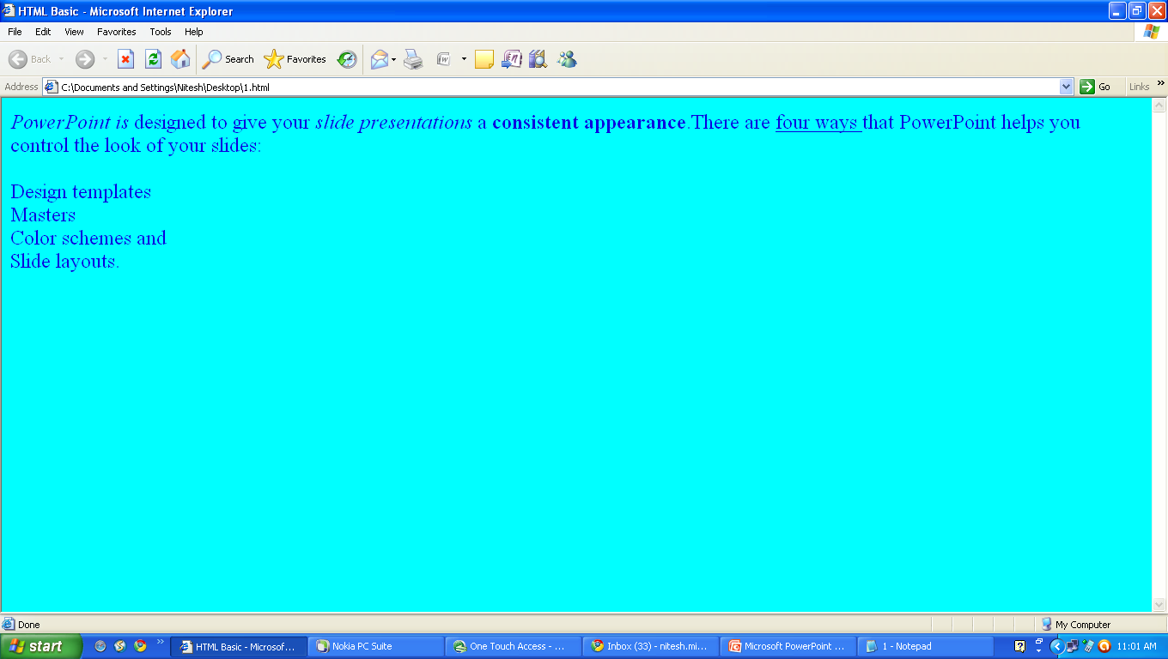

Slide 33
Special Characters
&nbsp; : non-breaking space
&lt : < less-than symbol
&gt : > greater-than symbol
&amp : & ampersand
&quot : “ quotation mark
The & means we are beginning a special character the ; means ending a special character and the letters in between are sort of an abbreviation for what it’s for.

Slide 34
&nbsp; Special Character
<HTML>
<HEAD>
<TITLE> HTML Basic </TITLE>
</HEAD>
<BODY bgcolor=“#ffffff”>
<font size=5 face=“arial” color=“blue”> <I>PowerPoint is
</I> designed to give your <I> slide presentations </I> a
<b>consistent appearance</b>.There are <U> four ways
</U> that PowerPoint helps you control the look of your
slides: <br> <br> &nbsp &nbsp &nbsp Design templates
<br> &nbsp &nbsp &nbsp Masters <br> &nbsp &nbsp
&nbsp Color schemes and <br> &nbsp &nbsp &nbsp
Slide layouts. </font>
</BODY>
</HTML>

Slide 35
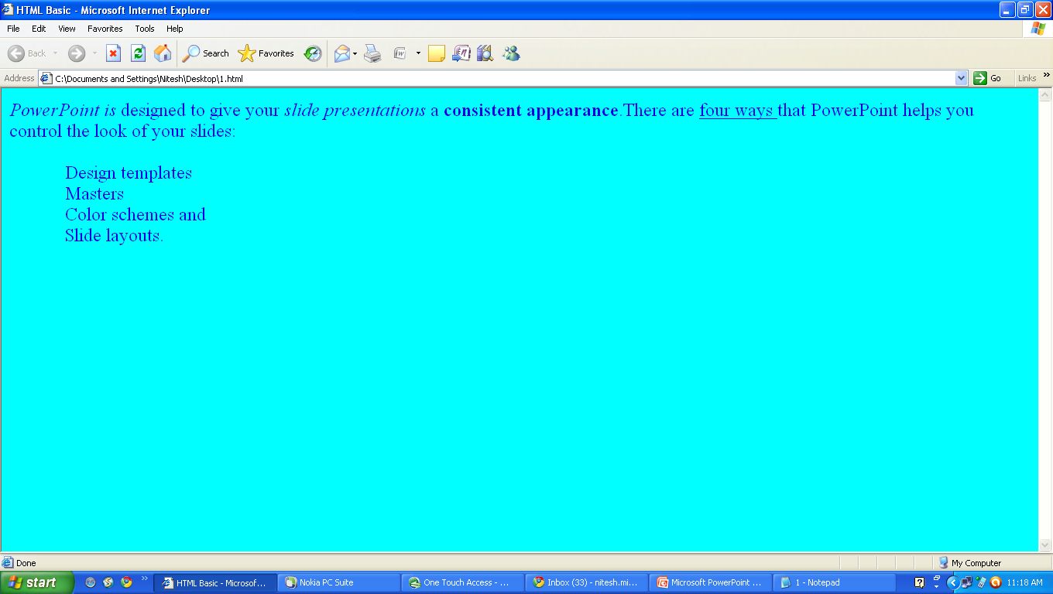

Slide 36
Pre-Defined Heading
<H1> ….. </H1> , <H2> ….. </H2>, <H3> ….. </H3>,
<H4> ….. </H4>, <H5> ….. </H5>, <H6> ….. </H6>
The highest level of heading is <H1> followed by <H2> and so on till <H6> which is the smallest level.
These headings give or display all the font changes, paragraph breaks before and after, and white apace necessary for heading. We can add alignment to the headings.
The Align=left/center/right attribute can be added to the <H1> through to <H6> elements to get the desired aligning.

Slide 37
Pre-Defined Heading
<HTML>
<HEAD>
<TITLE> HTML Basic </TITLE>
</HEAD>
<BODY>
<font face=“arial” color=“blue”>
<h1 align=“center”> Powerpoint Presentation </h1>
<h2> Powerpoint Presentation </h2>
<h3> Powerpoint Presentation </h3>
<h4> Powerpoint Presentation </h4>
<h5 align=“right”> Powerpoint Presentation </h5>
<h6 align=“right”> Powerpoint Presentation </h6>
</font>
</BODY>
</HTML>

Slide 38
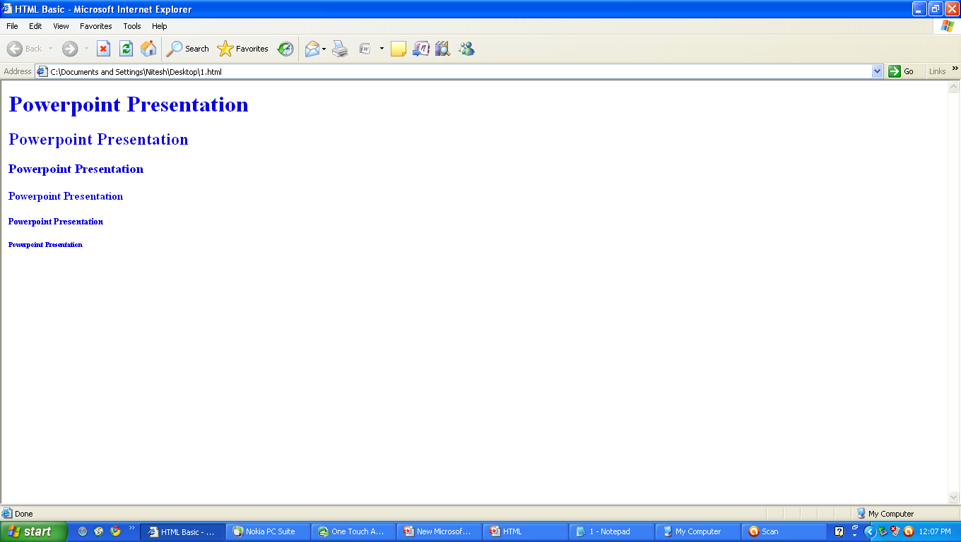

Slide 39
<P> …… </P> Paragraph Tag
On encountering <P> tag, the browser moves onto a new line skipping one line between the previous line and the new line.
The Align=left/center/right attribute can be added to the <P> to get the desired aligning.
Closing tag (</P>), is not entirely necessary . Nearly all browsers will assume that when a new <P> Paragraph has begun, the old one must have ended.

Slide 40
<P> …… </P> Paragraph Tag
<HTML>
<HEAD>
<TITLE> HTML Basic </TITLE>
</HEAD>
<BODY>
<font size=5 face=“arial”> PowerPoint is designed to give
your slide
presentations a consistent appearance. <P> There
are four ways that PowerPoint helps you control the
look of your slides: <P Align=“centre”> Design templates
<br> Masters <br> Color schemes <br> Slide layouts </P>
</font>
</BODY>
</HTML>

Slide 41
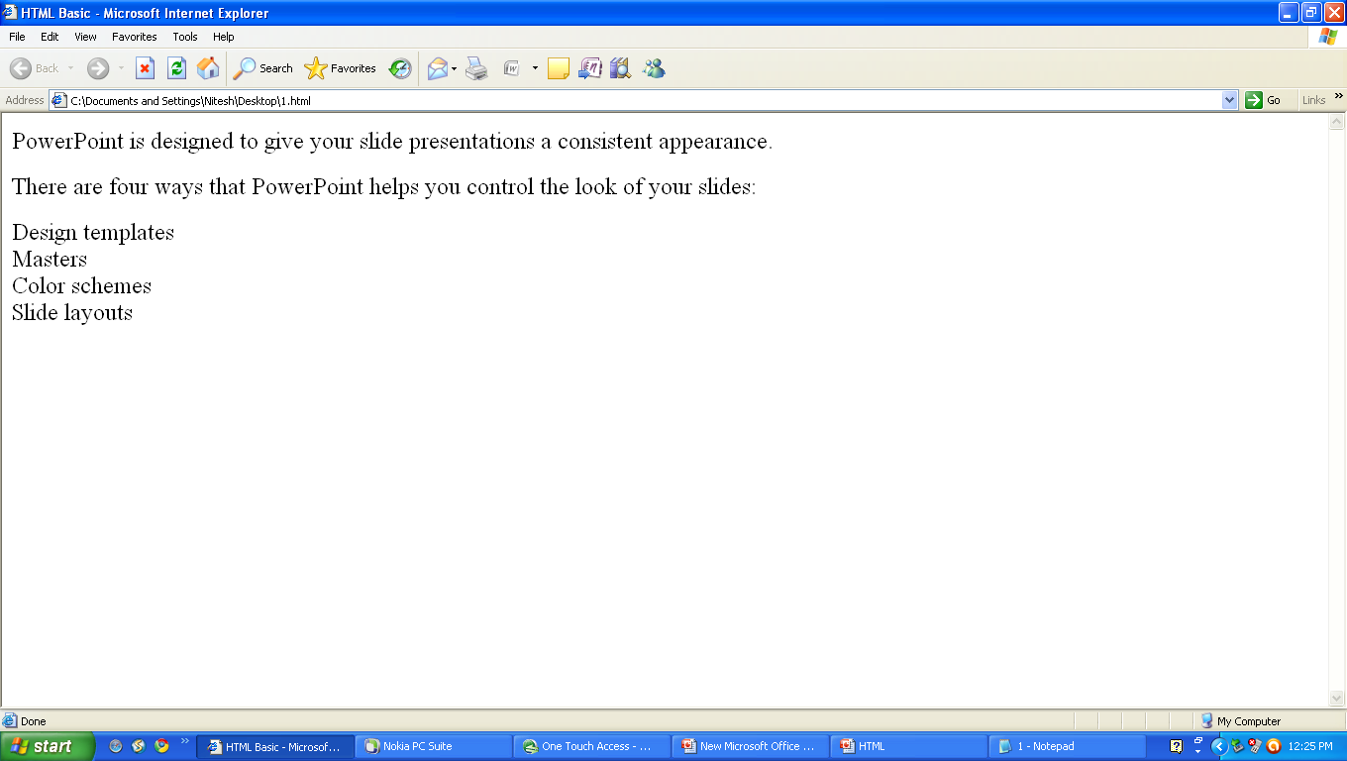

Slide 42
Comment Tag
Comment Tag :
Comments in HTML document is a diagnostic tool .
Comments do not appear on the web page – invisible to the user.
Comment begins with “<!–” and ends with “-->” .
Example :
<!– your comment goes here -->

Slide 43
LIST IN HTML

Slide 44
LIST IN HTML
TYPES :
<OL> …… </OL> : Ordered list and list item starts with <LI>
Attribute Type : Defines the kind of numbering to be used in an
ordered list.
START : Used to specify the number from which the list is to begin.
<UL> ….. </UL> : Unordered list and list items starts with <LI>.
Attribute Type : Defines the kind of bullet to be used in unordered
list.
<DT> : The item part in the definition/glossary list.

Slide 45
LIST IN HTML
LIST ITEMS USED :
<LI> ….. </LI> : It defines the individual items in any list.
Attributes Type : Applies only to <OL> and <UL> list value :
Allow resetting the numbering system in an <OL> list
<DL> …… </DL> : A definition/glossary list consisting of an item and it’s
definition.

Slide 46
LIST IN HTML
This is an ordered list | This is an unordered list
Something big | Something red
2. Something small | Something blue
3. Something short | Something old
4. Something tall | Something new
This is a definition / glossary list
Scripting Language
A Scripting language is a particular syntax used to execute commands on a computer. A program composed of commands from a particular scripting language is referred to as a script.

Slide 47
LIST IN HTML – Ordered List Example
<BODY>
What I want for Classroom OUTPUT :
<OL>
What I want for Classroom
<LI> A Pentium Computer
<LI> Over Head Projector
<LI> OHP Pen Set
<LI> LCD Projection System
<LI> A Laser Pointer
</OL>
</BODY>
1. A Pentium Computer
2. Over Head Projector
3. OHP Pen Set
4. LCD Projection System
5. A Laser Pointer

Slide 48
LIST IN HTML – Ordered List Example
<BODY>
What I want for Classroom OUTPUT :
<OL>
What I want for Classroom
<LI> A Pentium Computer
<LI> Over Head Projector
<LI> OHP Pen Set
<LI> LCD Projection System
<LI> A Laser Pointer
</OL>
</BODY>
A Pentium Computer
Over Head Projector
OHP Pen Set
LCD Projection System
A Laser Pointer

Slide 49
IMAGES IN WEB PAGES

Slide 50
IMAGES IN WEB PAGES
<IMG SRC=“Image file name” Attributes >
Tags will use JPEG(.JPG) or GIF(.Gif) file formats attributes.
Border : Set border size, 0 will hide the border.
Vspace : Adjusting space above and blow the image.
Hspace : Adjusting space to the left and right of the image.
Align : Top, bottom, middle, left, right, center.
Alt : Text displays in the absence of graphics.
Height : Sets the height of image.
Width : Sets the width of the image.
Background : Background image for the web page.

Slide 51
IMAGES IN WEB PAGES
<IMG> Tag some Examples
<IMG SRC=“soft.gif” height=“250” width=“45”>
<IMG SRC=“soft.gif” height=“250” width=“45” border=0>
<IMG SRC=“soft.gif” vspace=15 hspace=35 align=left>
<P> Web Based Graphics <IMG SRC=“soft.gif” height=“250” width=“45”>Is here </P>
<A HREF=“softimage.html”><IMG SRC=“soft.gif”> </A>
<IMG SRC=“soft.gif” AlT=“Web Page Design”>
<Body Background=“soft.gif”>

Slide 52
IMAGES IN WEB PAGES
Simple Examples
<body>
<font face=“Arial” color=“#ff0000” size=“4”> Image in the Web
Page </font>
<p align=“center”>
<img src=“cartoon.gif” border=“0” width=320 height=240>
</body>

Slide 53
IMAGES IN WEB PAGES - Example
<body>
<p align=“center”> <b> <font face=“arial” color=“#ff0000”
size=“4”>This is an example of inserting image in the web page.
</font> </b></p>
<p align=“center”> <b> <font face=“arial” color=“#008000”
size=“3”> You can write any size of the image </font> </b> </p>
<p align=“center”> <b> <font face=“arial” color=“#008000”
size=“3”> or can Define the position of the text </font> </b> </p>
</body>

Slide 54
TYPES OF LINKING

Slide 55
TYPES OF LINKING
Linking two or more web pages.
Linking within a web page.
Linking to external web page.
Linking to a specific point in another web page.
Mailto.
Linking with image file.

Slide 56
Linking two or more web pages
Linking Tag : <A> …….. </A>
<A HREF=“market.html”> Training Institute </A>
Example :
First file
Second file

Slide 57
Linking two or more web pages – first file
<body>
<font face=“arial”> <CENTER> <H2> Software Development House
</H2></CENTER>
<UL TYPE=“SQUARE”>
<LI> <A HREF=“SOFTWARE.HTML”> SOFTWARE DEVELOPMENT
</A>
<LI> <A HREF=“MARKETING.HTML”> MARKETING </A>
<LI> <A HREF=“CUSTOMER.HTML”> CUSTOMER SUPPORT </A>
</UL> </font>
</body>

Slide 58
Linking within a web page
LINKING Tag : <A Name> ……… </A>
Two Steps :
Marking
<A Name=“Software”> <B> Software Development </B> </A>
2. Direct hyperlink to section
<A href=“#software”> software development </A>

Slide 59
Linking to External web page
<body>
<font face=“arial” size=7>
Go to TTTI, Bhopal ! <br>
<A href=“http://www.tttibhopal.com”> A center of Excellence </A>
</font>
</body>

Slide 60
Linking To Specific Point In Another Web Page
LINKING Tag : <A Name> ……… </A>
Two Steps :
Marking in first page
<A Name=“office”> <B> Office Address </B> </A>
2. Direct hyperlink to section in second page
<A href=“address.html#office”> software development </A>

Slide 61
Linking with Image
<body>
<font face=“arial” size=7>
Go to Customer Support <br>
<A HREF=“customer.html”> <IMG SRC=“cartoon.gif” width=320
height=240> </A>
</font>
<body>

Slide 62
More HTML tags for Formatting / Linking
BGCOLOR , TEXT, LINK, VLINK and ALINK : These attributes allows control over the web page text and link text coloring.
BGCOLOR : Set the background color.
TEXT : Color for all the text in the document.
LINK : denotes the link.
VLINK : Stands for visited link.
ALINK : Stands for active link.
Example :
<body bgcolor=“#0000ff” text=“000000” link=“blue” vlink=“#400040” alink=“#red”> Some Text </body>

Slide 63
TABLES IN HTML

Slide 64
Basic Structure
<TABLE BORDER=“1”>
<TR>
<TH> TABLE EXAMPLE </TH>
<TD> 1234 </TD>
</TR>
<TR>
<TH> TABLE EXAMPLE </TH>
<TD> 123 </TD>
</TR>
</TABLE>

Slide 65
Tables in HTML
<TABLE> Elements
Border : Sets the border size.
Cellpadding : Pixels between the cell data and cell wall.
Cellspacing : Pixel between cells.
Width : Width the overall table in pixels or percent.
Caption : Placed centered text above the table.
Align : Align table left, right or center.
Bgcolor : Background color of the table.

Slide 66
Tables in HTML
<TR> Table Row Elements
Align : Aligns the row to the left, right or center.
Valign : Vertically aligns the row to thetop, bottom or center.
Bgcolor : Background color of the table.

Slide 67
Tables in HTML
<TD> OR <TH> Table Cell Elements
Align : Aligns the cell to the left, right or center.
Valign : Vertically aligns the cell to the top, bottom or center.
Bgcolor : Background color of the cell.
Width : Width of the cell in pixel or percent.
Colspan : Spans cell columns.
Rowspan : Span cell rows.

Slide 68
Tables in HTML
<HTML>
<HEAD>
<TILTE> TABLE </TITLE>
</HEAD>
<BODY>
<TABLE BORDER=“2” BORDER COLOR=“green” BGCOLOR=“yellow”>
<TR> <TH ROWSPAN=“4”> DATA </TH>
<TH COLSPAN=“2”> DETAILS </TH> </TR>
<TR> <TH> NAMES </TH>
<TH> MARKS </TH> </TR>
<TR> <TD> Sanjay Agrawal </TD>
<TD> 75 </TD> </TR>
<TR> <TD> Ravi Kapoor </TD>
<TD> 69 </TD> </TR>
</TABLE>
</BODY>
</HTML>

