Slide 1
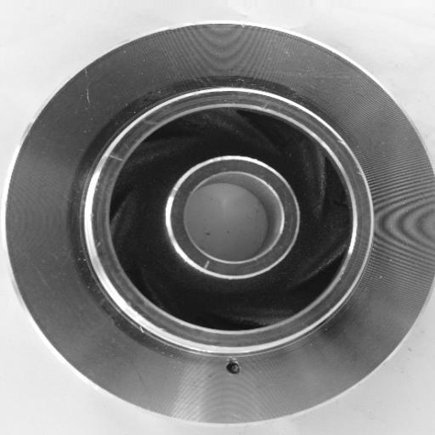
Visual Cast Defect Inspection
MTAI PROJECT
A phone app that finds casting defects, names their type and tells the operator what to do
Team 4
Ganesh Bhavaraju
114124024
Kruthika
114124056
Real defective impeller from a foundry inspection line (Kaggle, Pilot Technocast)
Naqiya
114124064
Nitesh
114124066
Notes:
Visual Cast Defect Inspection, MTAI project by Team 4: Ganesh Bhavaraju, Kruthika, Naqiya and Nitesh. The app runs on a phone, detects defective castings, names the defect type and gives pre-written corrective actions.

Slide 2



Manual casting inspection is slow, inconsistent and leaves no record
Slow and tiring
Every part checked by eye; accuracy drops over a shift
Our goal: inspection with only a phone
Detect defects on the device, no server or GPU
Add new parts from a few good photos or a CAD file
Never flag designed holes; catch the wrong part
Name the defect type and show where it is
Give causes, fixes and a PDF / CSV record
Inconsistent
Two inspectors grade the same part differently
No record
Nobody can say later why a part was rejected
Commercial vision systems need camera rigs, GPUs and thousands of labelled defect images, out of reach for most small foundries.
Notes:
Most small and medium foundries inspect castings by eye. It is slow, inconsistent and unrecorded. Our objectives: on-device detection, quick setup for new parts, no false alarms on designed holes, defect type and location, and pre-written remedies with a report.

Slide 3
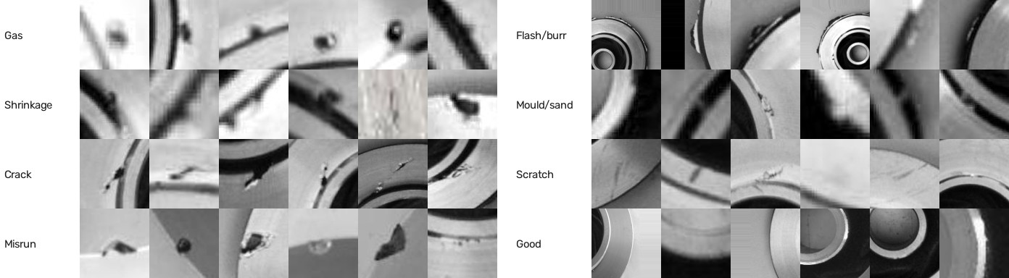
Trained on real foundry images and labelled defects, tested on CAD renders
7,348
foundry inspection-line photos
Kaggle · Pilot Technocast, Rajkot
2,066
photos with labelled defects
4 Roboflow sets, 9,513 crops
1,080
real sand-cast photos
Kaggle · SIFA
649
CAD renders of 5 parts
good and defective, for testing
Each labelled defect box became one close-up crop.
Split by source photo, so no photo is in both training and test.
Rejected: a 12-class Kaggle set that turned out to be painted-on shapes.
Notes:
Real data: the Kaggle impeller dataset photographed on the Pilot Technocast foundry inspection line; four Roboflow projects where those castings are annotated with defect boxes; SIFA sand-cast photos for good surfaces. We cropped every defect box into a close-up, merged class names into 8 classes and split by source photo. Synthetic renders of 5 CAD parts test the training-free tabs.

Slide 4
Everything runs on the phone: no GPU, no server, nothing uploaded
Offline training
PyTorch + timm on a CPU, exported to ONNX
Phone browser · installable web app · works offline
Camera and interface
3 tabs · verdict · heat map or CAD overlay · remedies · history
Base model
MobileNetV2 + EfficientNet-B0 in ONNX Runtime Web
Reference images
ResNet18 patch features + part mask
Reference CAD
cad.js geometry engine in a Web Worker
Vercel hosting
static files over HTTPS, cached on the phone
On the device
IndexedDB for saved parts · service worker for offline · PDF report and CSV log
Notes:
The app is a progressive web app. Models are trained offline in PyTorch and exported to ONNX; Vercel only serves static files. On the phone, ONNX Runtime Web runs the networks, our own cad.js engine handles CAD rendering and alignment in a Web Worker, IndexedDB stores parts, and a service worker makes it work offline.

Slide 5



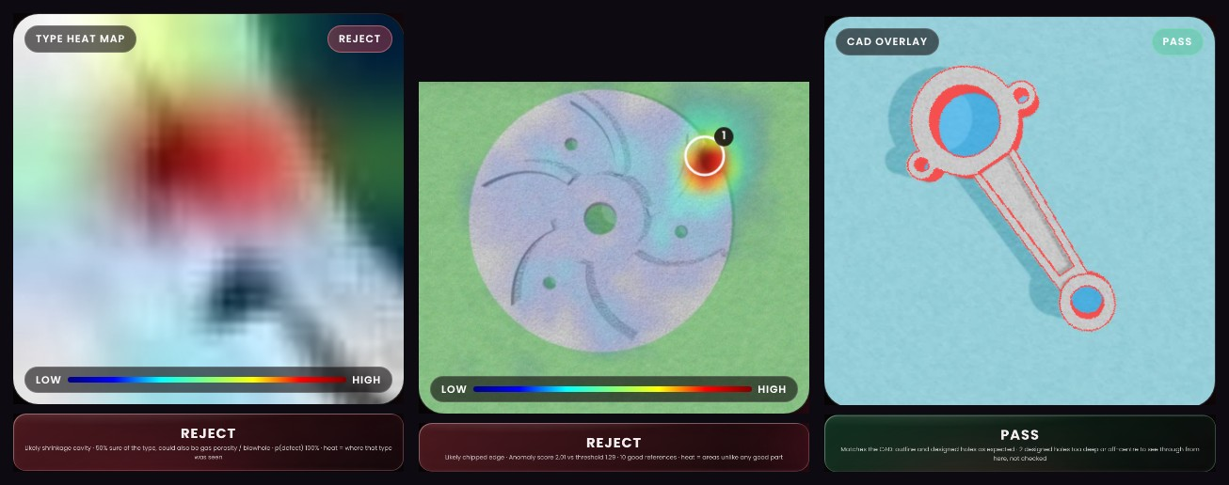

Three ways to inspect, each naming the defect and the fix
Base model
Reference images
Reference CAD
Close-up photo → 8 defect types (EfficientNet-B0). Whole part → defect / OK with Grad-CAM.
Learns from 1 to 20 good parts. Patch comparison, background ignored, type read against the best good photo.
Load STL or OBJ. Photo aligned to rendered CAD: holes, outline, wrong part, sizes in mm.
After every reject
Remedies card: how to confirm, likely causes, process fixes, what to do with the part
PDF report with an action-plan page
CSV log of every inspection
Notes:
Tab 1 uses trained networks: a close-up classifier that names 8 defect types and a whole-part classifier with Grad-CAM. Tab 2 learns a part from a few good photos with PatchCore-style patch comparison; the background and what shows through holes are ignored. Tab 3 compares the photo with the CAD model, so designed holes are never flagged and wrong parts are caught. Every reject shows pre-written causes and fixes and goes into the PDF report and CSV log.

Slide 6

Accurate on held-out data, fast on an ordinary phone CPU
99.7%
whole-part accuracy
715 Kaggle test photos
90.4%
close-up defect-type accuracy
1,534 held-out crops; 0.6% of defects missed
139/139
CAD findings typed correctly
validation defects on 4 parts
0.15–1 s
per photo on the device
no GPU, no server
Next steps
Retrain the close-up model with 20 to 30 of a partner foundry's own close-ups per type
Printed scale marker so the CAD tab measures absolute size
Fixed station with a ring light for repeatable photos
Notes:
Results: 99.7% on the Kaggle test set for the whole-part model, 90.4% type accuracy for the close-up model with 0.6% of defects missed, every detected CAD validation defect typed correctly, and 0.15 to 1 second per photo on a CPU. Weakest cases: hairline cracks and telling gas from shrinkage. Next steps: real foundry close-ups, a scale marker, and a fixed lighting station.

