Slide 1
Linux Booting Procedure
G.Siva Krishna

Slide 2
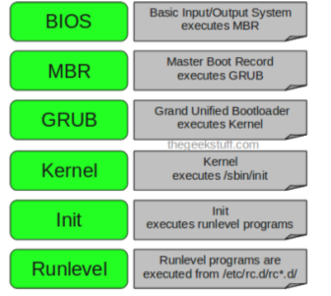

Slide 3
Before BIOS
1> Power Supply & SMPS(Switching Mode Power Supply)
2> Bootstrapping
  main task performed by SMPS, is to inform about the
  good power supply to mother board
  If the power signal level is perfect,then SMPS will send a
  POWER GOOD signal to the motherboard
  The address location FFFF:0000h contains one instruction
  The instruction is to jump to another memory address location. This JUMP
  command, will tell the location of the BIOS program in the ROM.

Slide 4
BIOS
First software program that runs when you start your pc
BIOS stands for Basic Input/Output System
POST(Power on Self Test) checks and confirms the integrity of the following
hardware components.
Timer IC's
DMA controllers
CPU
Hard Drive etc
BIOS loads and executes the MBR boot loader.

Slide 5
MBR
Stands for Master Boot Record
This is nothing but the first sector of your hard disk with 512 bytes size
As soon as bios finds a valid MBR, it will load the entire content of MBR to RAM
It contains information about GRUB (or LILO in old systems).

Slide 6
GRUB
GRUB stands for Grand Unified Bootloader.
If you have multiple kernel images installed on your system, you can choose which one
to be executed.
GRUB displays a splash screen, waits for few seconds, if you don’t enter anything,
it loads the default kernel image as specified in the grub configuration file.

Slide 7
Kernel
Kernel executes the /sbin/init program
Since init was the 1st program to be executed by Linux Kernel, it has the process id
(PID) of 1. Do a ‘ps -ef | grep init’ and check the pid.
When the kernel is loaded, it initializes various components of the
computer and operating system (/etc/init folder).
/etc/init.d folder contains the processes that runs automatically after kernel boots up

Slide 8
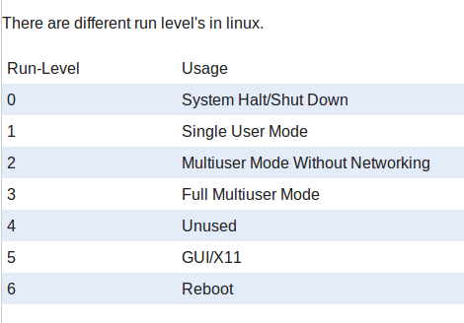
Init

Slide 9
How to check a current runlevel of your Linux system
runlevel or who -r
Changing between different runlevels :
Init 0 - shutdown
Init 6 – Reboot

Slide 10
AM335x -SOC
Features :
Up to 1-GHz Sitara™ ARM® Cortex®-A8 32-Bit
RISC Processor
32KB of L1 Cache
256KB of L2 Cache
176KB of On-Chip Boot ROM
64KB of Dedicated RAM(internal RAM)

Slide 11
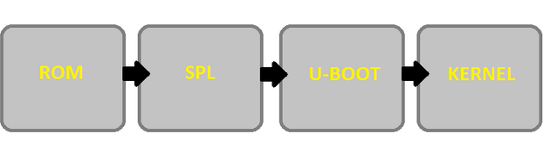
AM335x - Booting Procedure

Slide 12
The four bootloader stages are:
ROM
SPL (or Secondary Program Loader)
U-BOOT
Linux Kernel

Slide 13
1st Stage Bootloader: ROM Code
The ROM code has below functions:
Configuration of the device and initialization of primary peripherals
Stack setup
Configure Watchdog Timer 1 (set to three minutes)
PLL and System Clocks configuration
Ready device for next bootloader
Check boot sources for next bootloader (SPL)
Moves next bootloader code into memory to be run

Slide 14
2nd Stage Bootloader: SPL
Also referred as the MLO
The SPL is the first stage of U-boot, and must be loaded from one of the boot sources
into internal RAM
Makes external RAM available for u-boot
Loads u-boot

Slide 15
3rd Stage Bootloader: U-BOOT
U-BOOT allows for powerful command-based control over the kernel boot environment
via a serial terminal.
U-boot environment variables can be configured
These environment variables can be viewed, modified, and saved using the
printenv,setenv, and saveenv commands

Slide 16
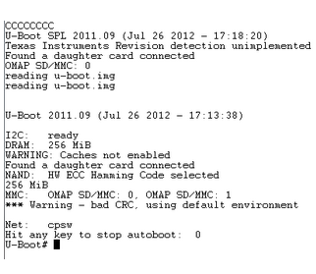
Below is an example screenshot from a serial terminal first running U-BOOT.

