Slide 1
MACHINE LEARNING

Slide 2
Machine learning (ML) can be either easy or hard. It is normally easier to learn if you are familiar with the prerequisites.
Maths: Linear algebra
Probability and statistics
Calculus
Numerical optimization
Coding: In any of the following:
Python
Java
C/C+

Slide 3
“Machine Learning is a collection of algorithms and techniques used to create computational systems that learn from data in order to make predictions and inferences.”
Recommendation System: YouTube brings videos for each of its users based on a
recommendation system that believes that the individual user will be interested in.Similarly
Amazon and other such e-retailers suggest products that the customer will be interested in and
likely to purchase by looking at the purchase history for a customer and a large inventory of
products.
Spam detection: Email service providers use a machine learning model that can automatically detect
and move the unsolicited messages to the spam folder.
Prospect customer identification: Banks, insurance companies, and financial
organizations have machine learning models that trigger alerts so that organizations
intervene at the right time to start engaging with the right offers for the customer and
persuade them to convert early. These models observe the pattern of behavior by a user
during the initial period and map it to the past behaviors of all users to identify those that
will buy the product and those that will not.

Slide 4
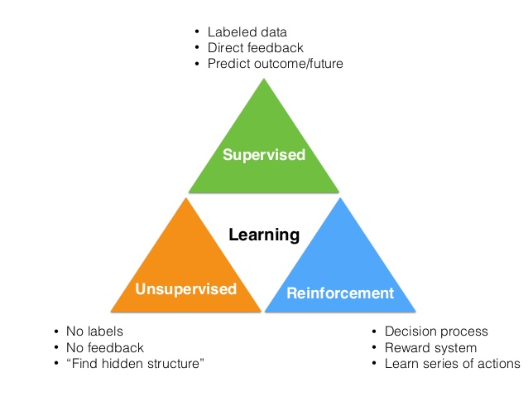
Machine Learning Categories

Slide 5
supervised
Supervised learning is the machine learning task of inferring a function from labeled training data.The training data consist of a set of training examples. In supervised learning, each example is a pair consisting of an input object (typically a vector) and a desired output value (also called the supervisory signal). A supervised learning algorithm analyzes the training data and produces an inferred function, which can be used for mapping new examples.

Slide 6
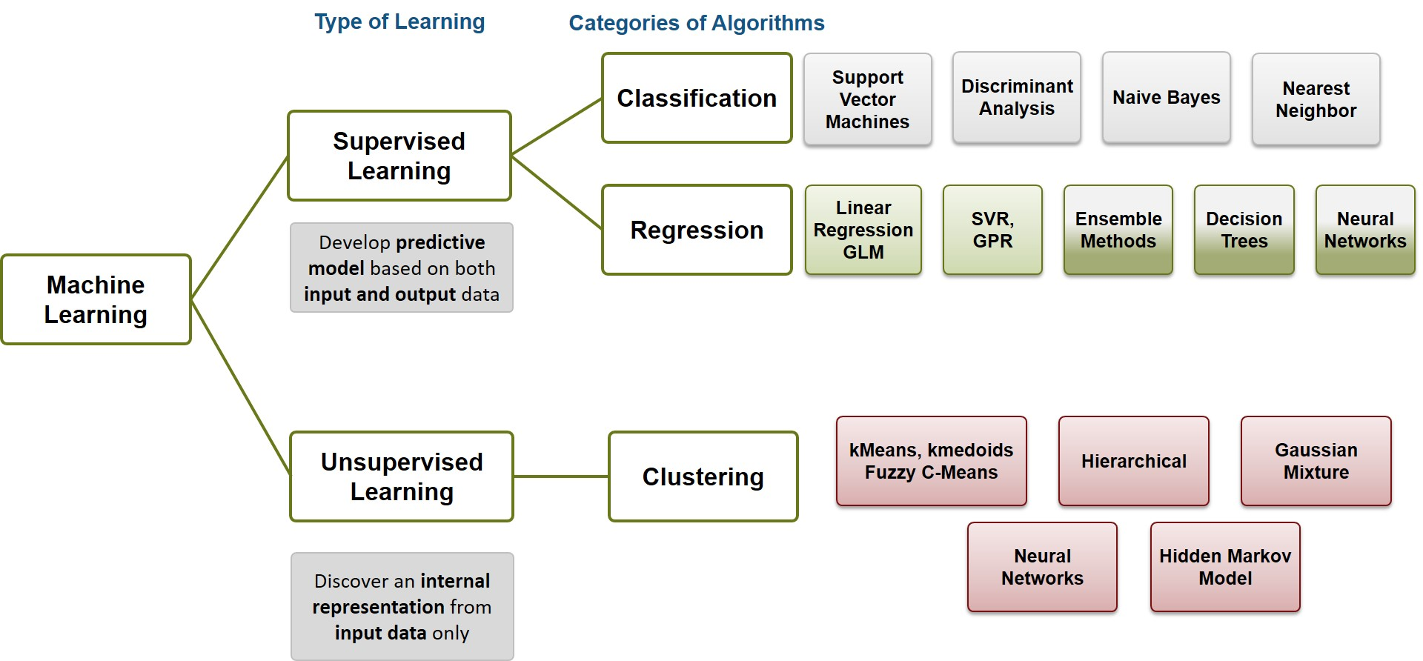

Slide 7
Regresstion & Classification
Regression: the output variable takes continuous values.
Classification: the output variable takes class labels.

Slide 8
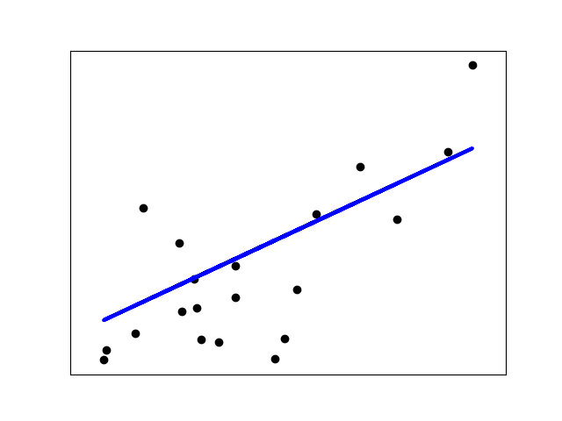
Generalized Linear Models
LinearRegression fits a linear model with coefficients w = (w_1, ..., w_p) to minimize the residual sum of squares between the observed responses in the dataset, and the responses predicted by the linear approximation. Mathematically it solves a problem of the form

Slide 9
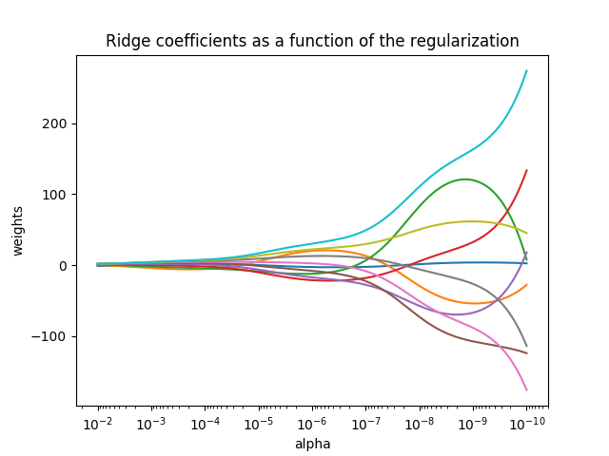
Ridge Regression
Ridge regression addresses some of the problems of Ordinary Least Squares by imposing a penalty on the size of coefficients. The ridge coefficients minimize a penalized residual sum of squares,

Slide 10

Lasso
The Lasso is a linear model that estimates sparse coefficients. It is useful in some contexts due to its tendency to prefer solutions with fewer parameter values, effectively reducing the number of variables upon which the given solution is dependent. For this reason, the Lasso and its variants are fundamental to the field of compressed sensing. Under certain conditions, it can recover the exact set of non-zero weights (see Compressive sensing: tomography reconstruction with L1 prior (Lasso)).

Slide 11
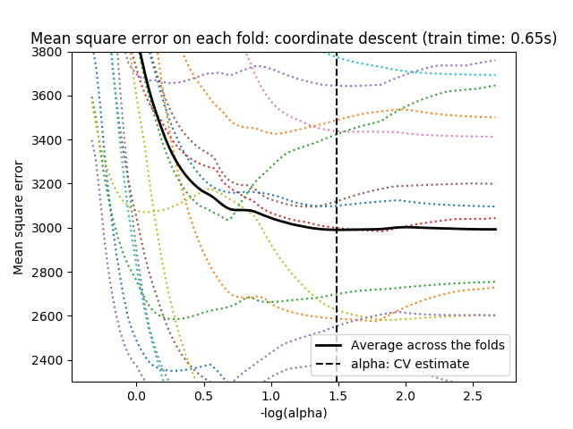

Slide 12

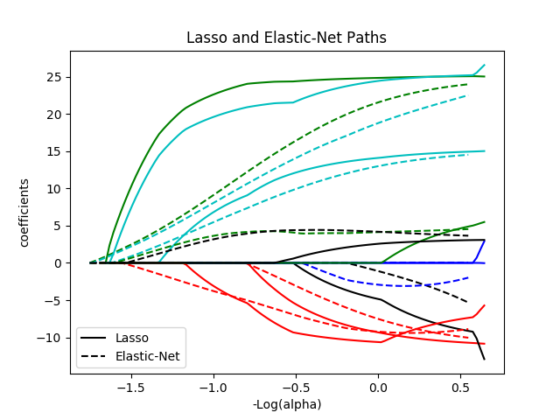
Elastic Net
ElasticNet is a linear regression model trained with L1 and L2 prior as regularizer. This combination allows for learning a sparse model where few of the weights are non-zero like Lasso, while still maintaining the regularization properties of Ridge. We control the convex combination of L1 and L2 using the l1_ratio paramete

Slide 13


Logistic regression
Logistic regression, despite its name, is a linear model for classification rather than regression. Logistic regression is also known in the literature as logit regression, maximum-entropy classification (MaxEnt) or the log-linear classifier.

