Slide 1
Building LTP For Linux kernel(x86)
Nitesh

Slide 2
CONTENTS
Project Introduction & Information
Project Architecture / Design
Approach Taken
Manual / Automation Test cases preparation
Role
Contribution.
Achievement’s
Lessons Learnt
Test Report

Slide 3
Project Introduction & Information
The project goal is to deliver tests to the open source community that validate the reliability, robustness, and stability of Linux.
The LTP testsuite contains a collection of tools for testing the Linux kernel and related features. Our goal is to improve the Linux kernel and system libraries by bringing test automation to the testing effort. Interested open source contributors are encouraged to join.
Features:
The Linux Test Project is a group aimed at testing and improving Linux. The goal of the LTP is to deliver a suite of automated testing tools for Linux as well as publishing the results of tests they run.

Slide 4
LTPdesign goals
Each test is an executable.
Each test is as self-contained as possible.
Each test covers a well-defined assertion or a small group of similar assertions.
Each test runs automatically. (There is no need for manual setup nor input during the test run.)
Overall test status is passed as an exit value.
Additional information is printed to stdout.
Global parameters are passed via environment variables.

Slide 5
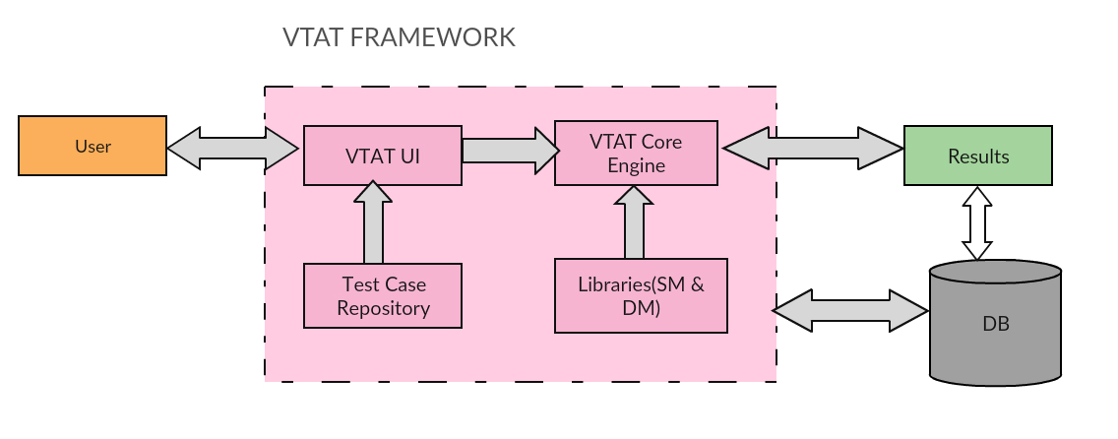
Project Architecture

Slide 6
Approach Taken :
I downloaded the LTP source from the official site which was
then compiled into a toolchain.
LTP source
build linux system(x86)
Collecting log files
(ipc,device drivers)
Prepare XML sheet with
All LTP test cases
&
Integrate with Tool
Execute Test Scripts
With VTAT Tool

Slide 7
Sample xml format
<root name="LTP">
<children name="runtest" iterations="1">
<children name="ipc" action="./runltp -p -l /tmp/ipc.log -f ipc" logfile="/tmp/ipc.log">
<children name="ipc_pipeio" action="./runltp -p -l /tmp/ipc_pipei.log -f ipc -s pipeio_1" logfile="/tmp/ipc_pipei.log"/>
<children name="ipc_sem" action="./runltp -p -l /tmp/ipc_sem.log -f ipc -s sem01" logfile="/tmp/ipc_sem.log"/></children>
<children name="Device_Driver"><children name="rtc" action="./runtest/rtc01 /dev/rtc > /tmp/rtc_test.log" logfile="/tmp/rtc_test.log"/>
<children name="rtc" action="./runtest/rtc01 /dev/rtc0 > /tmp/rtc_test.log" logfile="/tmp/rtc_test.log"/></children>
<children name="testscripts" iterations="1">
<children name="adp.sh" action="./adp.sh -d 10 -n 2" logfile="adp.log"/>
</children>
</children>
</root>

Slide 8
Role :
Build the LTP source and execute on an linux based system.
Integrated the Test cases with VTAT tool.
Executed the test scripts and analysed the results.

Slide 9
Contribution
Built the LTP from source into a linux system.
Working towards building the LTP source into an executable binary for Android

Slide 10
Lessons Learnt:
Learnt more about the compilation process and compilers in general
Improved familiarity with execute test suites and cross compilers

Slide 11
Test Report:
The final result has not yet been achieved due to some errors in the build configuration which I would be solving in the days to come. From what I’ve experienced the compilation steps are quite unusual compared to my previous activities where I compiled LTP for x86, and ARM7 based systems. Any input from someone who has prior experience in this would be of much help.

