Slide 1
Automation Linux Test Project
M.Nitesh

Slide 2
CONTENTS
Project Introduction & Information
Project Architecture / Design
Objective of the Project
Approach Taken
Sample XML Formate
Role
Contribution
Achievement’s
Lessons Learnt
Test Report

Slide 3
Objective of the Project
As part of Automation Linux Test Project team, I am working on ipc and device drivers.
Objective:
To test the stability,and robustness of the Linux kernel by exicuting test cases manually.
We have four test cases in our project:
Systemcalls,fs(file system),ipc(inter process communication,device drivers).
Converting test cases into xml formate and integrated them in VTAT tool.

Slide 4
Project Introduction & Information
LTP:
LTP is open source project.
It delivers test suits to the 'open source community' that validate the reliabilities,robustness and stability of linux.
Here,test suit consists of automated and semi automated tests for testing various aspects of linux operating system.
LTP aims to bring test automation to linux kernel development.
LTP focus on funtionality, tregression and stress testing for linux kernel.
Big problem in LTP is project goal is bit too broad.
LTP is large (roughly 4000c source files and 500 shell scripts)
Because of size the context varied in quality and quantity.

Slide 5
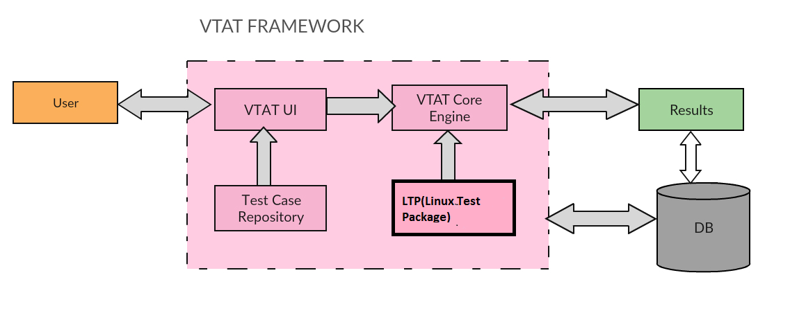
Project Architecture

Slide 6
Approach Taken
Download LTP
Manual testing
Converting
test cases to
XML format
Integrated
In
Vtat tool

Slide 7
Python scripts
To validate functionality of device driver wrote python scripts.
To validate functionality of file system wrote python scripts.
To validate functionality of syscalls wrote python scripts.
To validate functionality of ipc wrote python scripts..
Converted ipc and device drivers test cases into XML format.

Slide 8
Role
Manual Testing:
Understanding LTP document.
Downloading LTP on linux from open source community.
Setting up LTP test caes on linux.
Manually exicuting ipc and device drivers test cases.
Converted ipc and device drivers test cases into XML format.

Slide 9
Contribution
Executed ipc and device drivers test cases manually on linux os.
Written xml code for 08 ipc.
Written xml code for 34 rtc(device driver).

Slide 10
Achievement’s
Executed ipc manual test cases sucessfully.

Slide 11
Lessons Learnt
Learnt converting test cases into XML formate.
Learnt how to run VTAT tool.

Slide 12
Test Report
No.of test cases executed = 42
No. of test cases passed = 42
No. of test cases failed = 0

Slide 13
THANKYOU

