Slide 1
Distributed Movie Recommendation and User Analysis System
Apache Spark 4.2 · PySpark · GraphFrames · Spark MLlib (ALS) — MovieLens dataset
100,836
610
9,742
Nitesh Kumar
Roll No. 43 · Reg. No. 12306652
Cluster Computing (INT315)
ratings
users
movies
Notes:
Introduce the project: a distributed system that analyses movie ratings and recommends movies, built on Apache Spark. It covers all five tasks of the brief: architecture, data processing, graph analysis, machine learning and evaluation.

Slide 2
Project objectives
1
System architecture
Layered Spark design: ingestion → processing → graph + ML → evaluation
2
Ingestion and preprocessing
Schema-based CSV loading, cleaning, year and genre extraction, distributed aggregations
3
Graph analysis
User–movie and user–user graphs: popularity, PageRank, communities, connectivity
4
Machine learning
Two ALS models: rating prediction (explicit) and top-10 recommendation (implicit)
5
Evaluation
RMSE / MAE, Precision / Recall / NDCG@10, stage timings, data and core scalability
Notes:
These are the five tasks from the project brief, Sample Question 5/6 (Movie Recommendation). Each row says what was built for it. The rest of the deck follows this order.

Slide 3
Dataset: MovieLens (small)
100,836
610
9,724
98.3%
ratings (0.5–5 stars)
users, each rated ≥ 20 movies
movies with at least one rating
of user–movie pairs are empty
About the data
Collected by GroupLens, University of Minnesota
Ratings made between 1996 and 2018
Files used: ratings.csv and movies.csv (title, genres)
Average rating 3.50; 4.0 is the most common
Notes:
MovieLens comes from GroupLens at the University of Minnesota. The key number is sparsity: 98.3% of the user-movie grid is empty. Filling in that gap is what a recommender does. Ratings lean positive: 4.0 is the most common rating.

Slide 4
Technology stack
SP
Apache Spark 4.2
PY
PySpark
SQL
Spark SQL / DataFrames
Distributed engine: splits each job into tasks across all cores (local[*], 12 cores)
Python API for Spark; the whole project is written in it
Loading, cleaning, joins, aggregations and window functions
GF
GraphFrames 0.12.3
ML
Spark MLlib
PD
pandas + matplotlib
Graph analysis on Spark; the Python counterpart of GraphX (Scala-only)
ALS recommender, TrainValidationSplit tuning, regression and ranking evaluators
Reporting only: saving small result tables and drawing charts
Notes:
Everything distributed runs on Spark. GraphFrames is used for graphs because GraphX only has a Scala/Java API. GraphFrames runs on the same Spark engine, offers the same algorithms and includes a GraphX module. pandas and matplotlib only handle the small final results.

Slide 5
System architecture
Graph layer — GraphFrames
User–movie graph: in-degree, PageRank
User–user k-NN graph: Label Propagation, connected components
Evaluation
RMSE · NDCG@10 · timings · scalability
MovieLens CSV
ratings.csv
movies.csv
Ingestion and preprocessing
schema · cleaning · year · genres
ML layer — Spark MLlib
Model A: explicit ALS → rating prediction
Model B: implicit ALS → top-10 lists
Outputs
CSV tables · PNG charts · metrics.json
All stages run as distributed Spark jobs on local[*] (12 cores). The same code runs on a cluster by changing the master URL.
Notes:
Walk left to right. Data is loaded and cleaned once, cached in memory, then used by two layers: the graph layer (GraphFrames) and the ML layer (MLlib). Both feed the evaluation stage, which writes tables, charts and metrics.json. Every box runs as distributed Spark jobs. To use a real cluster, only the master URL changes.

Slide 6
Ingestion and preprocessing
1
Load
CSV read with an explicit schema, so Spark doesn't scan the data to guess column types
2
Clean
Drop nulls and duplicate (user, movie) pairs; keep ratings 0.5–5 → all 100,836 ratings valid
3
Extract features
Release year from the title, genre list from 'Action|Comedy', timestamp → date
4
Analyse
Spark SQL aggregations: sparsity, ratings per star, per genre and per user
Notes:
Four steps, all as Spark DataFrame operations. An explicit schema avoids an extra pass over the data. The dataset was already clean, so all 100,836 ratings were kept, but the checks are still needed for larger or messier data. The chart shows the distributed genre aggregation: Drama and Comedy have the most ratings.

Slide 7
Two graphs built with GraphFrames
User–movie graph (bipartite)
User–user similarity graph (k-NN)
Users
edge = rating
Movies
Each user → their 10 most similar users
Similarity = shared liked movies ÷ all liked movies (Jaccard)
609 users · 6,090 edges · 1 connected component
Used for: Label Propagation communities
10,352 vertices · 100,836 edges
Used for: in-degree, PageRank, liked-together pairs
Notes:
Graph 1 is bipartite: users on one side, movies on the other, and one edge per rating. It answers popularity and influence questions. Graph 2 links each user to the 10 users with the most similar taste, measured by Jaccard similarity on liked movies (rated 4 or more). A k-NN graph was used because a fixed 'shared likes' threshold made heavy raters into hubs, merging everyone into one community.

Slide 8
Most popular and most influential movies
329
ratings for Forrest Gump (1994), the most-rated movie
168
users liked both The Shawshank Redemption (1994) and Forrest Gump (1994)
In-degree and PageRank agree on the top 5 movies: popularity and centrality go together.
Notes:
In-degree counts the edges into a movie, which is simply how many people rated it. PageRank also weighs who rated it: a movie rated by well-connected users scores higher. Both measures pick the same top 5, so popularity and centrality go together here. The liked-together pairs come from two-hop paths movie → user → movie.

Slide 9
User communities (Label Propagation)
24
communities found
1
connected component: every user can reach every other
Lift = how much more a community likes a genre than the average user. C3 likes Film-Noir 2.75× more.
Notes:
Label Propagation starts with every user in their own group. Users then repeatedly adopt the most common label among their neighbours, so groups of similar users settle on one label. Each community is described by its 'lift' genre: the genre it likes much more than the average user. For example, community 3 likes Film-Noir 2.75 times more. Label Propagation has some randomness, so sizes can shift slightly between runs.

Slide 10
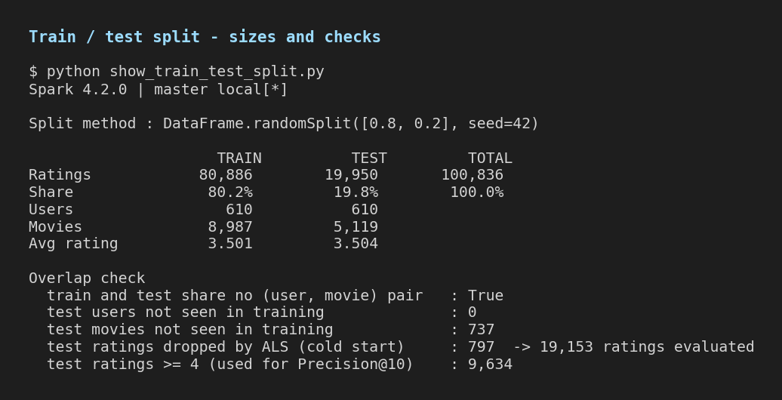
Train / test split
How the data was split
80 / 20 random split, seed 42: same split every run
80,886 training and 19,950 test ratings
No (user, movie) pair is in both sets
All 610 users appear in both sets
797 test ratings are for movies unseen in training → dropped (cold start); 19,153 evaluated
Tuning uses a validation split of the training data; the test set is used once
Screenshot: console output of show_train_test_split.py
Notes:
This screenshot is the console output of show_train_test_split.py, which repeats the exact split used by the models. 80% of ratings train the models and 20% are hidden for testing. The fixed seed means the split is identical every run. 797 test ratings belong to movies that never appear in training. ALS can't score those (cold start), so 19,153 test ratings are evaluated. Hyper-parameters are tuned on a validation split taken from the training data, so the test set is used only once, for the final scores.

Slide 11
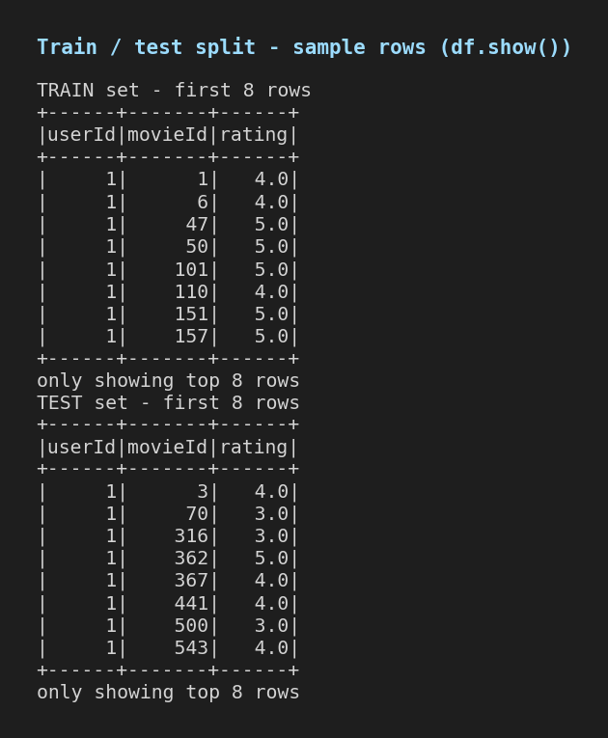
Train / test split: rows and balance
Train and test have the same rating mix (all differences < 0.5 percentage points), so the split is unbiased.
Notes:
Left: the first rows of each set as printed by Spark's df.show(). Same user, different movies, which confirms the split is by rating, not by user. Right: the share of each star value in train and test is almost identical (every difference is under half a percentage point), so the test set is a fair sample.

Slide 12
ALS: how the recommender works
A
Explicit ALS: rating prediction
R
ratings
610 × 9,724
98.3% empty
U
users
× k
Vᵀ
k × movies
Predicts the star rating a user would give
Learns from the exact rating values
Measured by RMSE and MAE
≈
×
B
Implicit ALS: top-10 lists
k = number of hidden taste factors (rank). Predicted score for a user and movie = their two factor vectors multiplied together.
Treats each rating as 'watched', with the rating as confidence
Ranks unseen movies for each user
Measured by Precision / Recall / NDCG@10
ALS alternates: fix V and solve U, then fix U and solve V. Each step splits into independent problems that Spark runs in parallel.
Both models recommend only movies with ≥ 20 ratings, and never a movie the user already rated.
Notes:
ALS, Alternating Least Squares, approximates the big, mostly empty ratings matrix as the product of two thin matrices: one row of taste factors per user, one per movie. It alternates: fix the movie factors and solve for users, then fix users and solve for movies. Each step is many independent least-squares problems, which Spark spreads across cores. Two models were trained, because predicting a star rating and ranking a top-10 list are different problems.

Slide 13
Hyper-parameter tuning
Model A: 9 combinations · 42 s
Model B: 8 combinations · 173 s
Rank | regParam | Validation RMSE ↓
10 | 0.2 | 0.8882
50 | 0.2 | 0.8894
20 | 0.2 | 0.8897
10 | 0.1 | 0.8915
50 | 0.1 | 0.8929
Rank | alpha | regParam | Validation NDCG@10 ↑
50 | 1 | 0.1 | 0.1795
20 | 1 | 0.1 | 0.1766
50 | 1 | 1 | 0.1679
20 | 1 | 1 | 0.1573
50 | 10 | 1 | 0.1568
Chosen: Model A rank 10, regParam 0.2 · Model B rank 50, alpha 1.0, regParam 0.1 (highlighted rows; top 5 of each search shown)
Selected on validation data carved from the training set; the test set played no part in tuning.
Notes:
Model A was tuned with Spark's TrainValidationSplit over 9 combinations of rank and regularisation, scored by validation RMSE. Model B was tuned over 8 combinations of rank, alpha and regularisation, scored by validation NDCG@10. Both searches use only the training data. Stronger regularisation (0.2) helped Model A because most users have few ratings.

Slide 14
Model A: rating prediction accuracy
0.881
RMSE on 19,153 held-out ratings
0.691
MAE: average error of about 0.7 stars
16%
lower error than predicting the average rating
Notes:
RMSE is the typical size of the prediction error, in stars. ALS gets 0.8806, against 1.0435 for always predicting the average rating and 0.9629 for predicting each movie's average. MAE 0.6905 means predictions are off by about 0.7 stars on average. Published ALS results on this dataset are usually around 0.86–0.90.

Slide 15
Model B: top-10 recommendation quality
+49%
precision@10 vs popularity (0.190 vs 0.127)
1.9
of every 10 recommended movies were ones the user liked
Model A ranks worse than popularity: a ranking task needs a ranking-trained model.
Notes:
Precision@10 is the share of the 10 recommendations that the user actually liked in the hidden test set. NDCG also rewards putting those movies near the top. Implicit ALS beats recommending the most popular movies by 49% on precision. Model A, trained to predict ratings, does worse than popularity at ranking. That is why the project uses a ranking-trained model for top-10 lists.

Slide 16
Example: recommendations for user 1
User 1 rated 5 stars
Model B recommends (unseen)
Tombstone (1993)
Canadian Bacon (1995)
Pink Floyd: The Wall (1982)
The Messenger: The Story of Joan of Arc (1999)
Good Morning, Vietnam (1987)
Rob Roy (1995)
Terminator 2: Judgment Day (1991)
Die Hard (1988)
Raising Arizona (1987)
Jaws (1975)
Cinderella (1950)
Aliens (1986)
The Blair Witch Project (1999)
Scream (1996)
Notes:
User 1's top-rated movies are mostly action, war and cult films. Model B recommends unseen, well-known titles in a similar vein: Terminator 2, Die Hard, Aliens. None of these were rated by user 1, and each has at least 20 ratings. Run the pipeline with --user N to show any other user.

Slide 17
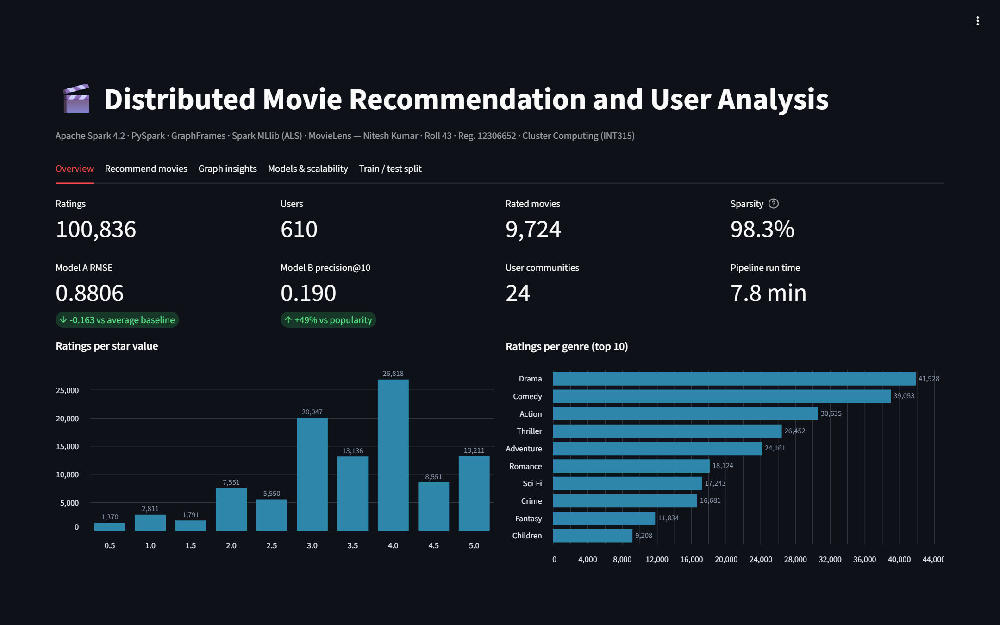
Live dashboard (Streamlit)
Open it live
movie-recommendation-spark.onrender.com
Five tabs:
Overview: dataset and key results
Recommend: any user 1–610
Graph insights
Models and scalability
Train / test split
Streamlit on Render; reads saved results, so no Spark is needed on the server
Screenshot: Overview tab of the live dashboard
Notes:
The results are also available as a live web dashboard built with Streamlit and hosted on Render. It reads the saved pipeline results, so the server doesn't need Spark or Java. Recommendations for all 610 users are precomputed by export_dashboard_data.py using the tuned Model B. Open the link during the presentation and pick a user ID to show recommendations live. The free server can take about a minute to wake up, so open it before you start.

Slide 18
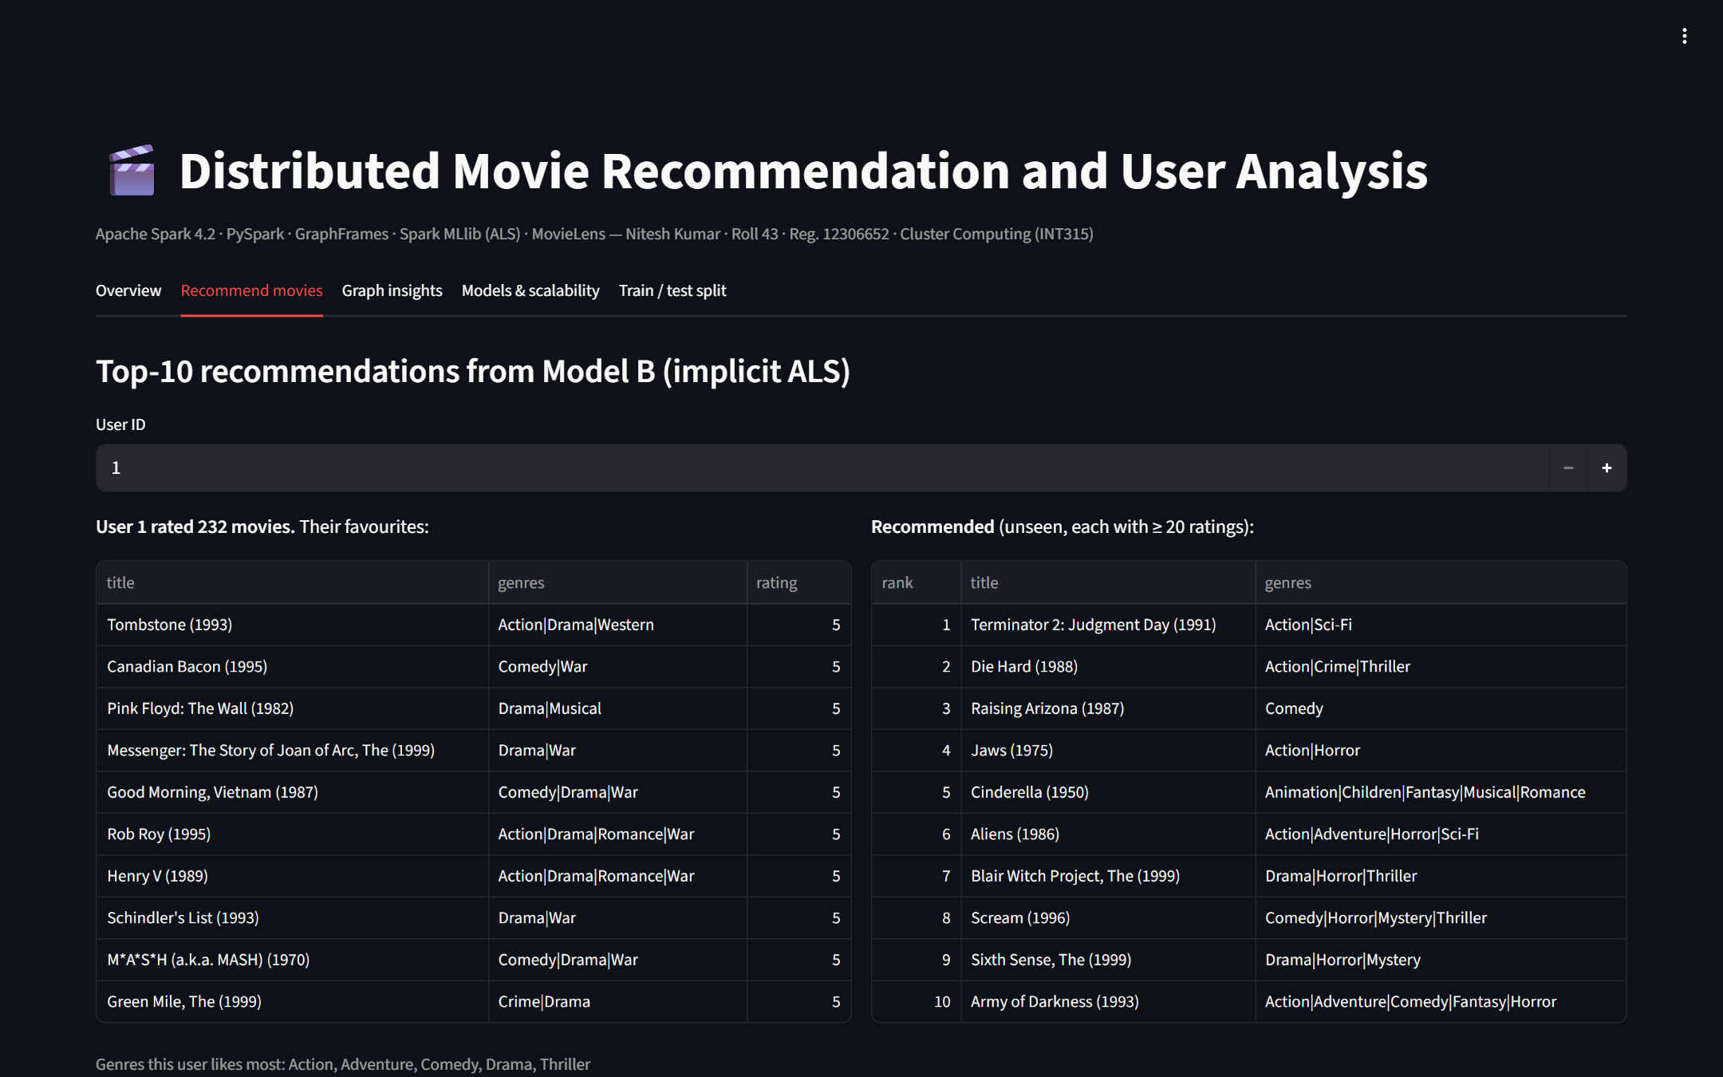
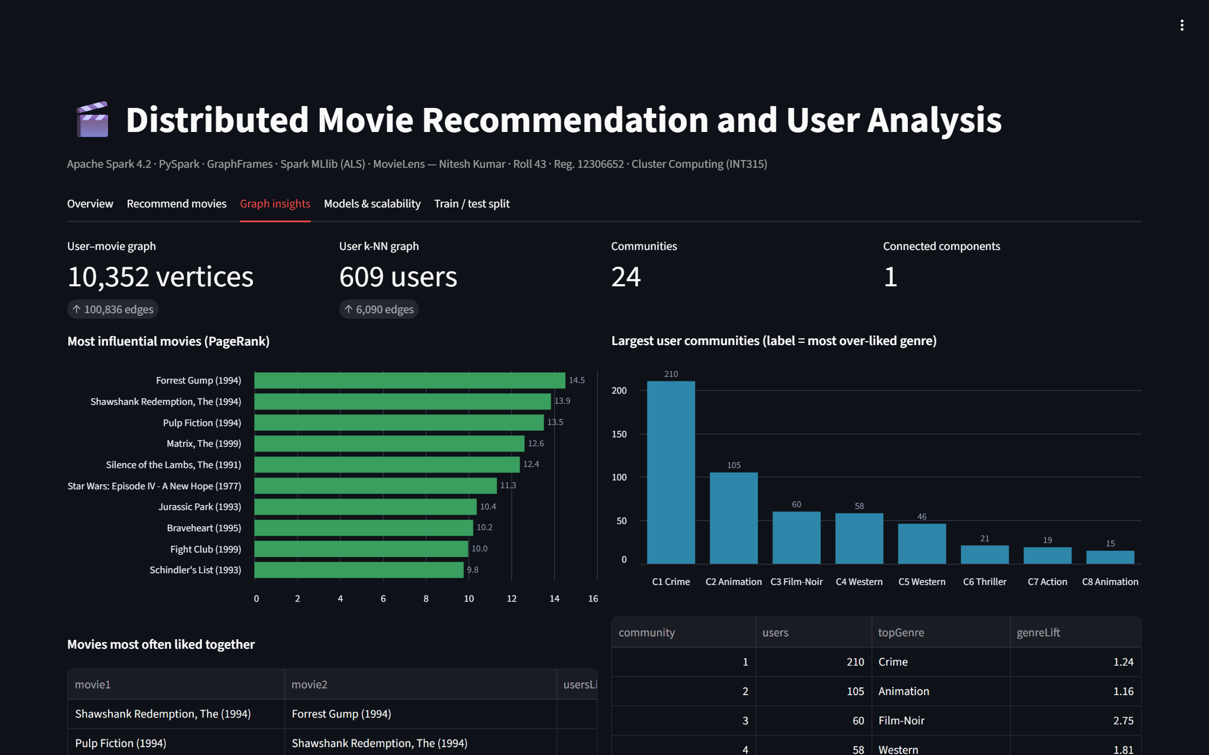
Dashboard: recommendations and graph insights
Recommend tab: user 1's favourites and top-10 picks
Graph insights tab: PageRank and communities
Live at movie-recommendation-spark.onrender.com · source on GitHub: github.com/Nitesh1123/movie-recommendation-spark
Notes:
Left: the Recommend tab. Choose any user to see their favourite movies next to Model B's top-10 recommendations. Right: the Graph insights tab with PageRank, communities and movies liked together, all interactive with hover details.

Slide 19
Scalability experiments
ALS: 12.5 s → 5.2 s on 8 cores (2.4× faster)
Fastest overall: 2 cores (15.8 s); overhead dominates on small data
More data → lower error: RMSE 1.012 → 0.881
Notes:
Left: the full workload on 1, 2, 4 and 8 cores. ALS training scales well, from 12.5 to 5.2 seconds. The graph stage doesn't, because on a small graph the cost of coordinating cores outweighs the work. Overall, 2 cores is fastest for this small dataset. Right: training on more data steadily lowers the error, while training time stays about 4 seconds, since Spark's fixed overhead dominates at this size.

Slide 20
Execution time per stage
7.8 min
for the whole pipeline, all 11 stages
173 s
Model B tuning: the slowest stage (8 models)
4.6 s
to train one ALS model on 80,886 ratings
Notes:
The full pipeline takes about 7.8 minutes on a 12-core laptop. Most of it is Model B tuning, which trains and ranks 8 ALS models. Training a single ALS model takes under 5 seconds. Every stage is timed automatically and saved in metrics.json.

Slide 21
Verification: 29 automated checks
3
8
5
29/29
Outputs exist
Matches pandas
Graph sanity
metrics, charts and result tables
counts, average rating, top-3 movies, graph size
PageRank top movie is popular; communities add up
checks passed
(python verify.py)
7
4
2
Spark results recounted with plain pandas, without Spark
Beats baselines
Recommendations
Scalability trends
RMSE below both baselines; ranking above popularity
10 unique, unseen, each with ≥ 20 ratings
more cores → faster ALS; more data → lower RMSE
Notes:
verify.py checks the results automatically and prints PASS or FAIL for each check. The key idea: Spark's numbers are recounted with plain pandas, which doesn't use Spark. It also checks that the models beat their baselines and that recommendations never include already-rated or rarely-rated movies. All 29 checks pass.

Slide 22
Challenges and solutions
Challenge | Solution
GraphX has no Python API | Used GraphFrames: same Spark engine and algorithms, DataFrame-based
Spark on Windows needs winutils.exe | Loaded jars through the driver classpath; saved results with pandas
Shared-like counts merged all users into one community | k-NN graph with Jaccard similarity → 24 communities
ALS recommended obscure movies with a single 5★ rating | Recommend only movies with at least 20 ratings
Rating-trained ALS ranked worse than popularity | Added implicit ALS for ranking: +49% precision@10
Notes:
These are the real problems found while building the system and how each was solved. Each one is a good talking point if asked what you learned.

Slide 23
Conclusion and future work
0.881
+49%
24
29/29
RMSE: 16% better than the average-rating baseline
precision@10 vs recommending popular movies
taste communities found in the user graph
automated verification checks passed
Future work
Run on a multi-node cluster (YARN / Kubernetes) with data on HDFS or S3
Scale to MovieLens 25M for a stronger scalability study
Hybrid recommender: add community and genre signals to handle new users (cold start)
Thank you · Questions?
Live: movie-recommendation-spark.onrender.com
Notes:
Summarise: all five tasks were delivered on Spark, the models beat their baselines, and the results were verified automatically. Future work focuses on a real cluster, a larger dataset and handling new users. Then invite questions.

