Slide 1

Auditing Algorithmic Fairness in Judicial AI: Empirical Evidence and a Framework for Indian Courts
M. Sc Project Work Review-1
Presented by
Mithuna Malini and Nitesh Pradhan
25MDT1036 and 25MDT1052
M. Sc Data Science
Under the Guidance of
Prof. Dr. Kriti Arya
School of Advanced Sciences
Vellore Institute of Technology, Chennai.

Slide 2
CONTENTS
INTRODUCTION
LITERATURE SURVEY
RESEARCH GAPS
DATA PIPELINE FOR JUDICIAL DATASET
PROPOSED EXPERIMENTAL DESIGN FOR TEMPORAL FAIRNESS AUDIT
REFERENCES

Slide 3
1. INTRODUCTION
The use of Machine Learning in judicial decision-support systems has increased with advances in NLP and digitized court records. However, deploying AI in high-stakes judicial settings raises serious concerns about fairness and accountability. Most existing fairness studies rely on demographic attributes, which are often unavailable or ethically sensitive in the Indian judicial context. This project instead focuses on temporal fairness, examining whether models trained on historical judgments remain consistent over time. The study conducts a systematic fairness audit of judicial outcome prediction models using Indian court data to promote responsible and unbiased AI adoption.

Slide 4
2.LITERATURE SURVEY
S.No | Article Title | Techniques Used | Key Findings | Limitations
1 | The Promise of Machine Learning for the Courts of India – Bhupatiraju et al. (2019) | Conceptual analysis of ML-based judicial data analytics | ML aids judges in bias detection and decision support without replacing them. | Focuses on conceptual analysis; no implementation-level study
2 | Artificial Intelligence in the Judiciary and Its Compliance with the Right to a Fair Trial – Terzidou (2022) | Qualitative analysis of AI in European courts under fair trial standards | Discusses AI support in case management and access to justice;. highlights transparency and ethics. | Focused on Europe; no empirical testing; limited coverage of complex cases.
3 | Artificial Intelligence in the Judiciary: Uses and Threats – Rocha & Carvalho | Descriptive and analytical discussion of AI in judiciary | AI model assists judges in repetitive tasks and reduces backlog; human judges remain central. | Limited to descriptive analysis; no empirical testing or impact assessment.
4 | Human Judges in the Era of Artificial Intelligence: Challenges and Opportunities – Xu (2022) | Conceptual and comparative analysis of human and AI-based judicial decision | Demonstrates AI support for judges in case handling and efficiency, judges remain central in complex cases | Conceptual study; no real dataset analysis

Slide 5
LITERATURE SURVEY (CONTD..,)
S.No | Article Title | Techniques Used | Key Findings | Limitations
5 | Systems and Methods for Responsible AI – US20240202351A1 (Jun 2024) | Responsible AI framework with bias detection and risk management across AI lifecycle | Demonstrates AI support for governance from training to post-deployment | Limited focus on generic technology, not adapted for courts.
6 | Algorithmic Bias and the Right to Equality – Sujith & Dinkar (2022) | Legal and constitutional analysis of AI bias | Discusses AI reinforcing discrimination, recommends audits and rights-based governance. | Conceptual only, no empirical testing;
7 | AI and Law: Mitigating Bias in AI through Indian Laws – Salaria & Kaur (2025) | Conceptual analysis; reviews constitutional principles, laws, and judicial precedents | Discusses AI bias in India; recommends audits, inclusive datasets, and judicial oversight | Conceptual only, no empirical testing; India-focused
8 | Systems and Methods for Model Fairness – US12169766B2 (Dec 2024) | Automated bias detection; fairness monitoring; | Demonstrates automated fairness reports and analyzes sensitive attributes | Not specific to judiciary; requires adaptation

Slide 6
3. RESEARCH GAPS
Limited research on bias and fairness in ML-based judicial decision-support systems.
Lack of studies addressing temporal bias arising from evolving legal language and changing case patterns.
Insufficient analysis of how predictive models behave across different time periods and the resulting disparities.
Need for systematic fairness audits, interpretability, and robust evaluation metrics to ensure unbiased, transparent judicial decision support.

Slide 7
4. DATA PIPELINE FOR JUDICIAL DATASET
Data Collection: Supreme Court of India judgments (1990–2025) obtained from Indian Kanoon in PDF format
Data Extraction: Judgment text extracted using PDFPlumber and PyTesseract OCR and stored as raw JSON [extracted.json].
Data Cleaning: Removal of headers, footers, page numbers, and noise using regex, producing cleaned.json.
Semantic Parsing: Legal text processed using spaCy NLP and BERT-based semantic extraction to preserve legal meaning, stored as parsed.json.
Semantic Validation: Re-parsing to recover missed legal content and resulting in the final dataset parsed-final.json.
The final JSON is prepared for ML-based prediction and fairness evaluation.

Slide 8
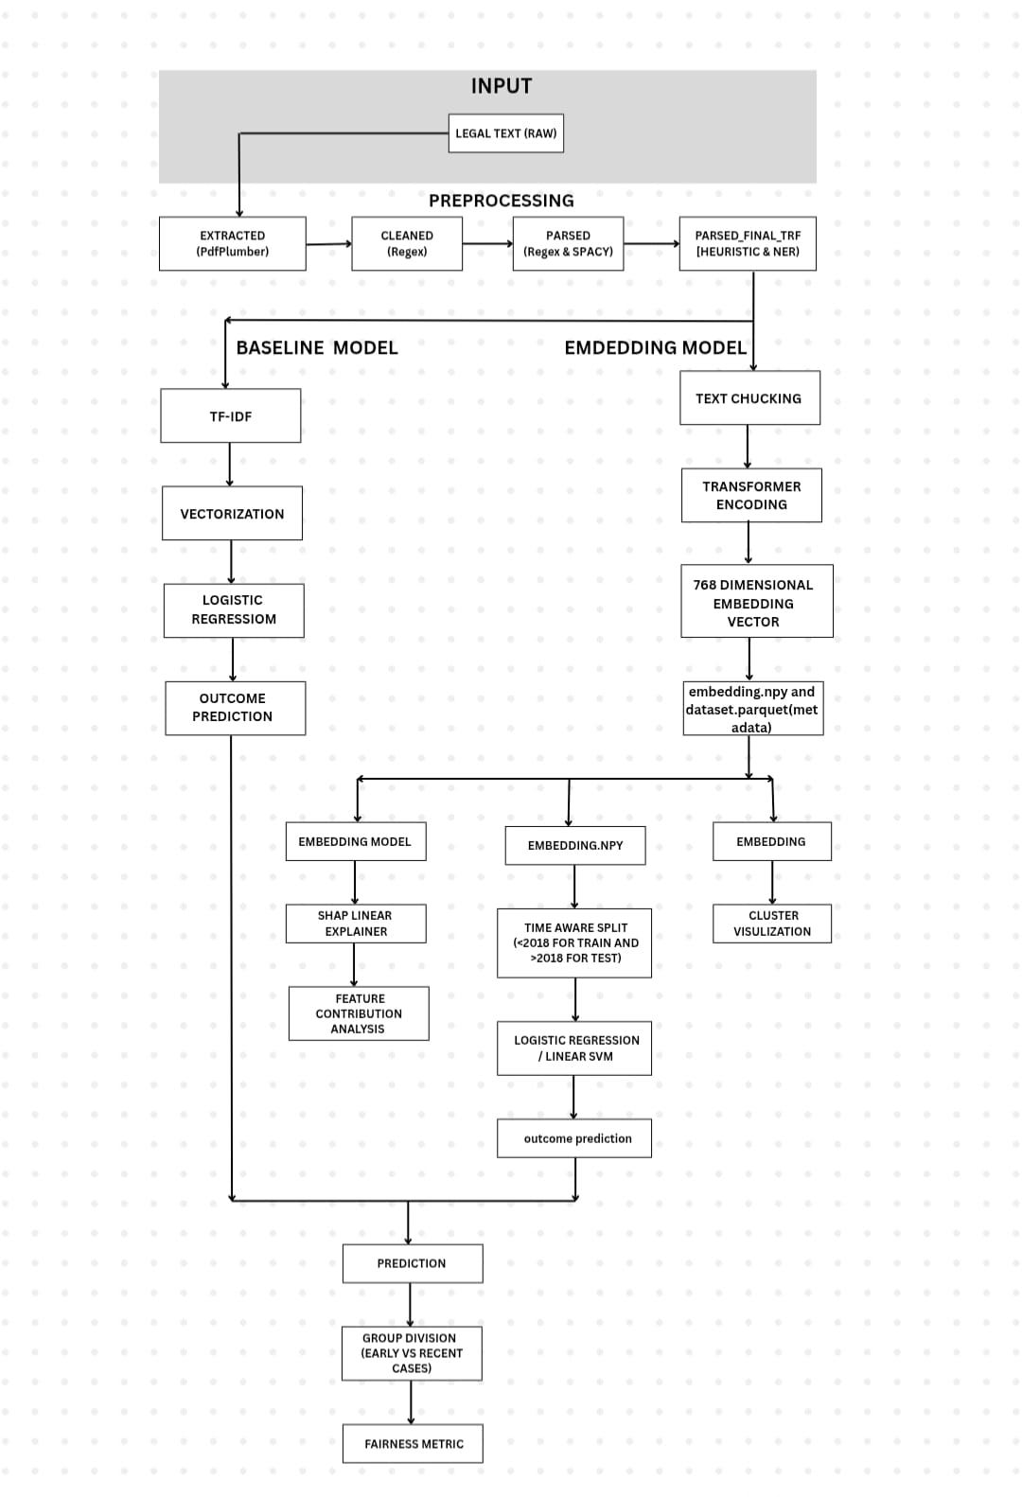
5. Proposed Experimental Design for Temporal Fairness Audit

Slide 9
6. REFERENCES
Bhupatiraju, R., Chen, X., & Joshi, A. (2025). The promise of machine learning for the courts of India. Journal of Legal Analytics and AI Applications
Terzidou, M. (2022). The use of artificial intelligence in the judiciary and its compliance with the right to a fair trial. European Journal of Law and Technology
Rocha, C., & Carvalho, J. (2024). Artificial intelligence in the judiciary: Uses and threats. International Journal of AI and Law
Xu, Y. (2022). Human judges in the era of artificial intelligence: Challenges and opportunities. AI & Society

Slide 10
REFERENCES (CONTD..,)
Sujith, P. D., & Dinkar, V. R. (2021). Algorithmic bias and the right to equality: Reimagining constitutional guarantees in the age of artificial intelligence. Indian Journal of Constitutional Law
Salaria, R., & Kaur, P. (2025). AI and law: Mitigating bias in AI through Indian laws. Journal of AI Ethics and Policy
US12169766B2. (2024). Systems and methods for model fairness. Google Patents. https://patents.google.com/patent/US12169766B2
US20240202351A1. (2024). Systems and methods for responsible AI. Google Patents. https://patents.google.com/patent/US20240202351A1

Slide 11
Thank You

