Slide 1
Zomato Restaurant

Slide 2
Key Findings Overview
📊
123,657 Restaurants
💰
Budget Dominance
Analyzed across multiple cities
Majority priced under ₹200
⭐
3.8-4.1 Rating Range
🚚
Delivery > Dining
Most restaurants cluster here
Higher delivery ratings

Slide 3
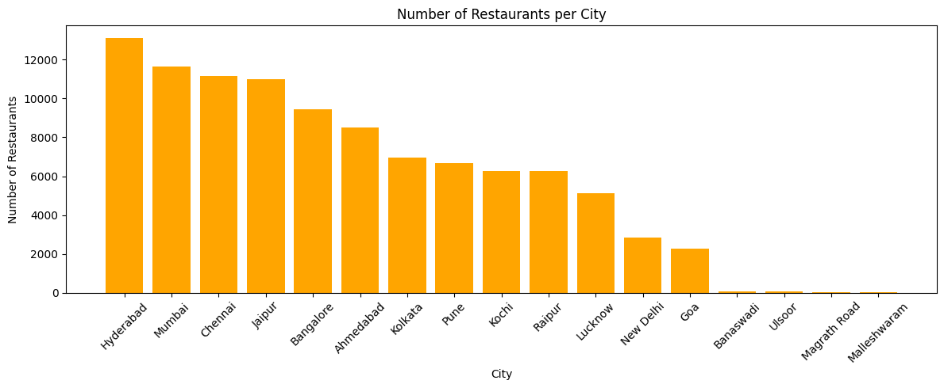
Insight 1: City Distribution
Finding:
Hyderabad have the most restaurants. These cities are Zomato's biggest markets.
💡 Action: Focus expansion efforts on these high-performing markets

Slide 4
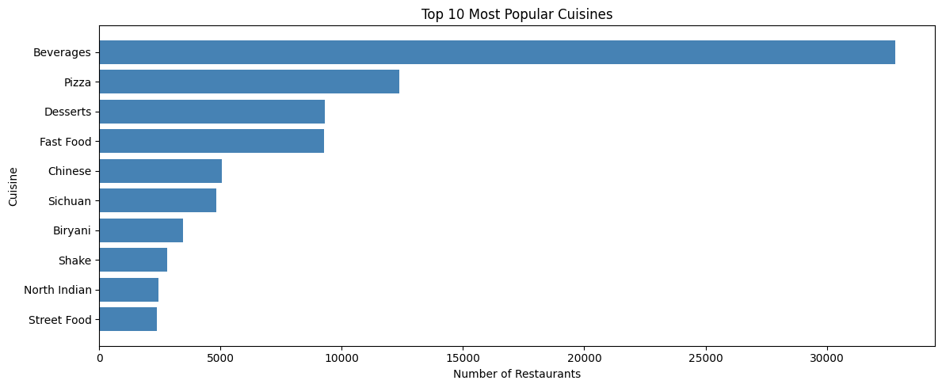
Insight 2: Popular Cuisines
Finding:
Beverages, Pizza and Fast Food are the top cuisines. Quick-service food is most popular on the platform.
💡 Action: Promote top cuisines in search and homepage banners

Slide 5
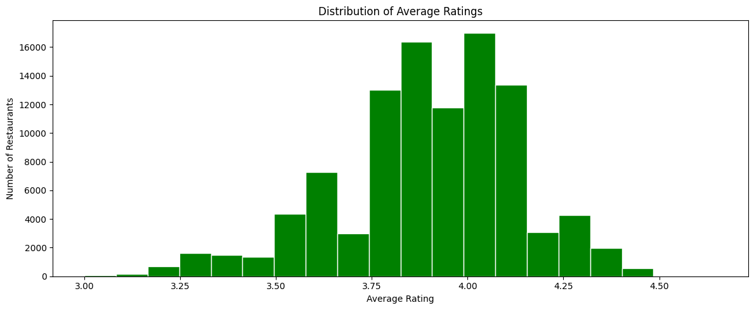
Insight 3: Rating Distribution
Finding:
Most restaurants have rating between 3.8 and 4.1. Very few restaurants reach 4.5 or above.
💡 Action: Give 'Zomato Choice' badge to top rated restaurants

Slide 6
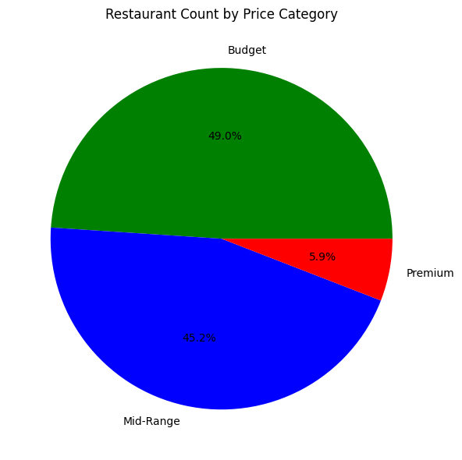
Insight 4: Price Category Breakdown
Finding:
Most restaurants are Budget priced (under ₹200). Zomato users mostly prefer affordable food.
💡 Action: Create a 'Best Budget Eats' section on the app

Slide 7
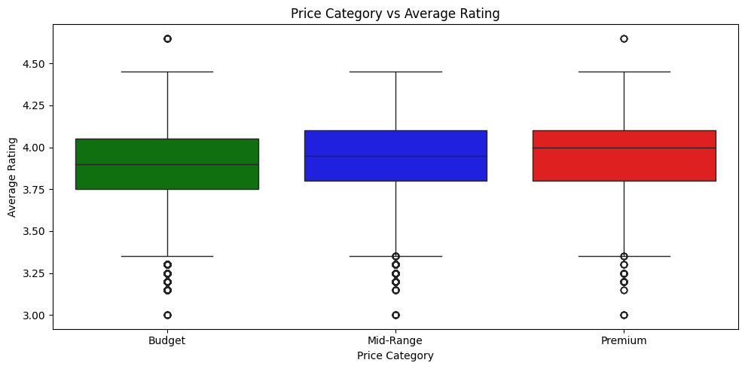
Insight 5: Price vs Rating Analysis
Finding:
Expensive restaurants do not always have better ratings. Some budget restaurants perform just as well as premium ones.
💡 Key Takeaway: Quality matters more than price for customer satisfaction

Slide 8
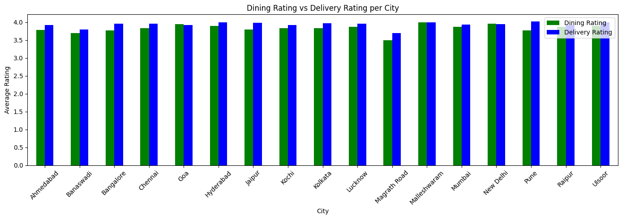
Insight 6: Dining vs Delivery Ratings
Finding:
Delivery ratings are slightly higher than dining ratings. Zomato delivery service is well received by customers.
💡 Action: Highlight restaurants consistent in both dining and delivery

Slide 9
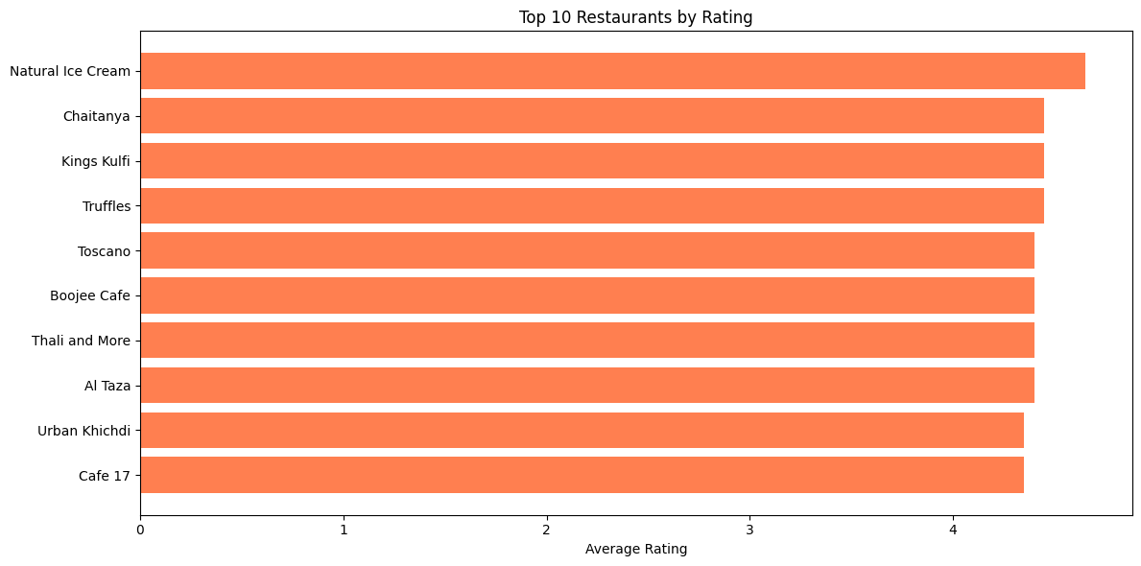
Top Performing Restaurants
Insight 7:
Natural Ice Cream is the best rated restaurant. Top restaurants should receive special badges on the app.
💡 Action: Award 'Zomato Elite' status to consistently top-rated establishments

Slide 10
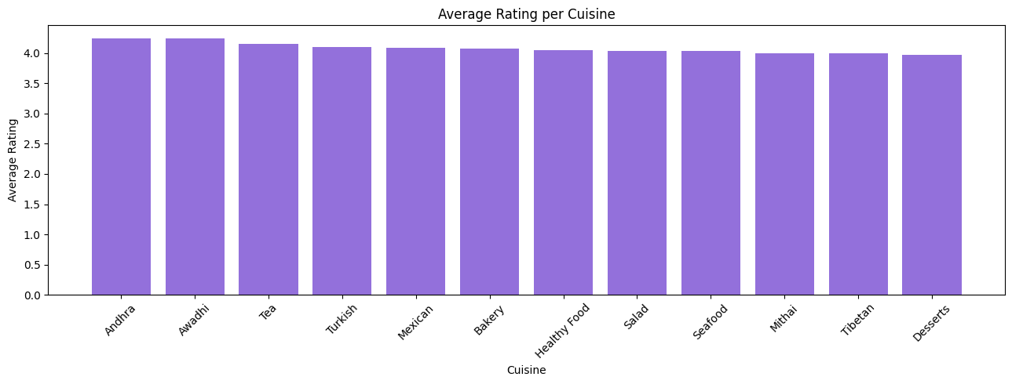
Cuisine Performance Analysis
Top cuisines show consistent quality across the platform

Slide 11
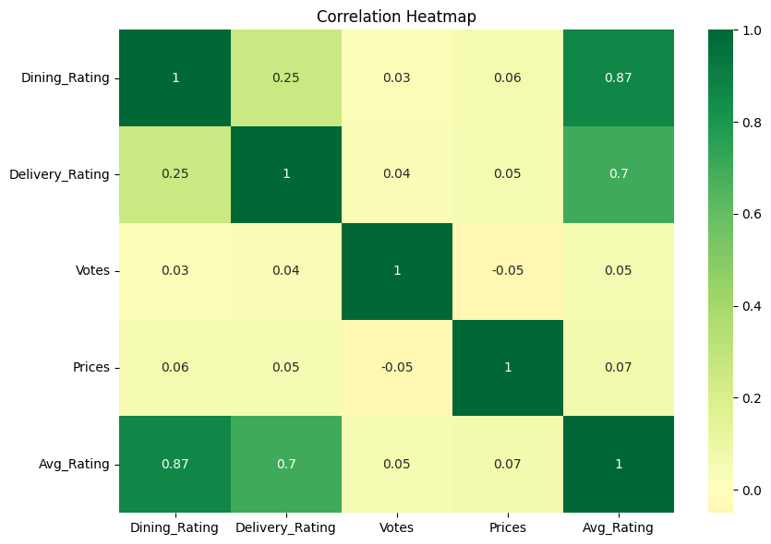
Data Correlation Insights
Strong correlation between dining and delivery ratings shows consistent service quality

Slide 12
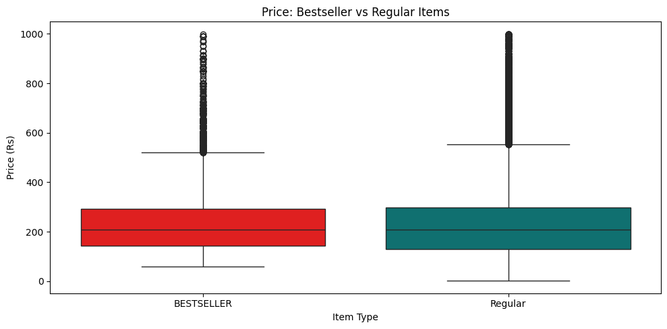
Insight 8: Bestseller Item Analysis
Finding:
Bestseller items have a clear price pattern vs regular items. Restaurants should tag more popular items as bestsellers.
💡 Action: Encourage restaurants to properly tag bestseller items

Slide 13
Strategic Recommendations
1
Give 'Zomato Choice' badge to top rated restaurants
2
Send quality alerts to restaurants with rating below 3.0
3
Create a 'Best Budget Eats' section on the app
4
Expand to smaller cities like Goa and Raipur
5
Promote top cuisines in search and homepage banners
6
Highlight restaurants consistent in dining and delivery

