Slide 1
Markov and Chebyshev’s inequality

Slide 2
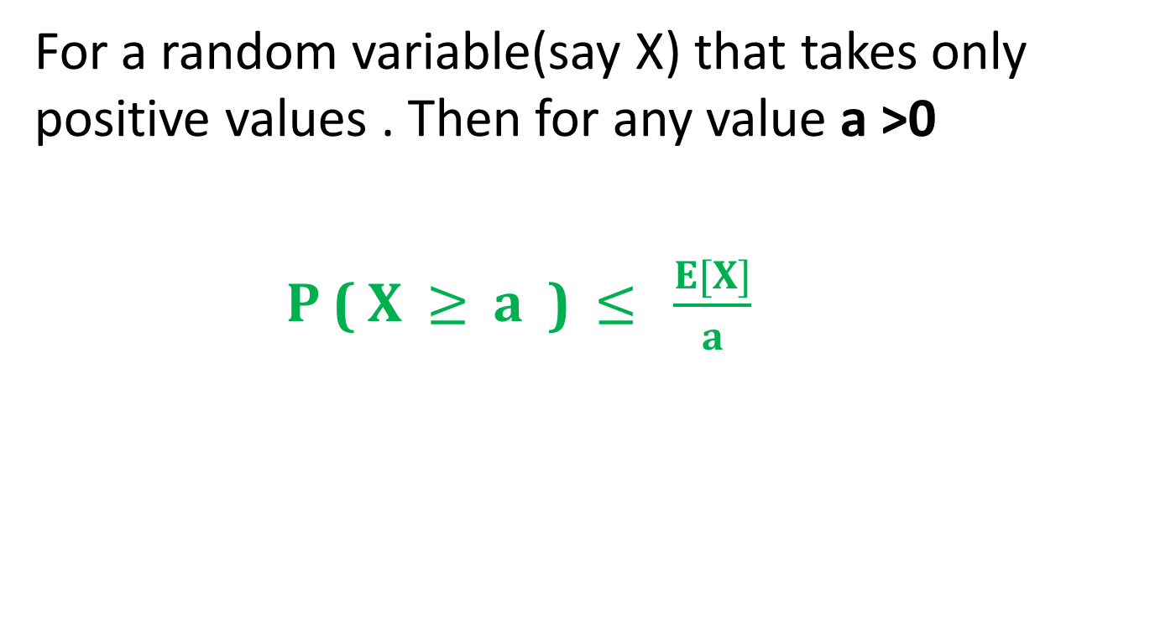
Markov’s Inequality
For a random variable(say X) that takes only positive values . Then for any value a >0
P ( X $≥$ a ) $≤$ $\frac{E[X]}{a}$

Slide 3
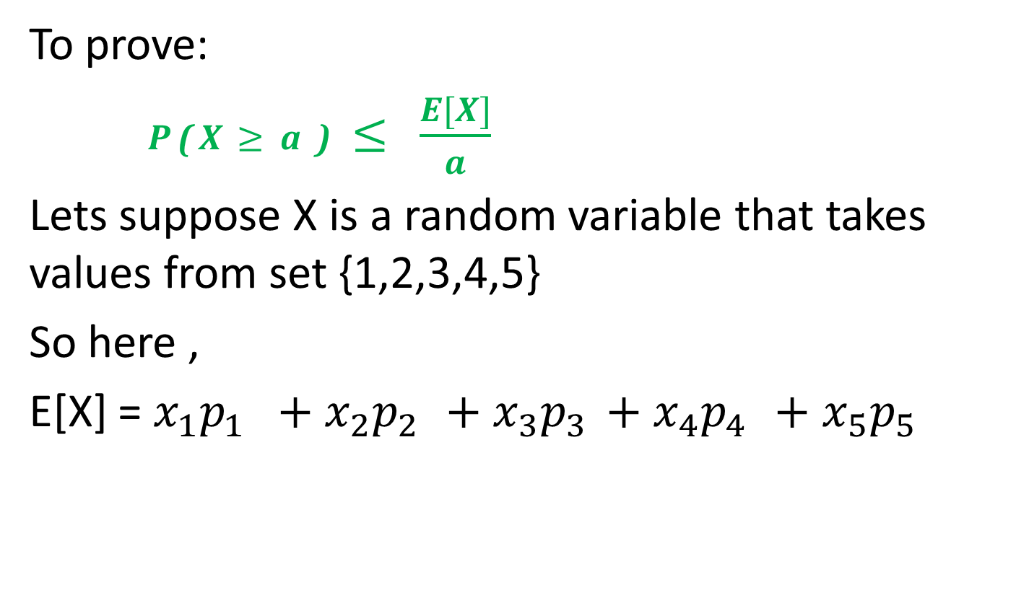
Proof of Markov’s Inequality
To prove:
P ( X $≥$ a ) $≤$ $\frac{E[X]}{a}$
Lets suppose X is a random variable that takes values from set {1,2,3,4,5}
So here ,
E[X] = $x_{1}p_{1} +$ $x_{2}p_{2 }$ $+$ $x_{3}p_{3 }$ $+$ $x_{4}p_{4 }$ $+$ $x_{5}p_{5}$

Slide 4
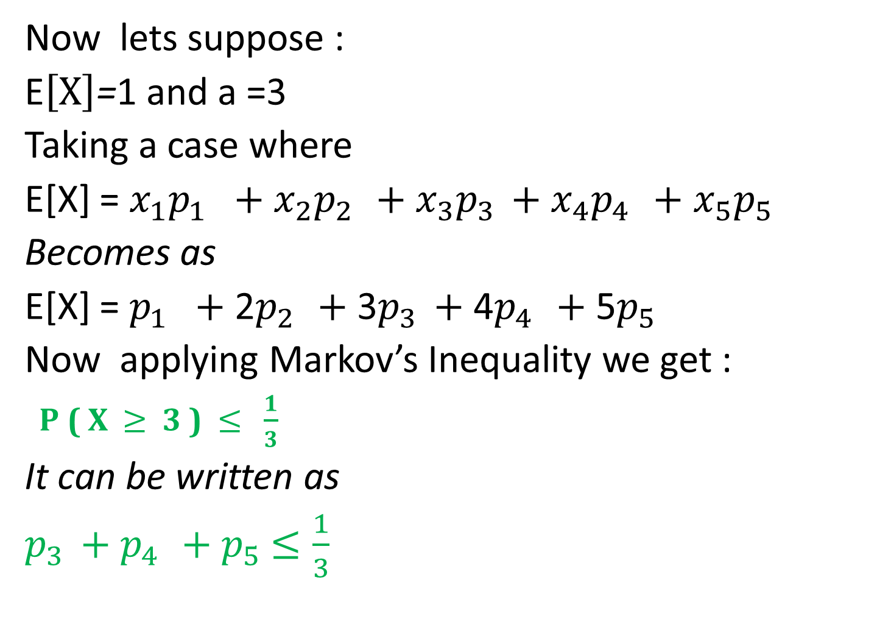
Now lets suppose :
E$\left[X\right]$=1 and a =3
Taking a case where
E[X] = $x_{1}p_{1} +$ $x_{2}p_{2 }$ $+$ $x_{3}p_{3 }$ $+$ $x_{4}p_{4 }$ $+$ $x_{5}p_{5}$
Becomes as
E[X] = $p_{1} +$ 2$p_{2 }$ $+$ 3$p_{3 }$ $+$ 4$p_{4 }$ $+$ 5$p_{5}$
Now applying Markov’s Inequality we get :
P ( X $≥$ 3 ) $≤$ $\frac{1}{3}$
It can be written as
$p_{3 }$ $+$ $p_{4 }+$ $p_{5}$ $≤\frac{1}{3}$

Slide 5
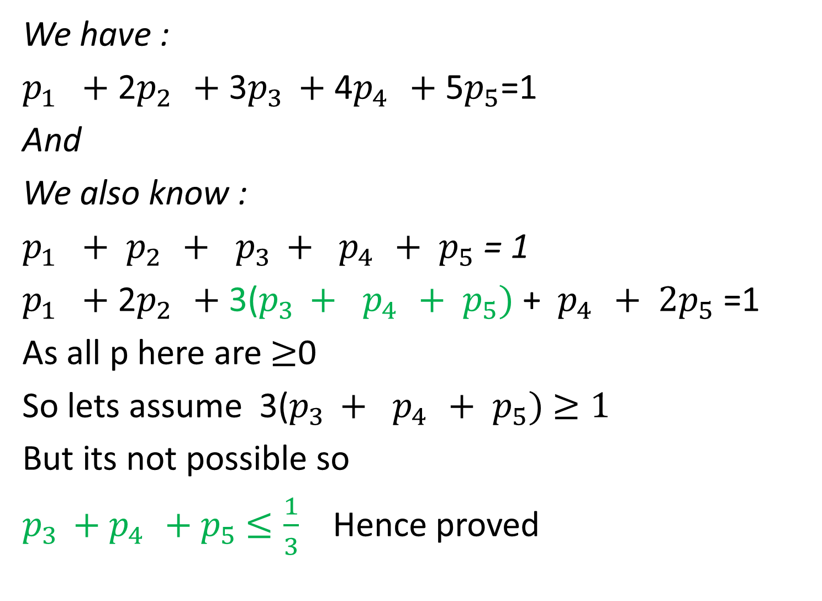
We have :
$p_{1} +$ 2$p_{2 }$ $+$ 3$p_{3 }$ $+$ 4$p_{4 }$ $+$ 5$p_{5}$=1
And
We also know :
$p_{1} +$ $p_{2 }$ $+$ $p_{3 }$ $+$ ${ p}_{4 }$ $+$ $p_{5}$ = 1
$p_{1} +$ 2$p_{2 }$ $+$ 3($p_{3 }$ $+$ ${ p}_{4 }$ $+$ $p_{5})$ + ${ p}_{4 }$ $+$ ${2p}_{5}$ =1
As all p here are $≥$0
So lets assume 3($p_{3 }$ $+$ ${ p}_{4 }$ $+$ $p_{5})$ $≥1$
But its not possible so
$p_{3 }$ $+$ $p_{4 }+$ $p_{5}$ $≤\frac{1}{3}$ Hence proved

Slide 6
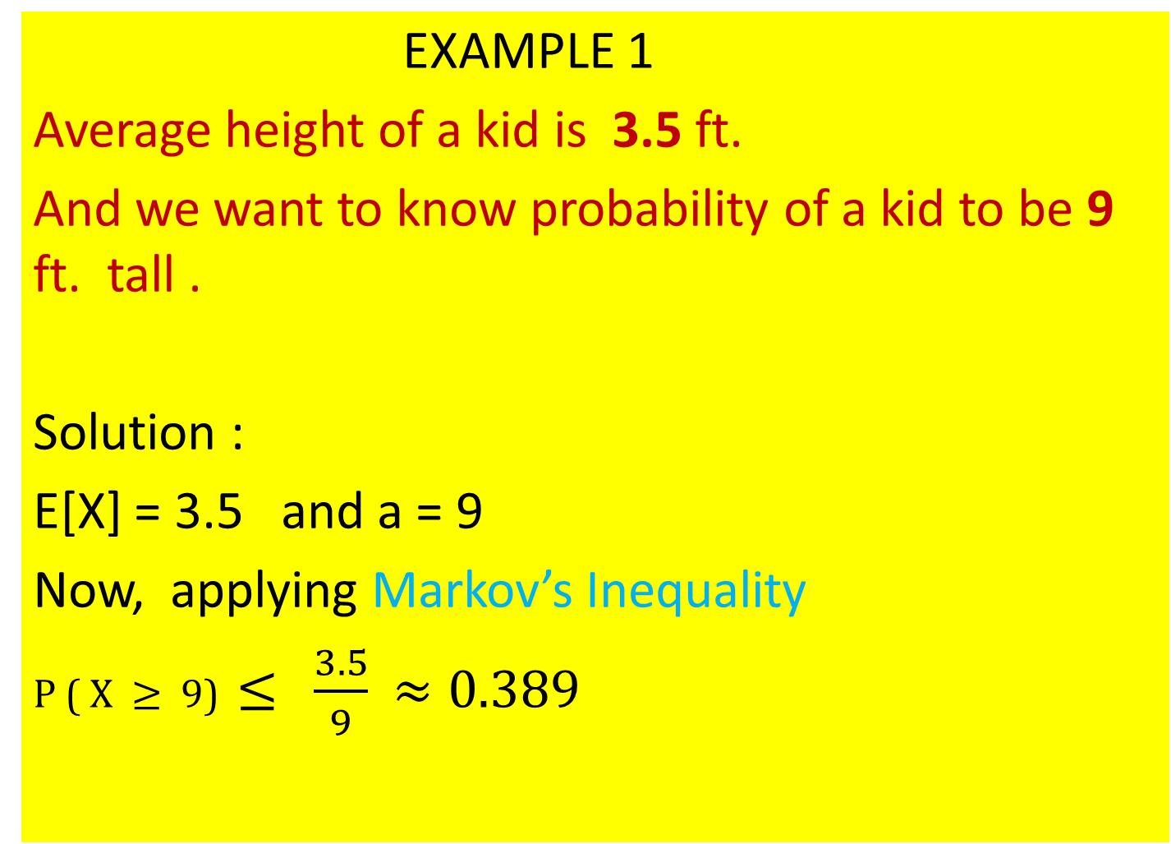
EXAMPLE 1
Average height of a kid is 3.5 ft.
And we want to know probability of a kid to be 9 ft. tall .
Solution :
E[X] = 3.5 and a = 9
Now, applying Markov’s Inequality
P ( X $≥$ 9) $≤$ $\frac{3.5}{9}$ $≈0.389$

Slide 7
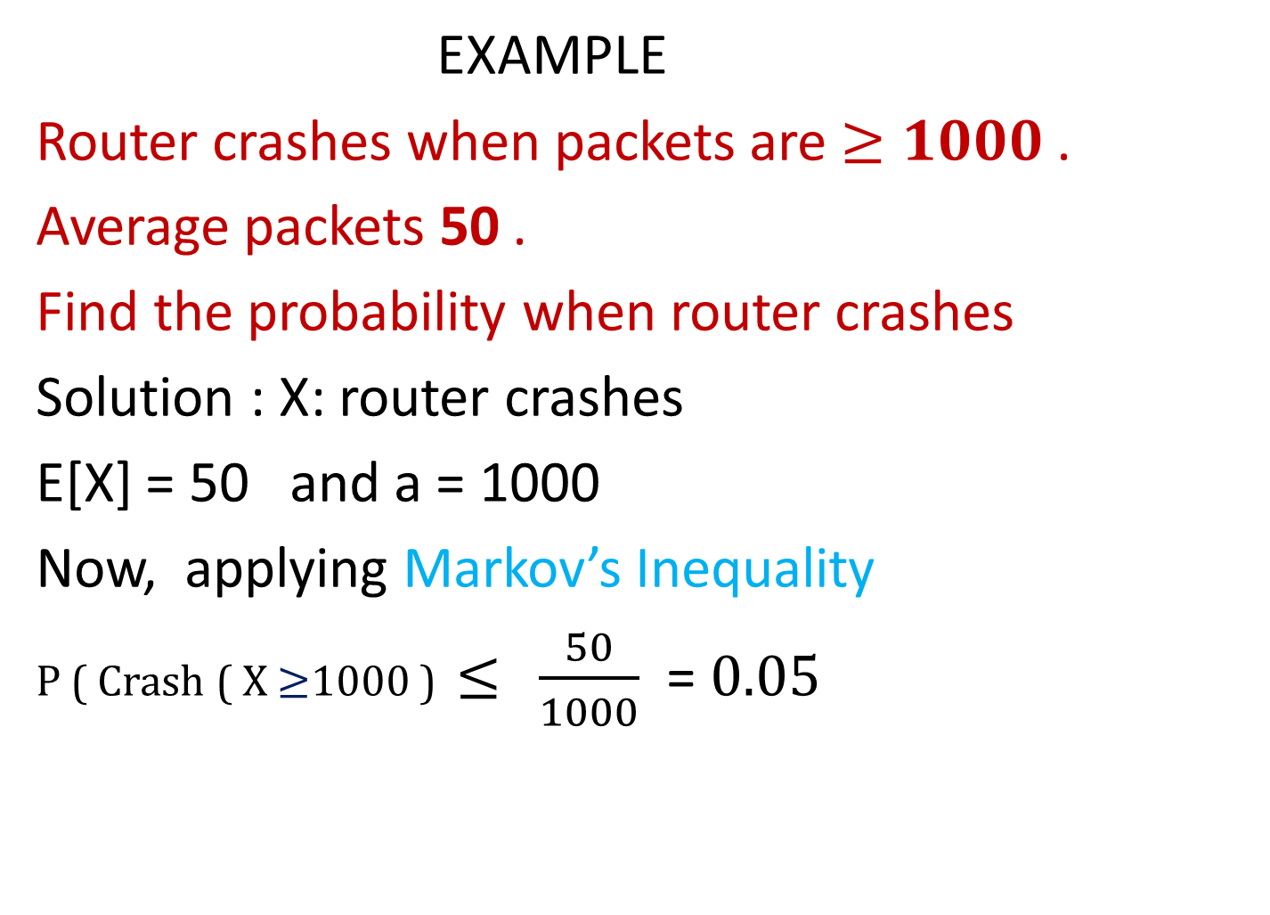
EXAMPLE
Router crashes when packets are $≥1000$.
Average packets 50 .
Find the probability when router crashes
Solution : X: router crashes
E[X] = 50 and a = 1000
Now, applying Markov’s Inequality
P ( Crash ( X $≥$1000 ) $≤$ $\frac{50}{1000}$ = $0.05$

Slide 8
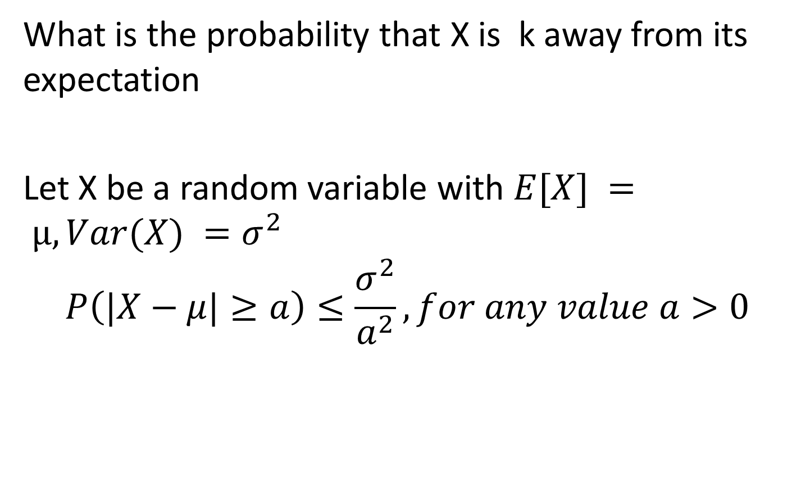
Chebyshev’s inequality
What is the probability that X is k away from its expectation
Let X be a random variable with $E[X] = µ, Var(X) =σ^{2}$
$$P\left(|X−μ|≥a\right)≤\frac{σ^{2}}{a^{2}},for any value a>0$$

Slide 9

Proof of Chebyshev’s inequality
To prove :
$$P\left(|X−μ|≥a\right)≤\frac{σ^{2}}{a^{2}},for any value a>0$$
Using Markov’s Inequality :
$$P\left(X≥a\right)≤\frac{E[X]}{a}$$

Slide 10
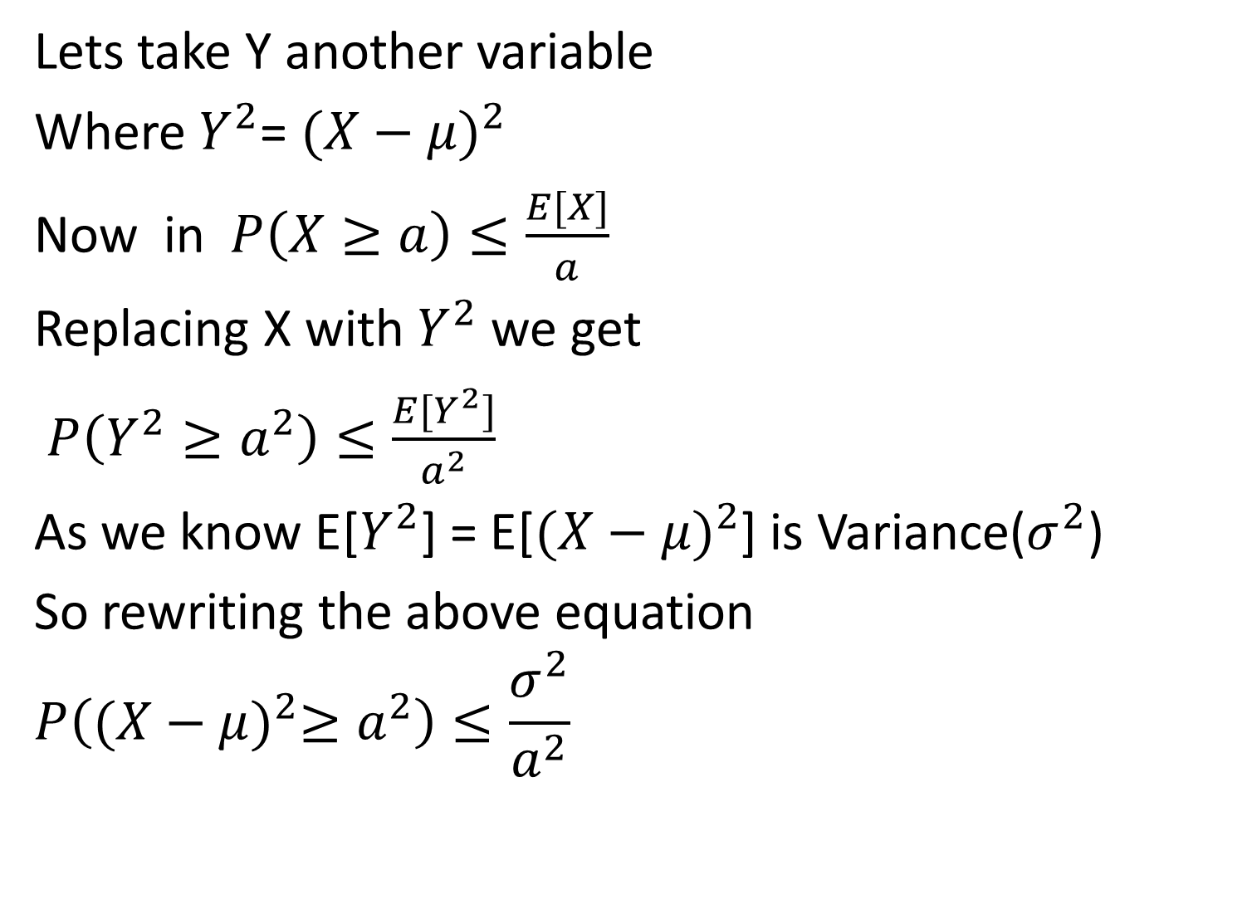
Lets take Y another variable
Where $Y^{2}$= ${(X−μ)}^{2}$
Now in $P\left(X≥a\right)≤\frac{E[X]}{a}$
Replacing X with $Y^{2}$ we get
$P\left(Y^{2}≥a^{2}\right)≤\frac{E[Y^{2}]}{a^{2}}$
As we know E[$Y^{2}$] = E[${(X−μ)}^{2}$] is Variance($σ^{2}$)
So rewriting the above equation
$$P\left({(X−μ)}^{2}≥a^{2}\right)≤\frac{σ^{2}}{a^{2}}$$

Slide 11

$$P\left({(X−μ)}^{2}≥a^{2}\right)≤\frac{σ^{2}}{a^{2}}$$
This can be written as :
$$P\left(|X−μ|≥a\right)≤\frac{σ^{2}}{a^{2}}$$
Hence proved .

Slide 12
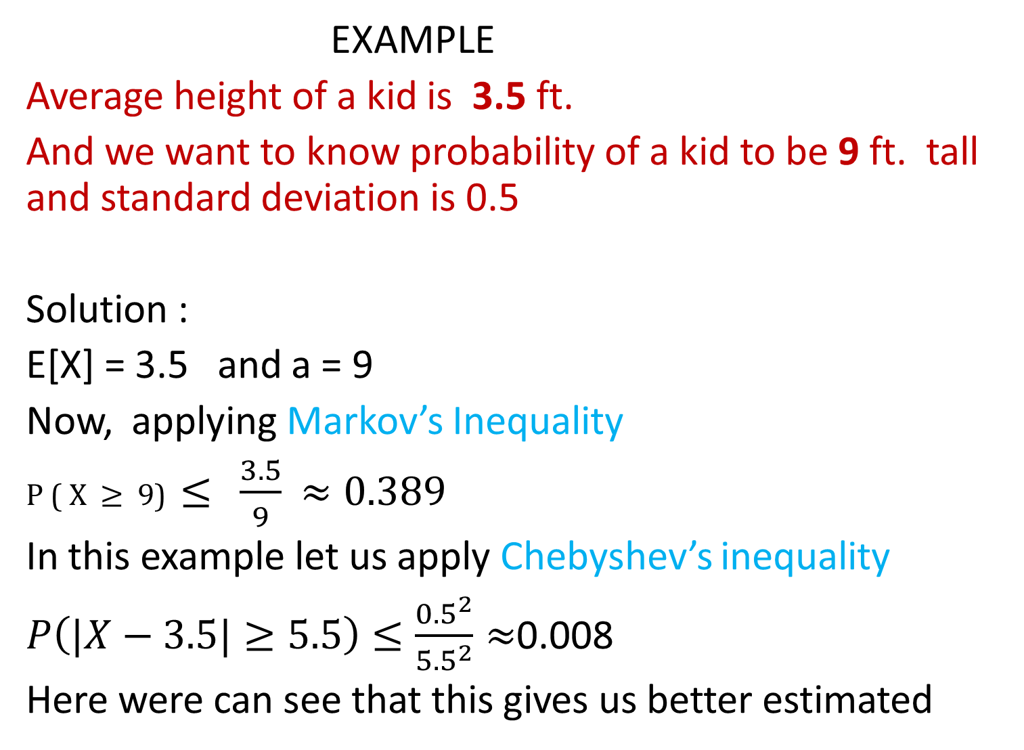
EXAMPLE
Average height of a kid is 3.5 ft.
And we want to know probability of a kid to be 9 ft. tall and standard deviation is 0.5
Solution :
E[X] = 3.5 and a = 9
Now, applying Markov’s Inequality
P ( X $≥$ 9) $≤$ $\frac{3.5}{9}$ $≈0.389$
In this example let us apply Chebyshev’s inequality
$P\left(|X−3.5|≥5.5\right)≤\frac{{0.5}^{2}}{{5.5}^{2}}≈$0.008
Here were can see that this gives us better estimated

Slide 13
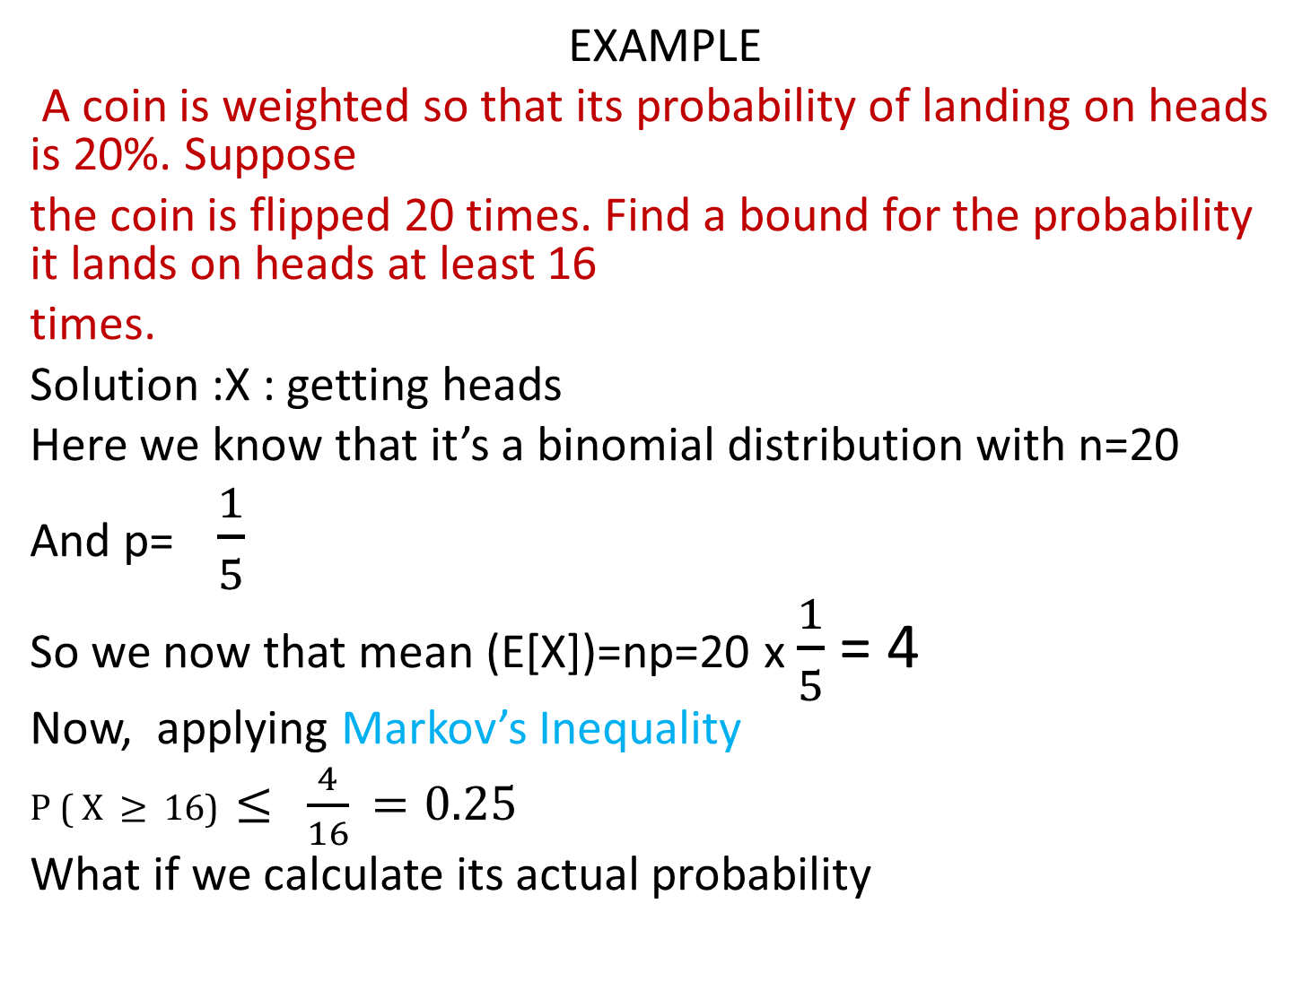
EXAMPLE
A coin is weighted so that its probability of landing on heads is 20%. Suppose
the coin is flipped 20 times. Find a bound for the probability it lands on heads at least 16
times.
Solution :X : getting heads
Here we know that it’s a binomial distribution with n=20
And p=$\frac{1}{5}$
So we now that mean (E[X])=np=20 x $\frac{1}{5}$ = 4
Now, applying Markov’s Inequality
P ( X $≥$ 16) $≤$ $\frac{4}{16}$ $=0.25$
What if we calculate its actual probability

Slide 14
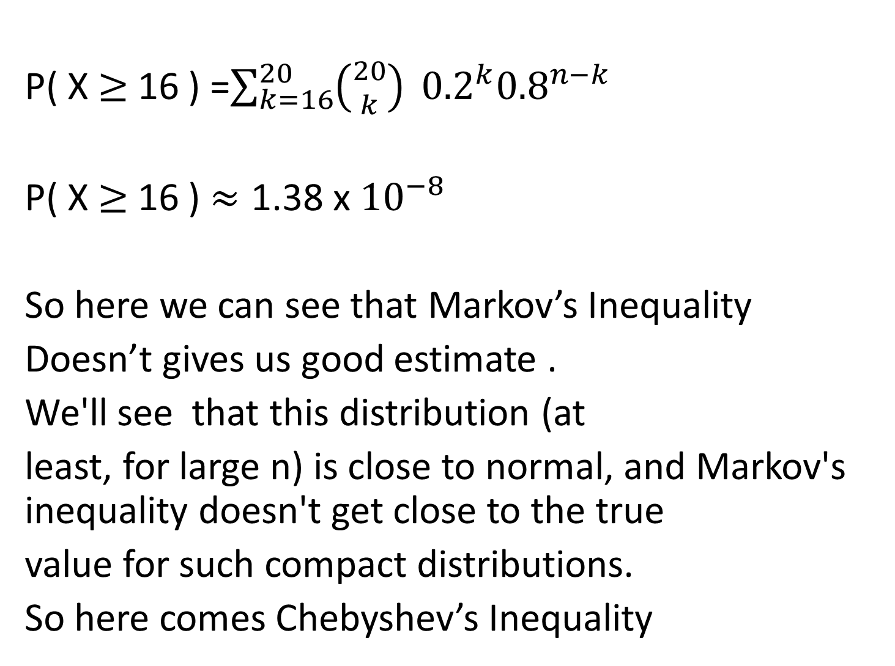
P( X $≥$ 16 ) =$\sum_{k=16}^{20}{\left({20 \atop k}\right)} {0.2}^{k}{0.8}^{n−k}$
P( X $≥$ 16 ) $≈\text{1}\text{.}\text{38 }\text{x} {10}^{−8}$
So here we can see that Markov’s Inequality
Doesn’t gives us good estimate .
We'll see that this distribution (at
least, for large n) is close to normal, and Markov's inequality doesn't get close to the true
value for such compact distributions.
So here comes Chebyshev’s Inequality

Slide 15
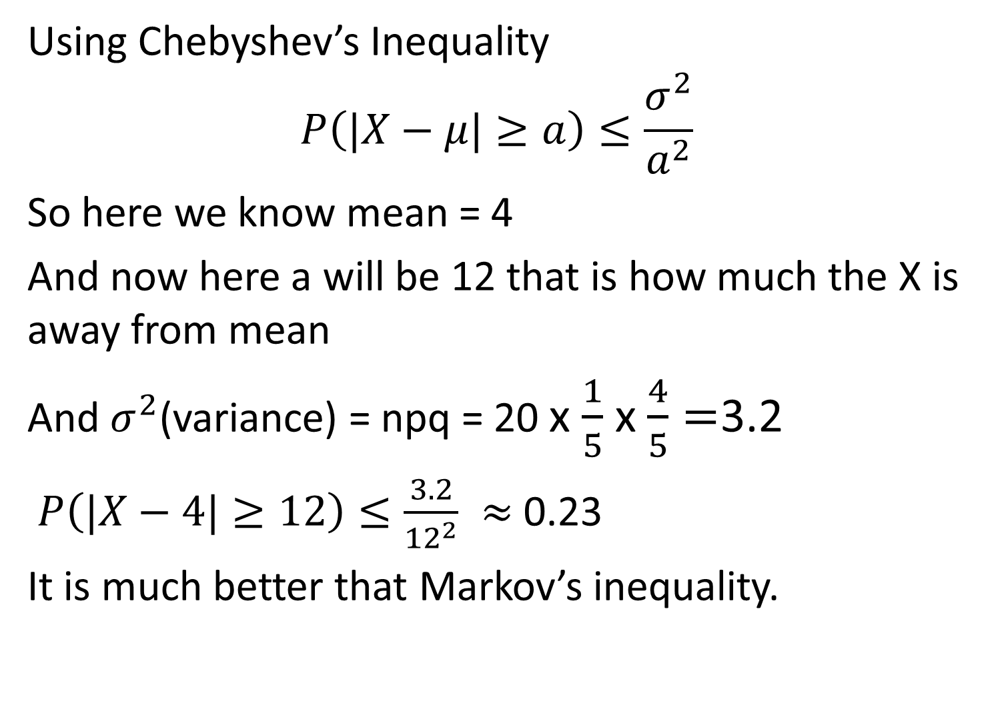
Using Chebyshev’s Inequality
$$P\left(|X−μ|≥a\right)≤\frac{σ^{2}}{a^{2}}$$
So here we know mean = 4
And now here a will be 12 that is how much the X is away from mean
And $σ^{2}$(variance) = npq = 20 x $\frac{1}{5}$ x $\frac{4}{5}=$3.2
$P\left(|X−4|≥12\right)≤\frac{3.2}{{12}^{2}} ≈$ 0.23
It is much better that Markov’s inequality.

