Slide 1
IOS Storyboards

Slide 2
This Talks
What, When, Why and How?
Demo

Slide 3
What?
New feature in Xcode and iOS
Visual way to specify views and transitions between them

Slide 4
When?
Xcode 4.2
iOS Deployment Target: iOS 5.0+
* Not supported for devices not running iOS 5.0

Slide 5
Why?
Reduces amount of glue code
“Bird’s Eye” view of your app

Slide 6
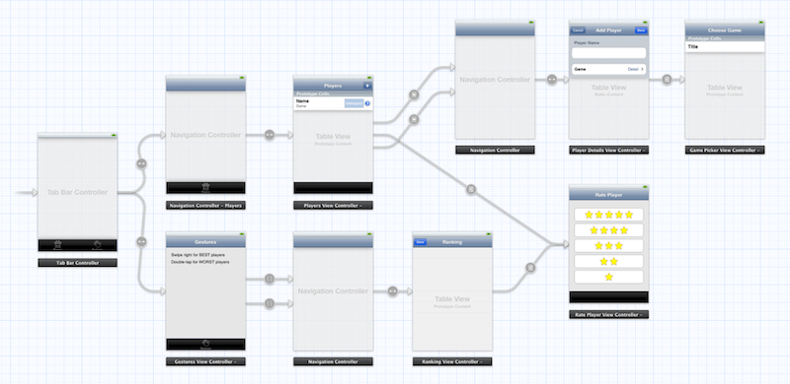
Sample Storyboard

Slide 7
Segues or Connections
A Segue is the transition between one View Controller and another that occurs when you press a button or any event…
Continue…

Slide 8
Segues
Relationship
Push
Model
Custom

Slide 9
Advantages
Single storyboard contains layout for ALL views/transitions (no separate nib files)
Ctrl-drag to create a transition
Flexible support for UITableViewCells
Design directly in storyboard (no nib file)
is deeply integrated into Objective C.

Slide 10
How?
New terminology
Scene - view controller
Segue - transition from one view to another
Create a new project w/ “Use Storyboard”
Create segues (ctrl-drag) in your Storyboard

Slide 11
How? (Optional #2)
Programmatically invoke a segue:
[self performSegueWithIdentifier:@”MySegue” sender:self];

Slide 12
How? (Optional)
Add a behaviour that occurs during (just before) a segue. Override method:
-(void)prepareForSegue:(UIStoryboardSegue *)segue sender:(id)sender {
if ([[segue identifier] isEqualToString:@”MySegue”]) {
SecondView *vc = [segue destinationViewController];
/* set some data on the view controller */
}
}

Slide 13
Demo

Slide 14
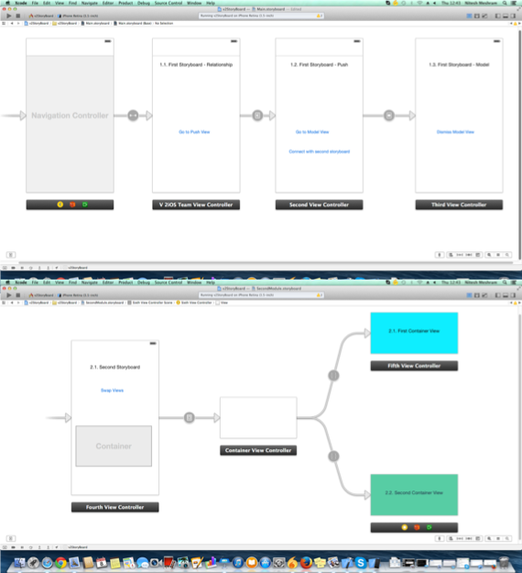

Slide 15
So what is UIStoryboard?

Slide 16
UIStoryboard is...
Runtime representation of everything configured in Interface Builder

Slide 17
Can load any scene with:
[UIStoryboard instantiateInitialViewController];
[UIStoryboard instantiateViewControllerWithIdentifier:@”myView”];
Can use multiple storyboards and load with:
[UIStoryboard storyboardWithName:@”myBoard” bundle:myBundle];

Slide 18
Thanks !!!

