Slide 1
PRECRIME
Crimes can be prevented

Slide 2
GROUP MEMBERS
Nitesh Mistry
Imran Memon
Asim Shaikh
Under the Guidance of
Prof. Gayatri Dantal

Slide 3
PROJECT DETAILS
Title : PreCrime
Project Category : Software
Project Area : Security / Data Mining / Android
Language to be used : C# / Java
Application development in : .Net / Android

Slide 4
AIMS AND OBJECTIVES OF THE PROJECT
The MISSION of PreCrime is simple: place officers at the right time and location to give them the best chance of preventing crime
PreCrime System has 2 modules
Windows module to predict future crime
Android module to report ongoing crime

Slide 5
NEED OF PRECRIME
Easy way to report the crime
Predict the future crime
Increase the odds of stopping crime
A way to bring police to speed more quickly

Slide 6
EXISTING SYSTEM
RAPID INFORMATION OVERLAY TECHNOLOGY (RIOT)
CLEAR
PREDPOL
TWEETSTRAP

Slide 7
RAPID INFORMATION OVERLAY TECHNOLOGY (RIOT)
Developed by Raytheon, a major American defense contractor
It is capable of tracking people's movements and predicting future behavior by mining data from social networking websites
Riot pulls out information, showing not only the photographs posted onto social networks by individuals, but also the location at which the photographs were taken

Slide 8
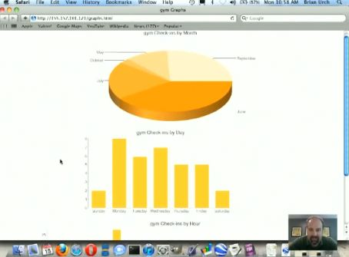
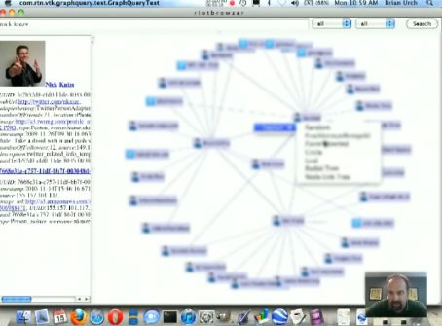
A look into the specifics of user’s daily schedule based on check-in trends
A web of user’s connections with other people.
Some phone numbers were included too

Slide 9
CLEAR
Developed by Thomson Reuters & its Fraud Prevention and Investigation unit
CLEAR has both public and proprietary records, arrest and incarceration records, photo lineups, work affiliations data, and other resources, and the methodology of its “Web Analytics” to search and categorize social media, blogs, news sites and watch lists.
Such public and proprietary records are then integrated into the user’s systems or searched via online platforms.

Slide 10
PREDPOL
Used by LA police
A map of a city is marked up with small red squares, each indicating a 500-by-500-foot zone where crimes are likely to take place next. A heat-map mode shows even more precisely where cars may be stolen, houses robbed
It calculates its forecasts based on times and locations of previous crimes, combined with sociological information about criminal behavior and patterns

Slide 11
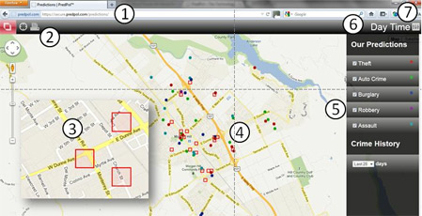
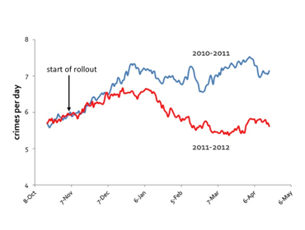

Slide 12
TWEETSTRAP
The goal of Tweetstrap to find the twitter mini-celebrities to help market his test tweet
The predictions are done based on the influence source of the tweet i.e. popularity of the source tweeter and also analysis of the content of the tweets (topics from the words or links it contains)

Slide 13
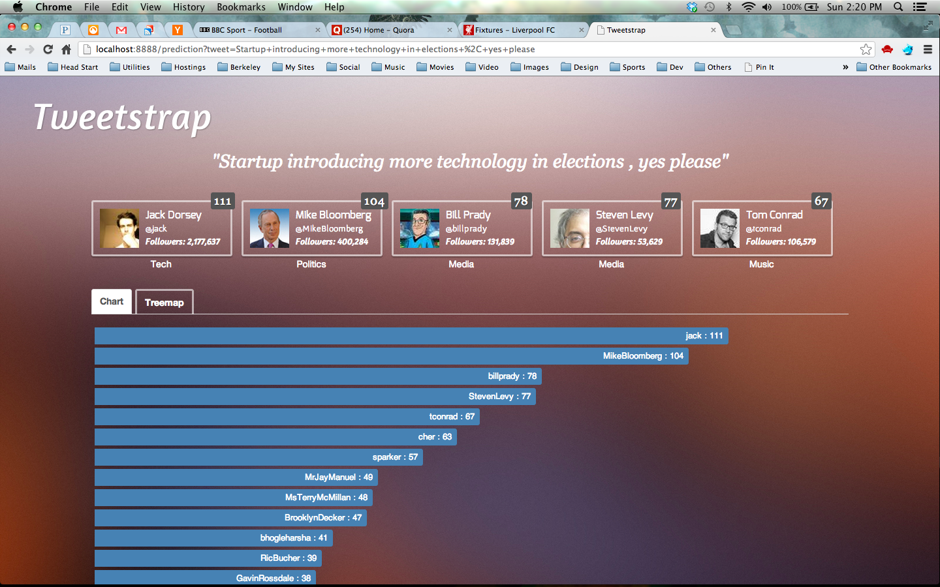
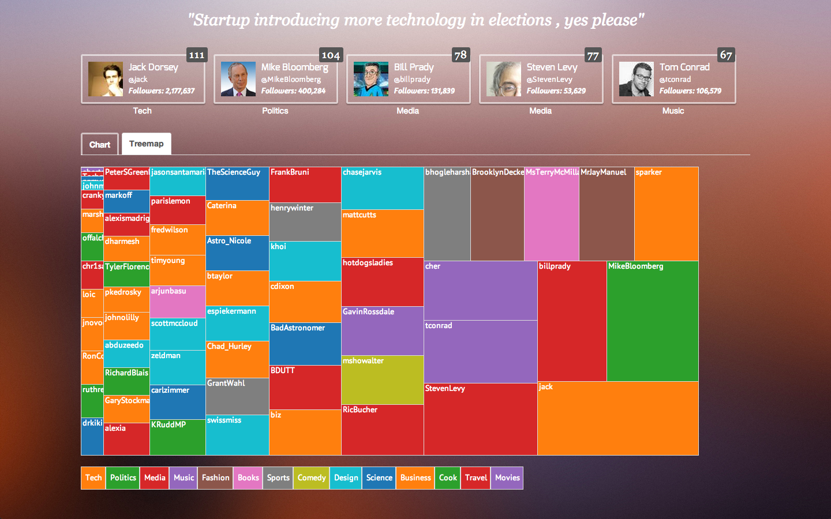

Slide 14
METHODOLOGY
Windows application
Accept report from android application
Verify the report is true or false alarm
Inform nearby police officers
Take past crime records
Process the records
Predict from records
Highlight predicted data in the Google Maps
Represented it in a tabular and graphical form
ANDROID APPLICATION
Register user with Adhar card number
Identify longitude and latitude of the user
Generate report
Send report to the police station server

Slide 15
DEVELOPMENT STAGES
Development of Windows Application
Development of Android Application
Testing both applications individually
Implement connection between Windows Application and Android Application
Test whole system after integration
Enhancement
Security enhancement
Quality improvement
Performance and speed improvement

Slide 16
THANK YOU

