Slide 1
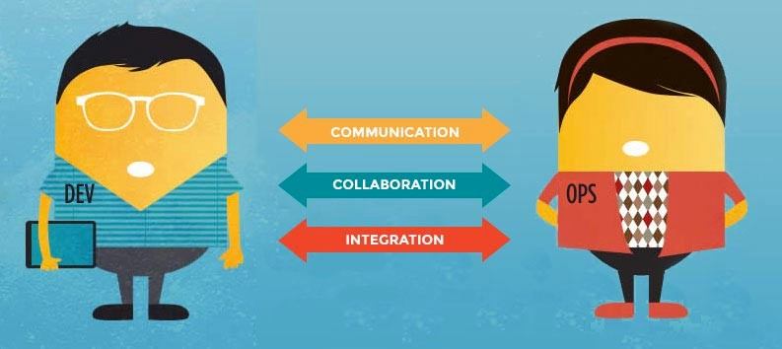


Nitesh Bhat
Serious Software Engineer @ https://niteshbhat.github.io/

Slide 2


What is DevOps?

Slide 3


DevOps is a set of practices intended to reduce the time between committing a change to a system and the change being placed into normal production, while ensuring high quality.

Slide 4
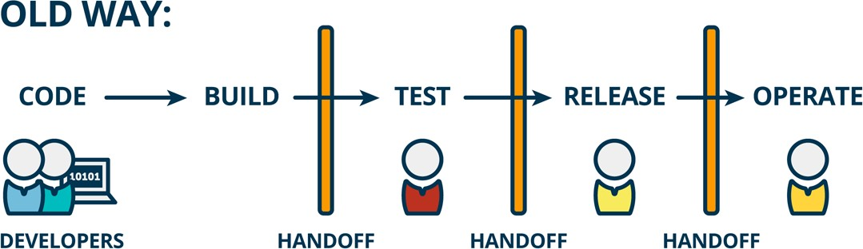
Checkin to release => it takes ages!
how many weeks, months, or years?!!

Slide 5
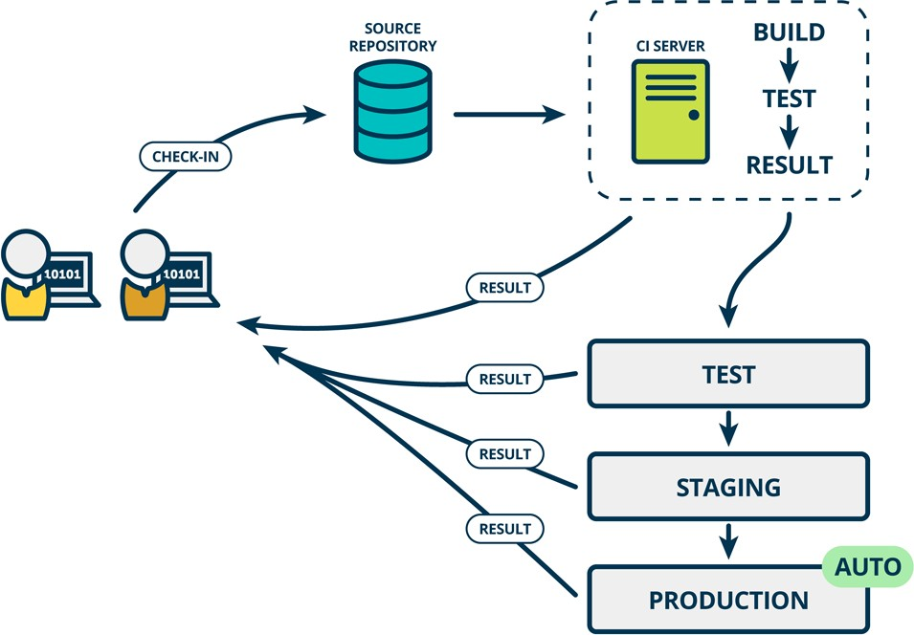
DevOps: Lightning fast!

Slide 6



Dev
Ops

Slide 7

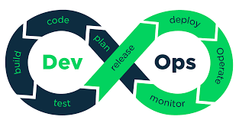

Slide 8
DevOps Roadmap
1)Plan
2)Code
3)Build
4)Deploy
5)Test
6)Rebase
7)Configure
8)Monitor
Step 1: Learn a Programming language
Step 2: Learn Tools that need to depend
Build : Maven, MS Build
SCM : GIT, GitHub, bitbucket, TFS
CI : Jenkins, Teamcity, Bamboo
CD : Octopus Deploy Containerization : Docker,k8s
Step 3: Learn how to run test from → CMD or CI/CD
Step 4: learn cloud service platform → AWS, Azure, GCP
Step 5: learn Infrastructure provisioning → Terraform
Step 5: learn config mazement tool → Chef, puppet, Ansible
Step 6: learn logging & monitor → New Relic, Nagios

Slide 9
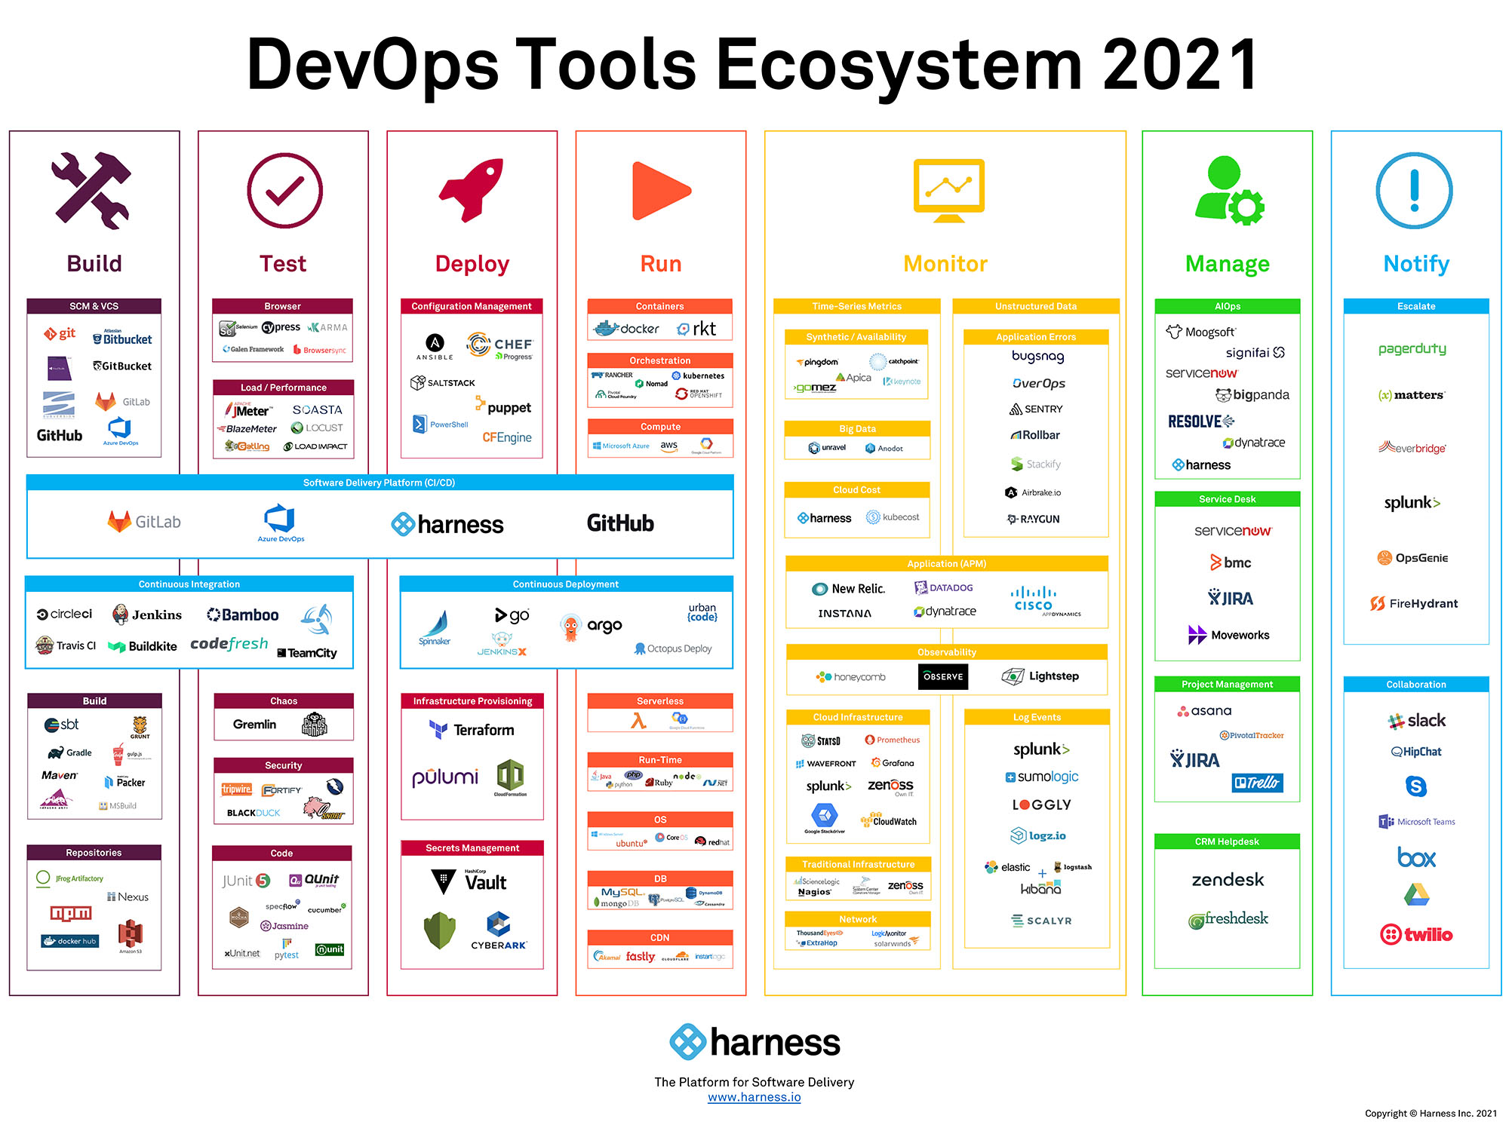

Slide 11
Free Books
https://github.com/Niteshbhat/Free-DevOps-Books-1

Slide 12
Thank YOU

