Slide 1
Personality Analysis using hash-tags from tweets

Slide 2
What is Personality Analysis?
Personality is defined as the totality of character attributes and behavioral traits of a person.
Personality Analysis is a methodology for categorizing the character and behavior of a person.

Slide 3
Concept of Analyzing
The personality of an individual, and plotting the sentiments of tweets according to user/community location.
Our application would consider the actual mentality of the individuals along with the situation and topic and assess their personality accordingly.

Slide 4
Big Five personality traits
The Big Five personality traits, also known as the five factor model (FFM), is a taxonomy for personality traits.
It is based on common language descriptors. When factor analysis (a statistical technique) is applied to personality survey data, some words used to describe aspects of personality are often applied to the same person.

Slide 5
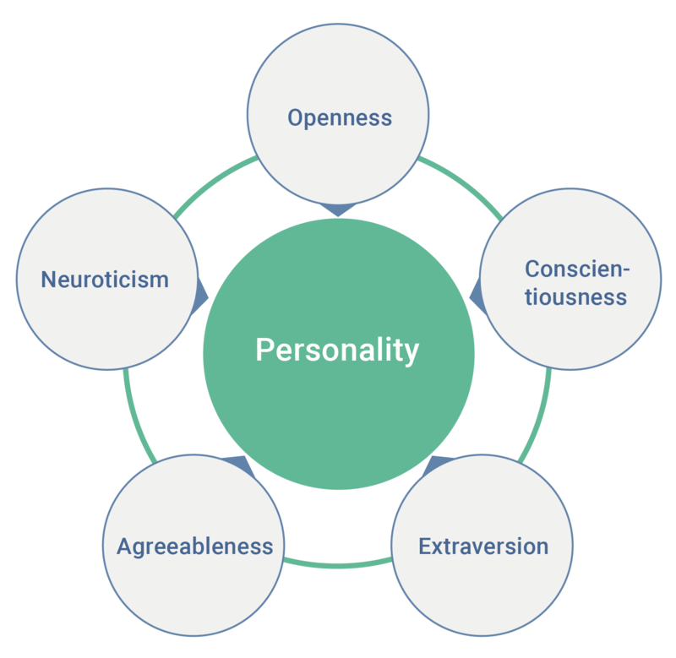
The five factors are:
Openness
Conscientiousness
Extraversion
Agreeableness
Neuroticism

Slide 6
Openness to Experience :
Openness to experience has been described as the depth and complexity of an individual’s mental life and experiences
traits related to openness to experience include:
Imaginative
Wide variety of interests
Original
Daring
Clever , etc.

Slide 7
Conscientiousness :
Conscientiousness is a trait that can be described as the tendency to control impulses and act in socially acceptable ways, behaviors that facilitate goal-directed behavior
Traits within the conscientiousness factor include:
Persistent
Ambitious
Thorough
Self-disciplined
Consistent , etc.

Slide 8
Extroversion :
This factor has two familiar ends of the spectrum: extroversion and introversion. It concerns where an individual draws their energy and how they interact with others.
The traits associated with extroversion are:
Sociable
Assertive
Outgoing
Energetic
Talkative , etc.

Slide 9
Agreeableness :
This factor concerns how well people get along with others. It is a construct that rests on how you generally interact with others.
traits fall under the umbrella of agreeableness:
Altruistic
Trusting
Modest
Humble
Patient , etc.

Slide 10
Neuroticism :
Neuroticism is the one Big Five factor in which a high score indicates more negative traits. Neuroticism is an ongoing emotional state defined by negative reactions and feelings.
traits are commonly associated with neuroticism:
Awkward
Pessimistic
Moody
Testy
Fearful, etc.

Slide 11
Conceptual Framework
The hashtags provide us with the topic about which the user has voiced his opinion. Analysis of hashtag is conducted in a way where a set of recent tweets containing the hash-tag term are collected, and the polarity of those tweets containing the term is analyzed whether people have a positive, negative or neutral opinion about it.
The second part is analysis of remaining text and finding the polarity of the tweet whether it is positive, negative or neutral. Along with the text if tweet contains any emoticons, the polarity of the emoticon is calculated using non-bmp map.

Slide 12
Tools used in Framework
Python
Django
Tweepy
Numpy
Pandas
Sklearn
NLTK

Slide 13
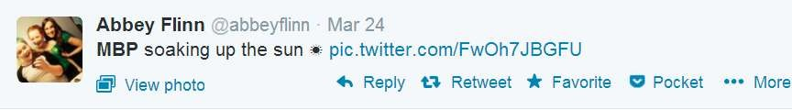
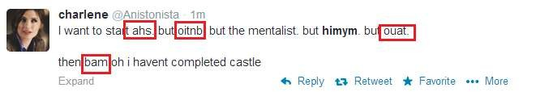
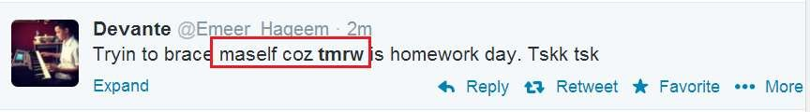
Challenges
Tweets are highly unstructured and also non-grammatical
Out of Vocabulary Words
Lexical Variation
Extensive usage of acronyms like asap, lol, afaik

Slide 14
PAUT Framework
Data Gathering:- To gather public opinion based on collected hashtags related to views about political parties including Twitter top trends
English Conversion:- Tweets gathered from user accounts were in the Urdu, English, and Roman Urdu Language. To add novelty in data analysis, we have included tweets of the Urdu language
EX:- انصاف ہو کس طرح کی دل صاف نہیں ہے”
“دل صاف ہو کس طرح کی انصاف نہیں ہے
“The heart is not clear how to be justice The heart is not clear how justice is”.

Slide 15
PAUT Framework
Data Pre-processing
Removing non-English Tweets
Replacing Emoticons by their polarity
Remove URL, Target Mentions, Hashtags, Numbers.
Replace Negative Mentions
Replace Sequence of Repeated Characters eg. ‘coooooooool’ by ‘coool’
Remove Nouns and Prepositions
Polarity Calculation and Analysis
Analysis can provide valuable insights from social media platforms by detecting emotions or opinions from a large volume of data present in unstructured format.

Slide 16
PREDICTING PERSONALITY
To predict the score of a given personality feature, we performed a regression analysis in Weka .
We used two regression algorithms: Gaussian Process and ZeroR, each with a 10-fold cross-validation with 10 iterations.

Slide 17
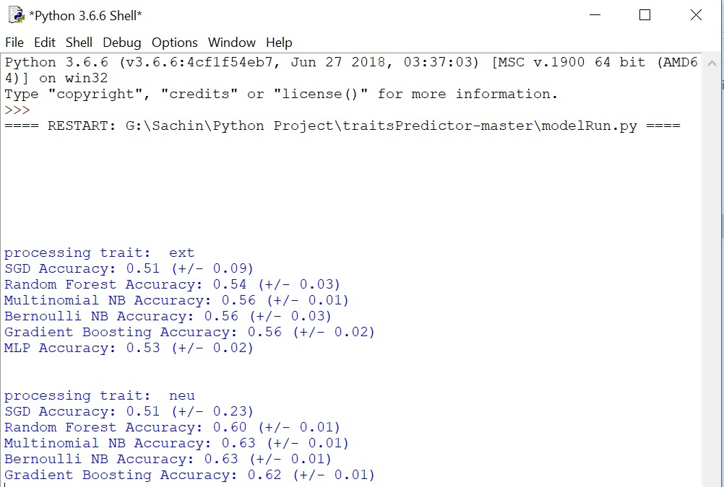

Slide 18
Flow of script
Feature Extraction
Tweet Scraping
Data Process
Data Trainning
ModelRun

Slide 19
Application:
The target audience varies from children to senior citizens who wish to know about people’s personality, response.
The software can be used for people working in HR department of their offices in analyzing the personality of an applicant whether the applicant’s personality is suitable or not.
People who are interested to know about their role models personality.

Slide 20
Conclusion
Our subjects completed a personality test and through the Twitter API, we collected publicly accessible information from their profiles. After processing this data, we found many small correlations in the data. Using the profile data as a feature set, we were able to train two machine learning algorithms - ZeroR and Gaussian Processes – to predict scores on each of the five personality .With the ability to guess a user’s personality traits, many opportunities are opened for personalizing interfaces and information.
We considered two structural features - number of friends and network density-but we did not look at personality scores between friends. Understanding the connections between personality, tie strength, trust, and other related factors is an open space for research. By improving our knowledge of these relationships,we can begin to answer more sophisticated questions about how to present trusted, socially-relevant, and well-presented information to users.

