Slide 1

SMART INDIA HACKATHON 2026
TRACE-X — Predict. Explain. Intervene.
Problem Statement ID – SIH26184
Problem Statement Title– Predictive Analytics Framework for Cybercrime Complaints to Forecast Likely Cash Withdrawal Locations
Theme– Blockchain & Cybersecurity
PS Category– Software
Team ID– [Insert Team ID]
Team Name– [Insert Registered Team Name]

Slide 2
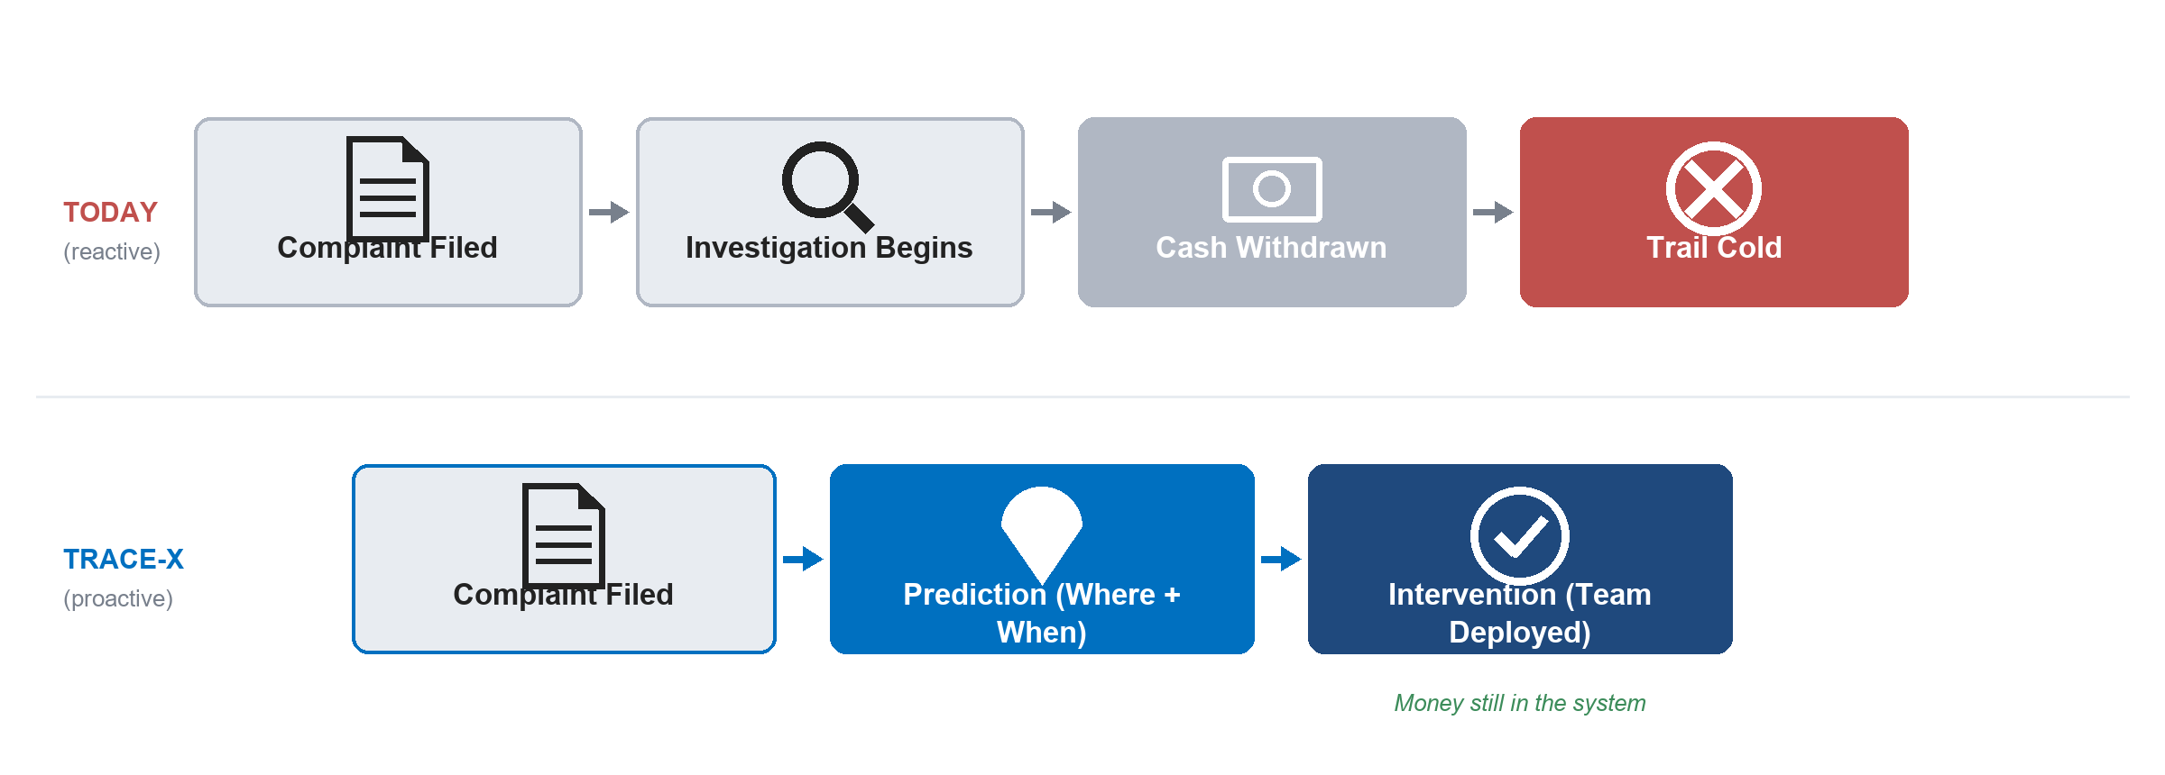
TRACE-X
TRACE-X
Stop chasing withdrawn cash. Predict where it's headed.
~8,000 fraud complaints a day. Once cash is withdrawn, the trail goes cold — TRACE-X predicts the withdrawal before it happens.

Slide 3
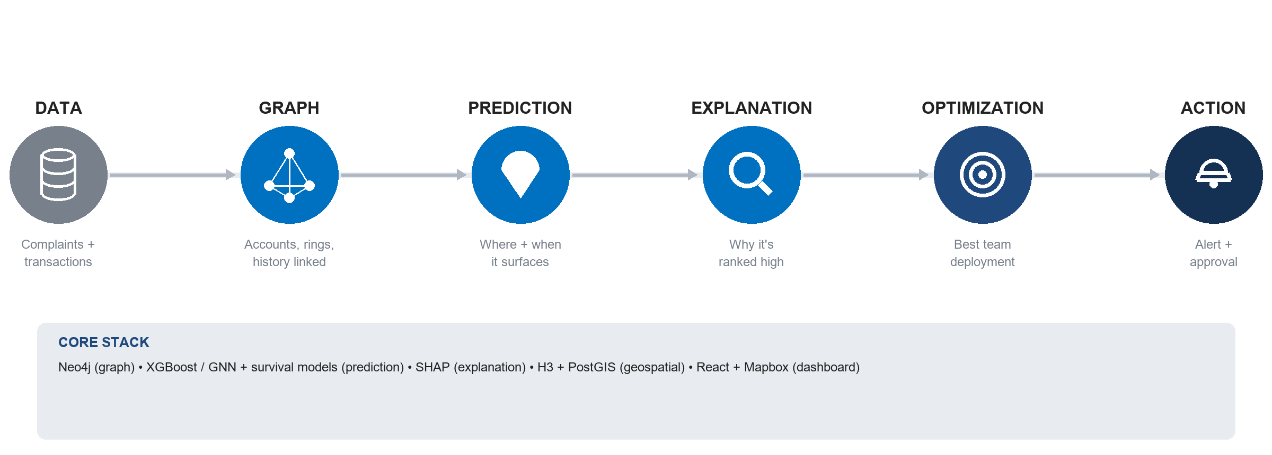
TECHNICAL APPROACH
TRACE-X
Not one model — a pipeline: graph, prediction, explanation, optimization.
Six connected stages turn a raw complaint into an explainable, resource-aware deployment decision.

Slide 4
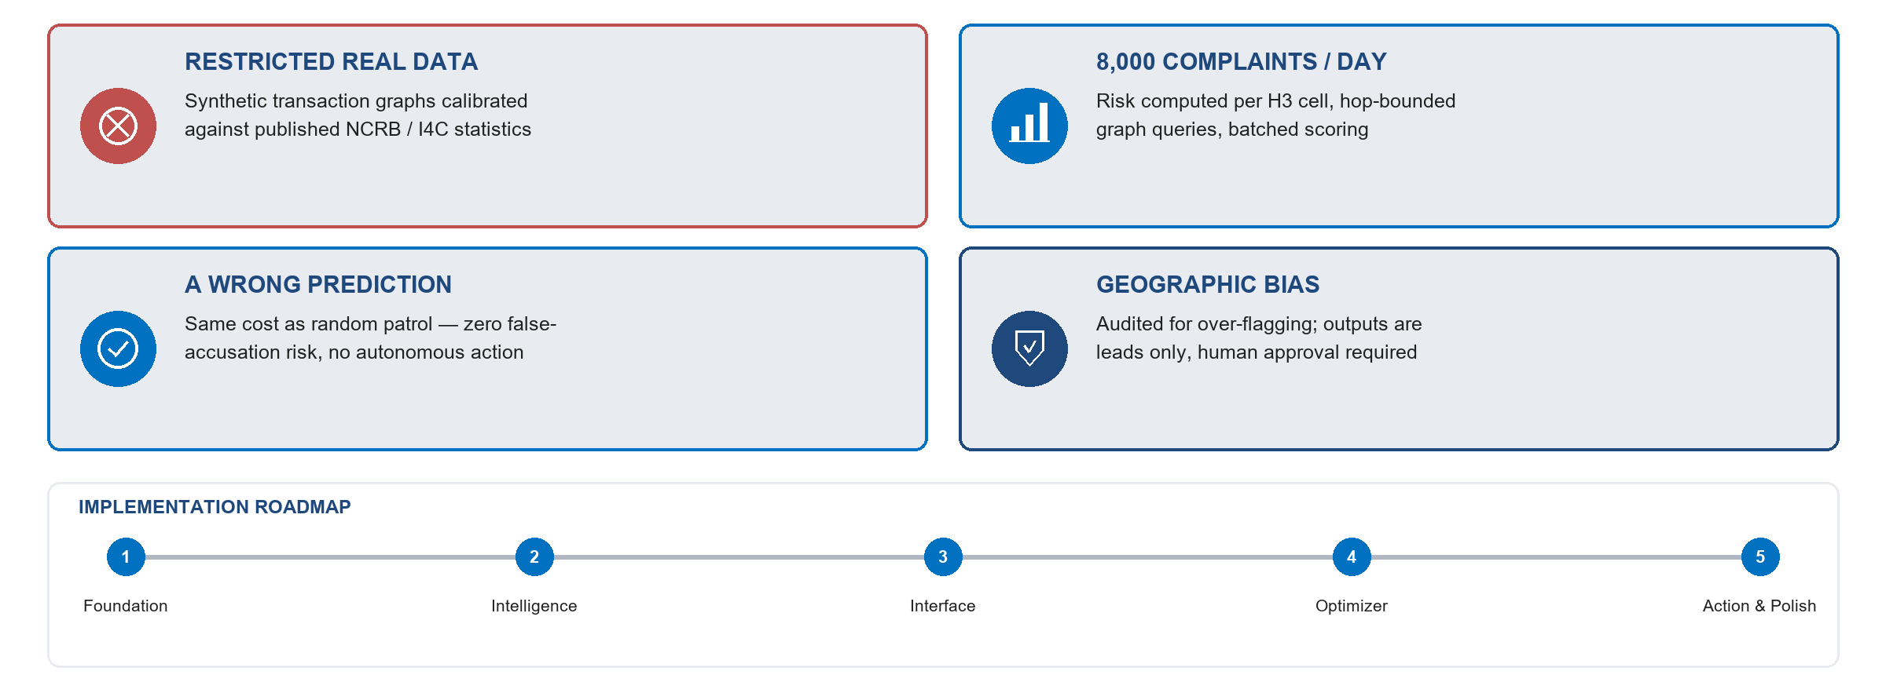
FEASIBILITY AND VIABILITY
TRACE-X
We've already answered the hard questions.
Restricted data, daily scale, false positives, geographic bias — each has a specific, engineered mitigation.

Slide 5
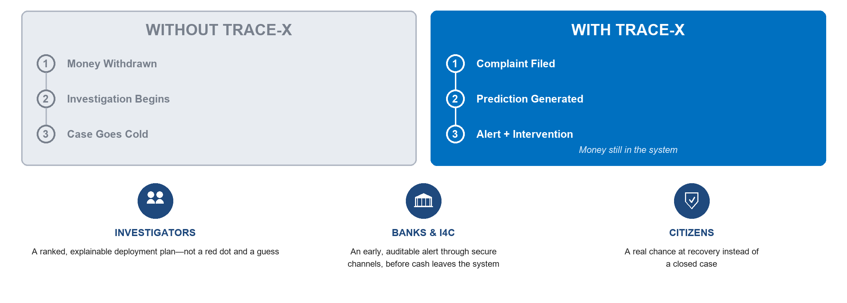
IMPACT AND BENEFITS
TRACE-X
Minutes of warning. A chance to recover.
The difference isn't incremental — a cold trail versus a live one, while the money is still in the system.

Slide 6
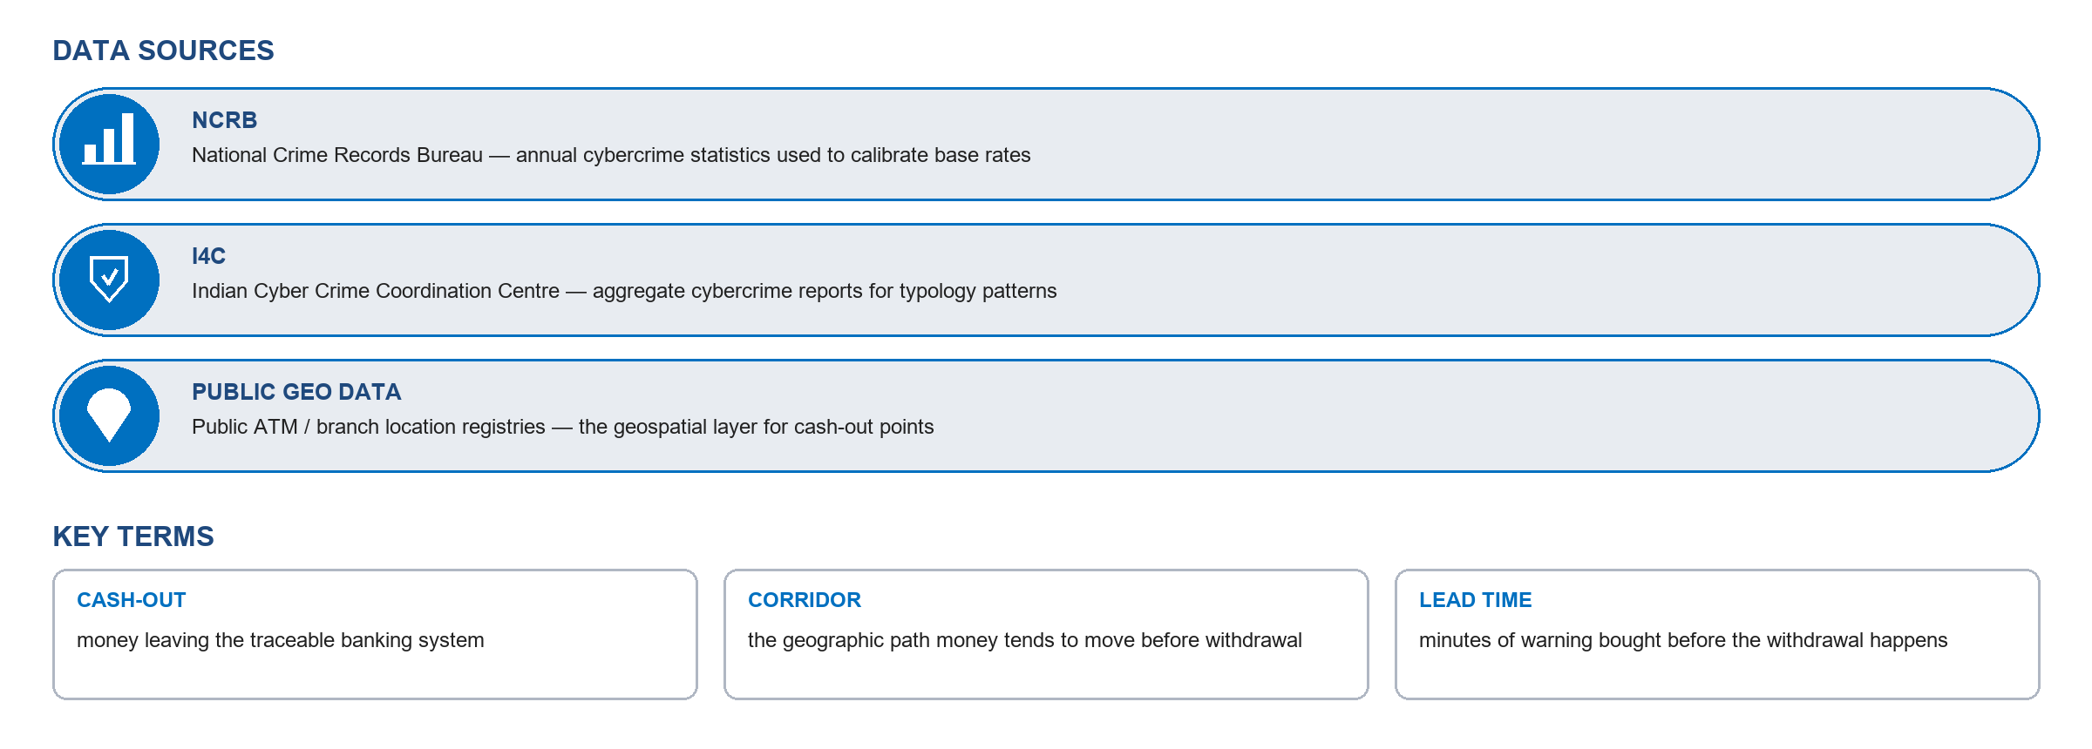
RESEARCH AND REFERENCES
TRACE-X
WHERE WILL THE MONEY GO NEXT?
TRACE-X — Predict. Explain. Intervene. From reactive cybercrime investigation to proactive cash-out intelligence.

