Slide 1

01
发展现状/Current Development Status
content
目 录
02
技术路线/Technical Approach
03
关键技术/Key Technologies
04
攻关与挑战/Research & Challenges

Slide 2


发展现状
01
02
海上风电增速显著
Growth Rate of Offshore
Wind Power is Remarkable
机组趋于大型化
Size unit is becoming larger
大兆瓦机组成为主流，齿轮箱高功率密度设计需
求迫切，推动行业降本增效。
全球风电装机容量持续增长，中国占比超40%，
陆上风电主导市场，海上风电增速显著，未来五
年年均增长率预计达12%。
As large-megawatt units become
mainstream, there is an urgent need for
high-power-density gearbox designs,
driving the industry toward cost reduction
and efficiency improvement.
The global installed wind power capacity
continues to grow, with China accounting
for over 40%. Onshore wind power
dominates the market, while offshore wind
power is showing significant growth, with
an expected average annual growth rate of
12% over the next five years.

Slide 3
01
发展现状/Current Development Status
content
目 录
02
技术路线/Technical Approach
03
关键技术/Key Technologies
04
攻关与挑战/Research & Challenges

Slide 4







技术路线
1
2
3
4
5
2
3
4
5
SCD
传统双馈
四点支撑中速
全集成中速
前集成双馈
SCD
Traditional
Dual Feed
Four-point
Support
Medium Speed
Fully
Integrated
Medium
Speed
Pre-
integrated
dual feed

Slide 5


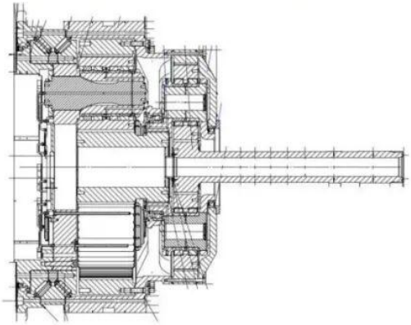
技术路线/Technical Approach
SCD(Super Compact Drive) 超紧凑风电机组/SCD (Super Compact Drive) super compact wind turbine
由明阳智能和德国aerodyn公司联合开发，其传动链由主轴承、行星齿轮和中速发电机组成。结合了传统中速与直驱型机组的传动链布局
优势，使得整体设计较其余两种中速机组结构更紧凑。
The drive train integrates medium-speed and direct-drive technologies, achieving superior structural compactness through
its main bearing + planetary gear + medium-speed generator configuration.
SCD/Super Compact Drive
输入端行星架连接方式 Input planetary gear carrier connection method | 螺栓 bolt
箱体连接方式 Box connection method | 螺栓 bolt
电机连接方式 Generator connection method | 花键 spline
齿轮箱传动结构 gearbox transmission structure | 2P/3P 2P/3P
行星架轴承 planetary bearing | 鹦鹉螺 nautilus
其它结构 Other structures | 柔性销 flexible pin

Slide 6


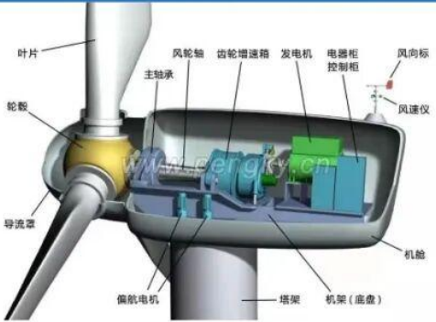
技术路线/Technical Approach
传统双馈机组/Traditional Dual Feed
齿轮箱单独一体，与主轴通过锁紧盘或法兰刚性连接，扭力臂通过弹性支撑固定在机舱上，电机与齿轮箱通过联轴器连接。可维护性能好
，但机组尺寸长，且高速轴轴承随着机组大型化面临着温度、寿命可靠性挑战。
The gearbox connects directly to the main shaft, with a torque arm anchored to the nacelle. While this standalone design
ensures good maintainability, it increases the overall length of the unit. Additionally,high-speed shaft bearings encounter growing
challenges in temperature management and long-term reliability.
传统双馈/Traditional Dual Feed
输入端行星架连接方式 Input planetary gear carrier connection method | 涨套/法兰 shrink disk/flange
箱体连接方式 Box connection method | 弹性支撑 elastic support
电机连接方式 Generator connection method | 联轴器 clutch
齿轮箱传动结构 gearbox transmission structure | 2P1H/3P1H 2P1-/3P1H
行星架轴承 planetary bearing | 双CRB/双TRB double CRB/ double TRB
其它结构 Other structures | /

Slide 7


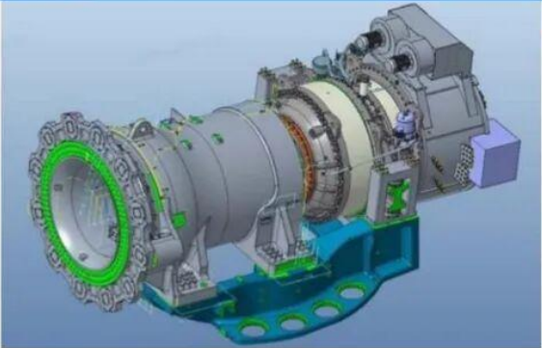
技术路线/Technical Approach
四点支撑中速机组/Four-point Support Medium Speed
四点支撑中速机组齿轮箱一般为两级或三级行星。输入端转架主轴一般采用刚性连接的形式，齿轮箱扭力臂通过弹性支撑固定在机舱上。
输出端与发电机刚性连接。全功率变频齿轮箱与主轴内刚外柔，结构较稳定。
Four-point medium-speed gearboxes use 2-3 planetary stages. Input is rigidly connected; torque arm elastically mounted.
Output couples rigidly to generator. The full-power variable frequency design ensures stability through internal rigidity and external
flexibility.
四点支撑中速/Four-point Support Medium Speed
输入端行星梁连接方式 nout side paracary gear frame corr octor methoc | 法兰/螺栓销 flange/bolt p n
箱体连接方式 Box connection method | 弹性支撑 elast support
电机连接方式 Generator connection method | 与齿轮箱集成，无联轴器 Integrated with gearbox ro coupling
齿轮箱传动结构 gearbox transmission structure | 2P/3P 2P/3P
行星架轴承 pletary bearing | 双TRB c ouple TRB
其它结构 Other structures | 输出轴密封 output shaft seal

Slide 8


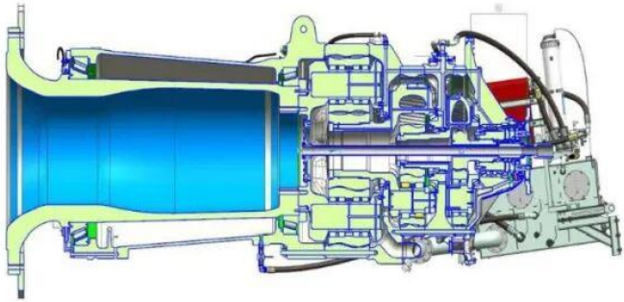
技术路线/Technical Approach
全集成中速机组--结构介绍/ Fully Integrated Medium Speed
全集成中速机组齿轮箱一般为三级行星。输入端转架、一级齿圈与主轴、轴承座一般采用直接连接的形式，输出端与发电机的连接形式
与四点支撑中速机组一致。
The gear box of the fully integrated medium speed generator is usually three-stage planetary gear box. The input end is
directly connected with the main shaft and bearing seat, and the output end is connected with the generator in the same way as
the four-point support medium speed generator.
全集成中速/Fully integrated Medium Speed
输入端行星架连接方式 Input planetary gear carrier connection method | 螺栓销 00 t air
箱体连接方式 Box connection method | 螺栓销 00 t air
电机连接方式 geabox transmission structure | 与齿轮箱集成，无联轴器 Integrated with gearbox co coupling
齿轮箱传动结构 gearbox transmission structure | 3P 3P
行星架轴承 planetary bearing | 无（主轴双TRB） No (Dual TRB spindle)
其它结构 Other structures | 输出轴密封 output shaft seal

Slide 9


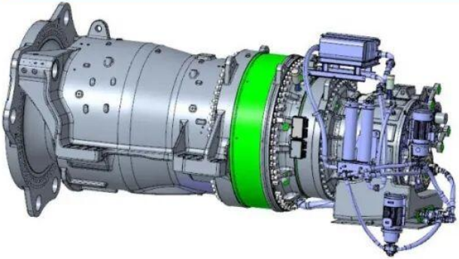
技术路线/Technical Approach
前集成双馈机组--结构介绍/Pre-integrated dual feed
前集成双馈机组齿轮箱一般为三级行星加一级平行级。输入端连接方式与全集成机组一致，输出端与发电机的连接形式与传动机组一致。
The gear box of the pre-integrated doubly-fed generator is usually a three-stage planetary gear box plus a parallel stage.
The input connection is the same as that of the fully integrated generator, and the output connection is the same as that of the
transmission generator.
前集成双馈/Pre-integrated dual feed
输入端行星架连接方式 In/out planetary gear carrier connection method | 螺栓销 bolt pin
箱体连接方式 Box connection method | 螺栓销 bolt pin
电机连接方式 gearbox transmission structure | 联轴器 cluction
齿轮箱传动结构 gearbox transmission structure | 3P1H 3P1F
行星架轴承 planetary gearing | 无（主轴双TRB） No (Dual TRB spindle)
其它结构 Other structures | / /

Slide 10


技术路线/Technical Approach
总结/Conclusion
路线名称 Route Name | 技术可靠性 Technical Reliability | 易制造性 Manufactur ability | 紧凑型 Compactne ss | 可维护性 Maintainability | 整机成本 Total Cost | 综合 Overall Rating
SCD | 2 | 3 | 5 | 0 | 4 | 14
传统双馈 Traditional Dual Feed | 5 | 5 | 0 | 5 | 3.5 | 18.5
四点支撑中速 Four-point Support at Medium Speed | 4.5 | 5 | 4 | 4 | 2 | 19.5
全集成中速 Fully Integrated Medium speed | 4 | 4 | 4.5 | 3 | 4.5 | 20
前集成双馈 pre-integrated dual feed | 3.5 | 4 | 4 | 3 | 5 | 19.5
一家之言，仅供参考。
This is just one persons opinion.

Slide 11
01
发展现状/Current Development Status
content
目 录
02
技术路线/Technical Approach
03
关键技术/Key Technologies
04
攻关与挑战/Research & Challenges

Slide 12
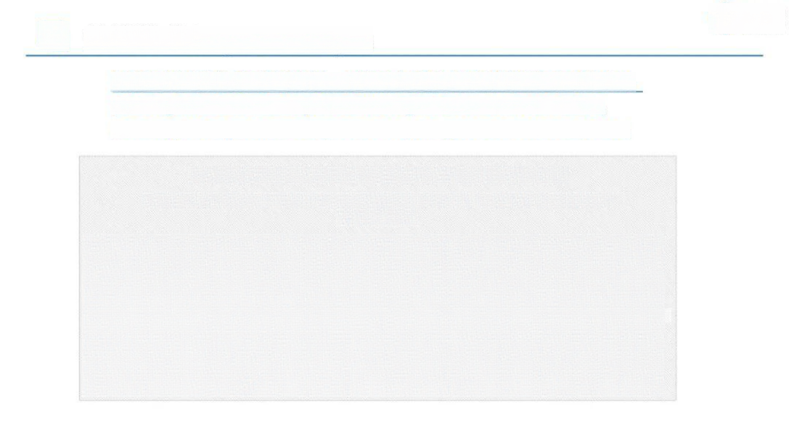


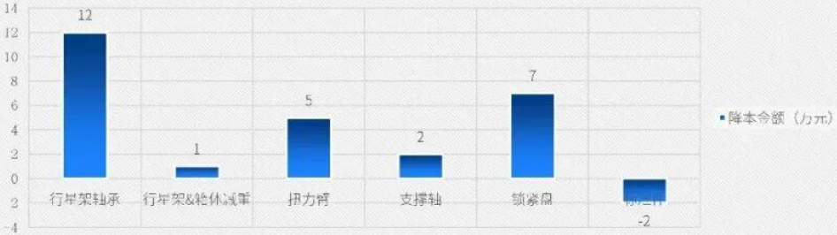
关键技术/Key Technologies
轴系与齿轮箱集成是必然趋势，目前最大前集成双馈齿轮箱已至20MW。
The integration of the shaft system with the gearbox is an inevitable trend.
Currently, the largest front-integrated doubly-fed gearbox has reached 20MW.
10MW前集成齿轮箱（相对于三点支撑）降本金额25万元
The 10MW pre-integrated gearbox (compared to three-point support) reduces costs by
250,000 yuan

Slide 13


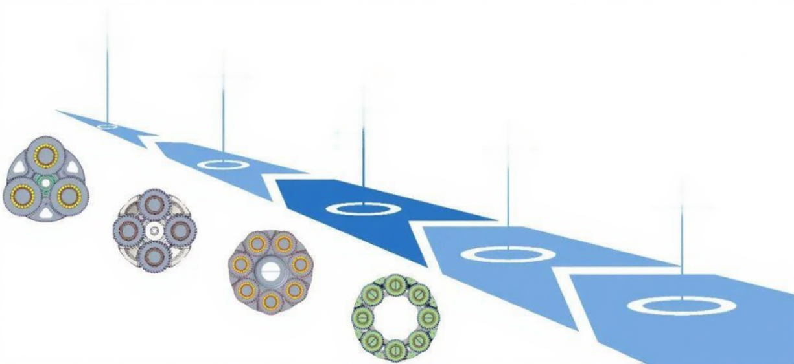
关键技术/Key Technologies
1~2MW
多行星应用
多为3、4个行星轮
Most of them are 3 or 4
5~6MW
Multi-planet Application
planetary wheel
多为4~7个行星轮
Most have 4 to 7 planetary
8~10MW
rings
一级多为1~8行星轮
The primary is usually a 7-
14~18MW
8 planet wheel
一级行星轮个数达到8~9个
The number of primary
planetary gears reaches
18MW以上
8~9.
一级行星轮个数突破9个
Number of Planetary
Wheel of Primary Stage
Breaks 9

Slide 14


关键技术/Key Technologies
减重/redution of weight
齿轮箱一级增加一个行星轮，以7行星轮到8行星轮为例，重量可较原方案重量降低约5%左右
By adding a planetary gear to the first stage of the gearbox, the weight can be reduced by approximately 5%
compared to the original design, as exemplified by upgrading from 7 to 8 planetary gears.
5%
零件直径减小/reduction
of part diameter
多行星优势
内齿圈、箱体、行星架直径减
小，延缓对机床最大加工范围
扩大的需求
9
280
扭矩密度/torque
density
9
280
The inner gear ring, the box
and the diameter of the
planetary carrier are reduced
to delay the demand of
expanding the maximum
machining range of the
machine tool.
前集成双馈方案，9行星以上齿
轮箱，扭矩密度可达280kNm/t
The pre-integrated doubly-fed
system features a gearbox with
over 9 planetary gears,
delivering a torque density of
up to 280 kNm/t.

Slide 15
01
发展现状/Current Development Status
content
目 录
02
技术路线/Technical Approach
03
关键技术/Key Technologies
04
攻关与挑战/Research & Challenges

Slide 16



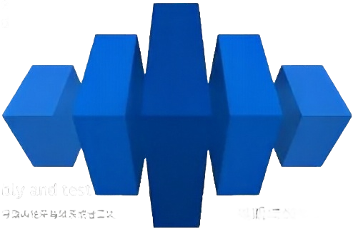
攻关与挑战/Research & Challenges
轴系变形对齿轮箱的影响/The Influence of Shaft System Deformation on Gearbox
对齿轮箱一级行星级甚至丁二级行星级吻合的影响、对一二级注滞环的影响、对二级行星架轴承的影响等。
The influence on the meshing of the gearbox first, and even second planetary gear, the 'influence on the oil ring of the first and second
planetary gear, the influence on the bearing of the second planetary carrier, etc.
多行星均载的控制/control of multiple
planets with uniform load
运维/operation
丙轮箱单独早装难度增大，需提前标定齿轮箱与轮毂
链的相对位置，且齿轮箱一旦卡死只能更换传动链。
行星架销轴孔的位置度、行星轮的精度一致性、行星轮轴承的一致
件、轴承座及大轮箱壳体刚度、轴承座及内轮箱壳体的精度等。
The difficulty of lifting the gearbox separately
increases, requiring advance calibration of the
relative position between the gearbox and the hub
lock. Once the gearbox gets stuck, only the
transmission chain car be replaced.
The position of the pin hole of the planetary frame, the precision
consistency of the planetary wheel, the consistency of the
planetary wheel bearing, the stiffness of the bearing seat and the
gearbox housing, the precision of the bearing seat and the
gearbox housing, etc.
装配及测试/assembly and test
齿轮箱与轴系整体发运成本太高，而齿轮箱与轴系分体发运又会导致齿轮箱与轴系或者二表
轴系的重复装拆从而带来清洁度、防锈、齿面砸碰、销孔拉伤等一系列风险。
电机与齿轮箱集成的影响/The Influence of Motor
and Gearbox Integration
The overall shipping cost of gearbox and shaft system is too high, while the separate
shipping of gearbox and shef: system will lead to repeated assembly and disassembly of
gear box and shaft system or tooling shaft system, which will bring a series of risks such as
clearliress, rus, prevention, tooth surface collision, p'n holc scratch and so on.
车电流如何期待
齿轮箱输出端密封可靠性
How to avoid axial currents
Reliability of the seal at the output end of the gearbox

Slide 17


感谢您的聆听！
T H A N K Y O U
汇报人：沈健
汇报时间：2025.12.03

